Slide 1

Electronics Developments at IN2P3
  IN2P3 Profile
  Instrumentation Network
  Microelectronics for Instrumentation
TWEPP 2014 – Aix-en-Provence
Claude Colledani CNRS/IN2P3

Slide 2
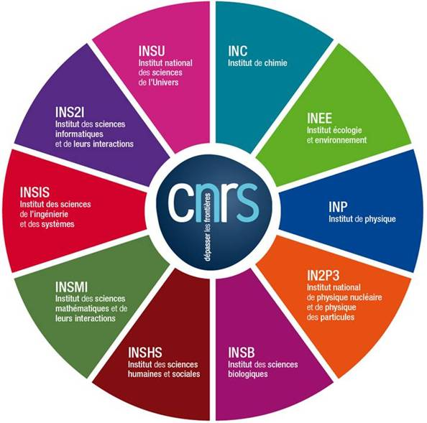
IN2P3, one Institute of CNRS
CNRS
10 institutes
1,100 research units
(95% in partnership)
34,000 researchers,
engineers, technicians
€3.3 billion
budget

Slide 3


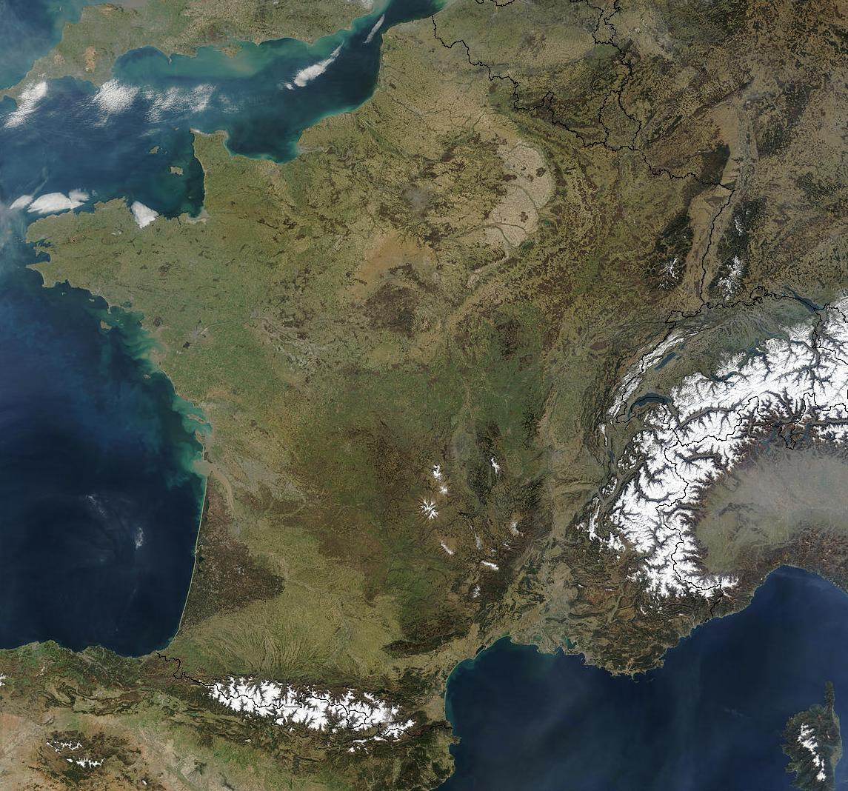
IN2P3
in partnership with IRFU
815 FTE
630 staff
150 postdocs-students
25 labs & platforms
2500 researchers, engineers and technicians
Ganil, LPC Caen
LNCA
APC, LPNHE,
Musée Curie
Irfu – CEA Saclay
Research in Astroparticles, Particle Physics
Nuclear Physics
CSNSM
IMNC, IPNO, LAL, LLR, IDGC, Omega
IPHC
Research fields:
(Astrophysics) Particles and Nuclear physics
Subatech
CC, IPNL, LMA
LSM,
Lapp
LPC Clermont
Technical Developments:
Instrumentation,
Grid computing, Accelerator R&D, Nuclear Energy, Medical Applications
Technical Developments :
Accelerator & Magnetism, Detectors and Electronics,
System Engineering
CENBG
LPSC
LUPM
Ref: U. Bassler- FCPPL 2014
CPPM

Slide 4
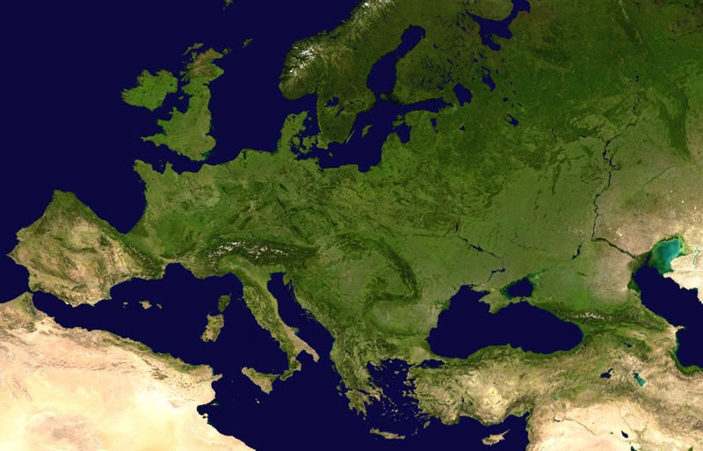
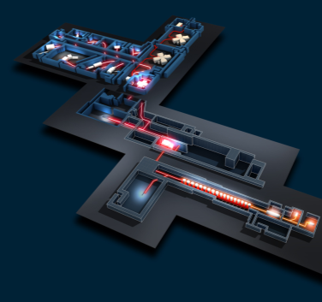
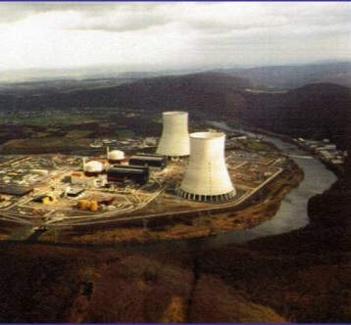
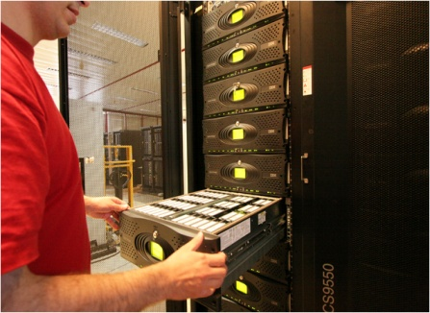
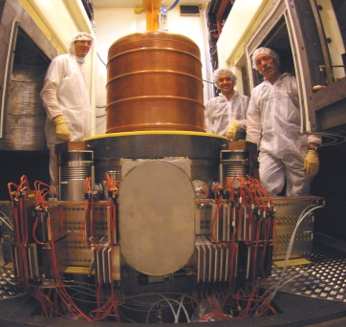
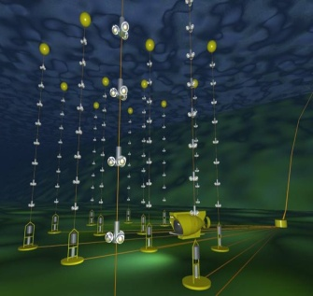
Research Infrastructures
Spiral2 / Ganil
DChooz
CC-IN2P3
Edelweiss, Nemo / LSM
Antares
© Ganil/Spiral2, CNRS/IN2P3, coll. Edelweiss, Antares, DChooz, Nasa – Conception graphique : Anna Thibeau (IPNL)

Slide 5
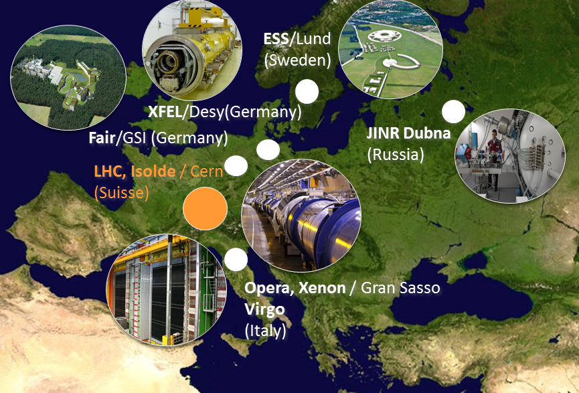
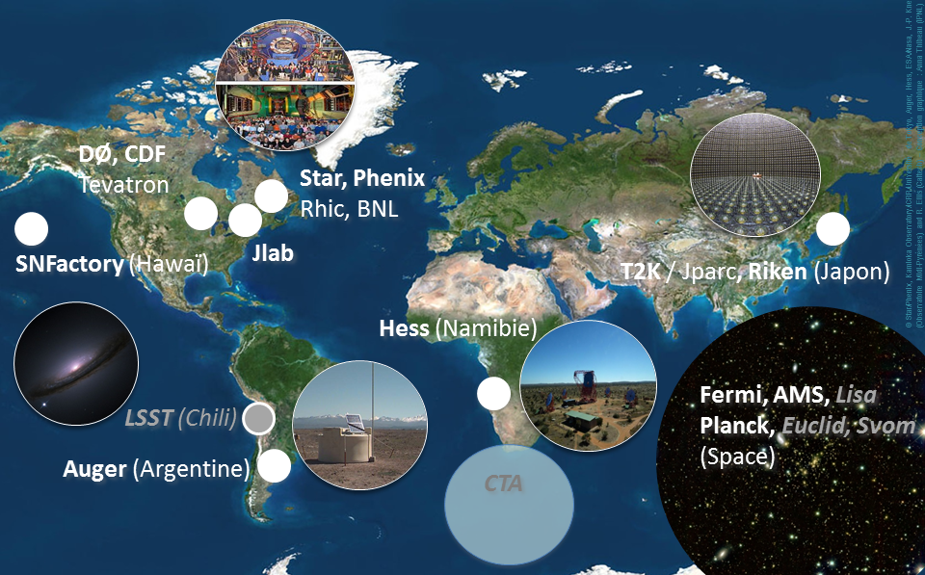
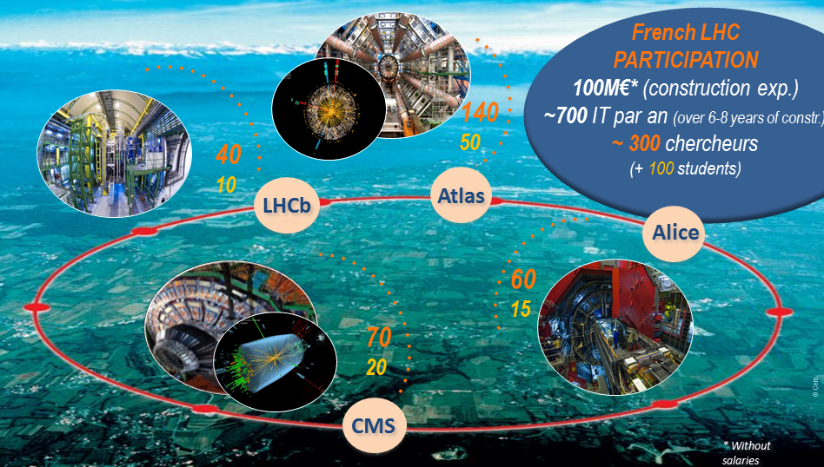
International Collaborations
40 Major International Projects
/ EGO

Slide 6
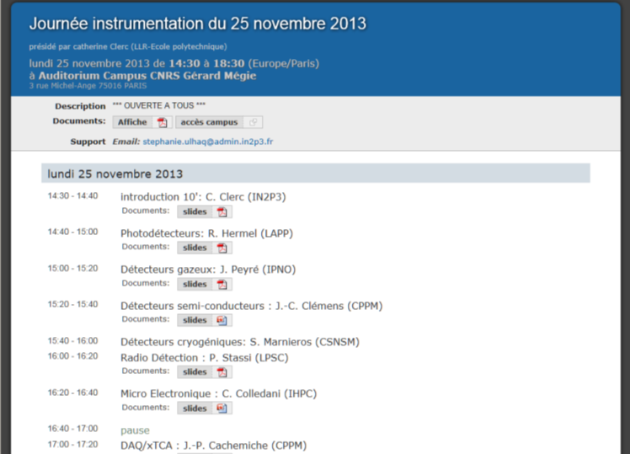
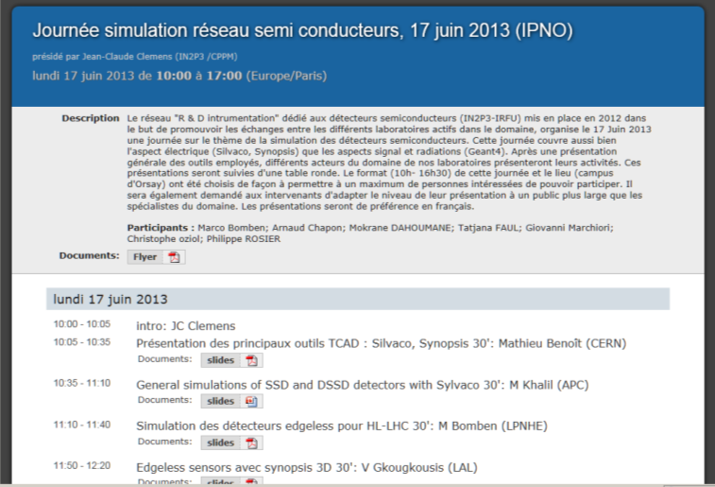
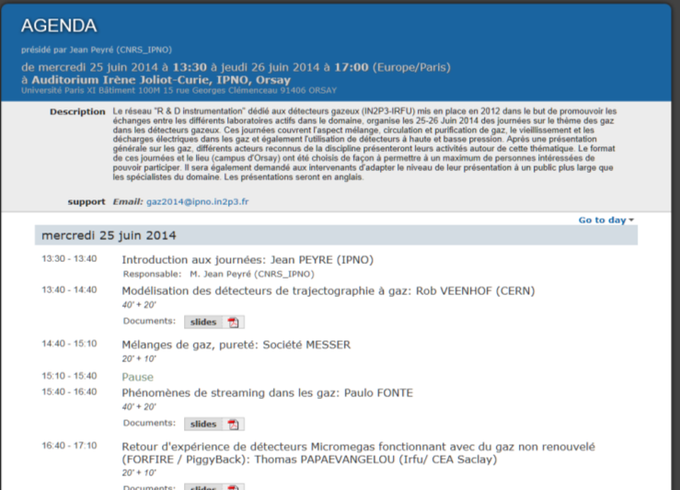
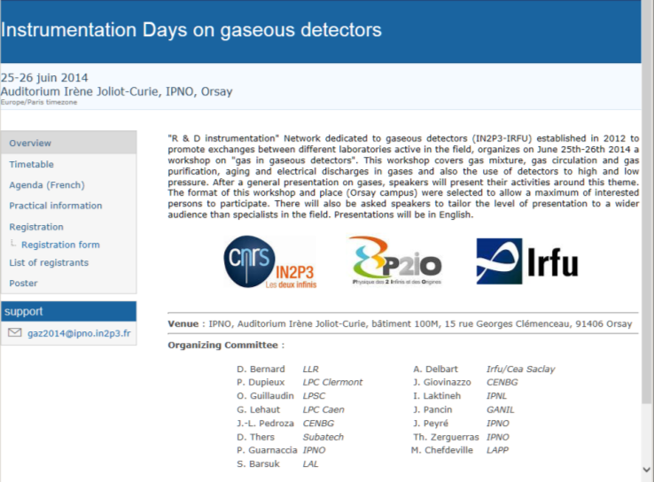
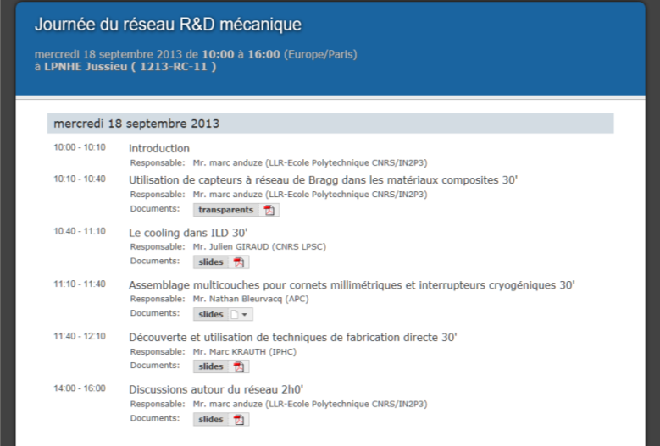
Instrumentation
Supporting Instrumentation R&D
  730 Engineers & Technicians
Instrumentation Network setup in 2012
  To improve exchanges between experts
  To promote common actions
5 Topics
  Radio-detection
  Cryogenic Detectors
  Photo-detectors
  Gaseous Detectors
  Semiconductor Detectors
3 Transversal Topics
  R&D for Mechanics
  DAQ
  Microelectronics
37%
+ 07/2014: Command & Control

Slide 7
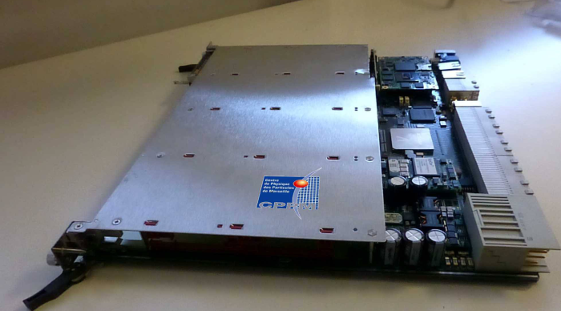
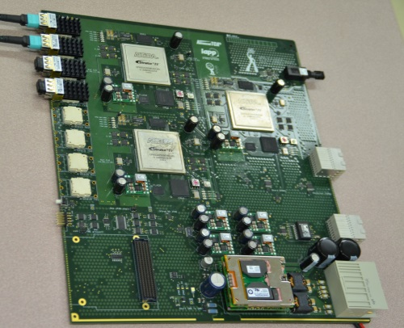
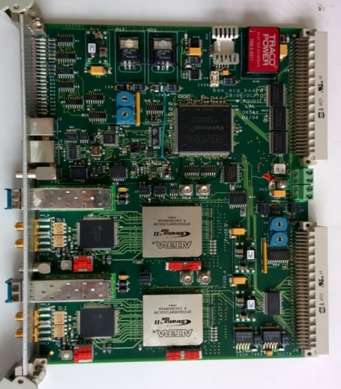
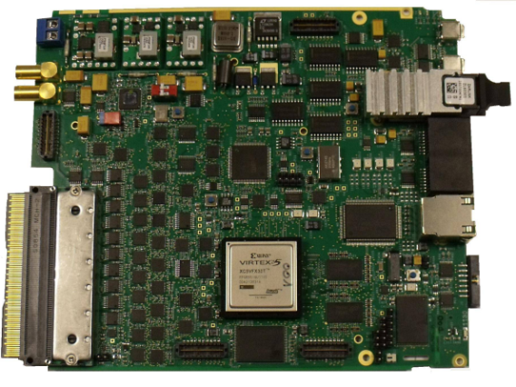
DAQ Network
Existing since 2011
  → 30 people
Promoting
  Common standards
  Design reuse, shared FPGA IPs
  Common developments centered on
    LHC upgrades
    GANIL experiments
Strong interest in xTCA
  Member of PICMG
    PCI Industrial Computer
    Manufacturers Group
  Working Group of xTCA for Physics
    Clocks, Gates and Trigger distribution
LHCb : Prototype Board
ATLAS LArg Cal: ATCA ABBA
BAORADIO- PAON:
Digitizer Frequency
Separator
SPIRAL2/FAIR : MUTANT

Slide 8
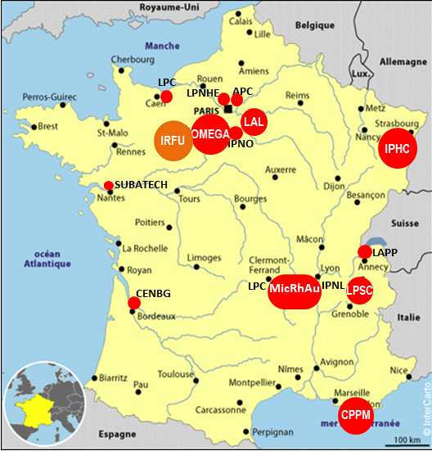
Microelectronics Network
Since 2005
14 Teams (+ Irfu)
  ➔7 teams ≥ 4 designers
    ➔ 3 teams ~ 10 people
Internal meetings
  School (1 week), alternating with
  Workshop (2 days)
Collaborations
Knowhow / IP exchanges
CAD tools
  Unified management
    License server @ IT Center
  Training program
    100 days / year for Cadence ASIC and PCB, ~35 Engineers/Technicians

Slide 9
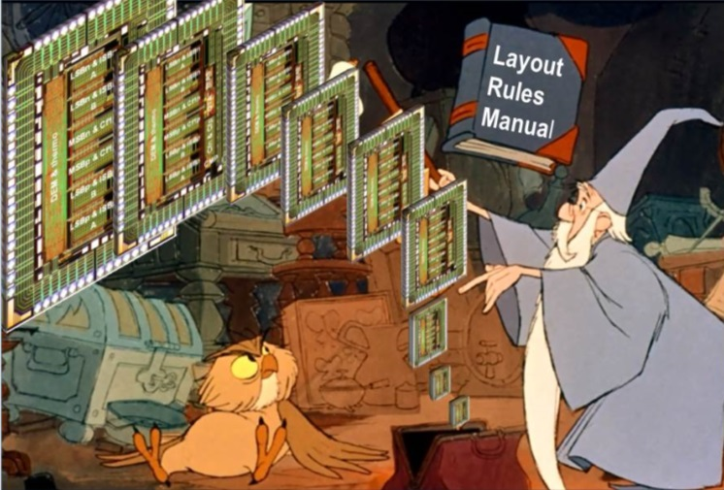
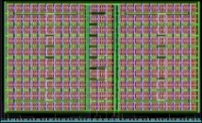
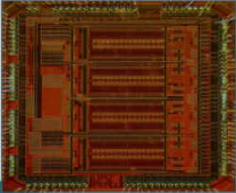
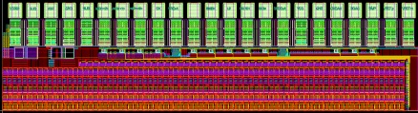
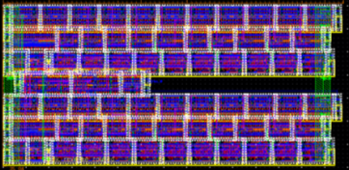
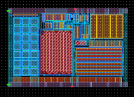
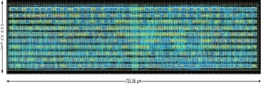
Expertise & Skill
Building Blocks
Low noise, low power & radiation tolerant
Analog, Mixed, Digital
FE amplifiers, shapers
DAC / ADC / TDC A-based, D-based
Memories: Digital / Analog
RO & Ctrl: Serializer, Tx , I2C, JTAG
Band Gaps, Regulators, POR
Building Blocks
SoC Designer
BB Designer
SoC
BB design from the point view of the Merlin Legend
4 x 12-bits SAR ADC
40 MSPS,
5mW/ch
10 mm²,
130 nm
System Level Design for SoC
Functional Block Assembly
Multi-Channel FE + Massive A 2 D
Data Reduction Processing
Memory Buffers/ Management
Embedded Regulation Systems
Distribution
Power Distribution Grid / Domain
Clock Distribution
Data Flow
12-bits SAR ADC 100 kSPS
180 x 300 µm²
IBM 130 nm
10 ps TDC R&D
35 x 75 µm²
IBM 130 nm
SEU Tolerant Memory
230 x 1820 μm² - 130 nm, FEI-4
BAND CAP
196 x 133 µm²
TJ 180 nm
JTAG
Ctlr
725 x 112 µm², TJ 180 nm

Slide 10


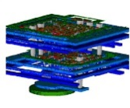
Looking for synergies
Participating to International R&D Programs
  RD53 (2013),
  AIDA (2011) + H2020
  EUDET (2006-2010)
  3DIC - TSV (2009)
Sharing Process
  Successive CERN nodes (65 nm, 130 nm & 180 nm for MAPS)
    9 laboratories applying for 65 nm TSMC NDA
  Specific & cheap processes
    For the numerous non-CERN experiments
      Few tens of channels to integrate , Limited ASIC production
FNAL
Large usage of CMOS / BiCMOS- SiGe .35 µm
Equivalent 180 / 130 nm nodes are considered

Slide 11



Looking for synergies
R&D covers all IN2P3 physics and detectors domains
  Large discrepancy in the projects size ➔ From small analog ASIC to full SoC
    Impact Design teams profiles
    Impact on process #
  New designs always required ➔ Design Reuse has to be considered first
    Impact on manpower, schedule, budget
  Pushing for coherent ASIC families development, which will
  provide flexible designs and staged performances
Detector Networks must help to converge
  Following of presentation is organized by detector categories
  Focus on circuits Designed for specific projects,
  Reused for other applications

Slide 12
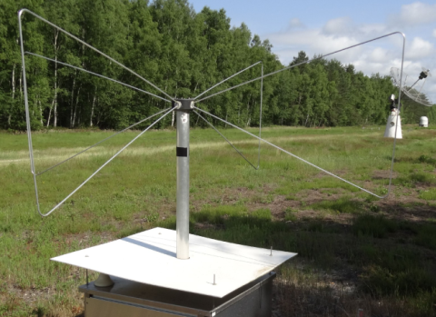
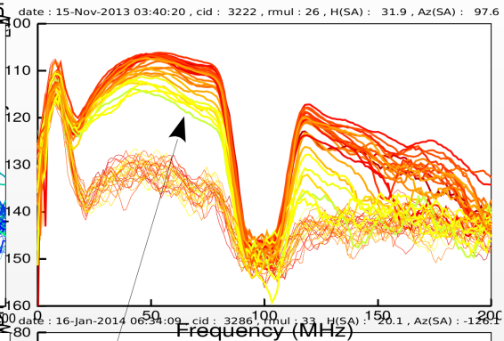
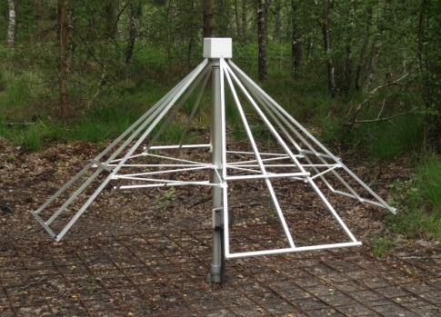
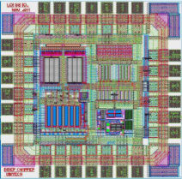
Radio-detection Network
Full Custom Analog ASIC - LNA optimized for associated antennas
  Developed to detect Air Showers produced by Ultra-High-Energy cosmic rays
LONAMOS for Butterfly & LWA
  Optimized for 20-80 MHz
  Efficient up to 200 MHz
Small but Successful
  1^{rst} generation, 0.8 µm CMOS
    2004, 400 chips
  2nd generation, 0.35 µm CMOS
    2011 700 chips
    2014 6000 chips
Power spectral density
of a CODALEMA event
0 - 200 MHz spectrum
dBm/Hz
Butterfly Antenna, 2.2 x 1.5 m
Codalema @ Nancay - France
Antenna
signals
FM Band rejection
LNA &
Galactic
noise
Experiment | Installed
CODALEMA@ Nançay-France | (60 Butterflies + 10 LWA) x 2
AERA @Auger-Argentina | 200 Butterflies
TREND @ China | 108 Butterflies
HELYCON @ Greece | 12 Butterflies
NenuFAR @ Nançay-France | 57 LWA x 2 + 6000
Long-Wavelength Antenna
NenuFAR @ Nancay - France
Fully differential architecture
Zin digitally adjustable
OIP3=33dBm
NF<1dB
Gp=27dB
BW>200MHz
LONAMOS 1,4 x 1,4 mm²
CMOS 0.35 µm , 2011

Slide 13
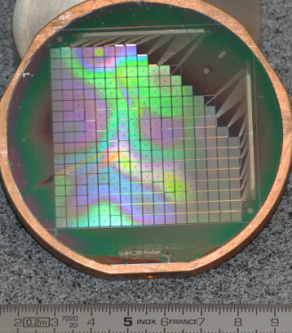
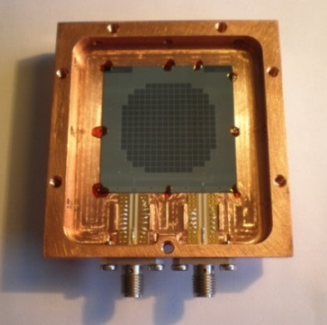
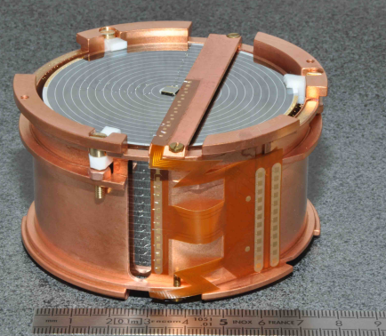
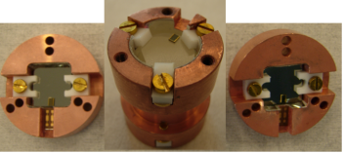
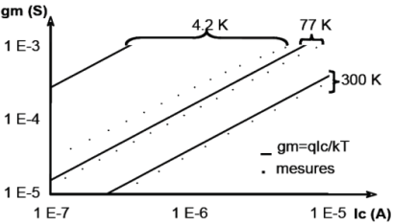
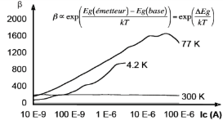
Cryogenics Network
250 pixels TES matrix
(Transition Edge Sensors)
QUBIC @ South Pole
Kinetic Inductance Detector
NIKA @ Pico Veleta, Spain
HP-Ge ionizing-heat detector EDELWEISS @ LSM, France
Scintillating Bolometer ZnMo4 and its 2 light detectors
LUMINEU @ LSM, France
Electronics main constraints @ ~2 - ~110 K (LAr)
  No valid transistor models ➔ Characterization
    Bipolar: gm , β  …
    MOS: Substrate becomes Insulated ➔ Kink Effect
    → T_{parasitic} , I_{leakage}, V_{th} history effect
Thermal & Electric effects of Interconnects
  Gm of SiGe bipolar 0.35µm
  β of SiGe bipolar 0.35µm

Slide 14
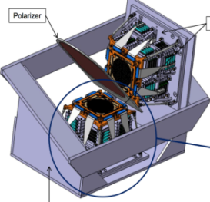
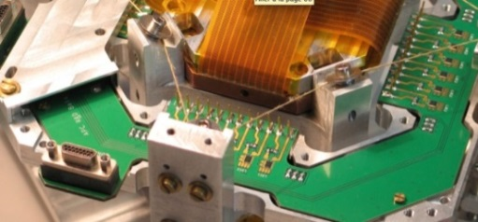
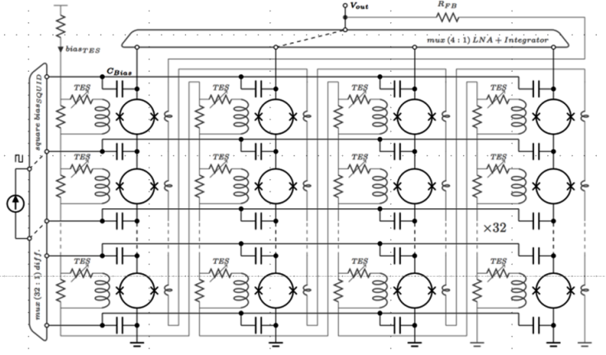
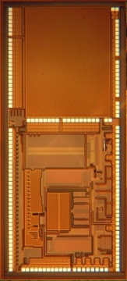
Cryogenic electronics for QUBIC
QUBIC Cryostat, 2016 @ Dome C - Antarctica
  To measure Cosmic Microwave Background (B-mode polarization)
SQMUX128 @ 40 K
  16 chips for the cryogenic focal plan
    2048 TES (NbSi Transition Edge Sensor)
    2048 SQUID multiplexed stage
      100 KHz readout , Input LNA (0.2 nV/√Hz)
  Cryogenic effects correction
    Digital lib. redesigned (Kink effect)
  ~100 chips to produce
    6 cryostats
Variant for collaboration @ PMO
  Purple Mountain Observatory
  (Dome-A / China)
Focal plan (@100mK)
SQUID implementation
Successive bias of 32 Rows
AC Multiplexed Current Sources
  4 Column Analog outputs
  multiplexed toward input LNA
4
Matrix RO: configurable up to 128 SQUIDS
32 Biasing Current Sources with Diff Outputs
4 Differential Multiplexed Analog Inputs
100 kHz multiplexed Input LNA (0.2nV/√Hz)
Individual automatic Squid offset compensation (8 bits ADC & DAC, FSM, 128 x 8 memory block)
8 mW Power Dissipation
32
SQUMUX128, 20mm² , 0.35 µm SiGe
SQUID matrix Read Out

Slide 15
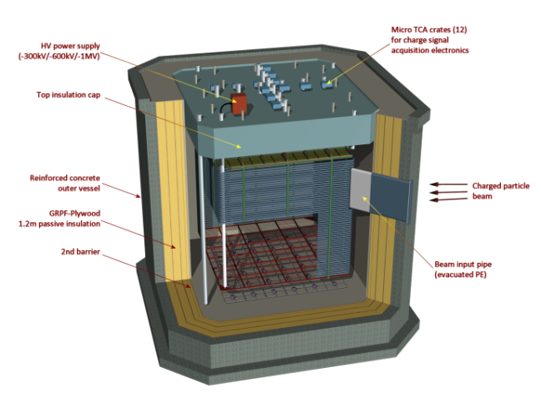
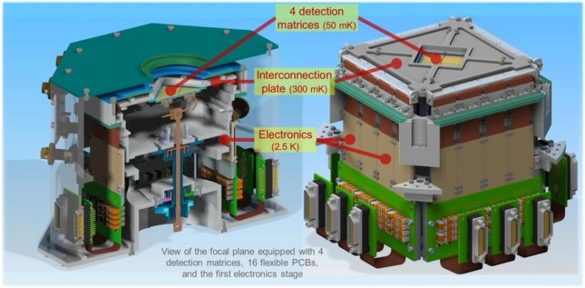

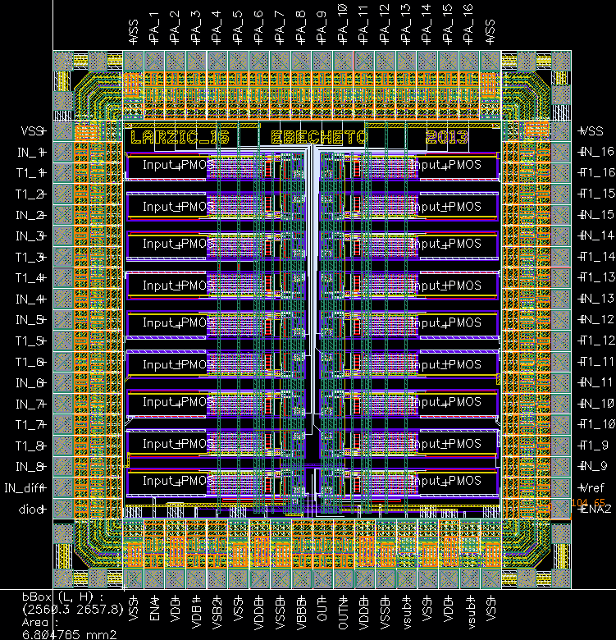
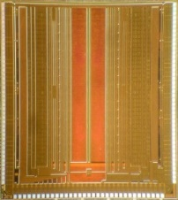
From Compact & Extreme Cold to
Huge & Cold
X-ray micro-calorimeter for IXO/ATHENA satellites
  2 stages of T: 2.5 K and 15 K
  Cryocooler with very-low power budget
3 circuits, 2 process (CNRS/LPN - CEA/Irfu col.)
  HEMT Input Stage @ 2.5 K (High Zin)
  Mxp & Pwr Commuting, SiGe ASIC @ 2.5K
  Amplifying SiGe ASIC @15 K
LAr TPC demonstrator, for WA105, LBNO_DEMO
16 ch. Amplifier + Buffer @ ~110 K
  To profit from minimal noise conditions
Schedule
  MPW submission : 22 September 2014
  Production: Q3 2015
  8 000 channel ~ 500 chips
4096 channels
6 dm³
300 tons
6x6x6 m³ (216 m³) active volume
7680 channels
for 36 m² anode plane
Courtesy LBNO_DEMO
Stage 3 chip - Irfu- CryoCanal1
24,1 mm²
Stage 2 chip -Irfu-
CryoCom1
9,4 mm²
LARZIC chip
CMOS
~6 mm²

Slide 16
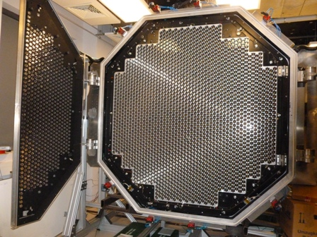
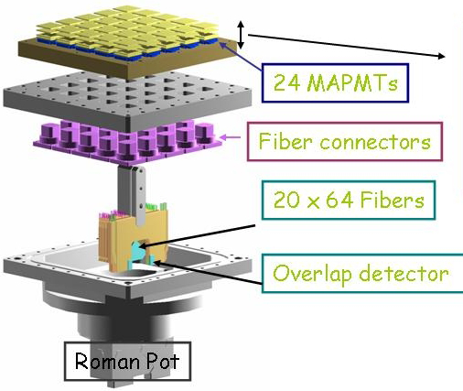
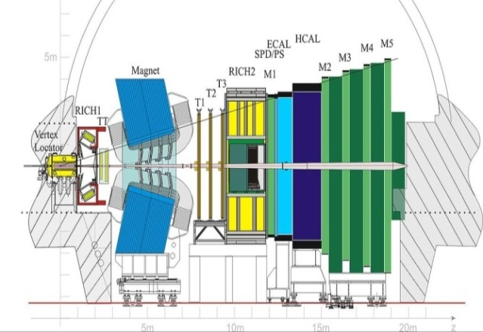

Photo-detectors Network
PMT, MA-PMT, MCP-PMT, Si-PM, Scintillators, …
  Overlap with Semiconductors Network (CCD, SiPM, APD)
HESSII camera, 2012 - Namibia
- 2048 PMTs , Diameter 2.3m, Weight 2000 kg
ATLAS Luminometer - CERN-
MA-PMT for Roman Pot
LHCb Tracker upgrade Phase 1 - CERN
FEE for SciFi + Si-PM , 2015
FEE increases in complexity
Teams with critical size / collaborations
2 categories of FEE
  Shapers and Peak Detectors circuits (IN2P3)
  Waveform Sampling circuits (Irfu)
Successive improved generations
Derived for different application fields
PACIFIC: Barcelona, Valencia, Heidelberg Universities, ETH Zurich & IN2P3 Collaboration
Detector | 300 000 channels
PACIFIC chip (2015) | 64 ch, TSMC 130 nm
Input Dynamic Range | 0.5 to 32 pe
ADC resolution | Nonlinear, 2-bit, 40 MHz
SNR | ≥ 10
Mx Pwr / Ch | < 10 mW
PACIFIC
16

Slide 17










Shapers & Peak Detectors circuits
ROC chips : OPERA-ROC, early 2000
  For OPERA Target Tracker at Gran Sasso, 3000 chips
7m
Chip | DType | Ch | Plrty | Dyn Range | Spec
MAROC | PM | 64 | < 0 | 5 fC- 5 pC | 64 trigger outputs, internal 8/10/12-bit ADC for charge measurement
SPACIROC | PM | 64 | < 0 | 2 pC - 220 pC | Fast photon counting (50 Mhz)
PARISROC | PM | 16 | < 0 | 50 fC - 100 pC | Internal TDC (<1 ns), 16 trigger outputs
SPIROC | SiPM | 36 | > 0 | 10 fC -300 pC | 36 HV SiPM tuning (8 bits), internal 12-bit ADC for charge & time measurement
EASIROC | SiPM | 32 | > 0 | 10 fC -300 pC | 32 HV SiPM tuning (8 bits), 32 trigger outputs
CITIROC | SiPM | 32 | > 0 | 10 fC -300 pC | 32 HV SiPM tuning (8 bits), 32 trigger outputs
PETIROC | SiPM | 32 | < 0 | 100 fC -300 pC | 32 HV SiPM tuning (8 bits), 32 trigger outputs, internal 10-bit ADC for charge & time (25 ps)
MAROC3
SPACIROC
Flexible Front-End → Variants suited to
  Detector type, # of channels, Input Dynamic Range
Adaptive Back-End
  8/10/12-bits ADC for charge measurement
  W /Wo time measurement, 1 ns / 25 ps TDC
  Counting
PETIROC
SPIROC2
EASIROC
PARISROC2

Slide 18







Multi-Anodes PMT Read-Out Chips
MAROC - From underground to space
  Produced for ATLAS Luminometer
    1000 chips, 2006
  Improved Maroc3
    1000 chips (2010) for > 50 users
      Double-Chooz, Neutrinos experiment
      Memphyno, Water Cherenkov R&D
      Medical Imaging, …
MAROC 3, 16 mm², 0.35 SiGe
64 channels (Z _{in} 50-100 Ω )
6-bit individual gain correction
Auto-trigger on 1/3 p.e. at 10 MHz
12-bit Wilkinson ADC Multiplexed on the Charge Output
Power = 3 mW/ch
MAROC 2 for
ATLAS Luminometer
Modified for EUSO Balloon (Launched 08/2014) / JEM EUSO
  To observe Extensive Air Showers in the earth's atmosphere
SPACIROC (Col. JAXA/Riken/Konan University)
  Analog Front-End (64 ch): ~MAROC3
  Back-End: Charge digitization replaced by
  TOT photoelectrons counting (<50MHz)
  Improved power consumption < 1 mW/ch
  Radiation tolerant : triple voting
SPACIROC
EUSO Balloon
18
18

Slide 19










SiPM Readout chips
  SPIROC for Analog hadronic calorimeter of CALICE
  F-E customized @ 36 channels
  B-E implements Time Measurement
  Embedded inside the detector
    Power budget
SPIROC, 0.35 SiGe
36 ch., auto-trigger & 15bit readout
Energy measurement : 15 bits, 2 gains
Auto-trigger down to ½ p.e.
Time measurement up to ~1ns
Power: 25µW/ch (pulsed power)
SiPM cameras for Cerenkov Telescope Array
Small Size Telescopes → CITIROC
  SPIROC derived
    32-ch, Charge & Trg , No ADC/TDC
HCAL Base Units
Large Size Telescopes → ALPS R&D
  SiPM: an alternative to PMTs
    Same detector among telescope classes
  Creating a large SiPM sensor
    Summing the pixel signals of a matrix
16 channels analog sum
Input range 0.2 to 2 10³ p.e
Fast common trigger
Bias monitoring / pixel (8 bits)
Adjustable High & Low gain / pixel
Noisy pixel disabled
4x4 SiPM
Hamamatsu matrix
ALPS 12mm2, SiGe 0.35µm, 07/2014

Slide 20













Switched Analog Memories
Fast Waveform Sampling → Amplitude & Time for signal reconstruction
  HAMAC by Irfu, for ATLAS LAr Calorimeter, 80 000 chips, 2002
Constant improvements: sampling speed, memory size, embedded A2D
Irfu's chips for common, IN2P3/Irfu, detector developments
Analog Ring Sampler 4 Inputs @ 1 GS/s, 128 cells AMS CMOS 0.8µm, 70 kT, 10 mm² , 2004 ANTARES & HESS I
Swift Analog Memory 2 Inputs @2 GS/s, 256 cells Embed Parallel 12 bits Wilkinson ADC AMS CMOS 0.35µm., 50 kT, 11 mm², 2005 HESS II
SAMLONG for SuperNEMO 2 Inputs @2 GS/s, 1024 cells AMS CMOS 0.35µm, 300 kT, 18 mm², 2010-14 Implemented in VME Wave Catcher Boards
NECTAR0 2 Inputs @2 GS/s in 1024 cells Embed X X bits X ADC AMS CMOS 0.35µm., 300 kT, 21 mm², 2010
SAMPIC R&D, waveform based TDC 16 Inputs @10 GSPS for ~1 ps resolution AMS CMOS 0.18µm, 7 mm² , 2013 ATLAS Foward Physics
ARS
HESS I Camera module
HESS @ Namibia
SAM
HESS II Camera 2012
Wave Catcher -CAENversion-2014
SuperNEMO demonstrator
SAMLONG
NECTAR0
NECTARCam
ATLAS
206 & 214 m
AFP Detectors
SAMPIC
DUT

Slide 21






Gaseous Detectors Network
Drift Chambers
Multi Wire
Proportional Chambers
Micro Pattern Gaseous Detectors
- Micromegas or GEM -
Ionizing Chambers
TPC (IO + MPGD or MWPC)
Drift chamber - SHARAQ
spectrometer -Japan
MWPC 1m²
ALICE-Muon Arm - CERN
Micromegas
SDHCAL- ILC
Micro TPC + Micromegas for
MIMAC @ LSM Modane
FEE for Gaseous detectors is similar to FEE for photo-detectors
  Shapers and Peak Detectors & Waveform Samplers
  With additional constraints such as material and power budgets

Slide 22















Extended FEE for Gaseous Detectors
HARDROC: GRPC DHCAL - CALICE
  AGET for ACTAR TPC R&D
  To Study exotic nuclear structures @SPIRAL2
  AGET for the 2048 channels of the TPC
    Variant of AFTER for µmegas @ T2K (6000 chips)
Embedded FEE in scalable GRPC detector layer
Active Target TPC
Demonstrator, 1 m³
40 layers
400 000 Channels
TOMUVOL: Volcano Tomography with Muons
AGET 0.35 µm CMOS, 65 mm^{2,} 2010
A DHCAL Spinoff
64-ch, Pos / Neg polarity
4 Ranges : 120 fC; 240 fC; 1 pC; 10 pC
16 Peaking Time Values (50ns to 1μs)
Fsampling: 1-100MHz; Fread: 25MHz
Auto trig: discri/ch + DACthreshold
Ch RO: All, Hit, Specific channels
SCA cells readout: 128/256/512
  64 ch, 3 discri/ch
    3 encoded charge values
  Event memory
  Power pulsing
  2010: 10 000 chips
    ,
HARDROC2
256 channels AsAd board
- 4 x AGET
- 12-bits, 25 MHz digitizer
- AGET steering,
test, calibration
26 mm², SiGe 0.35 µm

Slide 23










Designs for specific configurations
Trigger upgrade of Dimuon Spectrometer of ALICE
  FEERIC dedicated to new RPC in avalanche mode (aging)
  To replace ADulT chips for current RPC in streamer mode
  To provide calibrated pulses to trigger logic
  >3000 chips to produce, test, install, 2015-18
FEERIC
4mm²
0.35µm
CMOS
Test
Board
TDC for SNEMO @ LSM
- 54 ch. TDC, 3.6 ns resolution
- Configurable Inputs - gain & discri. threshold -
for anodic and cathodic signals
- 150 samples
Micromegas TPC, MIMAC @ LSM
- 64 ch., Coincidences detect. + TOT measures
- 50 MHz discriminators
- 400 MHz serializer
- ~100 samples
Drift Chamber
.35 µm
SiGe BiCMOS
23 mm²
2010
0.35 CMOS
40 mm2
2011
Test board
Manchester-UK courtesy
256 channels board

Slide 24









Semiconductors Network
CCD
Silicon Strips
Hybrid Pixel Sensors
CMOS Pixel Sensors
Diamond
Beam profiler
SPIRAL-France
Double-sided multi-strips
detector prototype
CCD for LSST - Chile
Studies &
Production testing
CMS Silicon Strips
TEC Petals:
Test & Construction
ATLAS Pixel Tracker
Test & Construction,
HPS design
STAR PXL Tracker
CPS design
Readout & Steering ASICs on DAQ Board
2/CCD - 6/REB
16/CCD - 48/REB
8 channel FE board
Time & Energy measurement
16 channels RO
18bits ADC
1Ms/s - AD7982
1/REB – 3/RAFT
FPGA
Vertex 5
ASPIC
DREB
CCD
16 Mpixel
DAQ: ATCA
2/CCD - 6/REB
Fast
ADC
Clocks, Biases, OD
CABAC
REB: 3/RAFT
3 CCD for 1 REB 9 CCD per RAFT
Faster: SYROCO_AMC board @ GANIL

Slide 25









ASIC for space applications at IRFU
IDeF-X ECLAIRs
IDeF-X family for Cd(Zn)Te or Si - Drift D, Double Sided D
  CSA+Shaper+peak detectors architecture
  Self triggered with low detection threshold (2 keV with CdTe)
  Very low noise for high energy resolution spectro-imaging systems
  Commercial low cost CMOS technology (AMS 0.35 & 0.18, XFAB 0.18)
  Hardened design for “space proof” missions
XRDPIX / IRAP
  XRDPIX detection module for SVOM (CNES and CNSA mission)
IDeF-X HD
Caliste-SO
@SDHCAL-IL
Chip | Det Type | Ch | Noise Floor (e-) | plrty | Dyn (ke-) | Power (mW/channel) | Output | Radiation
ECLAIRs | Cd(Zn)Te | 32 | 33 | - | 50 | 3,4 | Mux diff | SEL hardened + SEU flag
BD | Cd(Zn)Te DSSD | 32 | 33 | both | 50 | 3,4 | Mux diff | SEL hardened + SEU flag
HD | Cd(Zn)Te | 32 | 18 | - | 240 | 0.9 | Mux diff | SEL free + SEU flag
LXE | Cd(Zn)Te DSSD LiqAr TPC | 32 | 33 | both | 240 | 2.2 | // single | SEL free + SEU flag
D²R₁ | Cd(Zn)Te DSSD | 256 | 25 | both | 60 | 0.3 | Mux per Line | SEL hardened + SEU flag
  Micro gamma-camera for Solar Obiter (ESA Mission)
IDeF-X BD
  ASTRO-H (JAXA mission): detector characterization
  STEIN module
  for Solar Orbiter
25

Slide 26







Hybrid Pixel Sensors
FE-I4 chip for Insertable B-Layer of ATLAS upgrade (Phase 0, 2014)
  IB-Layer: 16 ladders, 384 FE-I4 with associated pixels
Pixel size | 50 x 250 | µm²
Matrix array | 80 x 336 | pixel
Chip size | 20.2 x 19.0 | mm²
Active fraction | 89 | %
A - D currents | 10 - 10 | µA/pix
Analog voltage | 1.4 | V
Digital voltage | 1.2 | V
Process | 130 nm
Radiation Tol | > 200 | Mrad
Existing
B-layer
Narrow beam
pipe 3,3 cm
Ladder:
FE-I4 +
Detector
Building Blocks design
  Pixel level
    Configuration memory
  Common functionalities of FE-I4
    Global configuration memory
    10-bit ADC Chip monitoring
    Buffers for characterization
Radiation dose & SEU effects measurements
IBL on new beam pipe
ATLAS/CMS - Phase 2
  Member of RD 53 for Pixel RO chip
    WG1, Radiation test / qualification
    WG3, Simulation-Verification test bench
    WG5, Analog Design (pixel ADC)
    WG6, IP blocks

Slide 27



CMOS Pixel Sensors: A Long Term R&D
1999 R&D initiated with ILC as ultimate objective
  Developing CPS with staged performances
  2008: Mimosa26 for EUDET telescope
  Major proof of concept achieved (IN2P3/Irfu)
CPS for experiments with increasingly demanding requirements
Eudet Telescope
6 reference planes of
Mimosa26, 50µm thin
σ_{s.p.} 2 µm on DUT
Mimosa26
~2x1 cm²
660 kpixels
Expt System | σ _{T} µs | σ _{Sp} µm | TID Rad | Fluence n_{eq}/cm² | T _{op} °C
STAR-PXL | <~ 200 | ~ 5 | 150 k | 3x10¹² | 30
ALICE-ITS | ≤ 30 | ~ 5 | 700 k | 10¹³ | 30
CBM-MVD | 10-30 | ~ 5 | <~10 M | <~ 10¹⁴ | <<0
ILD-VXD | <~2 | <~ 3 | O(100) k | O(10¹¹) | <~30
T
ime
Synergies - Constraints

Slide 28










CPS for PXL detector @ STAR
STAR HFT
Mimosa 28, ~4 cm², 1 Mpixels
  ~21 µm pitch, 50 µm thin, > 400 Ω.cm Hres Epi
  σ_{s.p.} ~>3.5 µm, Efficiency > 99%, T_{Ro} = 185 µs
  Rad Tol= 150 krad, 3 10¹² n_{eq}.cm⁻² @ +30°C
  Edgeless for improved sensor abuttal
  Wafers are pre-diced with DRIE
  Sensors are released during wafer thinning
Mimosa 28, ~4 cm², 0.35 µm
2-well CIS , Hres epi layer
928 x 960 pixel array, pitch 20.7 µm
In pixel CDS + column discriminators
Zero suppression
FRead 160 MHz on 2 LVDS outputs
Sensor configuration via JTAG
~170 mW/cm² @ 3.3V @ 35°C
Integration time 185.6 μs, σ_{s.p.} ~>3.5 µm
Detection efficiency
&Fake rate
PXL installed in January 2014
2 layers, radius: 2.8 & 8 cm, 40 ladders, 400 sensors, 0.15 m²
Typical
event of
4 months
of data
taking
IST
PXL
DRIE
Trenches
Wafer Scribe Lines pre-diced with DRIE
AMS courtesy
200 GeV Au+Au event
PXL installed

Slide 29



CPS for ALICE ITS upgrade
ITS upgrade: 10 m² of CPS to produce (2016)
  Towards a new state of the art ( & challenge )
  based on the accumulated expertise on previous sensors
  Common R&D with CERN on sensors developed in //
    Synchronous Readout CPS (Mimosa 28 like)
    - Mature architecture → robust → MISTRAL -IN2P3 driven
    Asynchronous Readout CPS
    - New & challenging, exploits process potential → ALPIDE - CERN driven
MISTRAL, based on 3 submatrices
  Full Scale Building Block (05/2014)
    160 kpixels matrix
    22 x 33 µm pitch → σ_{s.p.} ~5 µm
    Readout Time = 40µs
    Noise: TN ~0.87 mV, FPN ~0.55 mV @ 30°C
    Efficiency >99.5% (To Validate @BT 10/2014)
  Address ALICE ITS requirements
Q1 2013 run
4-well CIS 0.18 µm
3.1 x 2.3 cm² reticle
FSBB first prototype
0.18µm CIS Hres epi
MISTRAL sensor

Slide 30



Hybrid R&D, RO chip + HV-CMOS sensor
Exploit Deep Nwell featured by industrial CMOS process
  DNW Sensing diode polarized @ few tens Volts
  → To collect charges by drift only
    To improve speed & Radiation hardness
  Embedded CMOS amplifier
    Before interconnection to RO chip → Low noise
Expected performances
  Rad Hard Sensor up to 1 Grad
    Thin depletion zone (10µm),
    low bias voltage
  Small and fast pixels
    33 x 125 µm , (FEI-4: 50 x 250 µm)
  Low material budget
    Thinned down
  Low cost
    Standard process + cheap bonding
    Read Out Chip
    Capacitive bonding
    Gluing - no bump bonding
    HV CMOS Pixel Sensor
HV2FEI4p1
glued on FE-I4

Slide 31



























R&D for Societal Applications
Beam profiler
  Radioguided surgery
MAGICS: Peroperative compact imaging
gamma camera.
Sentinel lymph-node
mapping protocol.
Imaging
  CT & SPECT scanners
  PET scanners
  In vivo neuroimaging
Dosimetry
TRADERA: Beam Profiler for
Intensity modulated radiation therapy
IMABIO: Multimodal platform for small animal imaging
µCT, µSPECT, µPET
Deposited dose monitoring
XEMIS1: Liquid Xenon
Compton camera
Compton camera for ion range monitoring during hadron therapy
PICSIC: Brain implantable β+ radiosensitive probe
FASTPIXN: Neutron dosimetry for nuclear power plants survey

Slide 32







Technology transfer
Developing X ray imaging systems
based on hybrid pixel detectors and dedicated to biomedical, material science
XPAD S540
French-Swiss Public Interest Group
Assisting Small-Medium size Enterprises to setup collaborative projects for innovative mechatronics
Designing high-end analog & mixed
microelectronics for nuclear industry,
space industry, medical imaging
Technology Transfer:
Not only positive feedback in terms of IP and royalties but also for PhD, postdoc fellowships and grants (Local, France, Europe)

Slide 33
Summary
Numerous projects of physics, on large scope
  Instrumentation Network
ASIC developments
  Intense and diversified activity
  Permanent staff ➔ projects continuity
  Structured Design Team
  Evolutionary SoC / Sensors platforms
  ➔ It helps for technology diffusion
Microelectronics for CERN & LHC
  Important contribution of IN2P3 at early time of LHC
    It has structured the Microelectronics network
  Upgrade phases, a high priority with substantial means and human resources
    Focus on specific technologies, such as Hybrid pixel / Cmos pixel Sensors
  Personal comments
  To improve the current organisation
  "Small teams - broad spectrum" is over,
  Large teams with specific expertise:
  ➔ Calorimetry, Cryogenics, Trackers, …
  ➔ ADC, TDC, Transmission, …
  Ideal team: BB + ASIC System Designers,
  Test Engineers, CAD tool Engineers
  ASIC complexity ↗for every domains Φ
  ➔ State of Art R&D + Intensive D & R
  ➔ Limited set of nodes

Slide 34
Thank you for your attention
Thanks to the networks national contacts & other colleagues for their input and help

