Slide 2
SPS: impedance model and instability in the transverse plane
C. Zannini, H. Bartosik, G. Rumolo, B. Salvant
Acknowledgments: M. Barnes, O.Berrig, F. Caspers, E. Chapochnikova, H. A. Day,
G. Iadarola, E. Métral, N. Mounet, V.G. Vaccaro, J. E. Varela

Slide 3
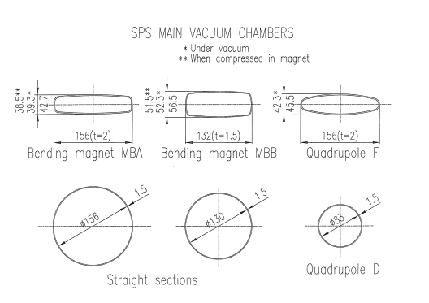
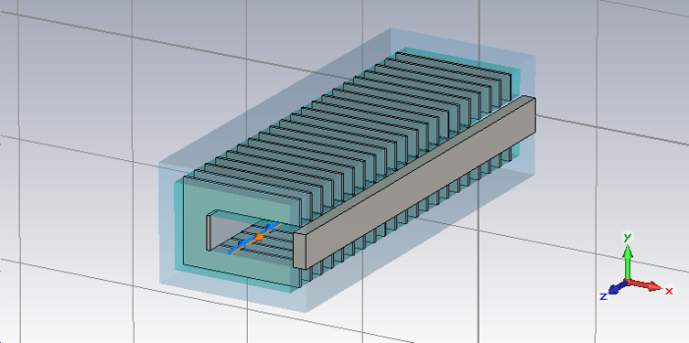
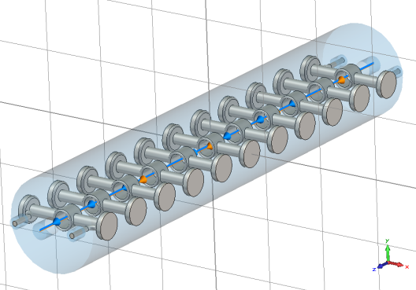
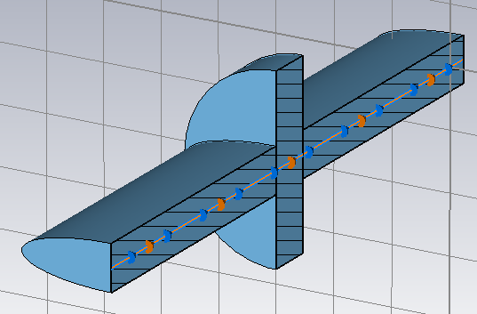
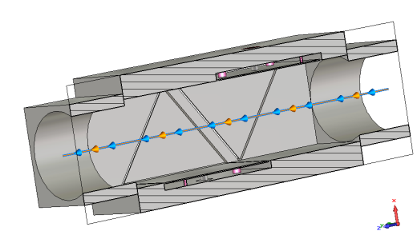
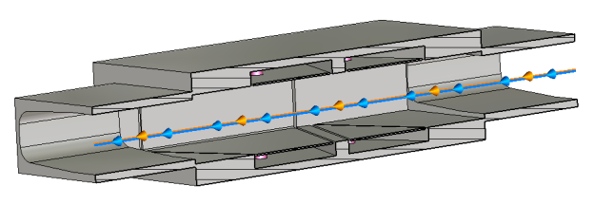
SPS transverse impedance model
Elements included in the database:
  Wall impedance that takes into account the different SPS vacuum chambers (analytical calculations)
  Kickers (CST 3D simulations)
  RF cavities (200 MHZ and 800 MHz) without couplers (CST 3D simulations)
  Broadband impedance of step transitions (CST 3D simulations)
  Horizontal (BPH) and vertical (BPV) beam position monitors (CST 3D simulations)
Beam pipe
Kickers
RF cavities
Step transitions
BPH
BPV

Slide 4
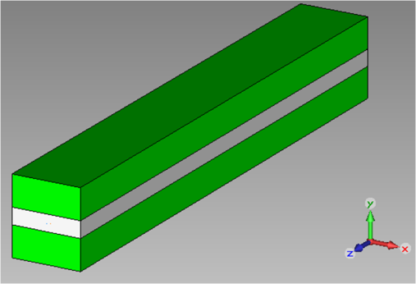
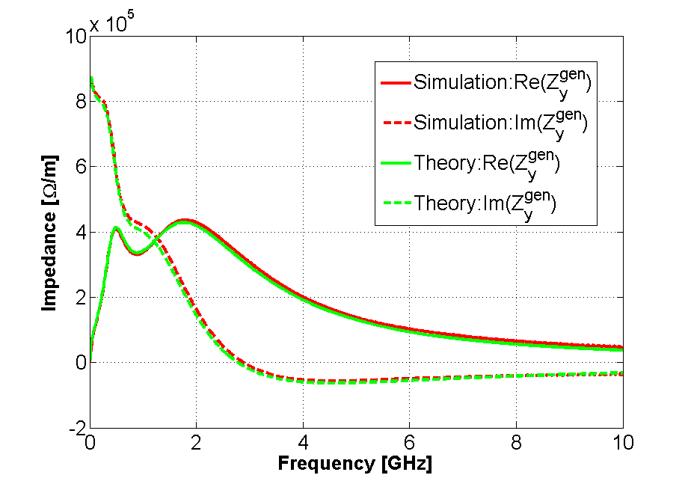
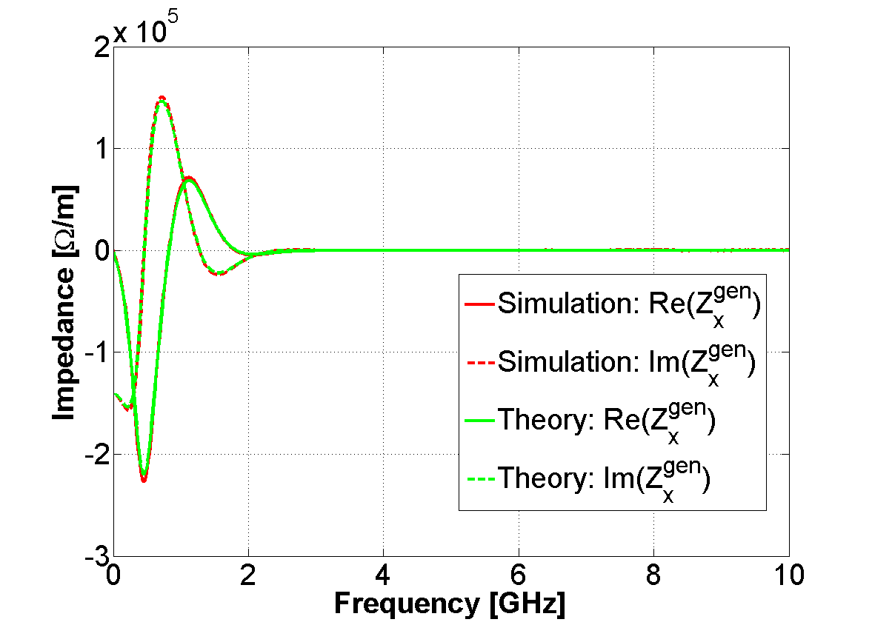
SPS kicker impedance model
Tsutsui model
Vertical
Horizontal
CST Particle Studio is found to be a reliable tool to simulate the impedance of ferrite loaded components

Slide 5
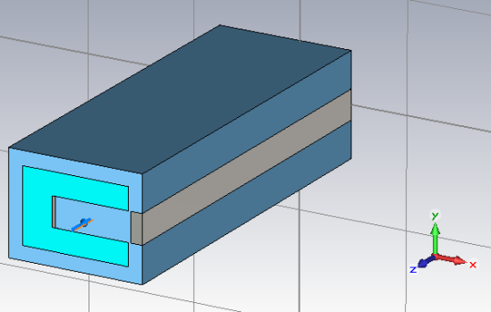
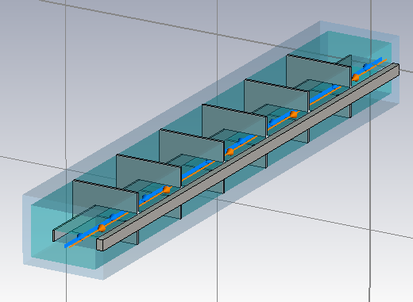
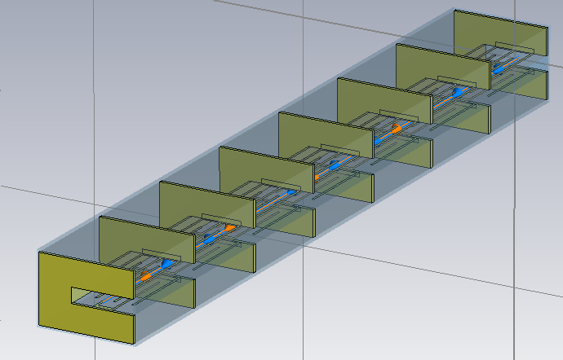
SPS kicker impedance model
SPS kicker magnet
Tsutsui model
C-magnet model
Realistic models: longitudinal cell segmentation and serigraphy

Slide 6
SPS kicker impedance model: experimental benchmark
Beam induced heating measurements
  The impedance model of the SPS extraction kicker with and without serigraphy can explain the beam induced heating observed in the SPS machine
Bench impedance measurements (stretched wire method)
C. Zannini, Electromagnetic simulations of CERN accelerator components and experimental applications. PhD thesis, Lausanne, EPFL, 2013. CERN-THESIS-2013-076.

Slide 7
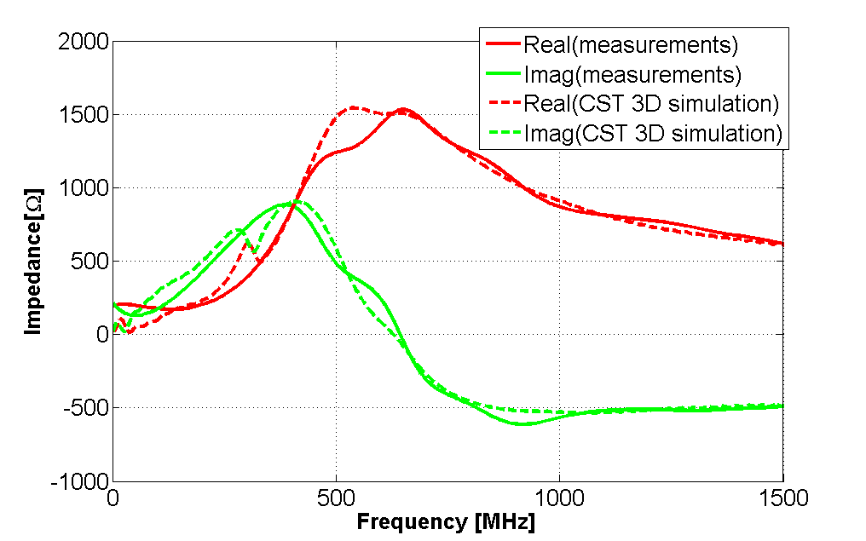
SPS kicker impedance model: comparison with bench measurements for the MKP11955 module
Longitudinal Impedance
Confirmation of the 3D simulation model

Slide 8
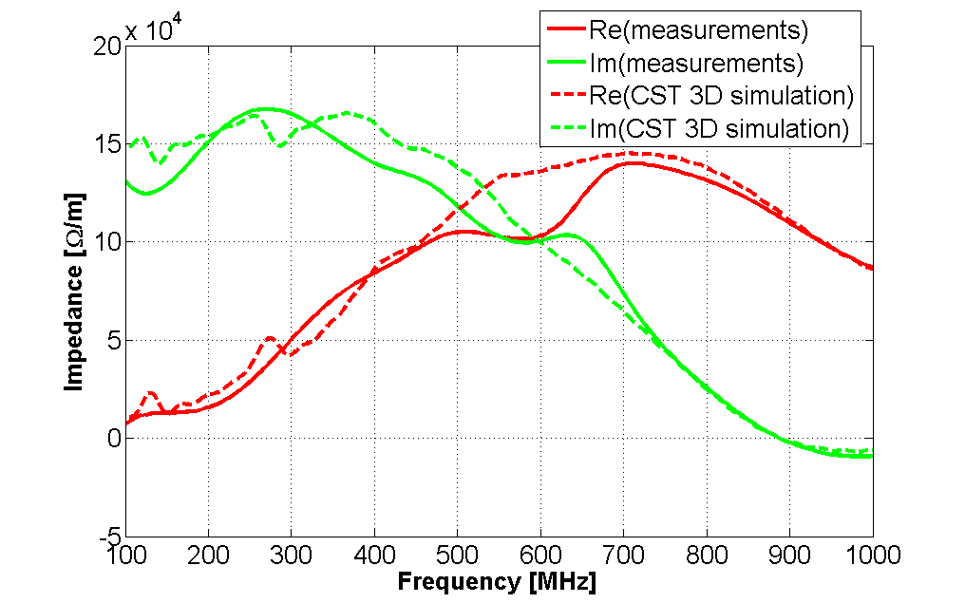
SPS kicker impedance model: comparison with bench measurements for the MKP11955 module
Vertical Impedance
Confirmation of the 3D simulation model

Slide 9
SPS transverse impedance model
Elements included in the database:
  Wall impedance that takes into account the different SPS vacuum chambers (analytical calculations)
  Kickers (CST 3D simulations)
  RF cavities (200 MHZ and 800 MHz) without couplers (CST 3D simulations)
  Broadband impedance of step transitions (CST 3D simulations)
  Horizontal (BPH) and vertical (BPV) beam position monitors (CST 3D simulations)
Beam pipe
Kickers
RF cavities
Step transitions
BPH
BPV

Slide 10
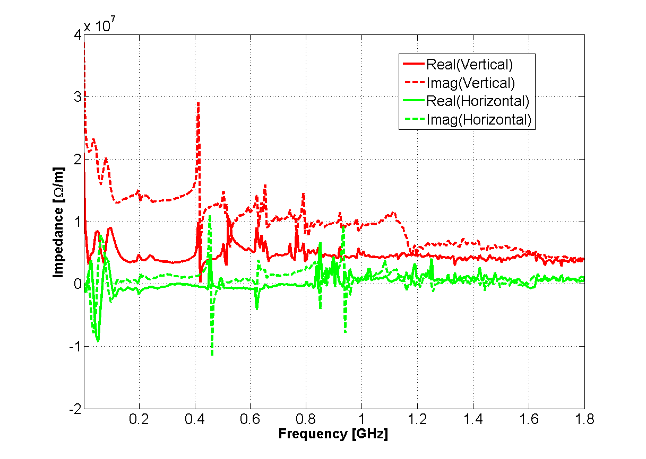
SPS transverse impedance model
Peaks due to the serigraphy of the extraction kickers

Slide 11
SPS transverse impedance model
Broadband impedance mainly from kickers, step transitions and wall

Slide 12
SPS transverse impedance model
Peaks due to the RF system and BPMs

Slide 13
SPS transverse impedance model
Benchmark with beam measurements
  Coherent tune shift
  Instability behavior

Slide 14
SPS transverse impedance model
Benchmark with beam measurements
  Coherent tune shift
  Instability behavior
A. W. Chao, Physics of collective beam instabilities in high energy accelerators

Slide 15
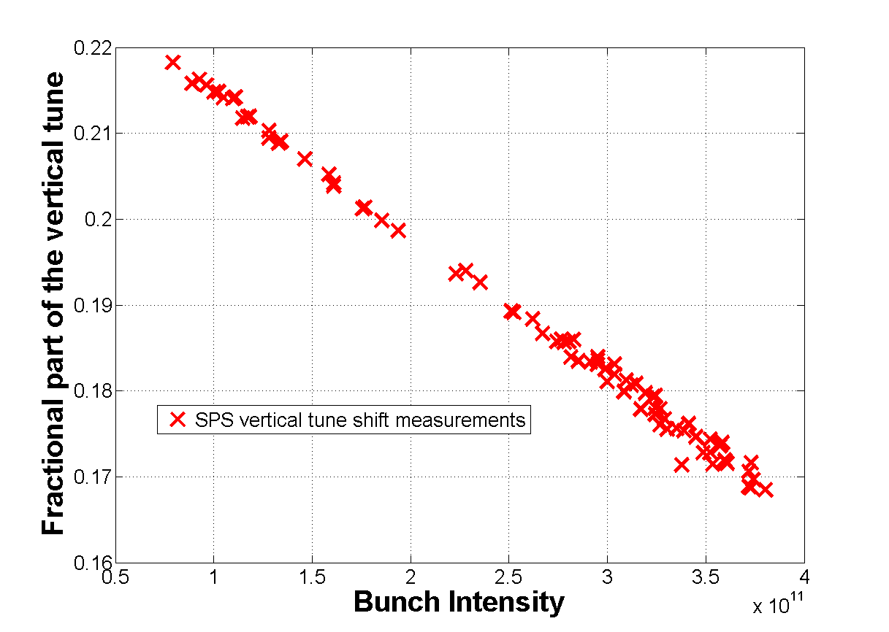
Benchmark of the SPS transverse impedance model: tune shift measurements
Vertical coherent tune shift: Measurements performed in September 2012
20 %
40 %
60 %
80 %
100 %

Slide 16
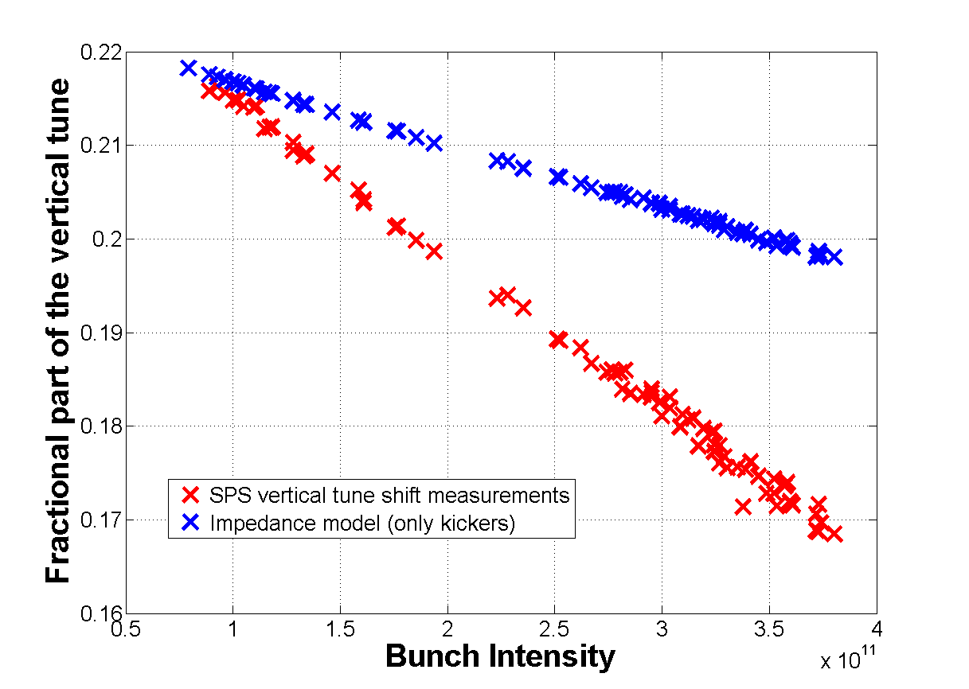
Benchmark of the SPS transverse impedance model: tune shift measurements
Vertical coherent tune shift: Measurements performed in September 2012
20 %
40 %
60 %
80 %
100 %

Slide 17
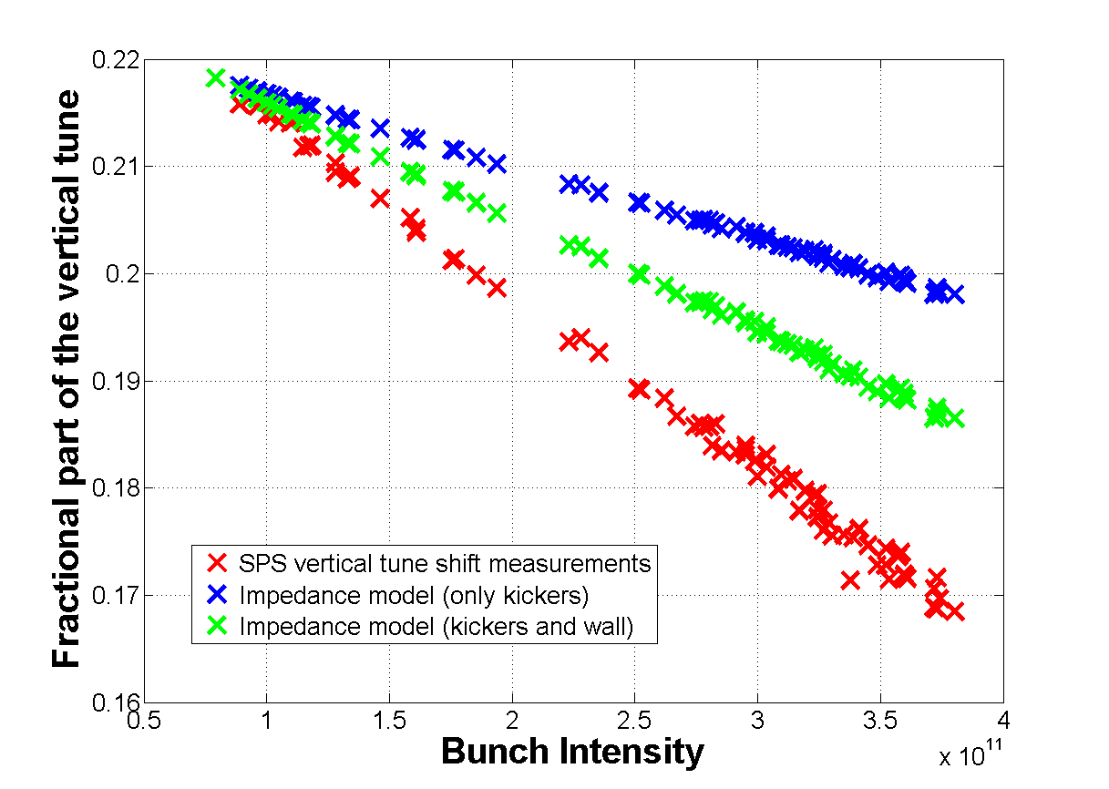
Benchmark of the SPS transverse impedance model: tune shift measurements
Vertical coherent tune shift: Measurements performed in September 2012
20 %
40 %
60 %
80 %
100 %

Slide 18
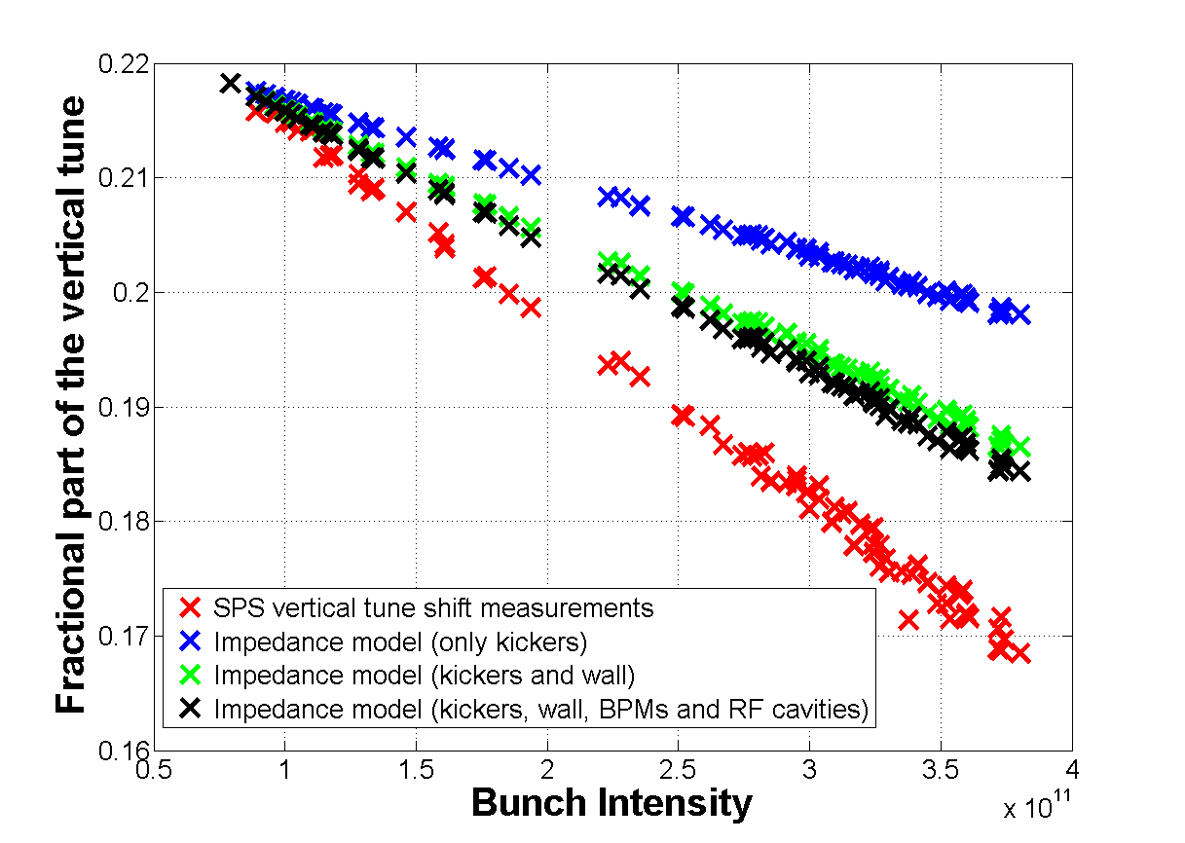
Benchmark of the SPS transverse impedance model: tune shift measurements
Vertical coherent tune shift: Measurements performed in September 2012
20 %
40 %
60 %
80 %
100 %

Slide 19
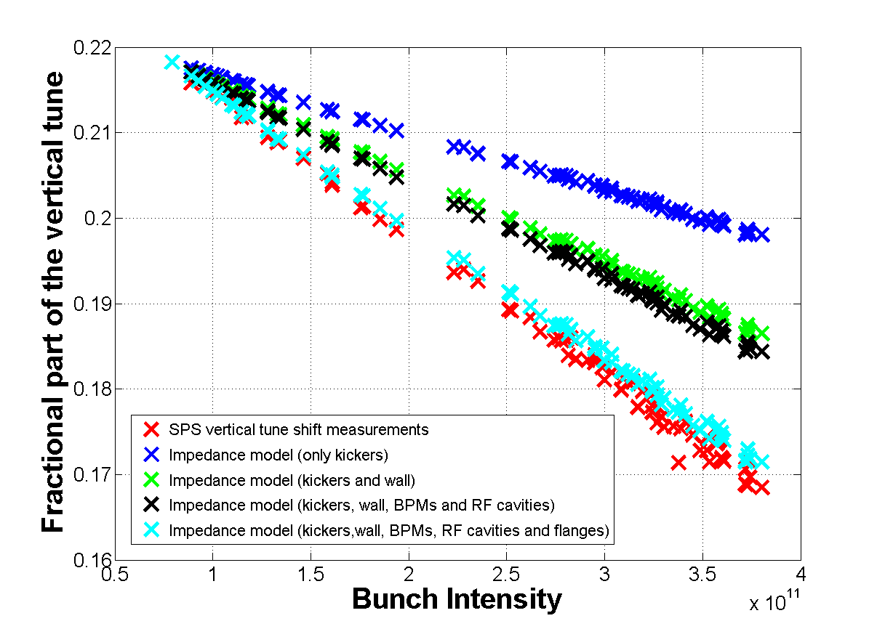
Benchmark of the SPS transverse impedance model: tune shift measurements
Vertical coherent tune shift: Measurements performed in September 2012
20 %
40 %
60 %
80 %
100 %
The SPS impedance model explains more than 90% of the measured vertical coherent tune shift

Slide 20
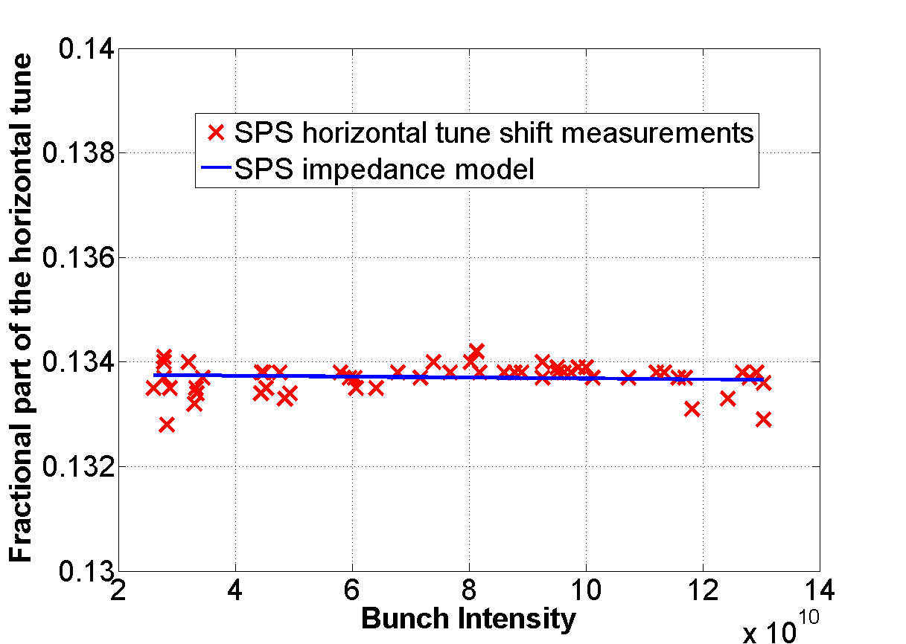
Benchmark of the SPS transverse impedance model: tune shift measurements
Horizontal coherent tune shift: Measurements performed in February 2013
The SPS impedance model predicts a very small horizontal tune shift (almost flat) in agreement with the measurements

Slide 21
SPS transverse impedance model
Benchmark with beam measurements
  Coherent tune shift
  Instability behavior
SPS impedance model
HEADTAIL
simulation
Transverse stability

Slide 22
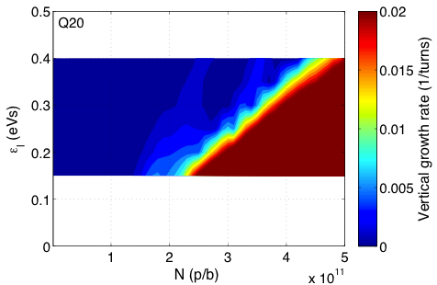
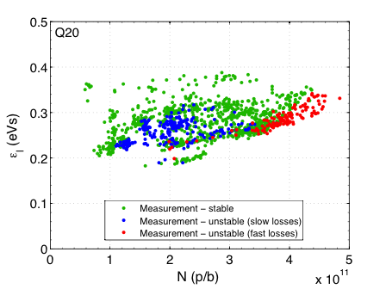
Benchmark of the SPS transverse impedance model: instability behavior
Two regimes of instability in measurements
  Fast instability threshold with linear dependence on ε_{l}
  Slow instability for intermediate intensity and low ε_{l}
Very well reproduced with HEADTAIL simulations
  SPS impedance model includes kickers, wall, BPMs and RF cavities
  Direct space charge not included
measurements
HEADTAIL simulations
nominal
Island of slow instability
4.5x10¹¹ p/b
@ 0.35 eVs
22

Slide 23
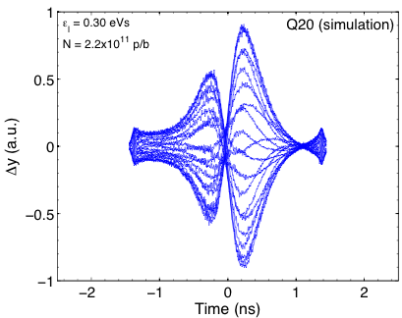
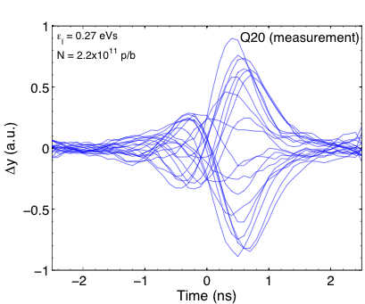
Benchmark of the SPS transverse impedance model: instability behavior
measurements
HEADTAIL simulations
nominal
Island of slow instability
4.5x10¹¹ p/b
@ 0.35 eVs
23

Slide 24
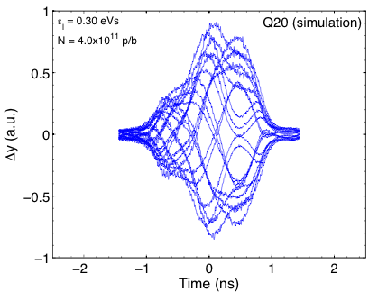
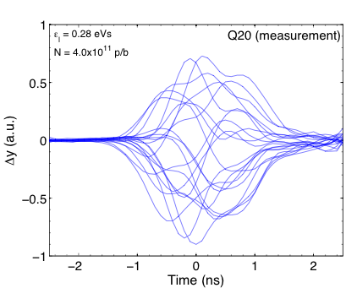
Benchmark of the SPS transverse impedance model: instability behavior
measurements
HEADTAIL simulations
nominal
Island of slow instability
4.5x10¹¹ p/b
@ 0.35 eVs
24

Slide 25
New elements to be added in the model
Simulations are ongoing or must be finalized
  Septa
  Wire scanner
  Non standard elements (special transitions, valves)
Update due to future installations and modifications
  New wire scanner
  New kicker for high bandwidth feedback system
  New MSI-V septum
  Serigraphy of the last MKE (7/8 were already serigraphed in the 2012)

Slide 26
Summary
The present SPS transverse impedance model includes kickers, wall, cavities, BPMs and step transitions
  The kickers are the main contributors to the SPS broadband impedance (about 40% of the measured coherent tune shift)
  The present SPS impedance model explains more than 90% of the measured coherent tune shift
  HEADTAIL simulations based on the SPS impedance model reproduce very well the instability behavior

Slide 27
Thank you for your attention

Slide 28
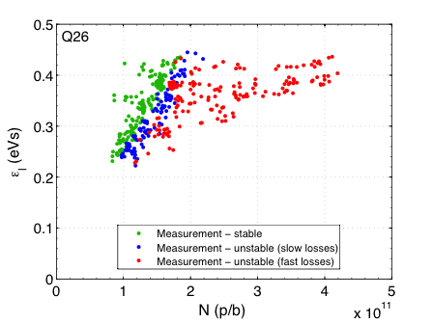
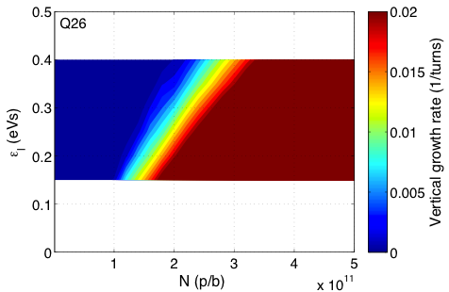
Stability diagram: Q26
Measured onset of instability linear in ε_{l}
  As expected, slower losses (lower growth rate) slightly above threshold
Linear dependence and instability thresholds reproduced in HEADTAIL
  SPS impedance model includes kickers, wall, BPMs and RF cavities
measurements
HEADTAIL simulations
nominal
1.6x10¹¹ p/b
@ 0.35 eVs

Slide 29

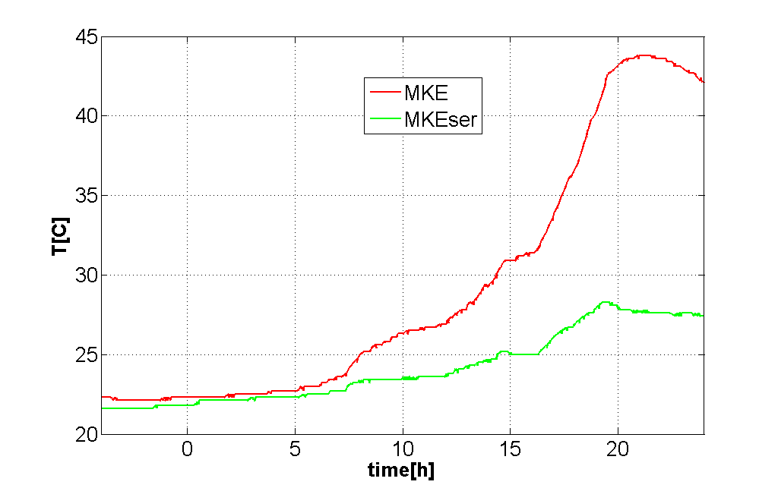
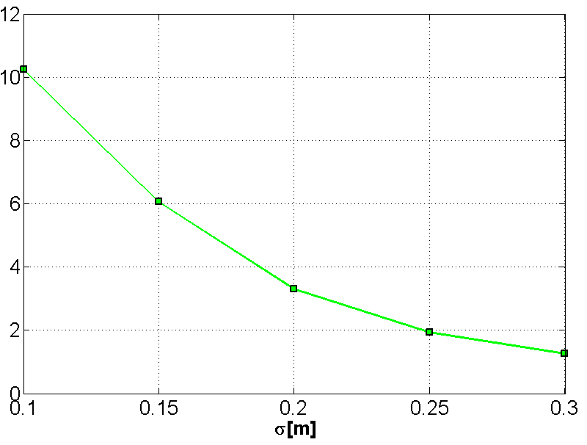
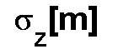

SPS kicker impedance model: comparison with beam induced heating observation (MKEs)
Beam induced heating: measurements (25/04/2012)
Power loss from the impedance model
ΔT_{MKE} =20 [K]
ΔT_{MKEser} =5 [K]
Bunch length during the experiment

Slide 30
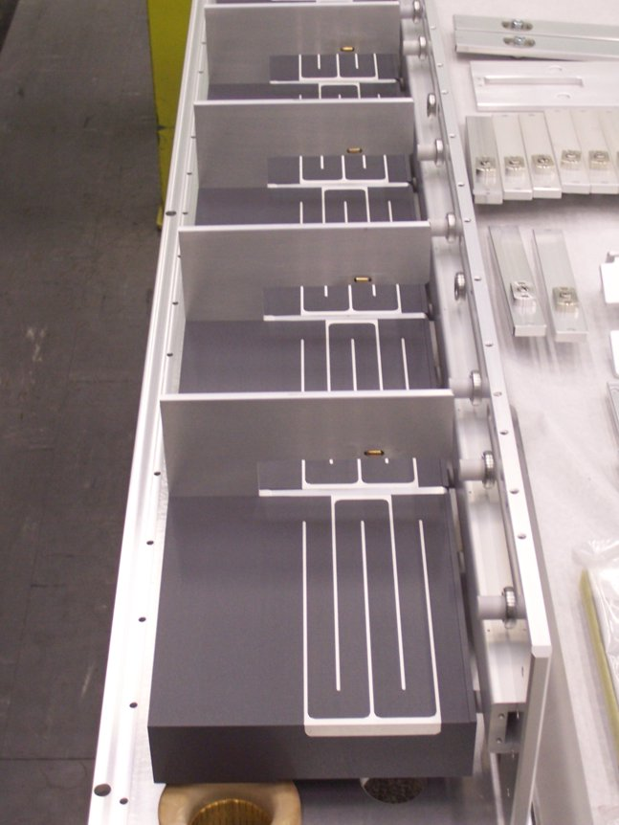
Realistic models: SPS extraction kicker (MKE-L)
Serigraphy
Seven out of eight SPS extraction kickers have been serigraphed
F. Caspers, T. Kroyer,
M. Barnes, E. Gaxiola et al.
Notes:
Inserire testo che 8 kicker sono serigrafati e uno no

Slide 31
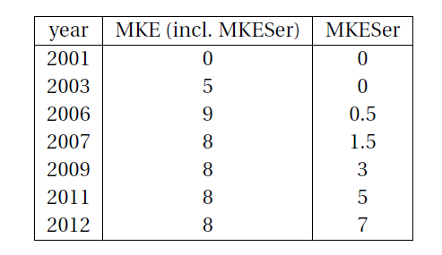
Evolution of the extraction kickers in the SPS
Post-LS1
2014 8 8
Notes:
Slide solo tabella storia

Slide 32
Realistic models: MKE kicker with serigraphy

Slide 33
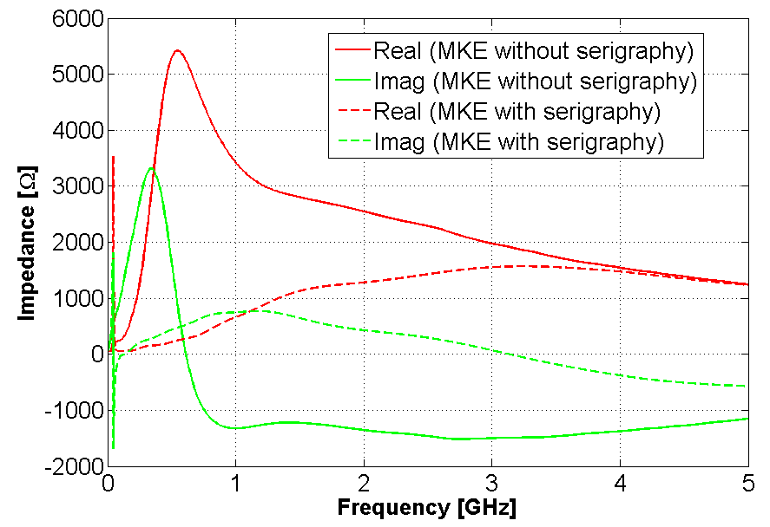
Comparing MKE with and without serigraphy
f=44 MHz

Slide 34
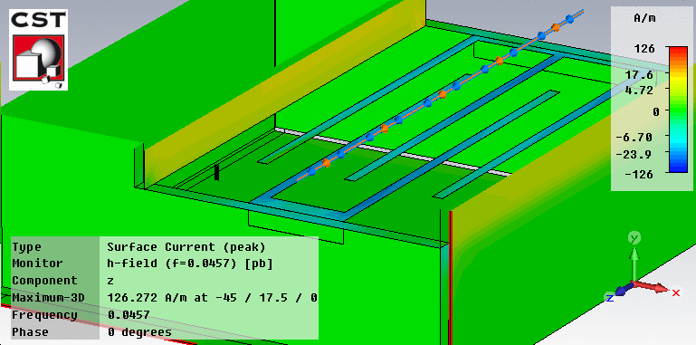
Comparing MKE with and without serigraphy
The peak observed in the MKE with serigraphy is a quarter-wavelength resonance on the finger length

Slide 35
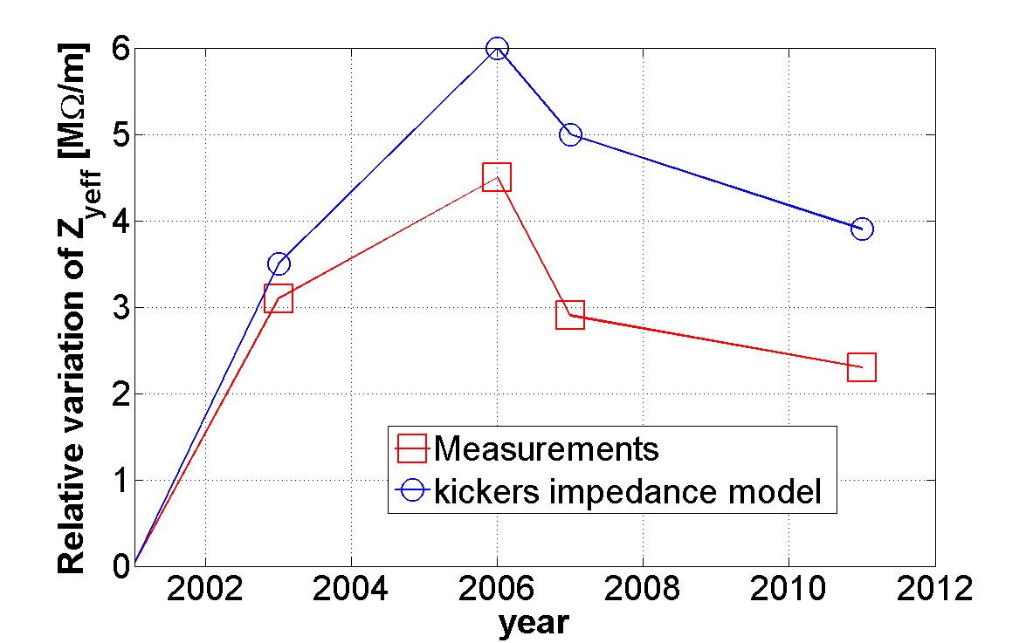
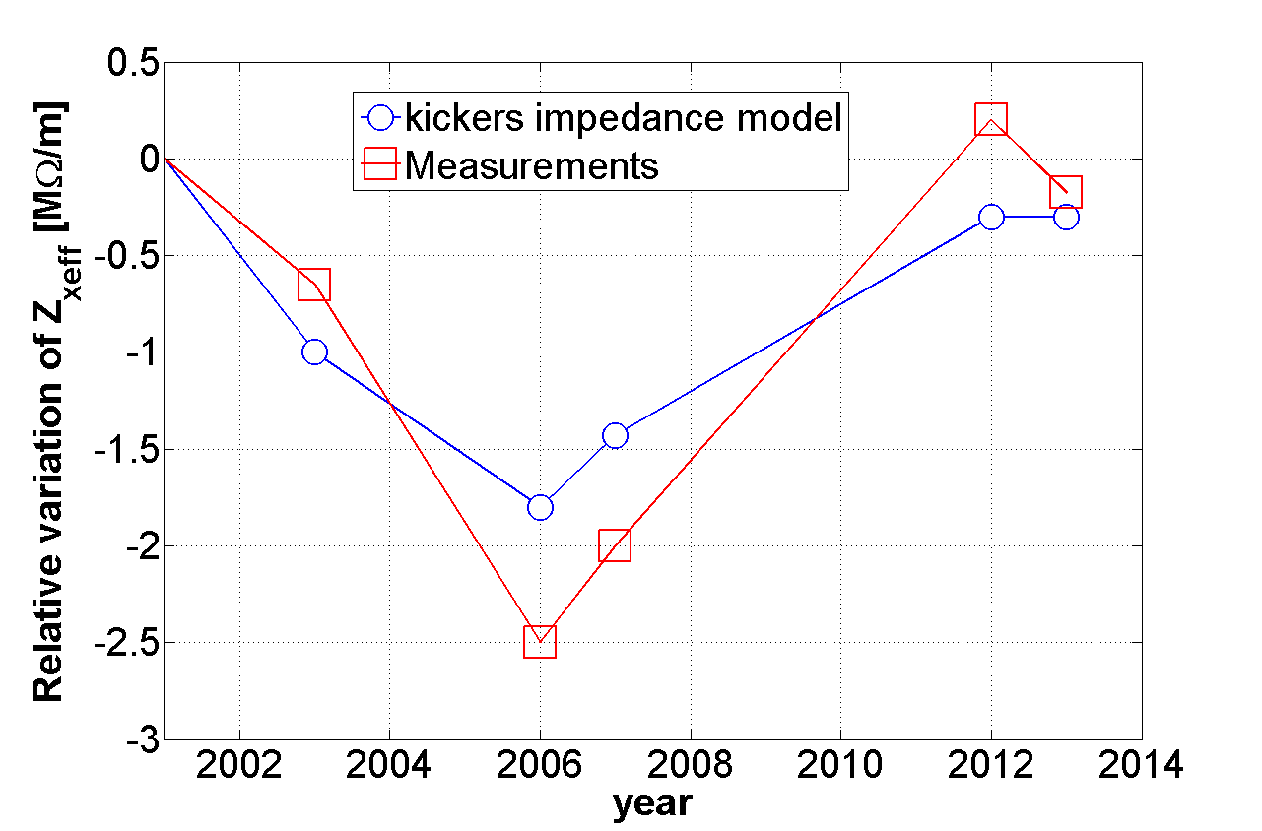
History of the extraction kickers in the SPS
The trend of the transverse effective impedance along the last 10 years is in good agreement with the expected changing of the kicker impedance model
Kickers play a major role in the SPS total impedance

Slide 36
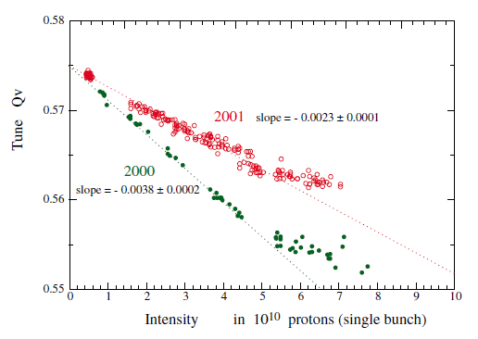
Pumping ports
Impedance reduction campaign: shielding of the pumping ports, lepton cavities etc.)
2000
H. Burkhardt, G.Rumolo, F. Zimmermann: Measurements of SPS Single-Bunch coherent Tune Shifts and Head-Tail Growth Rates in the Year 2001
The broadband impedance due to step transitions can give significant contribution to the coherent tune shift
Notes:
There are also other device that we are studying . Like……..

