Slide 2
LEIR model
A plan for understanding/upgrading the LEIR performance limitations
M.Bodendorfer BE/ABP & LEIR team

Slide 3
LEIR performance, 2013 and LIU Ions
Why upgrade?
All HI LHC experiments want by 2035: 10nb⁻¹
Parameter | Unit | LEIR 2013 run | LEIR Baseline upgrade | LEIR Full upgrade
Pb charge state | [-] | 54+
Output Energy | [GeV/u] | 0.0722
In/Out Bρ | [Tm] | 1.138 / 4.8
Inject. to next machine | [-] | 1
Bunches/ring | [-] | 2
Charge at flat bottom | Charges | ~6.0x10¹⁰ | 6.0x10¹⁰ | 1.1x10¹¹
Total extracted charge | Charges | ~5.4x10¹⁰ | 5.4x10¹⁰ | 8.6x10¹⁰
From: Performance of the injectors with ions after LS1
D. Manglunki for the LIU-Ions team, CERN, Geneva, Switzerland, 2013

Slide 4
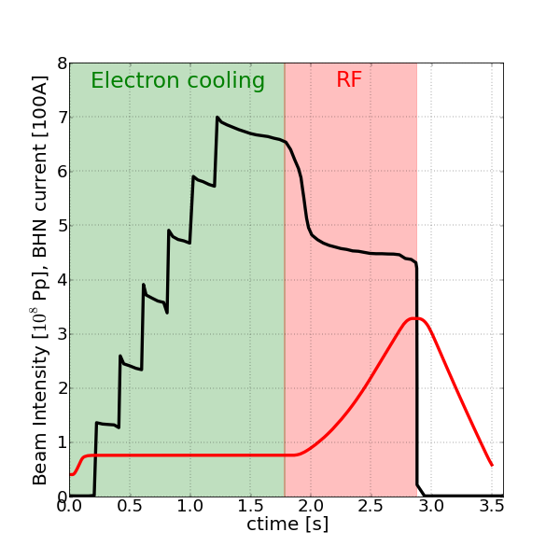
LEIR NOMINAL cycle
capture in H2, H4 @ 1780ms
(Coasting beam)
BHN current [100A]
Start of
Beam loss
Up to 50% beam loss
Extraction
@ 2880ms
6 injections. First at 215ms, then spaced 200ms. 200μs long.
B-field

Slide 5
Finding a solution for LEIR
What we have found so far:
  Working point on 4th order resonance
  Transverse instability at RF capture
  Positive chromaticity in the vertical plane
  Beam loss associated to RF-capture rather than magnetic Ramp
Proposed MDs series dedicated to each of the above findings in 2014, 2015.

Slide 6
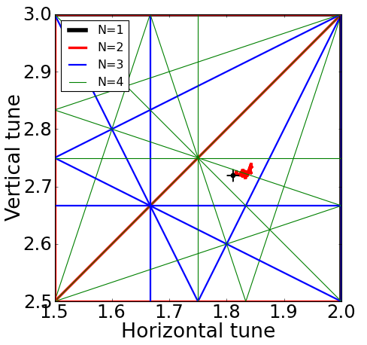
1. LEIR working point
Design tune: Q_{H}=1.82, Q_{V}=2.72
Q_{x} - Q_{y} = -1
2Q_{x} - Q_{y} = 1
4Q_{y} = 11
Q_{x} + 3Q_{y} = 10
3Q_{y} = 8
2Q_{x} + 2Q_{y} = 9

Slide 7
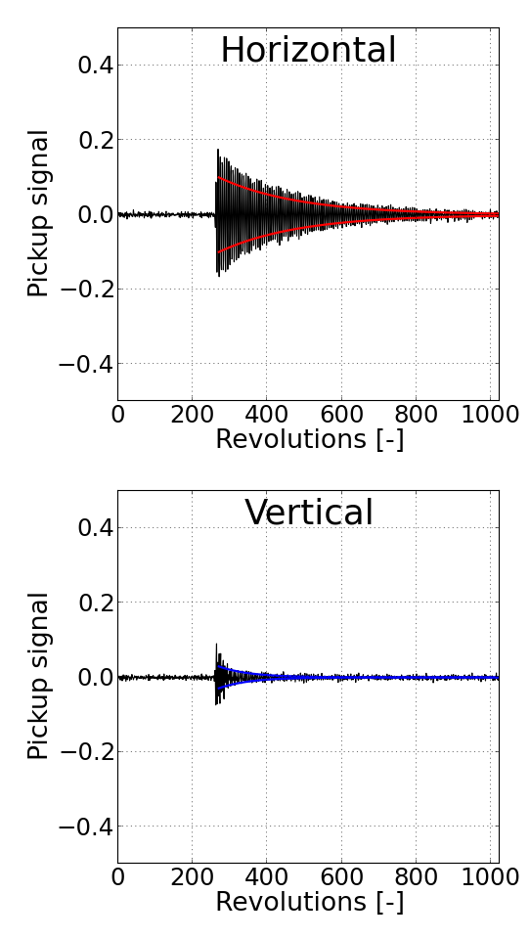
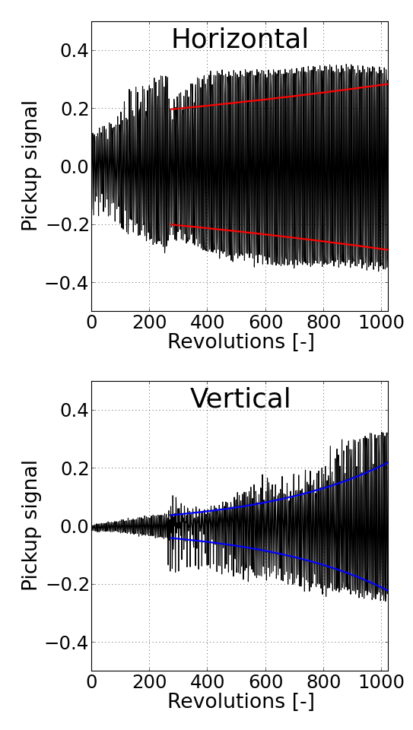
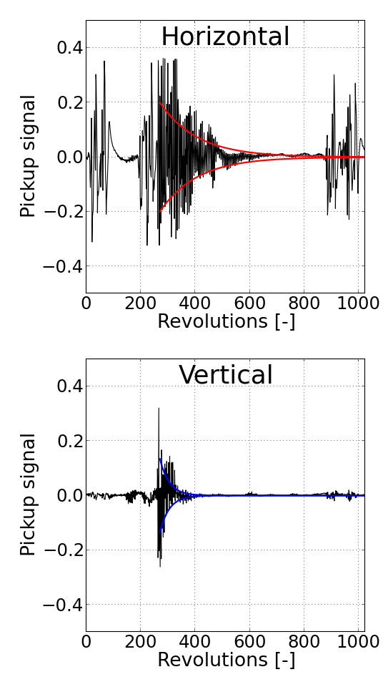
2. LEIR Instability at RF capture and ramp
Pickups output:
1815ms
Beam loss starts here
After: +20ms
Beam loss continues
Before: -20ms

Slide 8

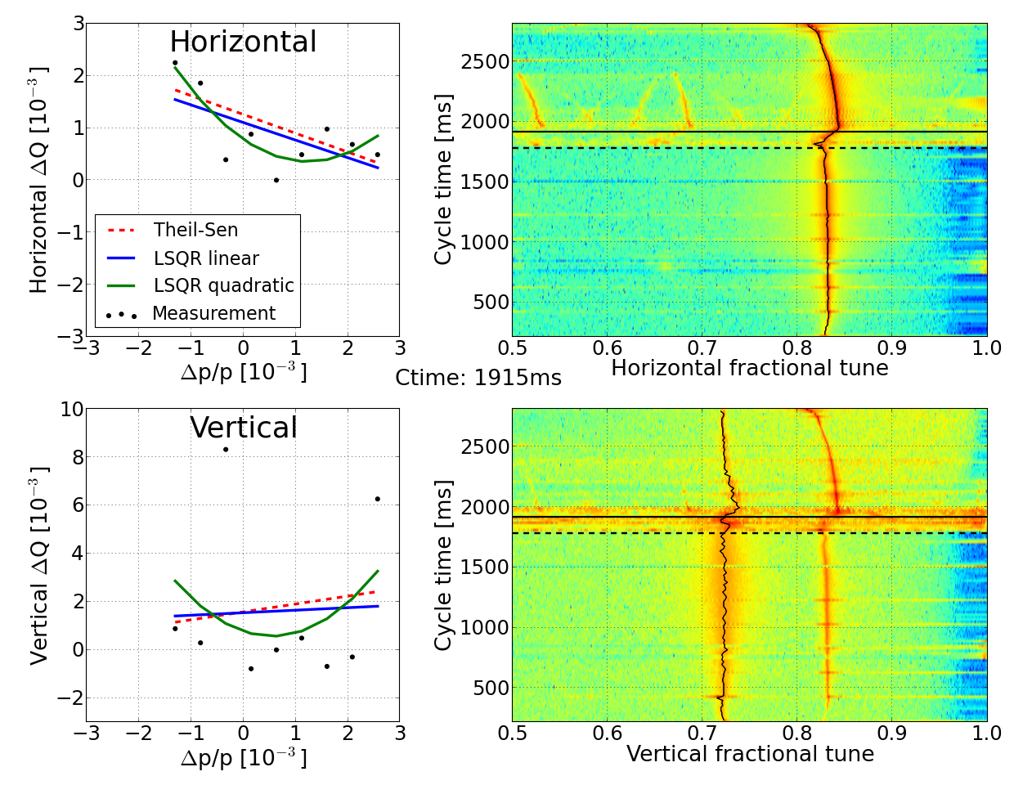
3. Tune and chromaticity measurement after RF-capture
Displayed
Beam
loss
✗
Bad fit
RF capture
Coasting beam & Ecooling
Displayed
Beam
loss
✗
Bad fit
RF capture
Coasting beam & Ecooling

Slide 9
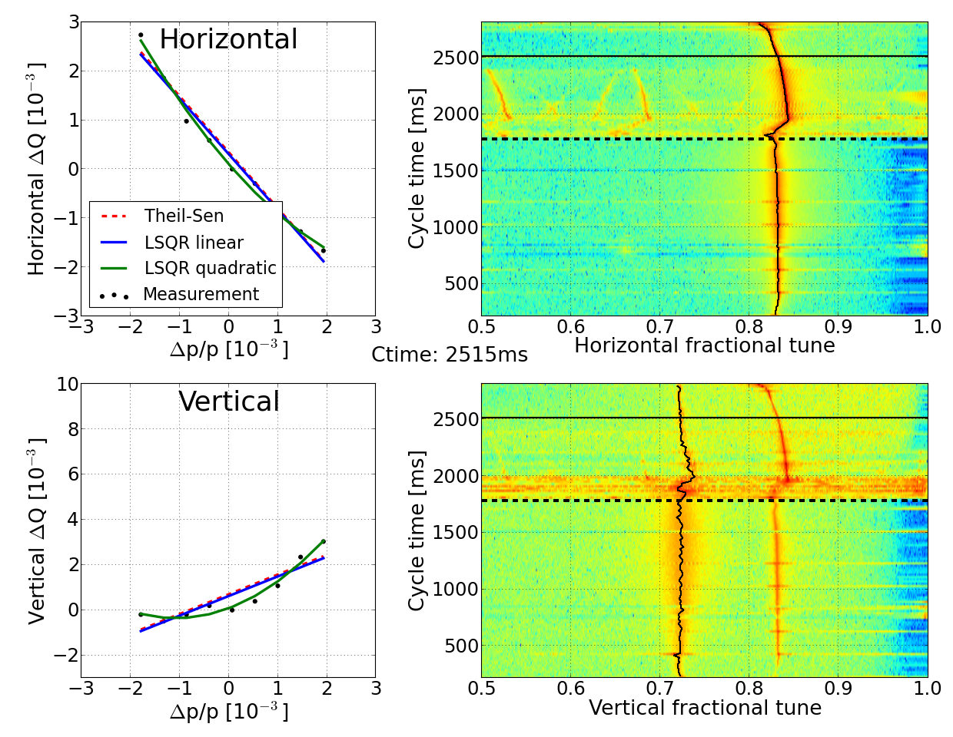
3. Tune and chromaticity measurement after RF-capture
Beam
loss
Displayed
✓
Good fit
RF capture
Coasting beam & Ecooling
Beam
loss
Displayed
✓
Good fit
(LSQR quadratic)
RF capture
Coasting beam & Ecooling

Slide 10
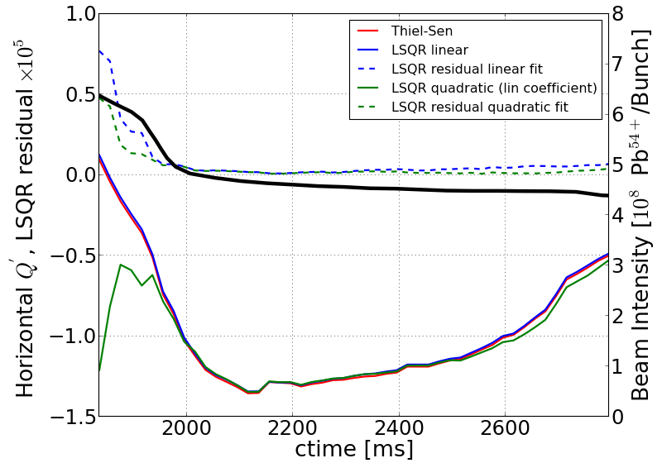
3. Horizontal chromaticity < 0 (after RF capt.)
(Horizontal design chromaticy = -1)
Residual of fit
Intensity
Fit slop
(Linear chromaticity)
Good fit

Slide 11
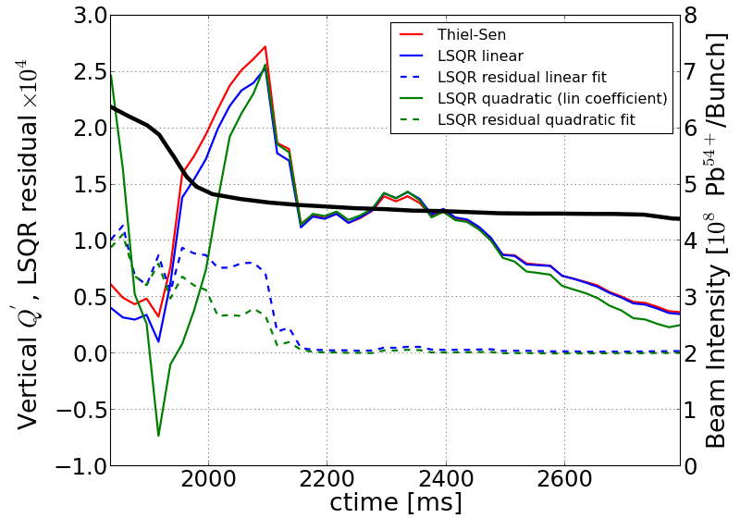
3. Vertical chromaticity > 0 (after RF capt.)
(Vertical design chromaticy = -1)
Intensity
Fit slope
(Linear chromaticity)
Residual of fits
Good fit

Slide 12
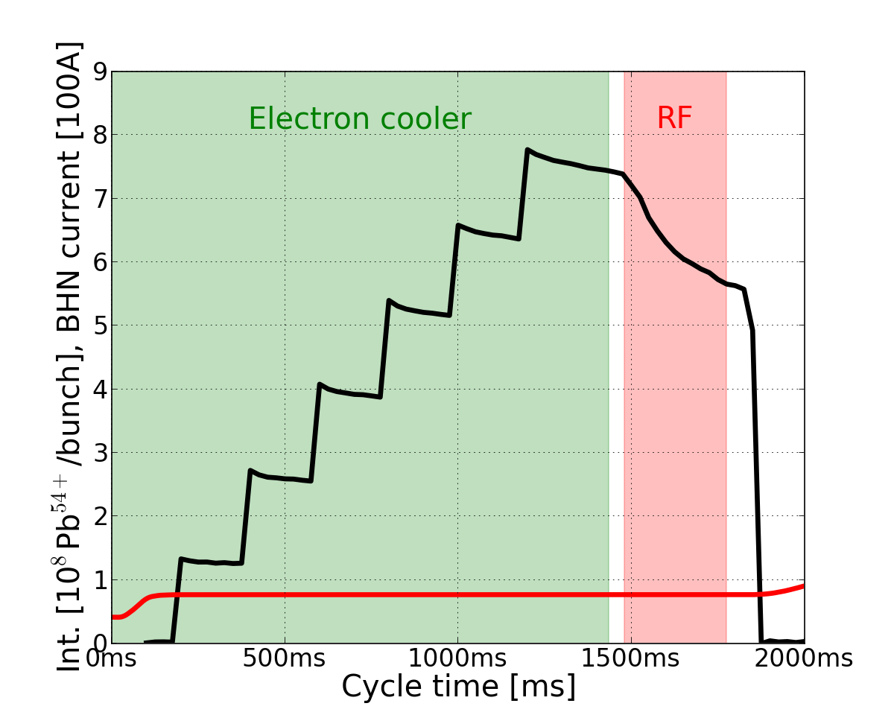
4. Disentangling beam loss from magnetic ramp
Beam loss with advanced RF-capture
RF beam bunching
⬇
Higher peak density increases
space-charge
⬇
Individual particle tune shift
⬇
Individual particles cross resonance
⬇
Loss
Advanced by 300ms
BHN current [100A]
Start of
Beam loss
Beam dump
Start mag. ramp

Slide 13
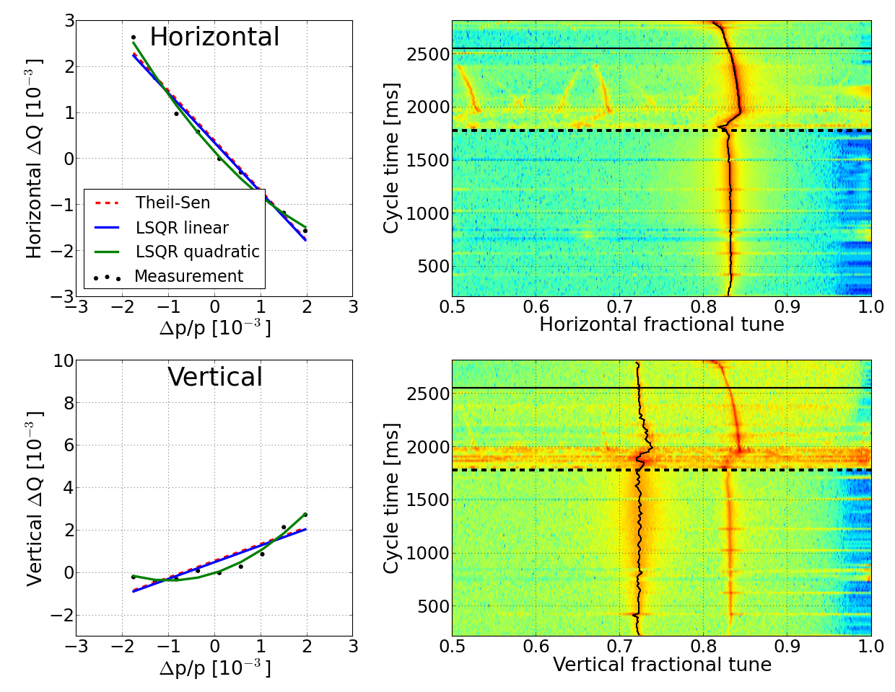
Summary of observations
Clues from measurements:
  Working point on 4th order resonance
  Transverse instability at RF capture
  Positive chromaticity in the vertical plane
  Beam loss associated to RF-capture rather than mag. ramp
4.
BHN current [100A]
2.
3.
1.

Slide 14
MD suggestions
Measurement clue and suggested MD:
  Working point on 4th order resonance
    Explore other regions of the tune space (Q_{y} > 2.75)
    Investigate chromaticity for new tune regions

Slide 15
MD suggestions
Measuremene clue and suggested MD:
  Working point on 4th order resonance
  Transverse instability at RF capture
    Study effect of the transverse damper
    Investigate origin of instability with transv. damper off

Slide 16
MD suggestions
Measuremene clue and suggested MD:
  Working point on 4th order resonance
  Transverse instability at RF capture
  Positive chromaticity in the vertical plane
    Chrom. < 0 for both planes
    Qmeter software from PS

Slide 17
MD suggestions
Measuremene clue and suggested MD:
  Working point on 4th order resonance
  Transverse instability at RF capture
  Positive chromaticity in the vertical plane
  Beam loss associated to RF-capture rather than magnetic ramp
    Try RF-capture with different beam parameters (bunch length and transverse emittances) to check the impact of space-charge.
    Study the effect of electron
    cooling and acceleration.

Slide 18
Conclusion & Summary
So far we have:
found working point on/close to resonance
found transverse instability
found wrong chromaticity
Pb⁵⁴⁺ beam loss associated to RF-capture rather than the magnetic ramp
The Plan:
Dedicated MD series for each finding.
Further disentangling of space-charge, transverse instability and resonant beam loss.
Refine the optics model of LEIR.
Further reading:
Plans for the upgrade of CERN’s Heavy Ion Complex, D. Manglunki et al., CERN-ACC-Note-2013-034
LINAC3 tank2 phase change and LEIR performance, M. Bodendorfer, R. Scrivens, CERN-ATS-Note-2013-035
Chromaticity in LEIR performance, M. Bodendorfer & LEIR team, CERN-ACC-Note-2013-0032
Longitudinal emittance reduction in LEIR of ion beams for LHC, M. E. Angoletta, M. Bodendorfer, A. Findlay. S. Hancock, D. Manglunki, upcoming

