Slide 2
Beams after LS1
Giovanni Rumolo and Hannes Bartosik
Acknowledgments: G. Arduini, H. Damerau, J. Esteban-Müller, A. Findlay, R. Garoby, S. Gilardoni, B. Goddard, S. Hancock, G. Iadarola, B. Mikulec, Y. Papaphilippou, E. Shaposhnikova, R. Tomás, PS & SPS Operation crews
LIU Day, 11/04/2014
Notes:
Keywords
e-cloud status in PS and SPS
scrubbing plans in SPS and LHC
BCMS for 25 ns in LHC
8b+4e option

Slide 3
Outline
The LHC beams
  Single bunches (probe and indiv)
  50 and 25 ns beams (standard and BCMS)
  Doublet beam (scrubbing)
  8b+4e (low e-cloud)
Summary

Slide 4
The LHC beams
  Single bunches (probe and indiv)
  Achieved performance in 2013
  50 and 25 ns beams (standard and BCMS)
  Doublet beam (scrubbing)
  8b+4e (low e-cloud)
Summary

Slide 5
LHCPROBE & LHCINDIV – specs @LHC injection
 | LHCPROBE | LHCINDIV
Intensity [p/b] | 5 x 10⁹ – 2 x 10¹⁰ | 2 x 10¹⁰ – 3 x 10¹¹
Transverse emittance, 1σ [μm] | 1 | < 2.5
Longitudinal emittance [eVs] | 0.35 | 0.35 – 0.5
LHCPROBE usually below or about 10¹⁰ p/b, transverse emittance not critical
LHCINDIV parameter range also extended in MDs to produce single bunches with up to 4.5 x 10¹¹ p/b and/or with lower longitudinal emittances (down to 0.15 eVs) at SPS injection
  Accelerate and extract high intensity variants for possible impedance or beam-beam studies ?

Slide 6
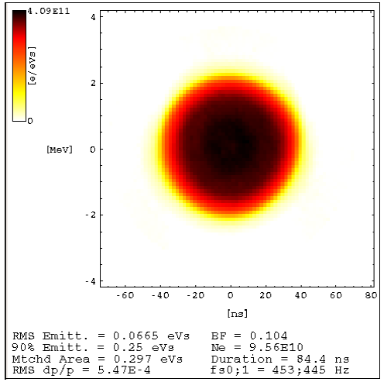
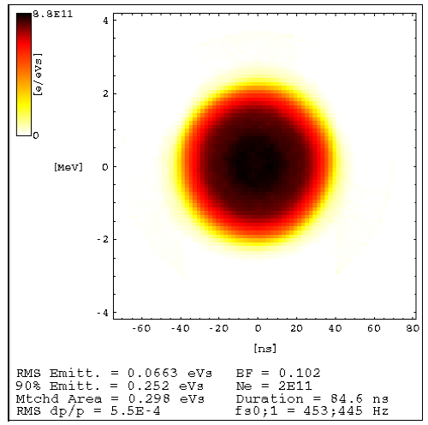
LHCPROBE & LHCINDIV – 2013 status
Since 2013, new production mechanism in the PSB to cover parameter range for both these beams (S. Hancock, CERN-ATS-Note-2013-040 MD)
Based on longitudinal blow up (C16 voltage) during the first part of the cycle for intensity setting
Excellent intensity shot-to-shot reproducibility preserving the 6D phase space unchanged for different intensity values
Baseline for post-LS1

Slide 7
The LHC beams
  Single bunches (probe and indiv)
  50 and 25 ns beams (standard and BCMS)
  Achieved performance in 2012
  Expected performance after LS1
  Doublet beam (scrubbing)
  8b+4e (low e-cloud)
Summary

Slide 8
LHC25 and LHC50 (std & BCMS) – pre-LS1 status
50 ns and 25 ns beam at the SPS extraction in 2012 (Q20)
Combined wire-scans at end of SPS flat bottom (values cross-checked with LHC) and intensity measured at SPS flat top after scraping
Transport through PS/SPS nearly within intensity loss and emittance blow up budgets (except for LHC25 std)
Budget | PS | SPS
Δε_{x,y} /ε_{x0,y0} | 5% | 10%
−ΔN/N₀ | 5% | 10%

Slide 9
LHC25 and LHC50 Post-LS1:
Expected performance
Recover 2012 performance
  Machines exposed to air, electron cloud
Potential for higher bunch intensity
  Possibly extended reach thanks to the upgraded longitudinal feedback in the PS
  25 ns up to 1.3 x 10¹¹ p/b at the SPS extraction (limited by RF power and longitudinal instabilities)
Potential for higher brightness
  Move RF manipulations in the PS to 2.5 GeV (instead of 1.4 GeV)
    Larger longitudinal emittance from the PSB
      Possible thanks to PSB control of longitudinal parameters along the cycle and at extraction
    Space charge alleviated by both longer bunches and larger momentum spread
  Improve SPS space charge limit (for 50 ns BCMS)
    Working point optimization for high brightness beams

Slide 10
SPS scrubbing in 2014/15
SCRUBBING RUN I (weeks 39 & 40)
Beam → Standard 25 ns
Main goals:
Qualify scrubbing after long shut-down (efficiency and duration)
Recover 2012 performance
Sept.
Nov.
2014
SPS MDs
  Set up the doublet beam with acceleration (long cycle)
  Push the intensity to higher values for 25 ns beam
Mar.
SCRUBBING RUN II (2 weeks)
Beams → High intensity 25 ns, scrubbing beam (doublet)
Main goal:
Determine whether scrubbing also works for high intensity
2015
Aug.
LIU-SPS Review
Scrubbing or coating?
Notes:
Scrubbing run I: operational recovery
Scrubbing run II: for LIU

Slide 11
Beam parameters at LHC injection after LS1
Assuming:
Transport in the PS and SPS within budgets
Benefits from reviewed longitudinal parameters in the PSB – PS transfer
Successful SPS scrubbing after exposure to air during LS1
Summary tables
25 ns | Intensity (p/b) | Emittance (μm)
Standard | 1.3 x 10¹¹ | 2.4
BCMS | 1.3 x 10¹¹ | 1.3
50 ns | Intensity (p/b) | Emittance (μm)
Standard | 1.7 x 10¹¹ | 1.6
BCMS | 1.7 x 10¹¹ | 1.1

Slide 12
The LHC beams
  Single bunches (probe and indiv)
  50 and 25 ns beams (standard and BCMS)
  Doublet beam (scrubbing)
  Achieved performance in 2012/13
  Expected performance after LS1
  8b+4e (low e-cloud)
Summary

Slide 13
Doublet beam
Machine tests in the SPS at the end of 2012-13 run
  Doublet production scheme at SPS injection validated
  E-cloud enhancement experimentally demonstrated
Production scheme
  Injection of trains of 72 x 10ns long bunches with 1.7e11 p/doublet on unstable phase and capture in two neighboring buckets in the SPS (done)
  Acceleration on slower ramp and extraction to LHC of 1.6e11 p/doublet (to be set up, possible beam quality degradation)
  Should be fine in LHC → only interlocked BPMs to be checked with doublets
4
3
1st inj.
200 MHz RF Voltage [MV]
2
1
0
4
-2
0
2
6
8
Time [ms]

Slide 14
Doublet beam
Machine tests in the SPS at the end of 2012-13 run
  Doublet production scheme at SPS injection validated
  E-cloud enhancement experimentally demonstrated
Production scheme
  Injection of trains of 72 x 10ns long bunches with 1.7e11 p/doublet on unstable phase and capture in two neighboring buckets in the SPS (done)
  Acceleration on slower ramp and extraction to LHC of 1.6e11 p/doublet (to be set up, possible beam quality degradation)
  Should be fine in LHC → only interlocked BPMs to be checked with doublets
4
3
1st inj.
200 MHz RF Voltage [MV]
 | Intensity (p/doublet) | Emittance (μm)
Doublets | 1.6 x 10¹¹ | > 3.0
2
1
0
4
-2
0
2
6
8
Time [ms]

Slide 15
The LHC beams
  Single bunches (probe and indiv)
  50 and 25 ns beams (standard and BCMS)
  Doublet beam (scrubbing)
  8b+4e (low e-cloud)
  Expected performance after LS1
Summary

Slide 16




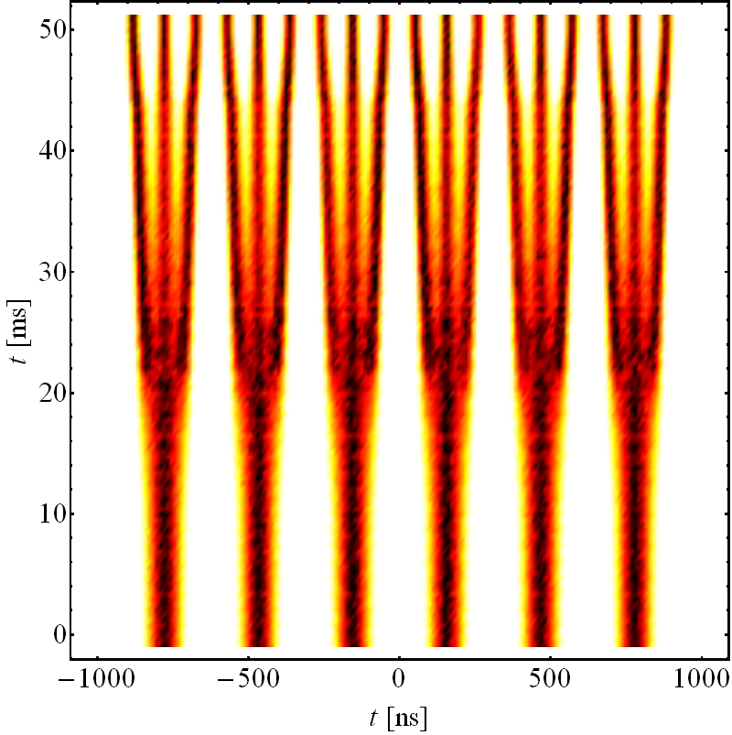
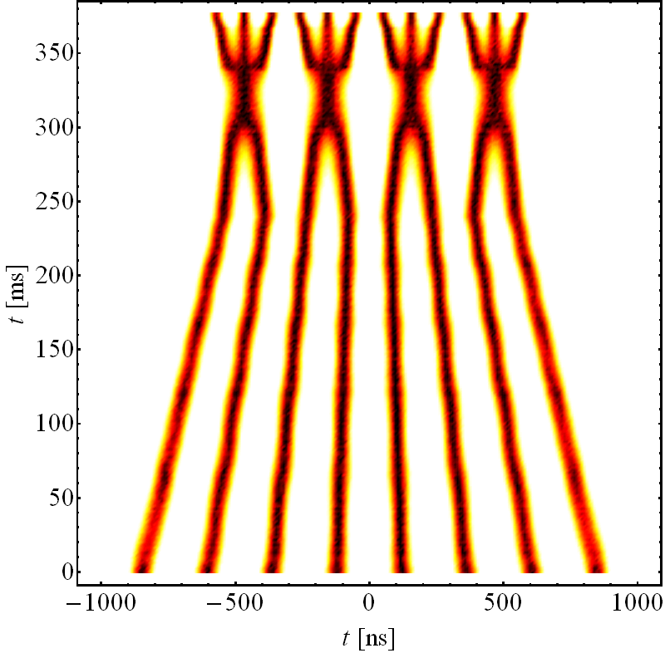
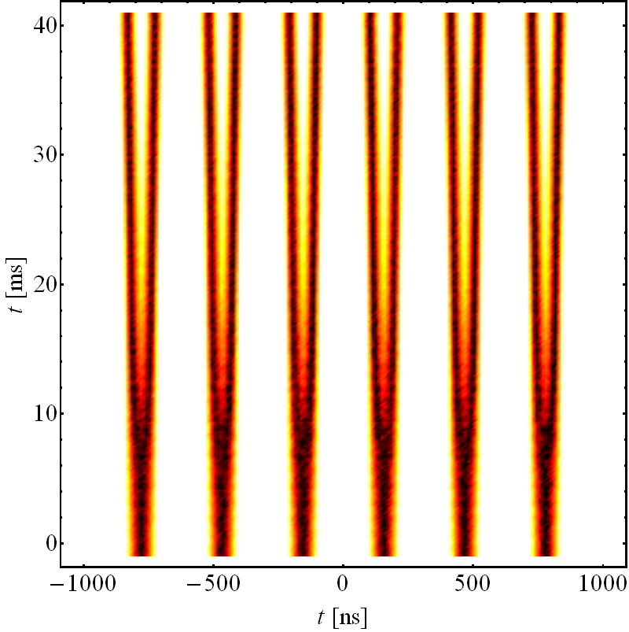
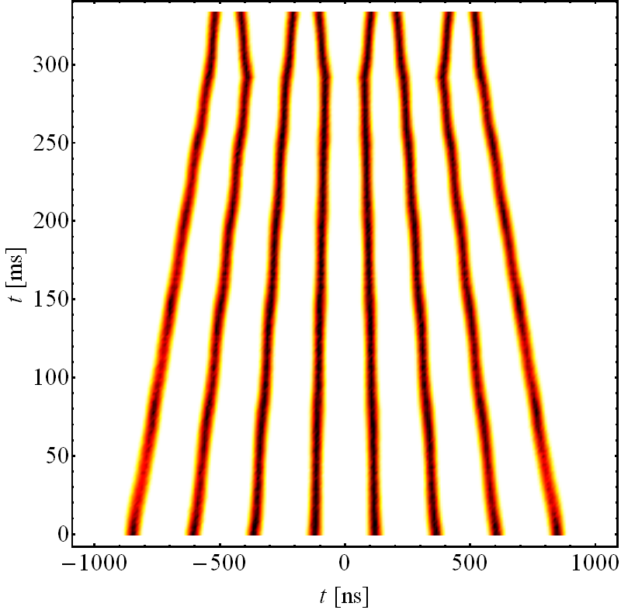
8b+4e scheme
Trains with 4 missing bunches every 8 bunches (H. Damerau, RLIUP)
  Allows for larger intensity per bunch
  Is expected to reduce e-cloud effects
Production
  Std scheme → Unbalance h = 7 → 21 triple split into a double split, leaving empty bucket – bunch pattern 6x(8b+4e) + 8b
  BCMS → merging and triple splitting suppressed – bunch pattern 3x(8b+4e) + 8b
E_{kin} = 2.5 GeV
E_{kin} = 2.5 GeV
E_{kin} = 2.5 GeV
E_{kin} = 2.5 GeV
  Simulation
  Simulation
  Simulation
  Simulation
Standard scheme
BCMS

Slide 17
8b+4e scheme
Limited to 1.8 x 10¹¹ p/b because of longitudinal instabilities in the SPS
Brightness limited by
  PSB brightness for standard scheme
  No outstanding bottleneck for BCMS
Standard scheme
BCMS

Slide 18
8b+4e scheme
Limited to 1.8 x 10¹¹ p/b because of longitudinal instabilities in the SPS
Brightness limited by
  PSB brightness for standard scheme
  No outstanding bottleneck for BCMS
25 ns (8b+4e) | Intensity (p/b) | Emittance (μm) | Bunch pattern
Standard | 1.8 x 10¹¹ | 2.3 | 6 x (8b+4e) + 8b
BCMS | 1.8 x 10¹¹ | 1.4 | 3 x (8b+4e) + 8b
Standard scheme
BCMS

Slide 19
The LHC beams
  Single bunches (probe and indiv)
  50 and 25 ns beams (standard and BCMS)
  Doublet beam (scrubbing)
  8b+4e (low e-cloud)
Summary

Slide 20
Summary
Lots of MD time needed to produce “old” beams with new schemes and “new” beams
LHC start up and scrubbing
  LHCPROBE and LHCINDIV with new production mechanism in the PSB
  LHC50 standard
    Up to 1.7 x 10¹¹ p/b with ε_{x,y}=1.6 μm
  LHC25 standard
    Up to 1.3 x 10¹¹ p/b with ε_{x,y}=2.4 μm
  LHC25 doublet
    Up to 1.6 x 10¹¹ p/doublet with ε_{x,y}> 3.0 μm
Physics
  LHC50 (standard or BCMS)
    BCMS up to 1.7 x 10¹¹ p/b with ε_{x,y}=1.1 μm
  LHC25 BCMS
    Up to 1.3 x 10¹¹ p/b with ε_{x,y}=1.3 μm
  8b+4e as alternative if LHC scrubbing is not enough to run with LHC25 BCMS
    Up to 1.8 x 10¹¹ p/b with ε_{x,y}=2.3/1.4 μm (std/BCMS)

Slide 22

Post-LS1: PSB – PS transfer
Recombination kicker rise time:
Kinetic energy, E_{kin} | Rise time
1.4 GeV | 105 ns
 | E_{kin} | Bucket length | Max bunch length | Bunch length (pre-LS1)
h=7 (std) | 1.4 GeV | 327 ns | 220 ns | 180 ns
h=9 (BCMS) | 1.4 GeV | 255 ns | 150 ns | 150 ns
Constraints on longitudinal emittance per bunch at PS injection
Bunches to the SPS with ε_{z}=0.35 eVs
Quality of RF manipulations at E_{kin}=2.5 GeV
Bunches crossing transition on h=21 with ε_{z}<1 eVs
PSB available voltage (h1+2) to obtain the above bunch lengths

Slide 23
Post-LS1: PSB – PS transfer
Recombination kicker rise time:
Kinetic energy, E_{kin} | Rise time
1.4 GeV | 105 ns
 | E_{kin} | Bucket length | Max bunch length | Bunch length (pre-LS1)
h=7 (std) | 1.4 GeV | 327 ns | 220 ns | 180 ns
h=9 (BCMS) | 1.4 GeV | 255 ns | 150 ns | 150 ns
Constraints on longitudinal emittance per bunch at PS injection
Bunches to the SPS with ε_{z}=0.35 eVs
Quality of RF manipulations at E_{kin}=2.5 GeV
Bunches crossing transition on h=21 with ε_{z}<1 eVs
PSB available voltage (h1+2) to obtain the above bunch lengths
RF Manipulation: | @1.4 GeV | @2.5 GeV
50 ns (Std/BCMS) | 1.2/0.9 eVs | 1.9/0.9 eVs
25 ns (Std/BCMS) | 1.2/0.9 eVs | 2.8/1.5 eVs

