Slide 1
LHC expectations on injectors (after LS1 and in the long term…)
R. De Maria
Thanks to G. Arduini, O. Brüning, H. Bartosik, R. Bruce, R. Calaga, F. Cerutti,
H. Damerau, L. Esposito, S. Fartoukh, M. Fitterer, R. Garoby, S. Gilardoni,
M. Giovannozzi, B. Goddard, B. Gorini, M. Lamont, E. Métral, N. Mounet,
T. Pieloni, S. Redaelli, L. Rossi, G. Rumolo, E. Todesco, R. Tomas,
HL-LHC and LIU teams.

Slide 2
Introduction
  General remark:
  As the aim of the LHC is saturating the experiments with useful luminosity, the Injectors aims at saturating the LHC capabilities.
  Once this regime is achieved, machine availability and reliability becomes the only effective lever arm for performances.
  Tentative schedule before HL-LHC:
  Run II: Integrate luminosity at 13 TeV center of mass. Target 25 ns operations and only if necessary fall back to 50 ns or 8b+4e.
  Run III: Maximize LHC performance. Prepare for HL-LHC times.
  Target performance:
  LHC program: Integrate 300 fb⁻¹ or more before LS3.
  HL-LHC program: Integrate 3000 fb⁻¹ or more for the following decade.

Slide 3
Injectors’ parameters as seen by the LHC
Bunch intensity: Will beams saturate the cooling capacity due to e-cloud or be unstable?

Slide 4
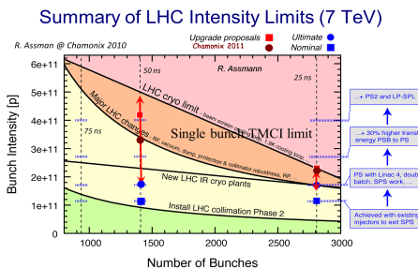
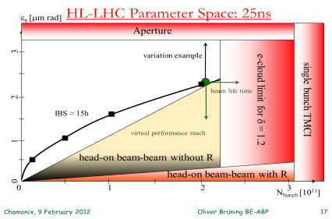
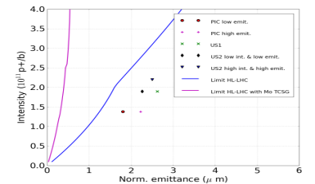
Beam current limitations
O. Bruning, R. Assmann,
E. Métral and teams
  Baseline 2.2 10¹¹ ppb, current ~1 A.
  Assuming e-cloud issues solved.
  Couple bunch instability stabilized by the damper.
  Single bunch instability threshold far in the present model (with metallic collimator) or stabilized by head-on tune spread.
Understanding intensity limitations in the LHC is constantly evolving.

Slide 5
E-cloud
G. Rumolo, G. Iadarola
E-cloud solution currently relying on:
Scrubbing for dipoles for suppression of electron cloud (SEY 1.3-1.4). (e.g. doublet beams for 25 ns scrubbing)
Expected to be difficult to eliminate the electron cloud in the quadrupoles (SEY<1.2-1.3).
Effects on on beam only at injection if ecloud in the dipoles. Can be cured if dipoles are scrubbed.
Cryo power compatible with the electron cloud in the quadrupoles only.
Arc quadrupole, 2808b, 1 beam
SEY=1.3
Based on simulations

Slide 6
Injectors’ parameters as seen by the LHC
Bunch intensity: Will beams saturate the cooling capacity due to e-cloud or be unstable?
Emittance: Will the emittance be preserved during cycle? Is sufficiently small? Can small emittance be traded with intensity or number of bunches?

Slide 7
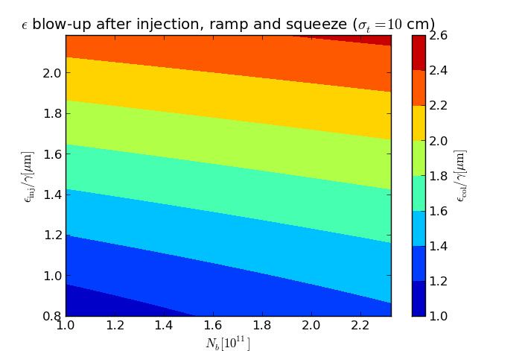
LHC Injection to Collisions
R. Tomas, O. Dominguez
5% intensity loss assumed: when and where do we loose? Transfer lines, septa, TDI, LHC (BLM sunglasses), injection, ramp and setup limits should be assessed.
20% emittance blow-up budget, implies:
  Control of the additive sources of blow-up.
  Control of the blow-up due to electron clouds.
  Impedance reduction with metallic collimators.
  10 cm bunch length during injection to stable beam.
  Lower limit on starting emittance.
ϵ_{col} ≈ ϵ_{inj} + 0.2 N_{b} /ϵ_{inj} [10¹¹/µm]
Assuming: 10% blowup on top of IBS

Slide 8
Transmission of Beam parameters
 | Bunch Spacing | Bunch Population Inj. | Emit. Std/BCMS Inj. | Bunch Population Coll. | Emit. Std/BCMS Coll.
LHC | 25 ns | 1.3 · 10¹¹ | 2.4 µm | 1.2 · 10¹¹ | 2.8 µm
 |  |  | 1.3 µm |  | 1.7 µm
 | 50 ns | 1.7 · 10¹¹ | 1.6 µm | 1.6 · 10¹¹ | 2.0 µm
 |  |  | 1.1 µm |  | 1.6 µm
 | 8b+4e | 1.8 · 10¹¹ | 2.3 µm | 1.7 · 10¹¹ | 2.7 µm
 |  |  | 1.4 µm |  | 1.9 µm
LIU | 25 ns | 2.0 · 10¹¹ | 1.4 µm | 1.9 · 10¹¹ | 1.9 µm
 |  |  | 1.9 µm | 1.9 · 10¹¹ | 2.3 µm
HL-LHC | 25 ns | 2.3 · 10¹¹ | 2.3 µm | 2.2 · 10¹¹ | 2.5 µm
 | 50 ns | 3.7 · 10¹¹ | 2.7 µm | 3.5 · 10¹¹ | 3.0 µm

Slide 9
Injectors’ parameters as seen by the LHC
Bunch intensity: Will beams saturate the cooling capacity due to e-cloud or be unstable?
Emittance: Will the emittance be preserved during cycle? Is sufficiently small? Can small emittance be traded with intensity or number of bunches?
Bunch spacing: Will collisions saturate the experiments?

Slide 10
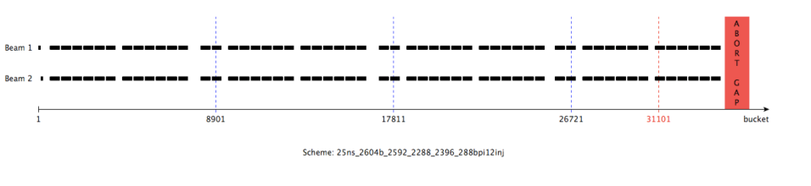
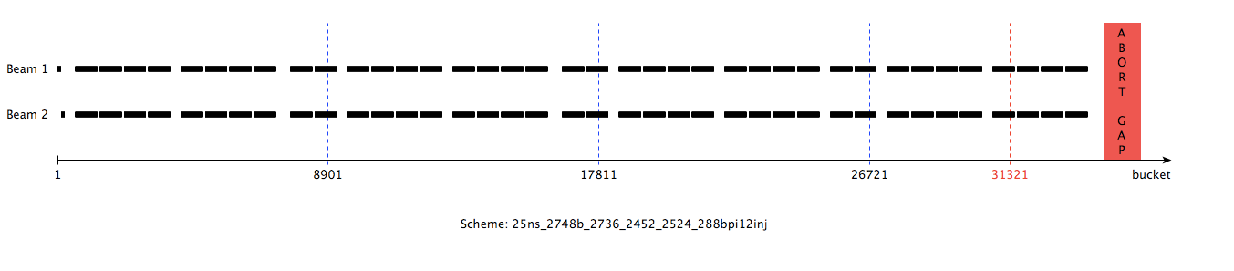
Bunch Spacing and Filling Schemes
Luminosity is proportional to n_{bunches .} If experiments limited by pile-up,
maximum luminosity and integrated luminosity is proportional to n_{bunches} too.
Filling schemes with 12 SPS injections in the LHC.
25ns: 2592; 50 ns: 1296; 8b+4e: 1728.
B. Gorini
Filling scheme | Total | IP1-5 | IP2 | IP8
BCMS: 48b 6 Ps inj, 12 SPS inj | 2604 | 2592 | 2288 | 2396
Standard: 72b 4 Ps inj, 12 SPS inj | 2748 | 2736 | 2452 | 2524

Slide 11
Assumptions on experimental conditions
Average pile-up limit in IP1, IP5:
  Maximum 50 event per crossing for after LS1;
  Maximum 140 events per crossing for HL-LHC with
  1.3 event/mm baseline but 0.7 event/mm stretched target;
Average pile-up limit in IP8: 4.5 events per crossing.
Max lumi leveled in IP2: 2 10³¹ cm⁻²s⁻¹.
Burn-off and pile-up estimation based on:
  Assumed visible cross-section: 85 mb in IR1/5, 75 mb in IP8;
  Assumed total cross-section: 110 mb.
A. Ball, B. Di Girolamo, B. Gorini, R. Jacobsson

Slide 12
Bunch spacing and pile-up
 | Bunch Spacing | Bunch Population | Emit. Std BCMS | Pile-up Max/Lev | Daily Lumi [fb⁻¹] | Fill duration [h]
LHC 6.5 TeV β*=60cm | 25 ns | 1.2 · 10¹¹ | 2.8 µm | 30/50 | 0.58 | 10.1
 |  |  | 1.7 µm | 50/50 | 0.78 | 7.5
 | 50 ns | 1.6 · 10¹¹ | 2.0 µm | 76/50 | 0.53 | 8.1(5.6)
 |  |  | 1.6 µm | 95/50 | 0.52 | 7.8(4.4)
 | 8b+4e | 1.7 · 10¹¹ | 2.7 µm | 75/50 | 0.72 | 8.5(4.7)
 |  |  | 1.9 µm | 90/50 | 0.70 | 8.3(5.9)
LIU 7 TeV β*=15cm | 25 ns | 1.9 · 10¹¹ | 2.3 µm | 419/140 | 2.99 | 7.2(5.7)
 |  | 1.9 · 10¹¹ | 1.9 µm | 510/140 | 2.93 | 7.8(6.7)
HL-LHC 7 TeV β*=15cm | 25 ns | 2.2 · 10¹¹ | 2.5 µm | 517/140 | 3.17 | 8.6(7.3)
 | 50 ns | 3.5 · 10¹¹ | 3.0 µm | 517/140 | 1.75 | 15(14.1)

Slide 13
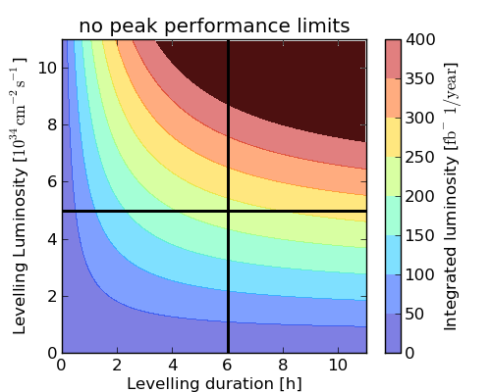
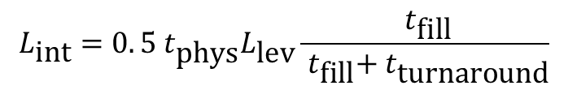

HL-LHC Performance reach
$$L_{\text{lev}} \sim n_{\text{pileup}} ∙n_{\text{bunches}}$$
Assuming 80 days of successful fills limited by leveled luminosity and fill durations, how much luminosity may we integrate in one year?
Simplest model that bounds integrated performance:
run at max allowed luminosity for half of the scheduled physics until a failure occurs.
$$L_{\text{int}}={0. 5 t}_{\text{phys}}L_{\text{lev}}\frac{{ t}_{\text{fill}}}{{ t}_{\text{fill}}+{ t}_{\text{turnaround}}}$$
Average fill
duration 2012

Slide 14
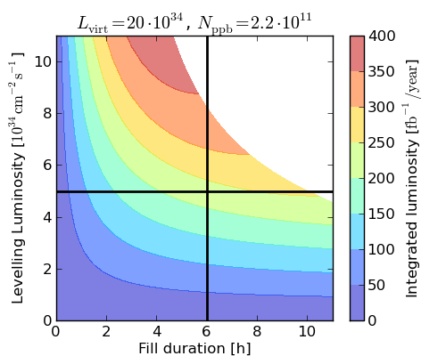
HL-LHC Performance reach
$$L_{\text{lev}} \sim n_{\text{pileup}} ∙n_{\text{bunches}}$$
Assuming 80 days of successful fills and a given peak luminosity, available current, how much luminosity could we integrate in one year?
Average fill
duration 2012
Adding a simple model of peak machine luminosity and burn-off decay (F. Zimmerman).

Slide 15
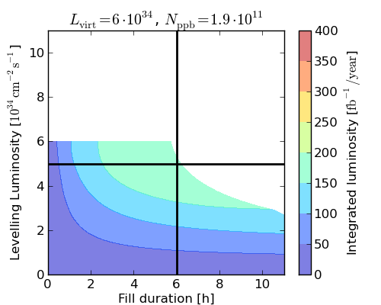
HL-LHC Performance reach
$$L_{\text{lev}} \sim n_{\text{pileup}} ∙n_{\text{bunches}}$$
Assuming 80 days of successful fills and a given peak luminosity and available current, how much luminosity could we integrate in one year?
Average fill
length 2012
→ Maximize leveled luminosity by pile-up limit and number of bunches,
→ Maximize probability of long fills
→ Obtain long fills

Slide 16
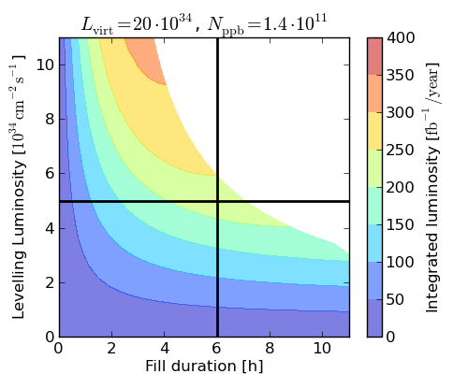
HL-LHC Performance reach
$$L_{\text{lev}} \sim n_{\text{pileup}} ∙n_{\text{bunches}}$$
Assuming 80 days of successful fills and a given peak luminosity how much luminosity may we integrate in one year?
Average fill
length 2012
→ Maximize leveled luminosity by pile-up limit and number of bunches,
→ Maximize probability of long fills
→ Obtain long fills
16

Slide 17
HL-LHC Performance reach
$$L_{\text{lev}} \sim n_{\text{pileup}} ∙n_{\text{bunches}}$$
Assuming 80 days of successful fills and a given peak luminosity how much luminosity may we integrate in one year?
Average fill
length 2012
→ Maximize leveled luminosity by pile-up limit and number of bunches,
→ Maximize probability of long fills
→ Obtain long fills
17

Slide 18
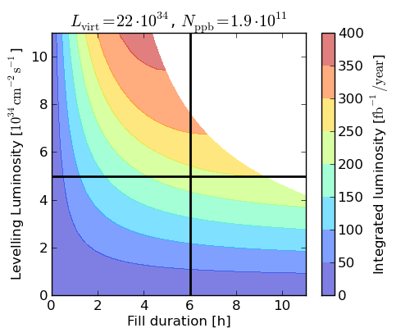
HL-LHC Performance reach
$$L_{\text{lev}} \sim n_{\text{pileup}} ∙n_{\text{bunches}}$$
Assuming 80 days of successful fills and a given peak luminosity how much luminosity may we integrate in one year?
Average fill
length 2012
→ Maximize leveled luminosity by pile-up limit and number of bunches,
→ Maximize probability of long fills
→ Obtain long fills by bunch population
18

Slide 19
Open questions for the LHC
200 MHz: If used as main RF in LHC, can it lift SPS bunch population limit?
Bunch-by-bunch variations: Does it affect performance (or how much the differences will limit the average)?

Slide 20
Performance of different scenarios (7 TeV)
 | N_{b coll} [10¹¹] | ε*_{n} _{coll} [μm] | Min β* (xing / sep) [cm] | Xing angle [μrad] | # Coll. Bunches IP1,5 | L_{peak} [10³⁴ cm⁻²s⁻¹] | L_{lev} [10³⁴ cm⁻²s⁻¹] | Lev. time [h] | Opt. Fill length [h] | η_{6h} [%] | η_{opt} [%] | Avg. Peak- pile-up density [ev./mm]
RLIUP2 | 1.5 | 1.3⁶⁾ | 15/15 | 341 | 2592 | 19.0 | 4.8 | 4.7 | 6.0 | 63.4 | 63.4 | 0.94
LIU-BCMS | 1.9 | 1.65⁶⁾ | 13.5/13.5³⁾ | 405 | 2592 | 23.4 | 4.8 | 6.7 | 7.8 | 61.0 | 57.5 | 0.98
LIU-STD | 1.9 | 2.26 | 14.5/14.5³⁾ | 457 | 2736 | 17.0 | 5.06 | 5.7 | 7.2 | 58.2 | 56.4 | 1.01
HL-Flat | 2.2 | 2.5 | 30/7.5¹⁾ | 335²⁾/550 | 2736 | 18.6 | 5.06 | 7.0 | 8.4 | 57.8 | 53.5 | 1.12
HL-Round | 2.2 | 2.5 | 15/15 | 476²⁾/590 | 2736 | 20.1 | 5.06 | 7.3 | 8.6 | 57.8 | 53.1 | 1.03
LIU-BCMS | 1.9 | 1.65 | 13.5/13.5³⁾ | 579 | 2592 | 23.4 | 6.87⁵⁾ | 4.6 | 6.4 | 51.4 | 51.3 | 1.34
HL-Round | 2.2 | 2.5 | 15/15 | 473 | 2736 | 20.1 | 7.24⁵⁾ | 4.8 | 7.0 | 48.2 | 47.4 | 1.37
HL-SRound | 2.2 | 2.5 | 10/10⁴⁾ | 600 | 2736 | 26.8 | 7.24⁵⁾ | 5.8 | 7.6 | 47.6 | 45.7 | 1.55
1) compatible with crab kissing scheme (S. Fartoukh)
2) BBLR wire compensator assumed to allow 10σ
3) β* could be reduced to 14.5 and 13.5 cm at constant aperture
4) Ultimate collimation settings
5) Pile-up limit at 200 event/ crossing 6) 30% blow-up from IBS makes 1.85 um is more likely

Slide 21
Conclusion
Injector beam parameters should aim at saturating the LHC and experiment capabilities.
When experiments are not limited by total pileup, BCMS beams are an effective tool for increasing performance.
For HL-LHC times, the LHC expects maximum injectable bunch population with the maximum number of bunches.
Present LIU offer is a close match, but increasing bunch population is a key to exploit large accepted luminosity or long fill durations.

