Slide 2


PS: longitudinal instabilities and damper
Speaker: L. Ventura
Acknowledgments: H. Damerau, G. Favia S. Gilardoni ,
M. Migliorati, M. Morvillo, M. Paoluzzi, G.Sterbini
LIU day
11 April 2014

Slide 3
Outlook
The PS RF system
Beam loading & cures
  Wideband negative feedback
Coupled-bunch instabilities measurements & simulations
Feedback system and new longitudinal kicker
10 MHz system impedance model and simulations
Summary and discussion

Slide 4
Outlook
The PS RF system
Beam loading & cures
  Wideband negative feedback
Coupled-bunch instabilities measurements & simulations
Feedback system and damper
10 MHz system impedance model and simulations
Summary and discussion

Slide 5
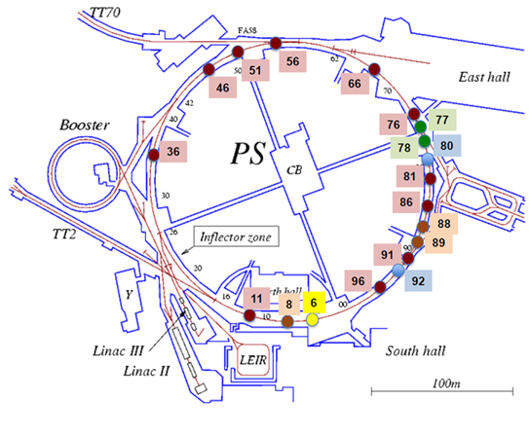
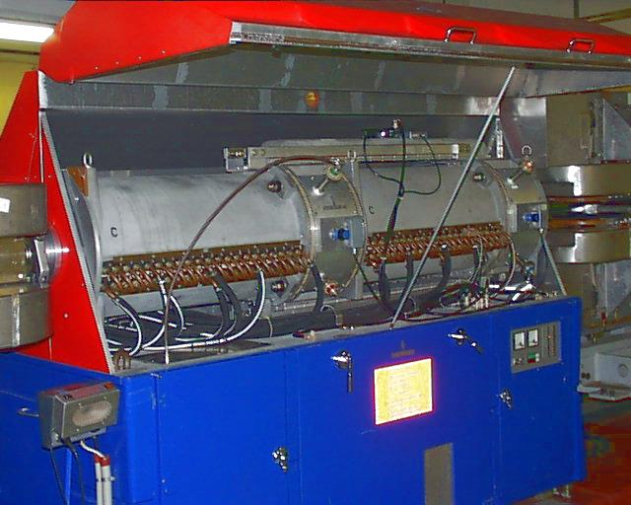
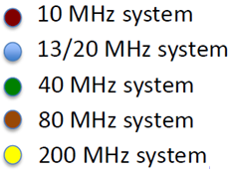
The PS RF system
The PS machine contains cavities operating at different frequencies. The 10 MHz cavities are the most important because they accelerate the bunches to the desired energy and perform the triple splitting.
The 10 MHz cavities (10+1 double gap cavities tuneable from 2.8 to 10 MHz) are driven by amplifiers based on electron tubes (vs solid state ones), for reasons of radiation hardness and power dissipation.
The 10 MHz cavity with a power up to 20 kV, it is tuneable from 2.8 MHz to 10.1 MHz, h = [6...21].
Finemet © cavity
Courtesy of Carlo Rossi –http://indico.cern.ch/event/160434/contribution/11/material/slides/0.pdf

Slide 6
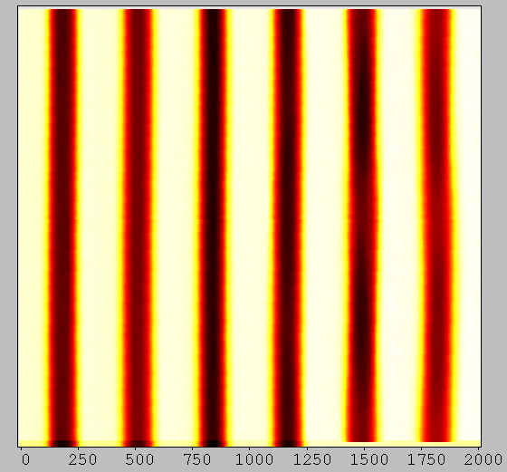
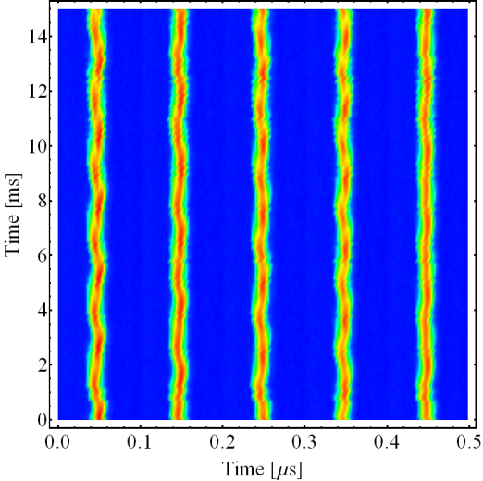
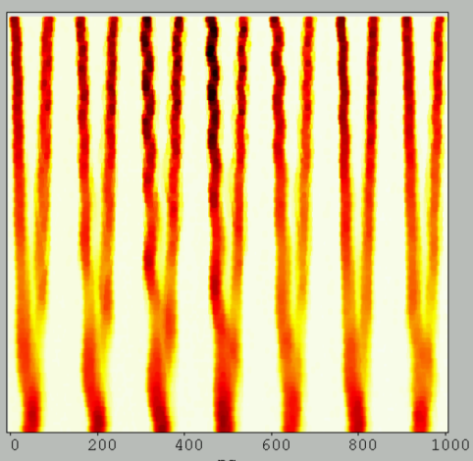
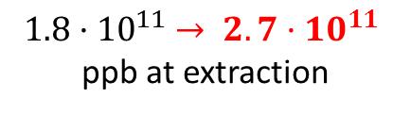
Beam Instabilities
The PS has a complex multi-harmonic system which determines the longitudinal structure of the bunch train for LHC. The 25 ns LHC beam is prepared in the PS.
In h=21, with 100 ns bunch spacing -> cross-talk of bunches which are coupled with the longitudinal impedance of the PS -> LONGITUDINAL INSTABILITY OF THE BEAM
STABLE
UNSTABLE
Not a correct population of the bucket
Time during cycle [ns]
Time during cycle [ns]
Impedance interaction
Machine circumference [ns]
Machine circumference [ns]
Injection
After triple splitting and transition
Double splitting at high energy
New LHC beam planned for the LIU project -> Increased intensity ->
$1.8·{10}^{11}$ $→ 2.7·{10}^{11}$
ppb at extraction
Increased voltage in the cavity
induced by the beam
Beam instabilities

Slide 7
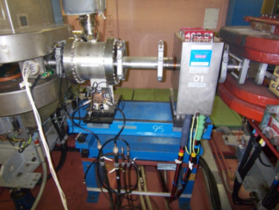
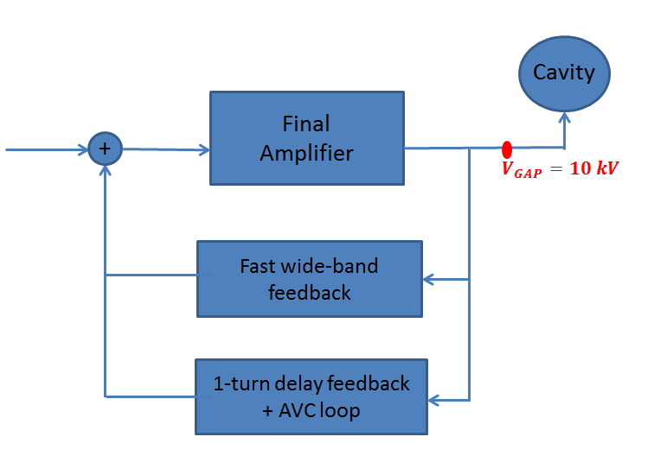
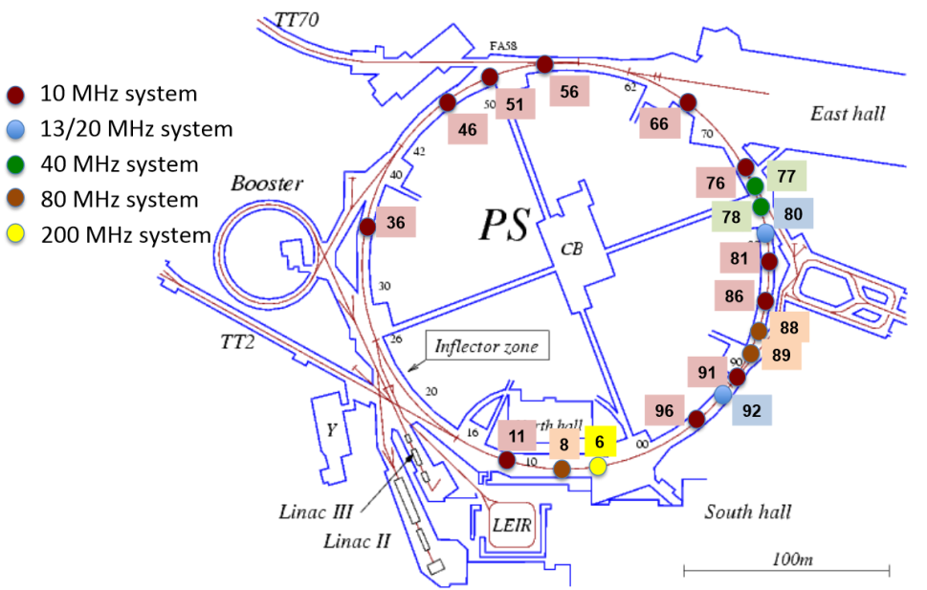

Beam instabilities & Feedback system
BEAM LOADING
COUPLED-BUNCH INSTABILITY
Action: Reduce the impedance seen by the beam
Action: damp unstable oscillation modes caused
by the 10 MHz cavities (as found in measurements
and simulations)
REDUCE
Cures:
Wideband negative feedback
1-turn delay feedback (see D.Perrelet talk)
COMPENSATE
Cures:
Coupled-bunch feedback
New longitudinal kicker -> Finemet © cavity
1) Wideband Feedback acts on the voltage sent to the cavity
2) Coupled-bunch Feedback acts on the beam

Slide 8
Outlook
The PS RF system
Beam loading & cures
  Wideband negative feedback
Coupled-bunch instabilities measurements & simulations
Feedback system and damper
10 MHz system impedance model and simulations
Summary and discussion

Slide 9
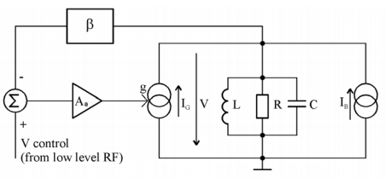
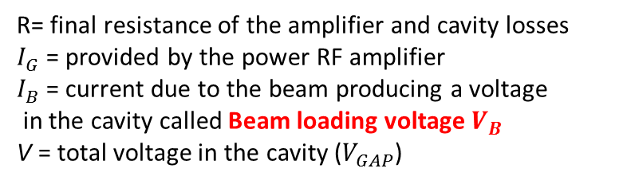

Beam loading &
wideband negative feedback
Any cavity close to its fundamental mode can be represented as a parallel RLC resonator.
The beam and the RF amplifier are modelled as ideal current generators.
R= final resistance of the amplifier and cavity losses
$I_{G}$ = provided by the power RF amplifier
$I_{B}$ = current due to the beam producing a voltage
in the cavity called Beam loading voltage $V_{B}$
V = total voltage in the cavity ($V_{GAP}$)
Maintain V constant, (in the limit of the input signal), minimizing the effect of $I_{B}$ -> minimize $V_{B}$
BEAM LOADING VOLTAGE
$${V_{B}=I}_{B}·Z_{BEAM}$$
Reduce the impedance seen by the beam

Slide 10






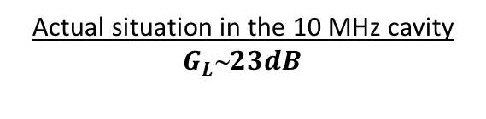

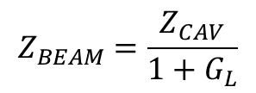
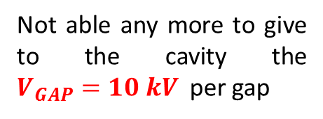
Wideband negative feedback
in the 10MHz cavity
G.Favia, V. Desquiens,
M. Morvillo
Reduce the impedance seen by the beam:
$f$ = feedback factor
$$Z_{BEAM}=\frac{Z_{CAV}}{1+G_{L}}$$
f
Cavity
$$V_{GAP}$$
+
A
Increase the loop gain
$$G_{L}=A·f$$
$A$ = forward gain
Not able any more to give to the cavity the $V_{GAP}=10 kV$ per gap
Why don’t increase just $f$ ?
Closed loop gain
$$G1/f$$
Actual situation in the 10 MHz cavity $G_{L}23dB$
OBJECTIVE: INCREASE OF $G_{L}$
UP TO ∼29dB (in the limit of stability)

Slide 11
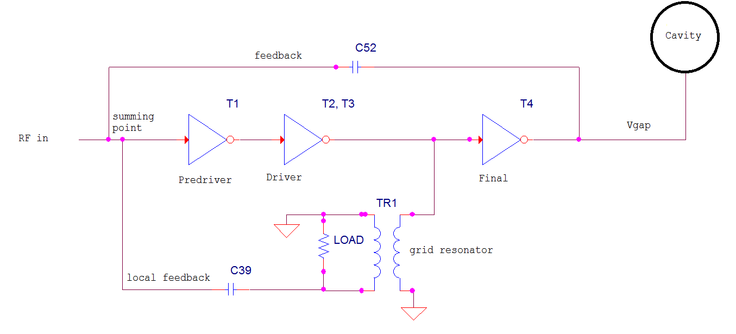
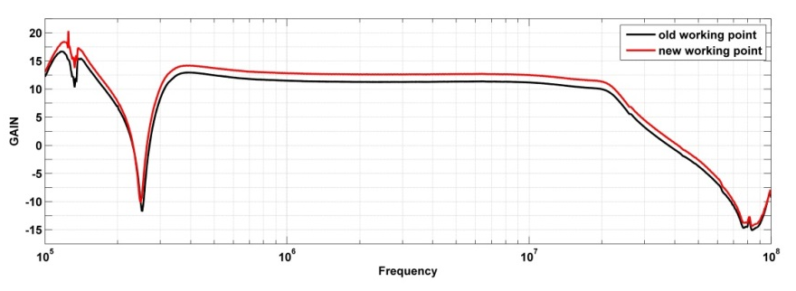
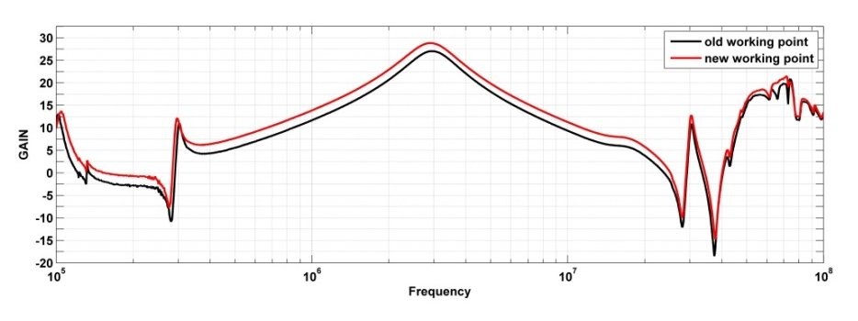
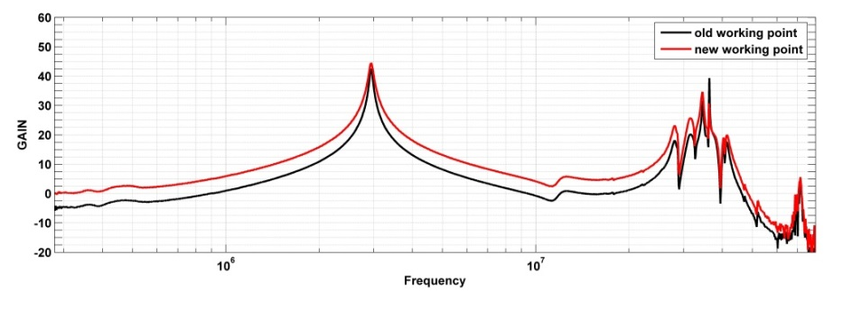


Work in progress: change the working point
of the electron tubes
$$f$$
Predriver
$$A$$
Driver
2014 preliminary results
STAGE | GAIN Old configuration | GAIN Change of tubes working point
Predriver | 11.1 dB | 12.76 dB
Driver | 27 dB @3MHz 24.35 dB @10MHz | 28.8 dB @3MHz 25.9 dB @10MHz
Final | 42.5 dB @3MHz 38.8 @10MHz | 44.6 dB @3MHz 42.17 dB @10MHz
Final
TO DO NEXT -> verify that with the new working points the amplificator (in the limit of stability and respecting the phase and gain margin) give to the cavity 10 kV per gap.

Slide 12
Outlook
The PS RF system
Beam loading & cures
  Wideband negative feedback
Coupled-bunch instabilities measurements & simulations
Feedback system and damper
10 MHz system impedance model and simulations
Summary and discussion

Slide 13
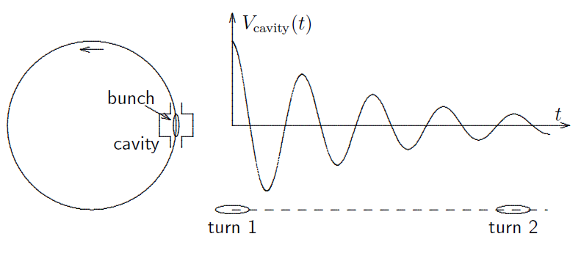

Coupled-bunch instabilities
Beam in a synchrotron ring made of bunches of charged particles.
Transverse (betatron) and longitudinal (synchrotron )
oscillations normally damped by natural damping.
Interaction of the particles with cavity-> wakefields.
Example of an n = 12 mode
Wake fields act back on the beam and produces growth
of oscillations.
If the growth rate is stronger than the natural damping the oscillation gets unstable.
Since wakefields are proportional to the bunch charge, instabilities are current dependent.
‘Theory and performances of the longitudinal active damping system for the CERN PS Booster’ F.Pedersen and F.Sacherer

Slide 14
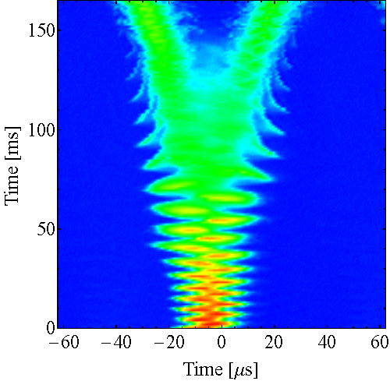
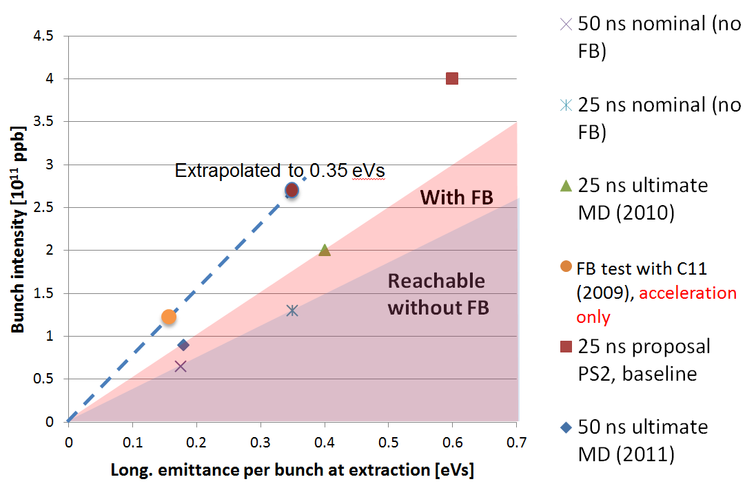
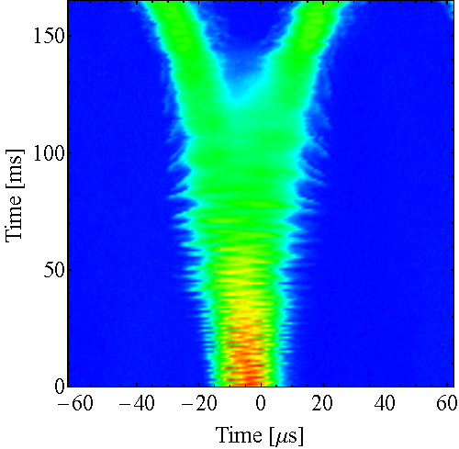

State of the art of coupled-bunch instabilities in the PS
Longitudinal coupled-bunch instabilities are observed in the CERN PS during acceleration (above transition energy) and on the flat-top.
For LHC-type of beam in the PS with bunch spacing below 100 ns only the motion of the centre of mass of the bunches has been observed.
Up to present intensities (achieved $1.8·{10}^{11}$ ppb at extraction) coupled-bunch instabilities are damped using a feedback system limited to the first two dominant oscillation modes, but it will become insufficient for the beam parameters planned within the LHC upgrade ($2.7·{10}^{11}$ppb at extraction).
FB OFF
New coupled-bunch feedback system based on the 1-turn delay scheme
FB ON

Slide 15
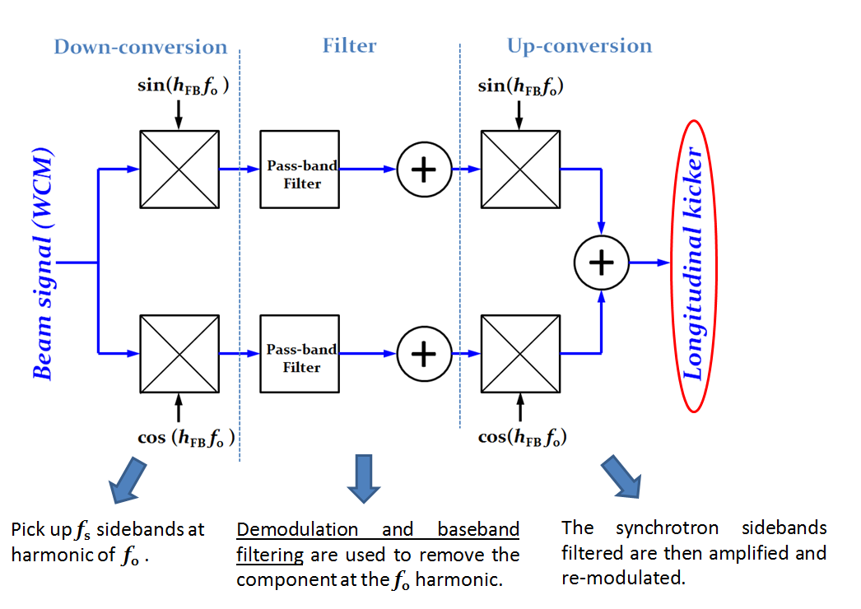


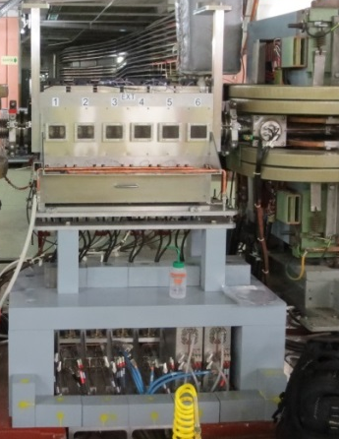
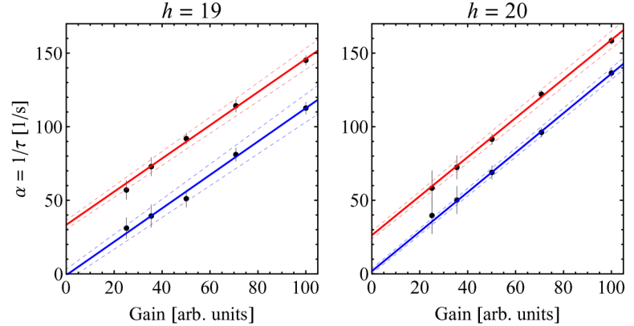
Coupled-bunch feedback & measurements
H. Damerau
Spare 10MHz cavity
Finemet © cavity
A large amount of measurements has been done to check the behaviour of the coupled bunch instabilities in the machine with the feedback system, studying the damping rate vs many parameters like gain, intensity, emittance and cycle time.
Measured damping rate with feedback on
Corrected for natural damping
Zero damping at zero gain
Natural damping independent from gain

Slide 16

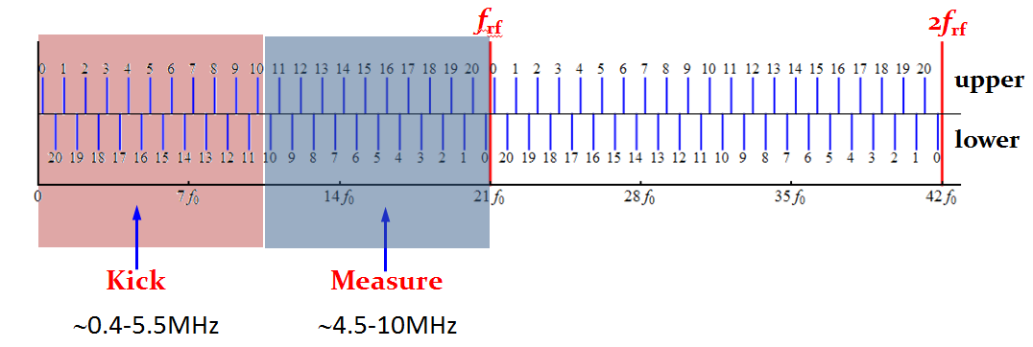
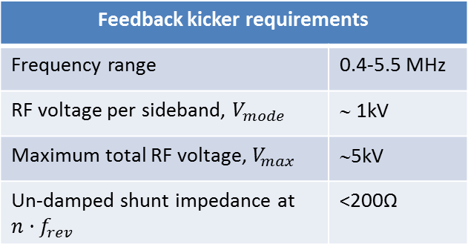
New PS longitudinal kicker cavity
M. Paoluzzi
During the first long shutdown (LS1) in 2013-2014, a new digital feedback has been installed, covering all coupled-bunch modes with a new longitudinal cavity based on the wideband frequency characteristics of Finemet © magnetic alloy and driven by solid-state amplifiers.
Installed in 2014
Finemet cavity used in LEIR but to accelerate
straight section 02
Feedback kicker requirements
Frequency range | 0.4-5.5 MHz
RF voltage per sideband, $V_{mode}$ | ∼ 1kV
Maximum total RF voltage, $V_{max}$ | ∼5kV
Un-damped shunt impedance at ${n·f}_{rev}$ | <200Ω

Slide 17
Outlook
The PS RF system
Beam loading & cures
  Wideband negative feedback
Coupled-bunch instabilities measurements & simulations
New feedback system and damper
10 MHz system impedance model and simulations
Summary and discussion

Slide 18
Coupled-Bunch Simulations
  Measurements done in 2013 before LS1 : coupled-bunch feedback and the spare cavity have been used to excite and damp coupled-bunch oscillation.
Need of SIMULATIONS to:
Study and deeply understand these instabilities
Predict the beam behaviour with the new LIU parameters
Longitudinal Coupled-Bunch simulation code
Tracks the longitudinal centre of mass motion of all the bunches, by including wakefields effects.
The feedback system in the code has been implemented according with the PS installation.
‘A time domain simulation code of the longitudinal multibunch instabilities’, M.Bassetti, A.Ghigo, M.Migliorati, L.Palumbo, M.Serio

Slide 19
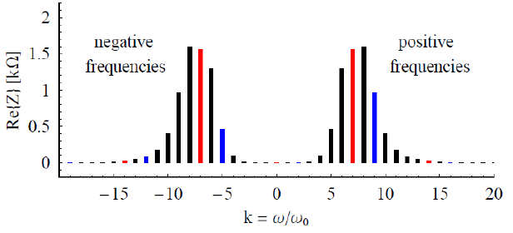

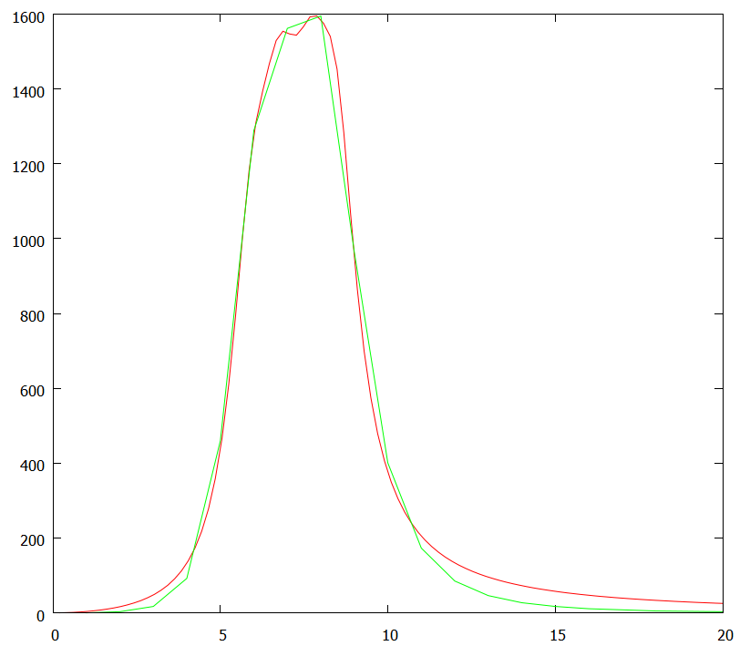
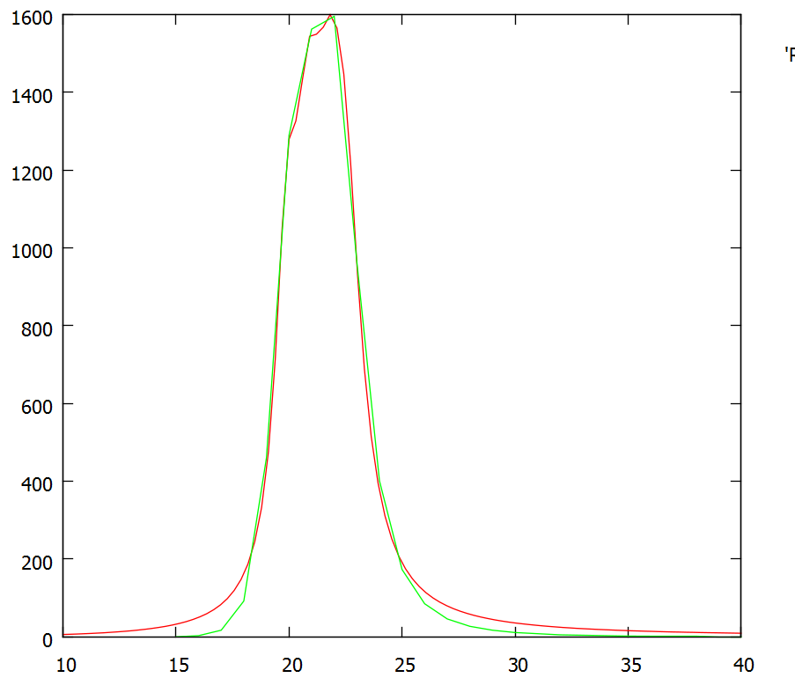
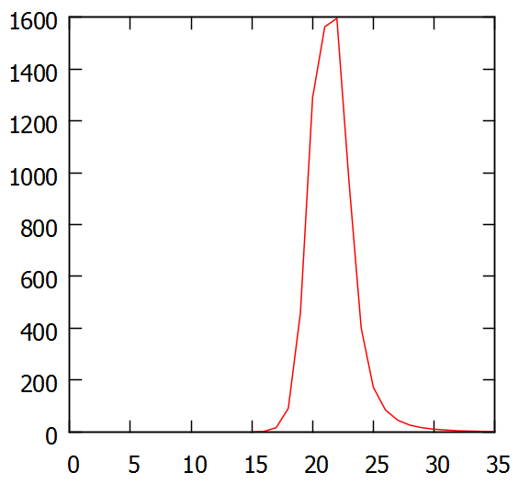
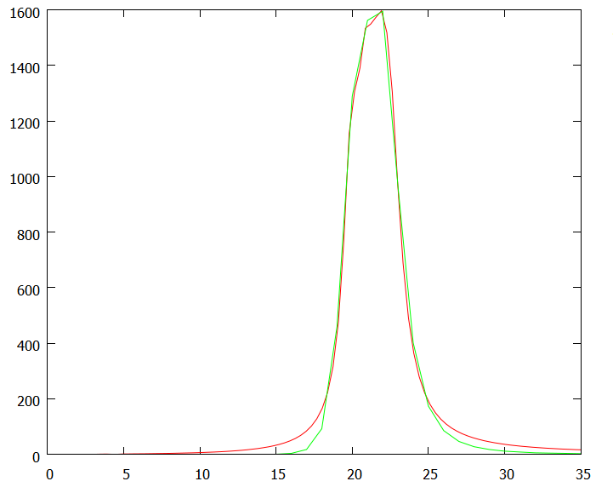
Impedance model of the 10 MHz RF system
Real part of the total impedance of the 10 MHz cavities at the revolution harmonics @ 3.3MHz
Coupled-bunch growth rate obtained by theoretical approach
Re(Z)
Fit
Re(Z)
Fit
@ 3.3MHz
@ 10.1MHz
Re[Z] [Ω]
Re[Z] [Ω]
ω/ω₀
ω/ω₀

Slide 20
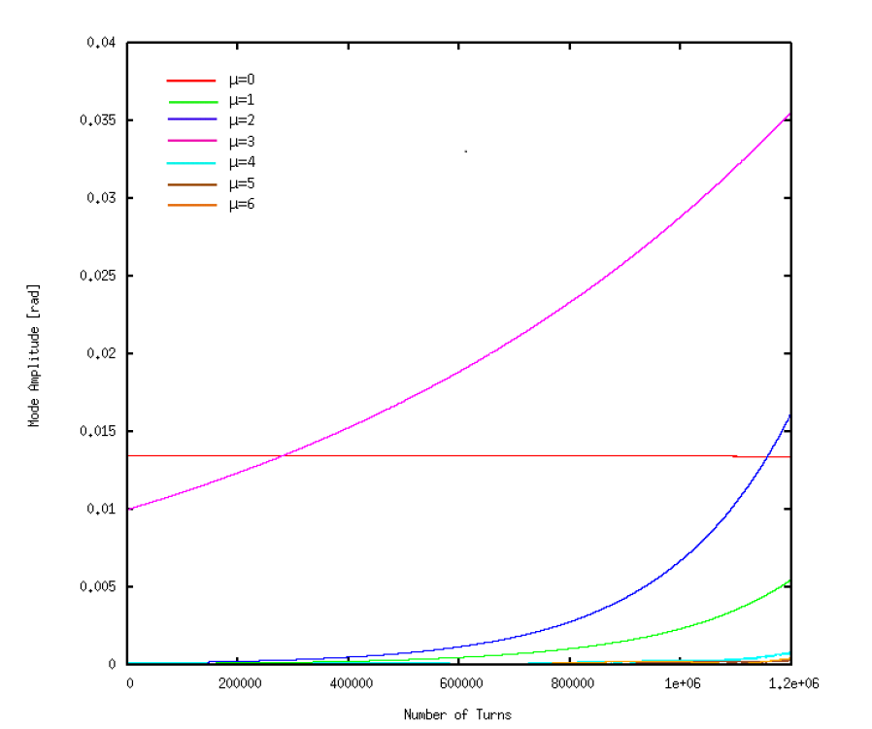
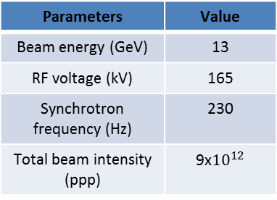
Simulations vs. stability data in h=7 (3.3MHz)
Parameters | Value
Beam energy (GeV) | 13
RF voltage (kV) | 165
Synchrotron frequency (Hz) | 230
Total beam intensity (ppp) | 9x${10}^{12}$
We compare the rise time of the instability obtained with simulations with
the CB growth rate from the eigenvalues system (PAC07).
Simulations results
Mode Number | 1 | 2 | 3
Growth Rate | 544ms | 467ms | 1.91s
Paper results
Mode Number | 1 | 2 | 3
Growth Rate | 400ms | 333ms | 1s
Longitudinal coupled-bunch instabilities in the CERN PS H.Damerau,S.Hancock,C.Rossi,E.Shaposhnikova,J.Tuckmantel,J.-L. Vallet

Slide 21
Simulations vs. stability data in h=7 (3.3MHz)
Parameters | Value
Beam energy (GeV) | 13
RF voltage (kV) | 165
Synchrotron frequency (Hz) | 230
Total beam intensity (ppp) | 9x${10}^{12}$
We compare the rise time of the instability obtained with simulations with
the CB growth rate from the eigenvalues system (PAC07).
Good agreement!!
Simulations results
Mode Number | 1 | 2 | 3
Growth Rate | 544ms | 467ms | 1.91s
Paper results
Mode Number | 1 | 2 | 3
Growth Rate | 400ms | 333ms | 1s
The code is a good tool to simulate coupled-bunch instabilities
Longitudinal coupled-bunch instabilities in the CERN PS H.Damerau,S.Hancock,C.Rossi,E.Shaposhnikova,J.Tuckmantel,J.-L. Vallet

Slide 22
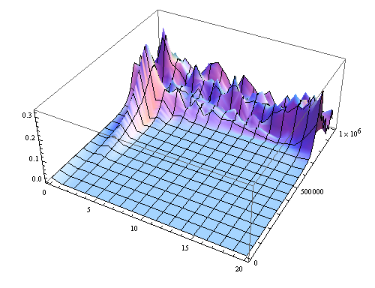
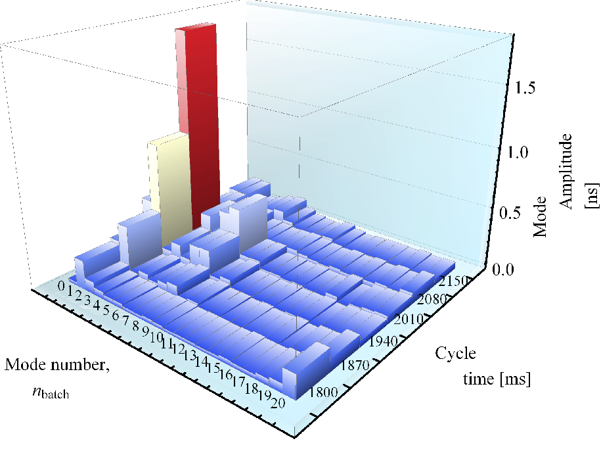
2013 measurements vs. simulations
in h=21 (10.1MHz)
Pattern of the oscillation modes at 10 MHz compared with measurements done in 2013 which show the evolution of the mode spectra for LHC50ns beam during acceleration for a full machine (21 bunches). The ‘mode pattern’ depends on the initial conditions and the oscillation amplitude depends on the bunch number in the train.
1) Simulation
2) Measurement
µ=2
µ=2
Mode amplitude
Number
of turns
Mode number
Simulations predict oscillation mode µ=2 as the stronger one before knowing the measurements results!!

Slide 23
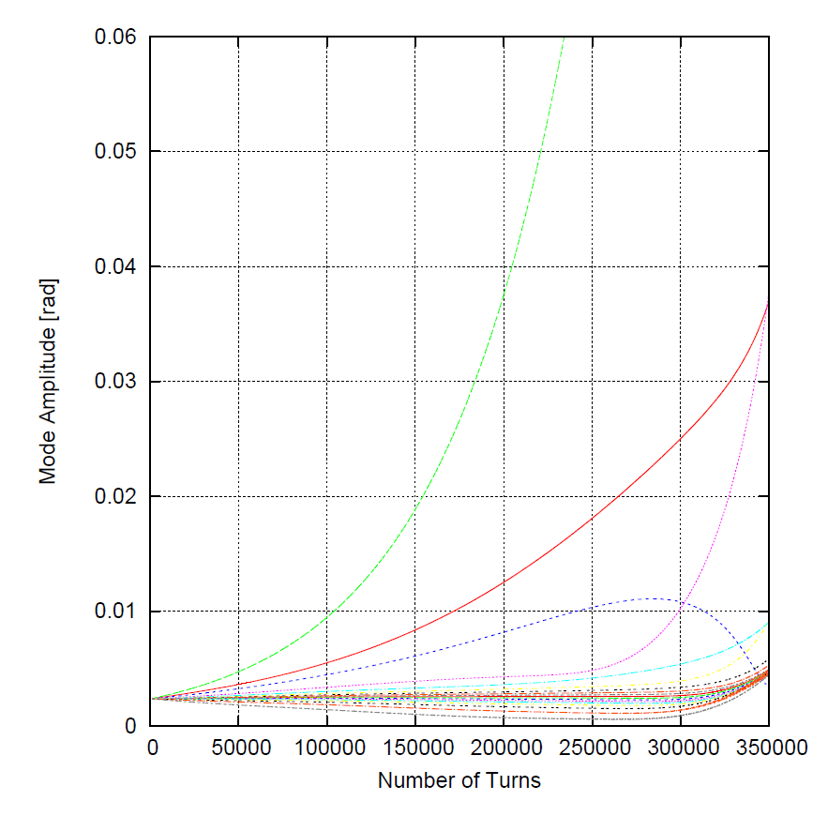
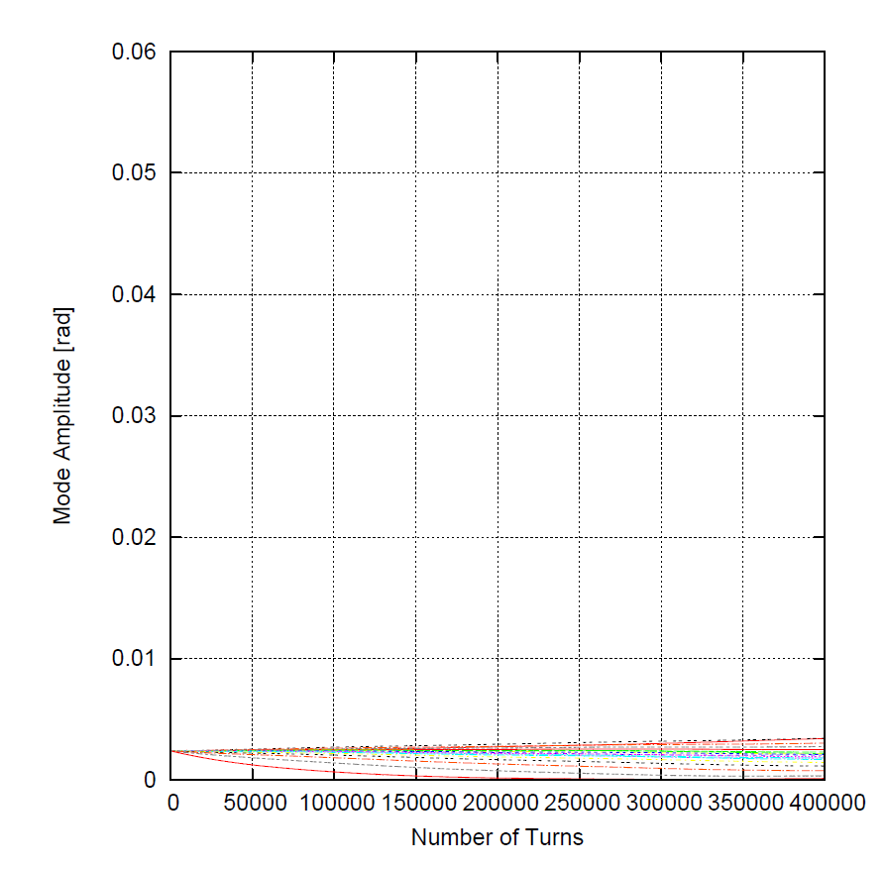
Simulations with LIU intensity
Preliminary results
Simulations performed with 21 bunches IN h=21 with an intensity of $2.7·{10}^{11}$ppb at extraction.

Slide 24
Outlook
The PS RF system
Beam loading & cures
  Wideband negative feedback
Coupled-bunch instabilities measurements & simulations
New feedback system and damper
10 MHz system impedance model and simulations
Summary and discussion

Slide 25
Summary
10MHz RF system behaviour with new LIU parameters: beam loading and coupled-bunch instabilities.
Modified the working point of the tubes into the amplifier to increase the loop gain and so reduce the impedance seen by the beam.
  In measurements done in 2013 before LS1 coupled-bunch feedback and the 10MHz spare cavity have been used to damp coupled-bunch oscillation.
  Finemet © cavity as new longitudinal kicker in the coupled-bunch feedback.
New feedback also to operate in the frequency domain, similar signal processing as existing feedback, but digital and covering all harmonics simultaneously based on hardware developed for the 1-turn feedback.
First test with the beam after the startup in 2014
10 MHz cavities impedance model implemented in the simulation code and crosschecked either with theory and measurements
Simulations with PS-LIU beam parameters with longitudinal feedback to find the maximum required feedback voltage (preliminary results)

Slide 26

THANK YOU FOR YOUR ATTENTION!

