Slide 1


Slide 2

Alessandra Valloni
Initial LHeC Coordination Group meeting
Test Facility
Stages and Optics
CERN, 5th February

Slide 3

Goals of a CERN ERL Test Facility
Test facility for SCRF cavities and modules
Test facility for multi-pass multiple cavity ERL
Test facility for controlled SC magnet quench tests
  Injector studies: DC gun or SRF gun
  Study reliability issues, operational issues!
  Could it be foreseen as the injector to LHeC ERL?
TARGET PARAMETER* | VALUE
Injection Energy [MeV] | 5
Final Beam Energy [MeV] | 900
Normalized emittance γε_{x,y} [μm] | 50
Beam Current [mA] | 10
Bunch Spacing [ns] | 25 (50)
*in few stages

Slide 4
^{Outline}
1. Stages of building design
- layouts
- baseline parameters
2. Arc optics architecture
3. Test facility for sc magnet tests

Slide 5
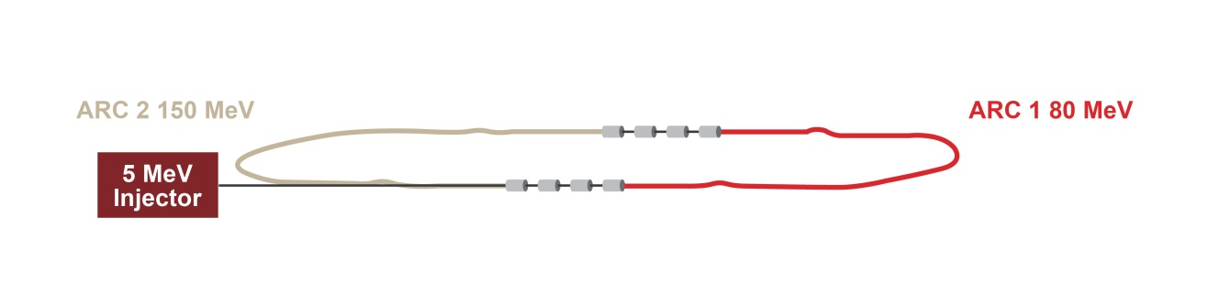
^{Planning for each stage}
STEP 1
SC RF cavities, modules and e⁻ source tests
- Injection at 5 MeV
- 1 turn
- 75 MeV/linac
- Final energy 150 MeV
ARC | Energy
ARC 1 | 80 MeV
ARC 2 | 155 MeV
LINAC 2*
LINAC 1*
*4 SRF 5-cell cavities at 802 MHz

Slide 6
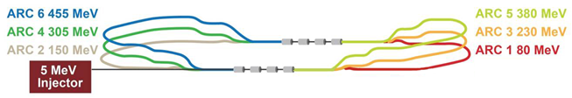
^{Planning for each stage}
STEP 2
Test the machine in Energy Recovery Mode
- Injection at 5 MeV
- 3 turns
- 75 MeV/linac
- Final energy 450 MeV
ARC | Energy
ARC 1 | 80 MeV
ARC 2 | 155 MeV
ARC 3 | 230 MeV
ARC 4 | 305 MeV
ARC 5 | 380 MeV
ARC 6 | 455 MeV
Recirculation realized with vertically stacked recirculation passes

Slide 7
^{Planning for each stage}
STEP 3
Additional SC RF modules test
Full energy test in Energy Recovery Mode
- Injection at 5 MeV
- 3 turns
- 150 MeV/linac
- Final energy 900 MeV
ARC | Energy
ARC 1 | 150 MeV
ARC 2 | 300 MeV
ARC 3 | 450 MeV
ARC 4 | 600 MeV
ARC 5 | 750 MeV
ARC 6 | 900 MeV

Slide 8

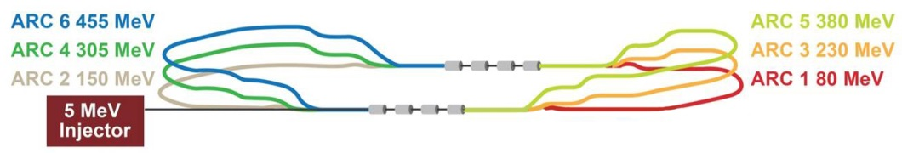
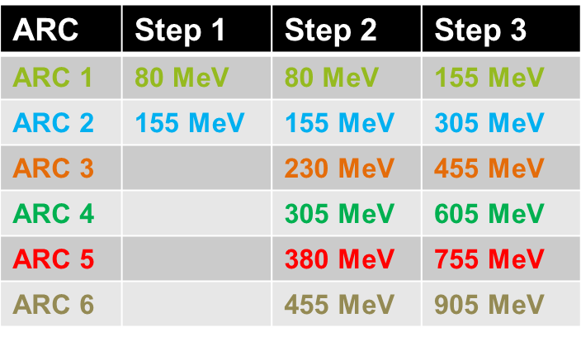
^{Planning for each stage}
Step 1
Step 2
Step 3

Slide 9
^{Outline}
1. Stages of building design
- layouts
- baseline parameters
2. Arc optics architecture for step 3
3. Test facility for sc magnet tests

Slide 10
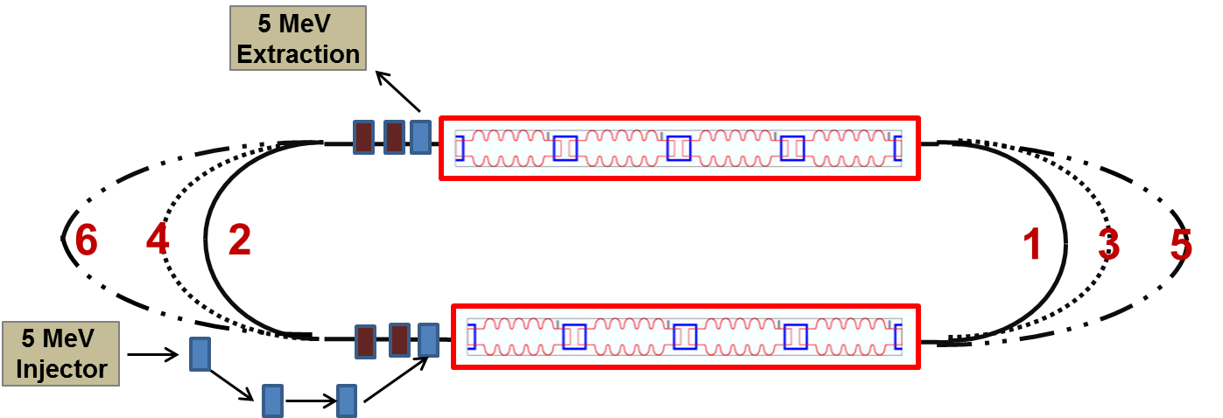
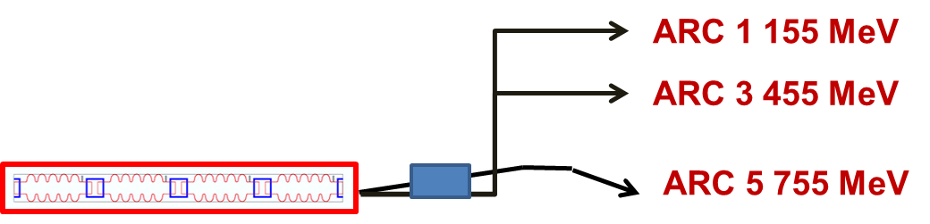
^{Layout}
A. Valloni, A. Bogacz

Slide 11
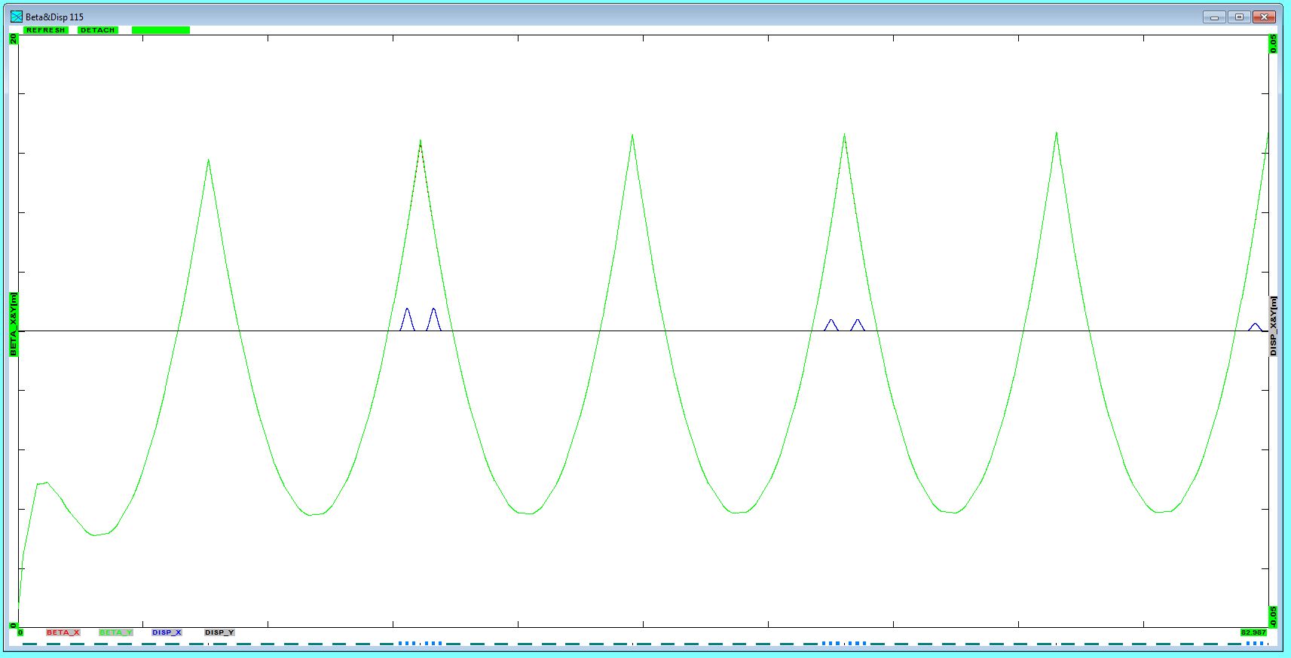
^{Linac 1 Multi-Pass Optics}
βx,y
Dx
5 MeV
155 MeV
305 MeV
455 MeV
605 MeV
755 MeV
905 MeV
A. Valloni, A. Bogacz

Slide 12
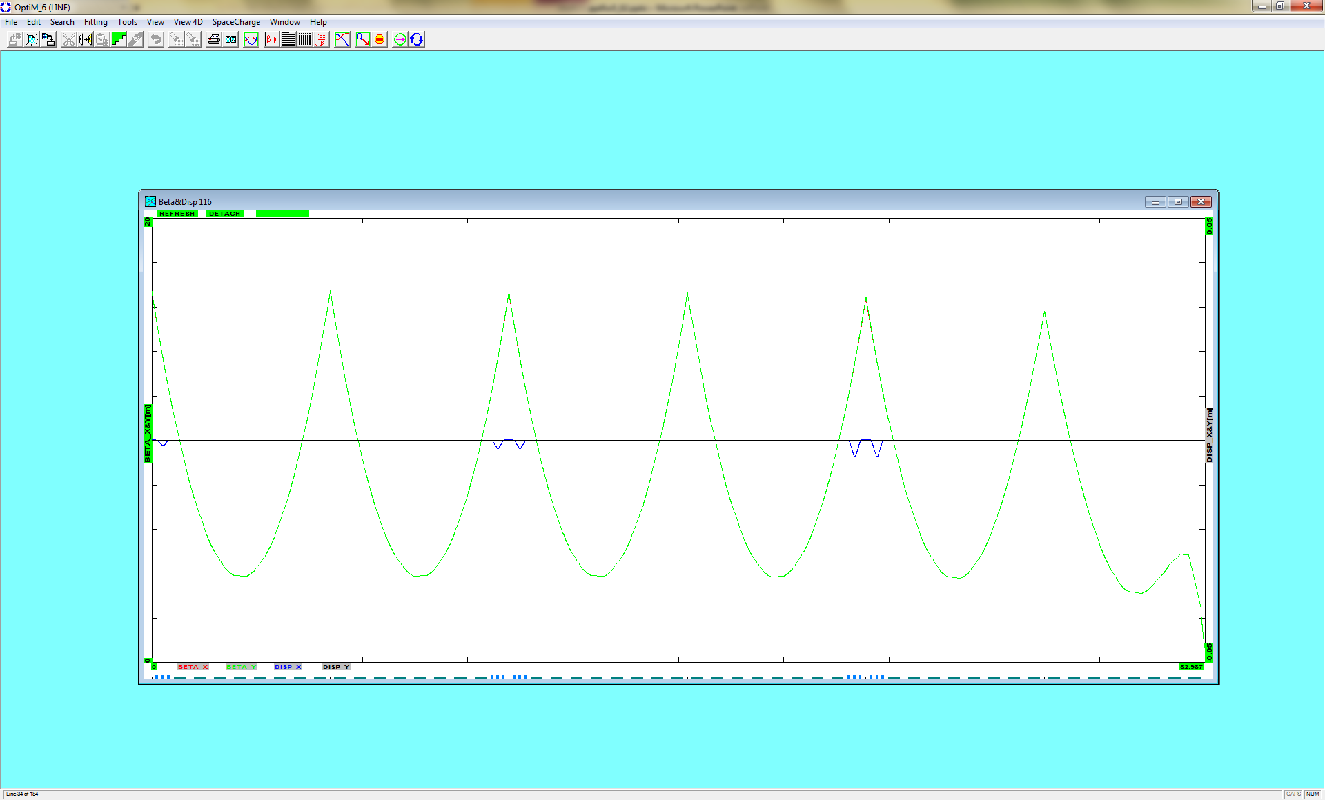
^{Linac 2 Multi-Pass Optics}
βx,y
Dx
905 MeV
755 MeV
605 MeV
455 MeV
305 MeV
155 MeV
5MeV
A. Valloni, A. Bogacz

Slide 13
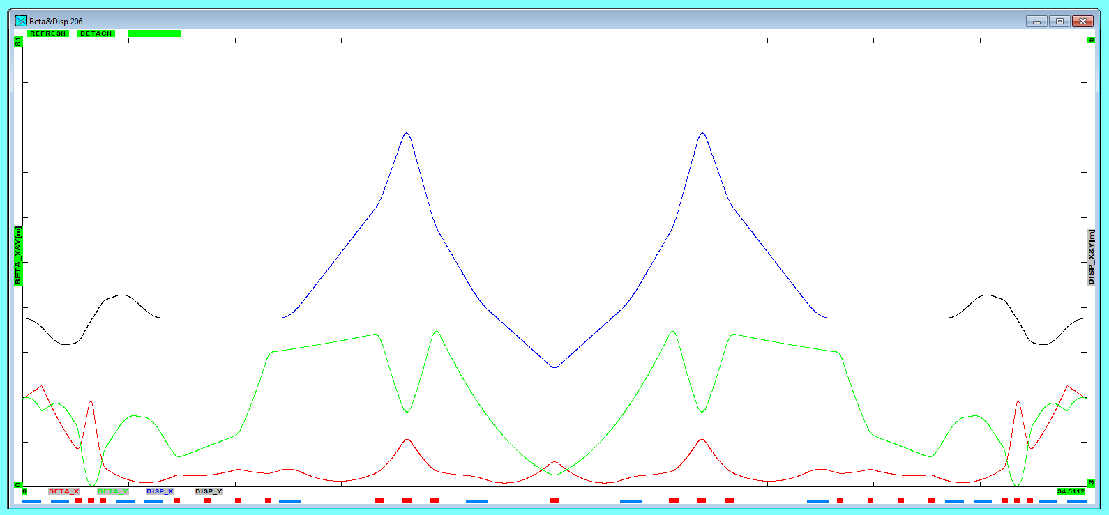
^{Arc 1 optics}
155 MeV
βx βy
Dx Dy
2-step vert.
Spreader
4×45⁰ sector bends
2-step vert. Combiner
Arc dipoles :
Ldip = 71.8 cm
B = 5.67 kGauss
ρ = 91.45 cm
30⁰ bends
(1 rec. + 3 sec.)
30⁰ bends
(1 rec. + 3 sec.)
A. Valloni, A. Bogacz

Slide 14
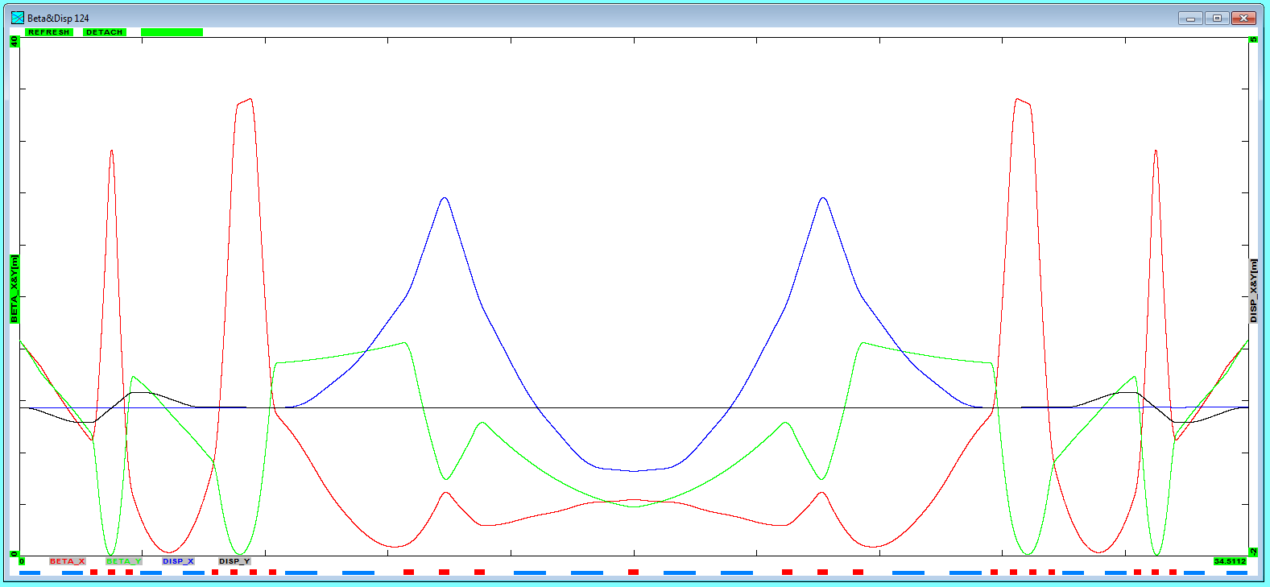
^{Arc 3 optics}
155 MeV
455 MeV
βx βy
Dx Dy
2-step vert.
Spreader
8×22.5⁰ sector bends
2-step vert. Combiner
Arc dipoles :
Ldip = 90.58 cm
B = 6.58 kGauss
ρ = 230.66 cm
9.8⁰ bends
(1 rec. + 3 sec.)
9.8⁰ bends
(1 rec. + 3 sec.)
A. Valloni, A. Bogacz

Slide 15
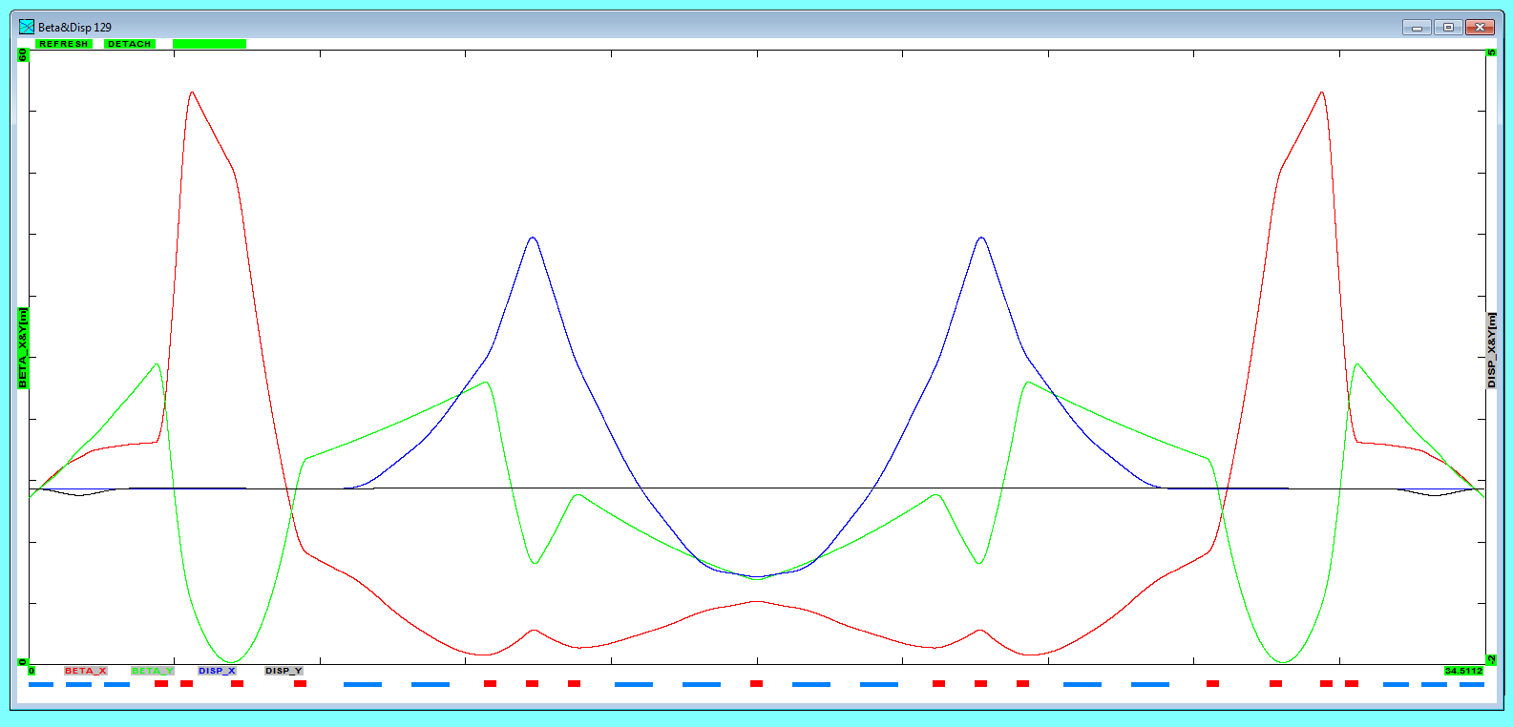
^{Arc 5 optics}
155 MeV
755 MeV
βx βy
Dx Dy
755 MeV
Vertical chicane
8×22.5⁰ sector bends
Vertical chicane
Arc dipoles :
Ldip = 90.58 cm
B = 10.92 kGauss
ρ = 230.66 cm
A. Valloni, A. Bogacz

Slide 16
^{Arc 1,3,5 layout}
Synchronous acceleration
Isochronous arcs
Achromatic arc
FMC optics
13.43 m
13.66 m
92.6 cm
Total Arc length for Arc 1,2,3
34.5112 m
94 x λrf
41.06 cm
6 cm

Slide 17
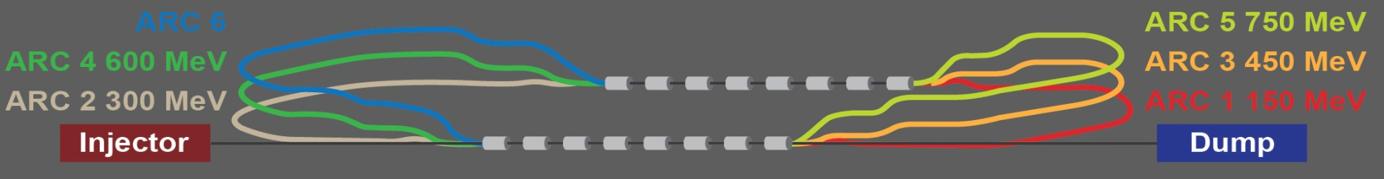
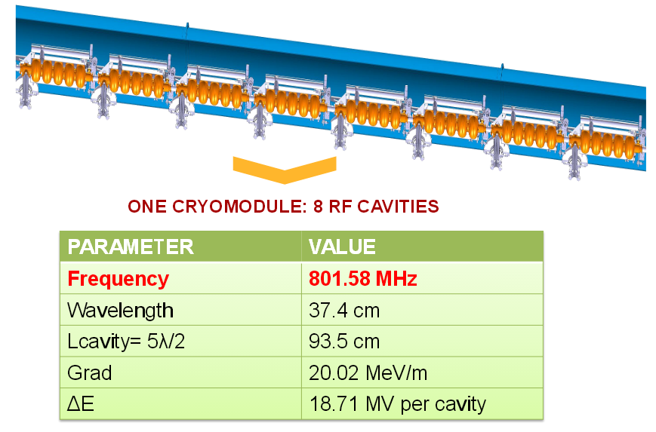
^{Footprint}
ARCS
LINAC
Total length for Arc 1,2,3
34.5112 m
94 x λrf
(last cavity linac1 to first cavity linac 2)
Total length for Arc 2,4
34.2704 m
101 x λrf
(last cavity linac1 to first cavity linac 2)
Total length for Arc 6
3445.74 m
101.5 x λrf
(last cavity linac 1 to first cavity linac 2)
Total length ~ 13 m
Chicane inj/extr
Length ~ 1.75 m
TOTAL DIMENSIONS
42 m x 13.7 m

Slide 18
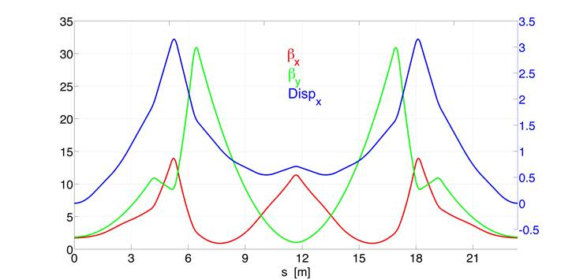
^{Arc optics OPTION 2}
Same optics layout for all the arcs 900/750/600/450/300/150 MeV
3 dipoles
on top of
each other
*Attilio Milanese
Arc dipoles :
8×22.5⁰ bends
Ldip = 100.6 cm
ρ = 256.3 cm
 | 1GeV | 750MeV | 600MeV | 450MeV | 300MeV | 150MeV
B FIELD | 1.30 T | 0.97 T | 0.78 T | 0.58 T | 0.39 T | 0.19 T
Arc quadrupoles
Lquads = 30 cm
 | Q1 | Q2 | Q3 | Q4
Kq[m⁻²] | -1.01 | 2.91 | 2.09 | 1.19

Slide 19
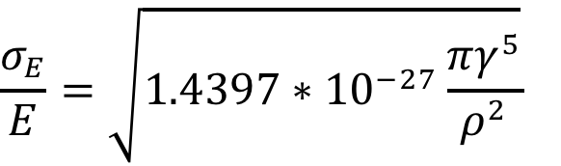
Incoherent Synchrotron radiation in return arcs
ARC | E [MeV] | ΔE [keV] | σE/E [%]
1 | 150 | 0.0087 | 0.00000387
2 | 300 | 0.139 | 0.00002199
3 | 450 | 0.708 | 0.0000621
4 | 600 | 2.239 | 0.000132
5 | 750 | 5.467 | 0.00024
6 | 900 | 11.337 | 0.00039
7 | 750 | 5.4667 | 0.00052
8 | 600 | 2.239 | 0.00066
9 | 450 | 0.708 | 0.00089
10 | 300 | 0.139 | 0.00135
11 | 150 | 0.0087 | 0.0027
Beam Energy loss
Beam Energy Spread

Slide 20
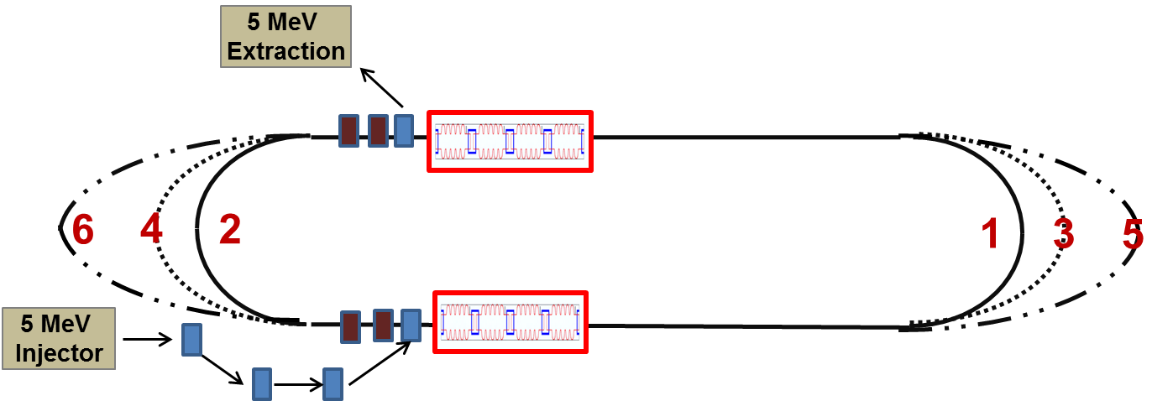
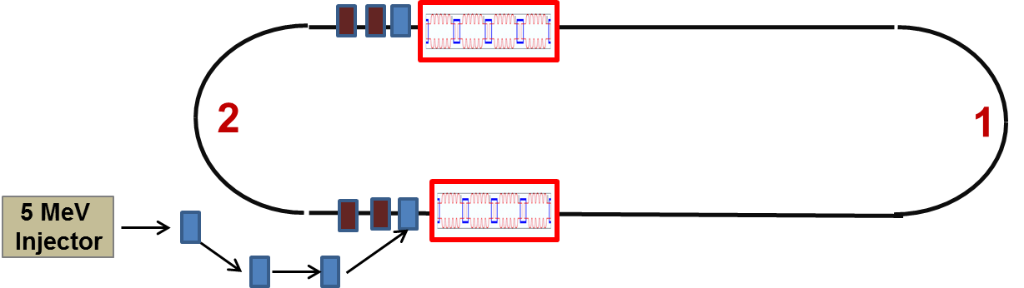
^{Next steps}
Complete Step 2 and Step 1 configuration and optics layout
Step 2
Available
space
Step 1

Slide 21
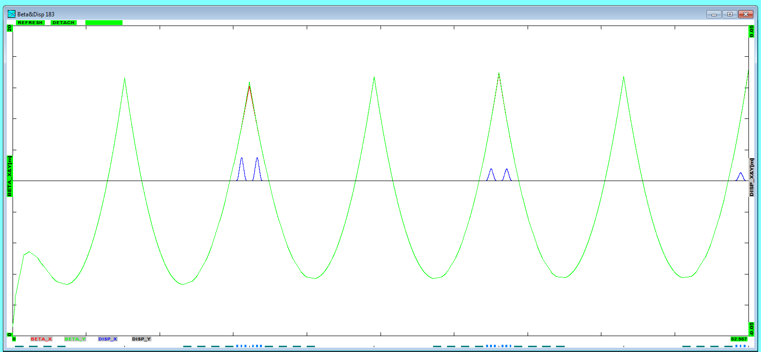
^{Linac 1 - Step 2}
βx,y
Dx
5 MeV
85 MeV
155 MeV
235 MeV
305 MeV
380 MeV
455 MeV

Slide 22
^{Outline}
1. Stages of building design
- layouts
- baseline parameters
2. Arc optics architecture
3. Test facility for sc magnet tests

Slide 23
Controlled quench tests of SC magnets
We are investigating the possibility of using the test facility for SC magnet tests
Requirements in terms of:
Beam energy, intensity and pulse length (energy deposition)
Space for the magnets installation (possible tests of cable samples and
full cryo magnets)
Cryo requirements
Vacuum requirements
Powering needs

Slide 24
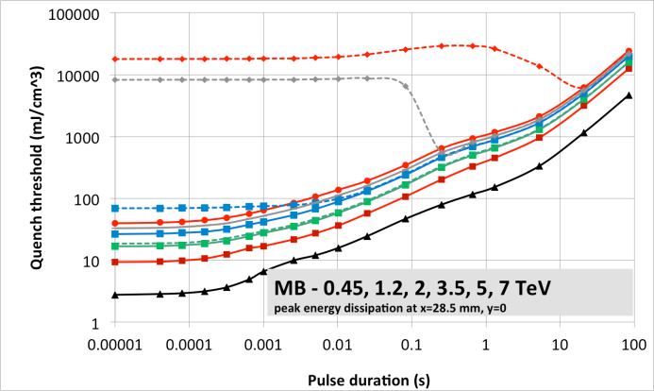
Controlled quench tests of SC magnets
Study beam induced quenches (quench thresholds, quenchino thresholds)
at different time scales for:
SC cables and cable stacks in an adjustable external magnetic field
Short sample magnets
Full length LHC type SC magnets
Quench limits of LHC dipole as expected from QP3 simulations for different pulse durations
Courtesy A. Verweij

Slide 25
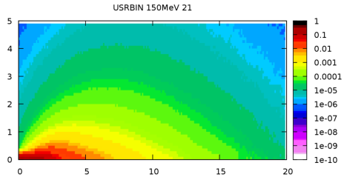
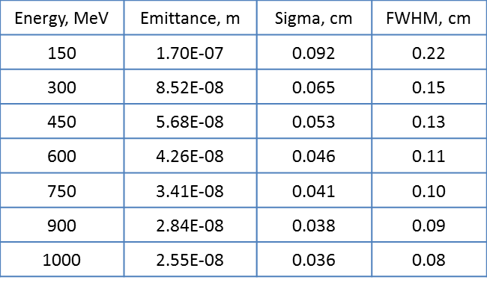
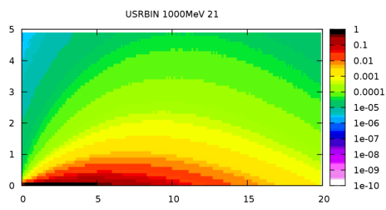
Beam parameters to generate a given amount of energy deposition
Calculations and FLUKA Simulations
Copper target
(no magnetic field)
Energy deposition, GeV/cm³/e⁻
Beam
150 MeV
Cylinder of copper
Radius = 50cm
Length = 100cm
Beam parameters
R,cm
1 GeV
Results are given for half of bulky target because of symmetry
Z, cm
Binning: 1 mm³ bins

Slide 26
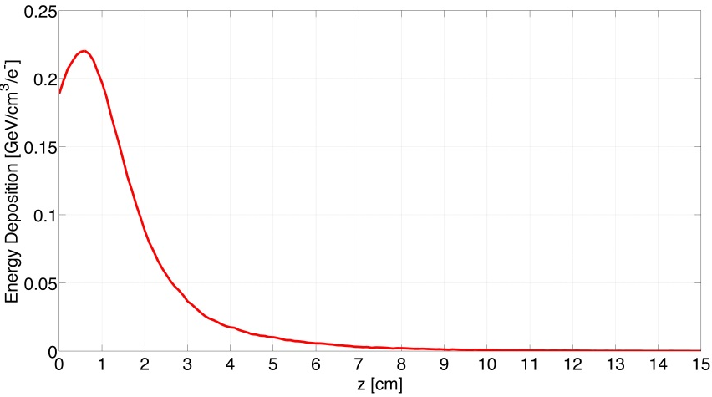
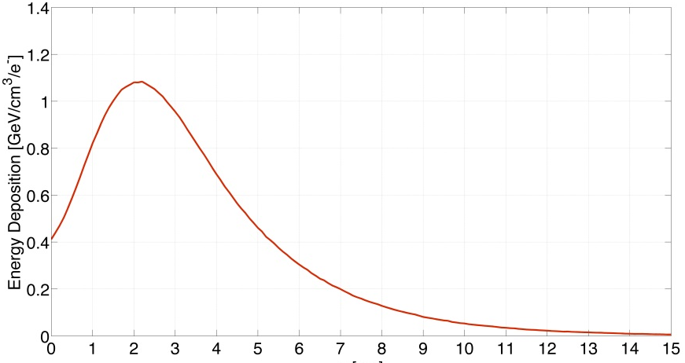
Beam parameters to generate a given amount of energy deposition
Calculations and FLUKA Simulations
Copper target
(no magnetic field)
Energy deposition, GeV/cm³/e⁻
Beam
Peak at z = 0.6 cm, r=0
Peak value = 0.2199 GeV/cm^3
Cylinder of copper
Radius = 50cm
Length = 100cm
Beam parameters
150 MeV
Peak at z = 2.1 cm, r=0
Peak value = 1.0785 GeV/cm^3
1 GeV
Results are given for half of bulky target because of symmetry
Binning: 1 mm³ bins
Z, cm

Slide 27
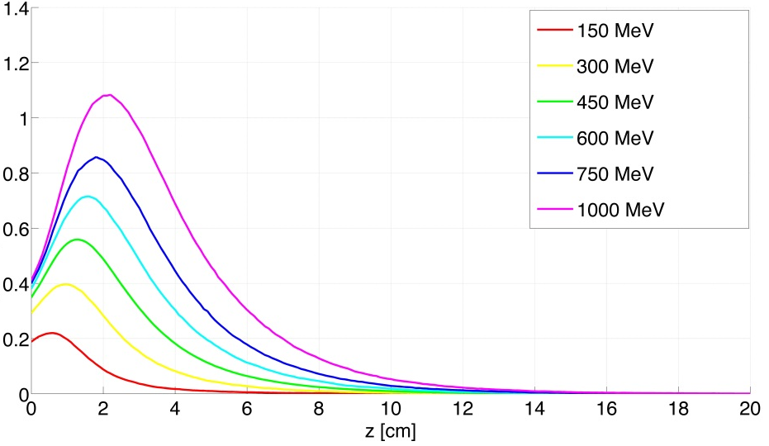
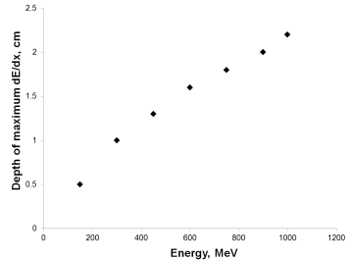
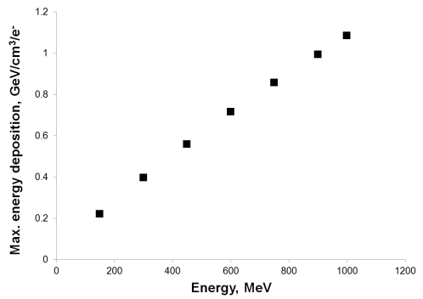
Beam parameters to generate a given amount of energy deposition
Max energy deposition
Depth
of max dE/dx
Energy Deposition, GeV/cm³/e⁻
Depth of max dE/dx
Max energy deposition

Slide 28
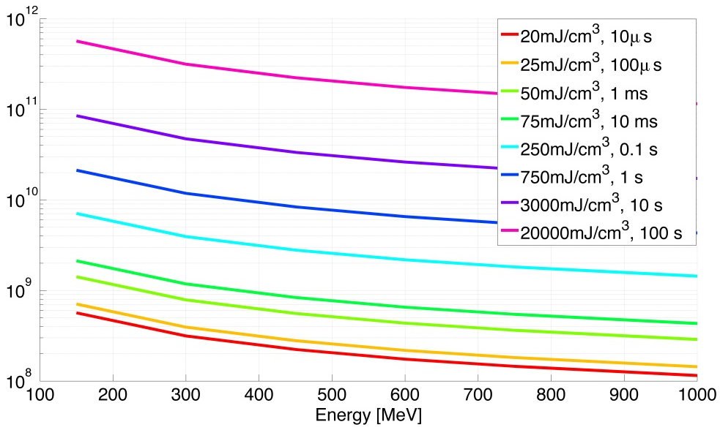

Beam parameters to generate a given amount of energy deposition
# electrons needed to quench the magnet
Quench threshold
Maximum value for
the energy deposition
MB quench limit 3.5 TeV
Energy Deposition, GeV/cm³/e⁻
Number of particles
1 GeV = 1.602 x 10⁻⁷ mJ
MB quench limit 450 GeV is 140mJ/cm³ in 10ms:
~2.2 x 10⁹ e⁻ @ 1GeV necessary
MB quench limit 7 TeV is 16 mJ/cm³ in 10ms:
~2.6 x 10⁸ e⁻ @ 1GeV necessary

Slide 29
^{Summary}
The concept of the ERLTF is designed to allow for a staged construction with verifiable and useful stages for an ultimate beam energy in the order of 1 GeV
A sketch of the ERLTF optics configuration is provided and other options are under investigation
First analysis of having controlled quench tests of next generation superconducting magnets has been carried out. Beam parameters seem to match the requirements….further investigation is required!
Complete the optics layout for Steps 2 and 3 and make a second-order analysis
Thank you for your attention

Slide 30


