Slide 1
PSB Half-Sector and Stripping Foil Test in L4T
B. Mikulec
BI Technical Board 27/02/2014

Slide 2
History
Complexity and related risk of the future PSB H⁻ charge-exchange injection section has been exposed at several occasions
  Idea of a test installation of PSB injection equipment in Linac4 first pronounced by P. Collier at the IEFC workshop March 2012.
EDMS note 1224575 (June 2012) with the first concept
Installation of a stripping foil unit and of half of the PSB H⁻ injection section of one ring in L4T approved by Linac4 BCC #43: https://indico.cern.ch/conferenceDisplay.py?confId=246360

Slide 3
Mandate
Installation of PSB injection equipment in the Linac4 transfer line supported by sector department heads and LIU management. Email from P. Collier from 08/10/2013 proposing a new project.
  Project plan to be presented at the IEFC beginning of 2014.
Informal project approval during the A&T Sector meeting 17/02/2014.

Slide 4
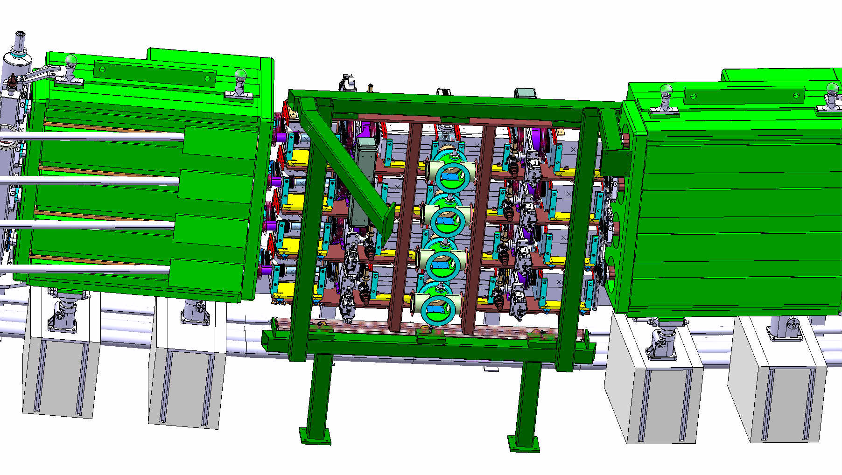
Future PSB H- Injection Section
No experience at CERN with H⁻ charge-exchange injection
Extremely compact and complex section (4 rings and very limited space); combining equipment from TE/ABT, EN/STI, BE/BI, TE/EPC, TE/VSC, TE/MPE + services
Long installation and commissioning times; critical for LS2 duration
~2.65 m
Courtesy of
L. Zuccalli

Slide 5
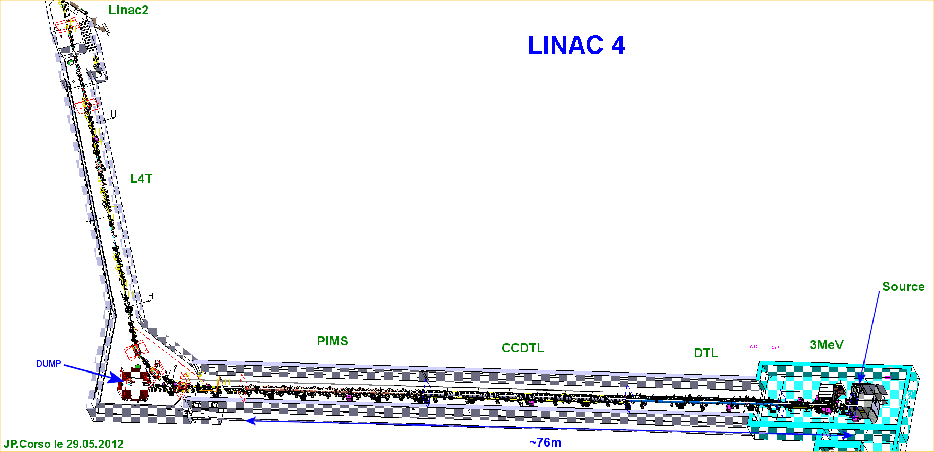
Location of the Test Installations
L4T: new Linac4 to Linac2 transfer line
Part 2: PSB half-sector test installation
Part 1: H⁻ stripping foil+BTV unit

Slide 6
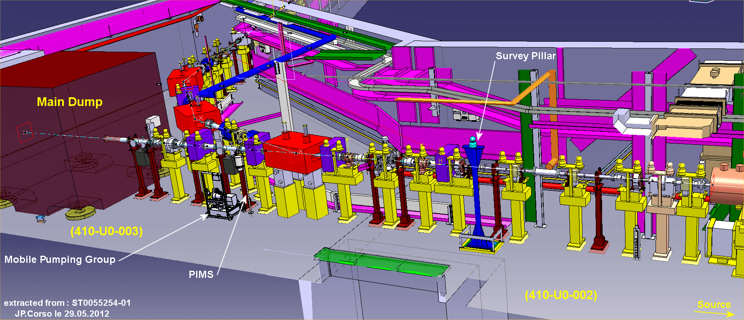
Scope of the Project – Part 1
Part 1: Permanent installation of H⁻ stripping foil+BTV unit
Reserved location for
H⁻ stripping foil unit
Proposed location for
BI laser stripping installation
(not part of this project)

Slide 7
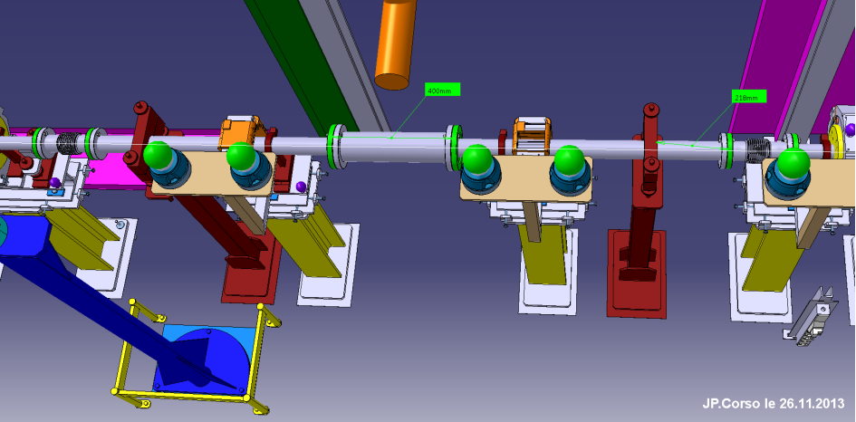
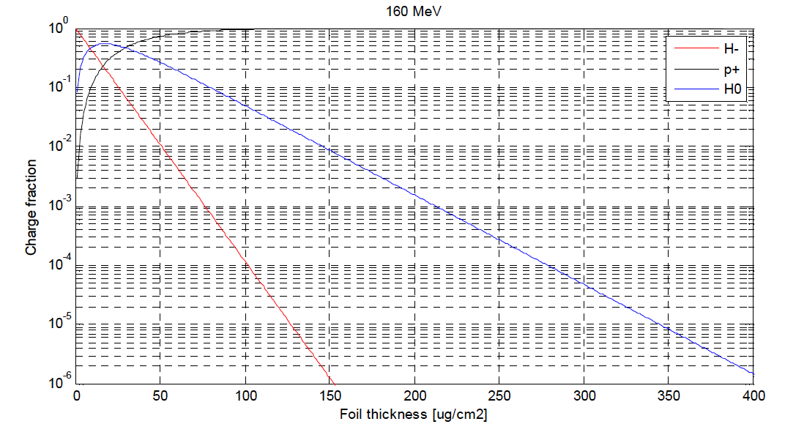
Part 1: Stripping Foil Test Stand
Permanent installation between L4T.MCHV.0115 and L4T.MCHV.0135
  Sufficient longitudinal space available (~400 mm)
  Lateral space to be checked
See presentation V. Dimov, BCC #38:
p, H⁰ and H⁻ beam can be safely dumped on the main Linac4 dump (in L4Z) by switching off the quadrupole L4T.MQF.0210
Beam size on dump can be adapted by varying strength of quadrupole L4T.MQD.0110
H⁰: 2%
H⁻: negligible
sLHC Project Note 0005

Slide 8
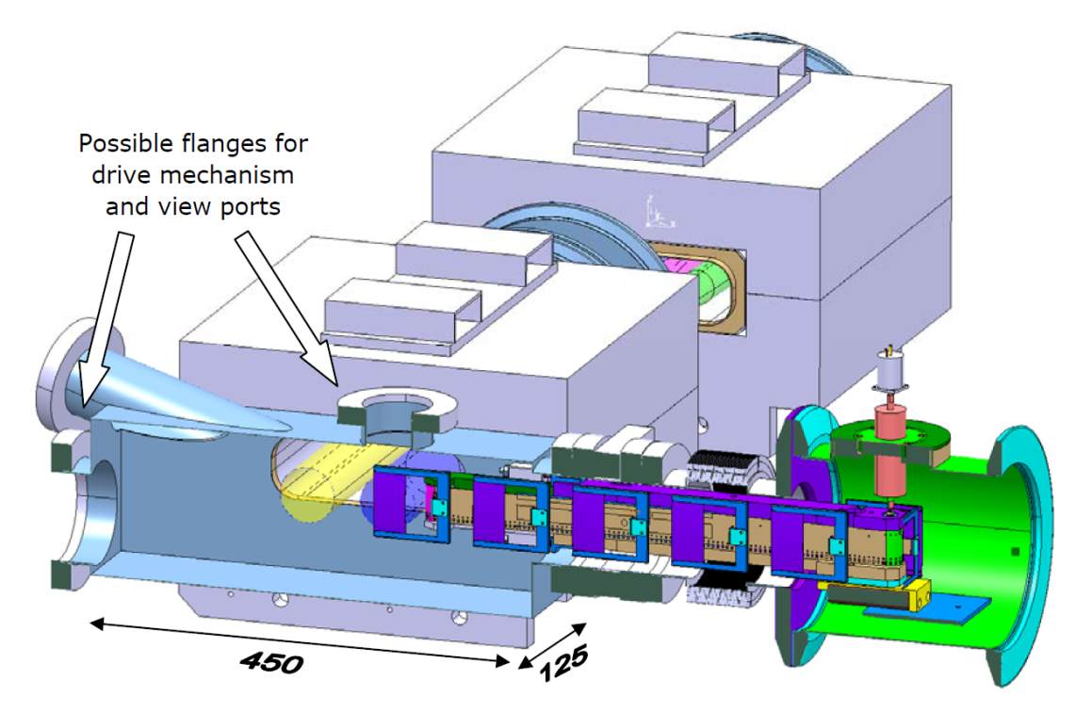
Part 1: BI Instruments Involved
Parts 1+2: Specifications identical to LIU-PSB implementation!
BTV system integrated in foil tank
  Visualise and measure beam spot (no foil)
    Position accuracy: 0.2 mm; size accuracy: 10%
  Internal interlocks for screen in case of foil movement
Measurement of foil current from foil holder
  Electrically isolate foil holder support and measure the total current
  Use the same concept as for the H⁰/H⁻ monitor (see later)
Rough measurement of stripping efficiency
  Use 2 well cross-calibrated BCTs (L4T.BCT.0107 and L4Z.BCT.0273)
J. Tan; LIU-PSB Review 2012

Slide 9
Part 1: Goals
What can be tested?
  Lifetime of different foils and foil holders over full Linac4 beam intensity range
  Controls of foil changer
  Commissioning and optimisation of the instrumentation at the stripping foil (screen + mirrors + camera)
  Rough estimate of stripping efficiency of different foil types and thicknesses
    Need 2 well cross-calibrated BCTs; H⁰ will not be detected and H⁻ signal will cancel with p (but H⁻ signal negligible)!
  Hope to be able to obtain a rough estimate of emittance growth through the foil
    Use grids in L4Z line
Beam size on foil will be similar to situation at PSB injection
Detection of foil breakage (foil current)
Tests can be performed in parallel to Linac4 beam tests (except for emittance measurements at end of the line)

Slide 10
Status of Part 1
Go-ahead given to the design office to start the design job for the modifications of L4T between PIMS and the start of L4Z
  This includes also the modifications necessary to install at a certain point the BI laser stripping test
    LIU will cover the cost for design, integration and follow-up
    BI should provide a budget code to cover ~2.5 kCHF for the cost of 2 beam pipes for the laser stripping test.

Slide 11
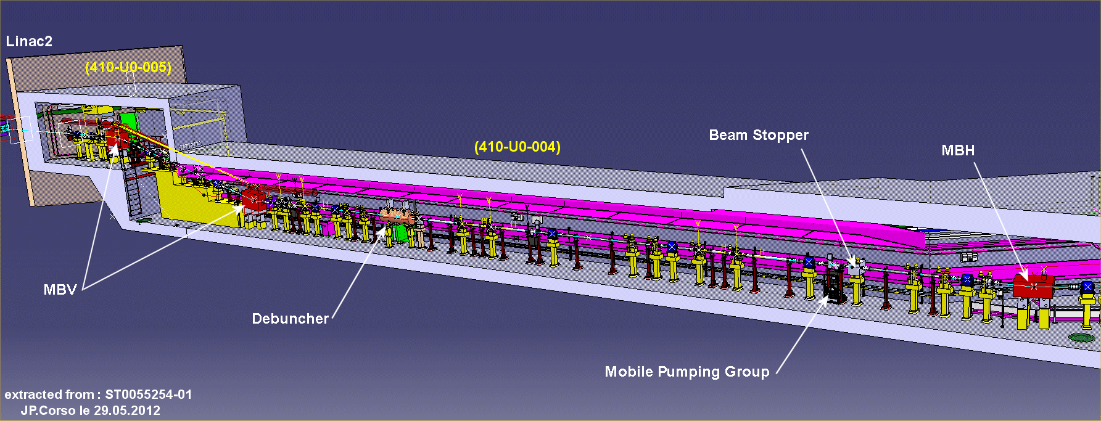
Scope of the Project – Part 2
Part 2: Temporary installation of half of the future PSB H⁻ injection chicane
  Around location of debuncher
  Install L4T only up to this point (plus line between 2 vertical bends)

Slide 12
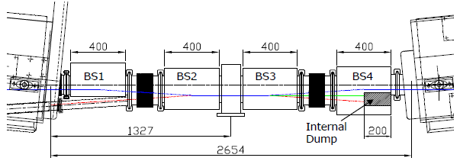
Part 2: Installation of the Half Sector Test
Install stripping foil+BTV unit, half of the injection chicane (BSW3+BSW4) including the H⁰/H⁻ dump and the H⁰/H⁻ current monitor
In addition: 1 standard + 1 diamond BLM, 2 BCTs (stripping efficiency cross-check), 1 BTV + external beam dump+shielding (including vacuum valve)
2 sector valves enclosing the installation, pumping groups
Use where possible prototypes or not yet installed Linac4 equipment and cabling (standard BLM and BCTs)
L4-T-EP-0002 rev 1.0
Notes:
Requires ~1.3 m space (half-sector with stripping foil unit).

Slide 13
Proposed Operation
Plan to run only during daytime and week days in 2 shifts (7am – 7pm)
Cannot run at higher intensity because of limitations due to prompt radiation
  Maybe single full-intensity shots with RP agreement towards end of operation
Operating Scenario | Phase 1 (2 months) | Phase 2 (2 months)
Max. pulse current | 40 mA | 40 mA
Max.+avg. pulse length | 0.5-1 μs | 10 μs
Max. repetition rate | 0.833 Hz | 0.833 Hz
Pulse period | 1.2 s | 1.2 s
Max. number of particles/pulse | 2.5E11 | 2.5E12
Particle energy | 160 MeV | 160 MeV
Energy/particle | 2.563E-11 J | 2.563E-11 J
Max. energy/pulse | 6.4 J | 64 J
Mean power/pulse | 5.33 W | 53.3 W
Beam designation | Pencil beam | Low-intensity beam
1σ beam size | 1.9 x 2.4 mm² | 2.2 x 3.3 mm²
Notes:
Change Phase2 to 10 us max. and make it last for 2 months (no phase 3 due to prompt radiation).

Slide 14
Part 2: Preliminary Layout (1)
SHIELDING
Courtesy of B. Riffaud
Notes:
Requires ~1.3 m space (half-sector with stripping foil unit).

Slide 15
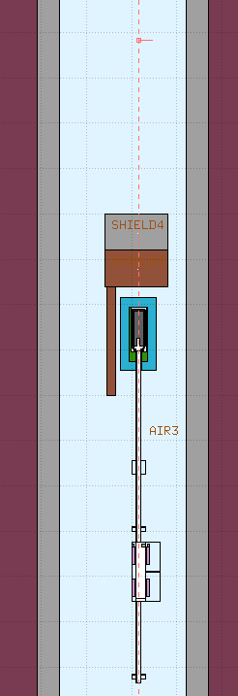
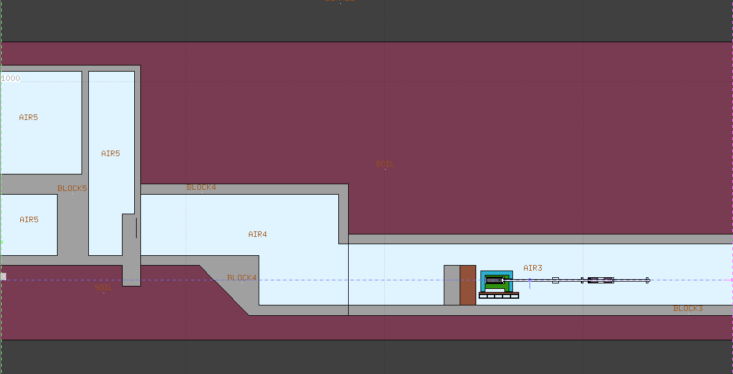
Part 2: Preliminary Layout (2)
Courtesy of J. Blaha
Notes:
Requires ~1.3 m space (half-sector with stripping foil unit).

Slide 16
Part 2: BI Instruments Involved (1)
BTV system integrated in foil tank (see part 1)
BTV system (from PS?) after chicane magnet to check beam position/shape
Measurement of foil current from foil holder (see part 1)
Measurement of stripping efficiency
  Use 2 well cross-calibrated BCTs (L4T.BCT.1243 and L4Z.BCT.1553)
    Accuracy <1%, shot-to-shot precision <0.3% (tbc), min. pulse length 100 ns
    Need a watchdog connected to the BIS!
BLMs: standard IC-type and diamond BLM
  IC-type specifications conform to Linac4 request:
    Resolution time 2 μs, ppm enable/disable, low-loss threshold (ppm with FESA) and high-loss threshold (non-ppm, HW, connected to BIS)
  Diamond BLM:
    Resolution time 100 ns, ppm acquisition, OASIS readout for observation only - What is the min. loss (2E10 mentioned during BI review seems too high to monitor a fraction of 2% losses of a beam of ~1E11 particles…)?

Slide 17
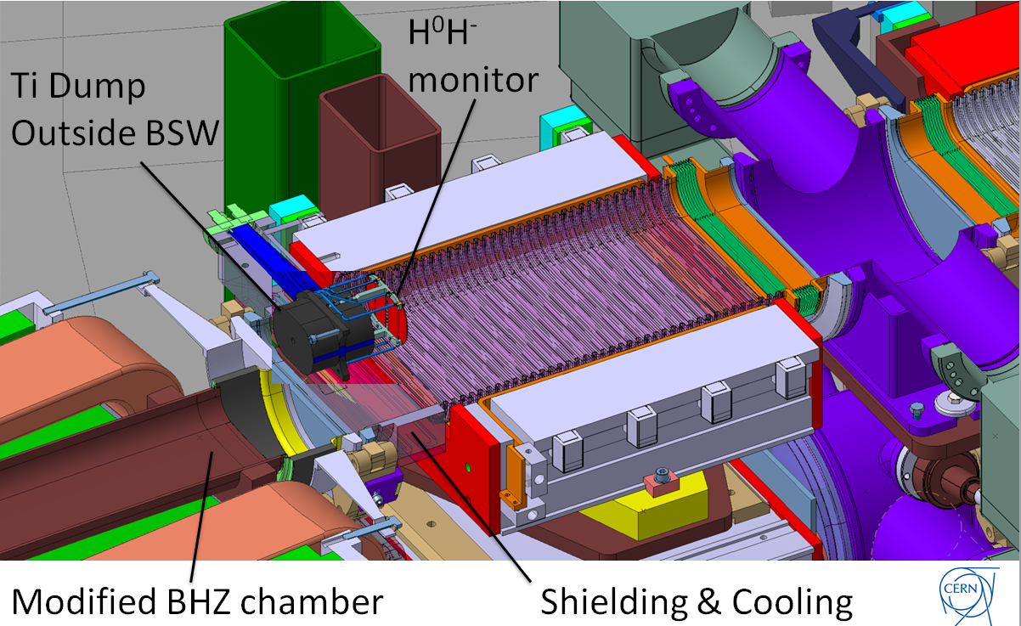
Part 2: BI Instruments Involved (2)
H⁰/H⁻ current monitor: essential for success of Half-Sector-Test
Provided by F. Zocca

Slide 18
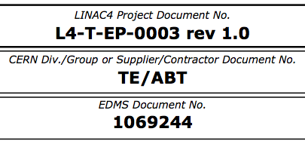
Part 2: BI Instruments Involved (3)
H⁰/H⁻ current monitor specifications:
  Robust (no maintenance)
  Radiation dose 0.1-1.0 MGy/year
  Vacuum level 10⁻⁹ mbar without beam (10⁻⁸ with beam)
  Withstand 0.18T pulsed magnetic field from BSW4 without perturbing field by more than 0.1%
  Maximise sensitive area to cover full halo
  Withstand heat load for normal operational conditions (up to 4/8 mA for H⁰/H⁻ foils) plus a few times per year a quarter of a full Linac4 pulse (stripping foil breakage; up to 80 mA for H⁻)
  Dynamic range: 5×10⁷ – 5×10¹² ions within a pulse length of 0.5 – 100 μs
  Absolute accuracy ±20%, relative accuracy ±10%
  Time resolution: require only integration over injection duration; however some time resolution in the few μs range would be useful
  Provide an interlock signal to the BIS to protect the dump (threshold at 10% of a quarter of the full Linac4 pulse)
Notes:
For the current measurement, G.J. Focker has originally foreseen current amplifiers and ADCs sampling at 250 kHz (4 us), which would not allow correct measurement of very short beam pulses. Therefore he proposes to add another chain in parallel with integrating amplifiers.

Slide 19
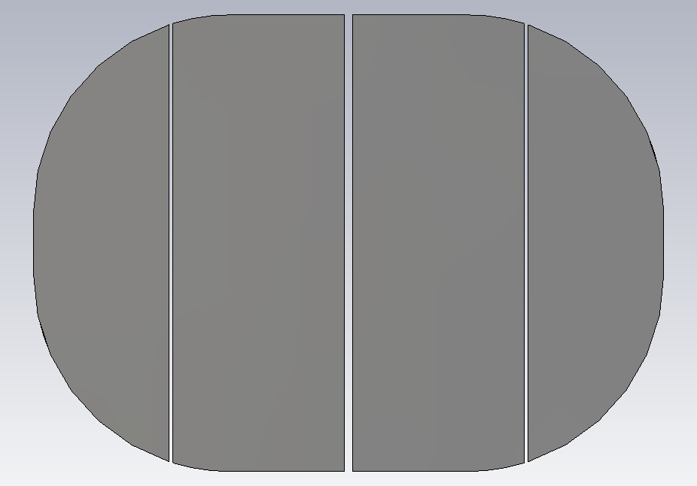
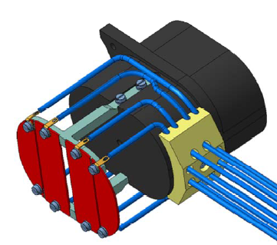
Part 2: BI Instruments Involved (4)
H⁰/H⁻ current monitor:
  Rough determination of horizontal position through segmentation of H⁰ and H⁻ foils
16.3 mm
21.8 mm
21.8 mm
18.1mm
58 mm
0.5 mm
1 mm
0.5 mm
80 mm
Provided by F. Zocca

Slide 20
BI Material from Linac4, LIU-PSB or from other Sources
  H⁰/H⁻ monitor + electronics and foil holder current measurement system (LIU-PSB spare)
  1 stripping foil + screen system (LIU-PSB spare)
  BCTs from Linac4 (incl. cabling + electronics), BLMs + electronics from Linac4 (incl. cabling) or LIU-PSB, 1 screen from PS spares
  Additional budget request from BI for project: 60 kCHF and 1 FTE until project completion.
Notes:
BI manpower request for full project duration: 1 PY.

Slide 21
Part 2: Goals (1)
What can be tested in addition to stripping foil test?
  BSW3+4
    Powering and control of half of the chicane magnets
    Refine chicane parameters
    Current stability and interlocking
  Stripping foil
    More precise stripping efficiency measurement of H⁰ and H⁻
    Interlocking of foil position
  H⁰/H⁻ dump
    Aperture check
    Temperature cross-check with simulated values → refine cooling requirements
    Interlocking (temperature and pressure drop – define operational thresholds)

Slide 22
Part 2: Goals (2)
What can be tested in addition to stripping foil test?
  Special BLM
    Diamond BLM to measure secondaries close to H⁰/H⁻ dump; evaluate operational conditions for foil degradation measurement and fast losses
  H⁰/H⁻ current monitor: new development!
    General operational check incl. for example secondary emission suppression
    Sensitivity check for H⁻; comparison to theory
    Aperture check
    Influence on measurement if beam passes besides the monitor (simulate circulating beam)?
    Interlocking – essential for dump protection
  Interlock system test for part of PSB injection (BIS + SIS)
  Specific applications

Slide 23
Software
What do we want to measure?
  Stripping efficiency, stripping foil degradation and rough steering (aperture checks):
    Watchdog
    Sum of H⁰ and H⁻ foil signals and time evolution over test period
    Individual integrated signal from each of the 4 monitor foils and time evolution over the test period; analog signal?
    Current measurement from stripping foil holder and time evolution over test period
    Loss signal from diamond BLM (foresee permanent OASIS input); compare to IC signal and H⁰/H⁻ sum signal
FESA classes and applications need to be prepared in time…

Slide 24
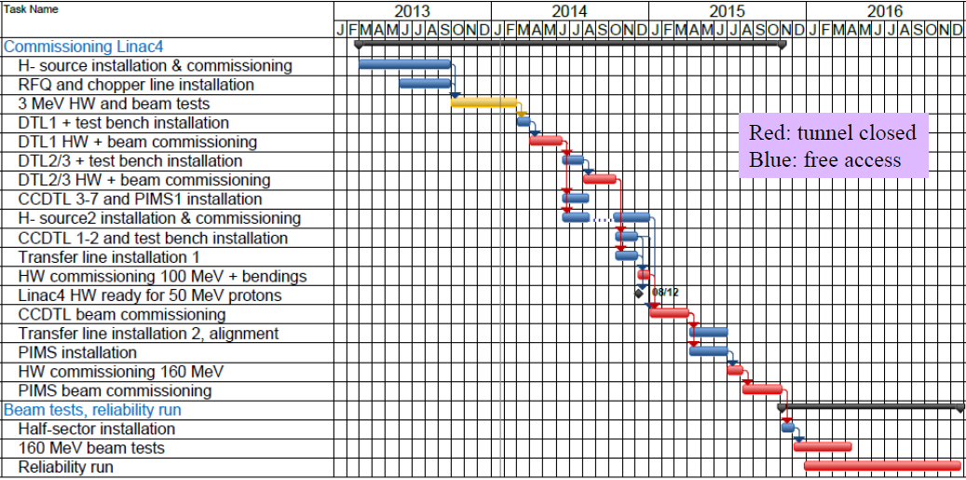
Planning - Linac4 Masterplan
Prepare stripping
foil installation
Install HST
services
Finalise HST
installation
M. Vretenar; Linac4 Project Meeting; 23/01/2014
Notes:
mid-October until November 2014: H- stripping foil permanent test stand installation (replace stripping foil system with vacuum pipe)
April – June 2015: HST services, cabling and what else can be installed (BCT + vacuum pumping module?)
November 2015: install everything else – will this be feasible (dump shielding installation?)

Slide 25
Proposed Work Breakdown Structure

Slide 26
Organisation
Indico site available (under LIU-PSB)
Twiki website created: https://twiki.cern.ch/twiki/bin/view/PSBHalfSectorTest/WebHome
Use LIU-PSB EDMS structure
Mailing lists:
  LIU-PSB-HALFSECTOR-TEST@cern.ch
  liu-psb-HST-WP-holders@cern.ch
Integrated in ~bi-weekly Linac4 installation coordination meetings (organised by J. Coupard)

Slide 27
Conclusions
Stripping foil and PSB half-sector test will be extremely beneficial
  From technical point of view for each sub-system to cross-check functionality and compliance to specifications
  For risk reduction
  For reduction of commissioning time for Linac4-to-PSB connection
Installation slots: October-November 2014, April-June 2015 + November 2015
Beam tests from August 2015 (Part 1) / December 2015 (Part 2)

