Slide 1
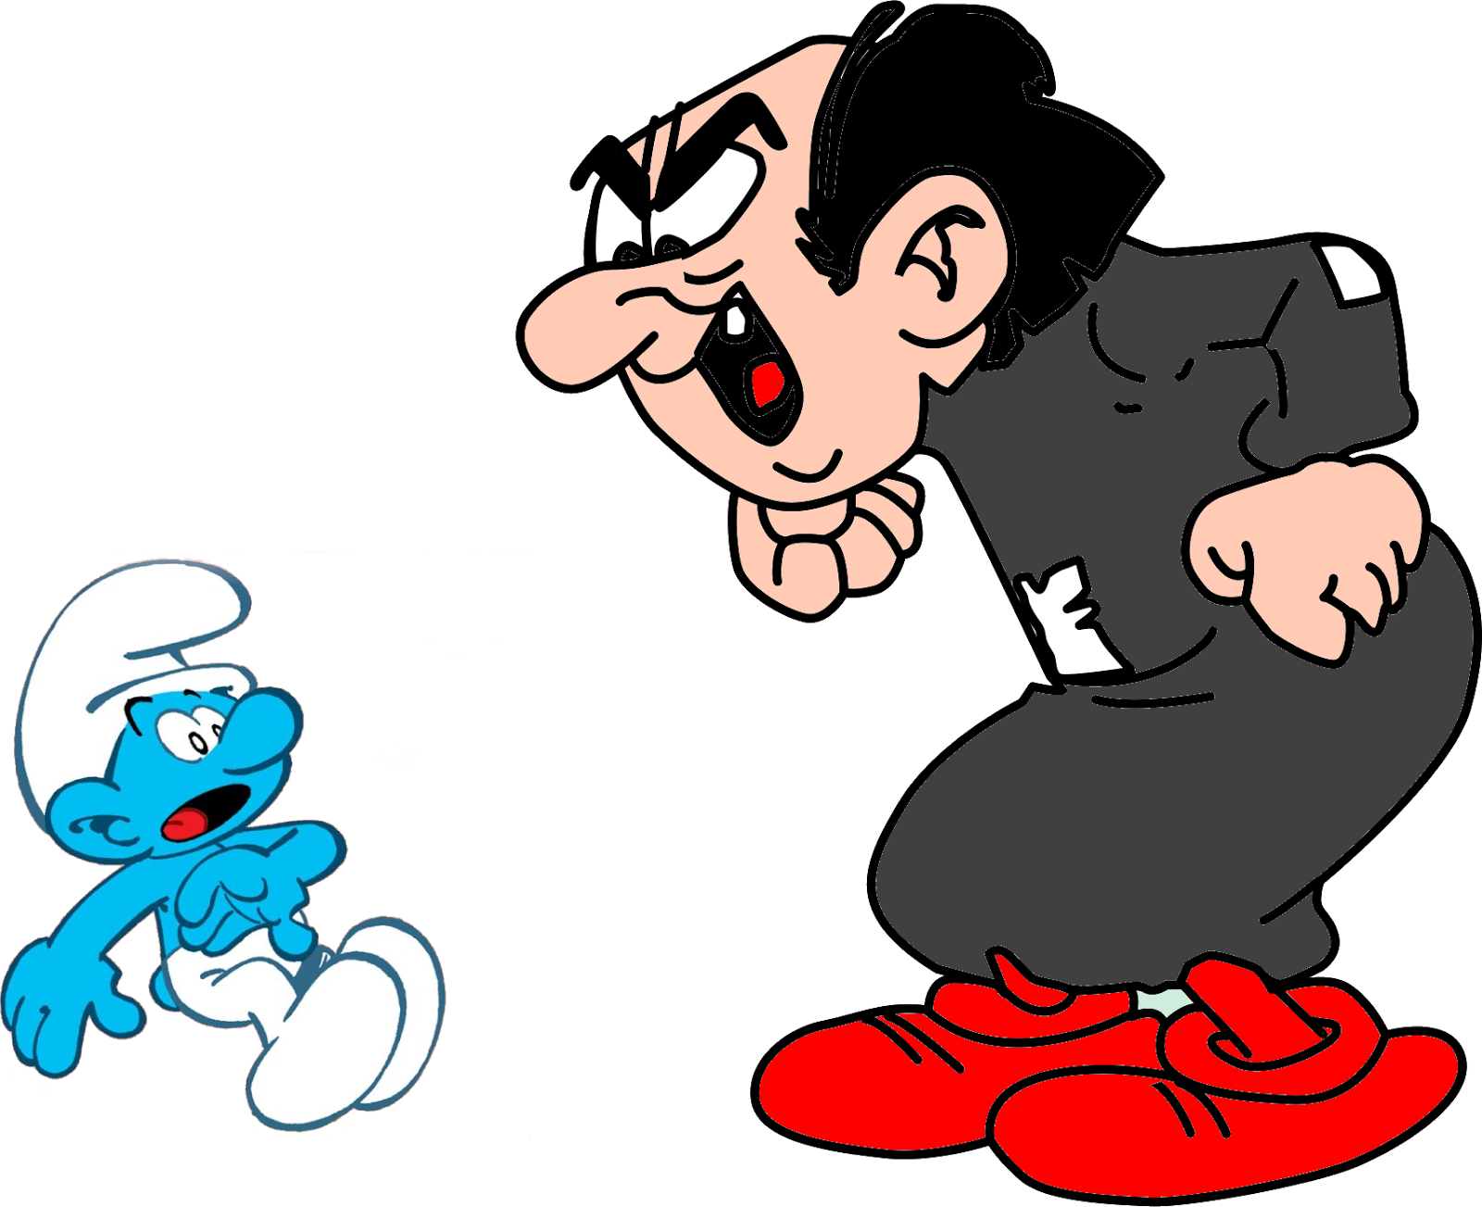
Gargamel(le)

Slide 2
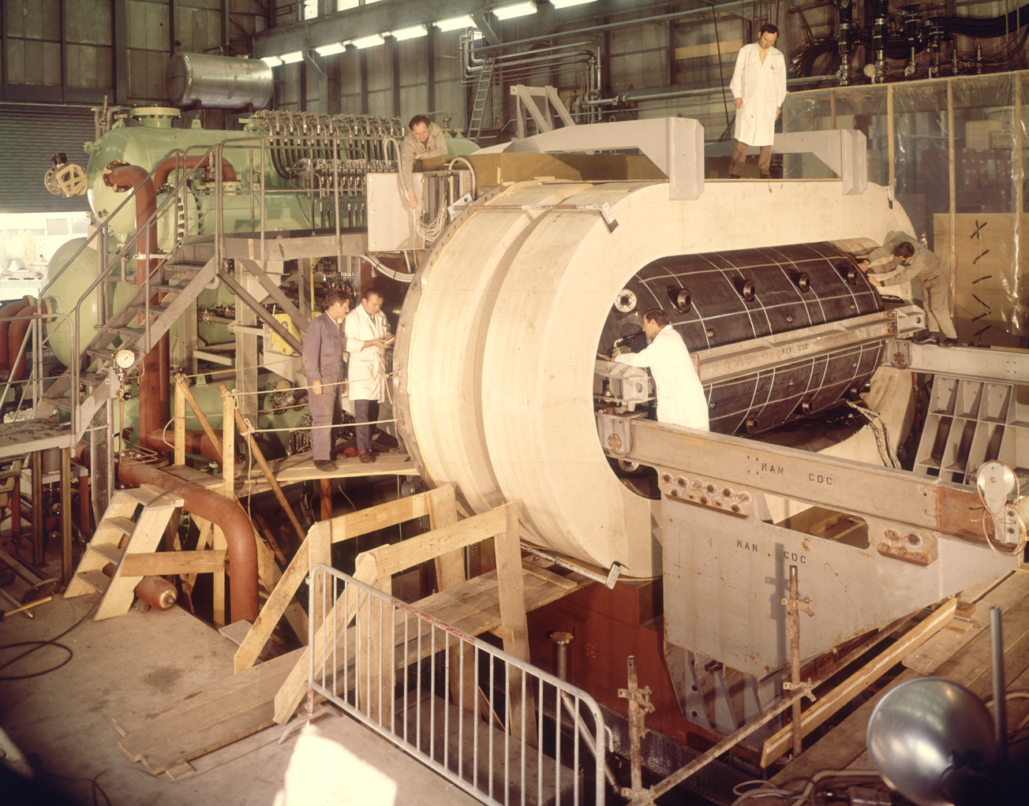
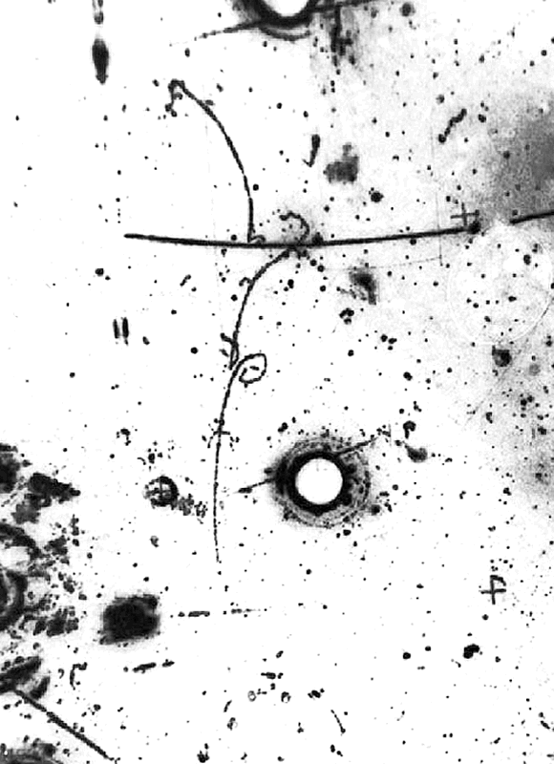
Observation of neutrino-like interactions without muon or electron in the gargamelle neutrino experiment
F.J. Hasert, S. Kabe, W. Krenz, J. Von Krogh, D. Lanske, J. Morfin, K. Schultze, H. Weerts
III. Physikalisches Institut der Technischen Hochschule, Aachen, Germany
The Real Thing

Slide 3


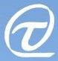


Neutrinos
Present and Future
Alfons Weber
University of Oxford & STFC/RAL

Slide 4
Content
Neutrinos
  WHY DO WE CARE?
Neutrinos…
… oscillate
… have mass
… are Majorana
… are the stuff the cosmos is made of
Neutrinos are the reason we are here

Slide 5
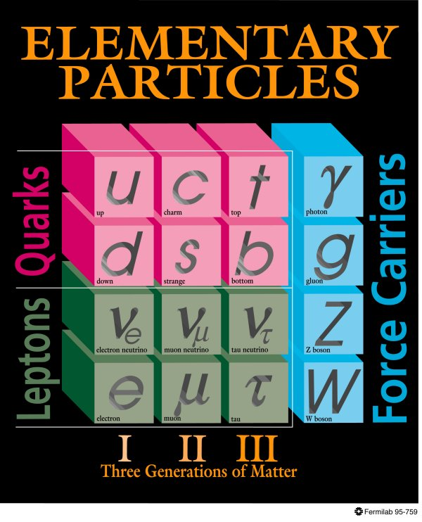
The SM 30 years ago
Neutrinos
  3 flavours
  Conserved lepton number
  Massless
  Strictly left handed
?
??
?
??
???
H
Higgs

Slide 6
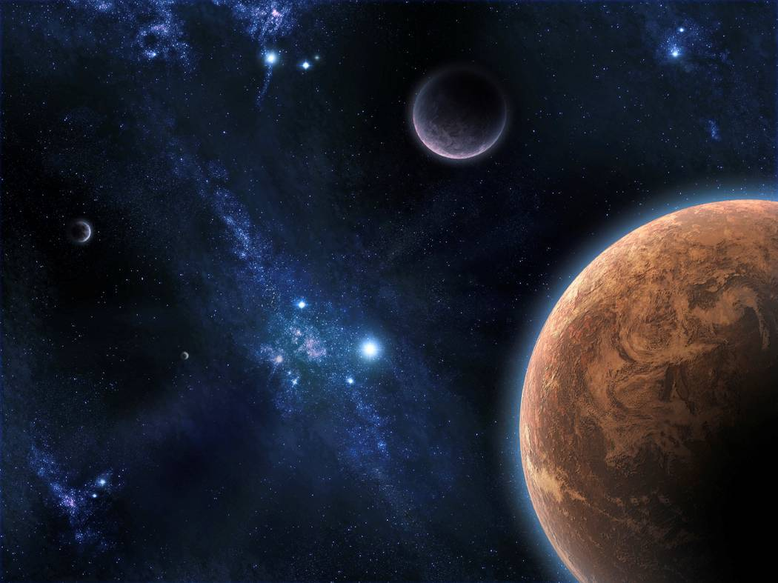
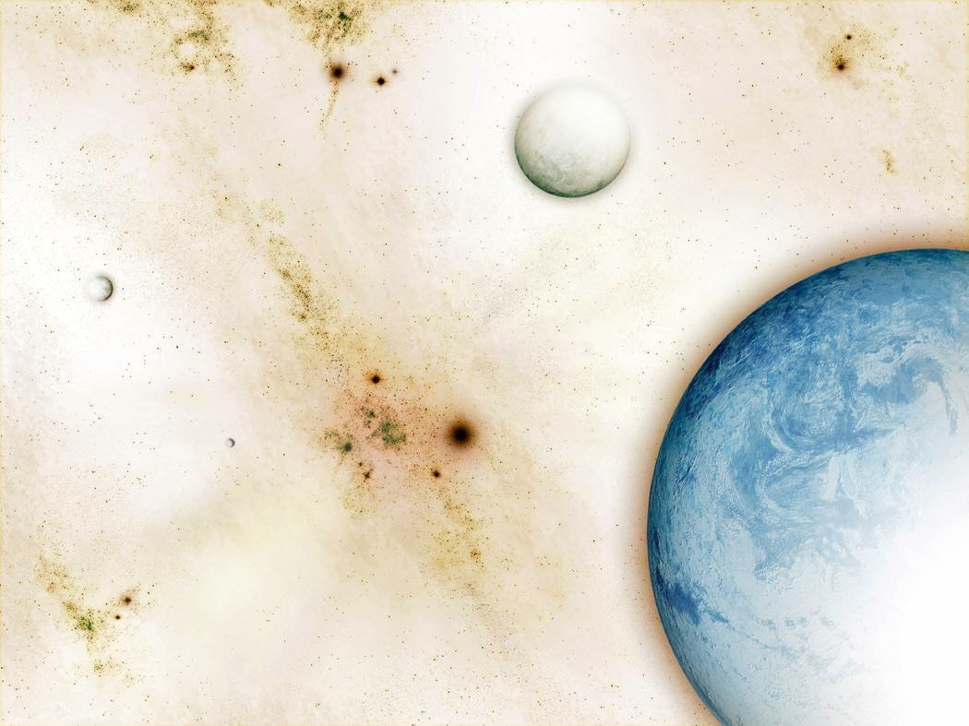
Why do we care!
Matter ⬄ Anti-Matter

Slide 7
Neutrino Mixing
The PMNS Matrix
Pontecorvo-Maki-
Nakagawa-Sakata
Assume that neutrinos do have mass:
  mass eigenstates ≠ weak interaction eigenstates
  Analogue to CKM-Matrix in quark sector!
Mass eigenstates
m₁, m₂, m₃
weak
“flavour eigenstates”
Unitary mixing matrix:
3 mixing angles
& complex phases

Slide 8
Who-is-Who
ν_{μ} disappearance
Solar neutrino oscillation
ν_{e} appearance in ν_{μ} beam
or
reactor neutrino experiments
ν–less double beta decay

Slide 9
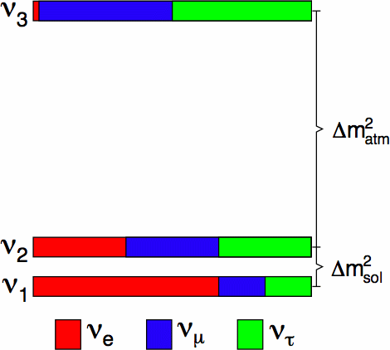
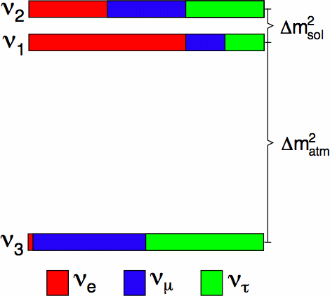
Mass Ordering
Normal Hierarchy or Inverted Hierarchy?

Slide 10
Matter Effects
Simplified treatment: two neutrinos only
In vacuum in matter
Matter modifies oscillation probability
  Sign of mass difference matters (opposite for anti-v)
  Larger effect at higher energies

Slide 11
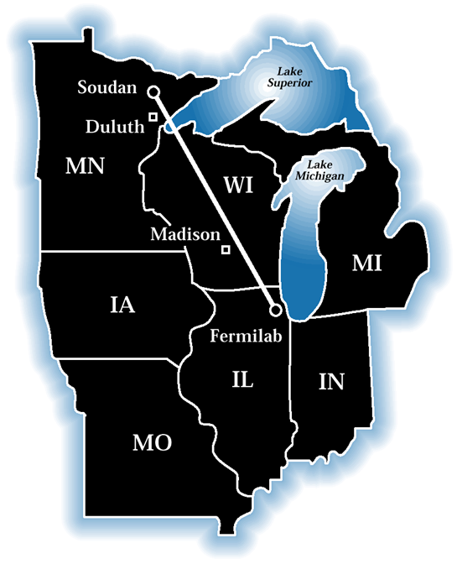
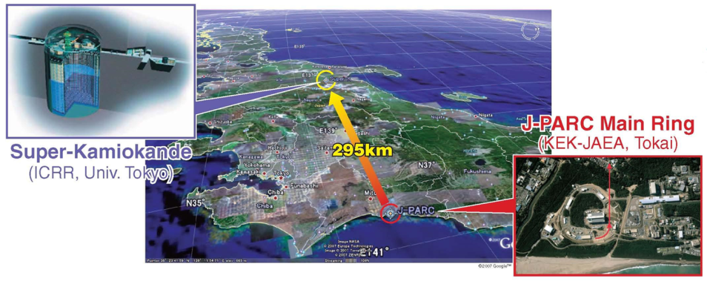
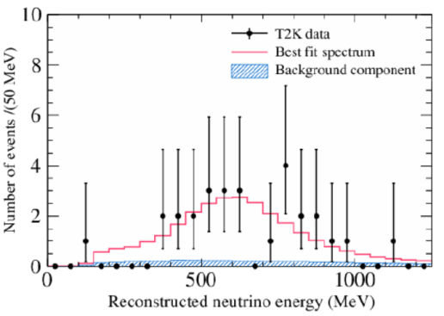
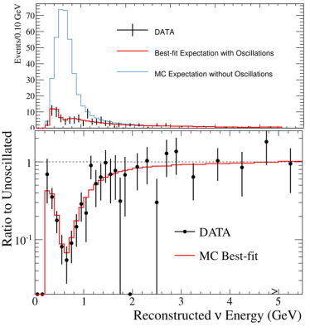
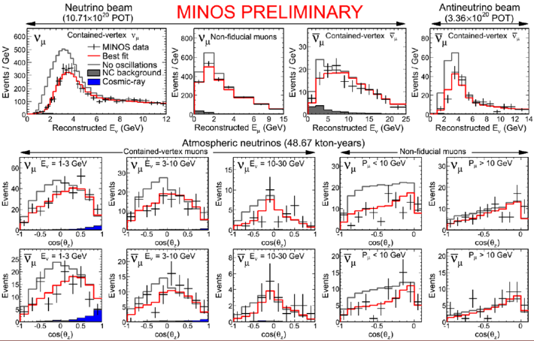
Oscillations Mesurements

Slide 12
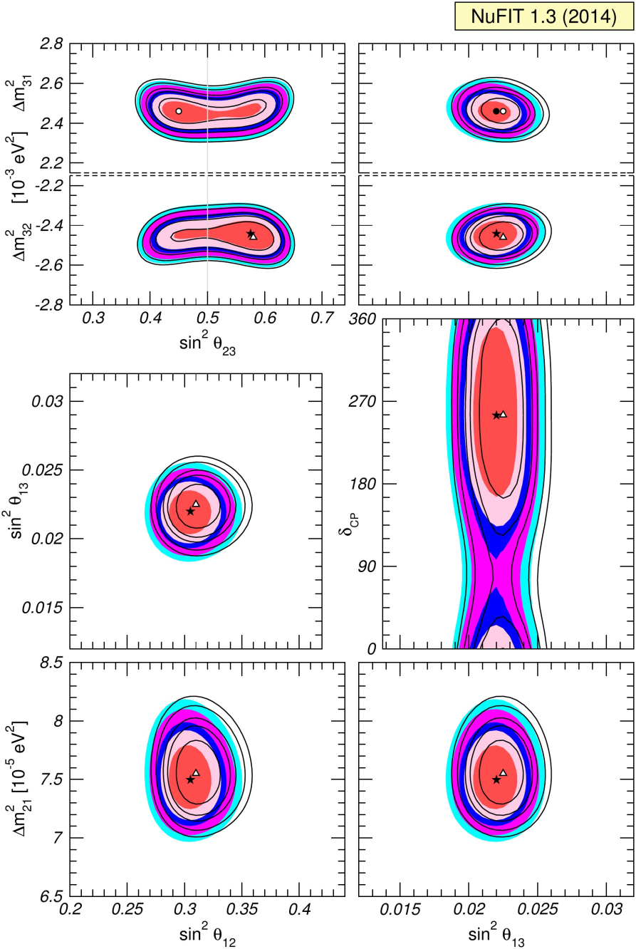

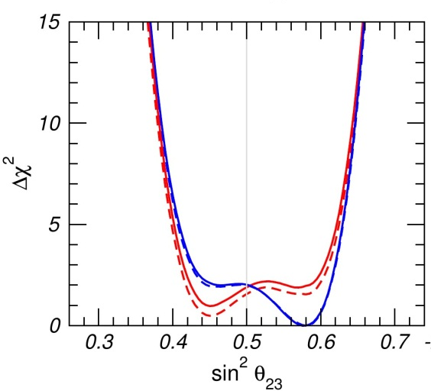
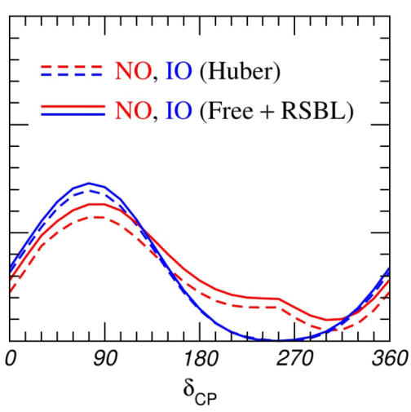
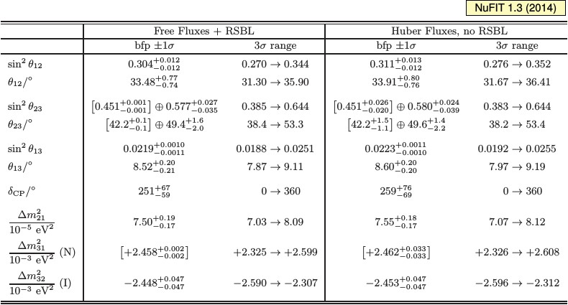
Global fits for oscillations
Update Nu2014
www.nu-fit.org
JHEP 12 (2012) 123

Slide 13
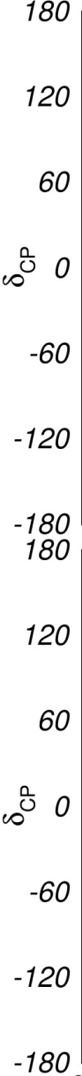

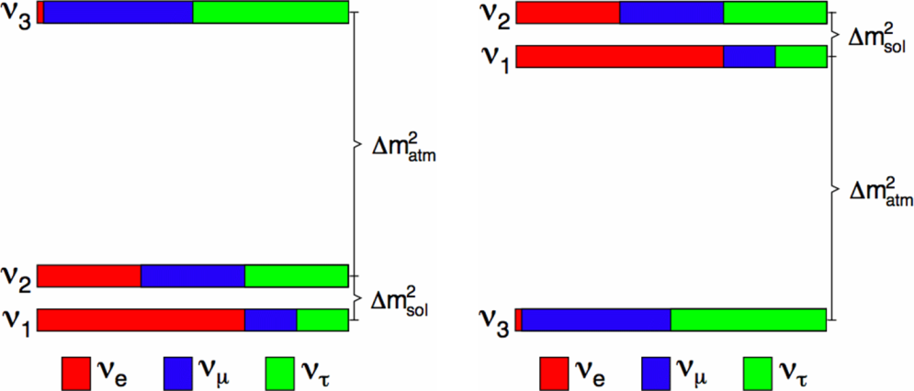
The Big Questions
Is θ₂₃ maximal and if not,
which octant is it in?
What is the mass hierarchy?
Is CP violated in neutrino oscillations?
We need more than 1σ-effects!
Power comes from combining exp.
NO
IO

Slide 14
Using Atmospherics

Slide 15
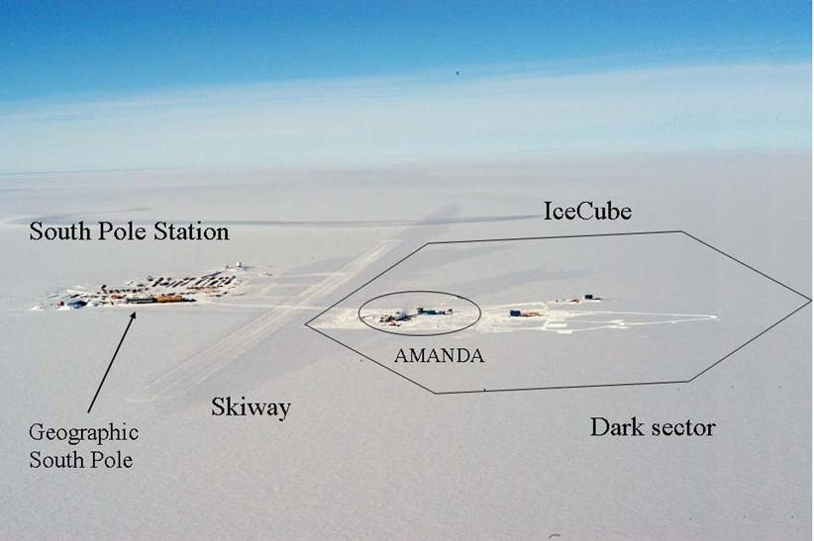
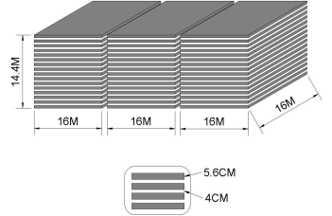
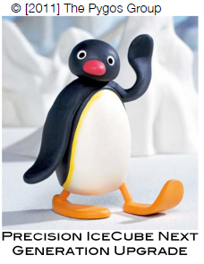
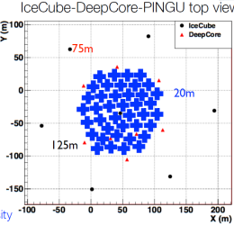
Experiments

Slide 16
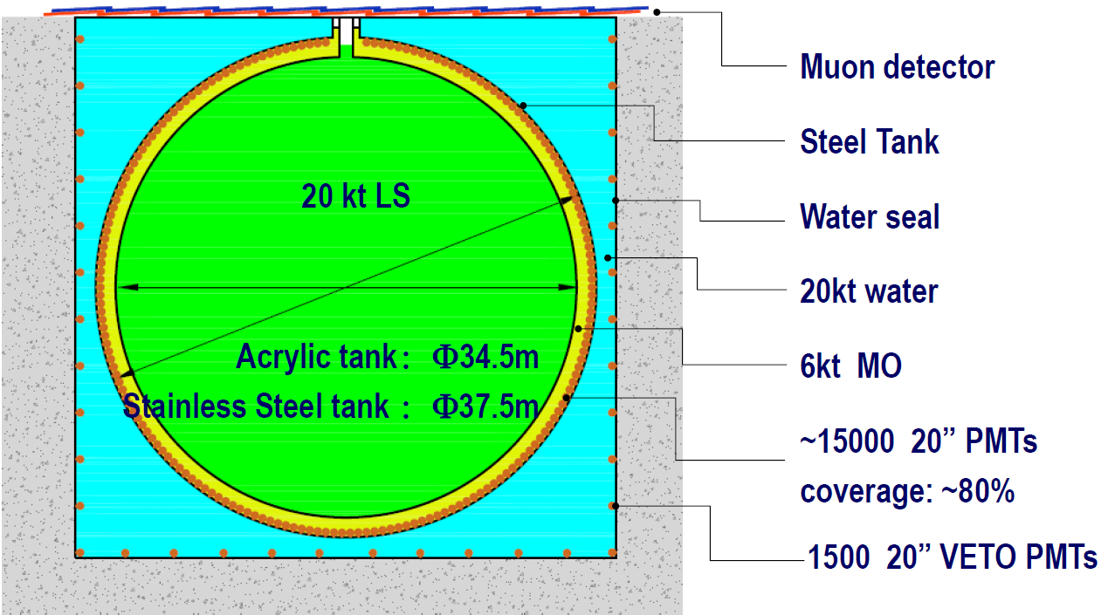
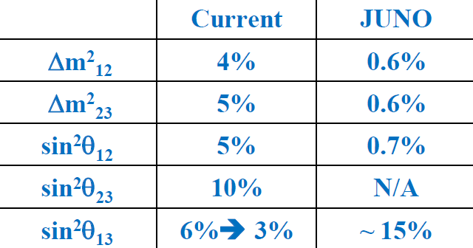
Future Reactors
Very Challenging!

Slide 17
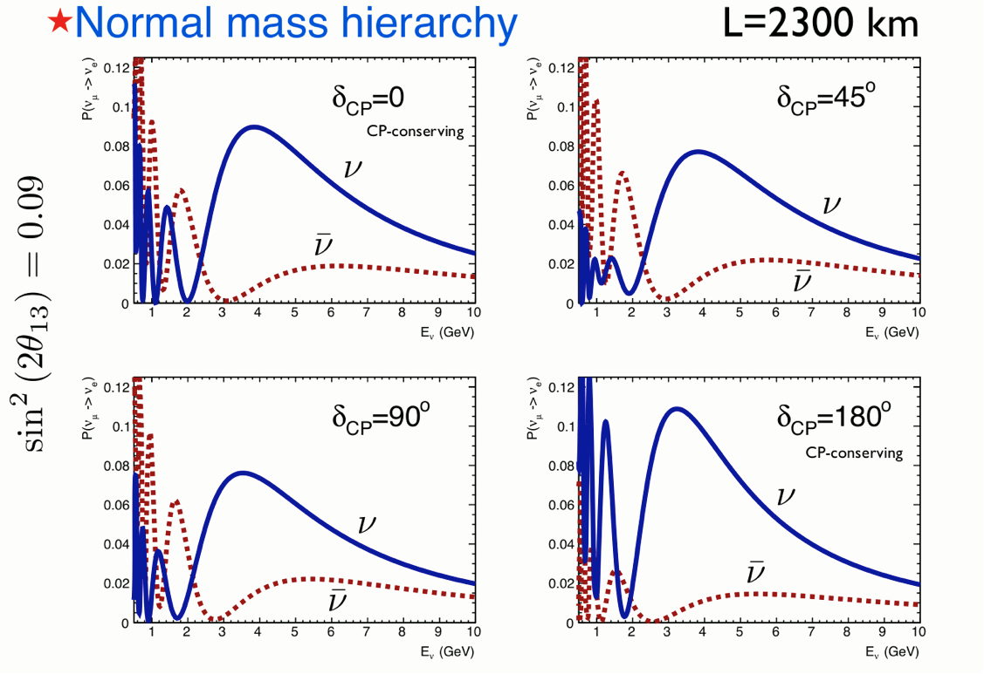
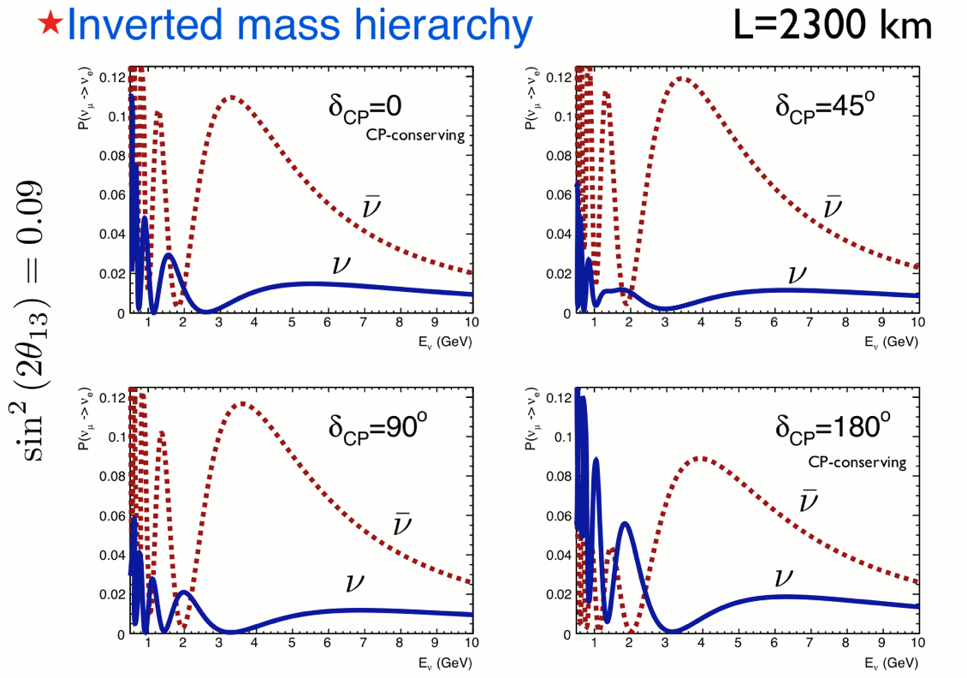
Going to Long Baselines

Slide 18
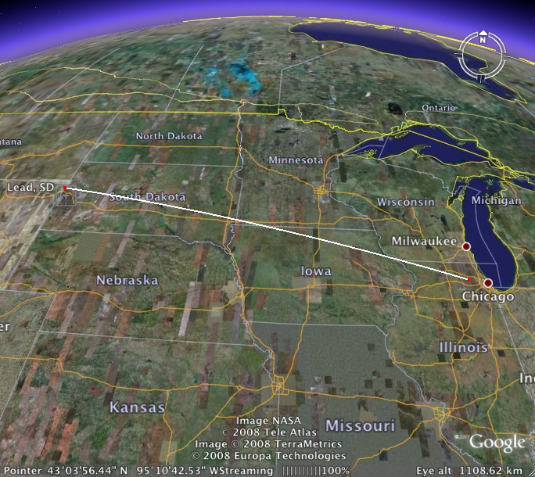

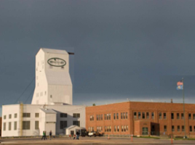
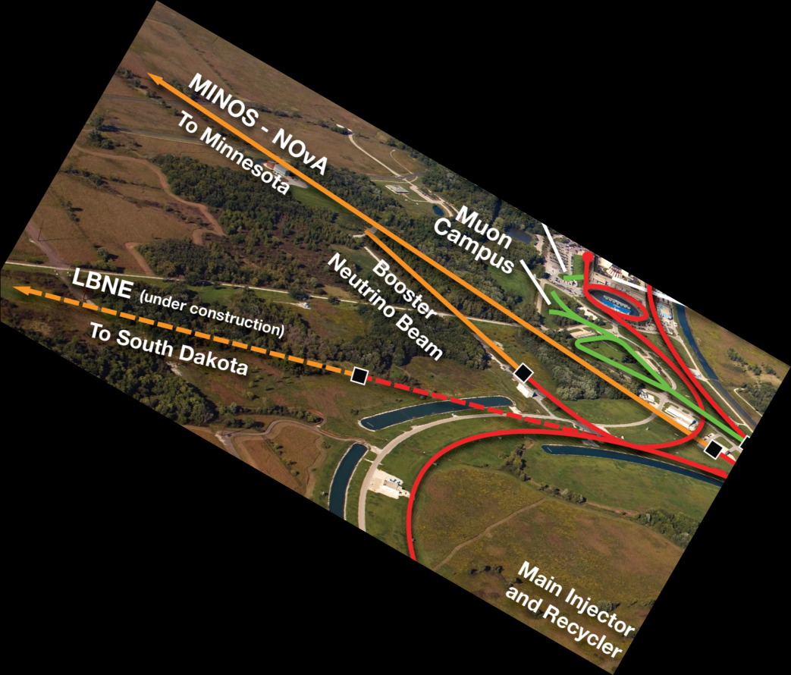

LBNE/F
ν
ν
1300 km
ν
ν
ν
ν
ν
A new neutrino beamline over 1300 km
Proton beam power assumption
  1.2 MW → 2.3 MW
A highly-capable near detector system
A ≥10 kt fiducial mass LAr TPC far detector underground at SURF
A cavern for a full 34 kt detector system

Slide 19
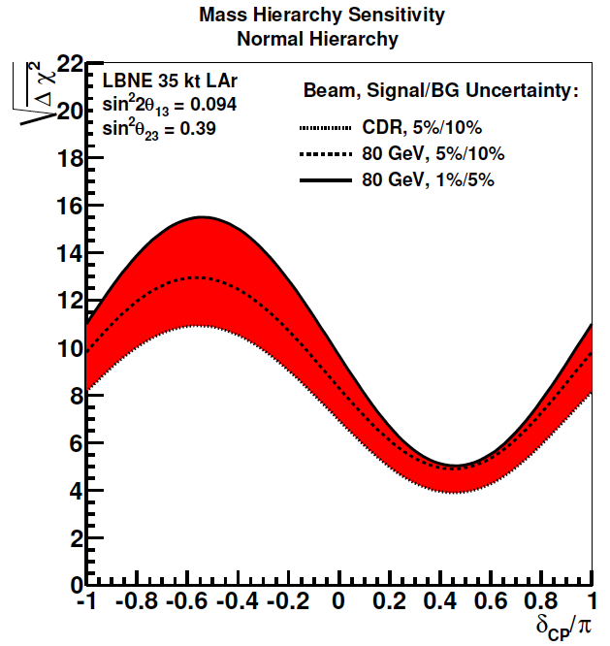
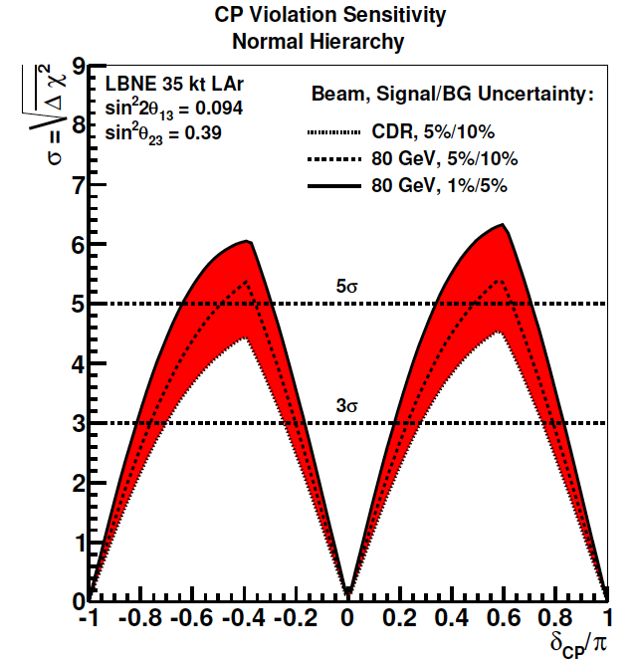
MH & CPV
Exposure 245 kt.MW.yr
(1.2 MW x (3ν+3ν) yr
CP Violation Sensitivity
Normal Hierarchy
Normal Hierarchy
Band is range of beam and
systematics assumptions
100%

Slide 20
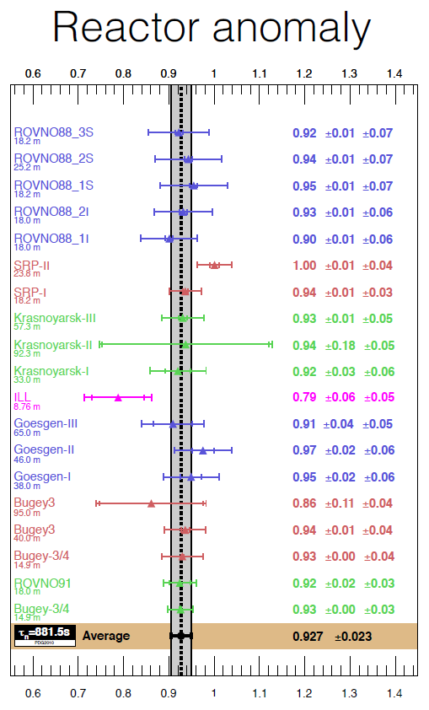
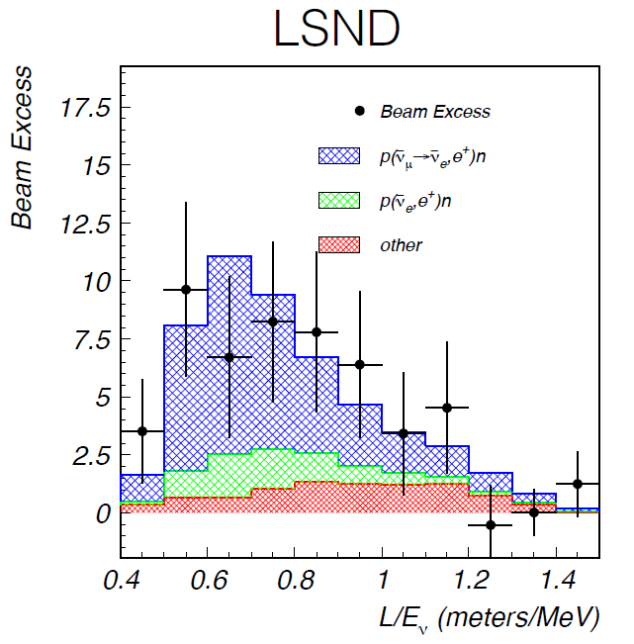
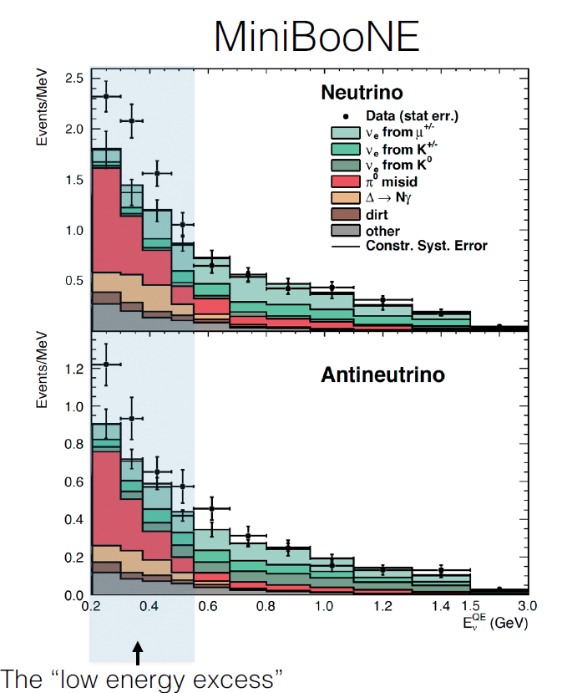
All is Fine?
Sterile Neutrinos

Slide 21
Steriles
Needs urgently
to be sorted out!

Slide 22
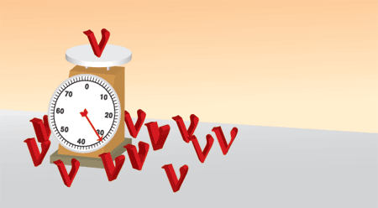
Absolute Mass

Slide 23
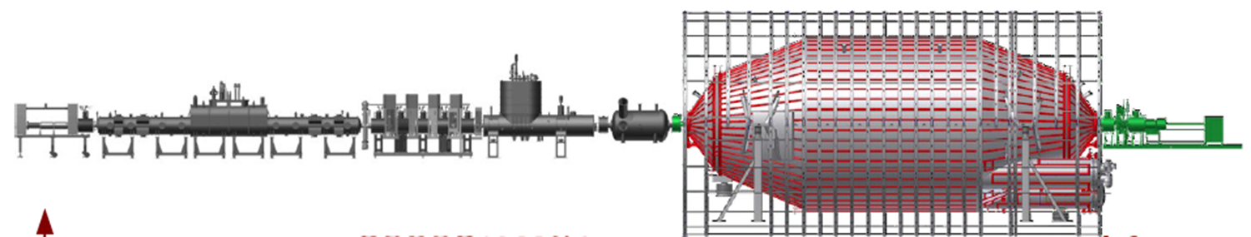
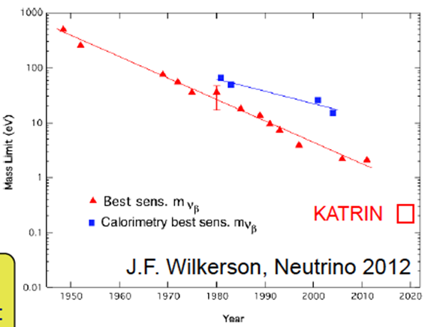
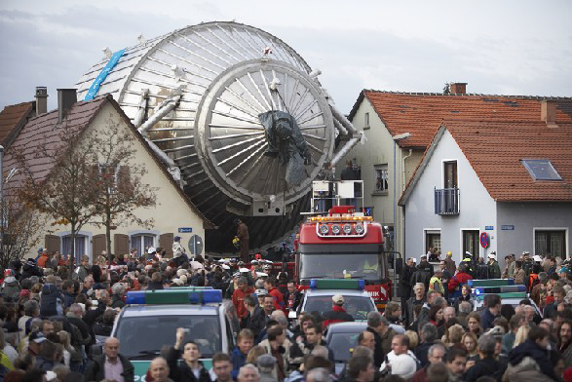
The Near Future

Slide 24
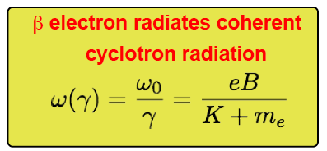
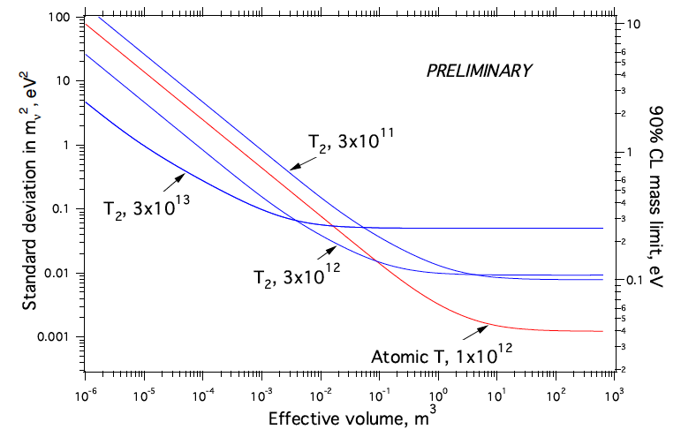
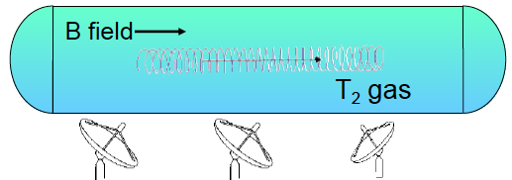
The Far Future
Project 8

Slide 25
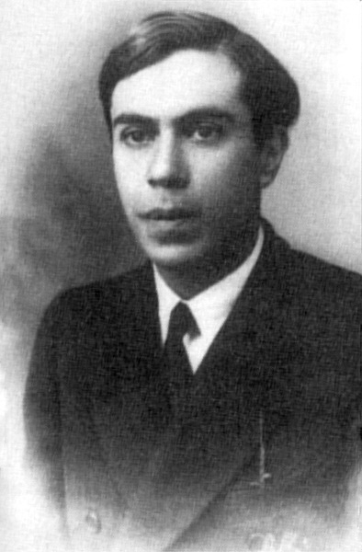
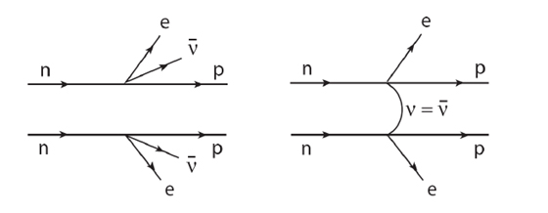
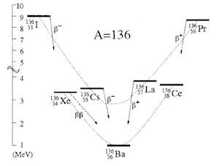

Ettore Majorana
Neutral spin ½ particles can be their own
anti-particles!
  2 neutrinos can annihilate each other
  Double Beta Decay
    With neutrinos
    Without neutrinos

Slide 26
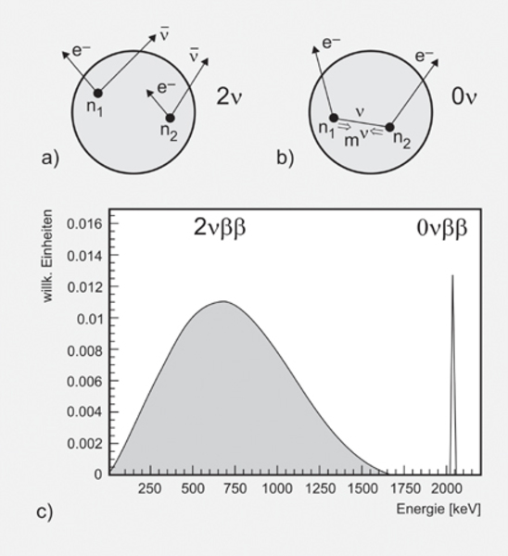
The Signature
The problems
  Isotope mass
  Energy resolution
  Radiological BG
  Radiological BG
  Radiological BG
  Radio …
  R…

Slide 27
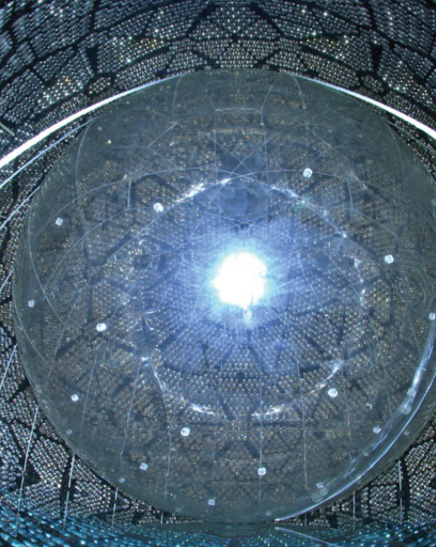


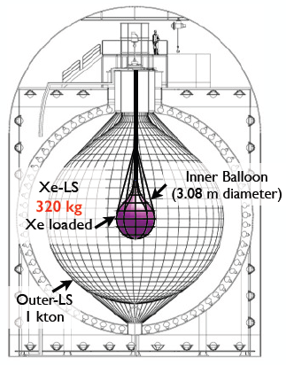
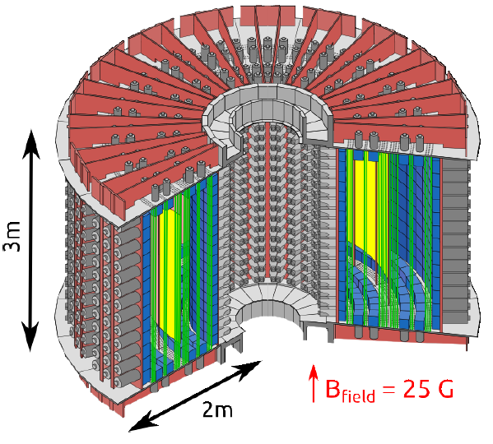









Some Experiments …

Slide 28

The Future?

Slide 29


Ton Scale Experiment
Highest natural abundance
Initially 0.3% loading
  800 kg of ¹³⁰ Te
Increase to 3%

Slide 30


Where to go!

Slide 31


Cosmology
m_{ν} = 0 eV
m_{ν} = 1 eV
m_{ν} = 7 eV
m_{ν} = 4 eV

Slide 32



Cosmic Microwave BG

Slide 33


Neutrinos & Cosmology
CMB
  fingerprint of early Universe evolution
Neutrinos
  Mass
    enhance structure formation
    more gravity
  N_{eff}
    Energy density of early Universe
    Expansion rate at given temparature

Slide 34

Summary

Slide 35
Summary
We know where we are!
But, where will we be in 20 years?
  Neutrino properties
  Neutrinos are Majorana
  Mass hierarchy is inverted
  Θ₂₃ is maximal
  CP is maximally violated
But Why?

Slide 36

Thank you for
your attention!
and before I forget:
The neutrino is
the new Higgs!

