Slide 1
Control System Considerations for ADS
EuCARD-2/MAX Accelerators for Accelerator Driven Systems Workshop, CERN, March 20-21, 2014
Klemen Žagar <klemen.zagar@cosylab.com>
Robert Modic <robert.modic@cosylab.com>
Mark Pleško <mark.plesko@cosylab.com>

Slide 2
High Availability
Fault tolerance and redundancy of the accelerator
  use of components far from their limits,
  parallel and serial redundancy of components,
  ability to repair failing section.
Control strategies for high availability
  Reliable components in the first place
  Redundant elements
  Protection systems without false positives
  Predicting faults before they occur
  Working around faulty equipment

Slide 3
Standard CS Architecture

Slide 4
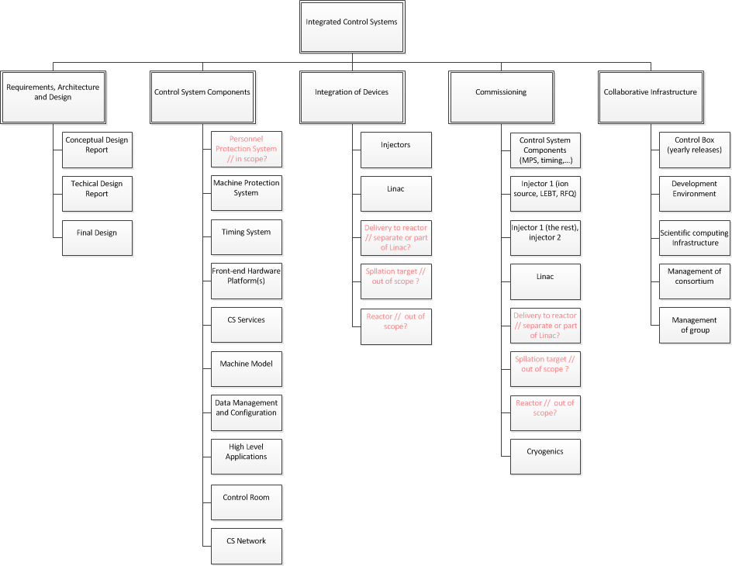
Planning: work breakdown

Slide 5
Hardware platform
Considerations:
  Maturity
  Performance
  Use in other facilities
  Obsolescence management
Today’s choices:
  VME [mature, nearing obsolescence]
  cPCI [suboptimal performance; cPCIe immature]
  PXI, PXIe [limited choice of vendors]
  μTCA/ATCA, μTCA.4 for physics
  [not much support from industry – yet]

Slide 6
Software Framework
We recommend EPICS as the control system infrastructure.
  Widely used in ACC community.
  Good community and commercial support.
  Significant reuse of existing components possible.
  Mature and proven technology.
  Hooks allow implementation of a redundancy scheme.

Slide 7
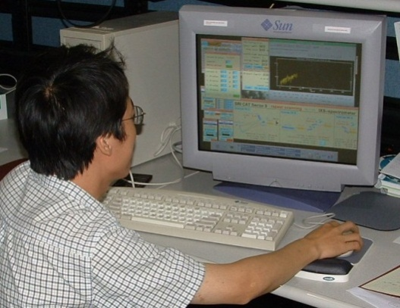
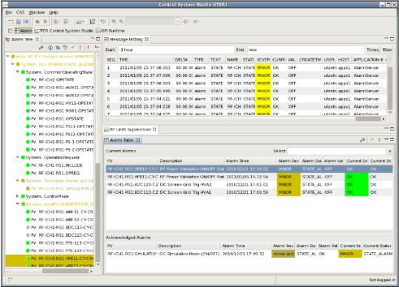
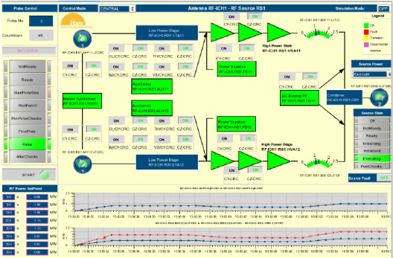
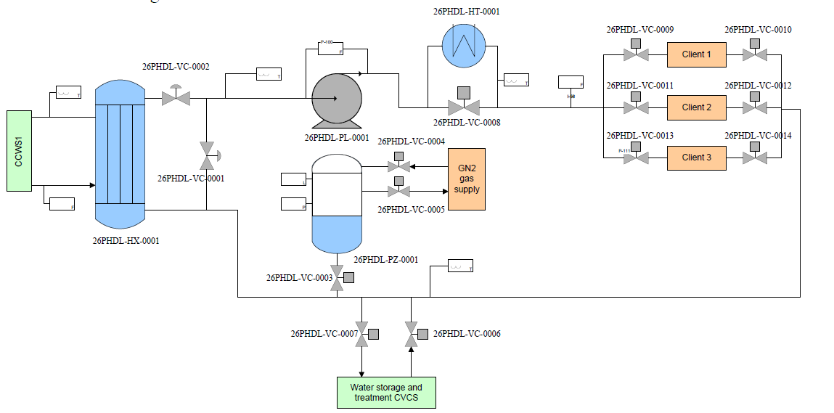

About EPICS
Channel Access Client
Channel Access Client
Channel Access Server
(IOC)
Sub-system
Process Variables:
CWS-PHTS-DLHT:VC1-FCVZ
Computer Interface
Flow
Control
Valve
CWS-PHTS-DLHT:VC1-FCVY1
CWS-PHTS-DLHT:VC1-FCVY2
Computer Interface
Computer Interface
Thermo-
meter
CWS-PHTS-DLHT:MT2-TT

Slide 8
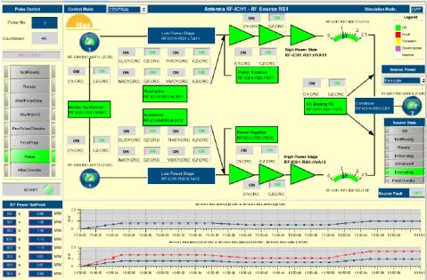
EPICS Data Flow
The Channel Access network communication protocol.
  UDP for discovery.
  TCP for data exchange.
“connection request” or “search request”
“get” or
“caGet”
“put” or
“caPut”
“set a monitor”
Who has a PV named
“CWS-PHTS-DLHT:TTSPTARGET”?
Change its value to 30.5
Notify me when the value changes
Channel Access Client
What is its value?
CA Client
CA Server
Channel Access Server
I do.
25.5 degC
OK, it is now 30.5
It is now 20.5 degC
It is now 10.3 degC
It is now 9.2 degC
Process Variables:
CWS-PHTS-DLHT:VC1-FCVZ
CWS-PHTS-DLHT:VC1-FCVY1
CWS-PHTS-DLHT:VC1-FCVY2
CWS-PHTS-DLHT:TTSPTARGET
“put complete”
“post an event”
or
“post a monitor”

Slide 9
EPICS and redundancy
One of the IOCs is a primary, and one is a backup.
Primary IOC sends all state changes (e.g., changes of values) to the backup to keep it in sync.
if heartbeat fails, backup node takes over, in the same state where the primary left off.

Slide 10
Equipment interfaces
How to integrate equipment:
Redundancy?

Slide 11
Use And Integration Of PLCs
Logic neither complex nor very fast (>10ms) ⇒ robust.
Used in off-the-shelf industrial systems
  Cryo plant, vacuum, building automation/HVAC, …
Used for personnel protection (interlocks).

Slide 12
Industrial Redundant Systems
PLCs
  implement redundancy in the CPU and with redundant hot swappable IO modules.
Network switches
  Predefining routing tables on nodes and switches
  This way communication can resume more quickly after switchover

Slide 13
Machine protection system
Multiple levels of protection:
  Hardwired protection system.
  Required for nuclear safety.
  Personnel protection system.
  Machine/investment protection.
  Quick reaction to faults. Graceful shutdown.
The first two are outside the scope of control system.
  But can be integrated with it (e.g., via 4-20mA signal interface).
  MPS issues a mitigation action when a problem is detected.
Topology:

Slide 14
Machine Protection is Redundant to Control System

Slide 15
Machine protection system

Slide 16
Predictive diagnostics
Statistical analysis of archived data (e.g., trends) to identify components nearing a fault.
Model and detailed monitoring of subsystems.
  E.g., monitoring of vibrations in mechanical subsystems.
Uses:
  Preventive maintenance planning.
  Preventively taking a component off-line.

Slide 17
Virtual accelerator
Simulator of the machine.
Uses real-time configuration data of beamline elements to simulate beam characteristics.
Useful to analyze failure scenarios.
An R&D topic: automatic reconfiguration in case of a subsystem failure.

Slide 18
Key recommendations
Initiate collaboration on control system with similar projects.
Introduce a naming convention early in the project.
Standardize and define control system interfaces for all delivered components and devices at the time of procurement.
Equip RFQ@UCL with fully functional and stable control system for its operation.
Foresee time and resources for reliability and availability investigation on RFQ@UCL.
Define the scope of the control system well – if subsystems don’t have a control system, foresee that it needs to be developed.

Slide 19
Questions

Slide 20
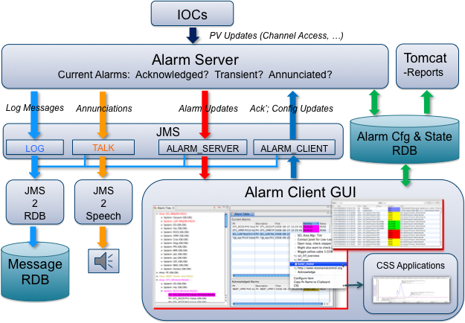
Alarms
Supervision of alarm state.
Guides operator in reacting to alarms.
E.g., BEAST.
  Part of the Control System Studio suite.

Slide 21
Archiving
Storing values of process variables (PVs) through time.
Usage:
  Monitoring (and analysis) of (mid-/long-)term trends.
  Predictive diagnostics.
  Comparison of performance at various times.
E.g., BEAUTY.
  Part of Control System Studio.
Not a high-performance
scientific archiving tool!

Slide 22
Timing system

Slide 23
Equipment interfaces
The Control Box

Slide 24
ITER CODAC
Packaging of control system software.
  Operating system.
  EPICS.
  User interface tools.
In addition, ITER-specific tools
  E.g., Self Description Data toolkit for providing meta-data and development of “plant system instrumentation & control”.
Can be used elsewhere as a baseline
  E.g., ESS.

