Slide 1

Long-baseline Neutrino Oscillations
Status and Prospects
Alfons Weber
University of Oxford & STFC/RAL
NuFact 2014
Glasgow, Scotland & UK

Slide 2
Content
What we try to do – the physics
The beams
  On- and off- axis
The experiments
  MINOS(+), NOvA, T2K, Opera
The results
  Disappearing neutrinos
  Appearing neutrinos
Further prospects

Slide 3
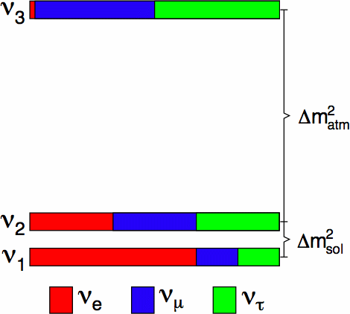
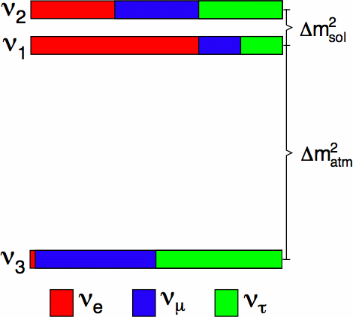
What we try to do
Open questions:
Normal Hierarchy or Inverted Hierarchy?
Phys. Rev. D 89, 093018
F. Capozzi, G. L. Fogli, E. Lisi, A. Marrone,
D. Montanino, and A. Palazzo

Slide 4
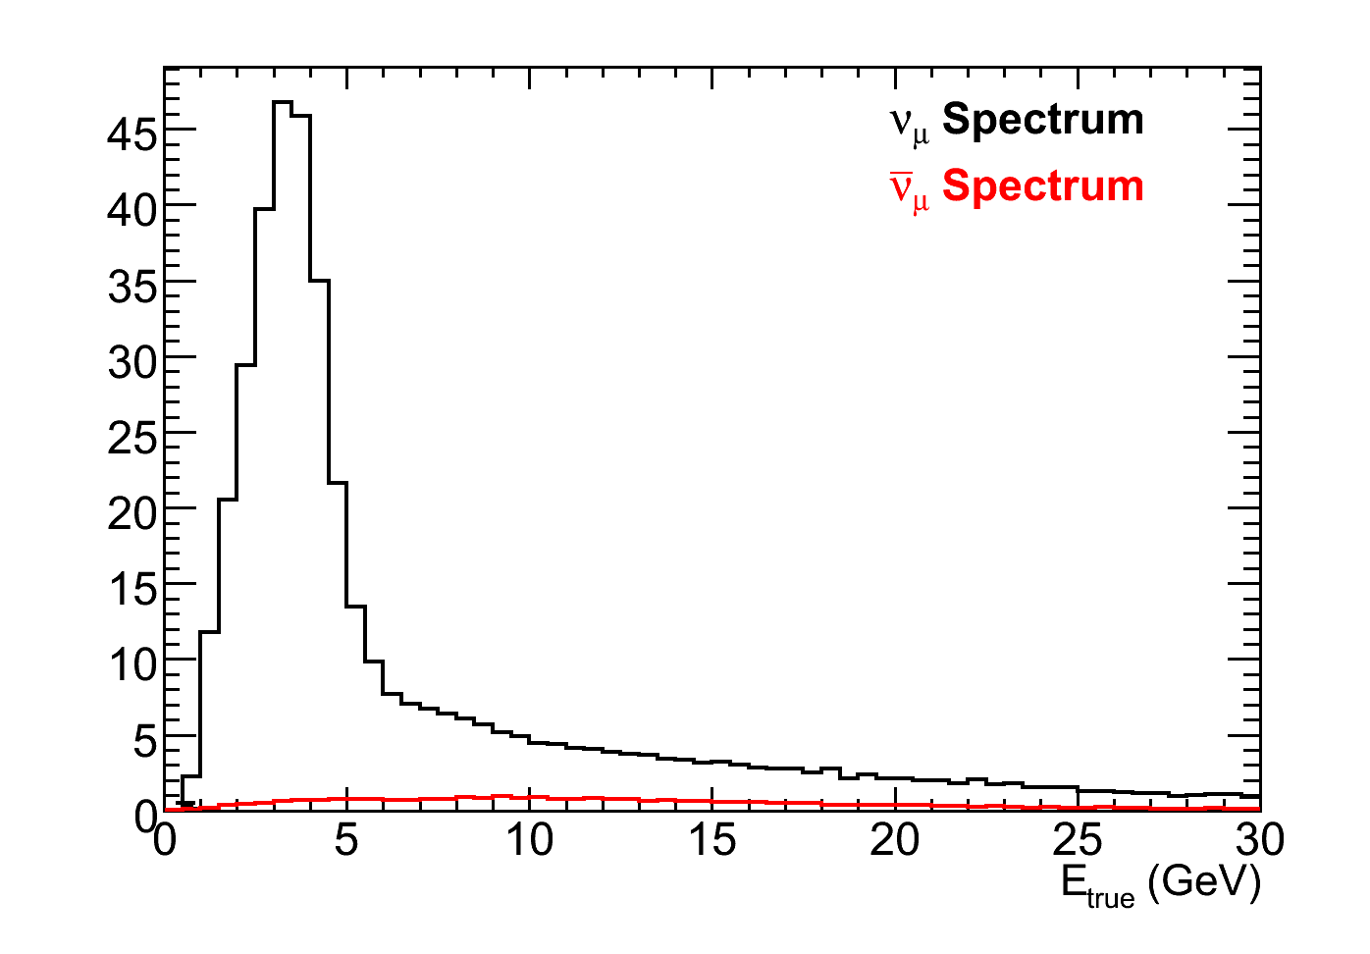
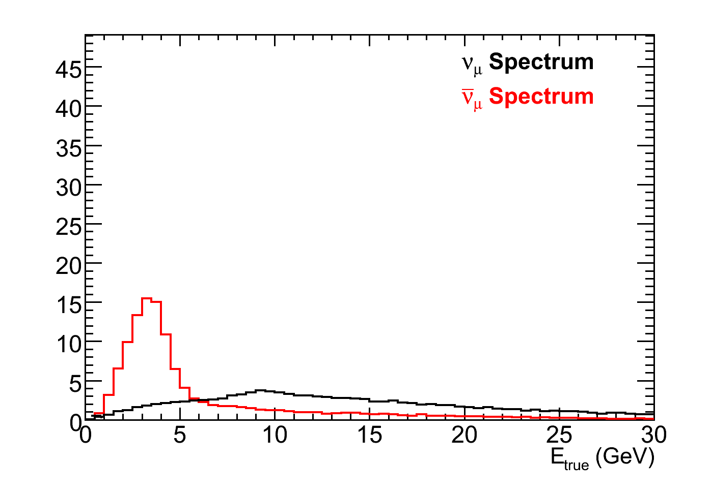
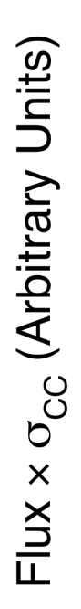
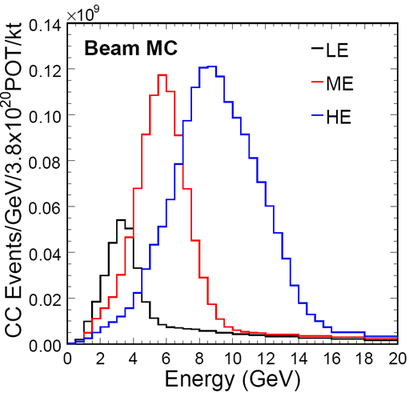
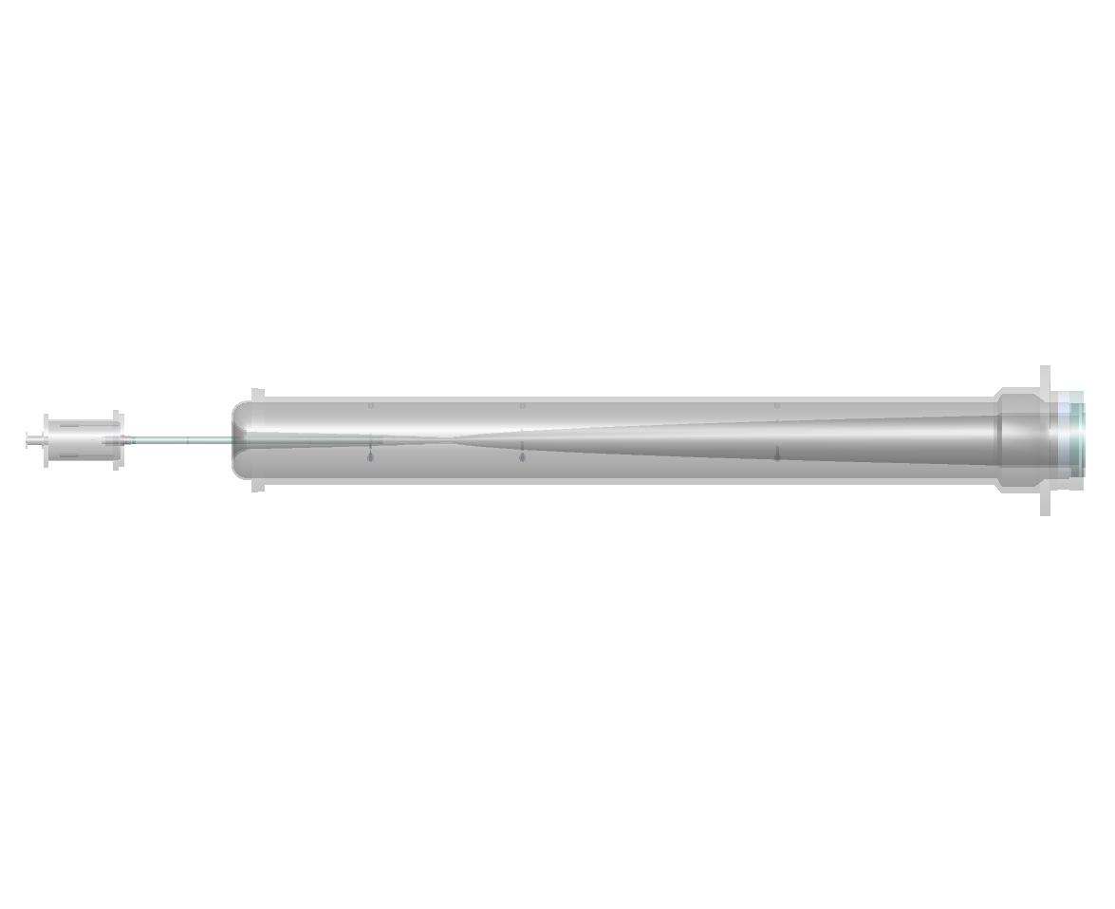
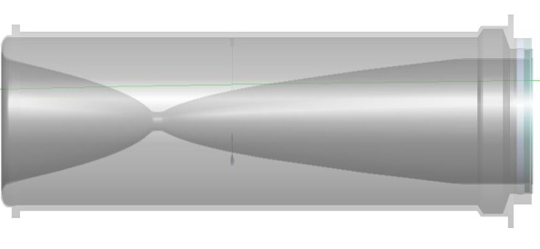
Neutrino Production
Example NuMI @FNAL
Neutrino mode
Horns focus π⁺, K⁺
Antineutrino mode
Horns focus π⁻, K⁻
Monte Carlo
Monte Carlo
Target
Focusing Horns
Decay Pipe
π⁺
2 m
ν_{μ}
protons
ν_{μ}
π⁻
15 m
30 m
675 m

Slide 5
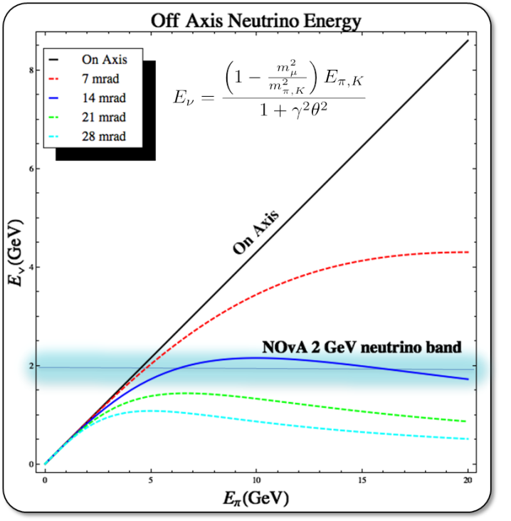
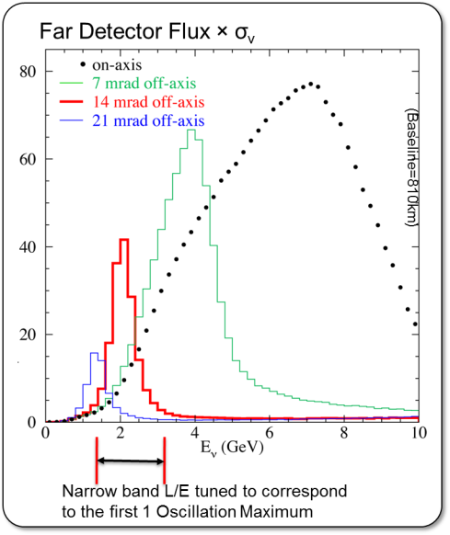

Off-Axis Beams
Creating a narrow band beam using relativist kinematics

Slide 6
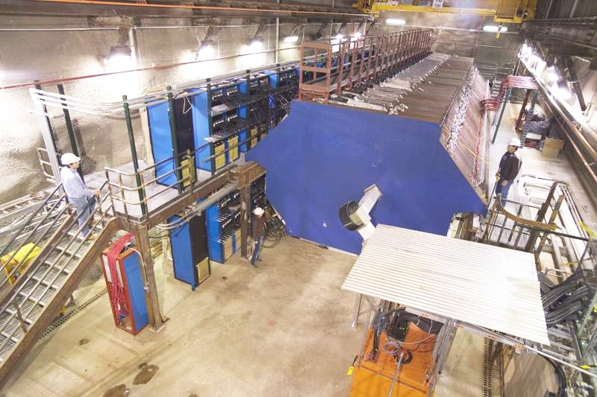
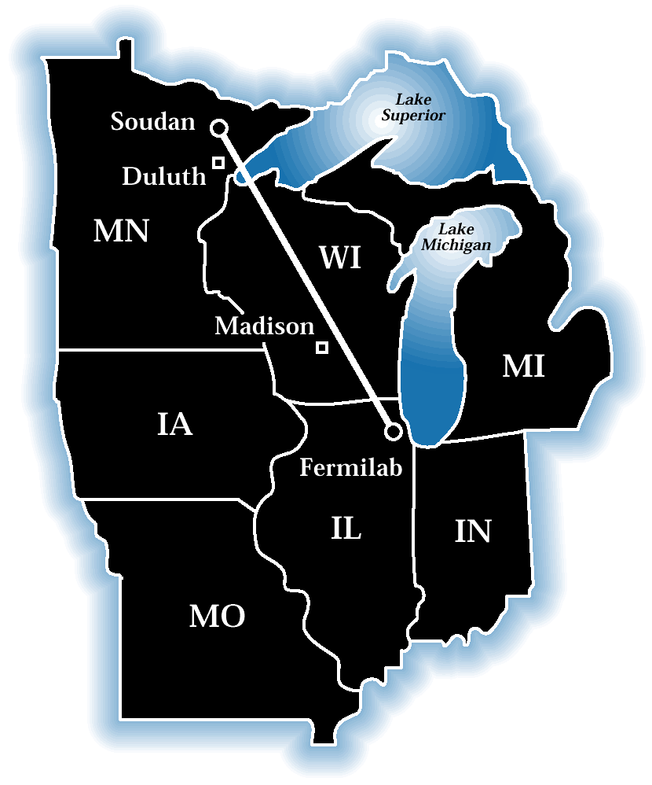
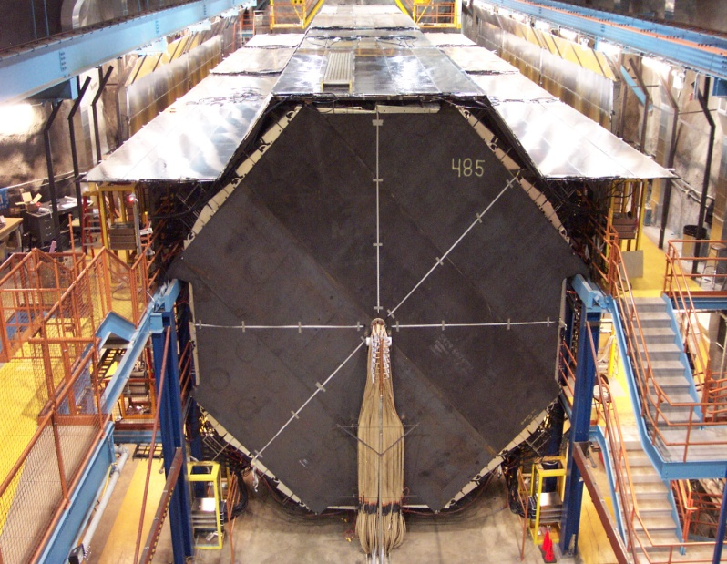
MINOS/MINOS+
alternating layers of steel plates and scintillator strips in a ~1.3 T toroidal magnetic field
FAR
NEAR
735 km from the target
5.4 kilotons
8 m tall planes
486 planes (30 m)
700 m underground
Few neutrino interactions/day
1 km from the target
1 kiloton
~4 m tall planes
282 planes (15 m)
100 m underground
Few neutrino interactions/spill

Slide 7
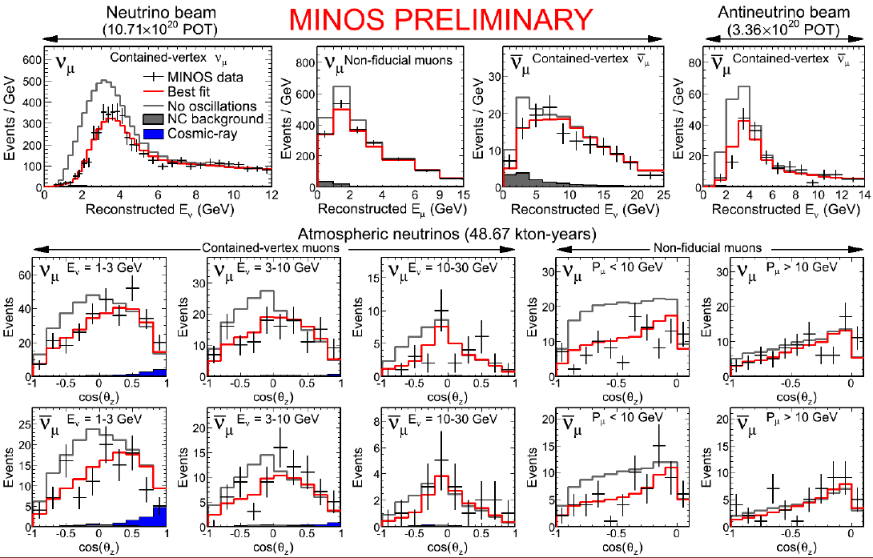
MINOS Final Results

Slide 8
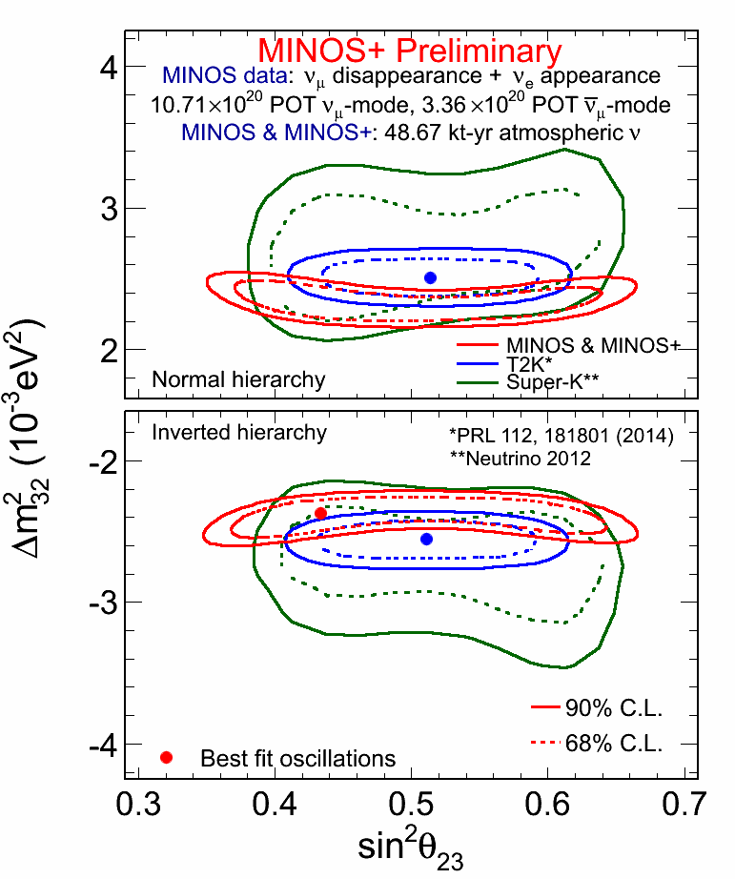
MINOS+ Results

Slide 9
MINOS+ Reach

Slide 10
MINOS Sterile Search

Slide 11
MINOS Sterile (ii)

Slide 12
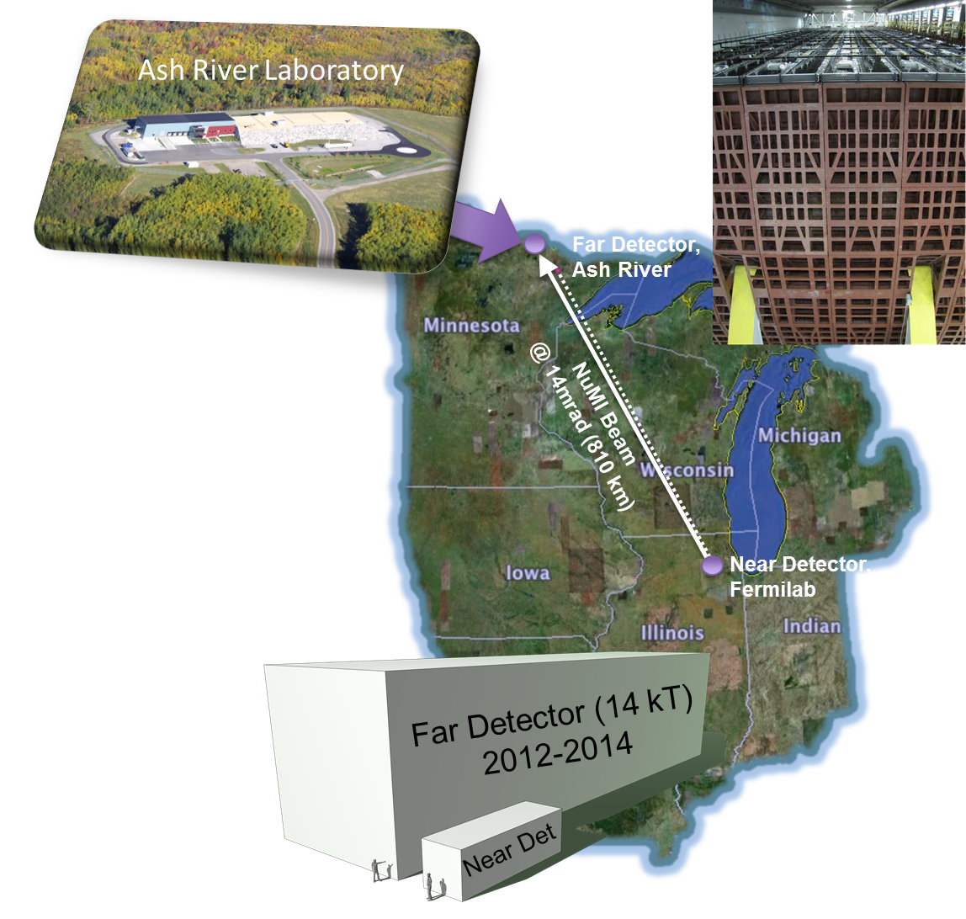

NOvA

Slide 13
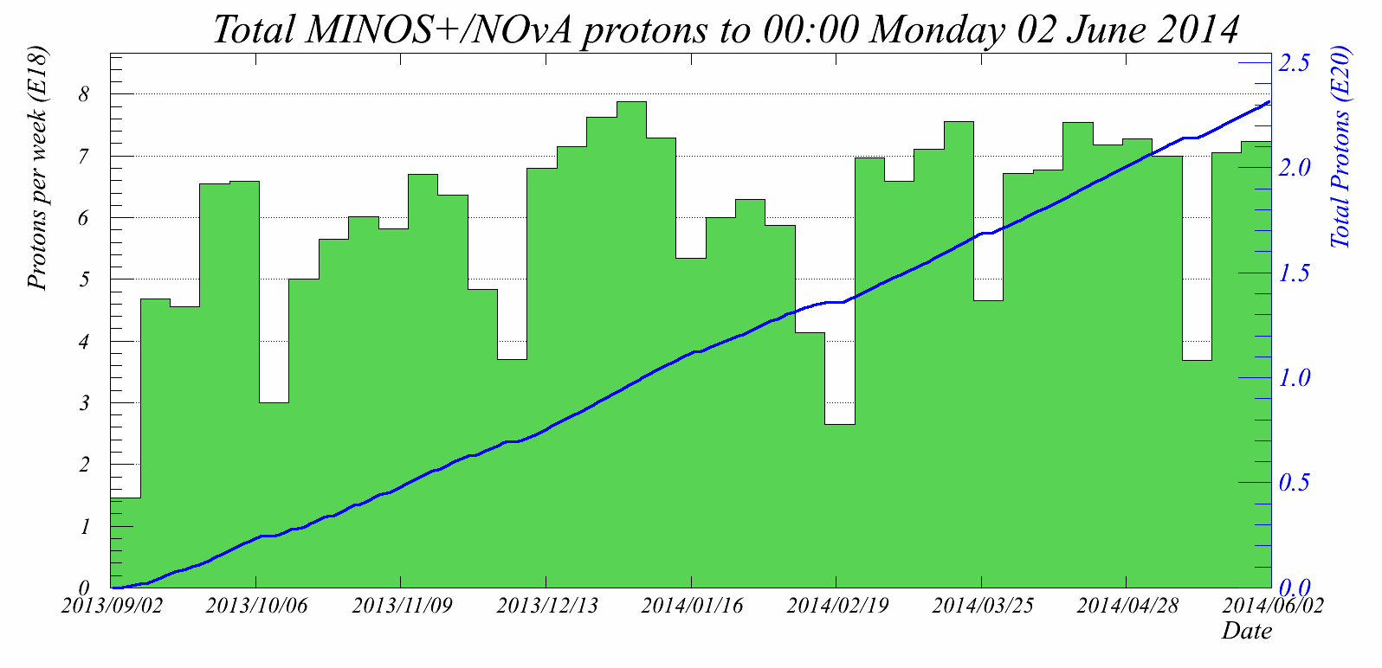
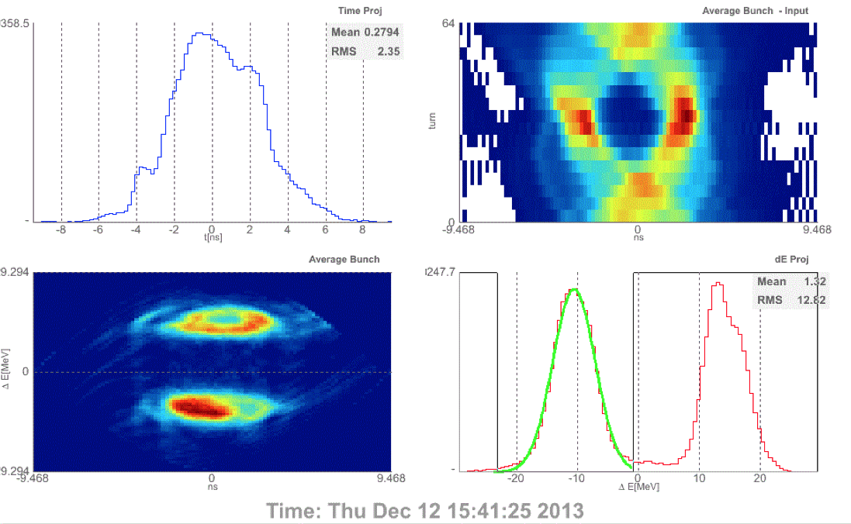
NuMI Upgrade
Major upgrades to the accelerator complex to double beam power
Designed to provide 700 kW
Average beam power being delivered ～280 kW
Ramp up to 500 kW through end of 2014
2.4E20 PoT Delivered since August 2013
Increase the spill repetition rate from 2.1 ➙ 1.33 s/spill
  Recycler commissioning in progress
  Operating in mixed mode 1.67/1.33s
PoT to NO𝜈A
Slip Stacking at Recycler to Main Injector Transfer
Bunch orbits in main injector (64 turn average)
Reconstructed beam profile at Recycler ➙MI Transfer

Slide 14
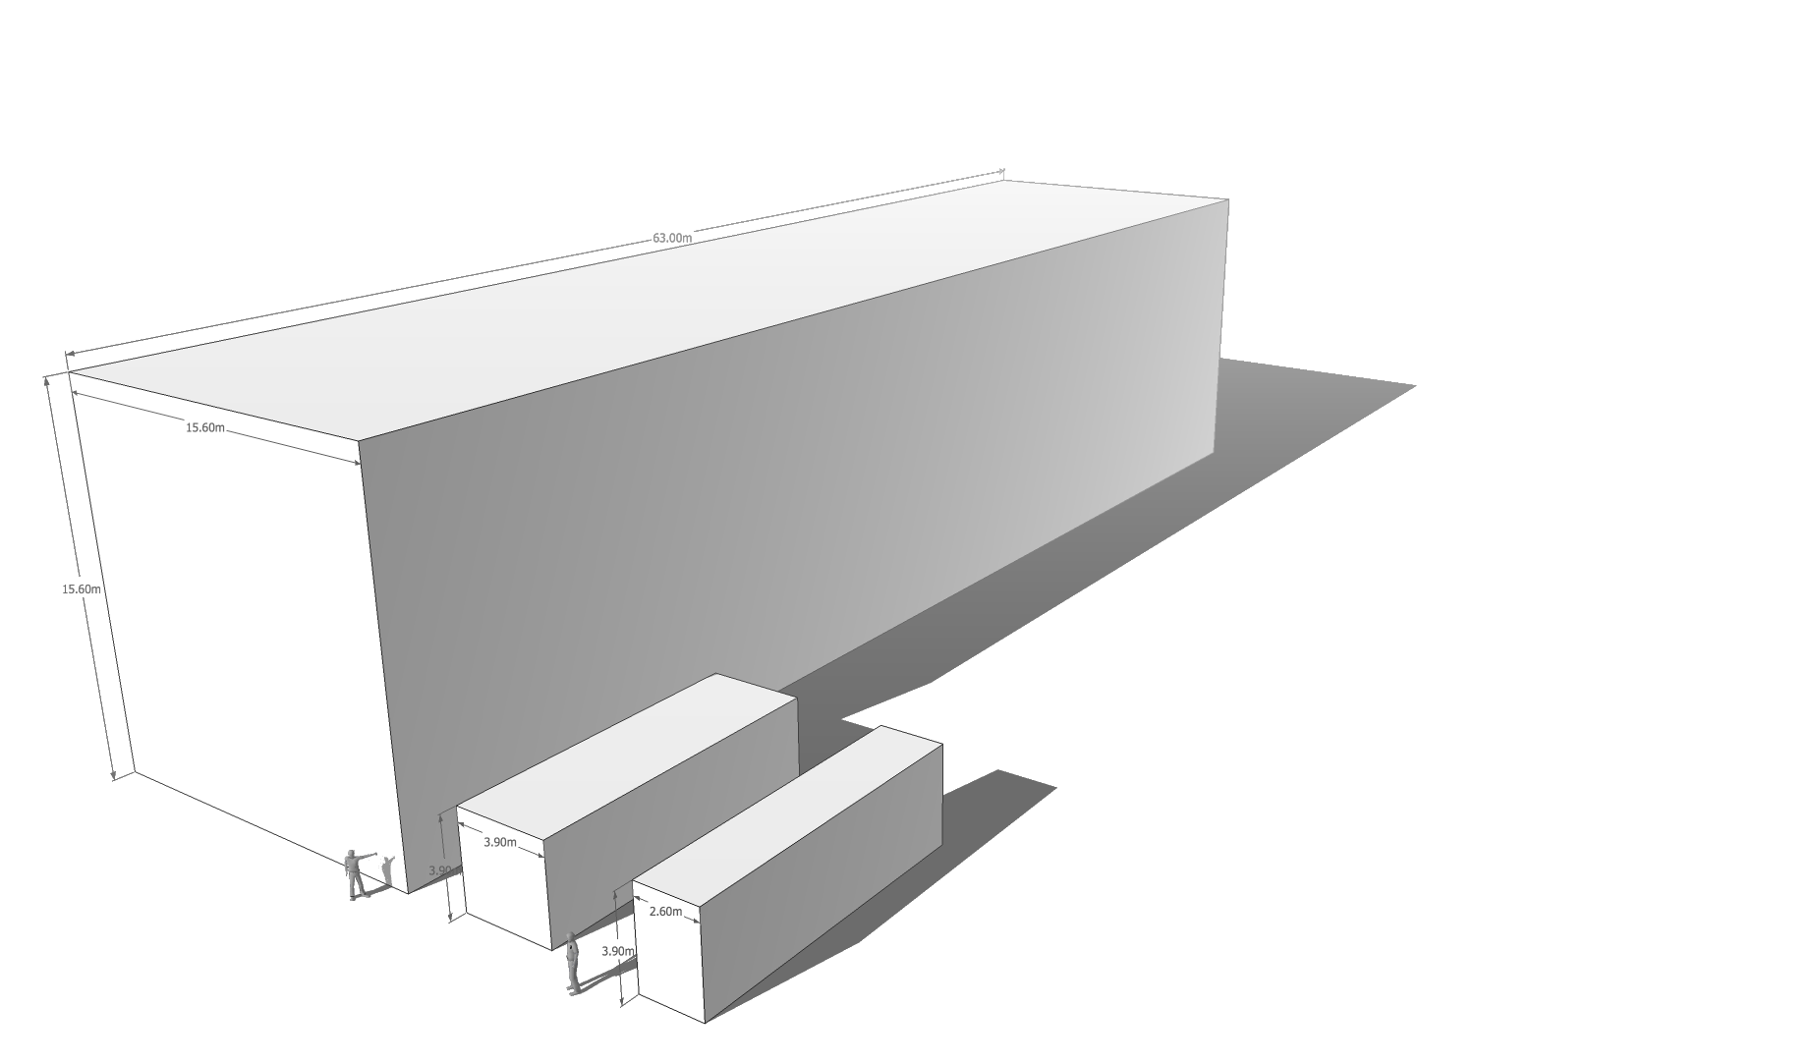
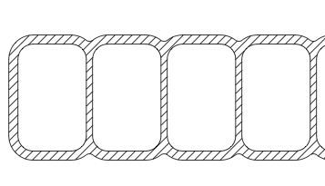
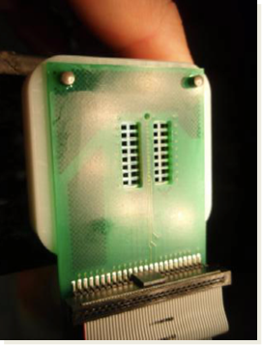
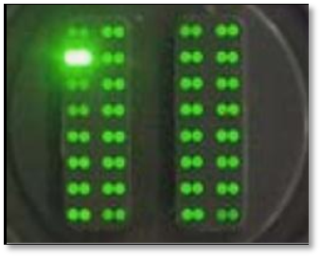
NOvA Detector
Single Cell
Far Detector
Surface Detector
14 kt “Totally Active”, Low Z, Range Stack/Calorimeter
Liquid Scintillator filled PVC
896 alternating X-Y planes
Optimized for EM shower reconstruction & muon tracking, X₀ ≈40cm, R_{m}≈11cm
Dims: 53x53x180 ft
“Largest Plastic Structure built by man”
Started Operations May 2013
First Beam Aug 2013
Completed April 2014
Far Detector
To APD Readout
Scintillation Light
Near
Proto
15.5m
High reflectivity PVC extrusion (16 cells/extrusion)
Particle Trajectory
Waveshifting
Fiber Loop
3.9cm
6.6cm
0.7 mm waveshifting Fiber readout (double end)

Slide 15
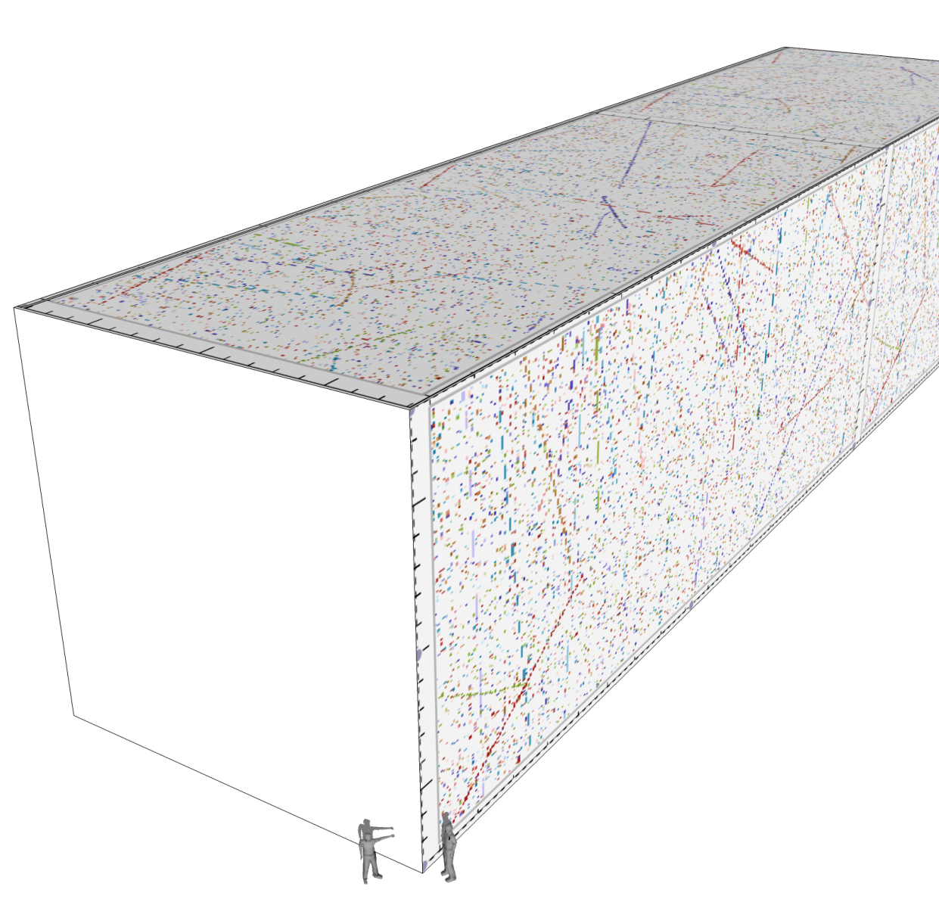
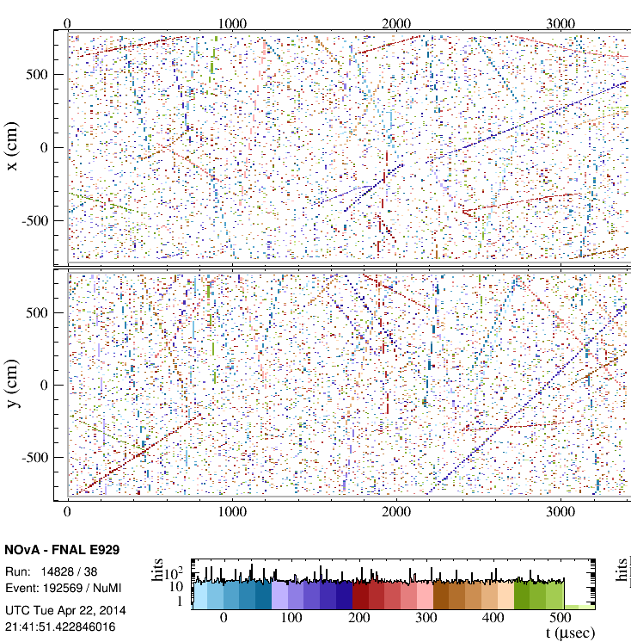
NOvA Event(s)
Beam Direction
DAQ is free running
Deadtime-less
Beam trigger
Full data driven trigger system

Slide 16
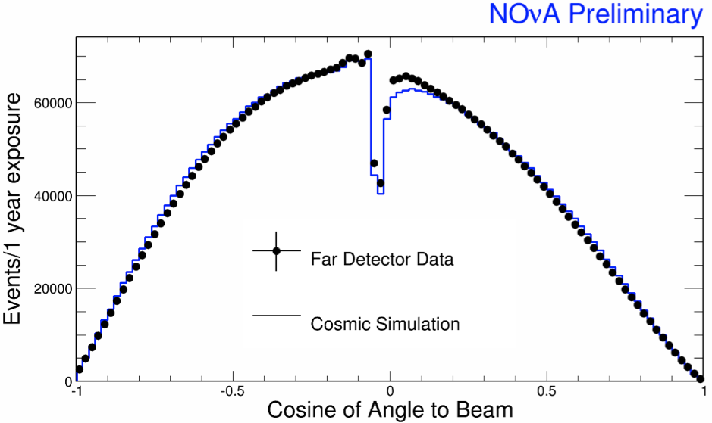
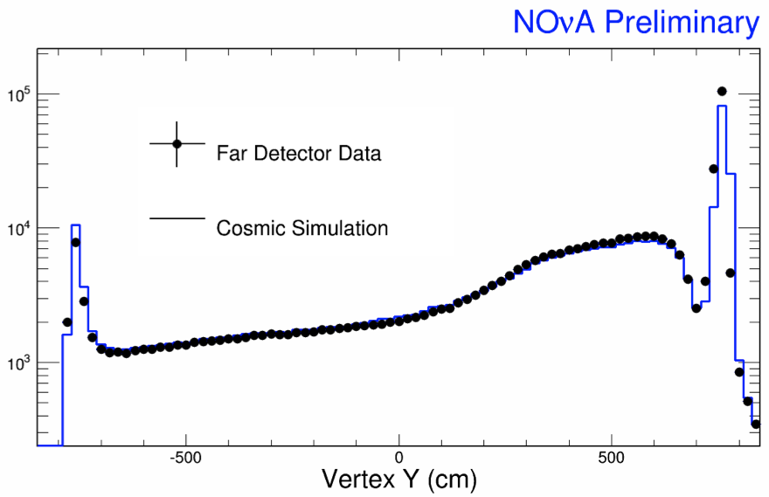
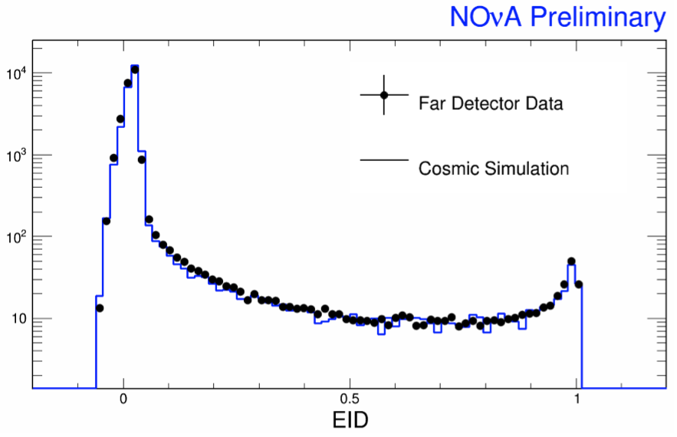
Cosmic Data

Slide 17
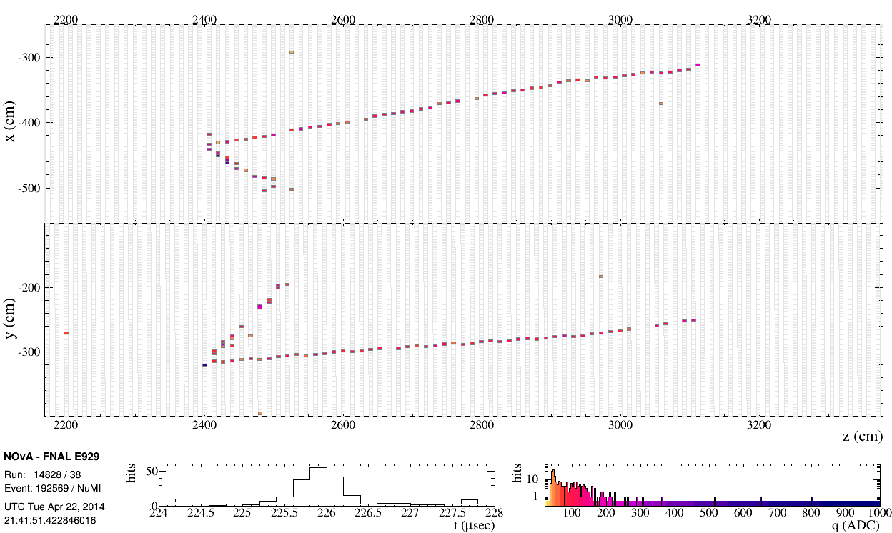
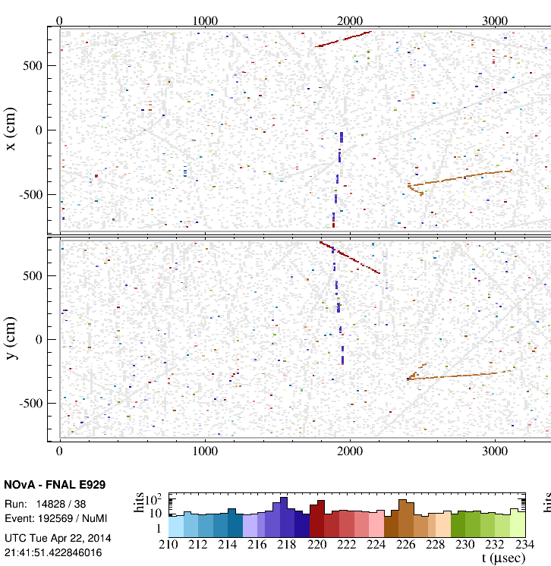
Muon Neutrino Candidate
𝜈
𝜈
Spectator
Cosmic Rays

Slide 18
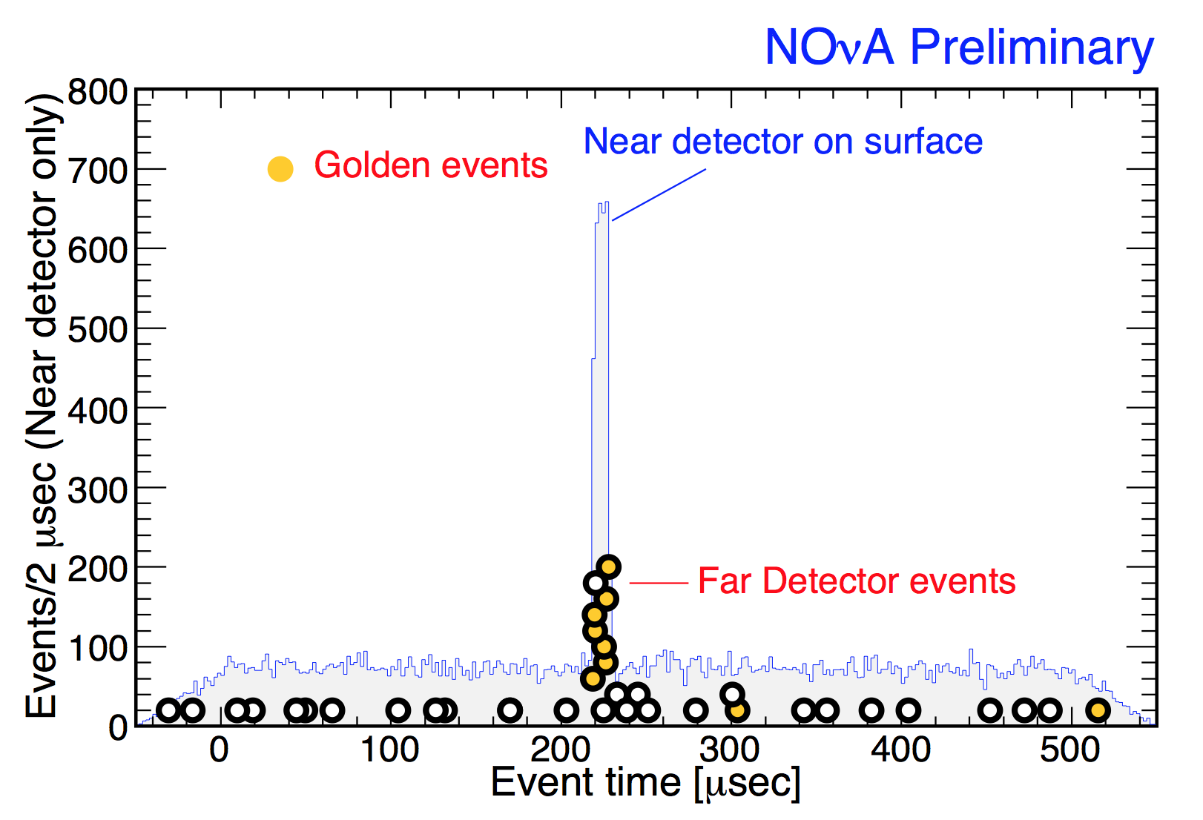
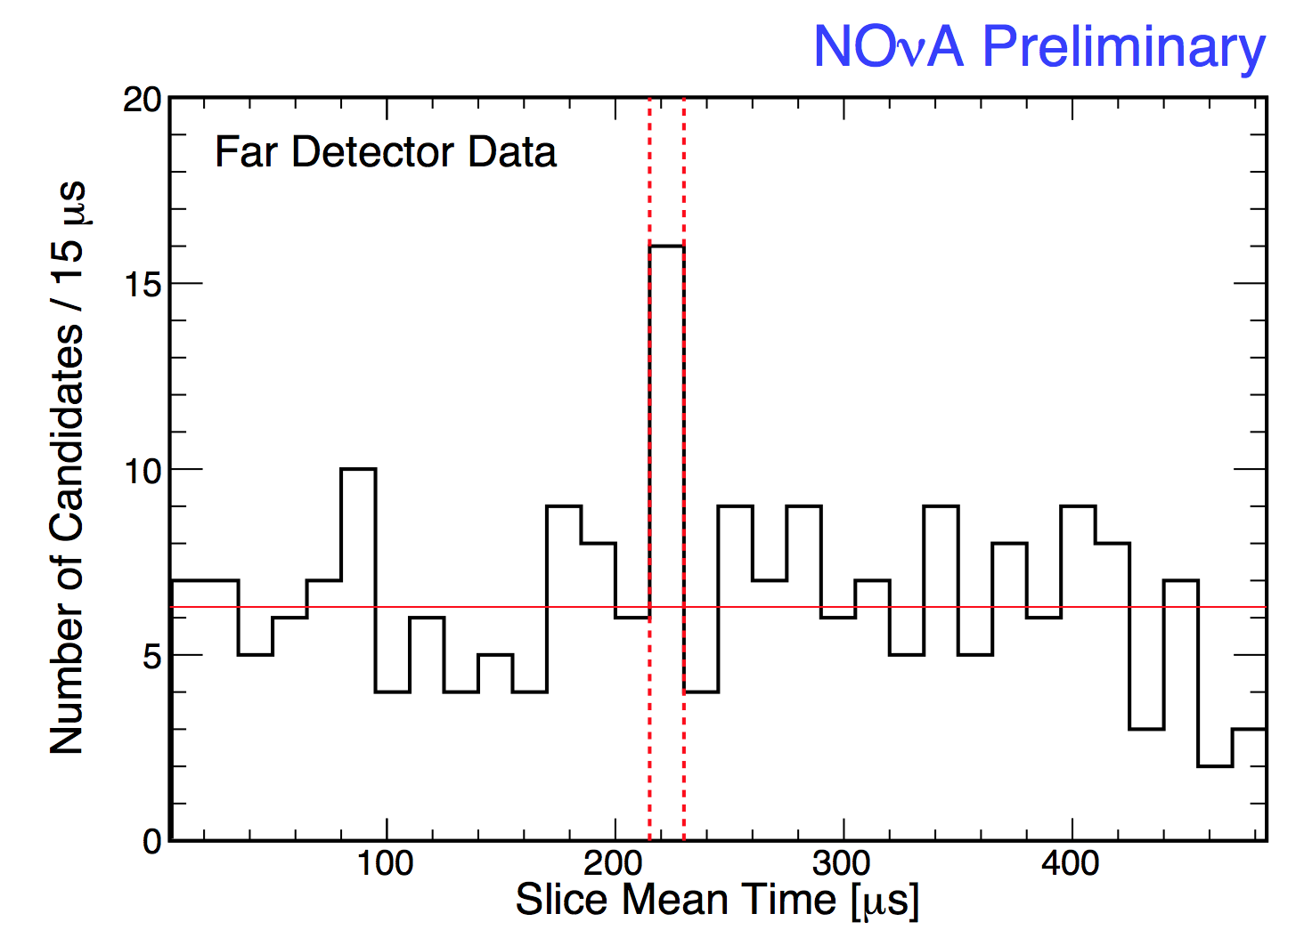
FD Events
Neutrino Candidate Events
Rock Muon Activity
Trigger Time T₀
(flight time corrected)

Slide 19
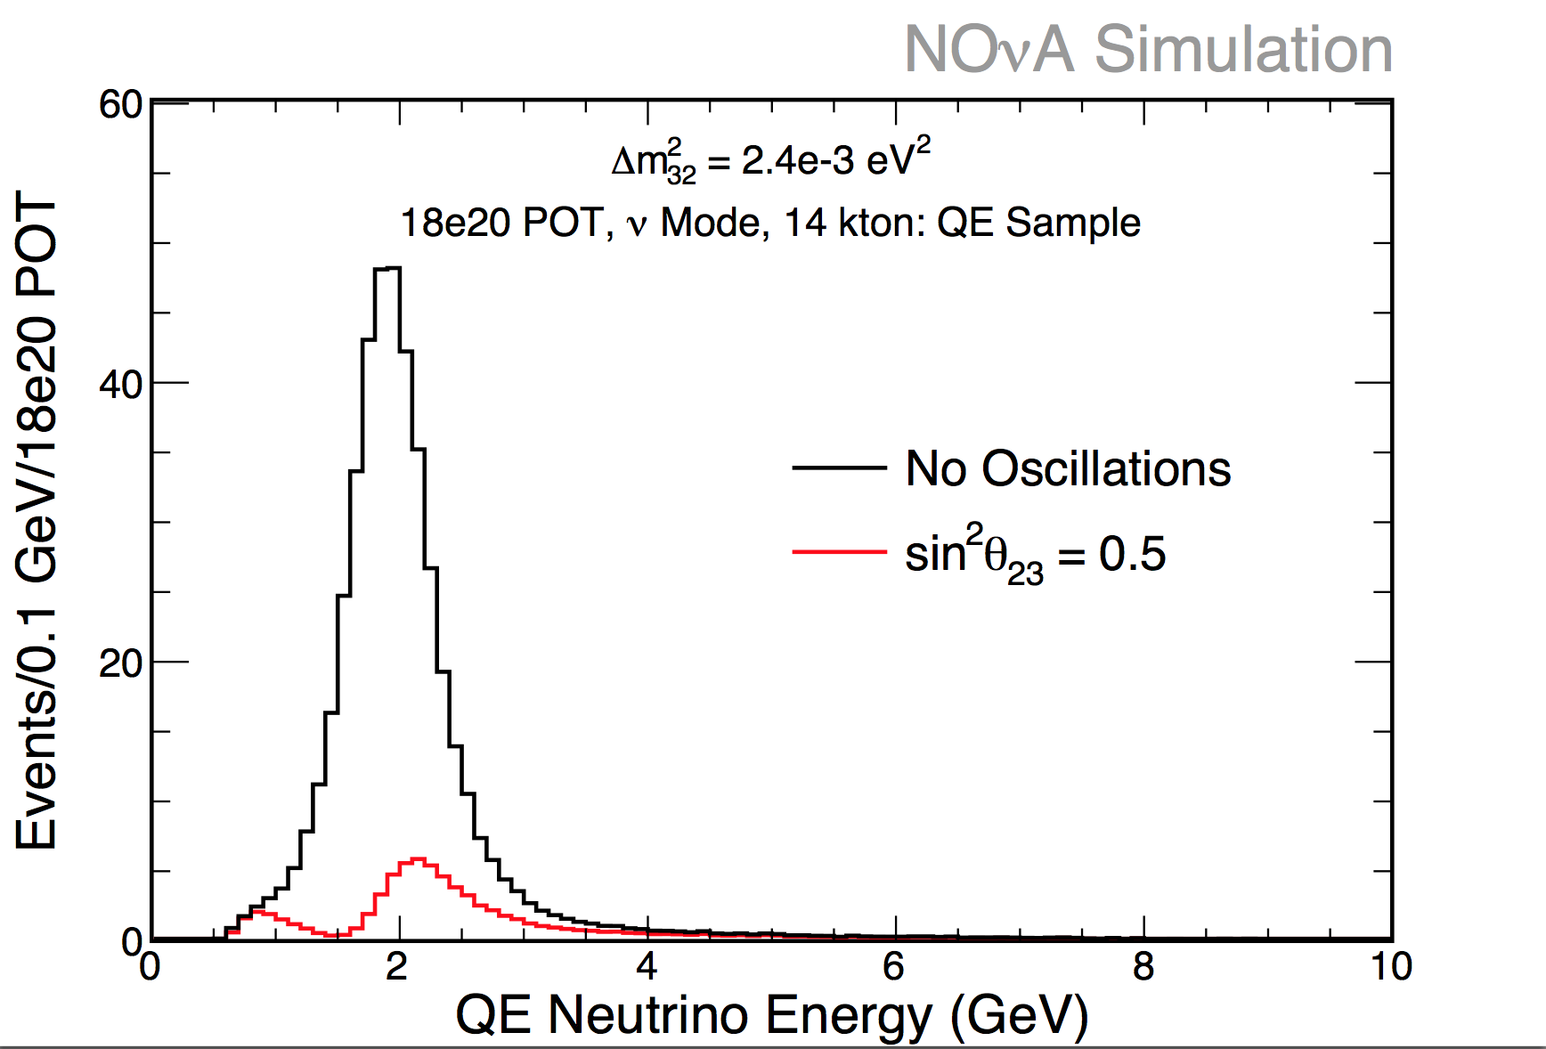
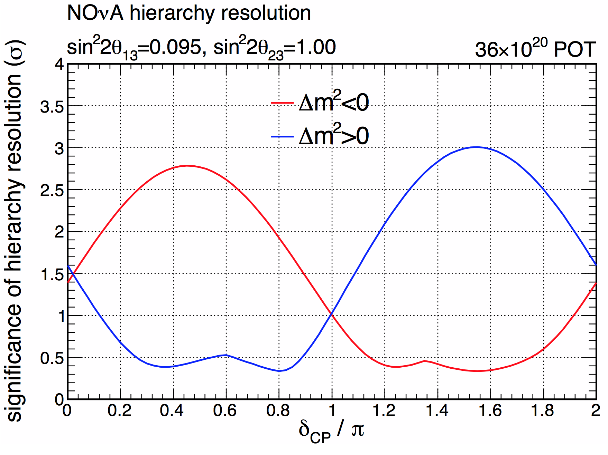
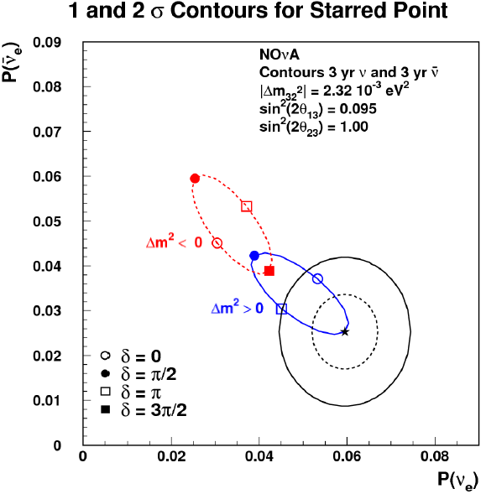
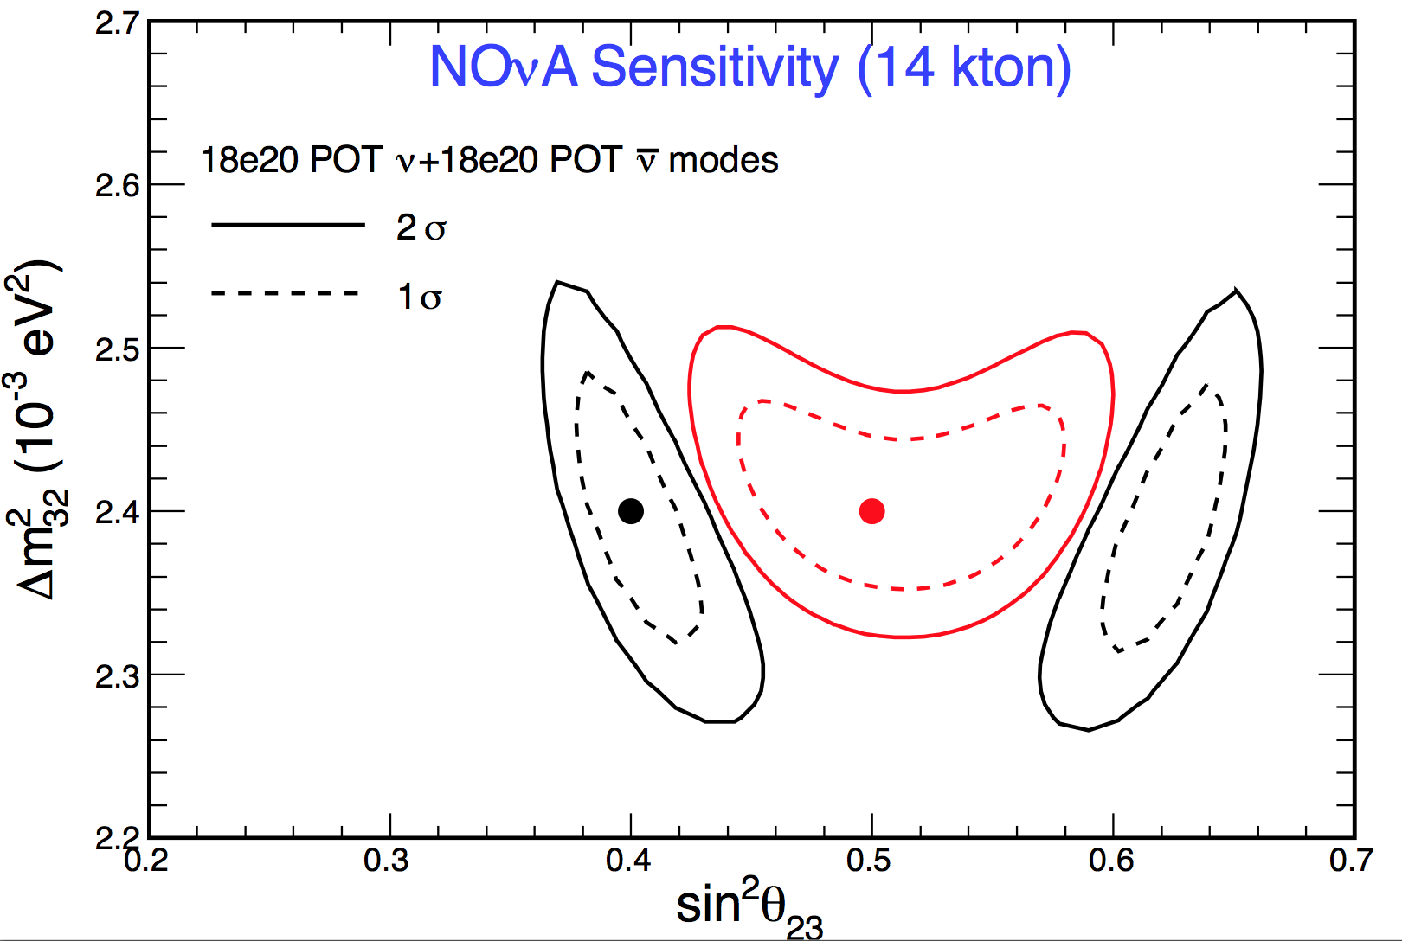
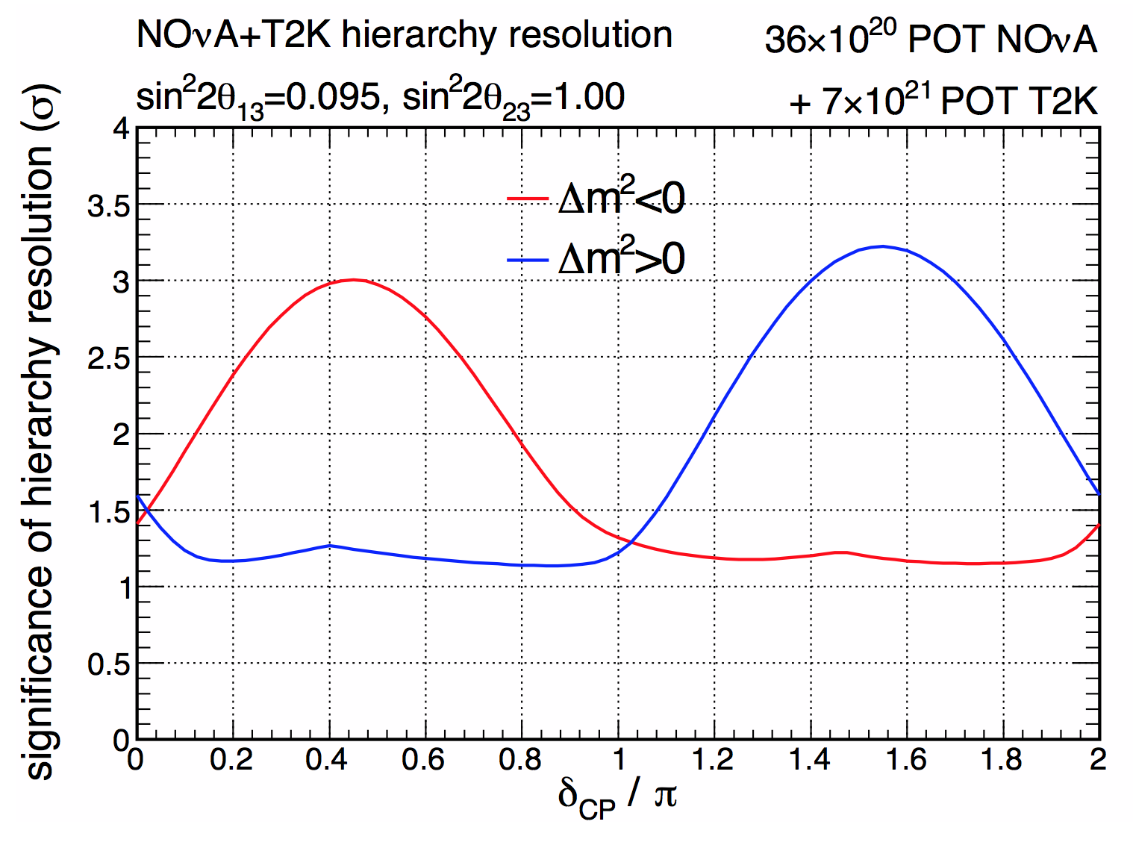
Sensitivity
Run with muon
  neutrinos
  anti-neutrinos
Measure
  Disappearance
  Appearance

Slide 20
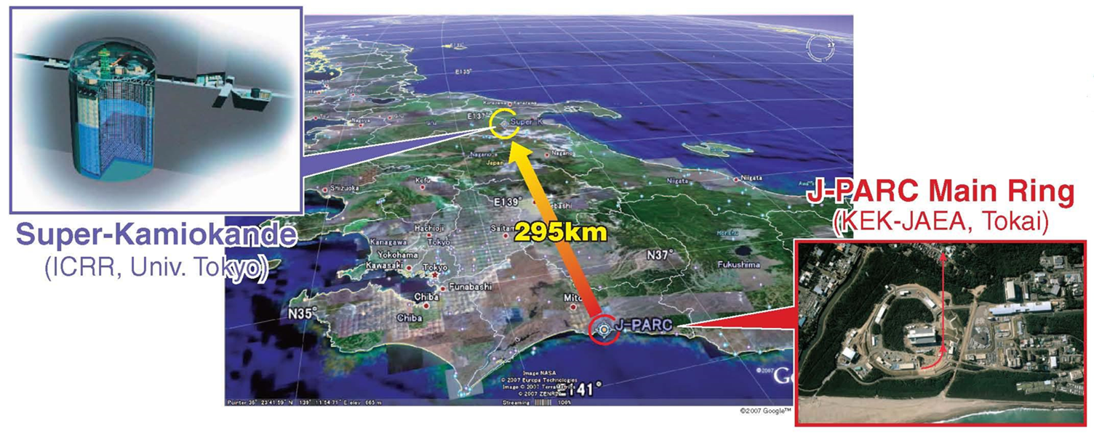
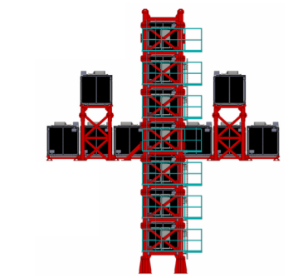
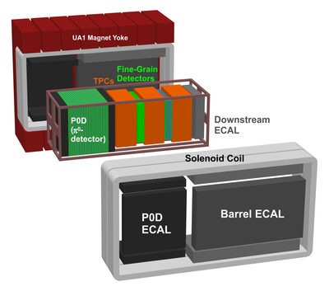
T2K Experiment
Tokai-to-Kamioka Experiment
  2.5 deg off-axis narrow band beam
  220+ kW beam power
  40 kton WC far detector

Slide 21
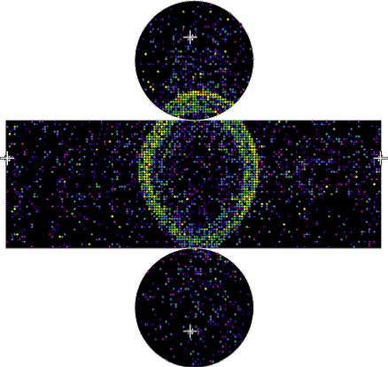
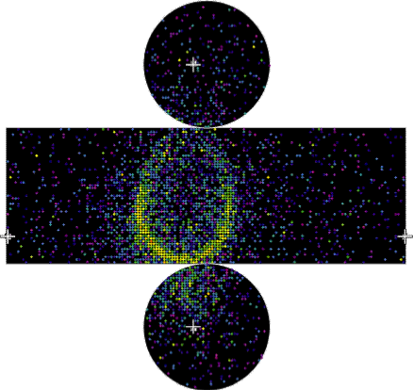
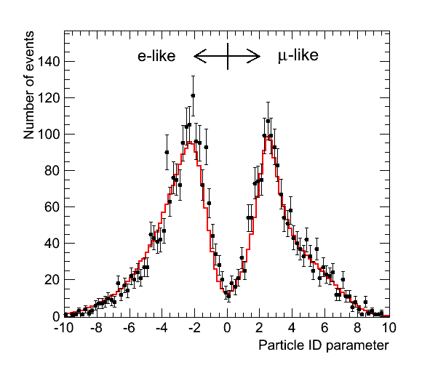
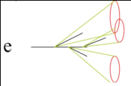

Particle Identification
MC
MC
μ-like
e-like

Slide 22
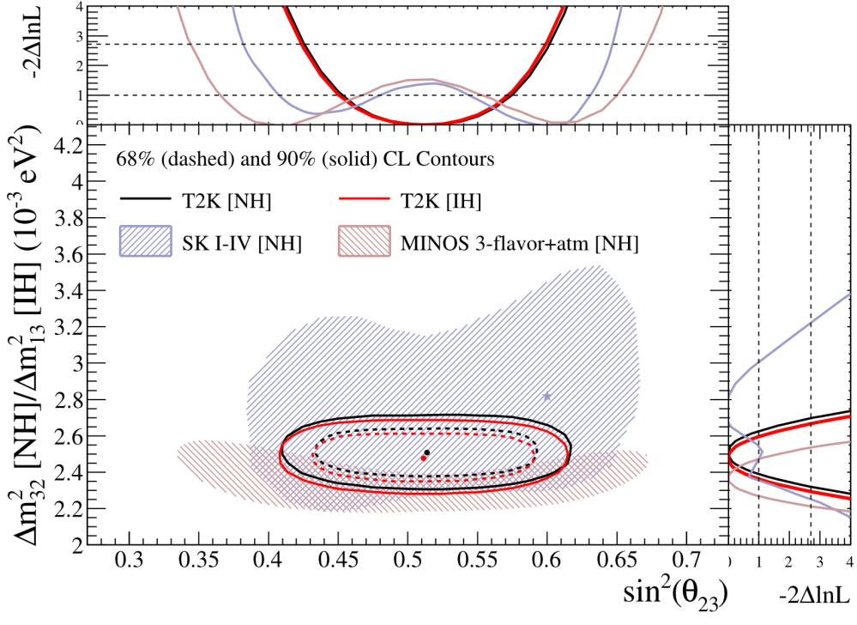
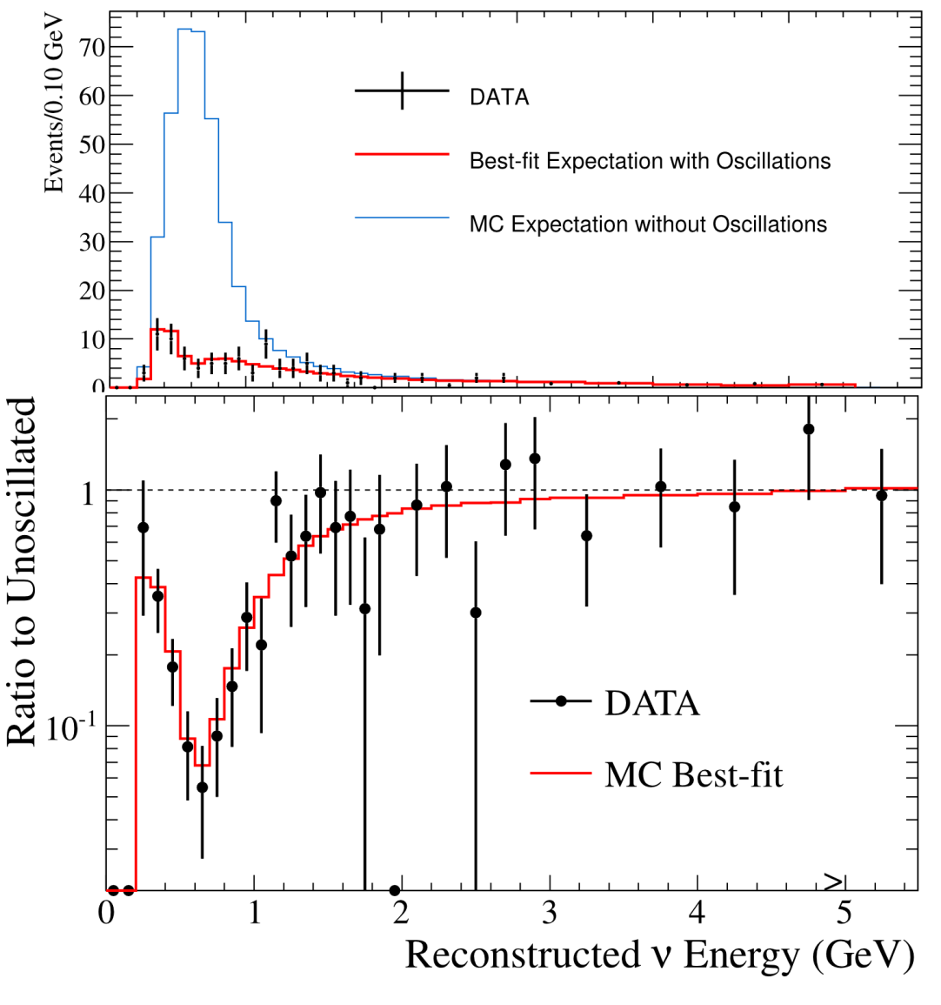
ν_{μ} Disappearance
PRL 112, 181801 (2014)
Parameter | Normal hierarchy | Inverted hierarchy
sin²(θ₂₃) | 0.514^{+0.055}_{-0.056} | 0.511 ± 0.055
|Δm²_{32/31}| (10⁻³ ev²/c⁴) | 2.51 ± 0.10 | 2.48 ± 0.10
Uncertainties indicate 68% confidence intervals obtained with Feldman-Cousins unified approach

Slide 23
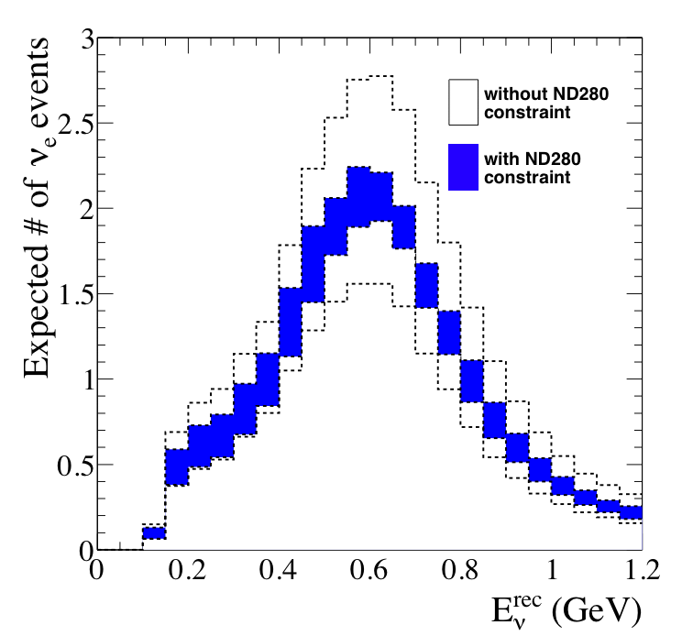
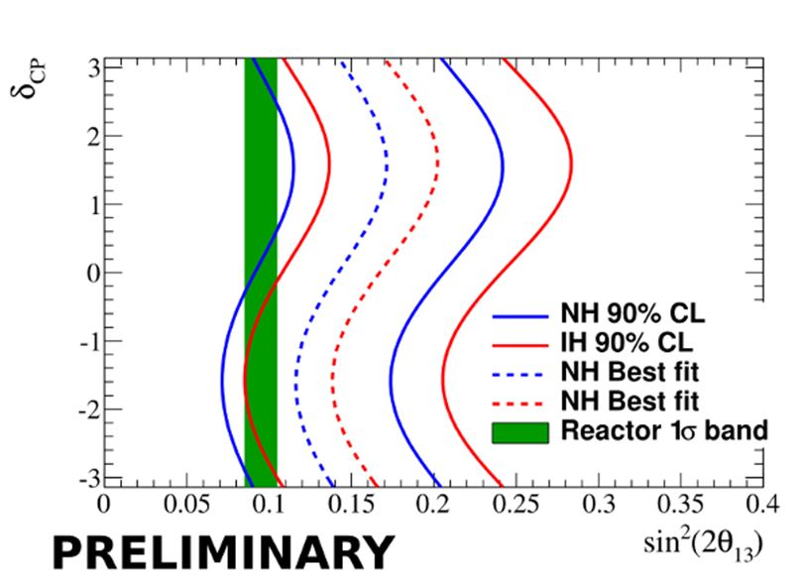
Electron Neutrino Search
Pure sample of electron neutrino interactions in far detector
Important constrain from near detector

Slide 24
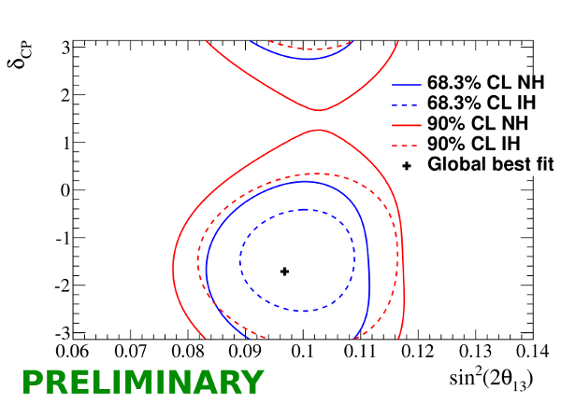
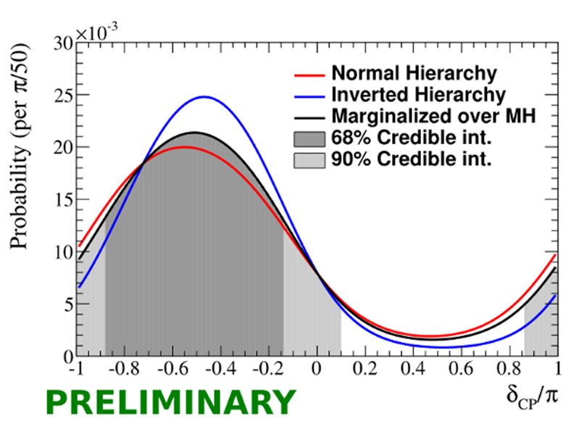
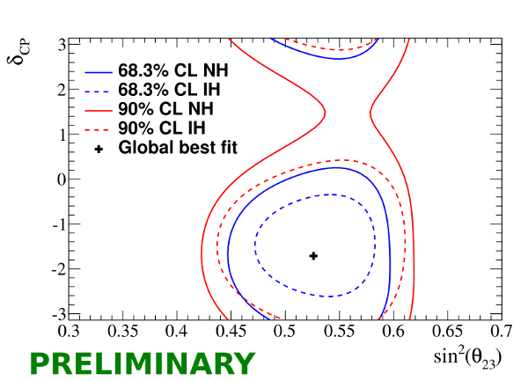
Is CP violated?
Tension between reactor and LBL experiments start to constrain CP phase
  MINOS favours π/2
  T2K favours –π/2

Slide 25
Future Sensitivity
Strongly depends on what the true parameters are

Slide 26


OPERA

Slide 27
4th τ-Neutrino Event

Slide 28

Summary

Slide 29

Summary
Update Nu2014
www.nu-fit.org
JHEP 12 (2012) 123

Slide 30
Summary
Where we are
  ν_{μ} disappear and become ν_{τ} and ν_{e}
  Not a gimps of a sterile neutrino
Where we will be in a few years
  Precision measurements of oscillation parameters
  Smell of mass hierarchy & CPV
Does not really capture progress!

Slide 31
Conclusion
Power comes from combining experiments
Combined analysis is more than just the sum
  Reduced uncertainties
  Over-constraining the 3-neutrino paradigm
Combinations are none trivial
  Systematics become important
  Correlated errors
    Within experiment
    Between experiments
  Efficiencies & fluxes
Community/experiments needs to get together
to do best job possible!

Slide 32
Backups

Slide 33


Making Neutrinos
Neutrinos from the Main Injector (NuMI)
10 μs spill of 120 GeV protons every 2.2 s
300 kW typical beam power
3 10¹³ protons per pulse
Neutrino spectrum changes
with target position

Slide 34

Muon Neutrino Disappearance
Monte Carlo
(Input parameters: sin²2θ = 1.0, Δm² = 3.35x10⁻³ eV² )
spectrum ratio
ν_{μ} spectrum
Unoscillated
Oscillated

Slide 35
MINOS CPV

Slide 36
MINOS NSI
Non standard Interactions might change transition probabilities

Slide 37



T2K Off-Axis Beam
off-axis (2.5°)
(30 GeV from MR
synchrotron)
π→μν
118 m
0º

Slide 38

SuperK Detector
Located in Mozumi mine
  2700 m.w.e. overburden
water Cherenkov detector
  22.5 kt fiducial mass
Inner detector
  11000 20-inch PMTs
Outer veto
  1900 8-inch PMTs
New DAQ system
  100% livetime
Excellent μ/e separation
  Probability to
  reconstruct μ as e ~ 1%

Slide 39



Effect of T2K ND
ν_{e} like
Error: 25%→6.3%
ν_{μ} like
Error: 23.4%→7.4%

