Slide 1

Tuning of the ultra slow muon beamline by utilizing ionized hydrogen
ADACHI, Taihei (KEK)
August 27, 2014
NuFACT2014

Slide 2
Content
Overview of the ultra slow muon transport system
Commissioning by using thermal ionized Li⁺
Commissioning by using laser resonant ionized H⁺
Schedule

Slide 3
Overview of the ultra slow muon transport system

Slide 4
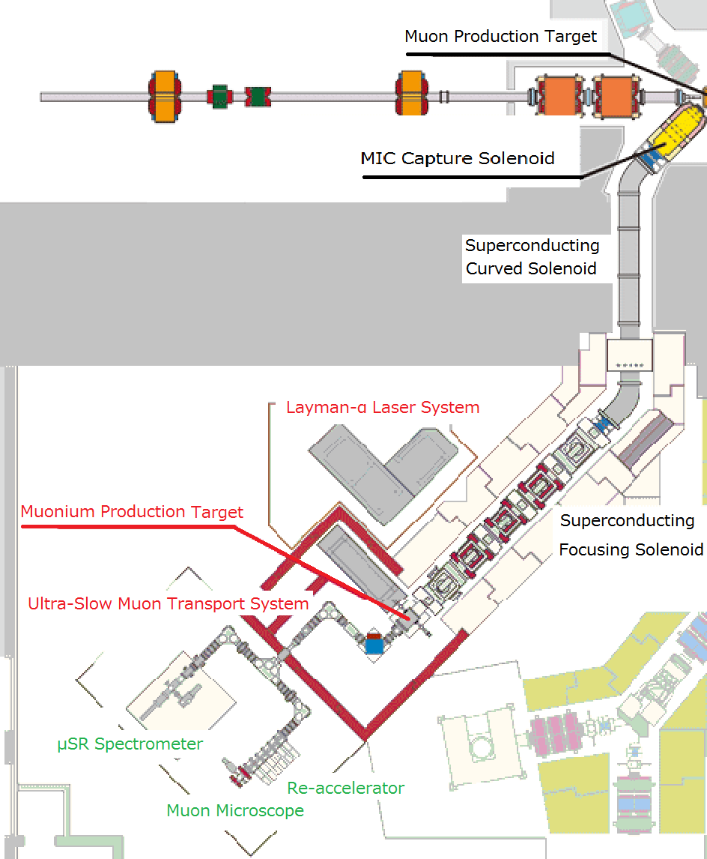
U-Line
3 GeV Proton
Muon Production Target
↓
MIC Capture solenoid
↓
Superconducting curved solenoid
↓
Superconducting focusing solenoid
↓
Muonium Production Target
↓
Ultra Slow Muon Transport System
↓
μSR Spectrometer
or
Re-Acceleration

Slide 5
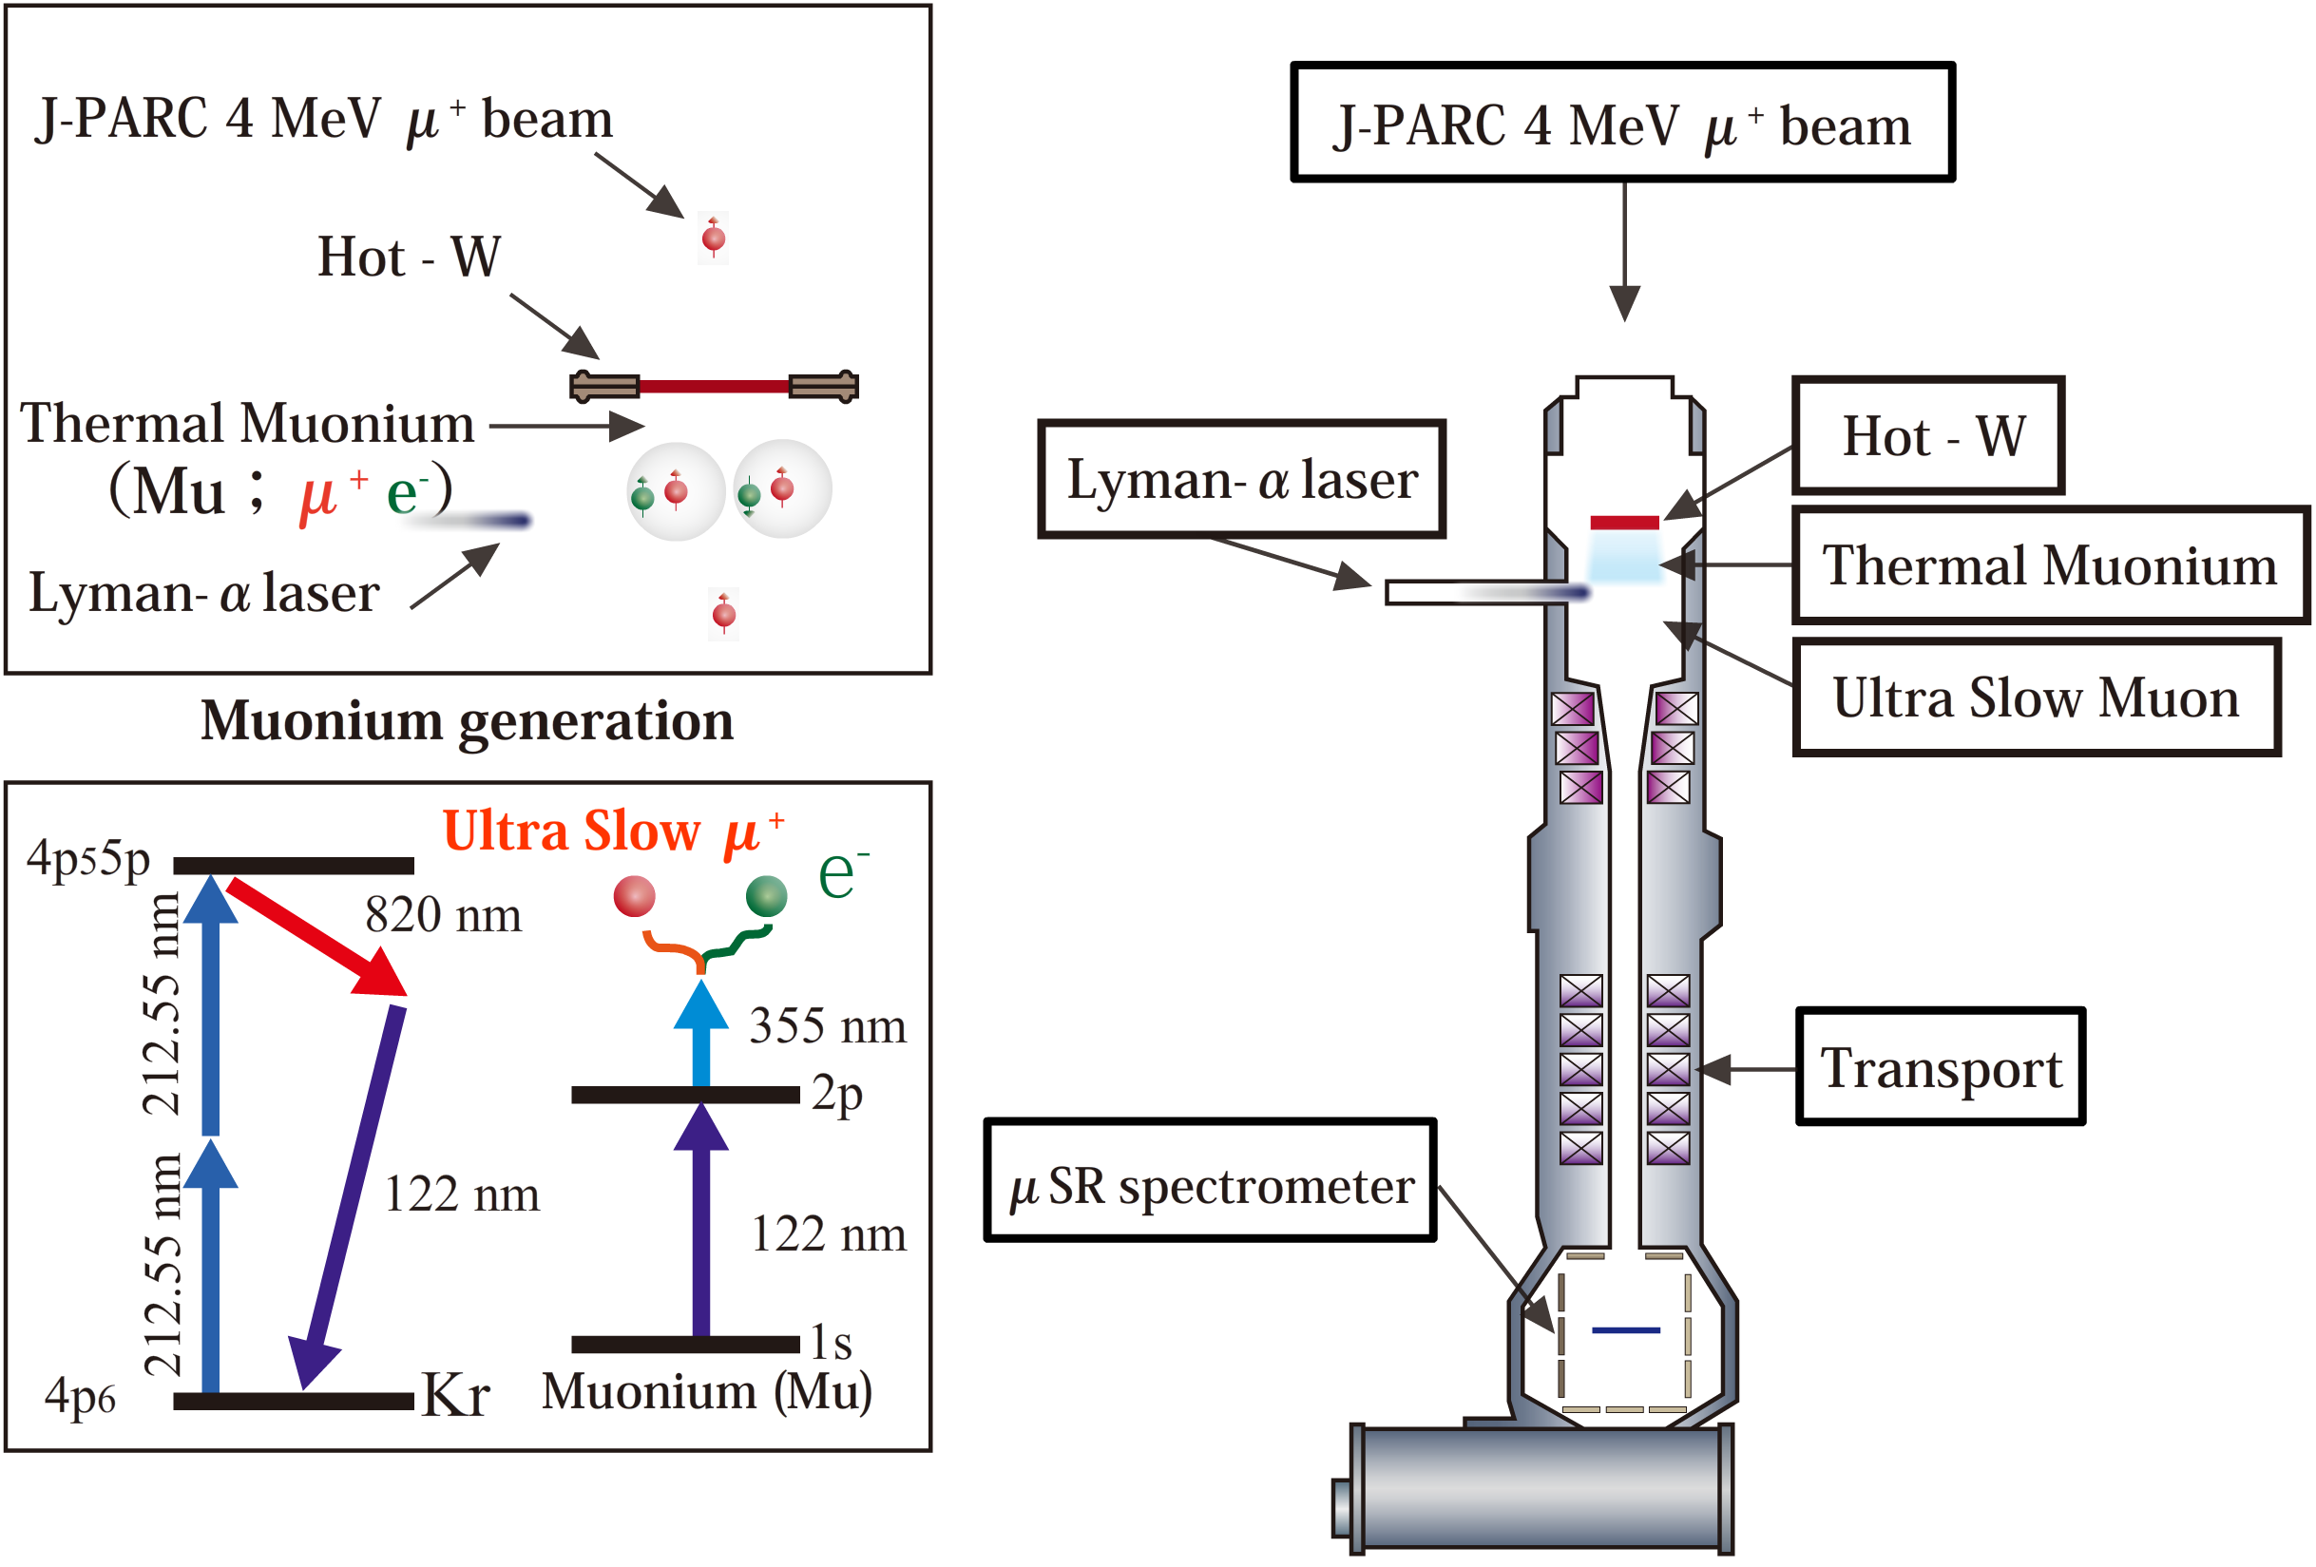
Schematics of the ultra slow muon beamline

Slide 6
Overview of the Ultra slow muon transport system
SOA Lens
Magnetical Bend
Re-accelerator
and microscope
will be installed
μ⁺
Q
Q
Q
Q
Laser
Q
Electrical deflector
Q
Q
Q
Q
Q
Q
Q
Sample position for μSR
Q
Q
Spin rotator
(Not installed yet)
Q
Q
Q
Electrical Bend
Q: Electrical Quadruple
Einzel lens
High Voltage Stage

Slide 7
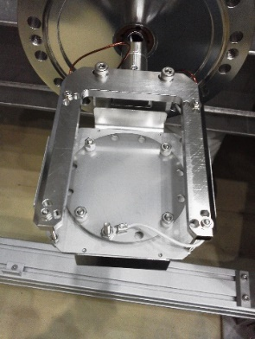
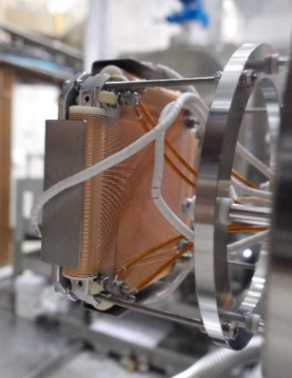
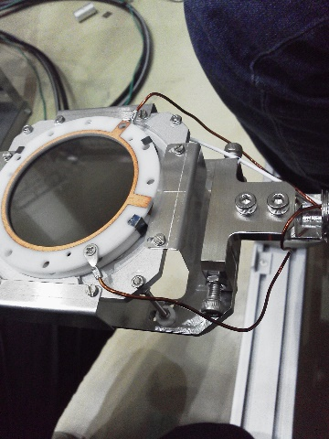
Beam Detector: MCP (Micro channel Plate)
μ⁺
Laser
MCP
Single Anode
Delay-line Anode
MCP #4
(Delay-line Anode)
MCP #1
(Single Anode)
MCP #2
(Single Anode)
Count number of particle
Destructive
Put in beamline when use
MCP #3
(Single Anode)

Slide 8
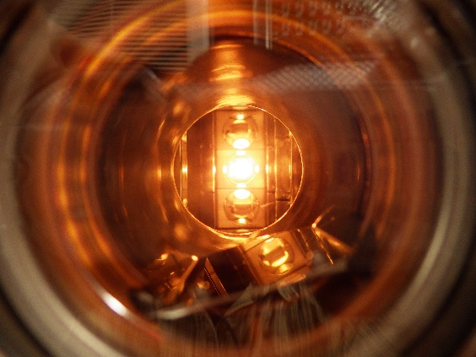
Commissioning by using thermal ionized Li⁺

Slide 9
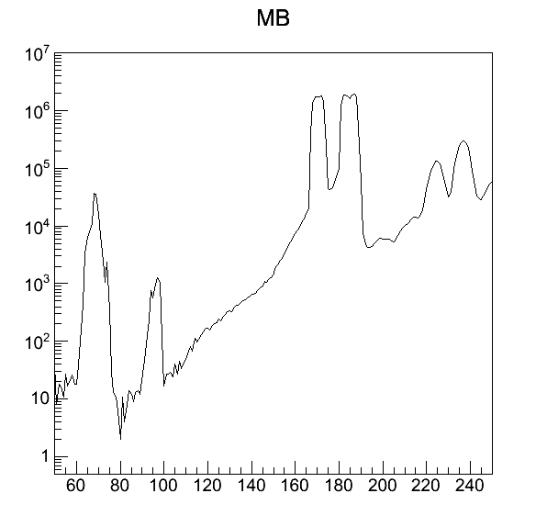
Mass Separation by Magnetic Bend
⁶Li⁺
⁷Li⁺
Magnetic Bend
¹¹B⁺
¹⁰B⁺
¹H⁺
Number of Event [events/4.8 s]
²H⁺
H₂⁺
Laser
Detector (MCP)
Current of Magnetic Bend [A]

Slide 10
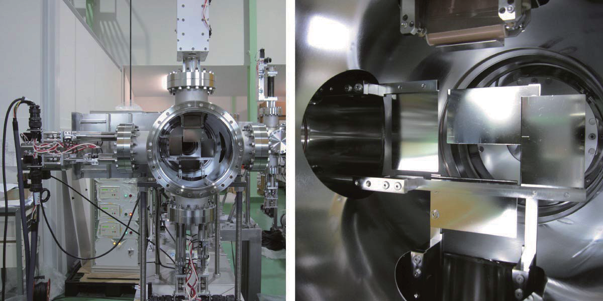
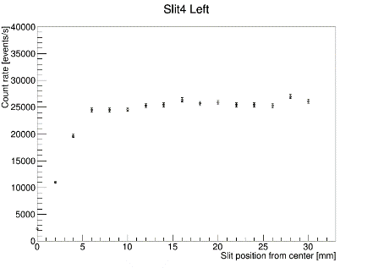
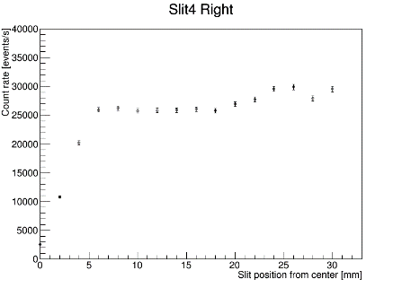
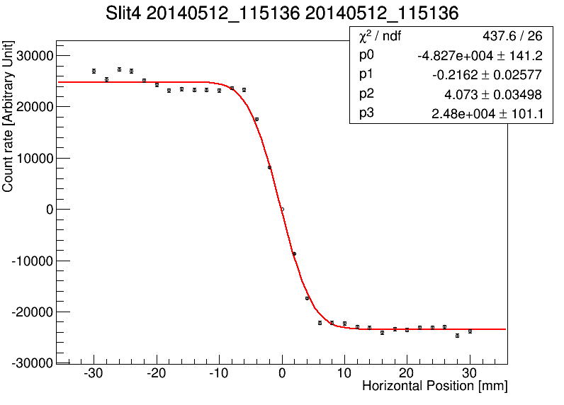
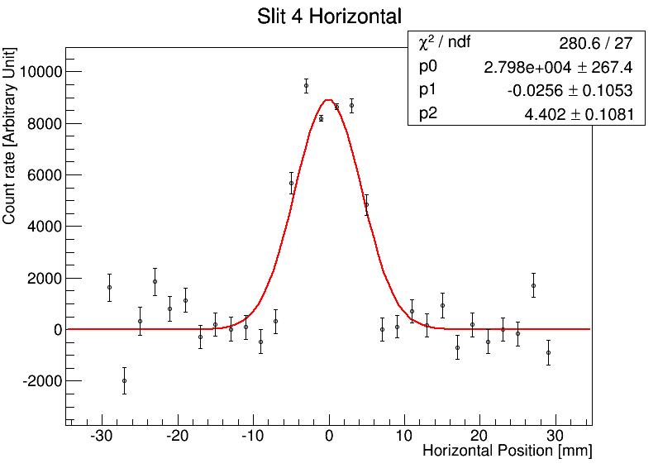

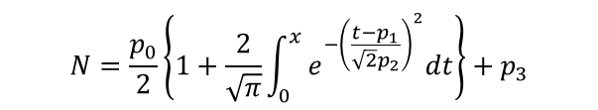
Scanning with Slits
Move & Measure
Move & Measure
Picture of a set of slits
Combine & Fit
Position Resolution: 0.1 mm
Range: -5 mm ～ 30 mm from center
Subtract & Fit
Fitting Function
$$N=\frac{p_{0}}{2}\left\{1+\frac{2}{\sqrt{π}}\int_{0}^{x}{e^{−{\left(\frac{t−p_{1}}{\sqrt{2}p_{2}}\right)}^{2}}dt}\right\}+p_{3}$$
$$N=p_{0}e^{−{\left(\frac{x−p_{1}}{\sqrt{2}p_{2}}\right)}^{2}}$$
P1: Beam Center
P2: Half Width (1σ)

Slide 11
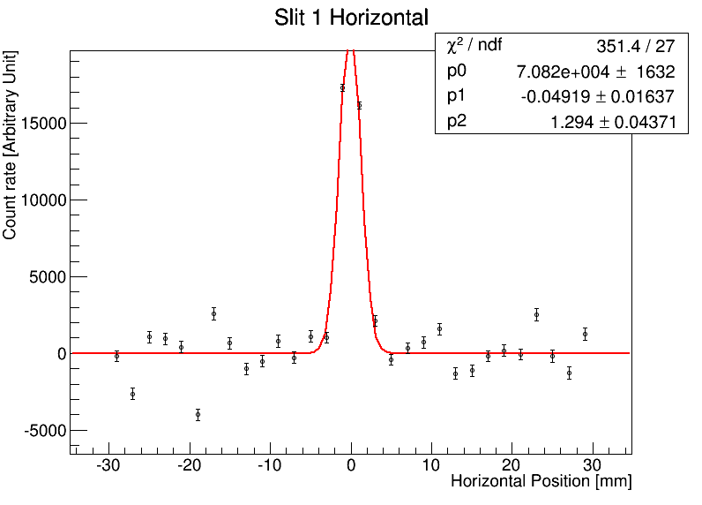
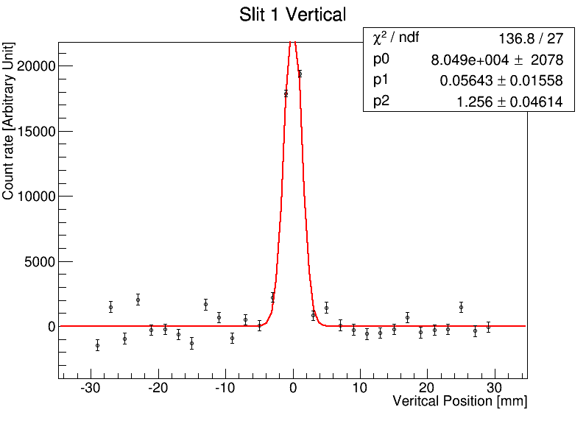
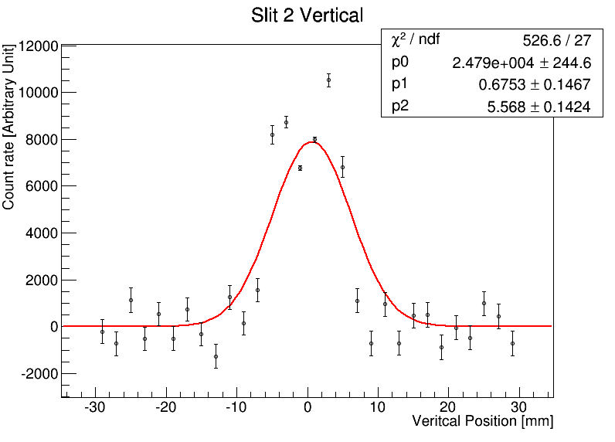
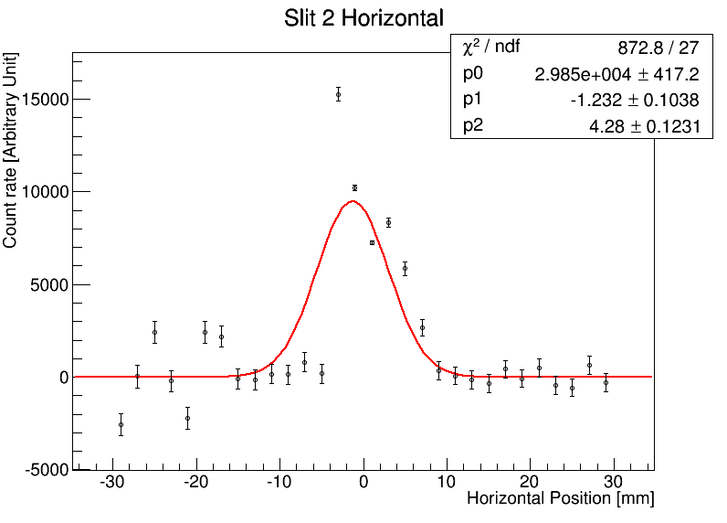
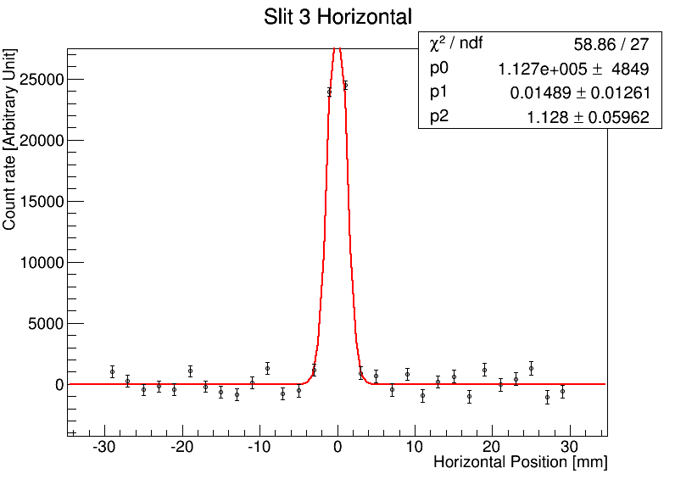
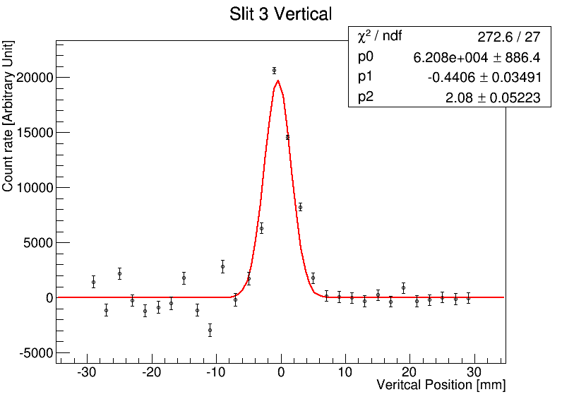
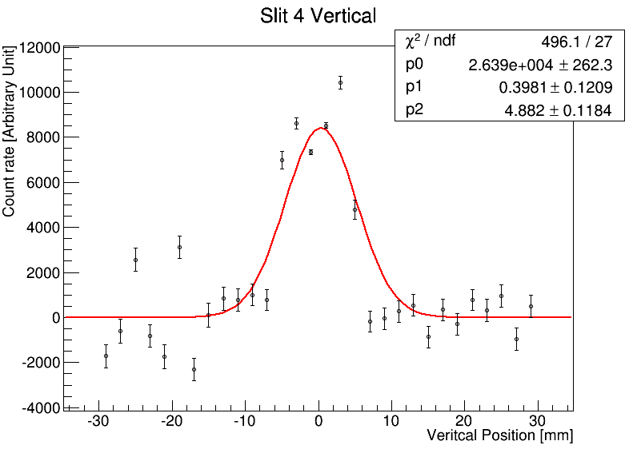
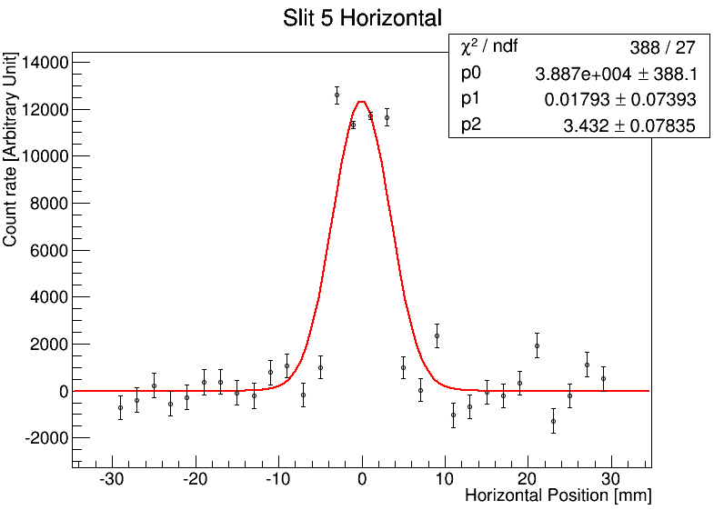
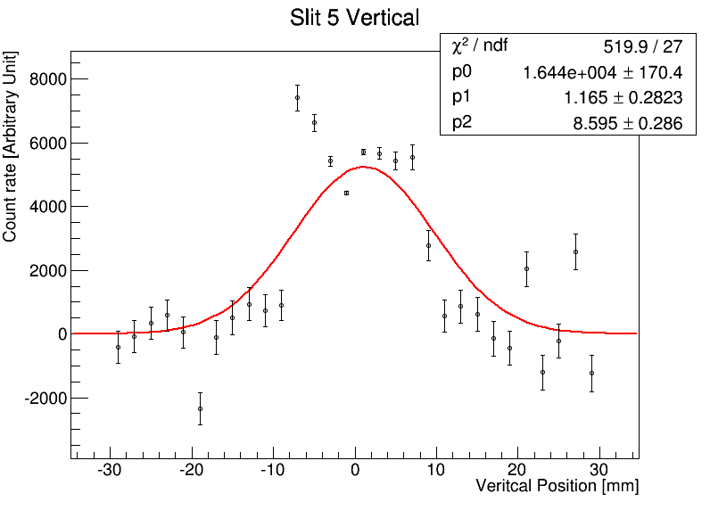
Beam Profiles
(L⁺ Tuning)
1
2
3
 | X mean | X sigma | Y mean | Y sigma
Slit 1 | -0.02 mm | 1.2 mm | -0.02 mm | 1.3 mm
Slit 2 | 0.02 mm | 3.8 mm | -0.10 mm | 4.1 mm
Slit 3 | 0.06 mm | 1.0 mm | -0.00 mm | 2.1 mm
Slit 4 | 0.18 mm | 3.8 mm | -0.36 mm | 4.0 mm
Slit 5 | 0.05 mm | 2.9 mm | 0.26 mm | 6.4 mm
4
5

Slide 12
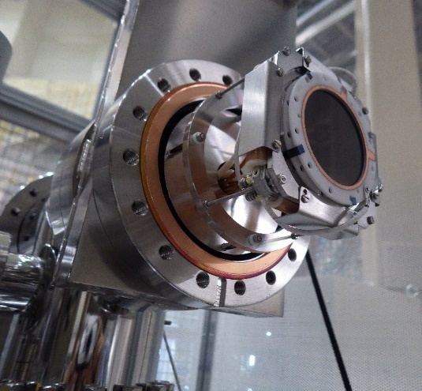
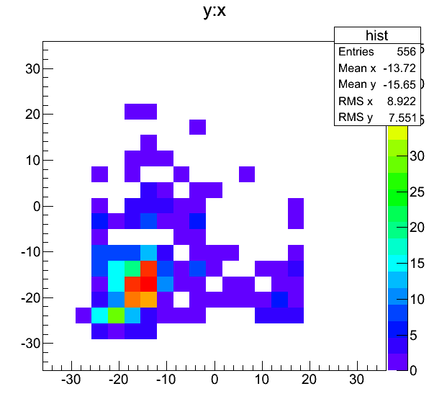
Measurement at Sample Position by using a MCP with delay-line anode
Delay-line-anode
MCP
Laser
Sample Position
(MCP with Delay-line anode)
Preliminary
Vertical Position [mm]
Horizontal Position [mm]

Slide 13
Commissioning by using Laser resonant Ionized H⁺

Slide 14
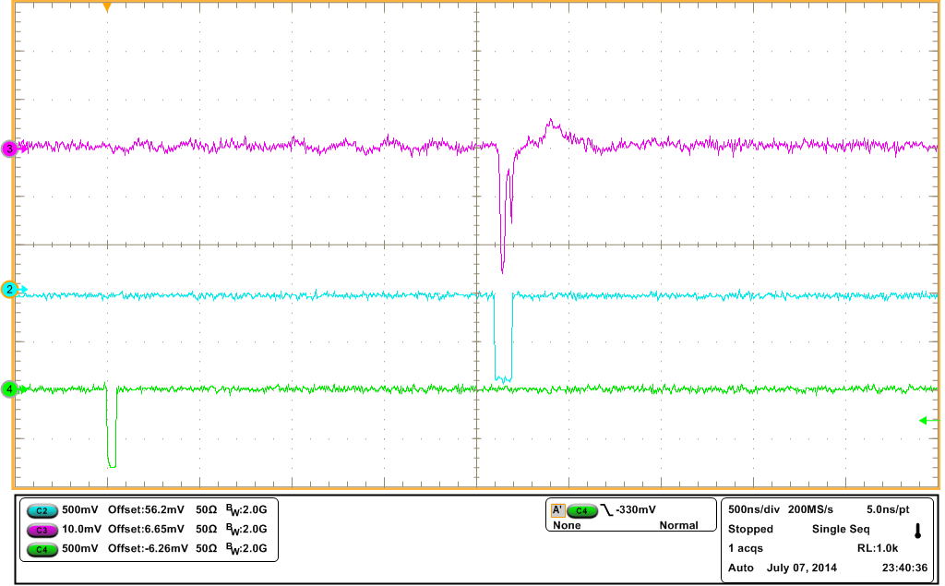
Measurement of Laser Ionized H⁺
unbound
unbound
355 nm
355 nm
2p
2p
Laser
121.57 nm
122.09 nm
Pulsed Lyman-α
1s
1s
H atom
Mu
Detector (MCP)
2.1 μs
MCP signal
QDC gate
Laser Timing Signal

Slide 15
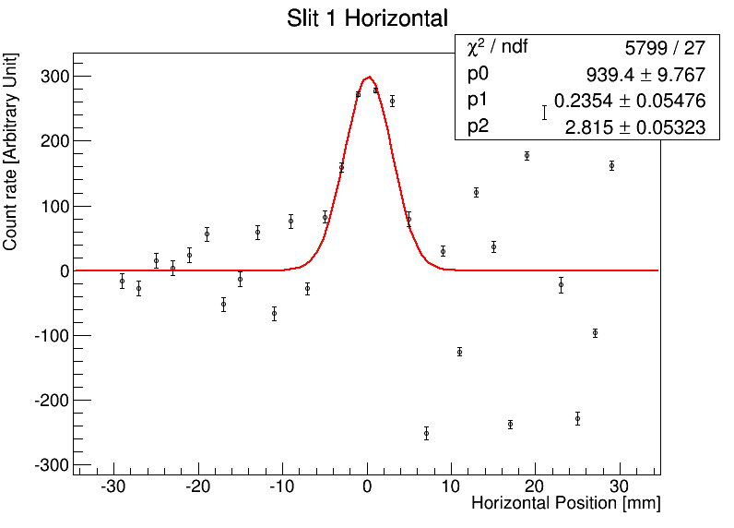
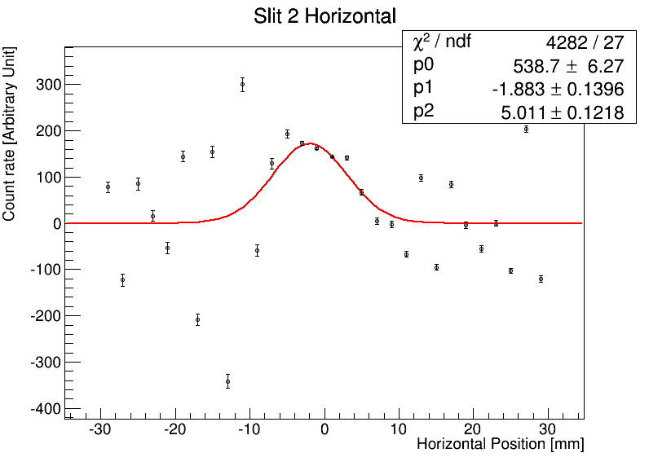
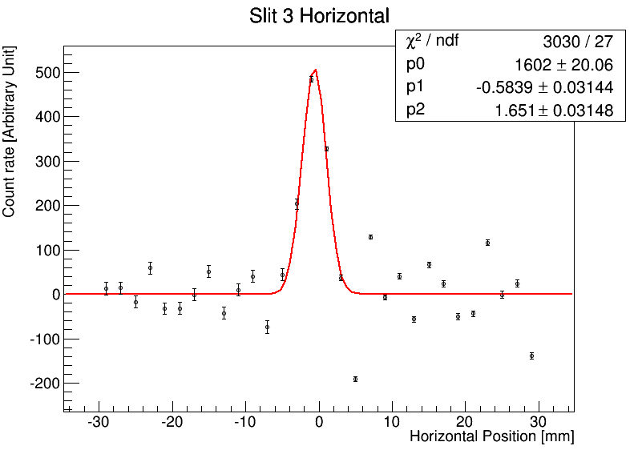
Beam Profiles
(Laser Ionized H+)
1
Laser
2
3
Detector (MCP)
Rate ～ 1 @ middle of the beamline

Slide 16
Schedule
August | September | October | November
9/10
Now
Laser
start-up
H⁺ Tuning
Target
annealing
11/1
Ultra slow muon

Slide 17
Summary
A part of ultra slow muon beamline is installed.
Commissioning by utilizing laser ionized H⁺ is on going.
The first ultra slow muon beam at J-PARC will be created at next November!

Slide 19



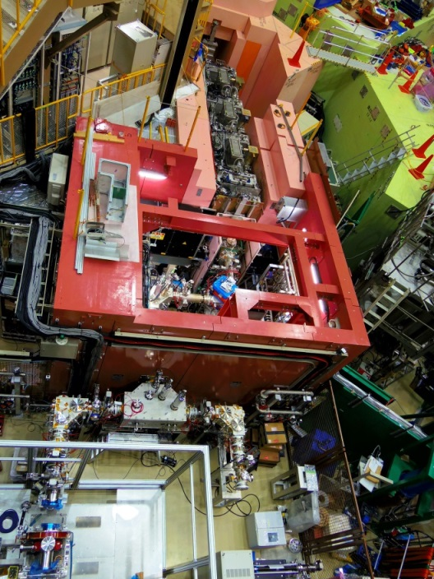
超低速ミュオン顕微鏡
超低速ミュオン
冷却 [エネルギーで7桁]
ミュオニウム
生成標的
(hot W foil)
超低速ミュオン
[0.2 eV~]
低速ミュオン
[4 MeV]
→30keV (加速)
レーザー
122 nm (Mu;1S→2P)
355 nm (Mu;2P→unbound)
物性実験に
使える強度へ
Superomega
beam line
unbound
Laser system
ω2
4p⁵5p
355 nm
820.65 nm
ω1
212.55 nm
2p
122.09 nm
122.09 nm
212.55 nm
ω1
Mu production chamber
Pulsed Lyman-α
二光子共鳴
四波混合法
Transport system of laser pulses
1s
4p⁶
Transportation line for USM
Mu
Kr

Slide 20
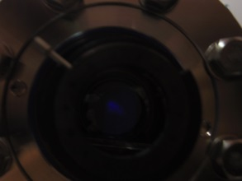
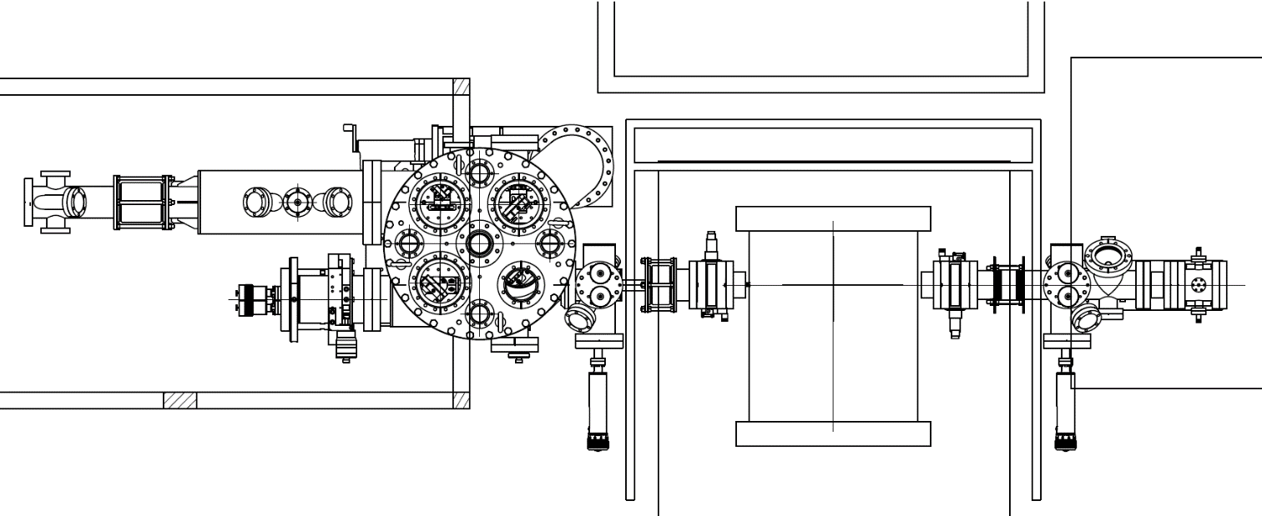
“H atom laser ionization” at MLF of J-PARC
Frontier of Materials, Life and Particle Science Explored by Ultra Slow Muon Microscope
July 2, 2014
All-solid-state laser system
as Lyman-α driving laser
J. Nakamura, T. Adachi (KEK)
Y. Oishi, K. Miyazaki, N. Saito (RIKEN)
From laser cabin
840 nm
212 nm
355 nm
dump
Gas cell
(2.4kPa Kr-Ar mixture)
W
Sodium salicylate
painted plate
dump
H⁺
Observed laser ionization of
hydrogen atom by MCP signal
Transportation line
MCP
(Micro Cannel Plate)
Mass Analyzing Magnet

Slide 21
Frontier of Materials, Life and Particle Science Explored by Ultra Slow Muon Microscope
“H atom laser ionization” at MLF of J-PARC
July 2, 2014
Lyman-α on
Two-Photon Resonance
Four-Wave Mixing
ω₁
ω₂
Kr Cell
ω_{Ly-α}
Lyman-α off
ω₁ (212.556 nm): Input to Kr Cell
ω₂ (845.25 nm): Blocked
ピーク高さ
ω₁
ω₂
Kr Cell
レーザーに同期 (25Hz) して
水素がイオン化している様子
を確認
unbound
355 nm
2p
121.57 nm
ピーク高さの
ω₂ 波長依存性を確認
1s
H atom

