Slide 1
Staging of a Neutrino Factory
(and beyond…)
NUFACT2014 XVIth International Workshop on
Neutrino Factories and Future Neutrino Facilities
Mark Palmer
Director, US Muon Accelerator Program
NuFACT 2014, Glasgow, August 25-30, 2014

Slide 2
Muon Accelerators for HEP
μ – an elementary charged lepton:
  200 times heavier than the electron
  2.2 μs lifetime at rest
Physics potential for the HEP community using muon beams
  Tests of Lepton Flavor Violation
  Anomalous magnetic moment a hints of new physics (g-2)
  Can provide equal fractions of electron
  and muon neutrinos at high intensity for
  studies of neutrino oscillations –
  the Neutrino Factory concept
  Offers a large coupling to the “Higgs mechanism”
  As with an e⁺e⁻ collider, a μ⁺μ⁻ collider would offer a precision leptonic probe of fundamental interactions

Slide 3
Outline
Why Neutrino Factories?
Neutrino Factory Concepts
  Short baseline a νSTORM
  Long Baseline
    The IDS-NF Reference Design
    Options for a staged implementation:
      The MAP Muon Accelerator Staging Study
      The staged NuMAX Concept
  Accelerator R&D Needs
Going Beyond a Neutrino Factory Facility
  Possibilities for a future Muon Collider Capability
Conclusion

Slide 4
Why Neutrino Factories?

Slide 5
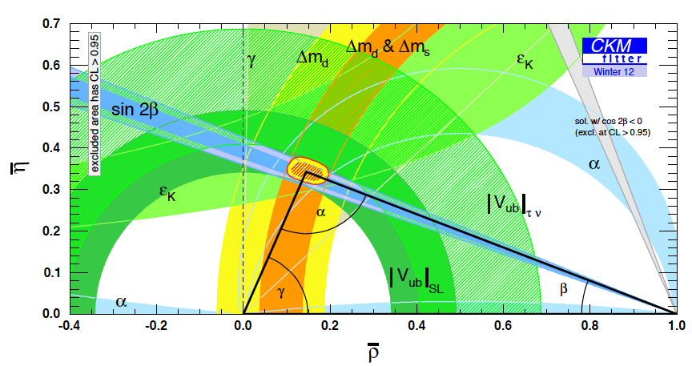
The Key Issues
What things must we understand in the neutrino sector?
  δ_{CP}
  The mass hierarchy
  The value of θ₂₃-π/4:
  +, - or zero?
  Resolve the LSND and other short baseline experimental anomalies
  And enable the search for new physics

Slide 6
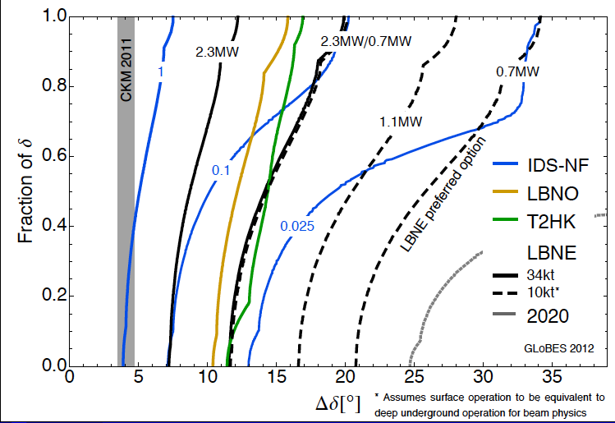
Neutrino Factory a Precision
CP violation physics reach of various facilities
Can we probe
the CP violation
in the neutrino
sector at the
same level as in
the CKM Matrix?
0.025 IDS-NF:
700kW target,
no cooling,
2×10⁸ s running time
10-15 kTon detector
P. Coloma, P. Huber, J. Kopp, W. Winter – arxiv:1209.5973

Slide 7
Microscopes for the ν Sector
Superbeam technology will continue to drive initial observations in the coming years
However, anomalies and new discoveries will drive our need for precision studies to develop a complete physical understanding
Neutrino Factory capabilities (both long- and short-baseline) offer a route to controlled systematics and precision measurements to fully elucidate the relevant physics principles
a Precision Microscopes for the ν sector

Slide 8
Neutrino FactorY Concepts

Slide 9
Neutrino Factory Overview
Short Baseline NF
  nuSTORM
    Definitive measurement of sterile neutrinos
    Precision ν_{e} cross-section measurements (systematics issue for long baseline SuperBeam experiments)
    Would serve as an HEP muon accelerator proving ground…
Long Baseline NF with a Magnetized Detector
  IDS-NF (International Design Study for a Neutrino Factory)
    10 GeV muon storage ring optimized for 1500-2500km baselines
    “Generic” design (ie, not site-specific)
  NuMAX (Neutrinos from a Muon Accelerator CompleX)
    Site-specific: FNAL a SURF (1300km baseline)
    4-6 GeV beam energy optimized for CP studies
      Flexibility to allow for other operating energies
    Can provide an ongoing short baseline measurement option
    Detector options
      Magnetized LAr is the goal
      Magnetized iron provides equivalent CP sensitivities using ~3x the mass

Slide 10
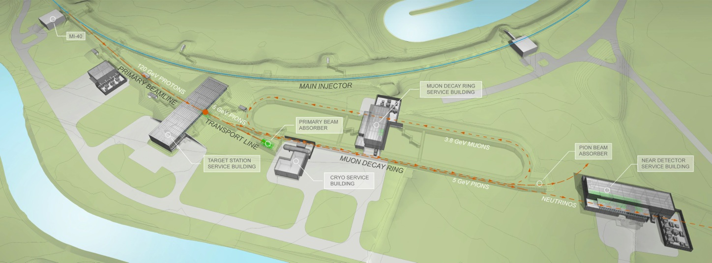
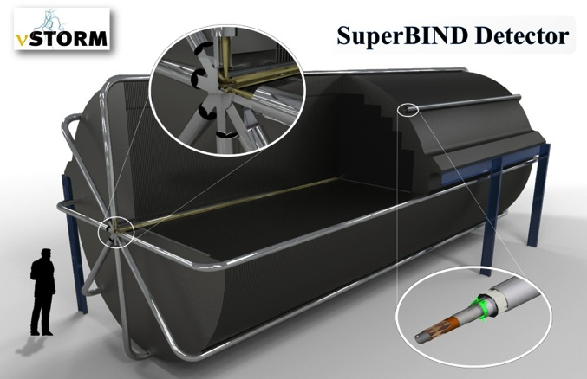
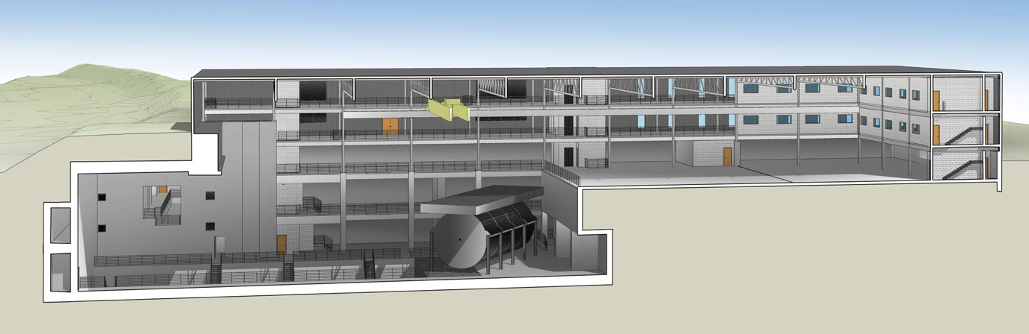
νSTORM
μ decay ring: P = 3.8 GeV/c ± 10%
  See talk by J-B. Lagrange
  Neutrino Physics Session: Friday 16:00
To Far
Hall
  No new technologies required!
  Could be deployed now!
Near Hall
Far Hall @1.9km
Far Detector

Slide 11
Example of Potential νSTORM Leverage for Long Baseline Experiments: T2HK
NuMAX+ targets equivalent sensitivity to CP violation in the ν sector as has been achieved in the flavor sector
nuSTORM + T2HK offers significantly improved sensitivity vs T2HK alone
GLoBES Comparison of Potential
Performance of the Various
Advanced Concepts (courtesy P. Huber)

Slide 12
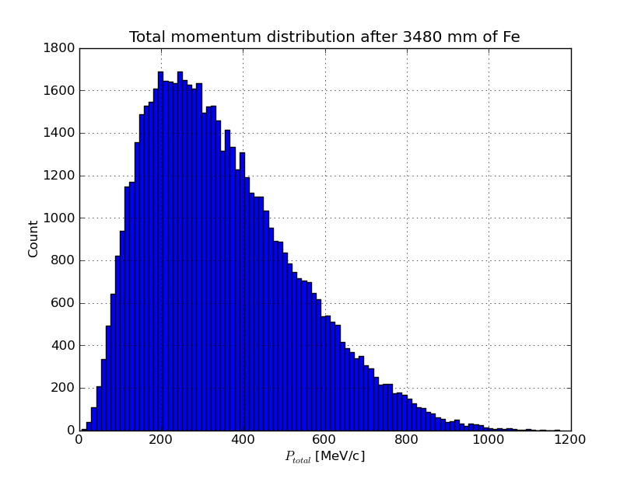
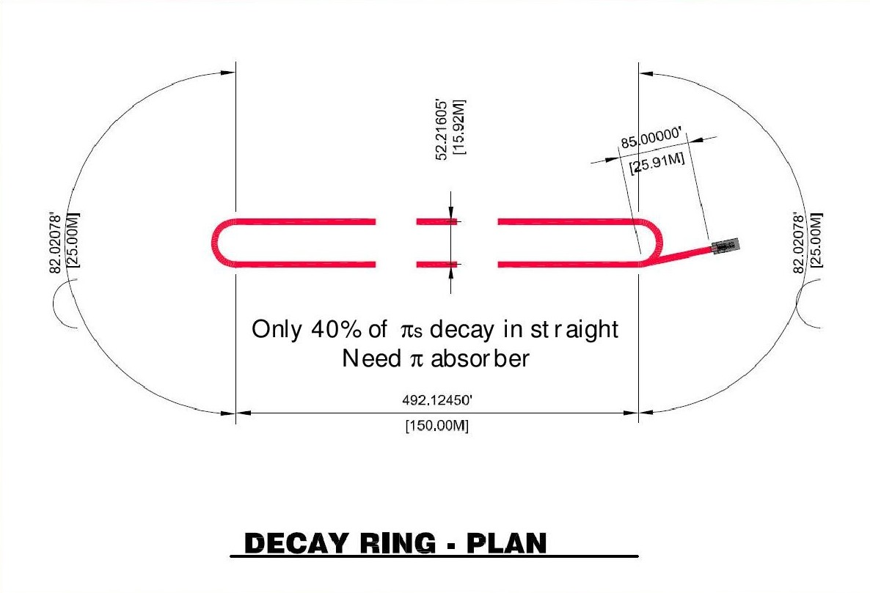
νStorm as an R&D platform
A high-intensity pulsed muon source
100<p_{μ}<300 MeV/c muons
  Using extracted beam from ring
  10¹⁰ muons per 1 μsec pulse
Beam available simultaneously with physics operation
νSTORM also provides the opportunity to design, build and test decay ring instrumentation (BCT, momentum spectrometer, polarimeter) to measure and characterize the circulating muon beam

Slide 13
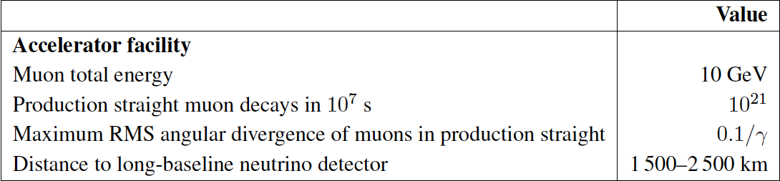
The Long Baseline Neutrino Factory
IDS-NF: the ideal NF
  Supported by MAP
MASS working group:
A staged approach -
NuMAX@5 GeVaSURF

Slide 14
The MAP Muon Accelerator Staging Study a NuMAX
NuMAX Staging:
Commissioning
  1MW Target
  No Cooling
  10kT Detector
NuMAX+
  2.75 MW Target
  6D Cooling
  34kT Detector

Slide 15
NF Staging (MASS)
6D

Slide 16
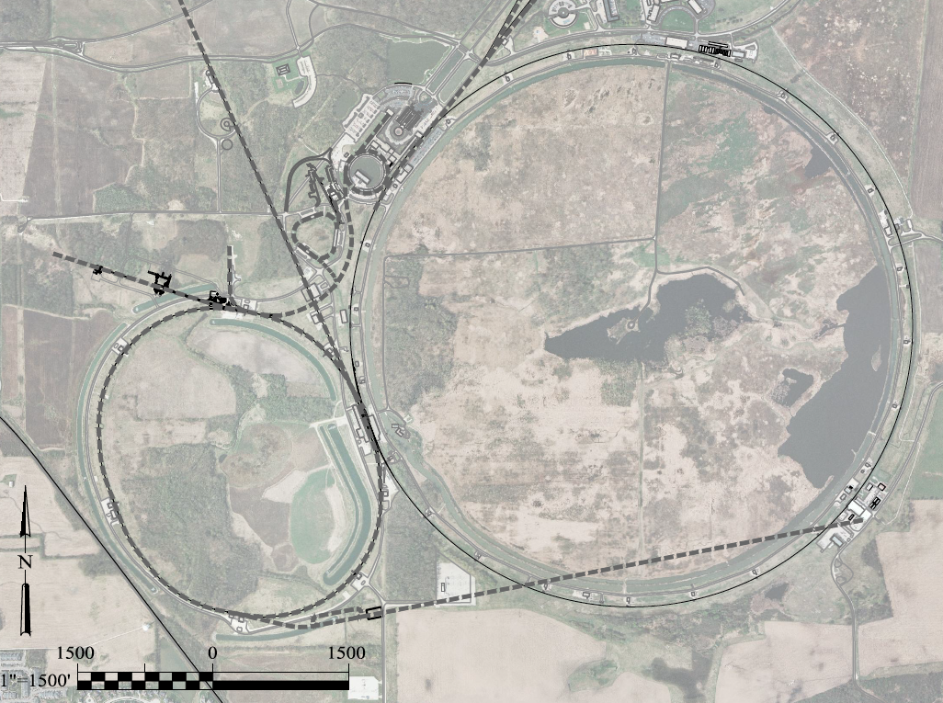
Possibilities for NF Capabilities at Fermilab:
νSTORM ➔ NuMAX
0.8 GeV Proton
Linac (PIP-II)
LBNF
Superbeam
Accumulator,
Buncher,
Combiner
Front
End
0.8-3 GeV Proton
Linac (PIP-III)
Remains fully compatible with the PIP-II a III staging option
To
SURF
Target
Final
Cool
NuMAX:
νs to SURF
6D
Cool
Initial
Cool
1 GeV Muon
Linac (325MHz)
3-7 GeV Proton &
1-5 GeV Muon
Dual Species Linac
To Near Detector(s) for
Short Baseline
Studies
Muon Beam
R&D Facility
Possible to deploy subsequent muon collider capabilities
ft
νSTORM
ft

Slide 17
Staged Performance of NuMAX
GLoBES Comparison of Potential
Performance of the Various
Advanced Concepts (courtesy P. Huber)

Slide 18
Accelerator R&D Effort (U.S. MAP)
Design Studies
  Proton Driver
  Front End
  Cooling
  Acceleration and Storage
  Collider
  Machine-Detector Interface
  Work closely with physics and detector efforts
Technology R&D
  RF in magnetic fields
  SCRF for acceleration chain (Nb on Cu technology)
  High field magnets
    Utilizing HTS technologies
  Targets & Absorbers
  MuCool Test Area (MTA)
Major System Demonstration
  The Muon Ionization Cooling Experiment – MICE
    Major U.S. effort to provide key hardware: RF Cavities and couplers, Spectrometer Solenoids, Coupling Coil(s), Partial Return Yoke
    Experimental and Operations Support

Slide 19
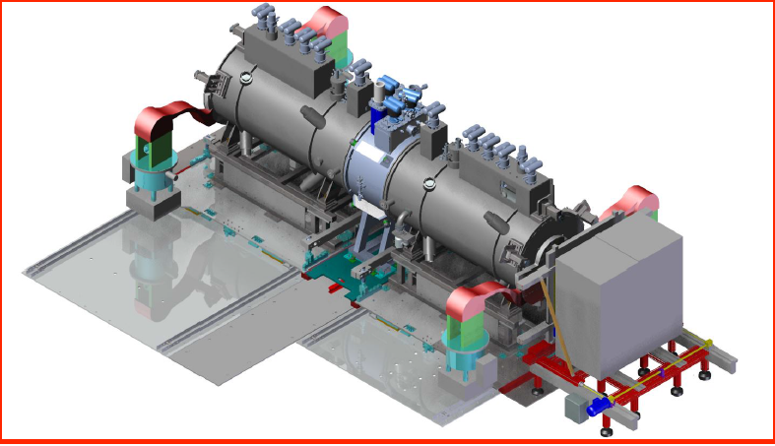
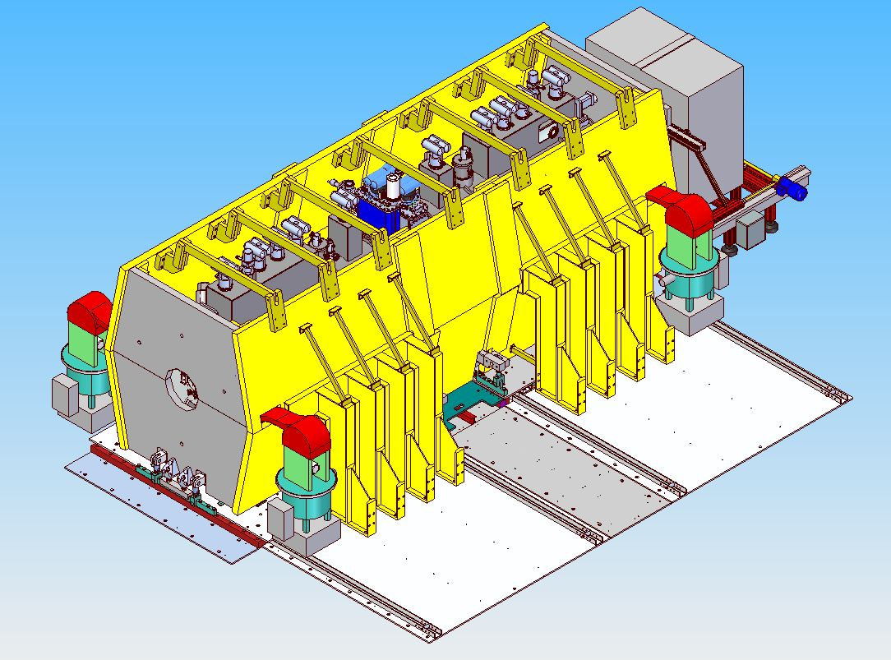
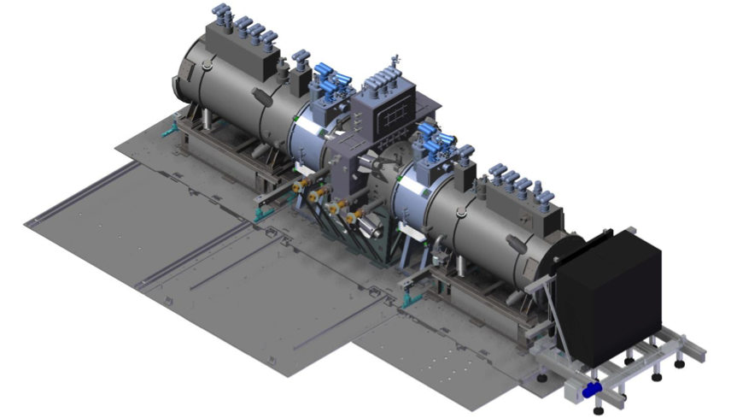
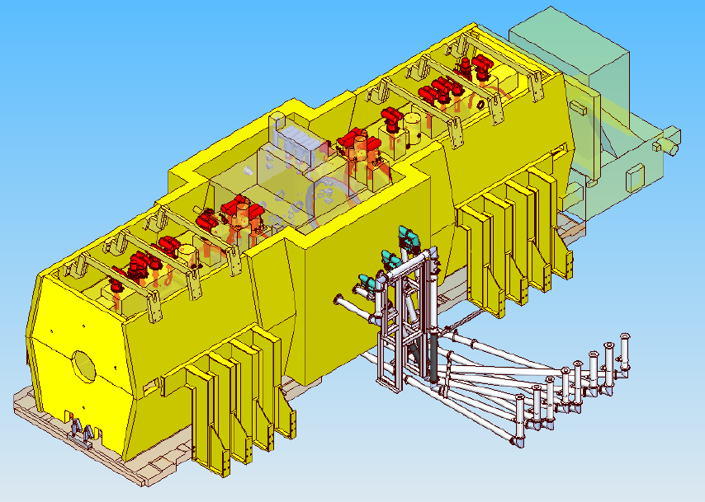
MICE Experiment @RAL
2015 Data
MICE Step IV:
Study of Absorber
Materials
US
US
US-UK
  See following talk by Ken Long
Commission
in 2017
(expedited
schedule)
MICE Step V: Demonstration of Muon Cooling w/RF
re-acceleration
US
US
US
US-UK

Slide 20
Going Beyond Neutrino Factory Capabilities

Slide 21
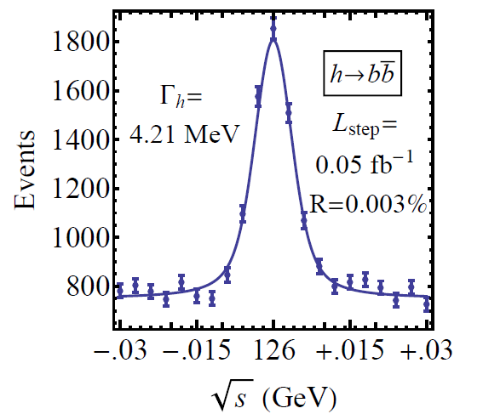
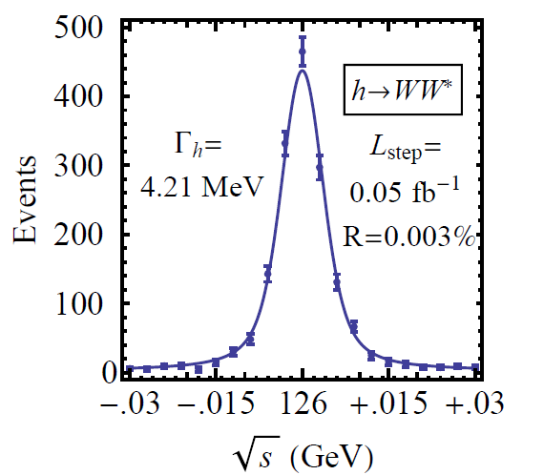

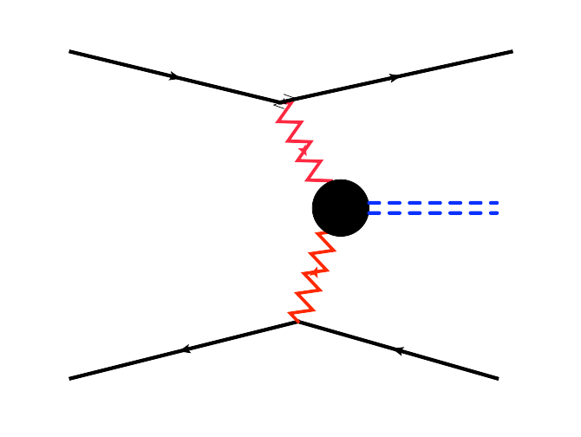
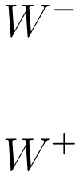


Features of the Muon Collider
Superb Energy Resolution
  SM Thresholds and s-channel Higgs Factory operation
Multi-TeV Capability (≤ 10TeV):
  Compact & energy efficient machine
  Luminosity > 10³⁴ cm⁻² s⁻¹
  Option for 2 detectors in the ring
  For √s > 1 TeV: Fusion processes dominate
  a an Electroweak Boson Collider
  a a discovery machine complementary to a
  very high energy pp collider
  At >5TeV: Higgs self-coupling resolutions of <10%
What are our accelerator options if new LHC
data shows evidence for a multi-TeV particle spectrum?

Slide 22
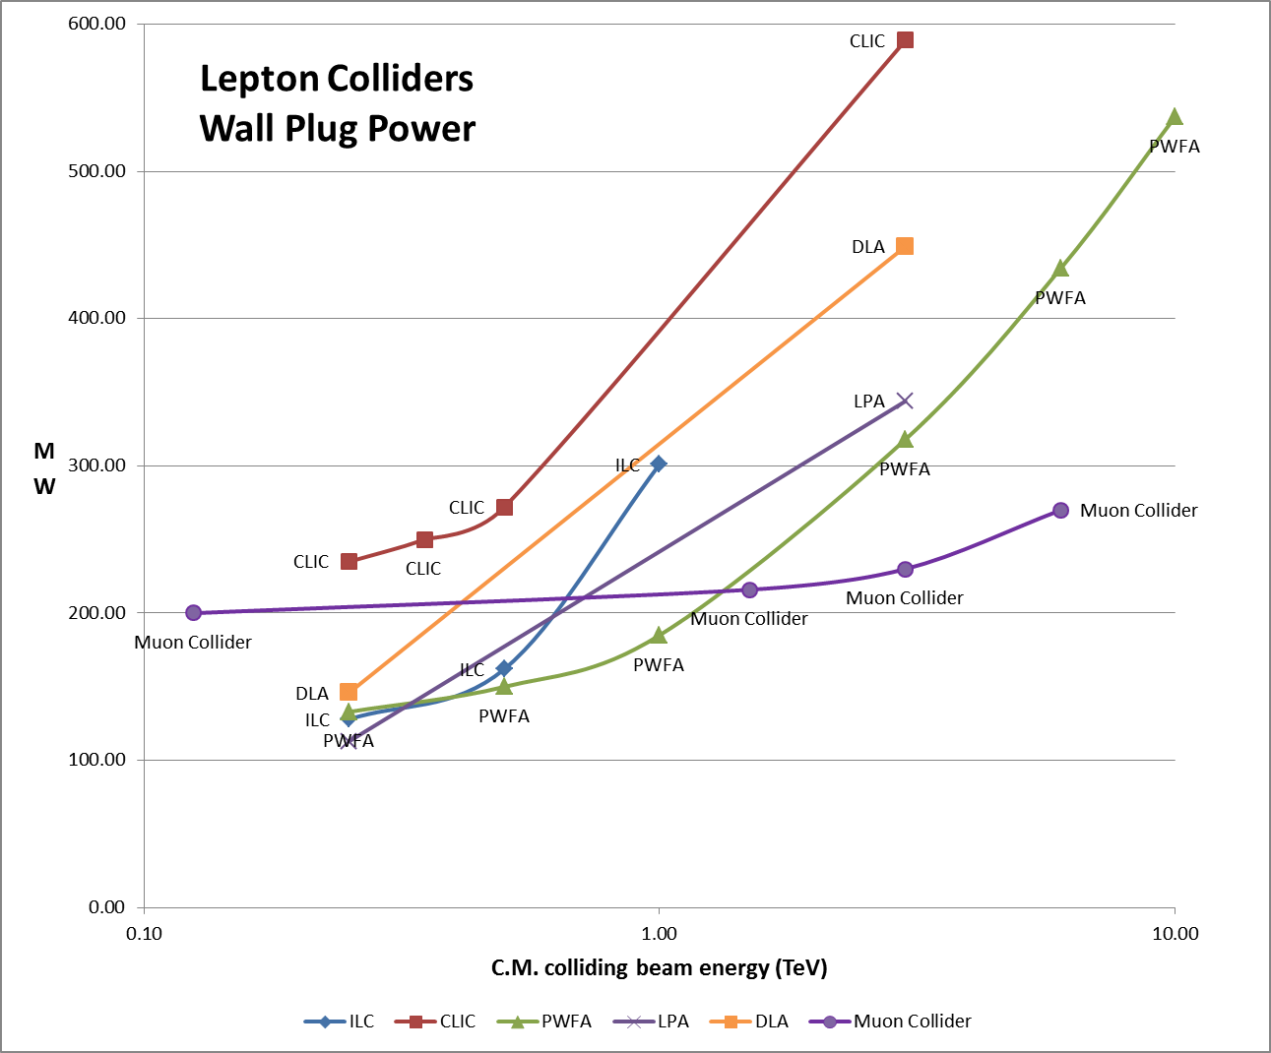
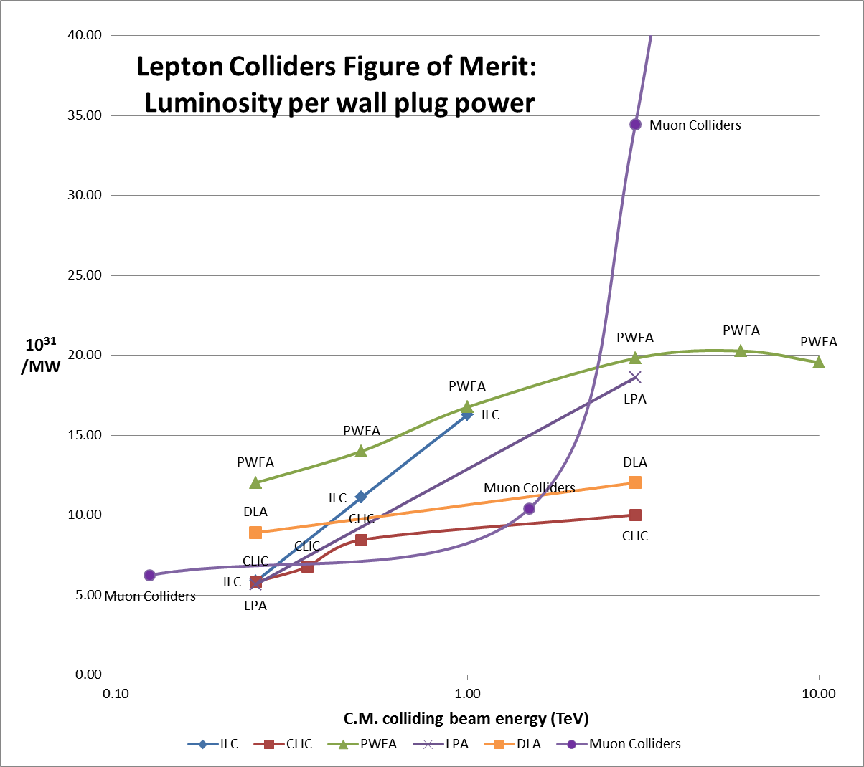
Muon Colliders extending high energy frontier with potential of considerable power savings
J.-P. Delahaye

Slide 23
NF/MC Synergies

Slide 24
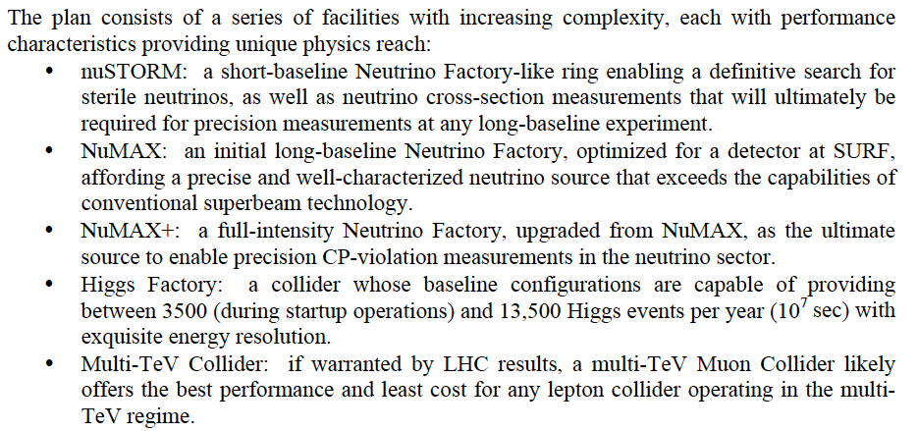
The Staging Study (MASS)
Enabling Intensity and Energy Frontier Science with a Muon Accelerator
Facility in the US - http://arxiv.org/pdf/1308.0494
Ability to utilize some or all stages

Slide 25
Concept for a Muon Accelerator Complex at Fermilab:
νSTORM ➔ NuMAX
➔ Higgs Factory and Beyond
0.8 GeV Proton
Linac (PIP-II)
LBNE
Superbeam
Accumulator,
Buncher,
Combiner
Front
End
0.8-3 GeV Proton
Linac (PIP-III)
Remains fully compatible with the PIP-II a III staging option
To
SURF
Target
Final
Cool
NuMAX:
νs to SURF
6D
Cool
Initial
Cool
1 GeV Muon
Linac (325MHz)
RLA to 63 GeV
To Near Detector(s) for
Short Baseline
Studies
3-7 GeV Proton &
1-5 GeV Muon
Dual Species Linac
300m Higgs Factory
Muon Collider
Muon Beam
R&D Facility
νSTORM
A 6 TeV Muon Collider would have a similar circumference as the Tevatron Ring
ft
ft

Slide 26
Concept for a Muon Accelerator Complex at Fermilab:
➔ Multi-TeV Lepton Collider
A TeV-Scale
Accelerator
System
SC Linac

Slide 27
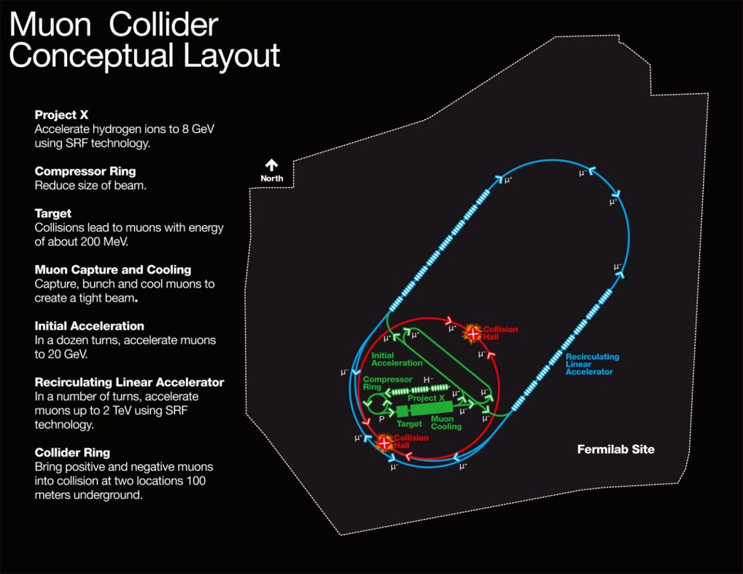
Muon Collider Parameters
Exquisite Energy Resolution
Allows Direct Measurement
of Higgs Width
Success of advanced cooling
concepts a several × 10³²
Site Radiation mitigation with depth and lattice design: ≤ 10 TeV

Slide 28
Conclusion

Slide 29
Concluding Remarks
Neutrino Factory capabilities offer the precision microscope that will likely be needed to fully probe the physics of the neutrino sector
For the last 3 years US Muon Accelerator Program has pursued options to deploy muon accelerator capabilities
  Near term (νSTORM)
  Long term (NuMAX)
  Along with the possibility of a follow-on muon collider option
In light of the recent P5 recommendations that this directed facility effort no longer fits within the budget-constrained US research portfolio, the US effort is entering a ramp-down phase
Nonetheless, the precision capabilities offered by Neutrino Factories represent a key option for the future of ν physics

