Slide 1
Fluidised powder target research
Chris Densham, Ottone Caretta, Tristan Davenne, Peter Loveridge,
Andrew Atherton, Luke Fry, Mike Fitton,
Joe O’Dell, Dan Wilcox, Jennifer Wark
(RAL)
Ilias Efthymiopoulos, Nikolaos Charitonidis, Adrian Fabich
(CERN)

Slide 2
Heat Removal and Thermal Stress Summary
Flowing or rotating targets
Segmented
Peripherally cooled monolith
T.Davenne

Slide 3
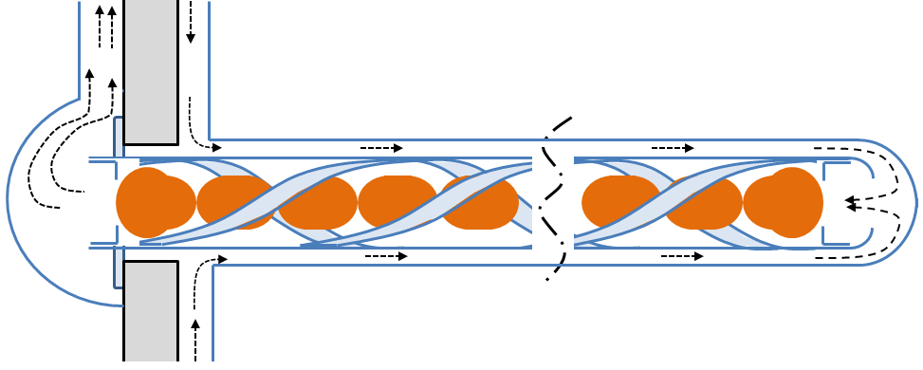
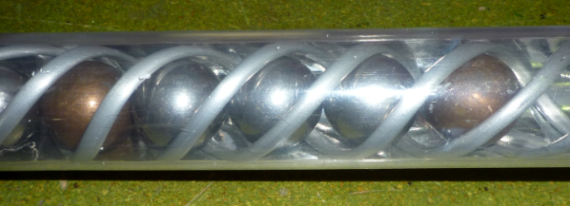
Pressurised helium cooled beryllium sphere concept for LBNE at 2.3 MW (20 μA)
Heat transfer coefficient
Stress vs beam spill length for fixed radius sphere

Slide 4
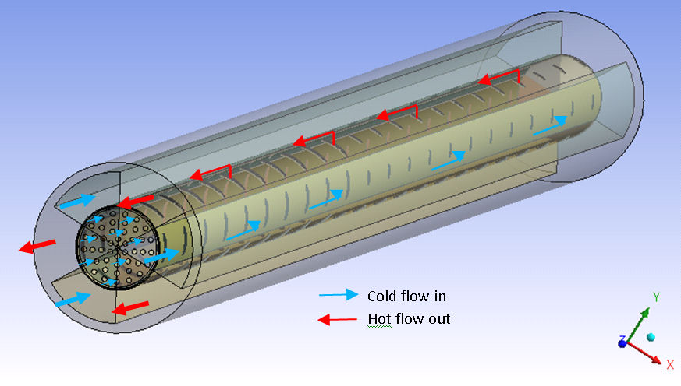
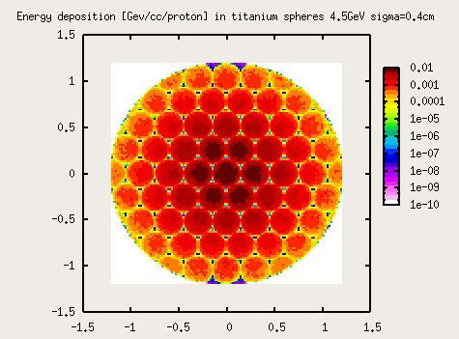
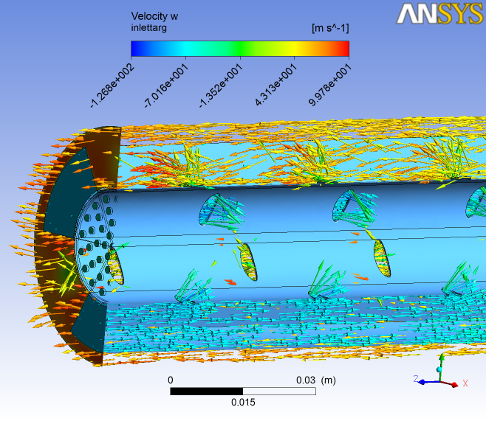
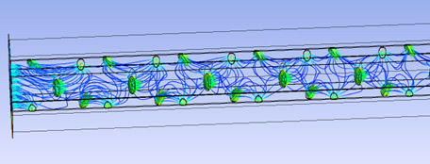

Packed bed target (EUROnu study for SPL-Superbeam)
Increased surface area. Coolant reaching
maximum energy deposition region
Stress limit reached for solid
peripherally cooled target
100 m/s helium
Packed bed target concept for 1 MW (200 μA per target) Limit for static target?

Slide 5
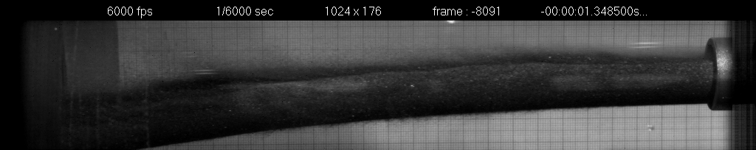
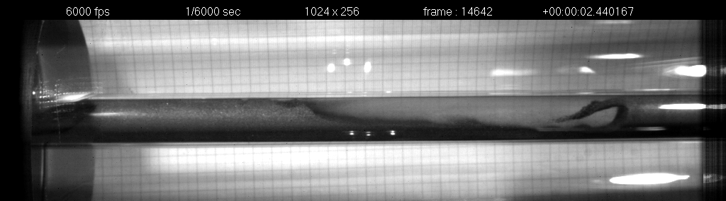
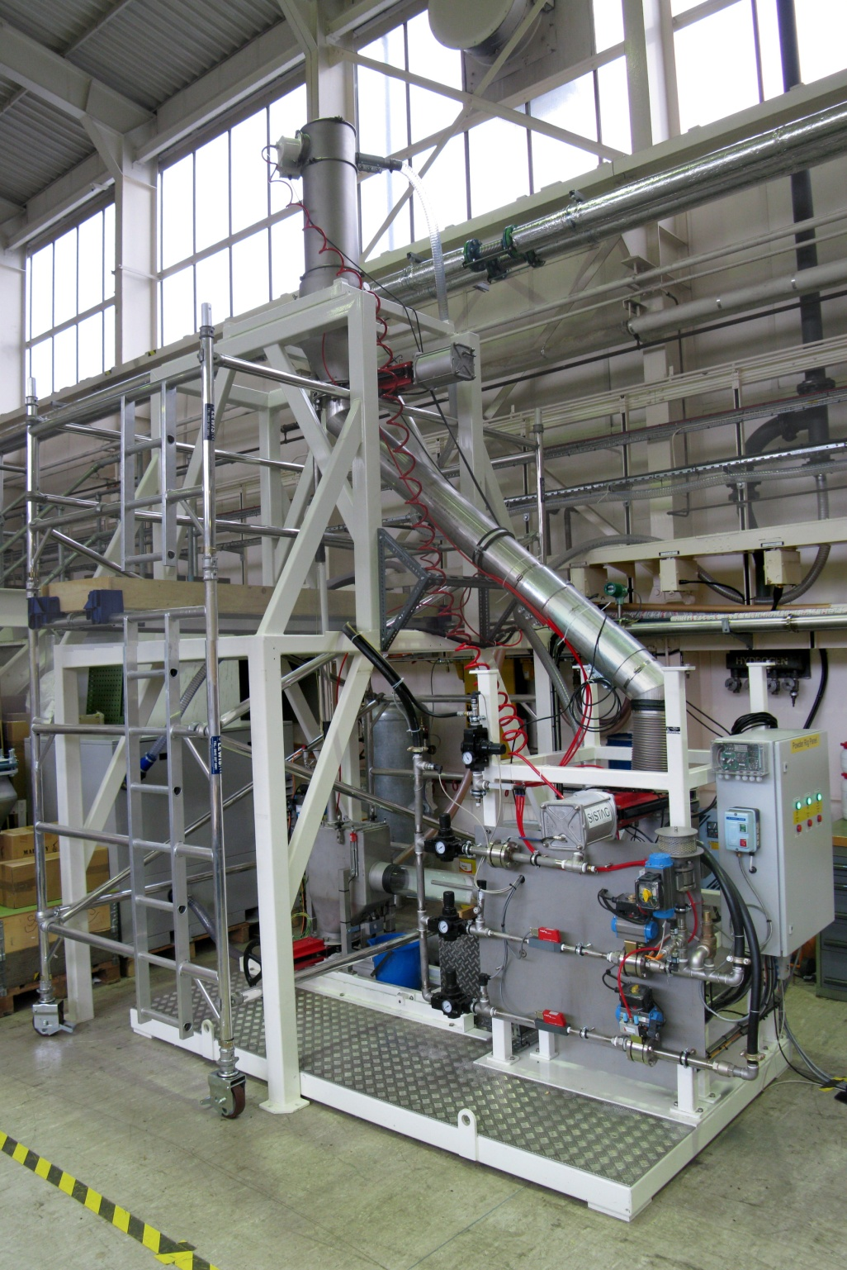
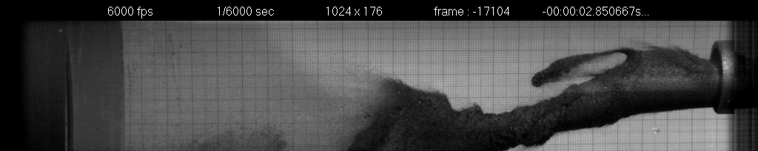
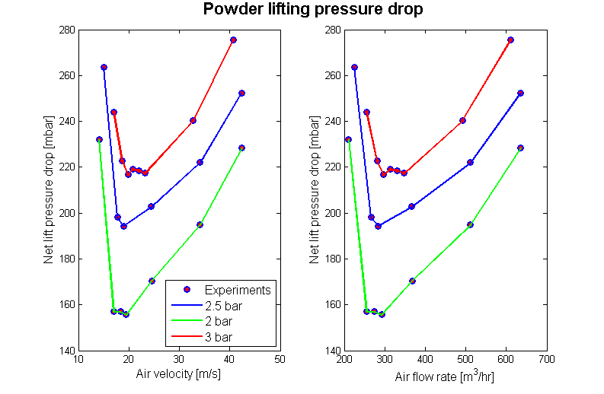
Fluidised tungsten powder target off-line test rig
Dense-phase delivery
Offline testing
  Pneumatic conveying
  (dense-phase and lean-phase)
  Containment / erosion
  Heat transfer and cooling of powder
High speed image: tungsten powder jet
High speed image: tungsten powder flow in a pipe
Unstable tungsten powder jet
2
Lean-phase lift
1
3
4

Slide 6
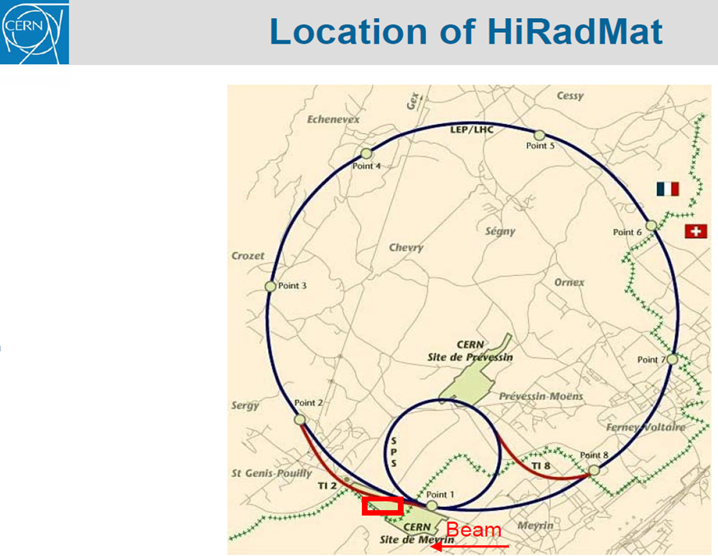
HiRadMat Beam Parameters:
A high-intensity beam pulse from SPS of proton or ion beams is directed to the HiRadMat facility in parasitic mode, using the existing fast extraction channel to LHC..
Beam Energy 440 GeV
Pulse Energy up to 3.4 MJ
Bunch intensity 3.0 · 10⁹ to 1.7 · 10¹¹ protons
Number of bunches 1 to 288
Maximum pulse intensity 4.9 · 10¹³ protons
Bunch length 11.24 cm
Bunch spacing 25, 50, 75 or 150 ns
Pulse length 7.2 µs
Beam size at target variable around 1 mm²
Pulsed-beam experiment
June 2012

Slide 7
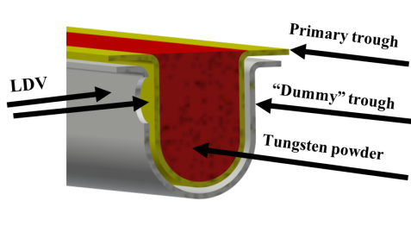
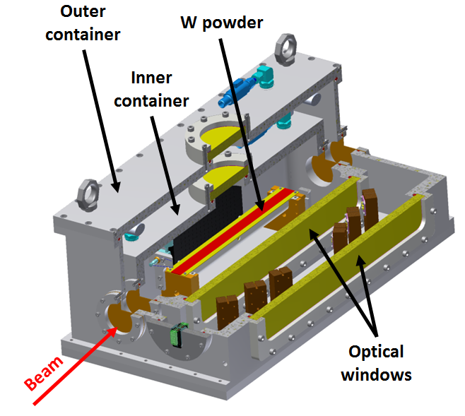
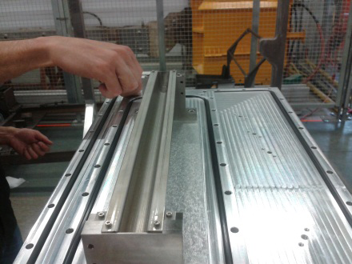
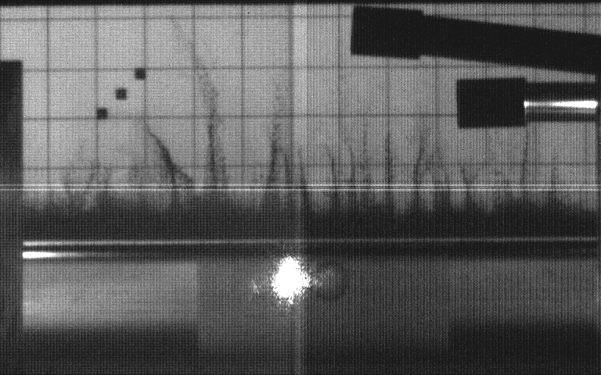
In-beam experiment at HiRadMat, CERN
Beam
Open trough Assembly
LDV/camera
Single tungsten powder sample in an open trough configuration
Helium environment
Remote diagnostics via LDV and high-speed camera
Tungsten powder response to a 440 GeV proton beam pulse at HiRadMat

Slide 8
HRMT-10: What We Learned
Identified an Energy threshold, beyond which significant eruption of the powder occurs
Lift height correlates with deposited energy
Eruption velocities are low when compared to liquid metal splashes
HRMT-10: Open Questions
Can Aerodynamic processes alone be shown to account for the observed response? Or is there something else going on?
Can we rule out other mechanisms such as:
  direct momentum transfer between grains
  (i.e. shock-transmission through the bulk solid)
  An electrostatic mechanism
  Trough Wall vibrations exciting the powder
-> Off-line test programme
-> New experiment at HiRadMat

Slide 9
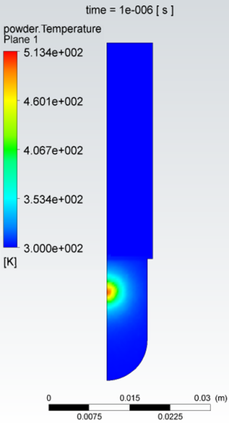
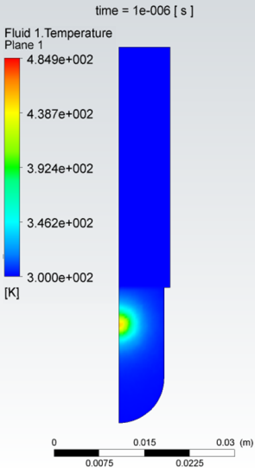
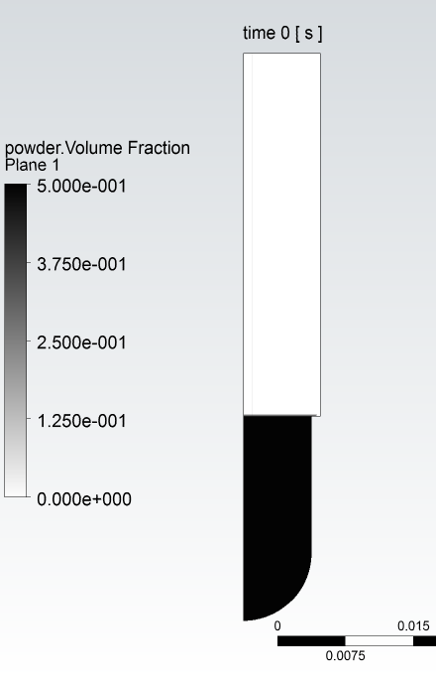
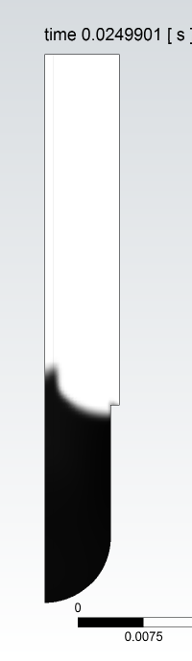
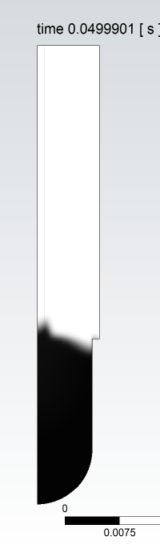
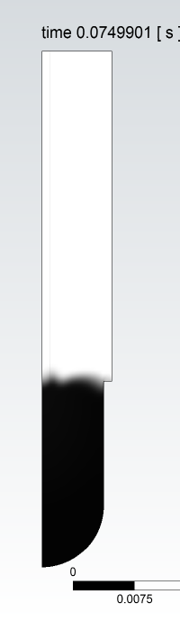

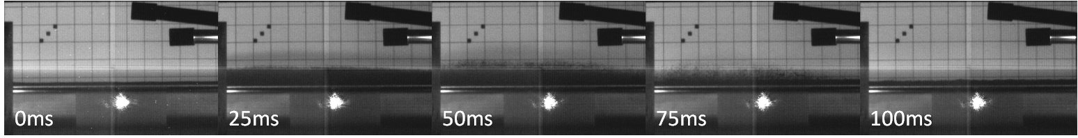
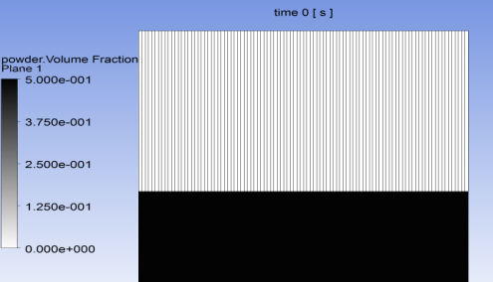
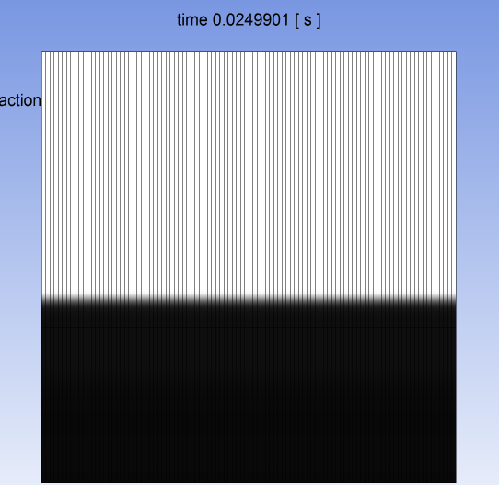
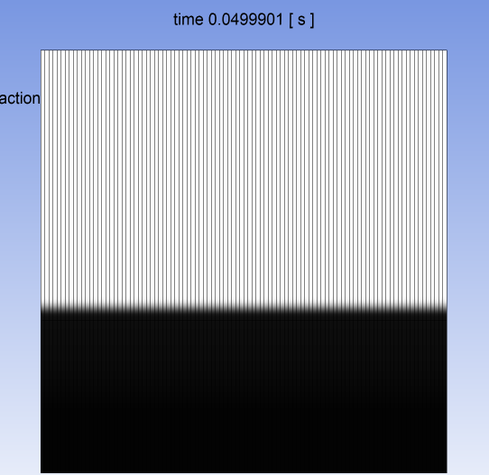
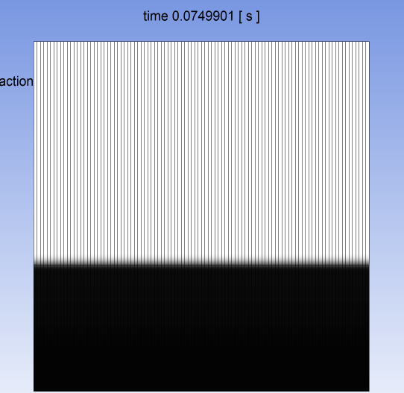
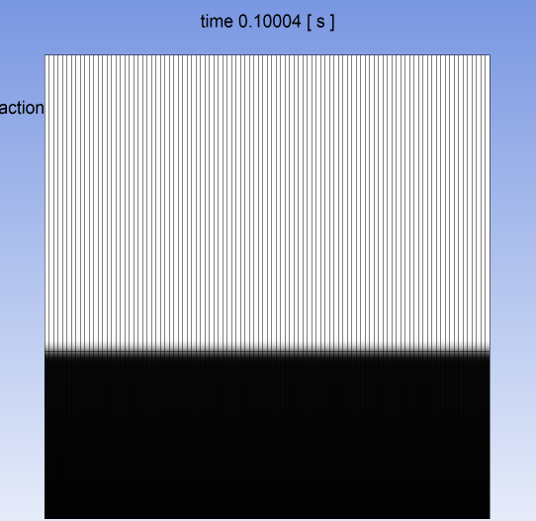
Davenne: CFD predictions/post fits
Beam heating
Powder lift was predicted by CFD
However the threshold intensity to lift the powder was found in the experiment to be an order of magnitude lower than predicted
So is the lift:
aerodynamic?
stress propagation?
electrostatic?
Test Results from Shot #8, 1.75e11 protons, beam sigma 0.75 mm x 1.1 mm
CFD simulation of Shot #8, assuming 1 micron particle size
(n.b. no lift with 25 micron particles at this intensity)

Slide 10
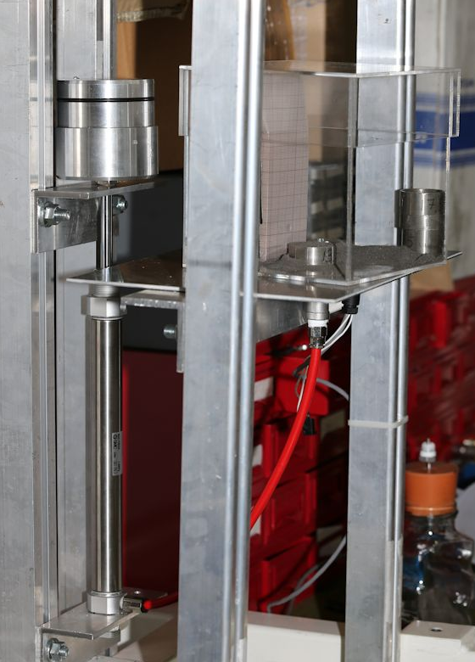
Tungsten powder puff experiment:
understanding the powder lift
piston
Puff cell

Slide 11
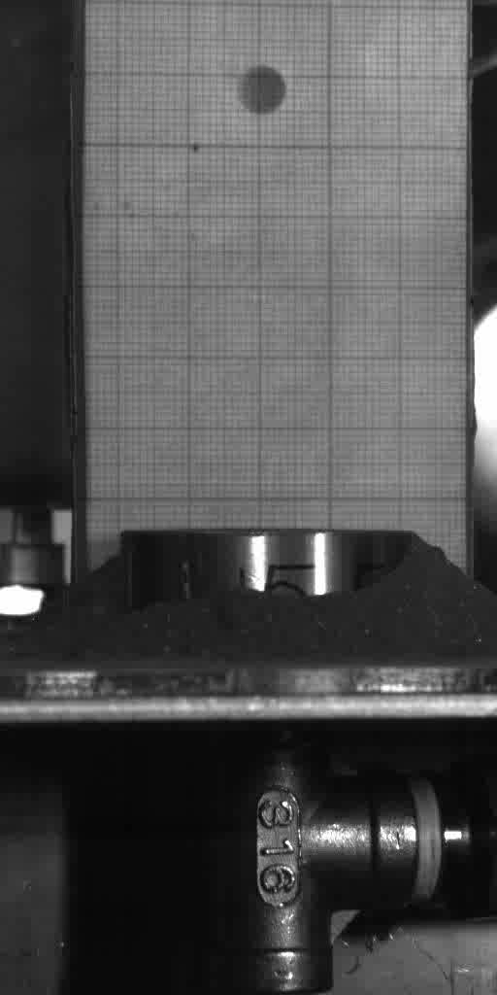
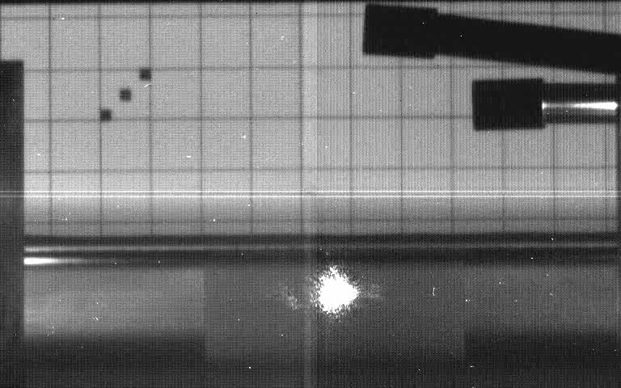
Tungsten powder puff experiment
Off-line test
Aim: To compare behaviour of Tungsten powder after a short pressure spike against the behaviour in the HiRadMat experiment
Method: Use a short pressure pulse to lift the powder
On-line test
Notes:
All experimental data and videos can be found in: \\te9files.te.rl.ac.uk\HPTshr\rachel\Powder puff experiment
in the various Powder Puff # folders
\\te9files.te.rl.ac.uk\HPTshr\rachel\Powder puff experiment\Powder puff test setup photos contains images of the test setup

Slide 12
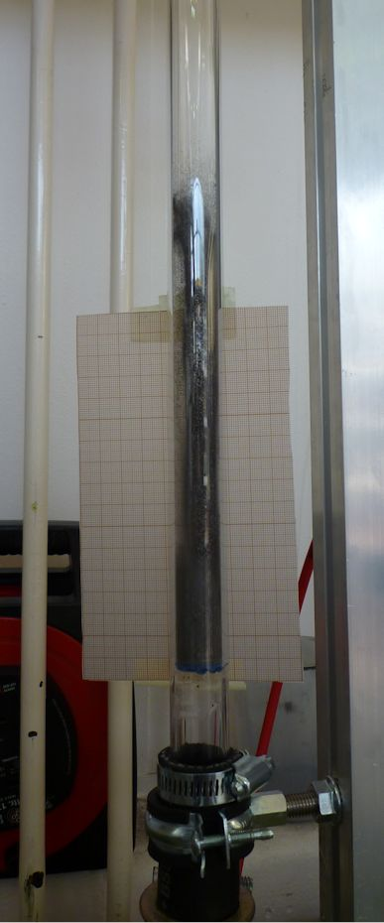
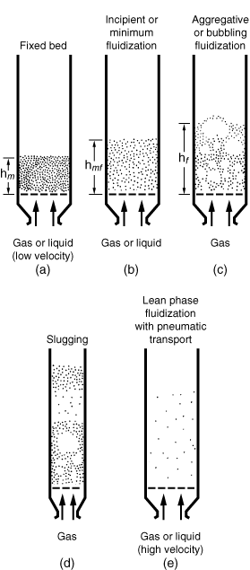
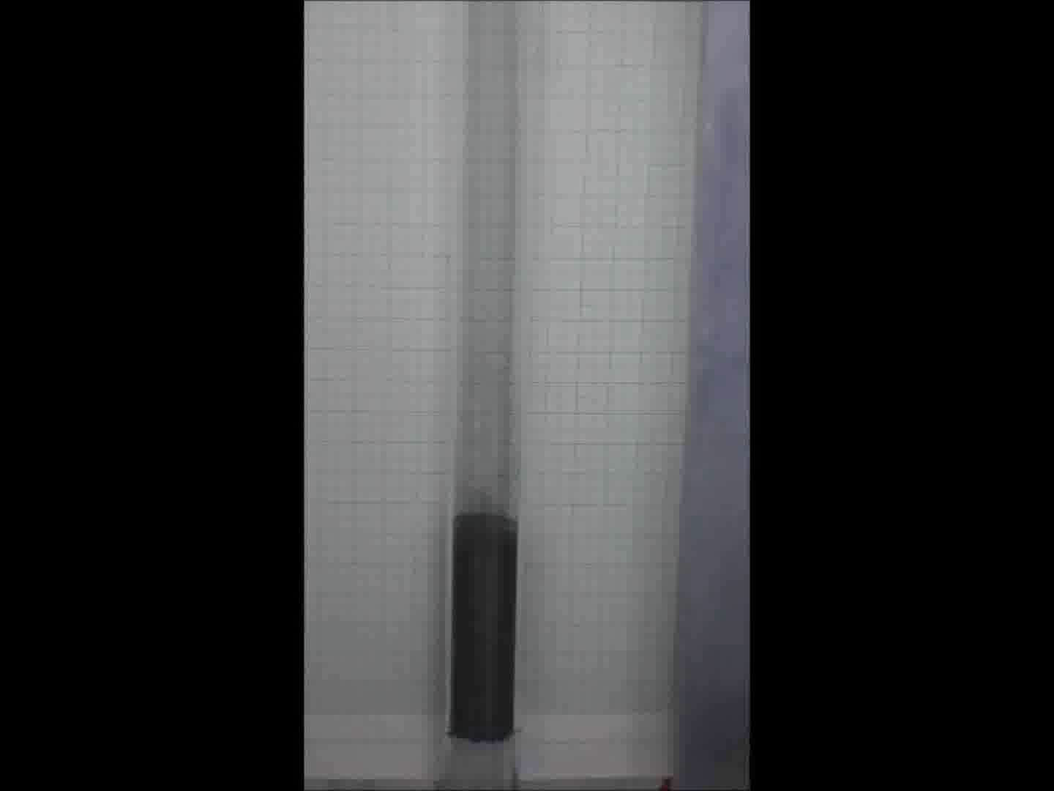
Understanding powder lift
Pressure drop for air flowing through a bed of powder
Atherton, Davenne
Notes:
\\te9files.te.rl.ac.uk\HPTshr\rachel\Fluidised bed experiment\Videos (106 to 150 microns)

Slide 13

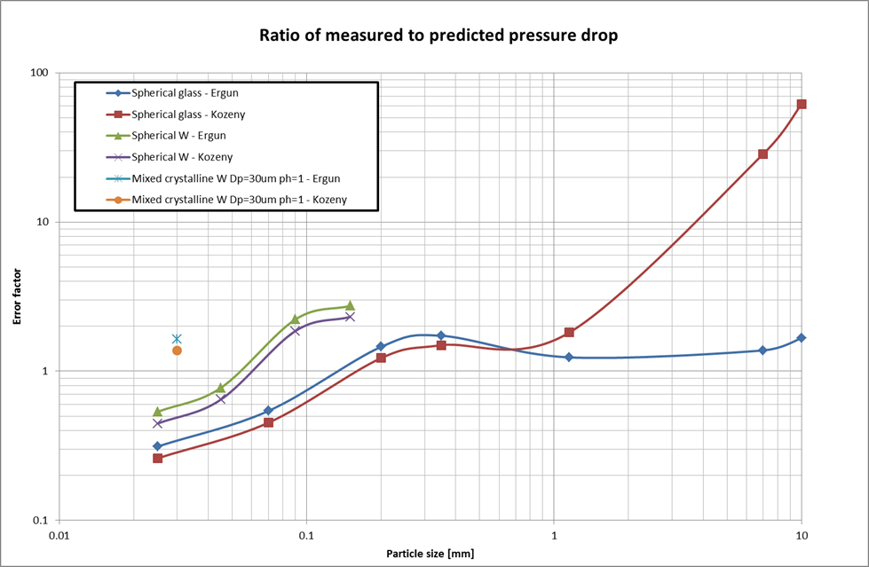
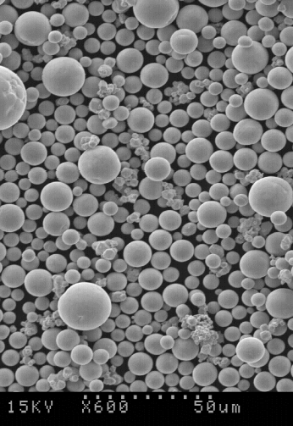
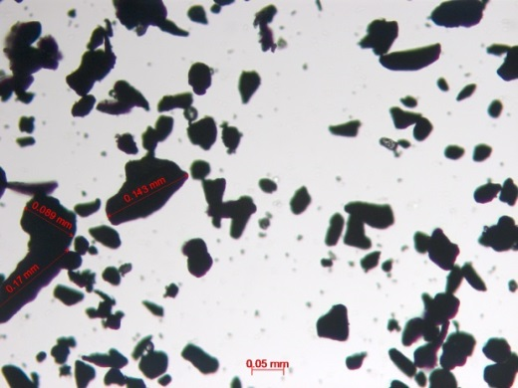
Packed bed experiment
Experimental pressure drop measured across a packed bed of W powder is in line with the analytical pressure drop given by Ergun (employed by CFX)
Notes:
Measured data for fluidised bed experiment is here: \\te9files.te.rl.ac.uk\HPTshr\rachel\Fluidised bed experiment
called Pressure drop data v3.xlsx
Calculations for expected pressure drop can be found here: \\te9files.te.rl.ac.uk\HPTshr\rachel\Fluidised bed experiment
1. Pressure drop calculations v2.xlsx
2. Tungsten_FLuidization v2.xlsx (Andrew’s document)
These calculations are based on equations from: http://www.umich.edu/~elements/12chap/html/12prof2a.htm

Slide 14

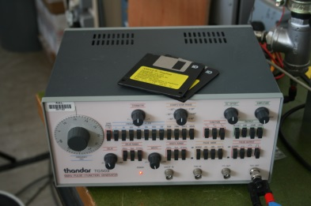
Sound propagation velocity and attenuation through granular materials
Piezo crystal source
Piezo crystal receiver
12 V signal generator

Slide 16
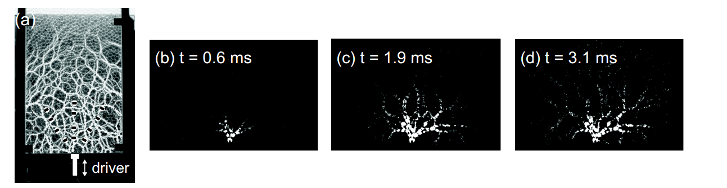
‘The propagation of acoustic signals is facilitated along strong force chains in granular materials via the increased contact area at strong contacts’ (Danielle S. Bassett, 2012).

Slide 17
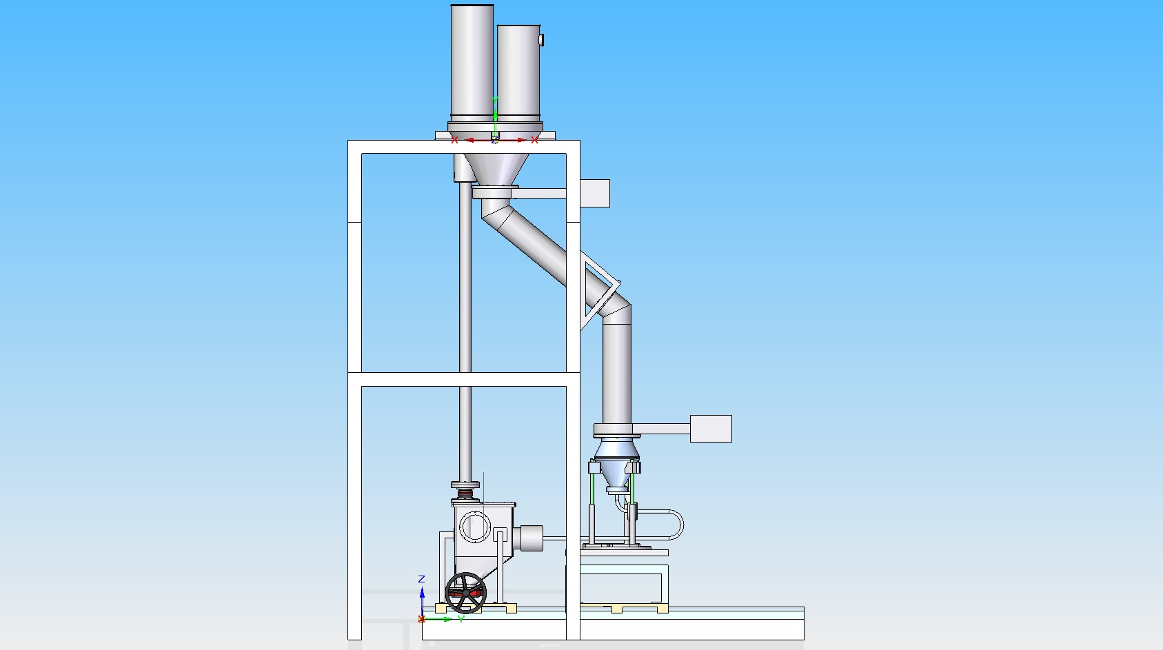
Fluidised powder test rig development
    Achieving solid dense-phase flow
    Investigation of 180° re-entrant pipe geometry
    CW upgrade
    Calorimetry – heat transfer with pipe wall
180° re-entrant pipe test – compatible e.g. with NuFACT solenoid geometry

Slide 18
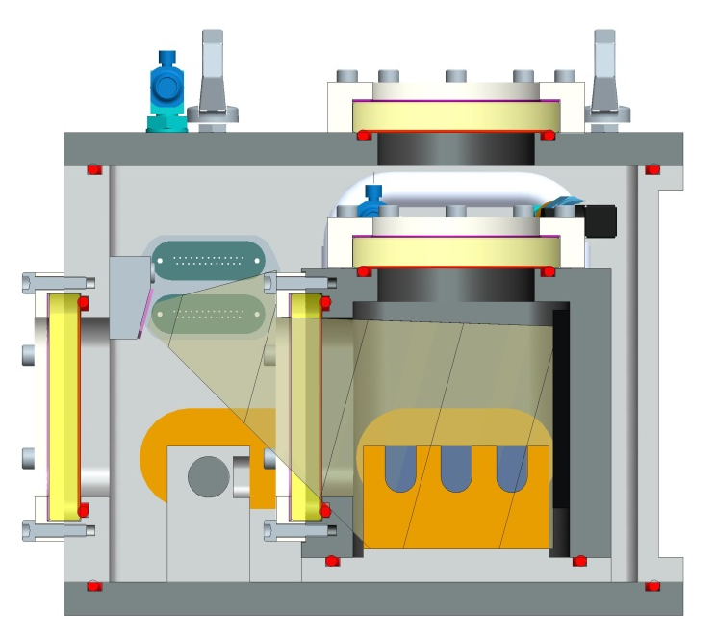
Key Developments for the HRMT-22 Experiment (Approved)
1. Test in both vacuum and helium environments
If we see an eruption in vacuum then it cannot be due to an aerodynamic mechanism!
2. Vessel updates
Elongated beam windows to facilitate hitting multiple samples. Extra optical window in the lid permits a view of the disrupted sample from above.
3. New Trough Concept
multiple samples, stiff (high natural frequency) to separate trough/powder disruption effects.

Slide 19
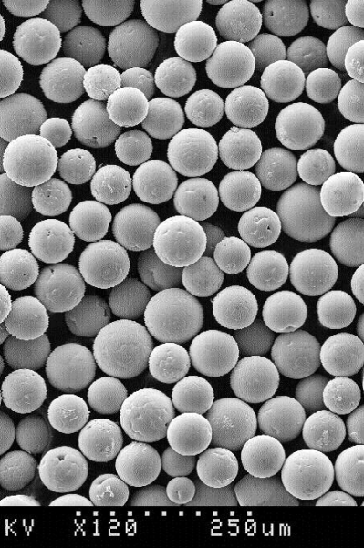
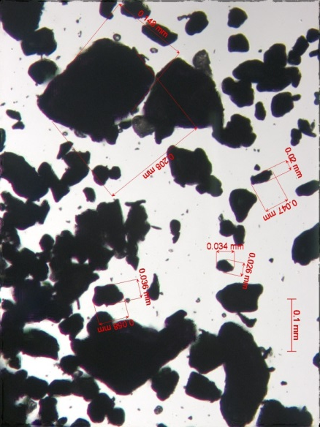
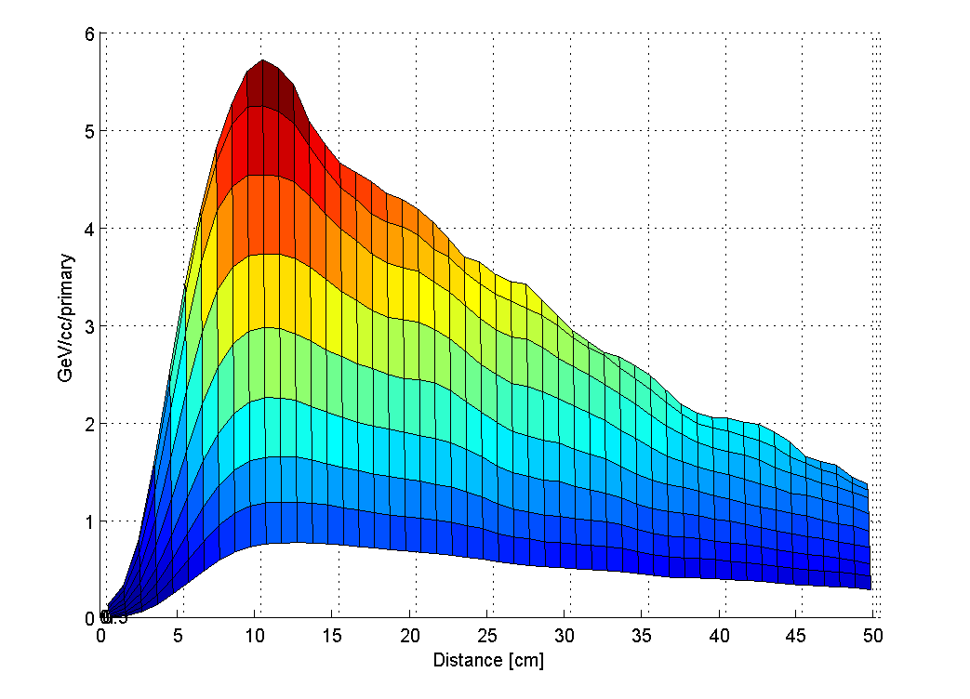
Key Developments for the HRMT-22 Experiment (Approved)
4. Use mono-dispersed spherical tungsten powder
To make the experiment fit the model(!)
5. Reconfigure the lighting rig to permit a view along the full length of the trough
To allow better correlation of lift vs energy deposition as the shower builds up along the sample
30 cm long sample
Energy deposited in a tungsten powder sample
from FLUKA simulation

Slide 20
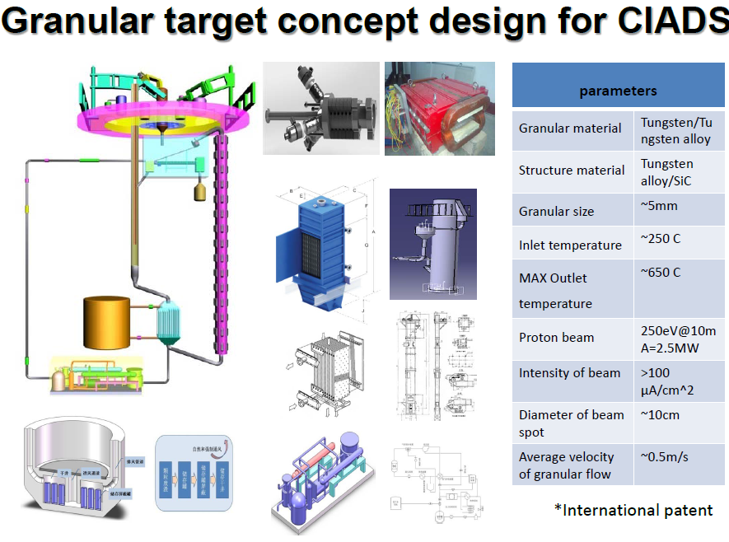

Slide 21
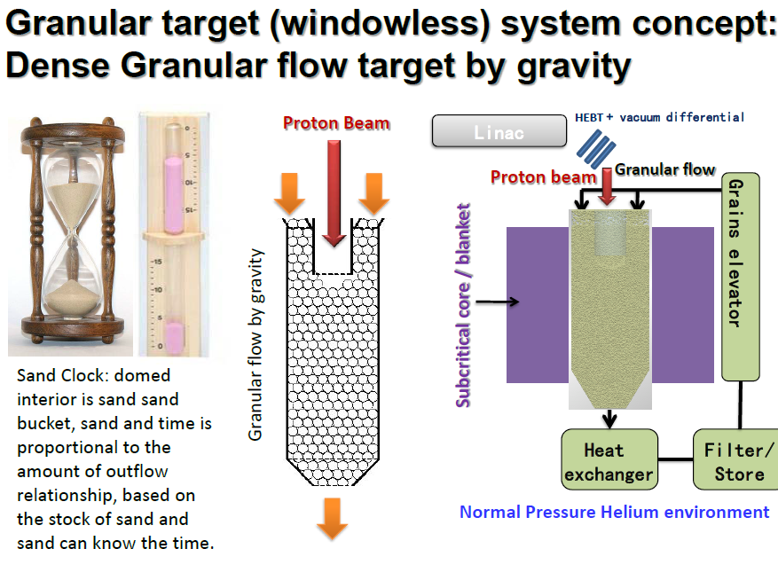
Lei Yang et al

Slide 22
Peripherally cooled cylindrical monolith targets have limited heat dissipation capability and experience high steady state and dynamic stresses.
Segmented internally cooled stationary targets can accommodate much higher heat loads and higher power densities.
A pebble bed target such as that proposed for EURONu or ESS-SB is probably the ultimate segmented target and may be relevant for other facilities where a solid cylindrical target is not viable. R & D in pebble bed and other segmented targets would be beneficial for future neutrino facilities and neutron sources alike.
At higher beam powers it may become necessary to employ flowing (powder and liquid metals) or rotating targets and that is why research in this area is required.
Physics performance is a function of reliability as well as optimum particle yield so the simplest target design possible is often the best choice.
Conclusions

