Slide 1



nuSTORM at CERN
NUFACT 2014
25-30 August 2014
Elena Wildner
CERN

Slide 2



Material used
Slides from several recent workshops:
  26-27 March 2013, CERN
  14-15 April 2013, Virginia Tech
  21-22 November 2013, Fermilab
  ICFA, neutrinos, Paris January 2014
Material in recent
  Expression of interest to SPSC, CERN arXiv:1305.1419
    Proposal to Fermilab PAC arXiv: 1308.6822, plus updates
    Discussions at CERN around nuSTORM at CERN (K. Long, M.Nessi, E. Wildner )

Slide 3
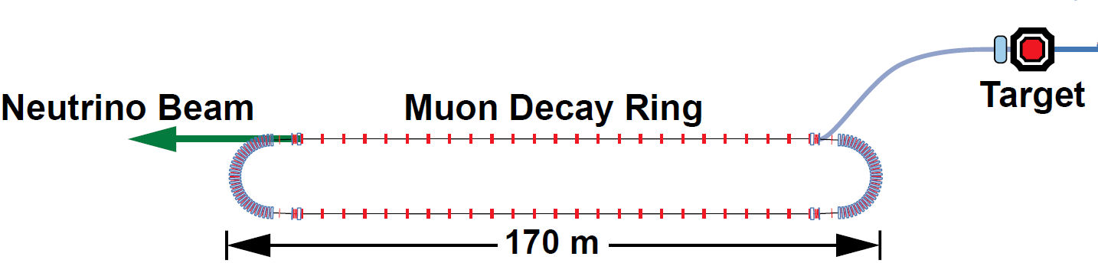
nuSTORM @ CERN
Concept and design study: Fermilab (A. Bross et al.)
Fit on CERN site (E. Wildner, Ken Long et al.)
Existing Infrastructures
  CERN SPS, North Area
Add a small storage ring (FODO/FFAG racetrack)
Several items can be developed independent of site
  Lattice, instrumentation, magnets, horn and target …
Some not
  Civil engineering, safety, controls system, target station…
Reuse/upgrade detectors
Develop generic detector concepts and technologies (Laguna, …)
π
p
ν
FNAL
9/1/14

Slide 4
CERN Neutrino Project
CERN Neutrino Platform
Investigate new programs (mu storage ring, betabeams ?, …)
Logistics +
Test Beams Infrastructure (EHN1 ext)
Neutrino detectors R&D
It will happen
Design and eventually implement a Neutrino Beam at CERN
EU participation in a High Intensity Facility
(detectors, beam, infrastr.)
PHYSICS
M. Nessi, Paris Jan. 2014

Slide 5
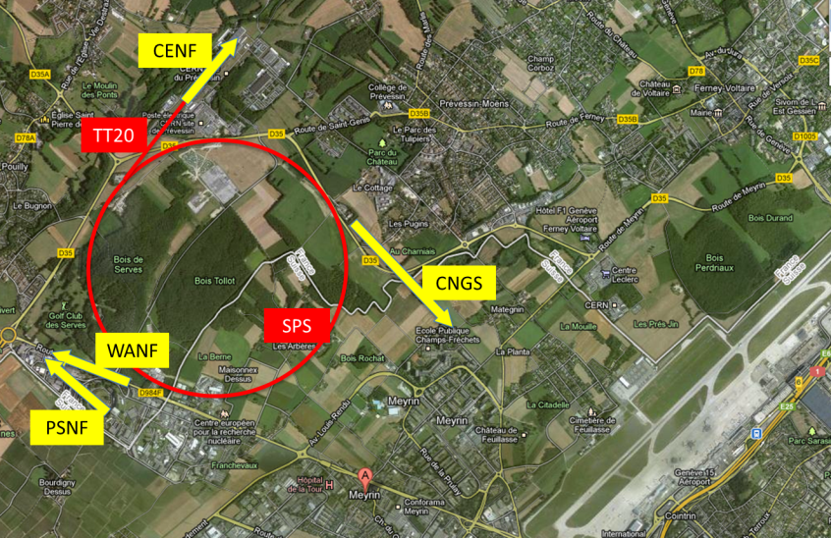
CERN Neutrino Platform
proposed
2006-2012
80-90s

Slide 6
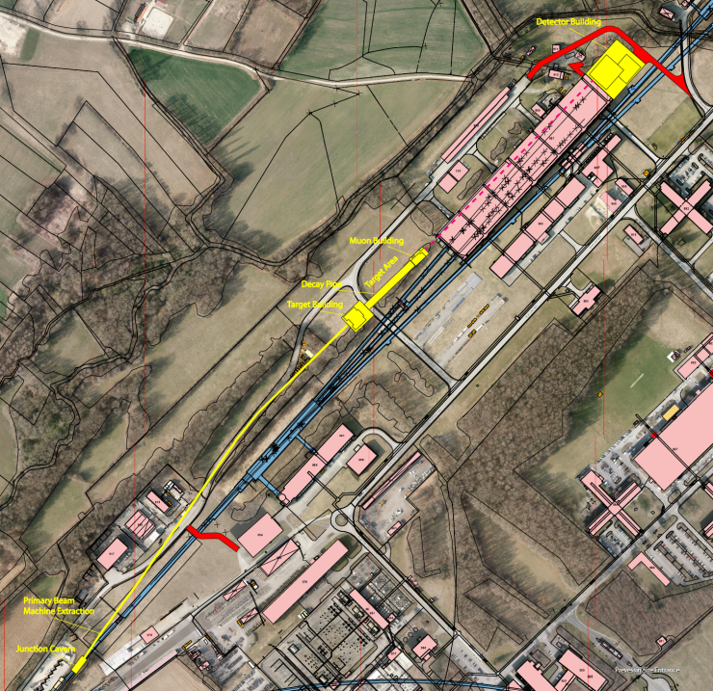

Slide 7
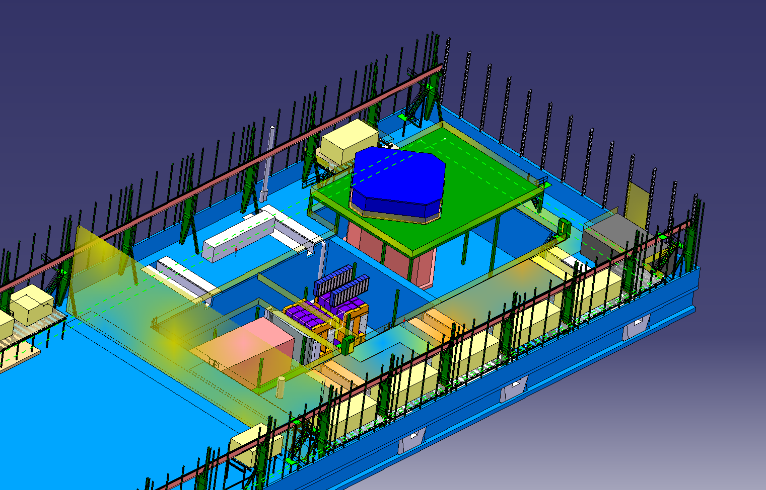
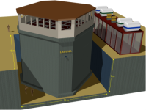
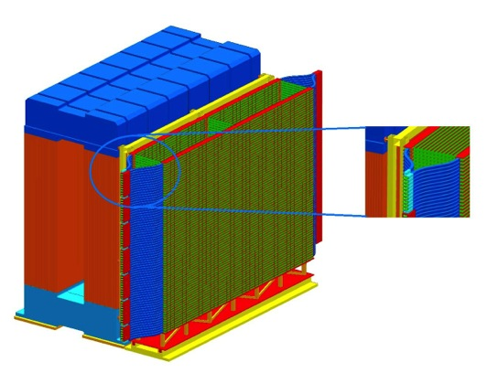
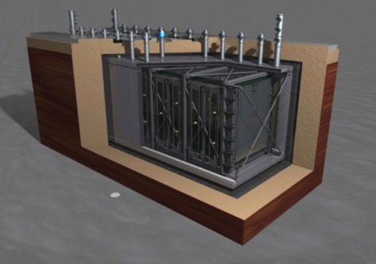
Detectors
ν + charged beams for all experiments
MIND
LAGUNA-PROTO
~64 meters
New detectors?
NESSiE
ICARUS T150

Slide 8
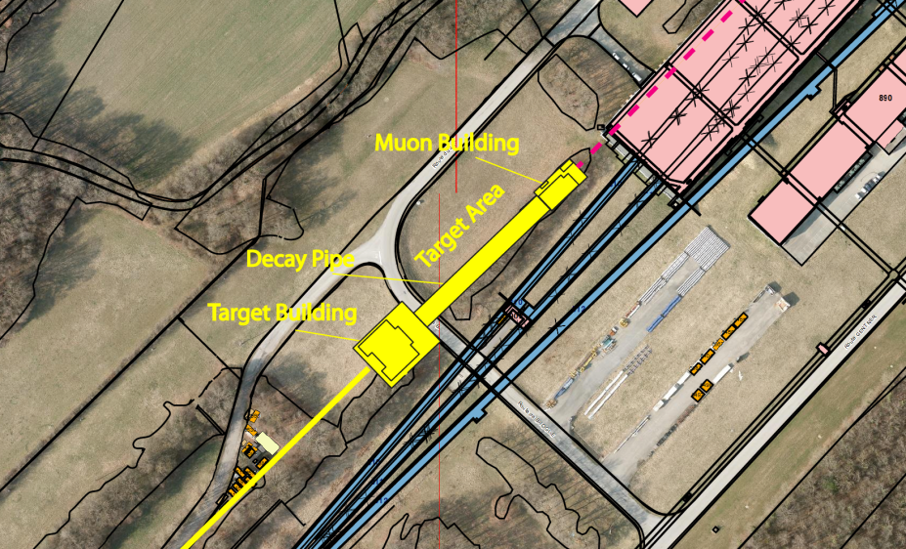
Charged beam for the detectors
Target station can be developed for nuSTORM ?

Slide 9
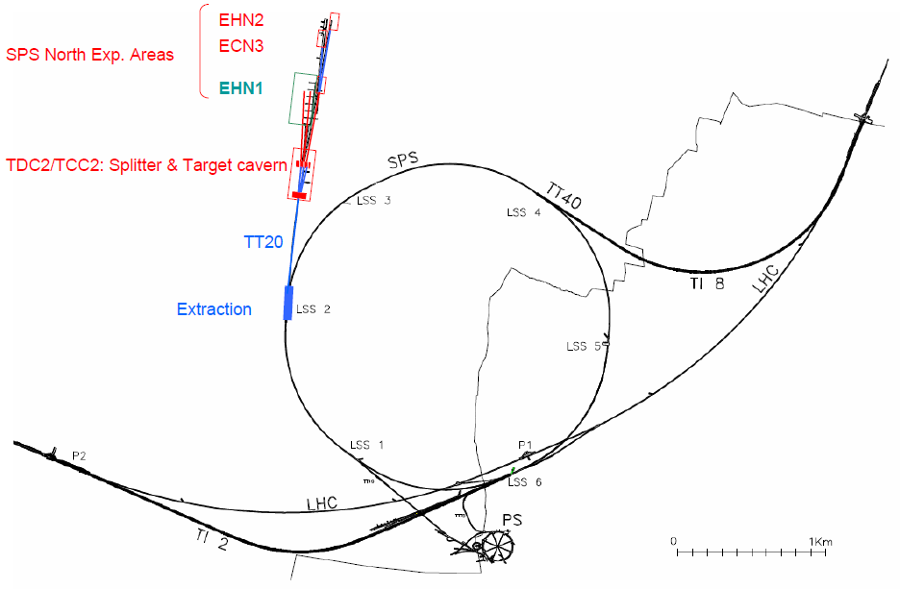

Primary Beam: Production & Extraction
Neutrino beam
North Area beam
Beam production scheme and beam structure similar to CNGS.
Successfully tested non-local fast extraction from LLS1 & LSS2.
Incompatible with simultaneous slow extraction → Time sharing.
Major upgrade/consolidation of machine protection system (BIS) required.
Magnetic septa (MST+MSE)
Inj. kicker (MKP)
50 ms
2nd Injection
from PS
100 GeV
1st Injection
from PS
1st Extraction
10.5 μs
2100 bunches
2nd Extraction
14 GeV
1.2 s
EOI 2013
Cycle / Pulse 3.6 sec. (every 6 seconds)

Slide 10
Configurations
CERN SPS primary beam pulse: 10 μsec.
FNAL MI primary beam pulse: 1.6 μsec.
Best case is a pulse length = to the ring circumference. This gives best nu_mu from pion decay beam and most efficient use of the muon decays.

Slide 11
Siting (from EOI)
CERN
CERN
CERN North Area
Neutrino platform (CENF), from EOI
FNAL

Slide 12
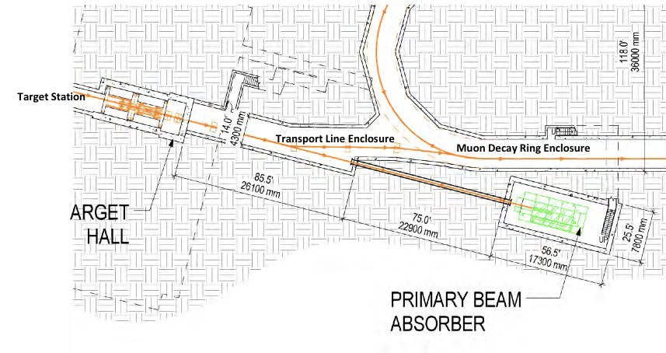
Target&injection region
CERN pion beam
The target station would be for nuSTORM
From project definition report
arXiv:1309.1389.

Slide 13
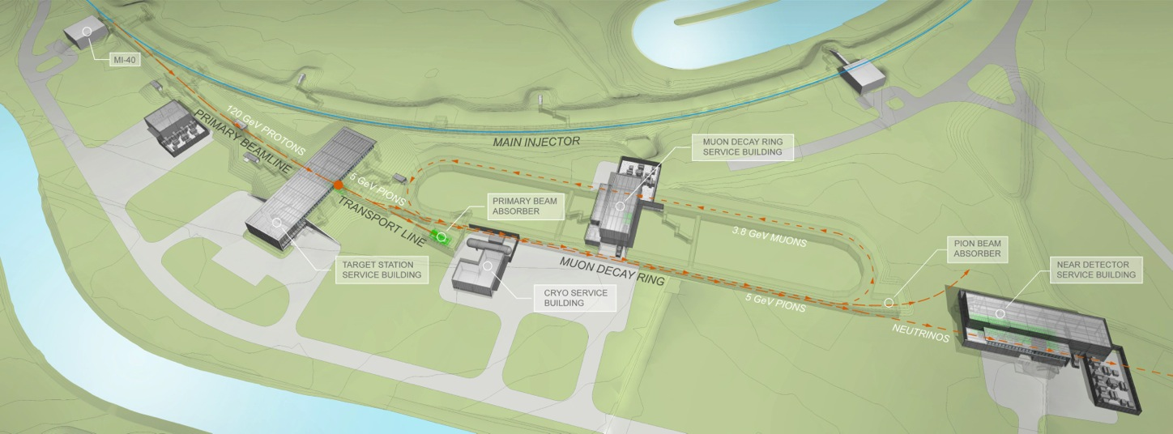
p-flux & ν-flux
FNAL Proposal: 10²¹ 120 GeV POT/10yr -> ~ 1.9 X 10¹⁸ useful μ decays
  In PIP era, extract one Booster batch/cycle (10²⁰ POT/yr ➔10 year run)
  Baseline FODO ring, C target, NUMI style 1 horn
  Inconel target + horn optimization + RFFAG ➔ X5 ( 2 year run)
Alan Bross P5 Face-to-Face Meeting, Fermilab, Nov. 2013
CERN EOI, Nov. 2013
CERN (EOI) 4.5 10²⁰ 100 GeV POT/10yr
  Assuming similar accelerator facility as FNAL (C target)
  Beam from SPS as proposed for the CENF primary beam
  Without any optimization

Slide 14
nuSTORM facility: parameters overview
Collect and transport pions from target: 5 GeV/c ± 10%
60% decay on the first straight section to muons
40%, up to 5 kW, go to pion dump or pion degrader for cooling experiments
Momentum of muons in ring 3.8 GeV/c ± 10%
p-beam: FNAL 120 GeV/c, CERN SPS 100 GeV/c (baseline)
  CERN SPS can deliver higher momentum, 450 GeV/c

Slide 15
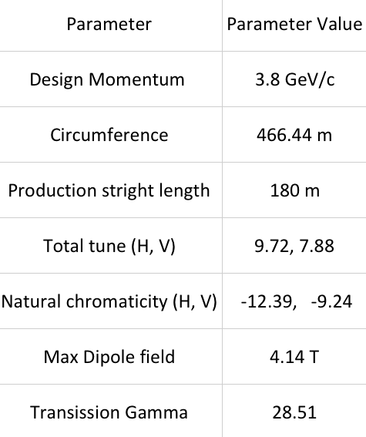
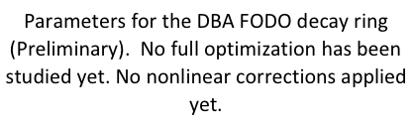
nuSTORM Ring Parameters
Courtesy A. Liu

Slide 16

The Three Pillars of nuSTORM
  Can add significantly to our knowledge of ν interactions, particularly for ν_{e}
Provides an accelerator & detector technology test bed for muons
Delivers on the physics for study of sterile ν
“European Strategy”: LBL program & collaboration
  Worldwide collaborative efforts
  paves the way to a high precision neutrino/muon program

Slide 17
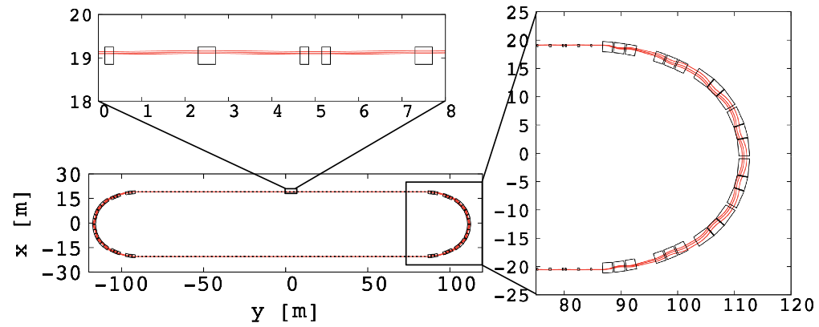
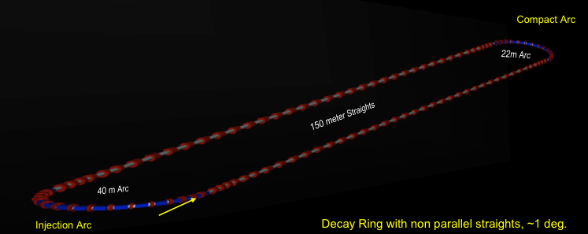
Lattice options
Racetrack FFAG
FODO
Fermilab layout drawings are for FODO
Dynamic aperture, tunes etc. still to be optimized.

Slide 18
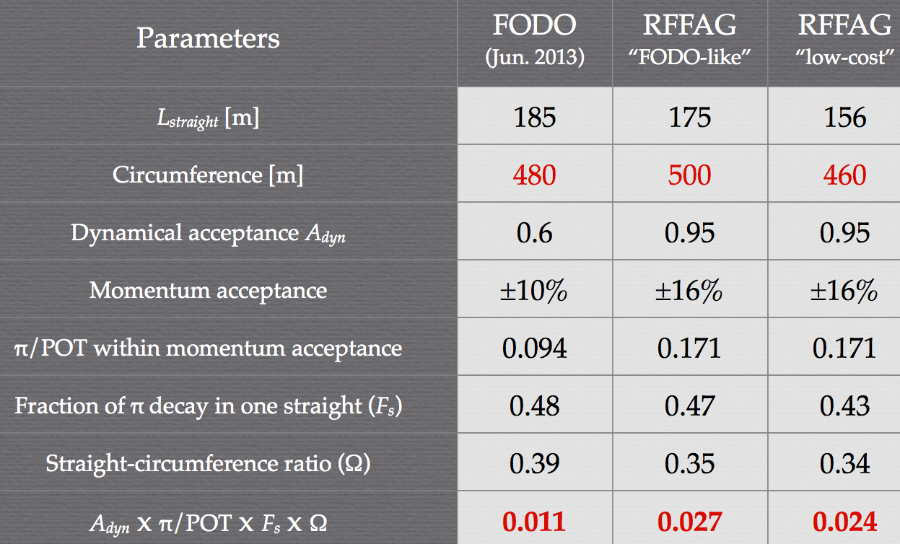
Lattice option comparison
Paris, Jan. 2014

Slide 19
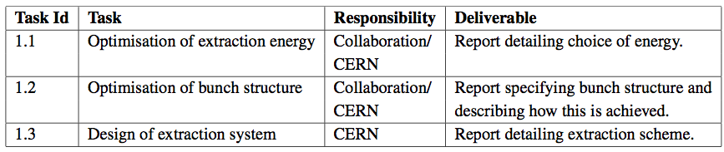
Workpackages @ CERN: SPS
Preliminary

Slide 20
Pion Production (FNAL)
120 GeV proton beam, beam radius – 1mm
5 GeV/c π+ yield optimization
  Inconel, Tungsten, Graphite
  Target length, radius, material and position inside horn. Horn current- 230 kA.
Yield rises very little with target length. Dependence on target position inside horn is weak. Dependence of yield on target radius is opposite for heavy and light targets.
Yields better for Inconel and Tungsten
Realistic horn model slightly decreases predicted yield, but changes distribution is not so marginal (interactions in the horn itself)
MARS model agrees well with exp. data on carbon in nuSTORM range of interest. MIPP and NA61/SHINE measurements for medium and heavy nuclei will be published in two years.
Development at CERN?

Slide 21
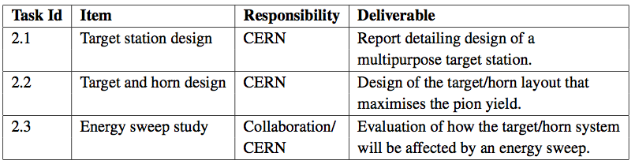
WP2 @ CERN: Target and collection
Preliminary

Slide 22
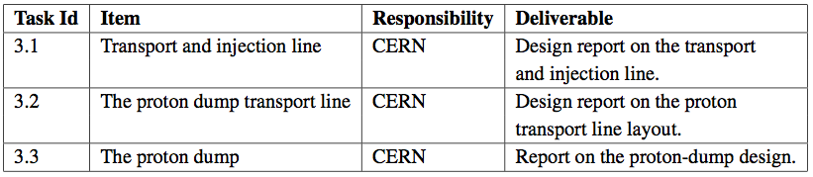
WP3 @ CERN: Collection and Transport
Preliminary

Slide 23
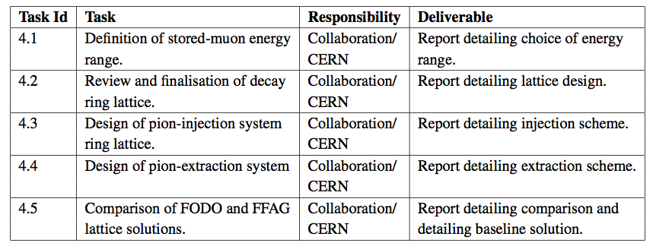
WP4 @ CERN: Decay Ring Layout
Preliminary

Slide 24
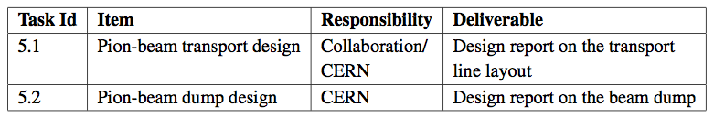
WP5 @ CERN: Pion Beam Dump
Preliminary

Slide 25
Preliminary magnet considerations, FODO Lattice
Straights:
  Resistive quite standard technology.
  The apertures are quite large, prototyping needed
Arcs:
  Superconducting magnets. Most of them coil dominated, possibly a few quadrupoles in between could be iron dominated (superferric), also to avoid warm-to-cold transitions.
  Lattice to be optimized for quadrupole feasibility (even with Nb₃Sn).
Space for sextupoles / orbit correctors (in the arcs): large apertures is a challenge (large stored energies per unit length, large forces and significant cross-talk between the magnetic elements)
Courtesy A. Milanese

Slide 26
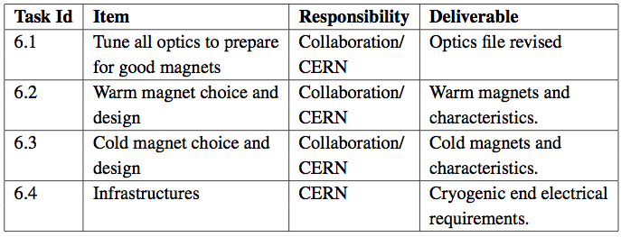
WP6 @ CERN: Magnets
Preliminary

Slide 27
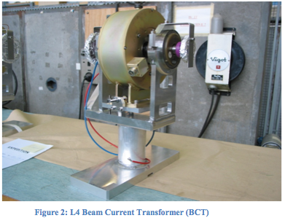
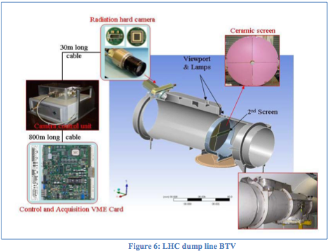
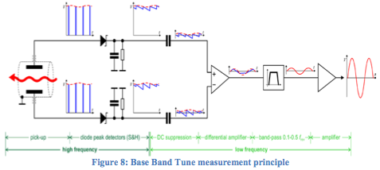
Instrumentation
Determine the neutrino flux at the near and far end detectors with an absolute precision < 1%, which depends on the number of Neutrinos and their energy distribution.
If the circulating muon flux in the storage ring is known on a turn to turn basis together with the orbit and orbit uncertainties (uncertainty on the divergence), then the neutrino flux can be predicted:
Circulating muon intensity (on a turn by turn basis) to 0.1% absolute.
Mean momentum to 0.1% absolute
Width of momentum spread to 1% (FWHM)
Tune to 0.01
Accelerator commissioning and running: (turn by turn)
Trajectory
Tune
Beam loss
Profile
Intensity, large chamber, challenging precision (0.1%)
L. Söby, CERN
Profile, low intensities, short lifetime (100μs), IPM not feasible, Sc. Screens or SEM strips to be foreseen, wire scanners not possible. Figure : 2m long tank, 60cm diameter, to be adapted.
Direct Diode Detection Base-Band Q (3D-BBQ) developed at CERN, by M. Gasior

Slide 28
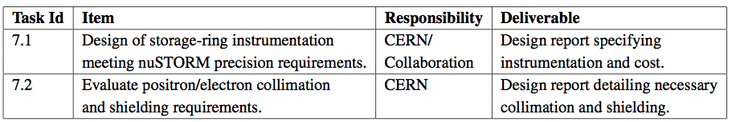
WP7 @ CERN: Instrumentation
Preliminary

Slide 29
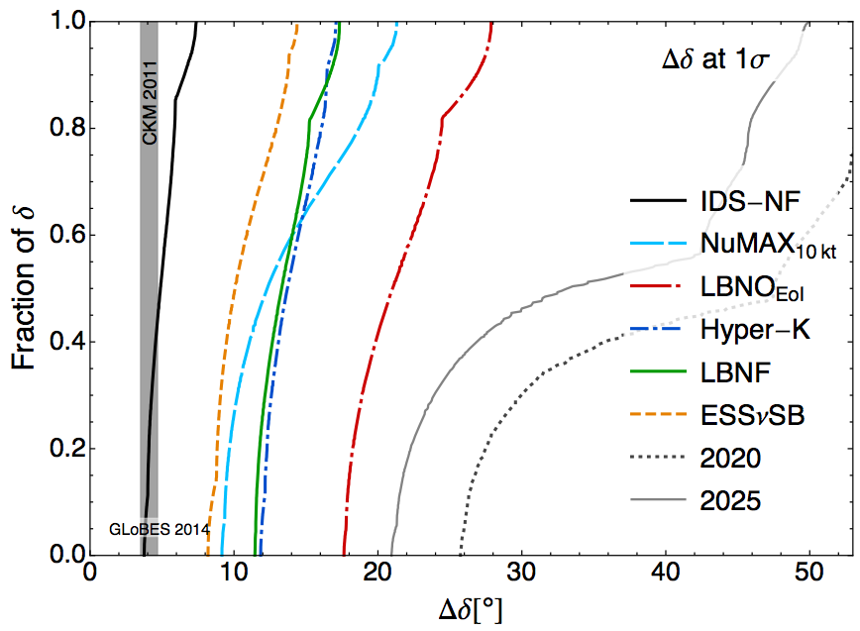
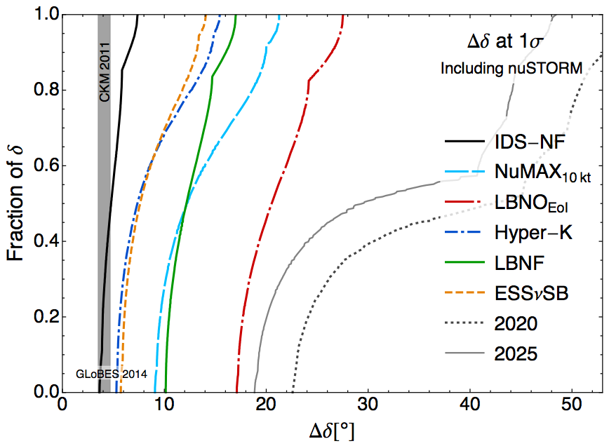
Including nuSTORM results
Systematics is the same as before, only that including nuSTORM it is assumed that cross sections are determined at the 1% level of precision, removing the constraint between the cross sections for different flavors, they are all allowed to vary independently in the fit.
LBNF (40 kton detector, 1.2MW beam power)
Pilar Coloma et al.
9/1/14

Slide 30
Thank you for your attention !
Stay tuned:
a workshop will be held at CERN
Nov-Dec 2014

Slide 31
Backup

Slide 32
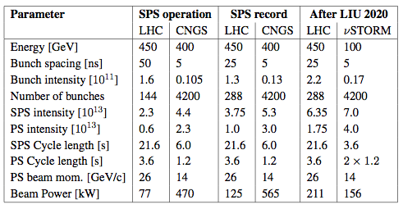
CERN Beams

Slide 33
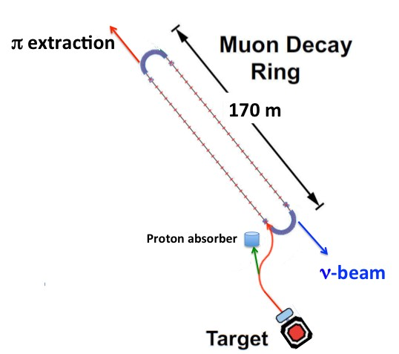
Beam parameters
Parameter | Value | Comments
Muon energy | 3.8GeV
Total intensity | 1 - 5E11? | Muon
Pulse length | 10.5µs | From SPS
Bunch frequency | 200MHz | Before injection
Nb of bunches | 233-2100? | Phase at injection?
Bunch length | 1-4ns? | Has to be simulated
Bunch intensity | 5E7-2E9? | More precise data needed
Rev. frequency | 851kHz | T = 1.17µs
Bunch current | 2-80mA ? | Injection scheme?
Average current | 14-68mA | At injection
Circumference | 350m
Beam size | 30cm | Diameter
Aperture | 40-60cm
Beam life time | 100 turns
Vacuum | 10E-7
Continuous multi turn (~9 turns) injection.
No RF
Injecting on top of circulation bunches NOT foreseen yet, i.e. 200MHz plus any frequency above is possible.
Structure in beam unknown for the moment

Slide 34
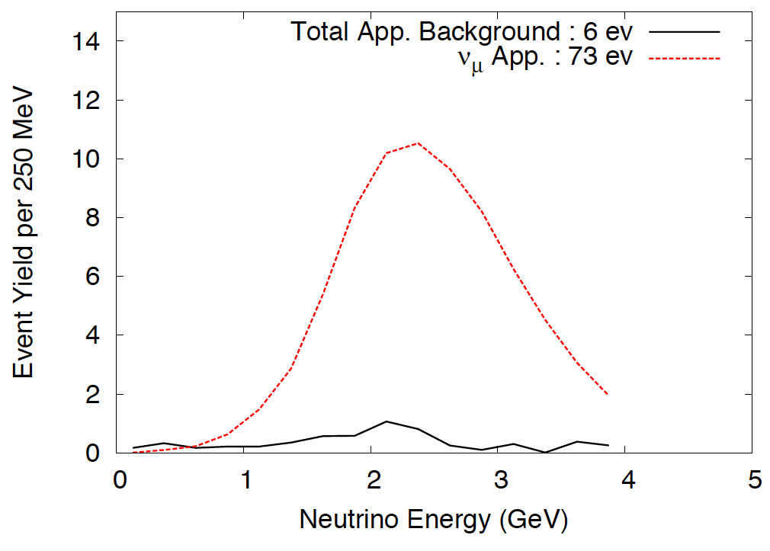
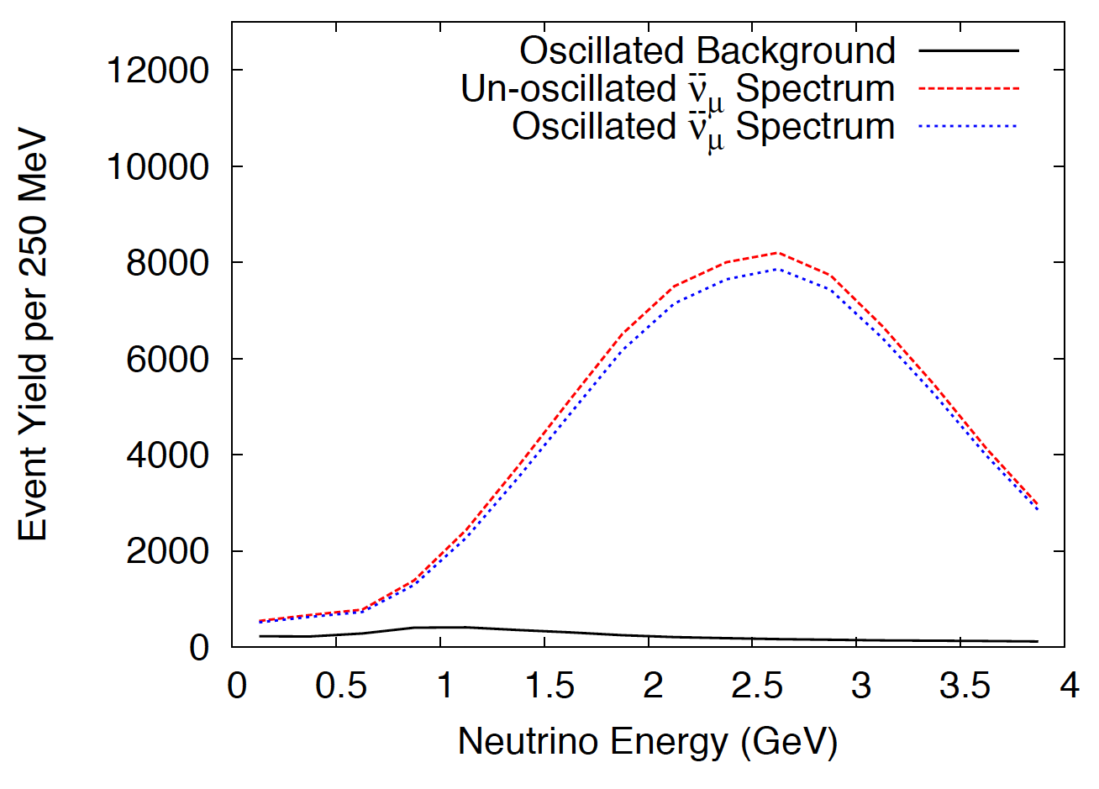
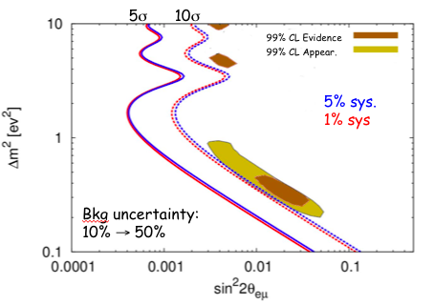
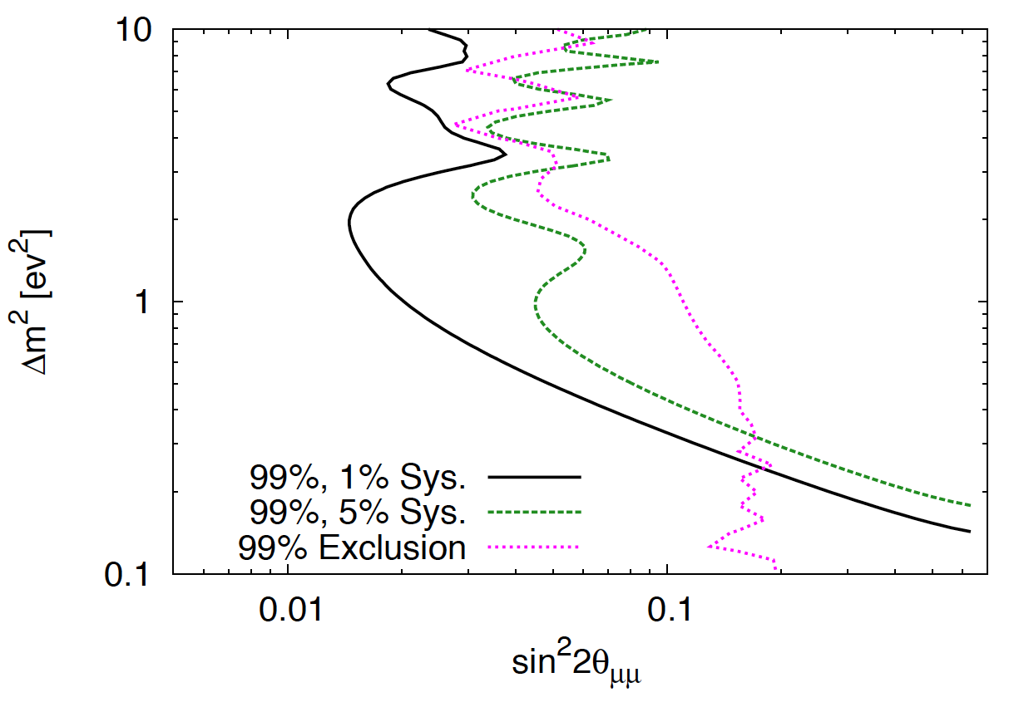
Sterile-neutrino search sensitivity
Global fit from: J. Kopp, P. A. N. Machado, M. Maltoni, and T. Schwetz (2013)
Notes:
o the left, the appearence sensitivity is shown. The top pane shows the event yield for different energies together with the mis-id events. Below is shown the 5 and 10 sigma exclusion contuors also showing that the difference between 1 and 5% systematic uncertainties is not important. nuSTORM would cover the brown and yellow areas that correspond to the LSND appearance data at the 10 sigma level.

Slide 35
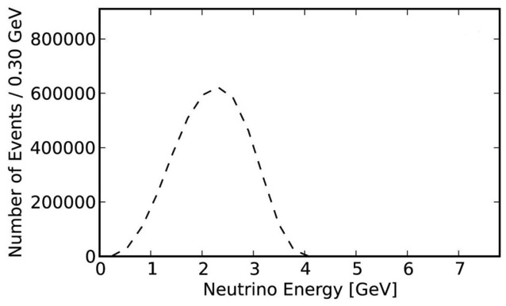
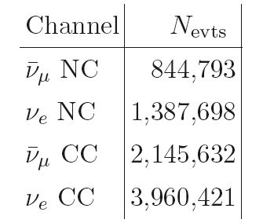
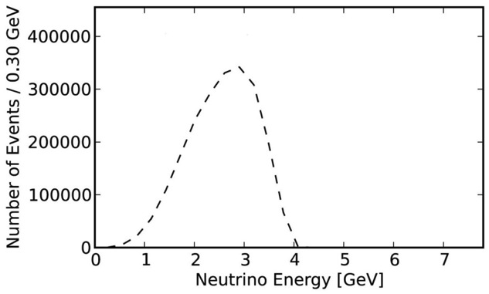
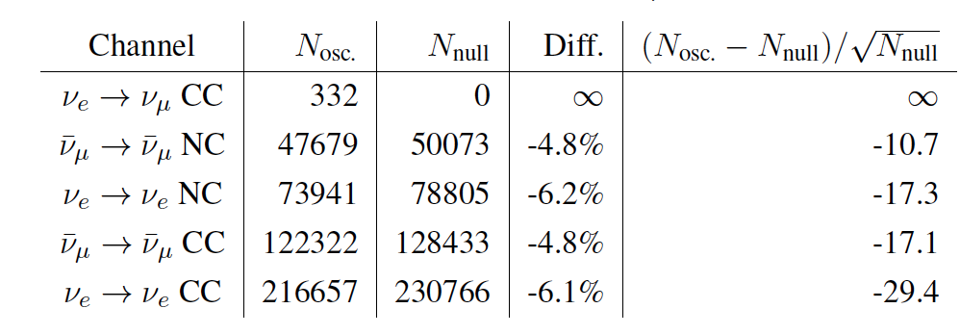
Spectra X cross-section (3.8 GeV/c μ⁺)
Event rates /100T at ND hall 50m from straight with μ⁺ stored for 10²¹ POT exposure
ν_{e}
Event rates at Far detector
ν_{μ}-bar
Notes:
the two left figures show the spectra times cross section for the neutrinos coming from the decay of a 3.8 GeV muons
In the table top right are shown the number of events expected from 10^21 POT in a near detector at 50 m from the end of the ring straight section.
In the table bottom right, the events in the far detector are shown. The red line would be the appearance events from mue going to numu via a sterile neutrino.
The disappearance channels are shown in the remaining four line

