Slide 1

Introduction to NUMAX
David Neuffer
C. Ankenbrandt, J-P Delahaye, M. Palmer, …

Slide 2
OUTLINE
Overview
  Staged Scenario Plan
  Compatible with FNAL
    succession of proton sources …
    PIP 1 → PIP 2 → ???
Sequence of neutrino sources
  LBN(E)F
  NuSTORM
  NuMAX
  Neutrino Factory

Slide 3
Fermilab Proton Sources
“Existing” (w PIP-1)
  0.4 GeV Linac → 8 GeV Booster→ Main Injector
    0.4 to 0.7 MW with~120 GeV MI
  1 → 3 → 8 GeV “Project X” – no longer baseline
    1MW→3MW (3 GeV)→ ?? 8GeV → 2+MW at MI
  PIP2 – 0.8 GeV pulsed linac
    Linac: 0.014 MW → ?
    MI to 1.2 MW ---? (LBNF expects 2.5 MW)
    Booster: 8 GeV at ~0.12 MW
  PIP2 is “upgradeable”
    could go to cw ~1ma →0.8MW at 0.8GeV
      Booster limits MI intensity
    upgrade could follow old Project X scenario
  Main Injector (60—120 GeV)
    0.4MW→ 0.7 → 1.2 MW ……..→ 2.5 MW (P5)

Slide 4
Muon Accelerator Concepts
Key issues and R&D to address feasibility
~10¹³-10¹⁴ μ / se
Tertiary prby MW p+
od.: pgπgFast μ: cosund
(1kHz0
Key Challenges
~10¹³-10¹⁴ μ / sec
Tertiary particle pgπgμ:
Fast cooling
(τ=2μs)
by 10⁶ (6D)
Fast acceleration
mitigating μ decay
Background
by μ decay
MW proton driver
MW class target
NCRF in magnetic field
Ionization cooling
High field solenoids (30T)
High Temp Superconductor
Cost eff. low RF SC Fast pulsed magnet
(1kHz)
Detector/machine
interface
Key R&D

Slide 5
Muon Accelerator Staging Scenario (MASS) in the FNAL context
nuSTORM (neutrinos from STOred Muons):
  short-baseline 10¹⁷ muon decays/year @ 3.8 GeV
  sterile neutrinos and cross sections
Neutrinos from Muon Accelerators at Project X (NuMAX) as first stage
  Neutrino Factory with 10²⁰ muon decays/year @ 5 GeV
  Neutrino ring at 5 GeV pointing towards Sanford (10kT LAr detector) upgraded fr
  use Phase 2 project X with 1MW@3 GeV as proton driver
Upgrade to full luminosity NuMAX+: 10²¹ muon decays/year@5 GeV
  Similar Physics performance as IDS-NF
  Upgrade proton driver to 3MW (PX2) and later 4 MW@8GeV of PX4 Larger magnetized detector (34kT)?
Follow with:
Higgs Factory: 125 GeV collider
Possible upgrade to a Top Factory
Multi-TeV Collider: up to 10 TeV

Slide 6
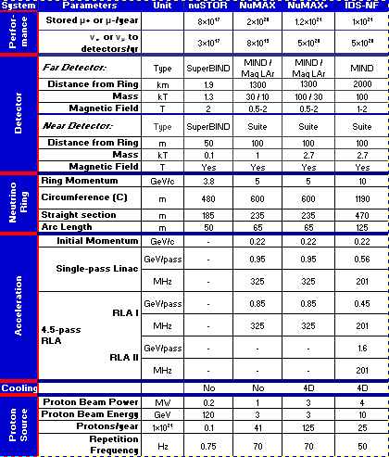
NuMAX parameters (pre P5)

Slide 7
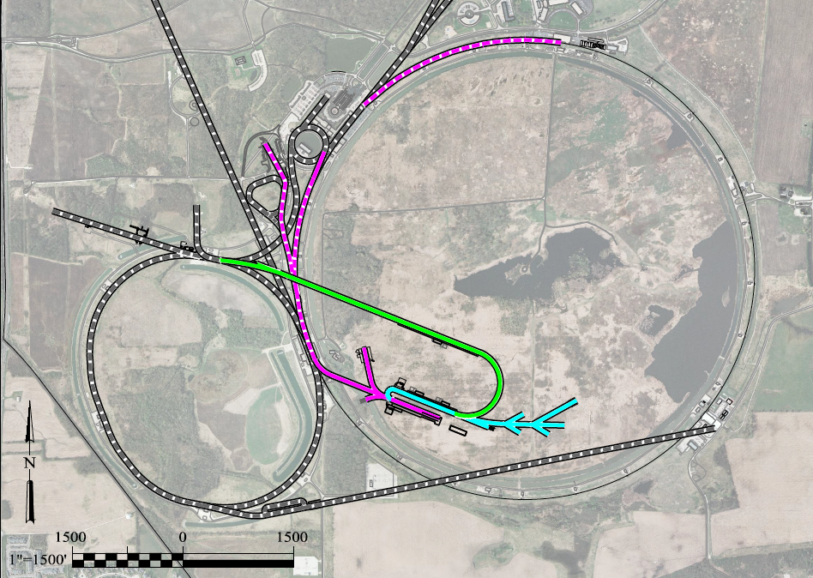
To Far Detector in
Sanford (1300km)
LBNE
Buncher/
Accumulator
Rings & Target
RLA to 63 GeV +
300m Higgs Factory
5 GeV
NF Decay Ring:
νs to Sanford
Front End+4D+6D
Project X
Stage III
Linac + RLA
SC 325MHz
to ~5 GeV
Project X
Stage II
Project X
Stage I
νSTORM + Muon Beam
R&D Facility

Slide 8
Modify to match FNAL scenarios
P5 Process forces modification
  PIP 2 (0.8 GeV pulsed linac) endorsed (with “LBNF”)
    NuSTORM too expensive for present
    Neutrino Factory not needed (yet…)
PIP2 needs upgrade(s) – to cw
  MI injection requires > ~6.75 GeV protons
    linac or synchrotron ?
Stage II of Project X was 3 GeV Linac
  PIP3 could be 3 GeV
Dual Use Linac
  could supply 6.75 GeV protons and 5 GeV muons

Slide 9
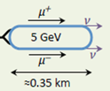
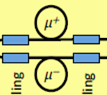

A cost effective and progressive installation in stages with increasing complexity
PIPII
Initially: 1MW on target
No cooling
NuMAX
0.8GeV
Post-cooling
Accelerator
PIPIII
Dual use
Linac
Higgs
Factory
2.2GeV
μ
Preinjector
0.25 GeV
3.75GeV
SC 650MHz
125GeV
300 m
Final cooling
1.0 GeV
325MHz
RLA
6.75 GeV
Protons
6D cooling
Bunch
merge
6D cooling
255MeV/c
Muons
RCS
Charge separator
1-2.3
To MI for
LBNF upgrade
1.5 to 6 (10) TeV
2.5 to 6km
MW
Muon
Collider
Buncher
6D Cooling
Front-end
Combiner
Initial Cooling
Accumulator
Target

Slide 10
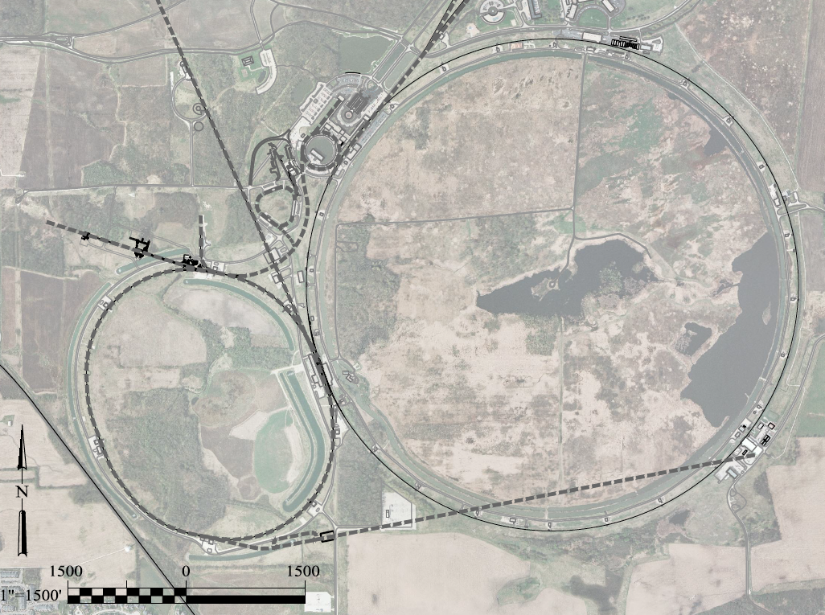
A Potential Muon Accelerator Complex at Fermilab:
νSTORM ➔ NuMAX
➔ Higgs Factory
0.8 GeV Proton
Linac (PIPII)
LBNF
Superbeam
Accumulator
Buncher &
Combiner
Front
End
0.8-3 GeV Proton
Linac (PIPIII)
Staging scenario fully compatible with the PIP-II stage option
To
SURF
Target
Initial
Cool
Final
Cool
NuMAX:
νs to SURF
6D
Cool
νSTORM
1 GeV Muon
Linac (325MHz)
RLA to 63 GeV
3-6.75 GeV Proton &
1.25-5 GeV/c Muon
dual use Linac
(650MHz)
To Near Detector(s) for
Short Baseline
Studies
300m Higgs Factory
Muon Collider
Later upgradable to a Muon Collider with Tevatron size at 6 TeV
ft
ft

Slide 11
Main parameters evolution
(increasing complexity and challenge)
 | NuMAX Commissioning | NuMAX | NuMAX+ | Higgs Fact 125 GeV
Beam energy (GeV/c) | 5 | 5 | 5 | 62.5
Cooling | No | Initial 6D | Initial 6D | 6D no final
Proton beam power on target | 1MW | 1MW | 2.75 MW | 4 MW
Proton beam energy on target | 6.75 GeV | 6.75 GeV | 6.75 GeV | 6.75 GeV
Acceleration cycle rep rate(Hz) | 60 | 60 | 60 | 15
μ / cycle at front end | 1.36 10¹² | 1.36 10¹² | 3.75 10¹² | 2.6 10¹³
Transmission efficiency (%) | 15.3 | 56.7 | 56.7 | 15.4
μ / bunch in ring | 7.0 10⁹ | 2.6 10¹⁰ | 3.5 10¹⁰ | 4 10¹²
Bunches in ring | 30 | 30 | 60 | 1
ν towards detector/year(10⁷s) | 4.9 10¹⁹ | 1.8 10²⁰ | 5.0 10²⁰
Higgs per year (10⁷ sec) |  |  |  | 13500
Luminosity (10³⁴ cm⁻²s⁻¹) |  |  |  | 0.01

Slide 12
NuSTORM Options
Iterate design; adapt to another location
  cross sections, steriles?, 1st μ storage ring for ν
Change ring location to match LBNEF
  could use same extraction
  Smaller, cheaper ring for near detector cross section measurements ?
  Same ring used also for nu fact to SD ?

Slide 13
Fermilab future upgrade path ??
0.8 GeV PIP2 -- could upgrade to cw
  Booster is bottleneck; must be replaced
3 GeV PIP3 is unlikely
Booster to be replaced by 0.8 → 8 GeV synchrotron
  power not yet certain; unlikely to be multi-MW
Main Injector would be ~2.5MW at 60—120 GeV
  could be more ???
  Main Injector could supply new (renamed) NuSTORM
  Could we add buncher ring to get short initial bunches for Neutrino Supersource / heavy-electron Collider?

Slide 14

Summary
NuSTORM Physics goals remain important
  ν_{e}, ν_{μ} cross sections; sterile neutrino limits
After LBNEF, more accuracy will be desired
  ν_{e}, ν_{μ} precision beams → ”NuMAX”
Use of multiMW beams upgraded from PIP-X could be a critical ingredient

Slide 15
BACK UPS

Slide 16
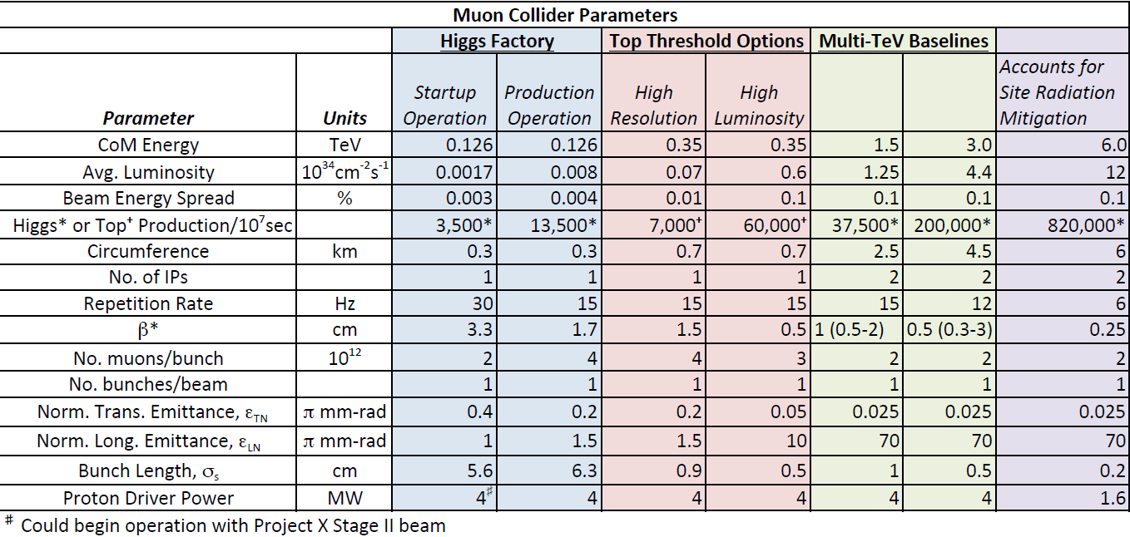
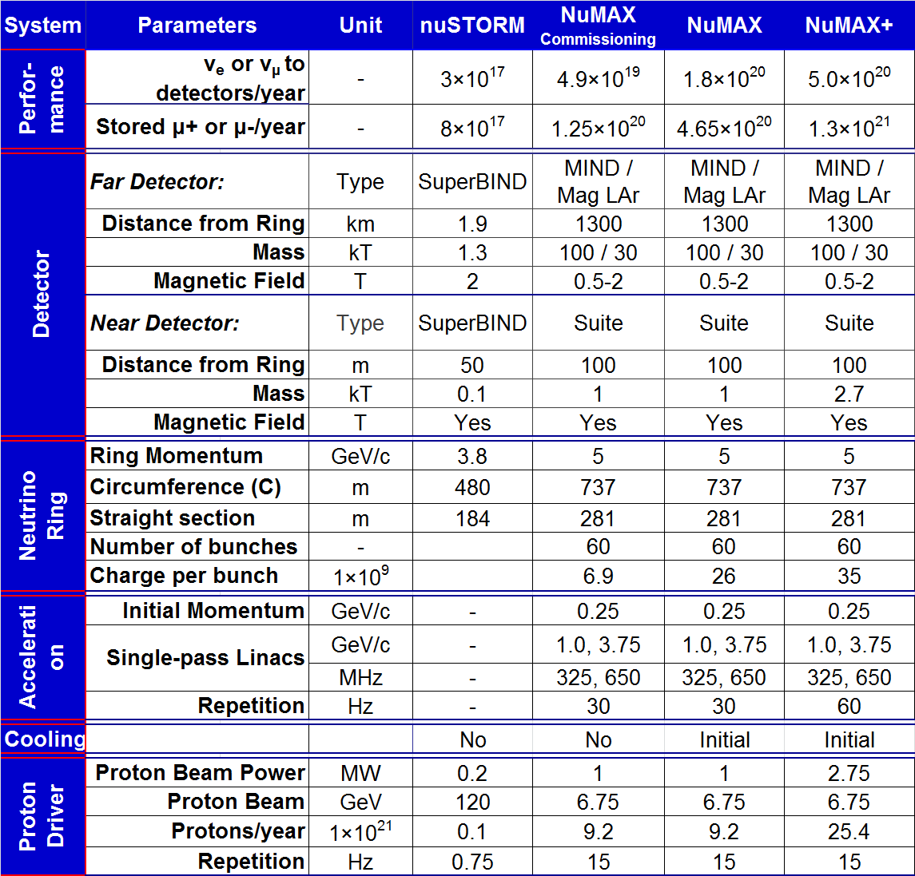
Staged Neutrino Factory and Muon Colliders
Parameters
Neutrino Factory at intensity frontier
Muon Collider at the energy frontier
Cooling 6D no final Full 6D

