Slide 1
ESS Linac Modifications for
ESSnuSB
Dave McGinnis
Chief Engineer / Accelerator Division
www.europeanspallationsource.se
August 27, 2014

Slide 2
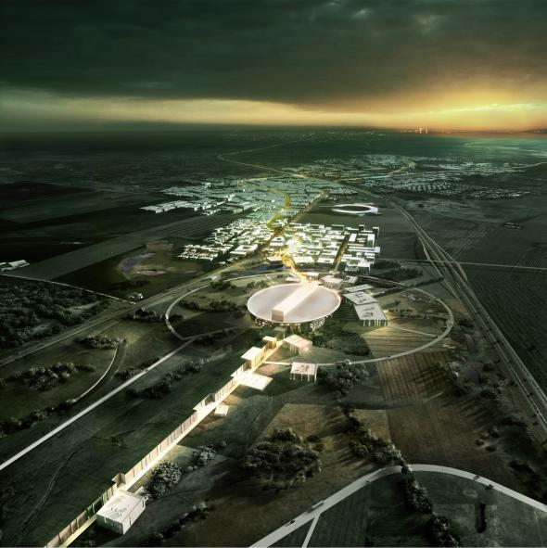


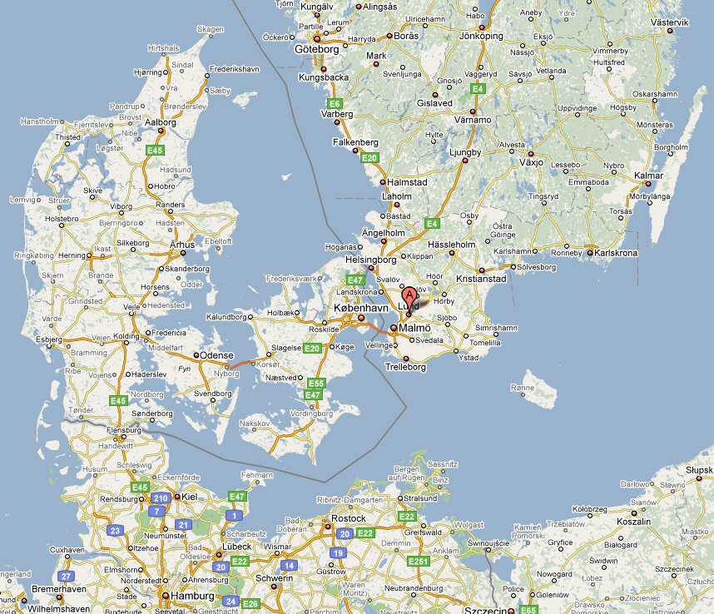


The European Spallation Source (ESS)
ESS is a neutron spallation source that will be built by a collaboration of 17 European countries.
ESS is located in southern Sweden adjacent to MAX-IV (A 4th generation light source)

Slide 3
The ESS Linac
The European Spallation Source (ESS) will house the most powerful proton linac ever built.
  Average beam power of 5 MW.
  Peak beam power of 125 MW
  Acceleration to 2 GeV
  Peak proton beam current of 62.5 mA
  Pulse length of 2.86 ms at a rate of 14 Hz (4% duty factor)
97% of the acceleration is provided by superconducting cavities.
The linac will require over 150 individual high power RF sources
  with 80% of the RF power sources requiring over 1.1 MW of peak RF power
  We expect to spend over 200 M€ on the RF system alone

Slide 4
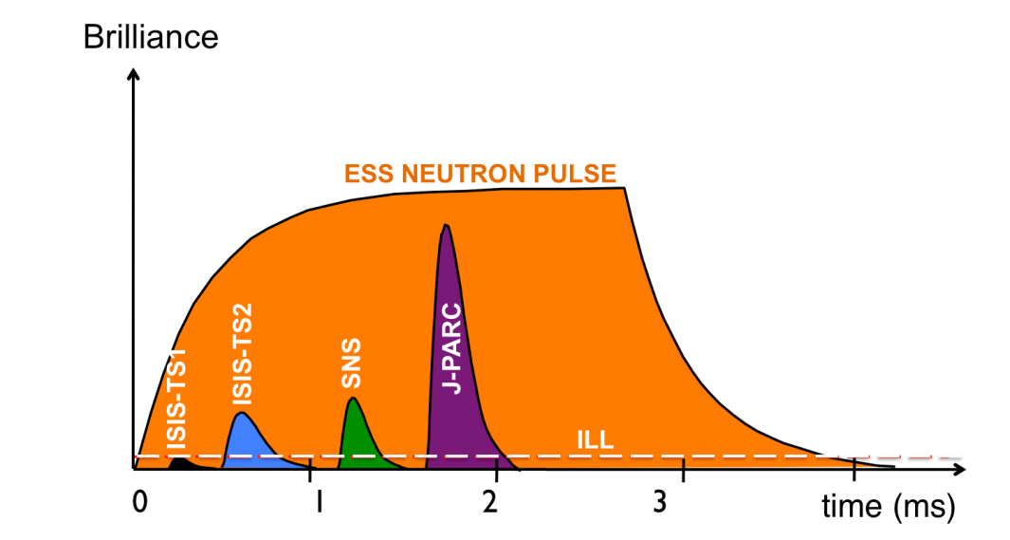
The Long Pulse Concept
Advantage - No compressor ring required
  No space charge tune shift so peak beam current can be supplied at almost any energy
  Relaxed constraints on beam emittance
    This is especially true if the beam expansion system for the target is based on raster scanning of the beam on the target.
  No H- and associated intra-beam stripping losses
  Permits the implementation of target raster scanning
Disadvantage - Experiment requirements “imprint” Linac pulse structure
  Duty factor is large for a copper linac
  Duty factor is small for a superconducting linac

Slide 5
Requirements for ESSnuSB
5 MW for neutrons
  Long pulse does not need a compressor ring
  Can use H- or H+
5 MW for neutrinos
  Needs a compressor ring
  Requires H-
Peak power in SRF elliptical couplers not exceed 1.2 MW

Slide 6
Increased Duty Factor
Maximum peak power in RF couplers in ESS baseline design is 1.1MW
Solution:
  Additional power provided by increasing r.m.s beam current while keeping peak beam current constant by adding an additional beam pulse 2.86 mS in length
    i.e increase the beam duty factor by a factor of two from 4% to 8%
  ESSnuSB might want to package the additional 2.86mS beam pulse in multiple pulses

Slide 7
RF Power
The majority of the power supplied to the Linac goes to the RF sources
  13 MW to RF sources
  7 MW for cryoplant, racks, power supplies, water skids, etc.
RF Power budget
  Power Amp (Klystron) efficiency = 60%
  RF Overhead = 1.3
  Modulator efficiency = 92%
  Cavity efficiency = 98%
  Total efficiency = 41.5%
Timeline
  Pulse length = 2.86 mS
  Cavity fill time 0.2 mS (loaded Q = 7e5)
  Modulator rise time = 0.1 mS
  Timeline efficiency = 90.5%
Total efficiency = 37.6%
  5MW of beam power requires 13.3 MW of wall plug power

Slide 8
ESSnuSB Timeline efficiency
1 ESSnuSB pulse: timeline efficiency =90.5%
  Extra power required = 13.3 MW
4 ESSnuSB pulse: timeline efficiency =79.2%
  Extra power required = 17 MW
8 ESSnuSB pulse: timeline efficiency =68%
  Extra power required = 22 MW

Slide 9
Klystron modulators for 14Hz operation
(present most likely scenario = Stacked MultiLevel topology) (C. Martins)
Cap. charger #1
HV pulser #1
HF
Transf.
Filter
AC /
DC
DC /
DC
DC /
AC
AC /
DC
DC-link
1.1 kV
AC
15 kHz
1 kV
AC
15 kHz
25 kV
AC + DC
15 kHz
25 kV
Capacitor bank 1 kV
Cap. charger #N
HV pulser #N
HF
Transf.
Filter
AC /
DC
DC /
DC
DC /
AC
AC /
DC
DC-link
1.1 kV
AC
15 kHz
1 kV
AC
15 kHz
25 kV
AC + DC
15 kHz
25 kV
Capacitor bank 1 kV

Slide 10
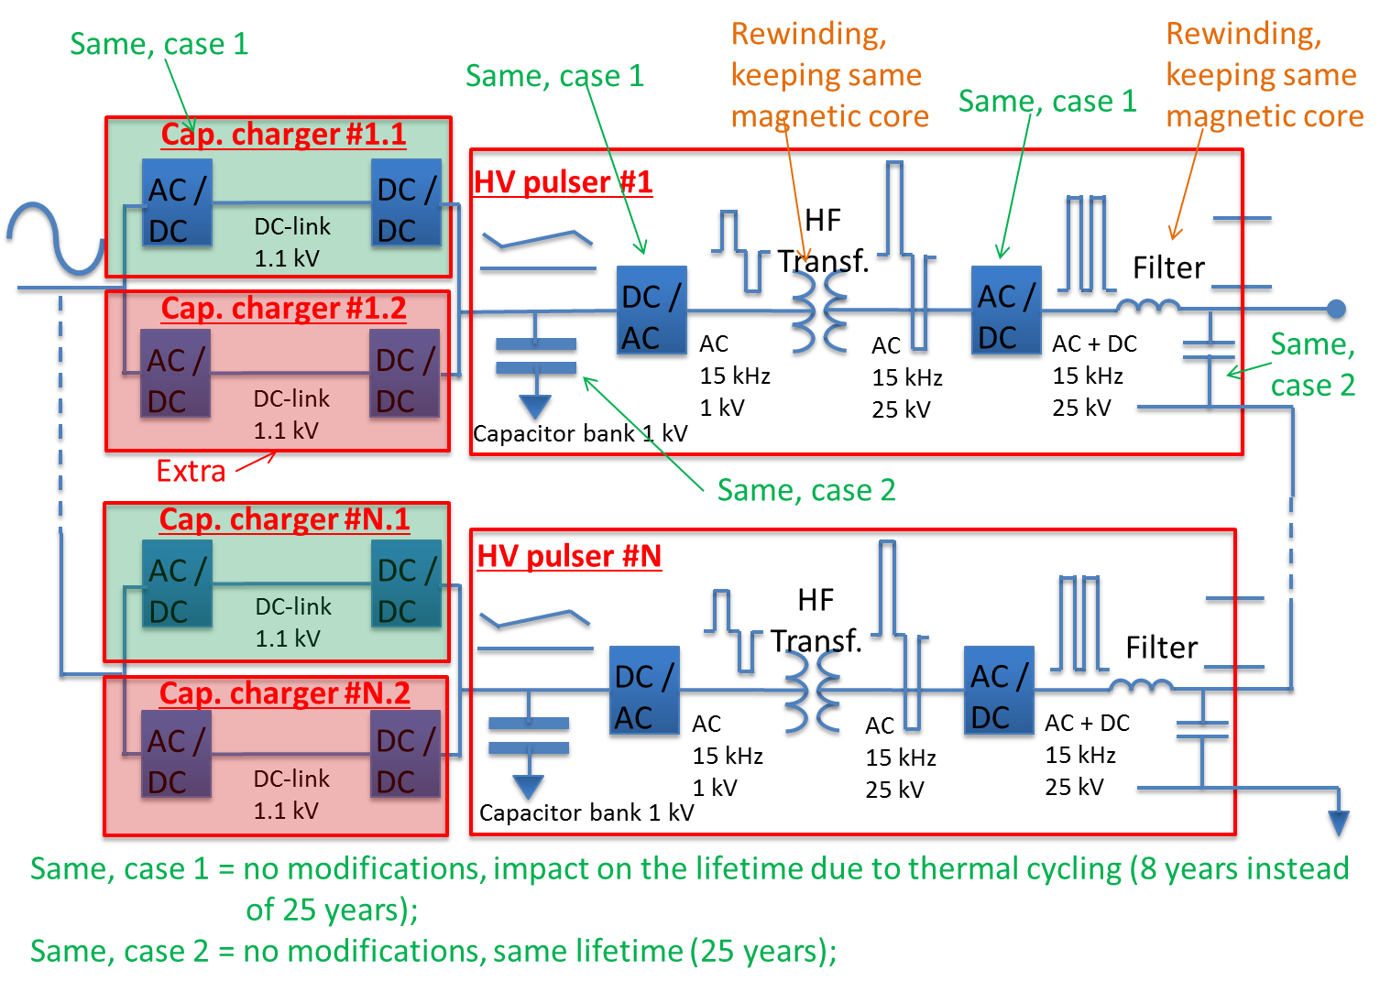
Klystron modulators for 28Hz operation (C. Martins)

Slide 11
Impact on modulators when upgrading from 14 to 28Hz (C. Martins)
Cost Impact | Per modulator | Total (45 modulators)
1)- Adding extra capacitor charger modules | + 60 kEURO | + 3 MEURO
2)- Re-winding HVHF transformers and output filter inductors | + 100 kEURO | + 4.5 MEURO
3)- Labour costs (contract follow-up, testing, etc.) |  | + 5 MEURO
Total cost increase for modulators’ upgrade |  | + 12.5 MEURO (+ 30%)
Footprint Impact | Per modulator
Footprint required for additional capacitor chargers | ~ 1.2m x 1m

Slide 12
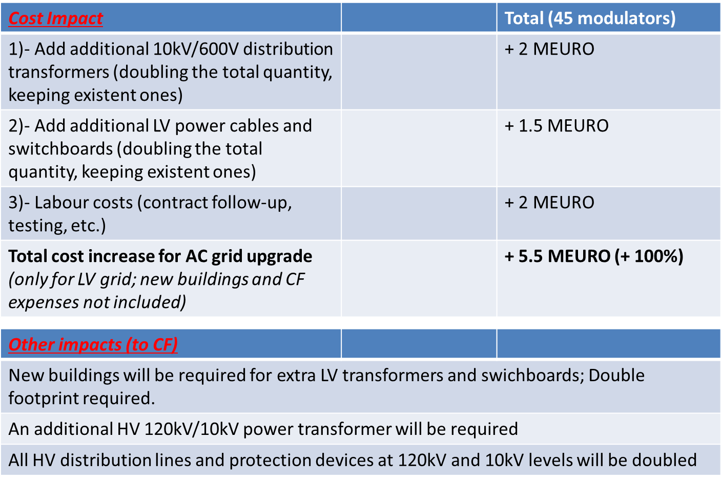
Impact on the AC distribution grid when upgrading from 14 to 28Hz (C. Martins)

Slide 13
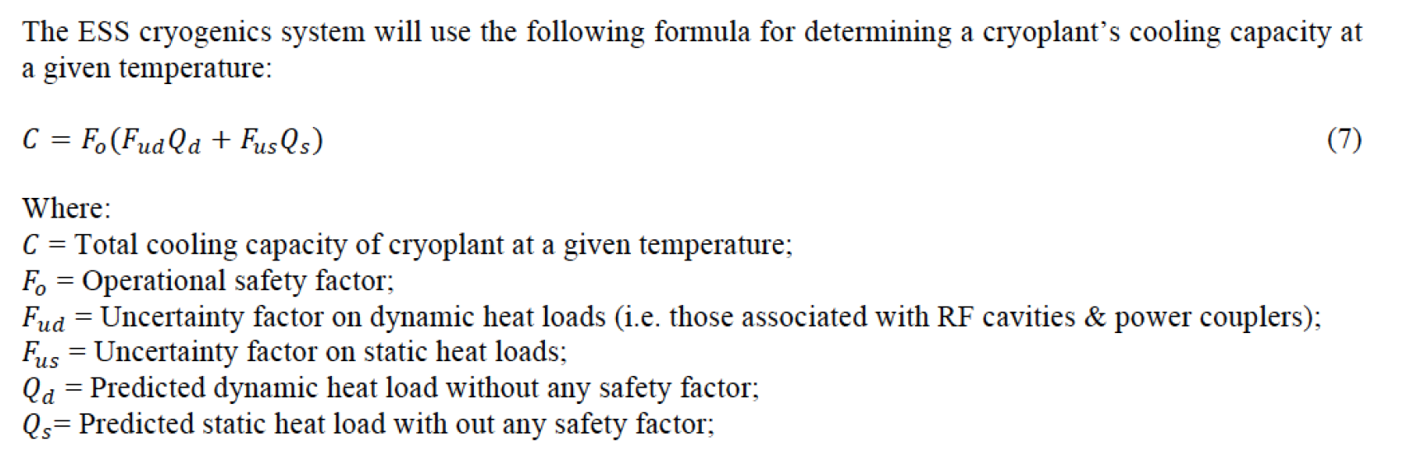
Cryogenics Safety Factors

Slide 14
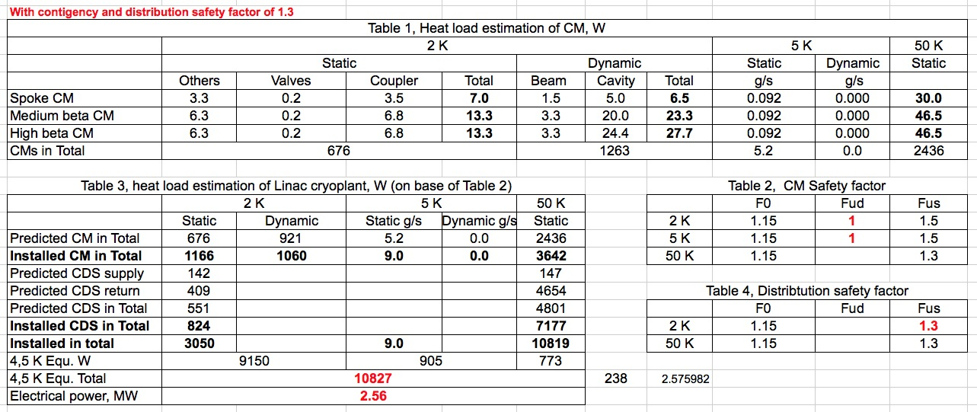
Heat loads
Very likely the same cryogenic distribution system can be used to remove the expected higher heat load from the cavities.
The cryogenic plant will most likely need to be upgraded to cover the needs of ESSnuSB.

Slide 15
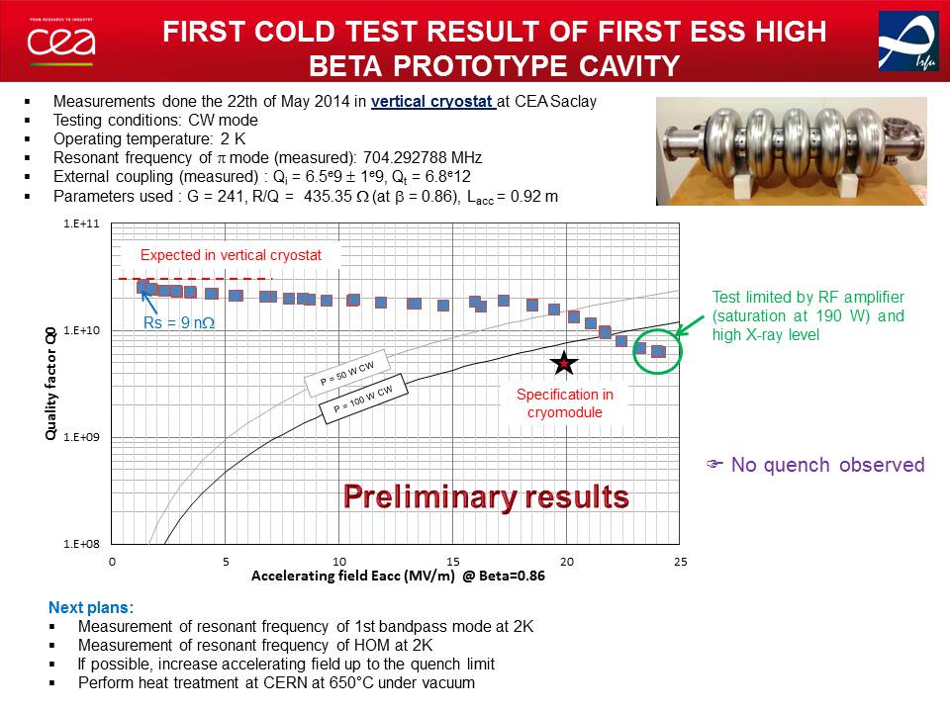
First cold test result of first ESS high beta prototype cavity

Slide 16
Major Issues
Modulator Charging
RF Gallery Transformers
Site Power distribution
Klystron Collector Cooling
Circulator cooling
RF Coupler cooling
Front-End Water skids
Cryo loads
  Dynamic loading
  Extra Beam loss
H- and H+ acceleration

Slide 17
Site Layout
Assuming the nominal accelerating gradient one could add 15 cryomodules of 66 MeV, so the final energy could be increased up to 3 GeV.
Very little space is foreseen for reception of equipment, equipment tests, storage of equipment/spares.
The extraction point can be at the end of the contingency space in the linac.
  Limiting H- stripping losses to 0.1 W per meter
  Assuming that the beam extraction line towards the accumulator can be filled to 75% with dipoles
The beam extraction line should branch off from the main linac with a radius of
  70 m for a 2 GeV, 5 MW beam
  133 m for a 3 GeV, 5 MW beam
The neutrino beam (and its preceding beam dump and target) will be in a line that crosses the linac tunnel.
  The neutrino decay line will most likely have to be below the linac level,
  The neutrino target will have to be located sufficiently deep
  potential irradiation risk for ground water

Slide 18
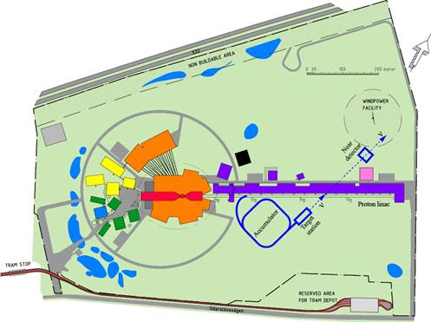
Cartoon of ESSnuSB Site Layout

Slide 19
Utilities
The main power station is designed with enough redundancy (2 main transformers) to enable
  continued operation of ESS in case of failure of HV equipment
  which has long (2 years) procurement time.
  The main cost of the main power station is linked to the switch gear and not to the actual transformers (only around 20%).
A bay for a third transformer is foreseen to potentially provide power to the neighboring science village.
  The presently empty bay can either be used for the science village or for an upgrade of ESS.
The trenches for the HV power cable are compatible with the needs for a ESSnuSB upgrade without major modification.
Although the sizing of the cooling pipes has been defined,
  However the margins within the present pipe sizes are not yet precisely known.
  The main water distribution pipes between the utility building and the klystron gallery, cryogenic plant will need to handle twice the flow.
Additional outside space is needed to:
  add electrical transformer buildings to supply the klystron modulators.
  upgrade the HVAC.
  increase the size of the utility building in order to house more heat exchangers and pumps

Slide 20
Front-End
Trim magnets are included in quadrupoles, and they may be difficult to pulse.
  Not being able to pulse the trim magnets may inhibit simultaneous operation of protons and H-
The cooling capacity in all normal conducting cavities needs to be upgraded.
The option to merge beams before the RFQ should be assessed.
  The merging would be done in the area of the space charge compensation which seems very difficult.
The option of adding a complete H- front-end with source, RFQ, MEBT should be considered.
  There seems enough space to fit racks for a 2nd complete front end.
  The ion source can be pushed back by up to 3 m.
  This gives enough space to fit a beam funnel (LEBT or MEBT) and to add quadrupoles for beam matching into the DTL

