Slide 1
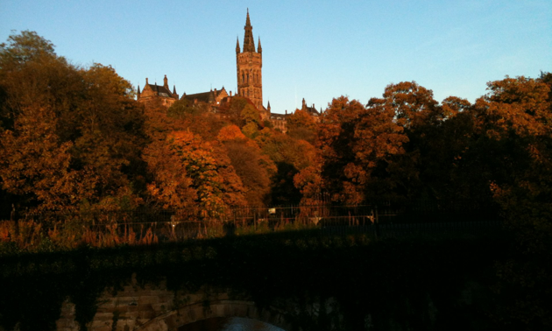
Source Neutrino Experiments
Jonathan Link
Center for Neutrino Physics
Virginia Tech
NuFact 2016

Slide 2
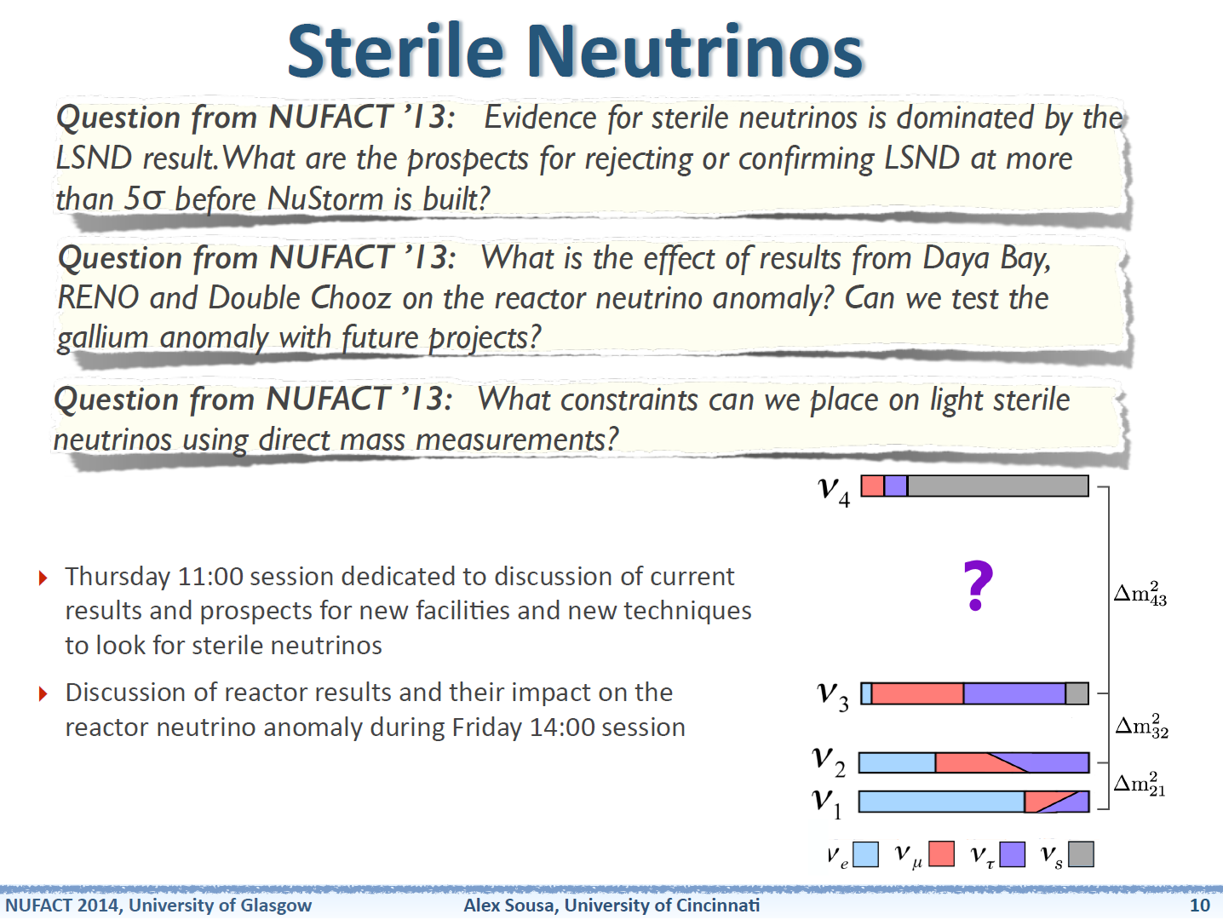

Slide 3
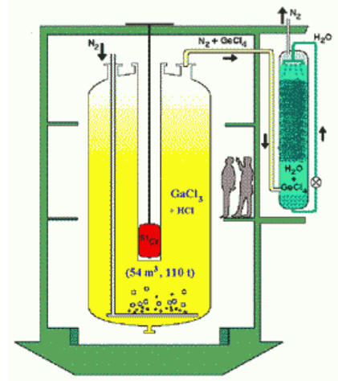
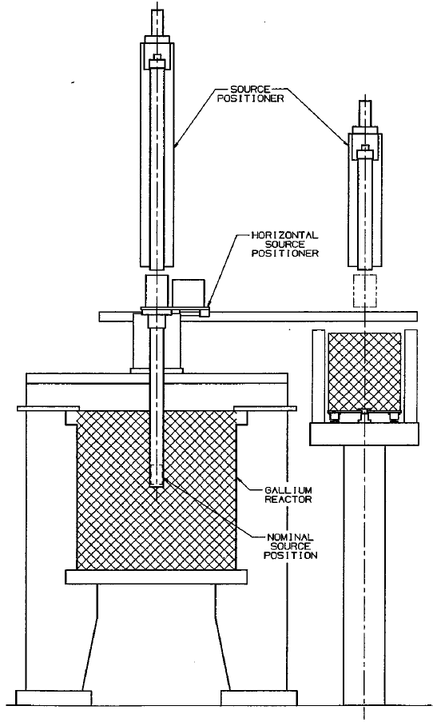
The GALLEX and SAGE Source Experiments
The solar radiochemical detectors GALLEX and SAGE used intense EC sources (⁵¹Cr and ³⁷Ar) to calibrate the ν_{e} detection efficiency.
GALLEX Sources: 1.7 MCi of ⁵¹Cr
1.8 MCi of ³⁷Ar
SAGE Sources: 680 kCi of ⁵¹Cr
409 kCi of ³⁷Ar
Neutrinos interact in the CC process, ν_{e}+⁷¹Ga→⁷¹Ge, and are detected by the decay of ⁷¹Ge.

Slide 4
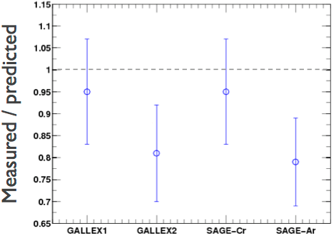
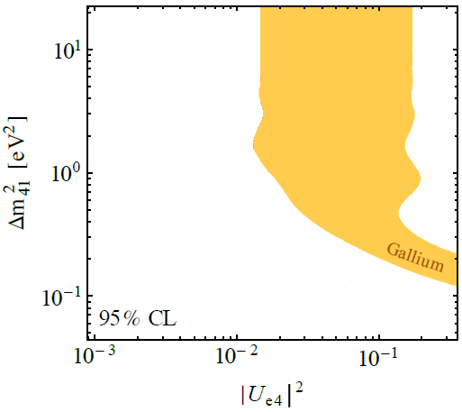
The Gallium Anomaly
Giunti and Laveder, Mod.Phys.Lett. A22, 2499 (2007) hep-ph/0610352
Acero, Giunti and Laveder, Phys.Rev. D78, 073009 (2008) 0711.4222 [hep-ph]
Giunti and Laveder, Phys.Rev.C83, 065504 (2011) 1006.3244 [hep-ph]
PLB 420, 114 (1998)
PRC 73, 045805 (2006)
Kopp, Machado, Maltoni and Schwetz, JHEP 1305, 051 (2013) 1303.3011 [hep-ph]
PLB 342, 440 (1995)
PRL 77, 4708 (1996)
Average ratio of measurement to predicted
R=0.86±0.05
Or even worse (better?)
R=0.76 .
(Bahcall)
(Haxton)
+0.09
−0.08

Slide 5
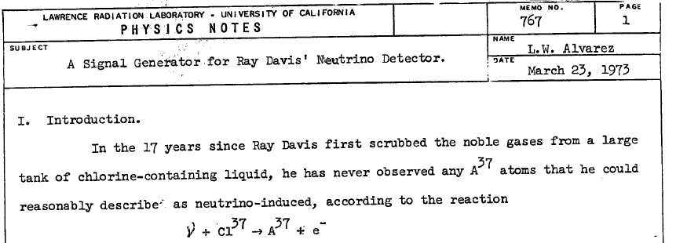
Electron Capture Neutrino Sources
Electron capture decays have two body final states, resulting in mono-energetic neutrinos at low energies.
Luis Alvarez proposed the first EC neutrino source: ⁶⁵Zn to calibrate Ray Davis’ chlorine detector.
Since then several such source have been proposed:
Isotope | τ_{½} | E_{ν} Max | Production Mechanism | Gammas | Notes
⁶⁵Zn | 244 d | 1.3 MeV | Thermal neutron capture | 770 & 345 keV (50%) | Proposed by Alvarez
⁵¹Cr | 27.7 d | 750 keV | Thermal neutron capture | 320 keV (10%) | Proposed by Raghavan, used by Gallex and SAGE
¹⁵²Eu | 13 y | 1.05 MeV | Unknown | 121 keV -1.7 MeV (100%) | Proposed by Cribier and Spiro
³⁷Ar | 34.9 d | 812 keV | Fast neutron ⁴⁰Ca(n,α)³⁷Ar | None | Proposed by Haxton, used by SAGE
Jonathan Link

Slide 6
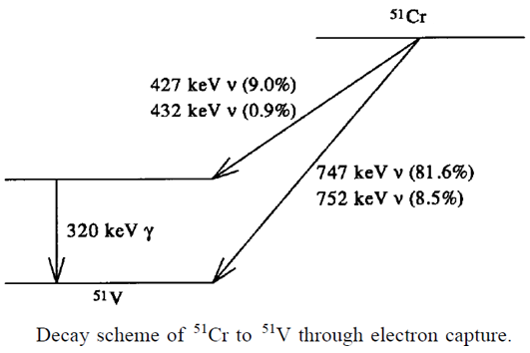
⁵¹Cr as a Mono-Energetic Neutrino Source
Can be easily produced with thermal neutron capture; ⁵⁰Cr has a 17 barn capture cross section.
90% of the time the capture goes directly to the ground state of ⁵¹V and you get a 750 keV neutrino.
Has only one, relatively easy-to-shield gamma that accompanies 10% of decays.
Natural Cr must be significantly enriched in ⁵⁰Cr (4.35% abundance)
τ_{½}(⁵¹Cr) = 27.7 days
K shell capture
L shell capture

Slide 7
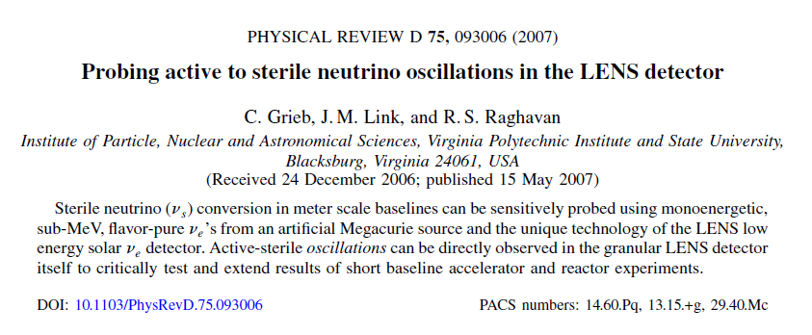
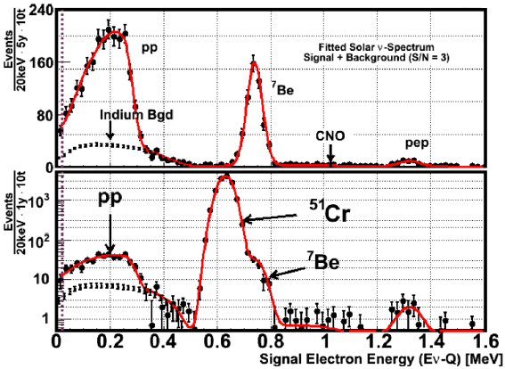
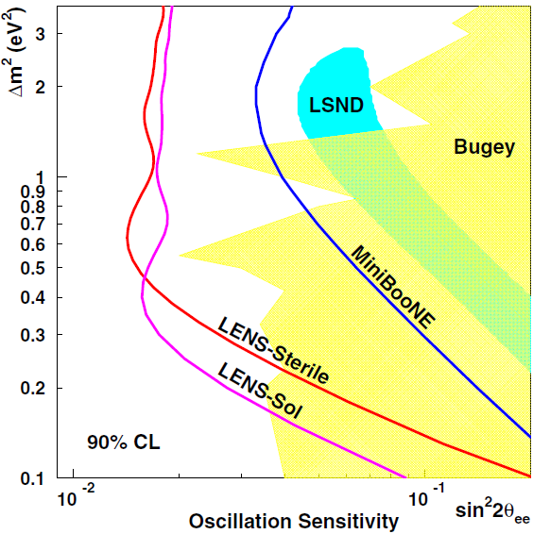
The LENS-Sterile Concept
Solar Neutrino Background
Plus ⁵¹Cr Signal
LENS is a proposed pp solar neutrino detector based on a CC transition in ¹¹⁵In to measure the solar ν spectrum.
By inserting a Mega-Curie ⁵¹Cr source in the center of the LENS detector one could observe a full wavelength, or more, of large Δm² oscillations in a few meters.
4×10 MCi
100 days each
Jonathan Link

Slide 8
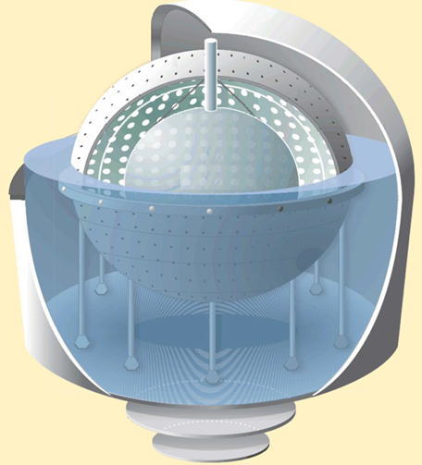
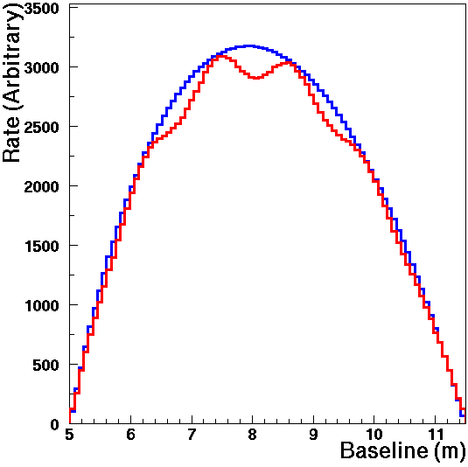
SOX: Source Oscillations at BoreXino
Combine a mega-Curie ⁵¹Cr source with the Borexino detector to search for ν_{e} disappearance. JHEP 1308, 038 (2013) 1304.7721 [physics.ins-det]
Will use the GALLEX source material irradiated at HFIR at ORNL.
Multiple oscillation wavelengths inside the detector for the sterile Δm².
It has the “oscillometry” signature that was so appealing in the LENS-Sterile concept.
sin²2θ_{ee} = 0.12
Δm² = 1.5 eV²
⁵¹Cr
Source

Slide 9
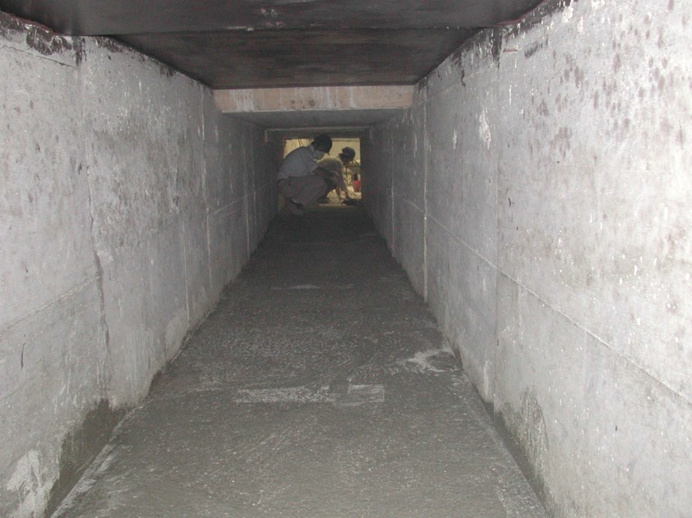
Tunnel Beneath the Detector
Borexino was designed with neutrino source calibrations in mind

Slide 10
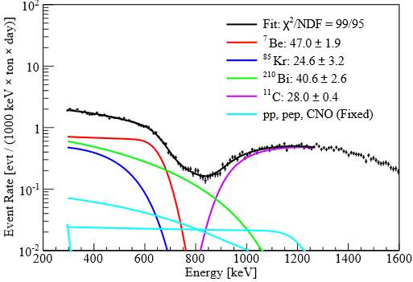
The Borexino Detector
Unprecedented and still unmatched radio-purity
Nested vessels contain increasingly more pure materials from outside in
Observes ν_{e} by neutrino-electron elastic scattering with a 250 keV threshold
The only detector to have observed ⁷Be solar neutrinos (862 keV)
SOX Background
Bellini et al., Phys.Rev.Lett. 107, 141302 (2011)

Slide 11
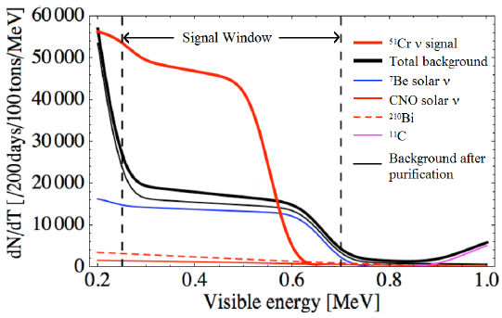
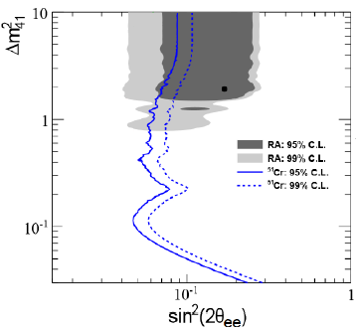
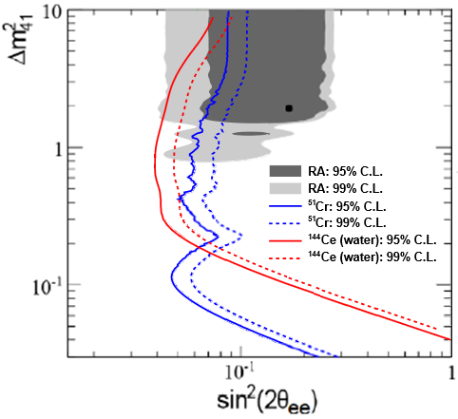
SOX Sensitivity
Elastic scattering signal is an edge and continuum in energy
⁷Be solar neutrinos are the largest background to ⁵¹Cr neutrino signal
Sensitivity from two 100 day runs of 5 MCi each
SOX covers much of the ν_{e} disappearance allowed region, with a great discovery potential.
There is also a ¹⁴⁴Ce antineutrino source experiment planned…

Slide 12
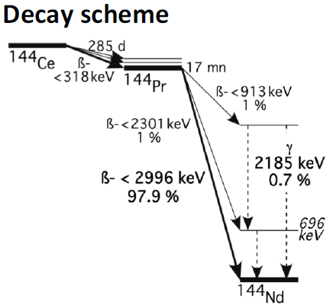
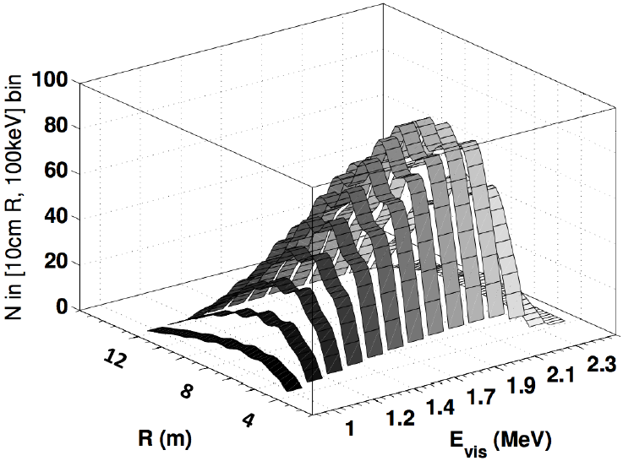
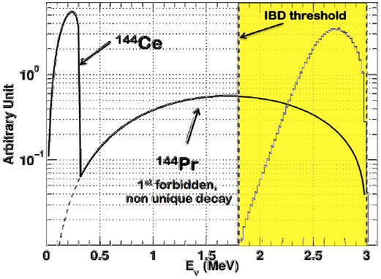

¹⁴⁴Ce Source at Borexino
Cribier et al., Phys.Rev.Lett. 107, 201801 1107.2335 [hep-ex]
The source is made from spent nuclear fuel.
    The source is not monoenergetic, so oscillations must be studied in L/E.
    100 kCi of ¹⁴⁴Ce gives a similar number of events as 5 MCi of ⁵¹Cr.
$\overline{ν}$ detected by inverse beta-decay.

Slide 13
Source Searches for Neutrino Magnetic Moment (μ_{ν})

Slide 14
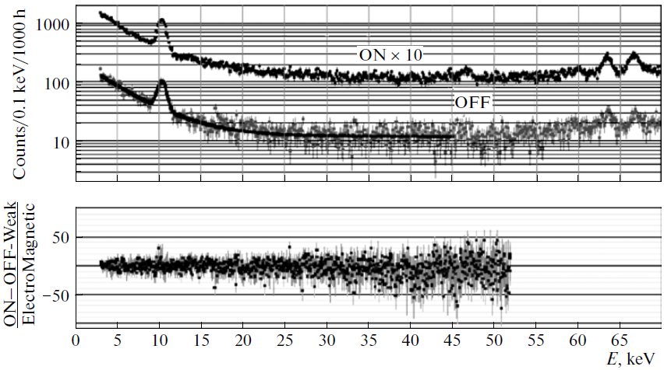

Best Direct Limit of the Neutrino Magnetic Moment
The best terrestrial limit comes from Gemma, which used a 1.5 kg Ge detector at a 3 GW_{th} commercial reactor in Russia.
$μ_{ν}<2.9×{10}^{−11}μ_{B}$ (90% CL)
The limit is based on the absence of a increase in the on/off ratio at low recoil energy.
Reactor neutrino magnetic moment experiments are dominated by backgrounds
They are unable to tell when the reactor-on from reactor-off.

Slide 15
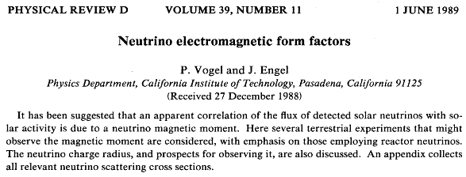
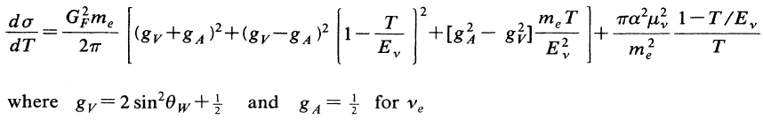
Neutrino-Electron Elastic Scattering
Neutrino-Electron Elastic Scattering Cross Section
Weak Part
E&M Part
The E&M contribution to the elastic scattering cross section would be a consequence of a non-zero neutrino magnetic moment.

Slide 16
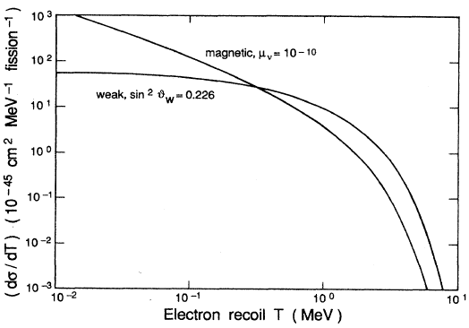

Signature of ν Magnetic Moment in Elastic Scattering
$$∝\frac{1}{T}$$
Evidence of a non-zero neutrino magnetic moment would appear as a dramatic increase in the scattering rate for the lowest energy recoil electrons.

Slide 17
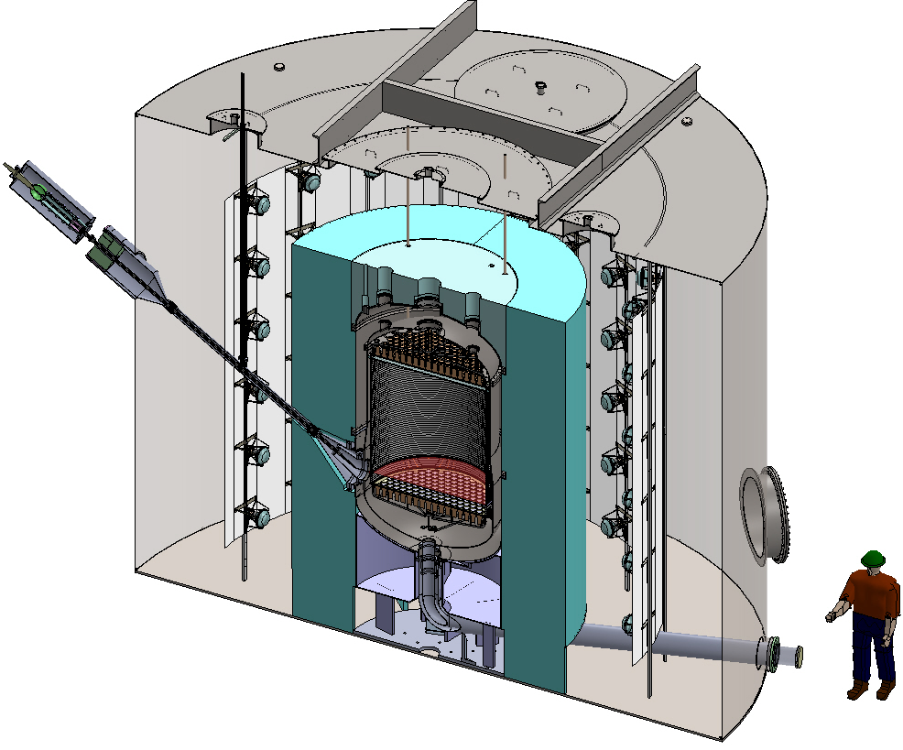
Liquid Xe Dark Matter Detectors
The next generation LXe detectors will have tones of usable liquid xenon embedded in a very low-background environment.
Two-phase LXe detectors, like LZ, are sensitive to individual drift electrons from scintillation light produced in the gas phase.
The Proposed LZ Detector
They will have a spatial resolution
of better than 1 cm.
Their goal is to look for nuclear recoils from WIMP scattering with a threshold below 1 keV in electron equivalent energy.
⁵¹Cr
Source

Slide 18
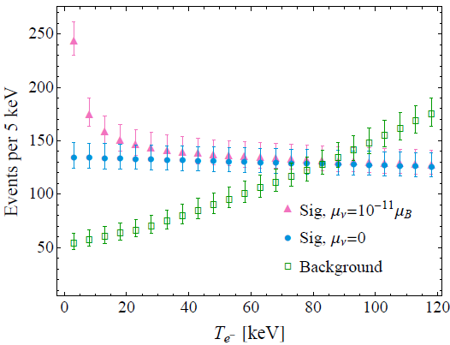
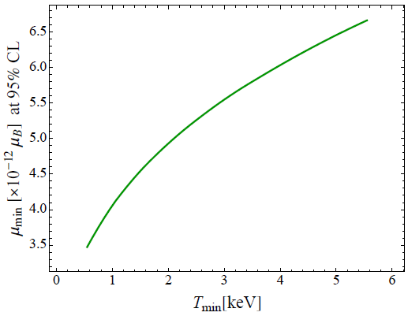
Calculation of Elastic Scattering Rate in LZ
Assuming an exposure of 100 days from a single 5 MCi source. This corresponds to 5.8×10²³ neutrinos emitted.
The source center is located 1 m from the edge of the fiducial volume (a cylinder 137.2 cm high × 137.2 cm in diameter)
The total number of weak interaction events would be ~12,500.
At the Gemma limit, E&M
interactions would add more
than 3,000 events.
The measurement is statistics
limited, meaning that additional
runs should take the sensitivity
below the astrophysical limit.
Sensitivity as a function of recoil detection
threshold
Astrophysical Limit
Coloma, Huber and Link, 1406.4914 [hep-ph]

Slide 19
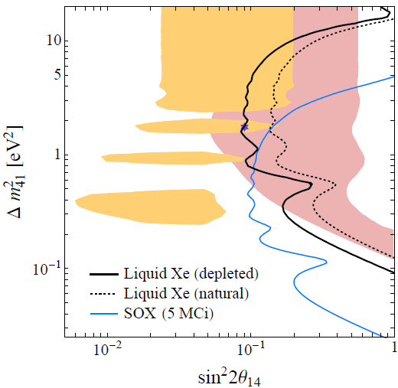
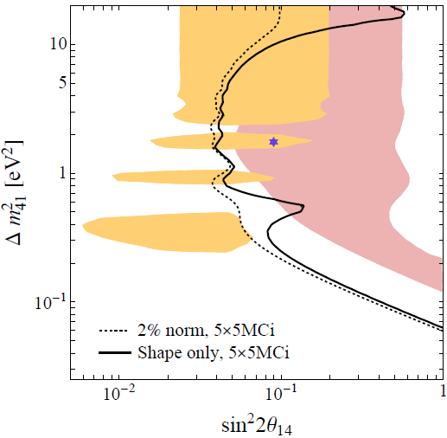
What about Sterile Neutrinos?
The shape only sensitivity shows the oscillometric coverage.
Across the full Cr ν energy ¹³⁶Xe is a significant source of background.
5 source runs with 2% normalization error covers the full Ga anomaly.
Jonathan Link

Slide 20
Conclusions and Perspectives
Radioactive neutrino sources, based on electron capture isotopes are a proven technology.
Advances in detector technology:
  Low energy & background solar ν detectors (e.g. Borexino)
  Liquid Xe dark matter TPCs (LZ, Xe 1-ton…)
allow measurements not possible at the time of GALLEX and SAGE.
Direct tests of the Gallium Anomaly can be achieved using these sources.
Terrestrial searches for neutrino magnetic moments, comparable to astrophysical limits are within reach.
Radioactive neutrino sources are fertile grounds for innovative neutrino experiments.
Jonathan Link

