Slide 1
Virtex-6 Radiation Studies & SEU Mitigation Tests
Jason Gilmore (Texas A&M University)
Ben Bylsma (The Ohio State University)
Workshop on FPGAs in HEP, 21 March 2014

Slide 2
Considerations for SEUs in FPGAs
Configuration memory SRAM is often corrupted by SEUs
  This can be measured in a beam test…
    Recovery from this is done with scrubbing tools or a Program cycle
      E.g. subsystems have CMS issue a Program command every 20 minutes
      This is suitable for preventing long-term accumulation of errors
  But these SEUs do not necessarily cause a disruption in operations
    A large fraction of the SRAM bits are not used in a given firmware project
    SEUs in these unused bits have little or no impact on logic operations
  It is more useful to determine the probability to have a real operational problem: we look for SEUs that cause a logic failure
For the SEUs that cause operational disruptions
  What is the SEU cross section for this to happen?
  How does it depend on which FPGA elements are involved?
    CLB logic, Block RAMs, GTX modules, etc.
  Design firmware with tests that are sensitive to each specific element in the FPGA architecture, and measure the error rate
  Results can be extrapolated to an arbitrary firmware design based the on fraction of each device element in used in the test

Slide 3
SEU Tests for CMS Muon Electronics
    This work was done as R&D work for the Cathode Strip Chamber electronics in the CMS Endcap Muon system
    Tests were performed at UC Davis and TAMU Cyclotron facilities using a collimated proton beam
  The beam was collimated uniformly on one chip at a time with a precision flux measurement
  We tested two identical FPGAs running the same firmware
  All chips tested survived 30 kRad dose in the beam
Firmware design for rad tests
  Specific modules were instantiated in the code to test different FPGA elements
    Block RAMs, CLBs and GTX
    Used a large fraction of each in the FPGA
  All of these modules were running simultaneously in firmware
  Errors in each module were monitored & logged by software via gigabit Ethernet fiber connection to a PC

Slide 4
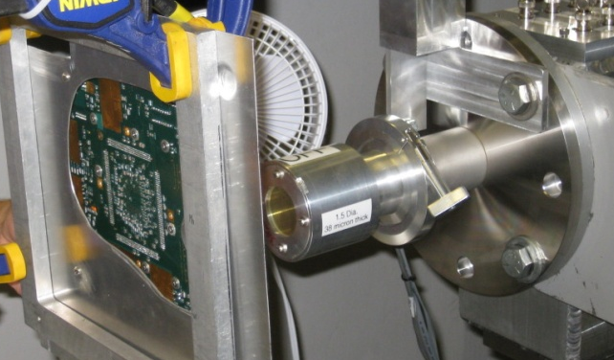
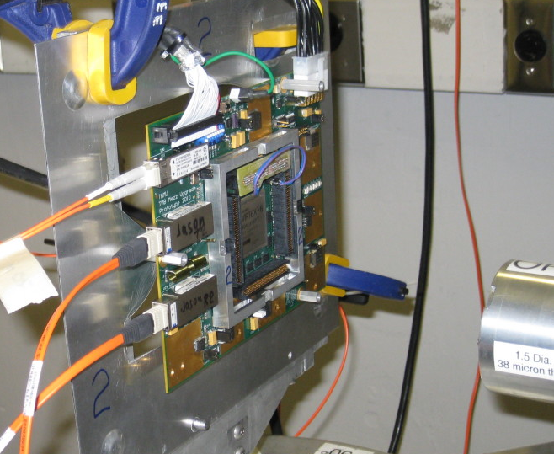
Test Beam Photos
The Texas A&M University cyclotron at the Radiation Effects Facility, and the UC Davis Crocker Laboratory cyclotron

Slide 5
FPGA SEU Results for CSCs
Xilinx Virtex-6 FPGA, model xc6vlx195t-2ffg1156ces
  Enabled native ECC feature in Block RAMs to protect data integrity
  CLB tests based on a triple-voting system
    Implemented with a custom designed TMR logic module
  Results are summarized below
GTX Transceiver (55% used in FPGA)
  Random PRBS data patterns @3.2 Gbps on each of eight links
  These SEUs only caused transient bit errors in the data
  SEU cross section result: σ = (10 ± 0.8) *10⁻¹⁰ cm²
Block RAM (74% used in FPGA)
  Software controlled write and read for BRAM memory tests
  No data corruption was detected in the BRAM contents
  SEU cross section: σ_{90%} < 8.2 *10⁻¹⁰ cm²
CLB (43% used in FPGA)
  SEU cross section result: σ = (6.0 ± 0.5) *10⁻⁹ cm²
    With this we expect ~1 CLB SEU per FPGA per day per CSC chamber in CMS
  Our results here were less than ideal… to be repeated later this year

Slide 6
Xilinx Scrubbing Tool Experience at OSU
SEM Controller for Xilinx Virtex-6
  Xilinx LogiCORE IP Soft Error Mitigation Controller v3.6
Xilinx built-in feature for Soft Error Mitigation
  Continuously reads configuration memory and checks each frame for errors
  If single bit errors exist, it corrects the error and re-writes the frame
But the built in feature has known issues
  A simple web search explains how to deal with them
  Experts suggest using the SEM Controller IP core
The SEM Controller:
  Utilizes the built-in feature to do continuous readback and CRC checking
  Handles correcting single bit errors
  Has port for injecting errors for testing

Slide 7
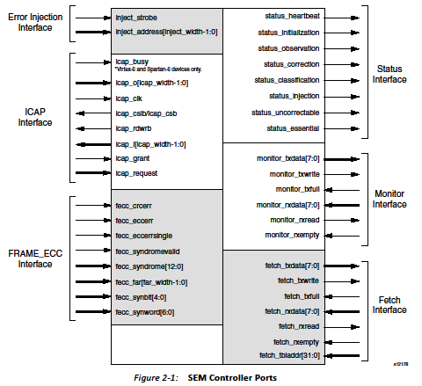
SEM Controller
Taken from Xilinx document PG036

Slide 8
SEM Controller
Virtex-6 primitives
Internal Configuration Access Port
ICAP
Frame
ECC
Configuration Frame Error Correction
JTAG
SEM Controller
Status Reg
Chip Scope Pro
Status
VIO
Injection
Monitor
Mon out
Mon in
Configured with wizard
Single bit errors corrected automatically
Double bit errors indicated in status register
  Software polls status register for double errors
  Get Frame address of double bit error
  Re-write Frame through JTAG access
Sngl Err Cnt
Dbl Err Cnt
FAR Addr

Slide 9
Extra Slides…

Slide 10
SEU Test Results for Other CSC Electronics
Finisar Optical Transceiver ftlf8524e2gnl: Transmit side
  Gigabit Ethernet packet transmission tests to PCI card, 4 kB @ 500 Hz
    Bad or missing packets received at the PC are “transmit” SEUs
    Note that the duty cycle here is significantly less than 100%
  These SEUs caused lost GbE packets and rare “powerdown” events
  SEU cross section result: σ = (4.3 ± 0.3) *10⁻¹⁰ cm²
  Correcting for real CSC transmitter duty cycle: σ = 6.7 *10⁻⁸ cm² per link
    We expect to see ~10 SEU per link per day during HL-LHC running
      Very low rate of single bit errors: just 1 error per 20 trillion bits on each link
Finisar Optical Transceiver ftlf8524e2gnl: Receive side
  These SEUs only caused transient bit errors
  SEU cross section: σ = (7.5 ± 0.1) *10⁻⁹ cm² per link
    We expect to see ~1 SEUs per link per day
  *Three Finisars tested: one died at 33 krad, another at 41 krad
    The third chip survived with 30 krad and still working on the bench in 2014

Slide 11
Summary of All TAMU Reactor Tests (1)
Part/Chip Name | Chip Type | 10 krad Exposure Pass/Fail | 30 krad Exposure | Result Comments
Maxim 8557ETE | Voltage Regulator | Pass | Fail | 5 out of 6 die at 30 krads
Micrel MIC69502WR | Voltage Regulator | Pass | Pass
Micrel MIC49500WU | Voltage Regulator | Pass | Pass
National Semi LP38501ATJ-ADJCT-ND | Voltage Regulator | Pass | Pass
National Semi LP38853S-ADJ-ND | Voltage Regulator | Pass | Pass
Sharp PQ05VY053ZZH | Voltage Regulator | Pass | Fail | Fails to regulate
Sharp PQ035ZN1HZPH | Voltage Regulator | 50% Pass | Fail | Fails to regulate
Sharp PQ070XZ02ZPH | Voltage Regulator | Fail | Fail | Fails to regulate
TI TPS740901KTWR | Voltage Regulator | Pass | Pass
TI TPS75601KTT | Voltage Regulator | Fail | Fail | Fails to regulate
TI TPS75901 | Voltage Regulator | Fail | Fail | Fails to regulate
ST Micro 1N5819 | diode | Pass | Pass
ON Semi 1N5819 | diode | Pass | Pass
Fairchild 2N7000 | N-channel FET transistor | N/A | Pass
Analog Devices AD8028AR | High Speed, Rail-to-Rail Input/Output Amplifiers | N/A | Pass
Analog Devices ADM812 | Voltage Monitor | N/A | Pass
National Semi LM41211M5-1.2 | Precision Micropower Low Dropout Voltage Reference | N/A | Pass
National Semi LM4121AIM5-ADJ | Precision Micropower Low Dropout Voltage Reference | N/A | Pass

Slide 12
Summary of TAMU Reactor Tests (2)
Part/Chip Name | Chip Type | 10 krad Exposure Pass/Fail | 30 krad Exposure | Result Comments
National Semi LM19CIZ | TO-92 Temperature Sensor | N/A | Pass
Maxim MAX680CSA | +5V to ±10V Voltage Converter | N/A | Pass
Maxim MAX664CSA | Dual Mode 5V/Programmable Micropower Voltage Regulator | N/A | Fail | Dead
Maxim MAX4372 | High-Side Current-Sense Amplifier | N/A | Pass
Micrel MIC35302 | High-Side Current-Sense Amplifier | N/A | Fail | Dead
Micrel MIC37302 | High-Side Current-Sense Amplifier | N/A | Fail | Dead
Fairchild MM3Z4V7C | Zener Diode | N/A | Pass
Fairchild MM3Z5V1B | Zener Diode | N/A | Pass
Sharp PQ7DV10 | Variable Output 10A Voltage Regulator | N/A | Pass
TI TPS7A7001 | Very Low Dropout, 2A Regulator | N/A | Fail | Fails to regulate

Slide 13
Summary of TAMU Reactor Tests (3)
Part/Chip Name | Chip Type | 10 krad Exposure Pass/Fail | 30 krad Exposure | Result Comments
TI SN74LVC2T45 | Two-bit Dual-supply Tri-statable Bus Transceiver | N/A | Pass
Analog Devices ADM660AR | CMOS Switched-Capacitor Voltage Converter | N/A | Pass
Analog Devices ADM8828 | Switched-Capacitor Voltage Inverter | N/A | Pass
Intersil ICL7660S-BAZ | Switched-Capacitor Voltage Converter | N/A | Fail | Dead
Linear Technology LTC1044CS8 | 100mA CMOS Voltage Converter | N/A | Pass
Maxim MAX1044CSA | Switched-Capacitor Voltage Converter | N/A | Fail | Dead
Maxim MAX860-UIA "uMAX" | Switched-Capacitor Voltage Converter | N/A | Pass
Maxim MAX861-ISA | Switched-Capacitor Voltage Converter | N/A | Pass
Microchip TC1044SCOA | Charge Pump DC-TO-DC Voltage Converter | N/A | Pass
Microchip TC962COE | High Current Charge Pump DC-to-DC Converter | N/A | Pass

