Slide 1



Physics Activities at CAPP, Korea
Yannis Semertzidis
CAPP/IBS at KAIST
4 July 2014
PATRAS WORKSHOP, CERN
Strong CP-Problem
Axion dark matter search:
  State of the art axion dark matter experiment in Korea
  Collaborate with ADMX, CAST…
Proton Electric Dipole Moment Experiment
  Storage ring proton EDM
  Muon g-2, mu2e, etc.

Slide 2
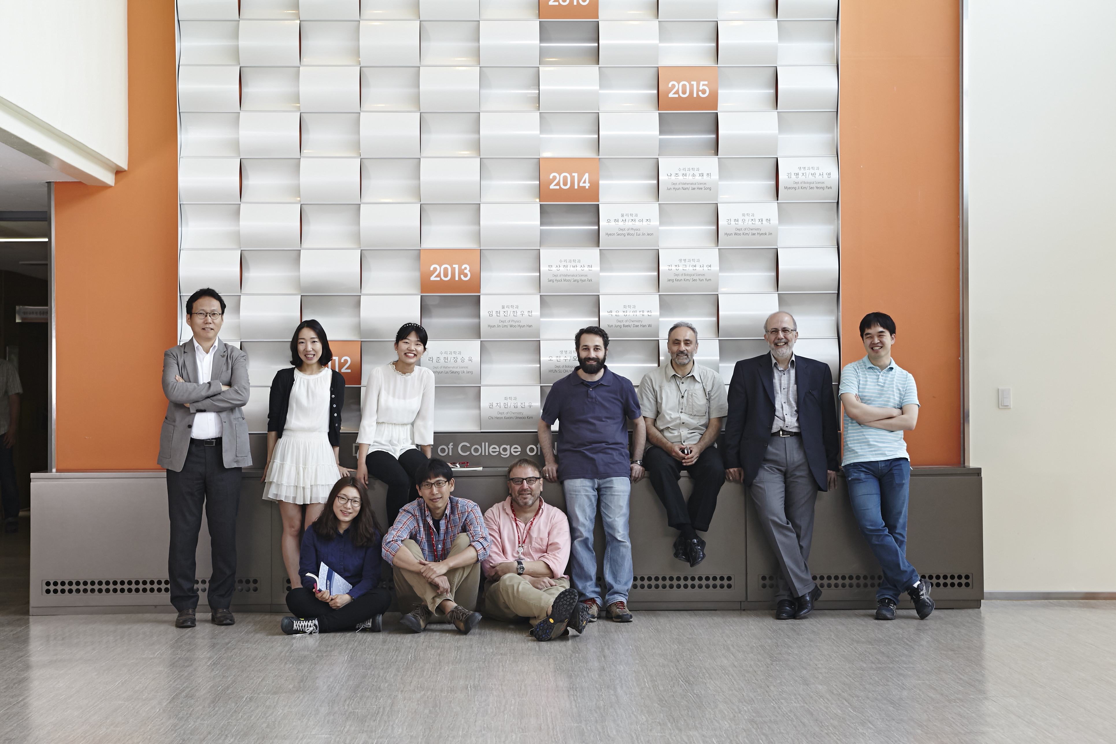
Axion dark matter hunters at KAIST
CAPP axion-dark matter group, 2014 (Five additional scientists are either already in CAPP or have signed up.)
http://capp.ibs.re.kr/html/capp_en/

Slide 3
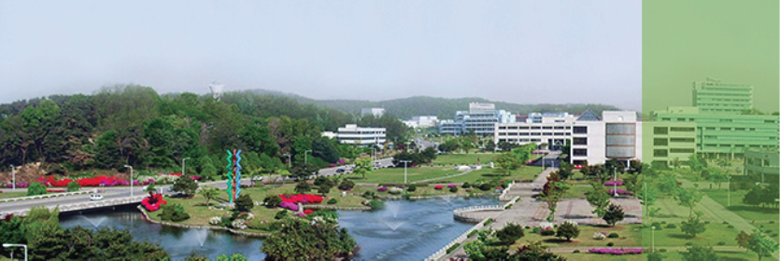
Center for Axion and Precision Physics Research: CAPP/IBS at KAIST, Korea
Four groups
15 research fellows, ~20 graduate students
10 junior/senior staff members, Visitors
Engineers, Technicians
Promised: New IBS building at KAIST

Slide 4
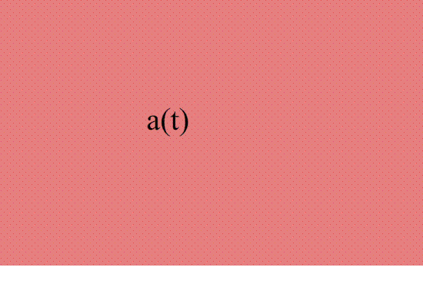
Axion dark matter: Imprint on the vacuum since the Big-Bang!
Animation by Kristian Themann

Slide 5
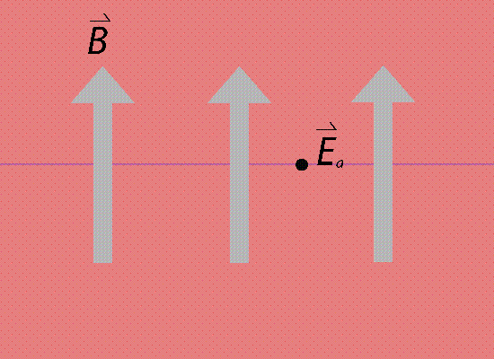
Axion dark matter is partially converted to a very weak flickering Electric (E) field in the presence of a strong magnetic field (B).
Animation by Kristian Themann

Slide 6
P. Sikivie’s method: Axions convert into microwave photons in the presence of a DC magnetic field (Primakov effect)
a
X
Detector

Slide 7
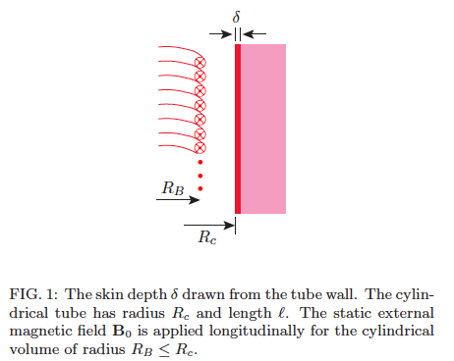
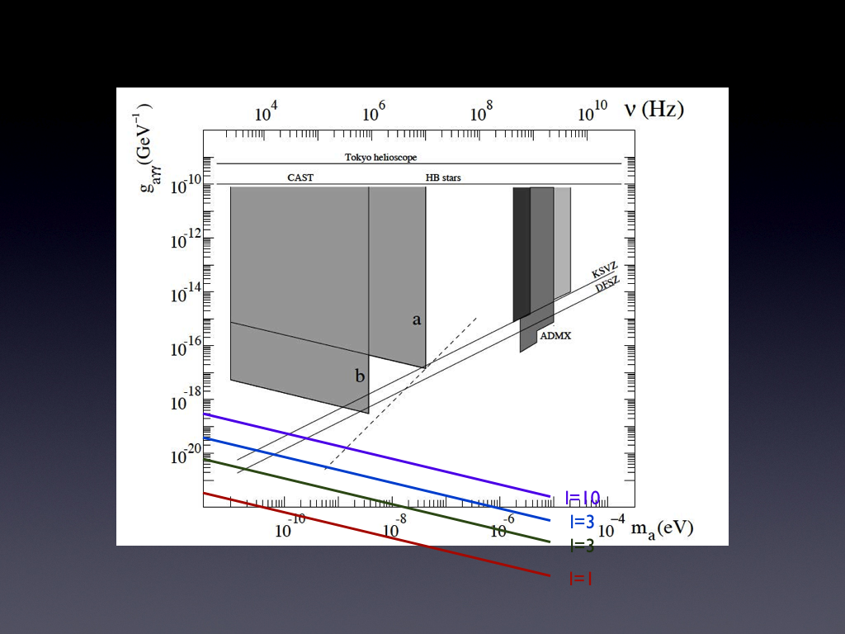
Effect of cavity quality factor
J. H., J.E. Kim, S. Nam, YkS
hep-ph: 1403.1576

Slide 8
The conversion power on resonance
The axion to photon conversion power is very small, a great challenge to experimentalists.

Slide 9
What’s there to improve?
B², Q, Ampl. noise/physical temperature, V.
Magnetic field B:
  Develop 25T, 10 cm inner bore, 50cm long magnet.
  35T, 5cm inner bore, 50 cm long magnet based on high T_{c}.

Slide 10
(CAPP) Axion dark matter plan, 1
We have started an R&D program with BNL for new magnets: goal 25T, 10cm diameter; then 35T, 5cm diameter. Currently all axion experiments are using <10T.
Based on high T_{c} cables (including SUNAM, a Korean cable company). ~5 year program.

Slide 11
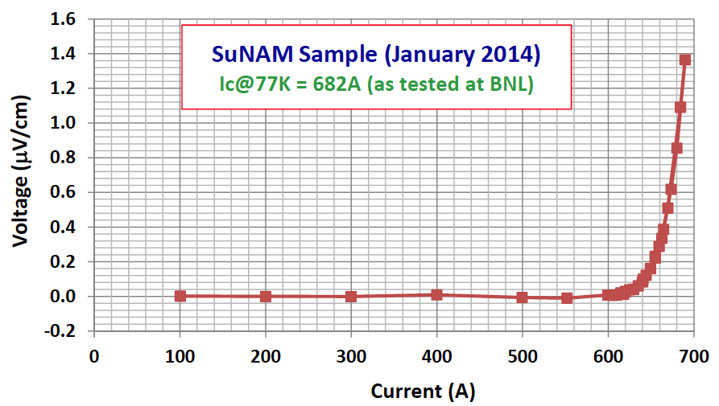
Magnet Development plan
Already signed an agreement for a prototype magnet
development between CAPP/IBS and BNL. Duration 1 year.
Goal: Determine the cable for the final design.
Spring 2014

Slide 12
What’s there to improve?
B², Q, Noise temperature/physical temperature, V.
Copper cavity Q: ~10⁵, axion Q_{a}: ~3x10⁶
  Goal: Q: ~10⁷, potential gain factor: 30.
V: Torroid cavities; several cavities simultaneously (first ADMX attempt in the 90’s)

Slide 13
Axion dark matter plan, 2
We have started an R&D program to achieve large Q in the presence of large B-fields.
Presently: Q~10⁵ copper cavities. Aiming for ~10⁷.

Slide 14
Improving the quality factor Q
Superconducting vertical walls (ADMX). Parallel magnetic field B_{r} < 100Gauss.
Top and bottom walls perp. to magnetic field. R&D at KAIST to bypass the problem.
Do we need top/bottom cavity walls? Open cavity with high-Q dielectric. R&D at KAIST.
Toroidal cavity (no end walls!); work at KAIST.

Slide 15
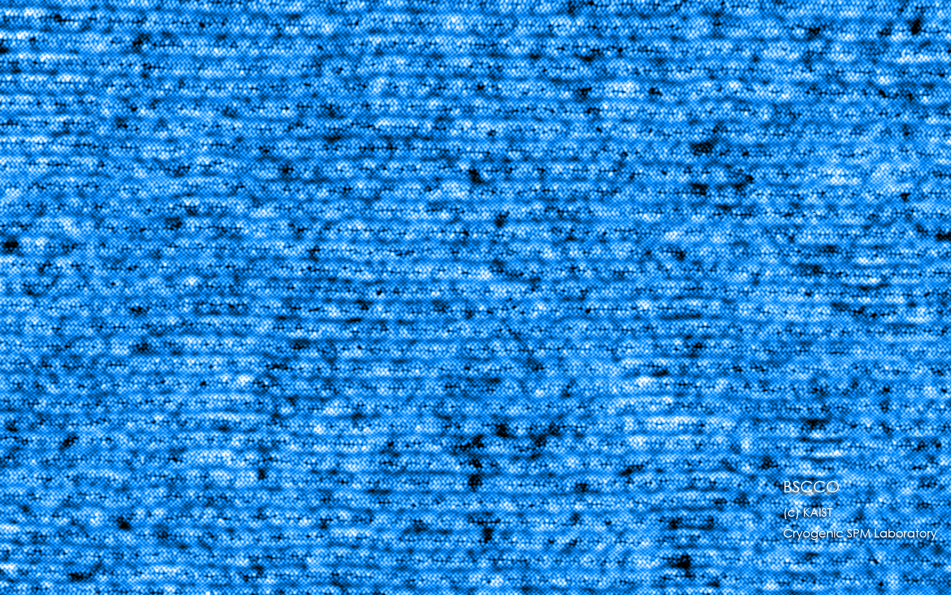
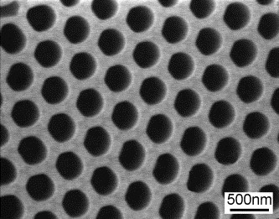
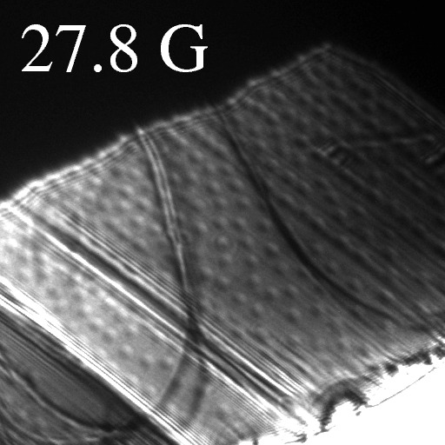
Proposal of Cryogenic STM Research Group
(Jhinhwan Lee/KAIST and CAPP)
Enhancement of the High Tc Superconductors by Novel Vortex Engineering
Our Idea: Each Ion Implantation Site
Designed to Hold Multiple Vortices
for High Field Applications
Special Anodized Alumina Masks are to be used
for Ion Implantation
Lorentz Microscopy Visualization of Distributed Vortices on BSCCO
Notes:
이 동영상에서는 각각의 에너지에서 왼쪽에 전자 파동의 공간적인 분포를, 오른쪽에는 이를 FT하여 밴드 구조 정보로 보여드리고 있습니다.

Slide 16
Axion dark matter plan, 3
We have started a development program with KRISS to provide us with (near) quantum noise limited SQUID amplifiers in the 1-10 GHz range. Evaluate method for higher frequency. 5 year program.
Physical temperature: aiming for 30mK (Q.L.: 50mK at 1GHz).

Slide 17
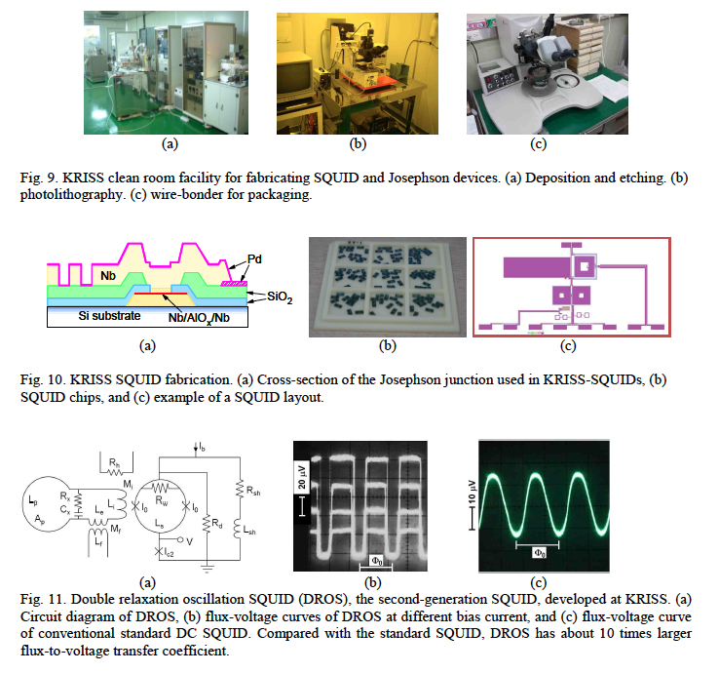
Outsourcing:
SQUID amplifiers from KRISS

Slide 18
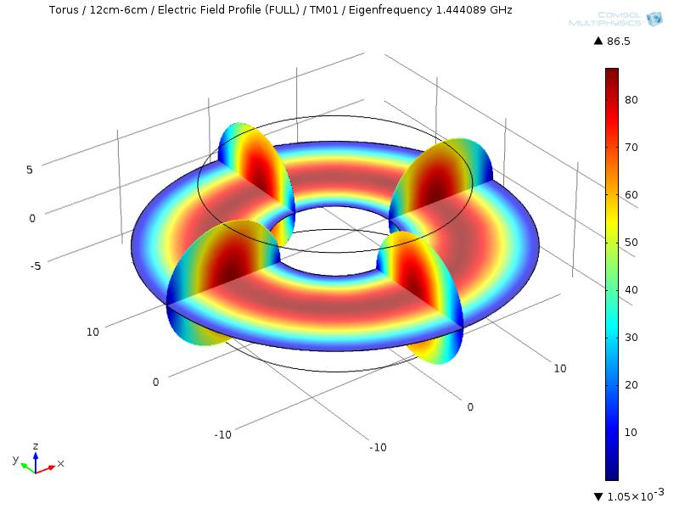
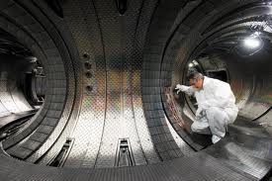
Axion dark matter plan, 4
Large volume for low frequencies (e.g., Tokamaks). Critical issue is temperature. Very expensive. Opportunity for large collaborations.
Electric field simulation of a TM010 mode in a toroidal cavity

Slide 19
Advantages of a toroidal cavity:
Large volume gain >10x, great B²V.
B-field tangential to cavity walls, i.e., cavity walls can be super-conducting. Quality factor gain >10x
Low frequencies accessible, noise temp. possible but an engineering challenge
Opportunities to discover axion dark matter at below 10% dark matter level.

Slide 20
Storage Ring Proton EDM: study of CP-violation beyond the Standard Model

Slide 21
Measuring an EDM of Neutral Particles
H = -(d E+ μ B) ● I/I
B
E
B
E
m_{I} = 1/2
d
µ
d
µ
ω₁
ω₂
m_{I} = -1/2
d = 10⁻²⁵ e cm
E = 100 kV/cm
⇒
ω = 10⁻⁴ rad/s

Slide 22
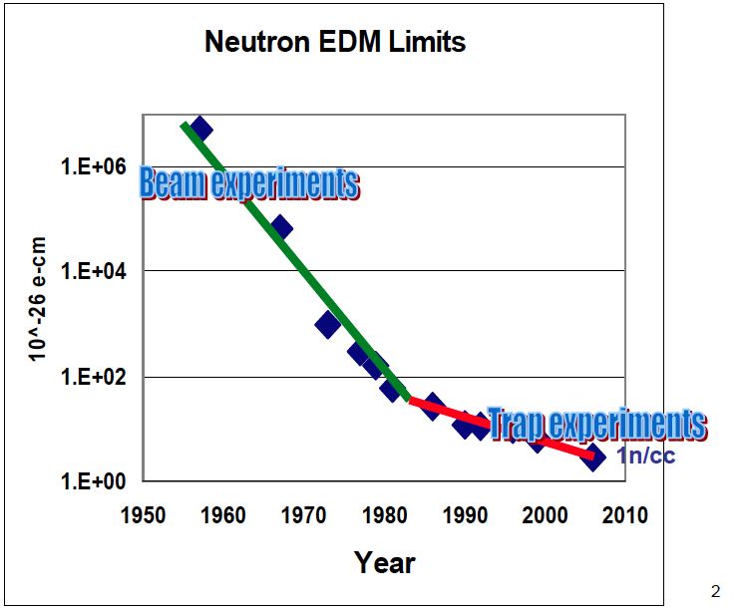
Proton storage ring EDM experiment is combination of beam + a trap

Slide 23
Stored beam: The radial E-field force is balanced by the centrifugal force.
E
E
E
E
Yannis Semertzidis, CAPP/IBS, KAIST
Notes:
Yannis Semertzidis, BNL
23

Slide 24
What’s the breakthrough?
Statistics: 10¹¹ polarized protons per cycle in a well behaved beam!
Method: applying g-2 techniques. Maximize EDM sensitivity, minimize systematic errors.
First stage goal: 10⁻²⁹e•cm, >3 orders of magnitude improvement over present nEDM. Probing Baryogenesis.

Slide 25
A Storage Ring Proton EDM experiment
An experiment to measure proton EDM to 10⁻²⁹ecm, revolution in statistics: 10¹¹ pol. Protons per cycle.
Most sensitive, flavor-conserving CP-violation probe
Complementary to LHC; probes New Physics ~10²-10³ TeV
Based on the “muon g-2” experience using the magic momentum technique with electric fields
R&D issues resolved: 1) Polarimeter stat. & syst., 2) Spin Coherence Time understanding, 3) Electric field strength & fringe-field effects. On going R&D: SQUID-based beam position monitors (CAPP/IBS, KAIST, KRISS/Korea, Garching/Germany)

Slide 26
The Proton EDM experiment status
Support for the proton EDM:
  CAPP/IBS, KAIST in Korea, R&D support for SQUID-based BPMs, Prototype polarimeter, Spin Coherence Time (SCT) simulations.
  COSY/Germany, studies with stored, polarized beams.
DOE-HE requested a white paper to establish the proton EDM experiment plan, after the P5 endorsement in 2014.
Large ring radius is favored: Low E-field strength, Long SCT, 1nT B-field tolerance in ring. Use of existing ring preferred.

Slide 27
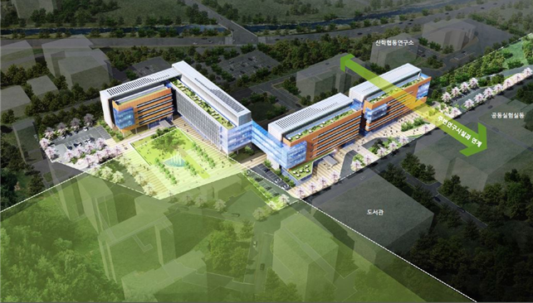
Future, state of the art IBS building at KAIST: scheduled for ~2018
A bird’s eye view for the IBS building in KAIST campus.
The four connected buildings may enclose up to 10 IBS centers.
The red polygon shows a suggested area for IBS physics building
which may change shape and size in the future.

Slide 28
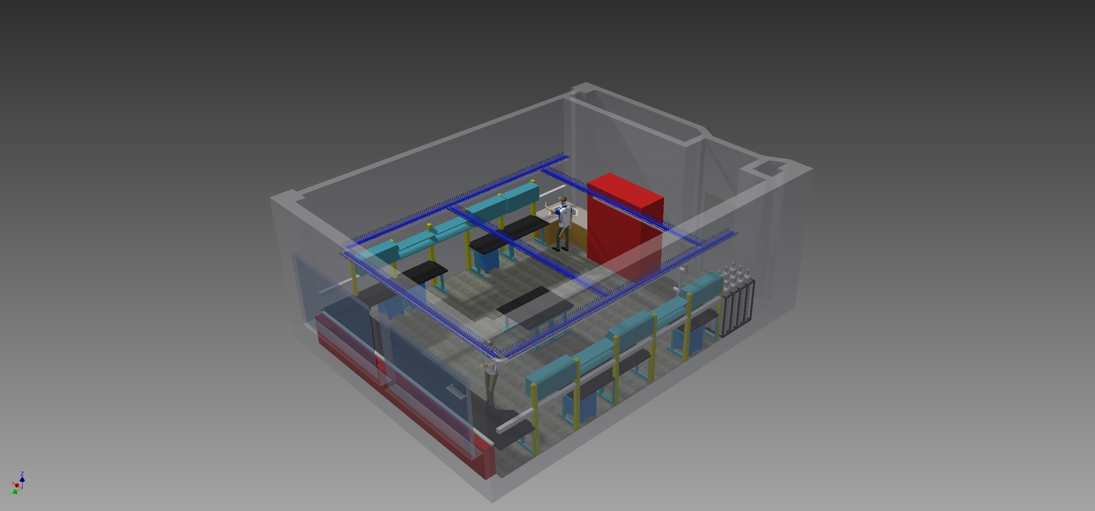
Temporary CAPP experimental area. Target ~2015

Slide 29
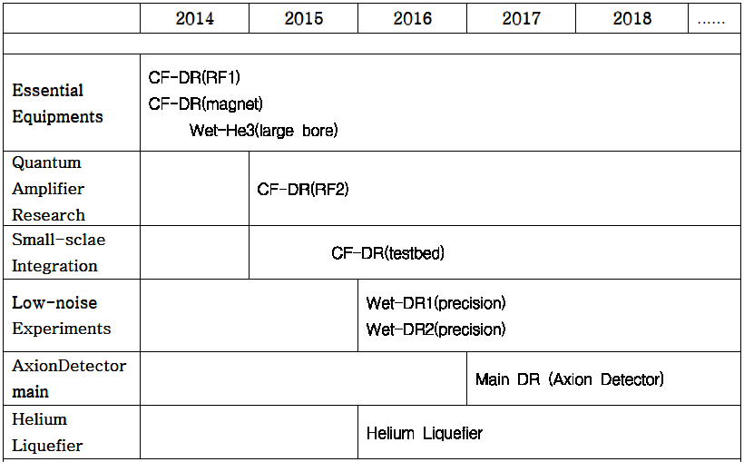
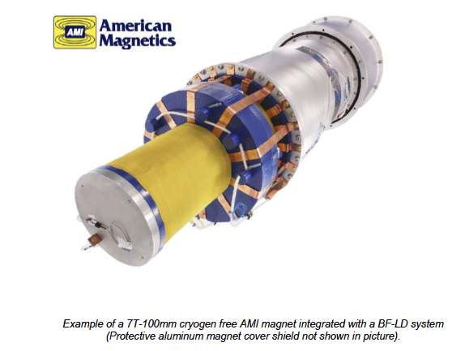
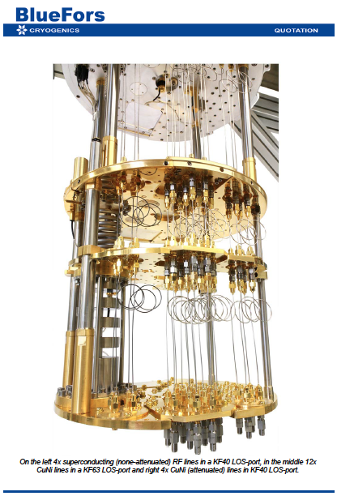
Cryo Development plan

Slide 30
Axion exp. development plan
 | 2014 | 2015 | 2016 | 2017 | 2018
Magnet | Prototype, testing of cable characteristics. |  | 25T, 10cm inner bore design | 25T, 10cm inner bore construction | Magnet delivery; design of 35T
Lab space | Temporary building. Design of new build. |  | Constr. Of new building |  | Delivery of new building
Axion dark matter | Proc. Equipment Study res. geom. | Testing high Q dielectric; Development of high Q resonators |  | Production of high-Q resonators
Electronics, amplifiers | Establ. Collabor. w/ KRISS | Design for 1-10GHz Obtain JPAs, test. Develop higher freq. ampl. |  | Ampl. deliveries from KRISS
Axion cavity Exp. | Design of exp., procure a low field magnet |  | Experimental setup. First test run. |  | Swap magnets

Slide 31
Visitors
Send us an email when you want to visit
Write down what you want to work on
Develop your ideas
Come and do your experiment (you as PI)
(Leading to eventual publishable results)
Incentives for teaching Nuclear/Particle Physics/Cosmology at KAIST (need at least six months warning to setup course).

Slide 32
Summary
Axion dark matter experiments are closing in. CAPP can have a significant role in probing the axion mass range 1-100 μeV.
Proton EDM: Probe EW-Baryogenesis, high-mass scale New Physics up to ~10³ TeV.
Two of the most important physics questions today: 1) What is the Dark Matter? 2) Probe the matter-antimatter asymmetry (Baryogenesis) and Physics Beyond the Standard Model.

Slide 33
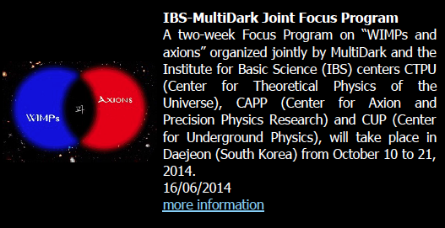
IBS-MultiDark Joined Focus Program
Daejeon, South Korea, October 10-21, 2014 http://www.multidark.es/

Slide 34
Extra slides

Slide 35
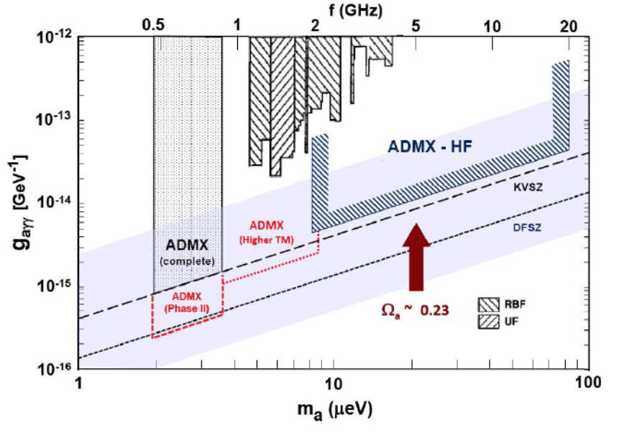
ADMX goals and CAPP plan
Current
plan,
low T
B-field
High-Q
B-field

Slide 36
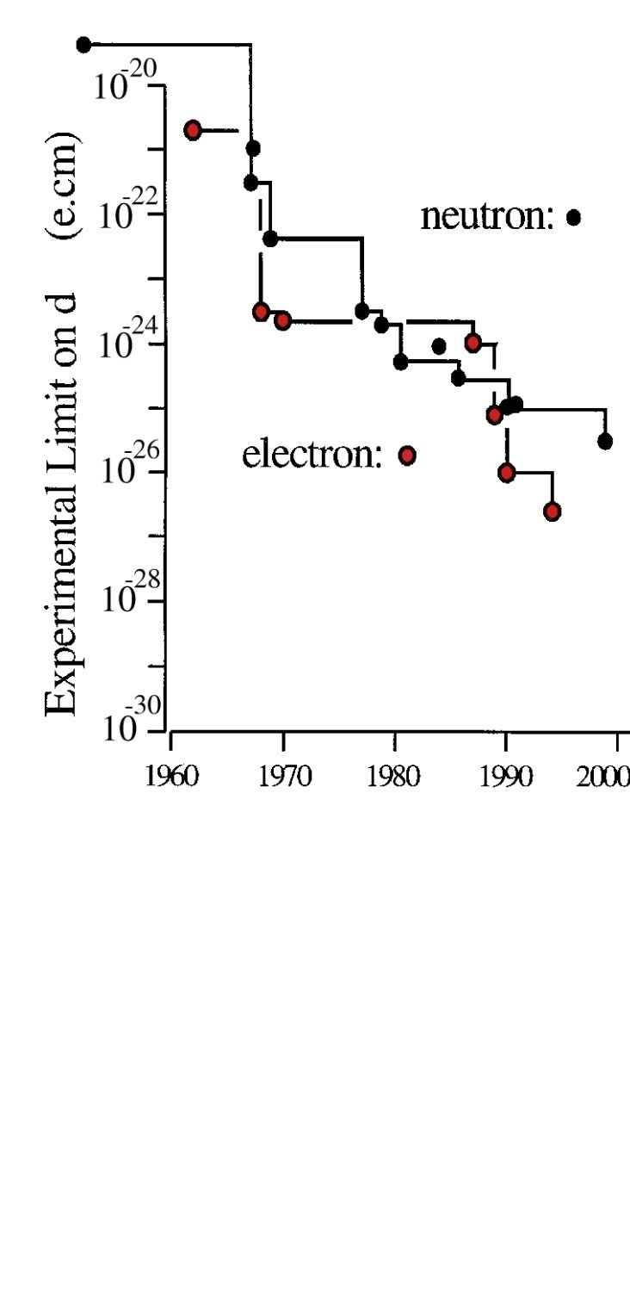
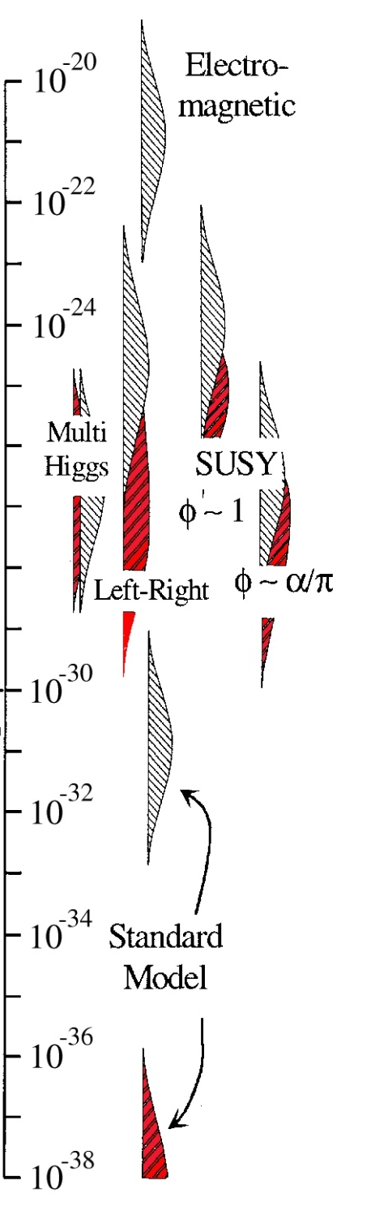
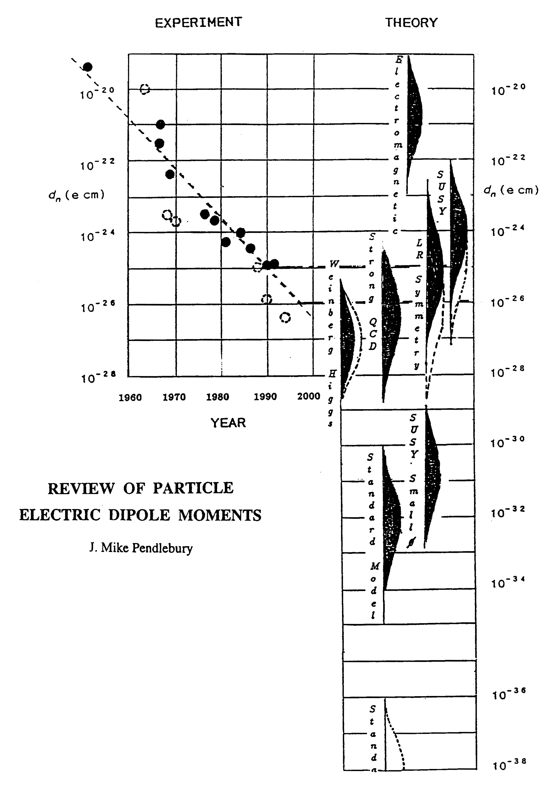
Sensitivity to Rule on Several New Models
Gray: Neutron
Red: Electron
If found it could explain
Baryogenesis
(p, d, n (or ³He))
n current
e current
GUT SUSY
Electroweak
Baryogenises
n target
p, d target
e target
Upgrade?
Electron EDM New Physics reach: 1-3 TeV,
Gabrielse et al., 2013
Statistics limited
Much higher physics reach
than LHC; complementary
e-cm
J.M.Pendlebury and E.A. Hinds, NIMA 440 (2000) 471

Slide 37
CAPP-Physics
Establish Experimental Particle Physics group. Physics involvement driven by the interest of CAPP individual scientists.
Involved in important physics questions:
Strong CP problem
Cosmic Frontier (Dark Matter axions)
Particle Physics (most sensitive proton EDM experiment, flavor conserving CP-violation)
Muon g-2; muon to electron conversion (flavor physics)

Slide 38
CAPP Physics plan
Setup lab for axion dark-matter search at KAIST based on
  High Field magnets: 25T, 35T,…
  R&D towards utilizing high-Q super-conducting cavities with large volumes, high magnetic fields
Coordinate with ADMX to avoid duplication. Aim to start taking data within 5-6 years.
Play a leadership role in the Storage Ring Proton EDM experiment at Fermilab and significant roles in the muon g-2/EDM experiments, …

Slide 39
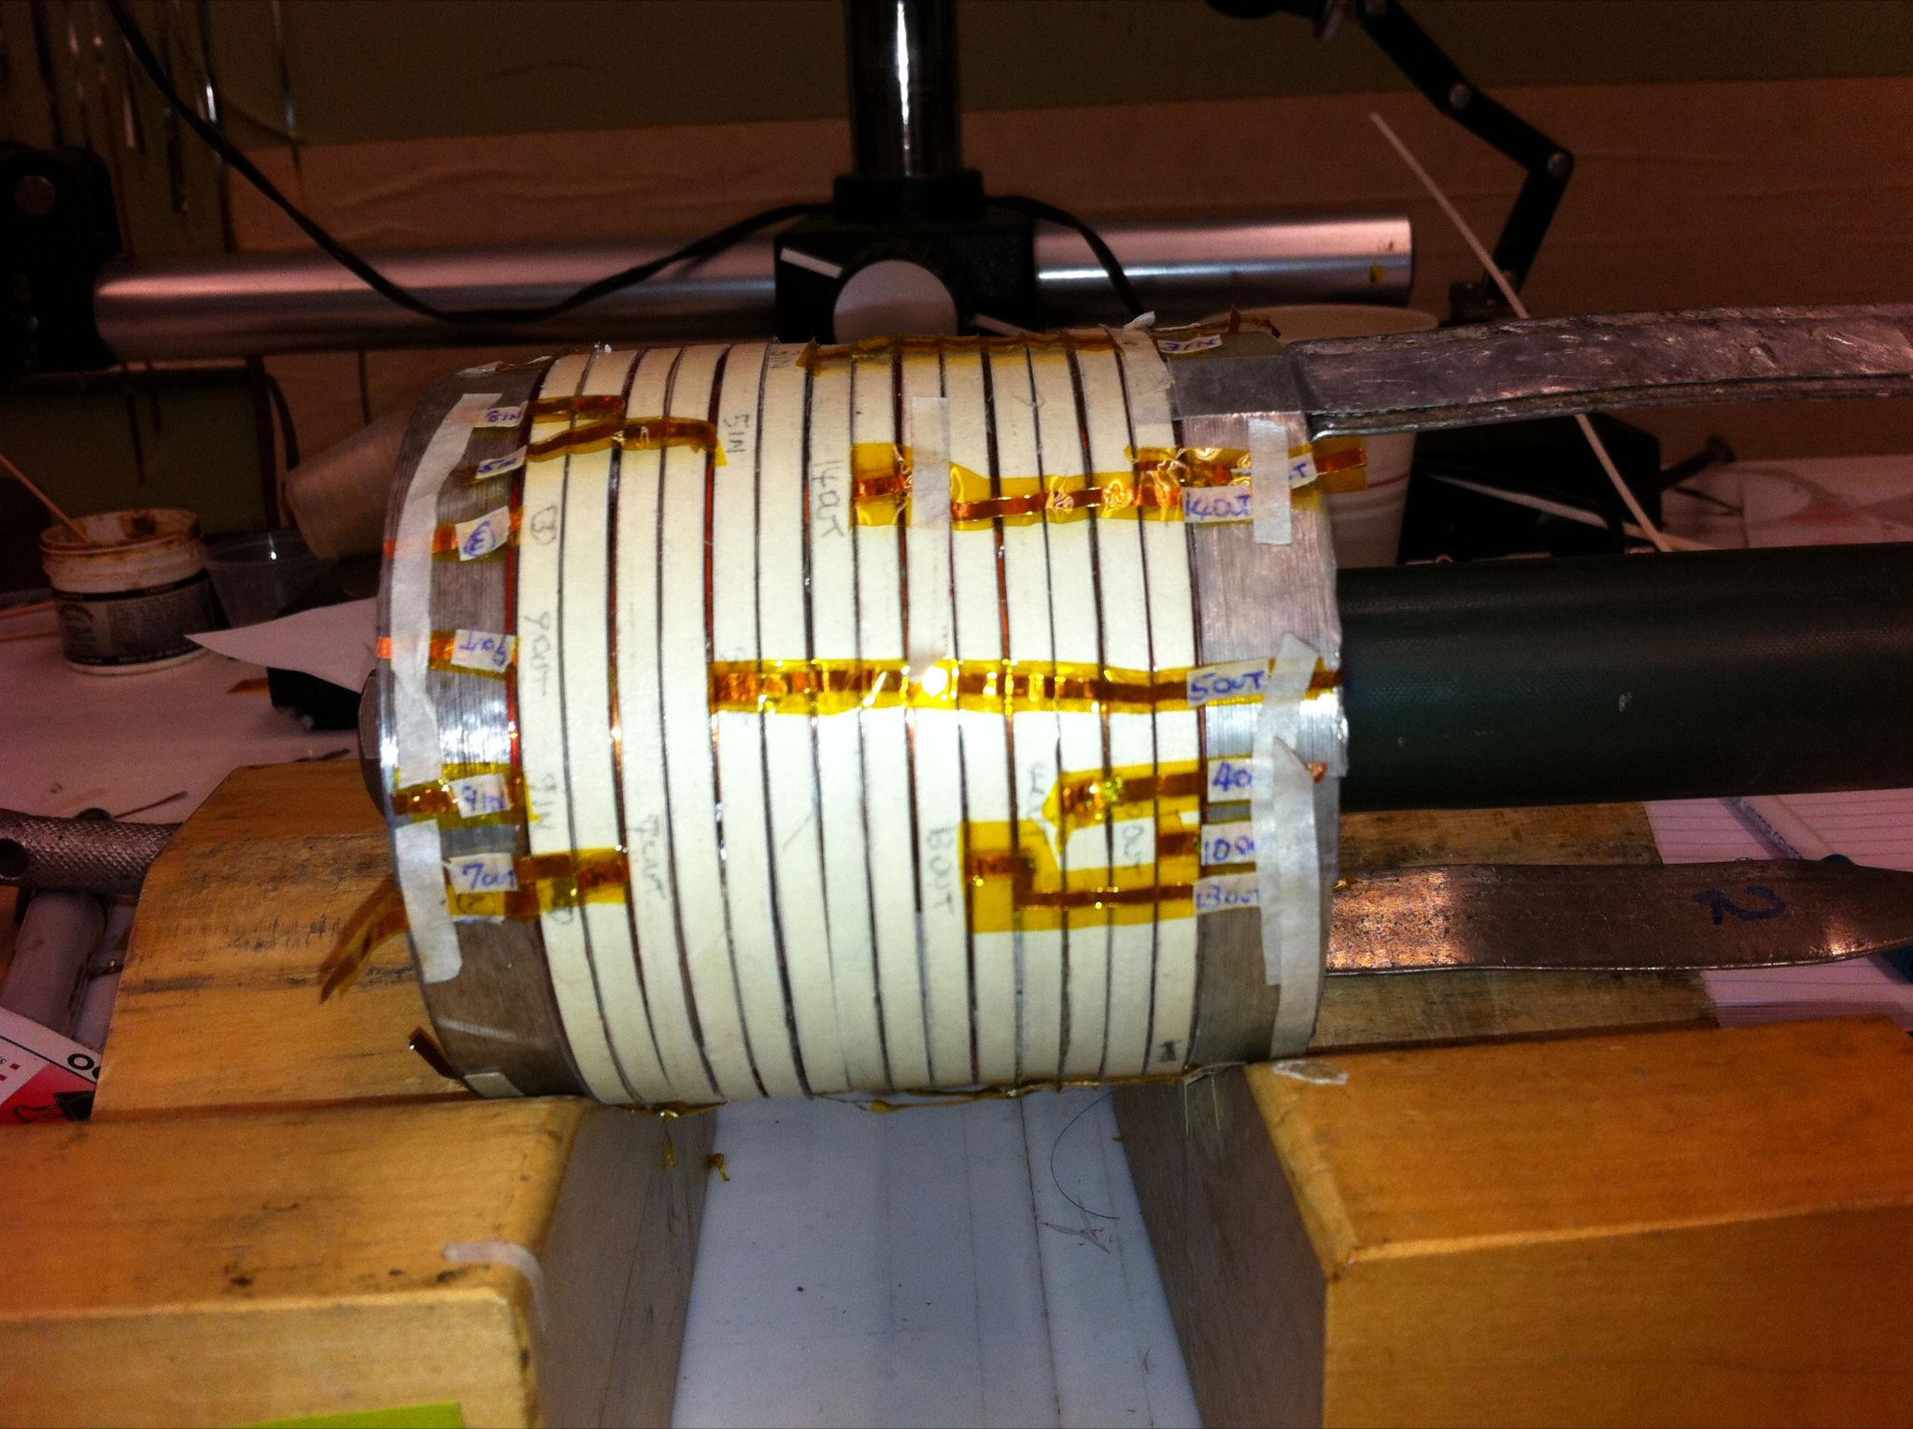
New record field, 16 T, for solenoid wound with YBCO High Field Superconductor
High Field Superconductor =
High Temperature Superconductor at 4 K (not 77 K)
Previous record: 10 T
YBCO tape: 0.1 mm x 4-12 mm
OHEP SBIR with Particle Beam Lasers, BNL as subcontractor (2 Phase IIs, 1 Phase I) – YBCO vendor: SuperPower
Full program: 3 nested coils, can test full set to ~ 40 T
I = 285 A
id = 25 mm, od 91 mm
700 m tape
Did not quench
R&D program at BNL, from P. Wanderer

Slide 40
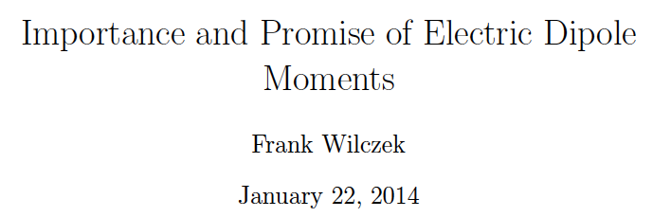
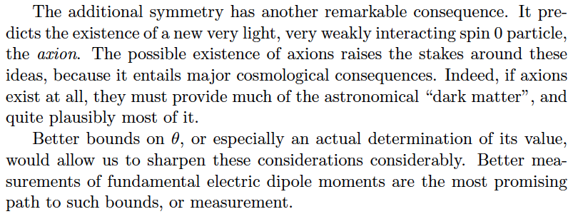

Slide 41
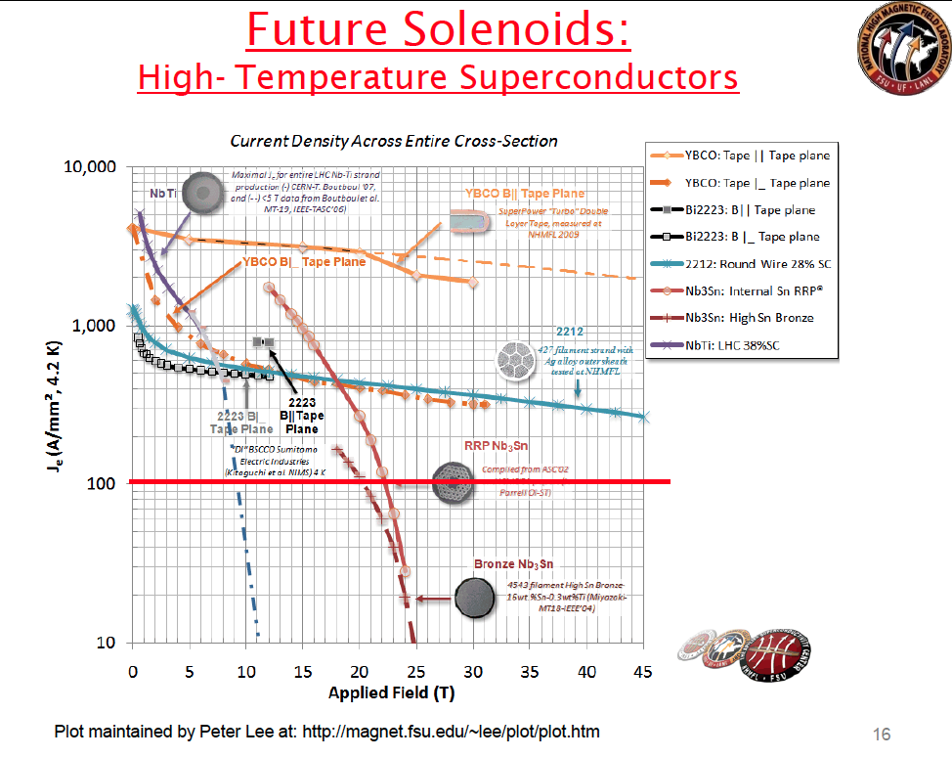

Slide 42
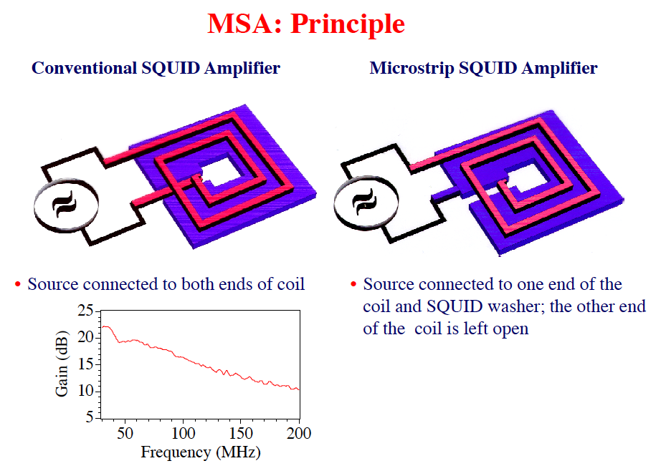
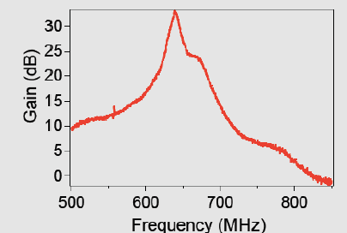
SQUID amplifiers

