Slide 1


Practical school experiments with
MX-10 Particle camera
Vladimir Stanislav - JABLOTRON , (Vladimír Vícha - IEAP CTU in Prague)

Slide 2

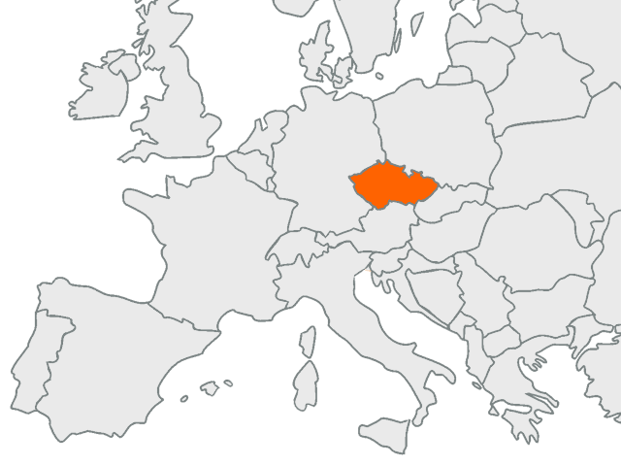

about us
Jablonec n. N. - JABLOTRON
Prague - IEAP

Slide 3
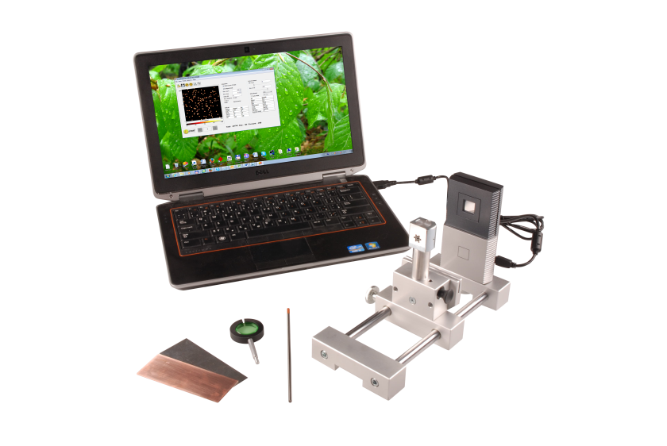
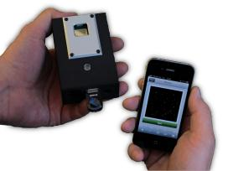
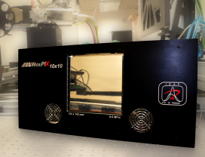

about us
  JABLOTRON ALARMS a.s.
  100% Czech privately-owned alarm systems manufacturer
  producer of MX-10 particle camera and the EDUKIT set
  cooperation with IEAP on the read-out interface for MX-10 camera
  Institute of Experimental and Applied Physics, Czech Technical University in Prague
  member of Medipix collaboration
  developed evaluation and control software Pixelman and a number of devices incorporating Medipix family chips

Slide 4
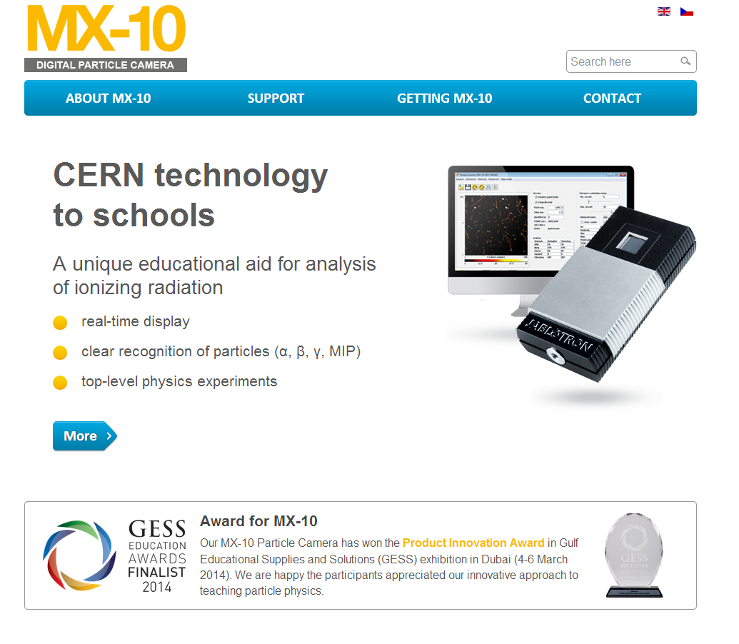
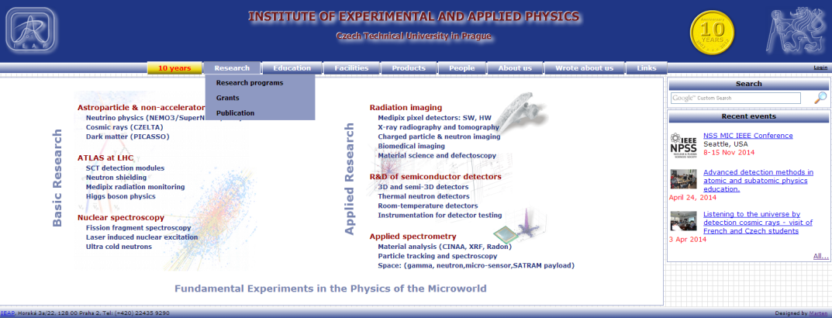
contacts
  www.particlecamera.com
  www.utef.cvut.cz/en/

Slide 5
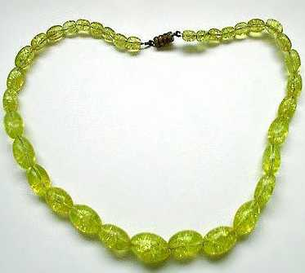
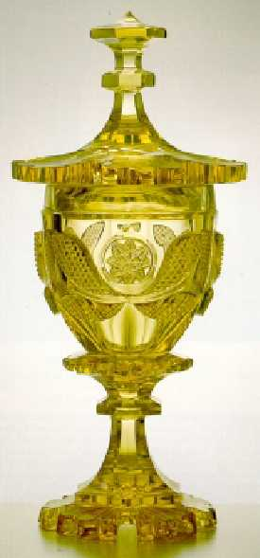
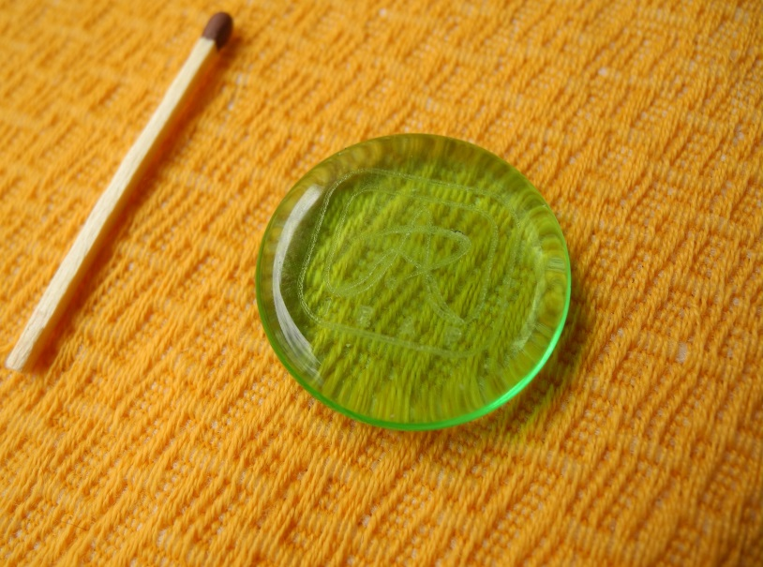
1. RADIOACTIVITY FROM URANIUM GLASS
Measured glass

Slide 6
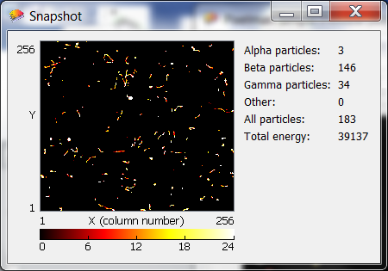
A typical image (U), exposure time 60 s.

Slide 7
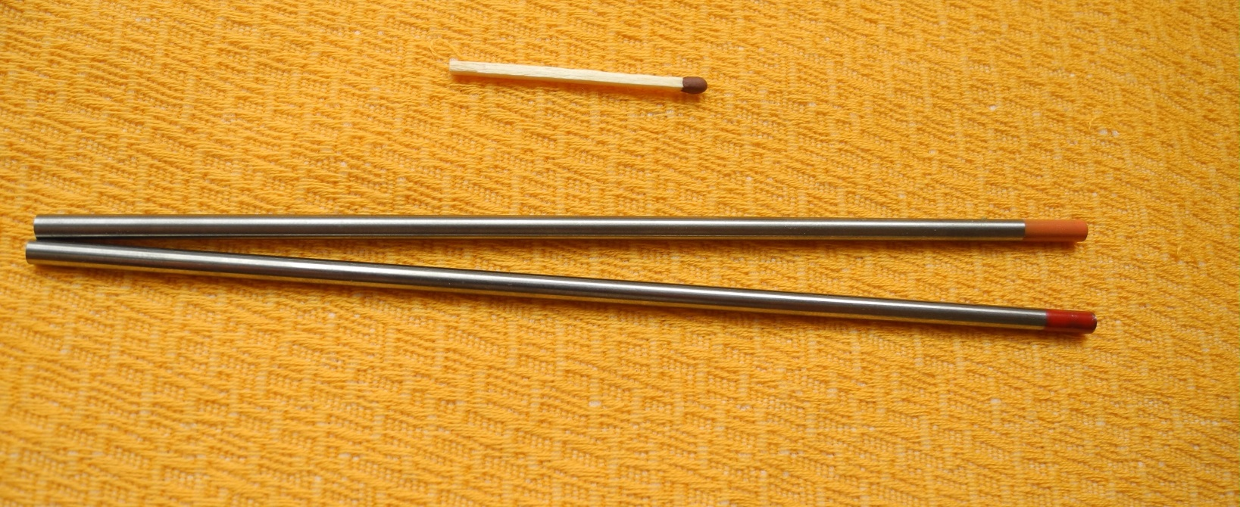
2. RADIOACTIVITY FROM TUNGSTEN WELDING Electrode with thorium additive
WTh-40
WTh-20

Slide 8
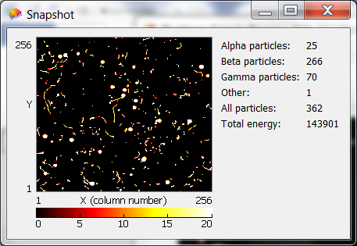
A typical image (Th), exposure time 30 s.

Slide 9
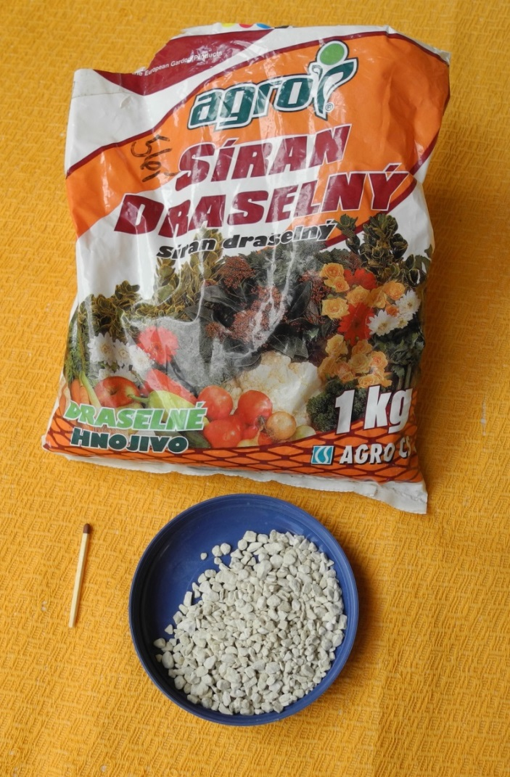
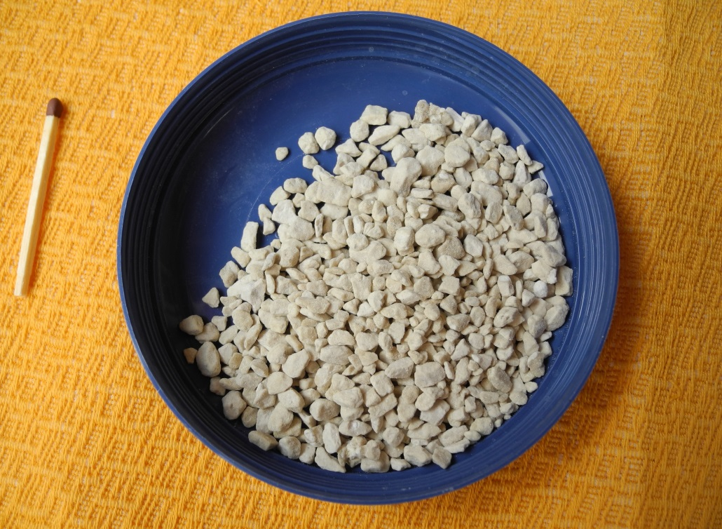
3. RADIOACTIVITY FROM Potassium sulphate
potassium flower fertilizer

Slide 10
Americium - artificial radionuclide
School RADIATION source „alpha“ (²⁴¹americium, 9.5 kBq)
1 - closed
3 –“short hole“
4 –“deep hole“
2 - „sieve“

Slide 11
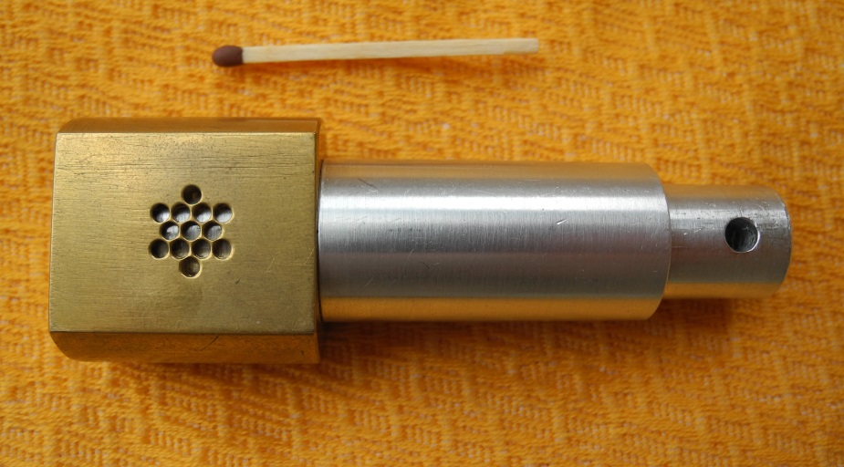
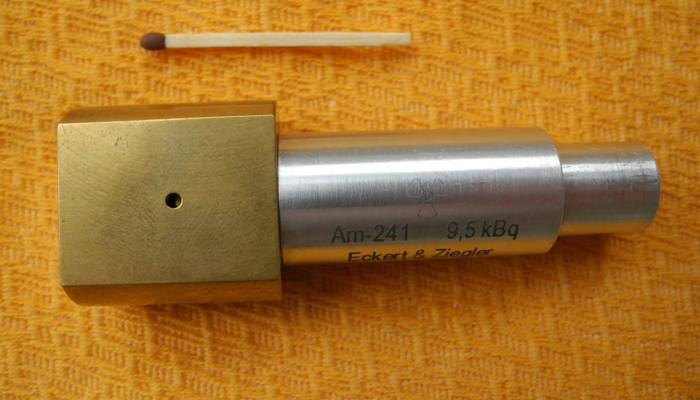
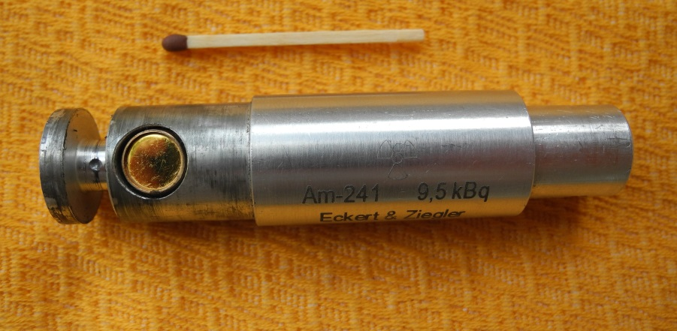
brass
Am

Slide 12
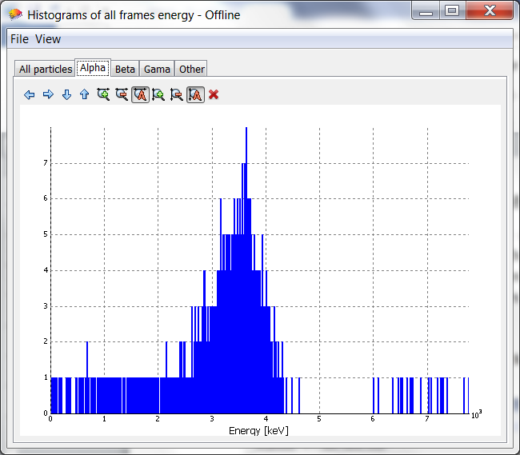
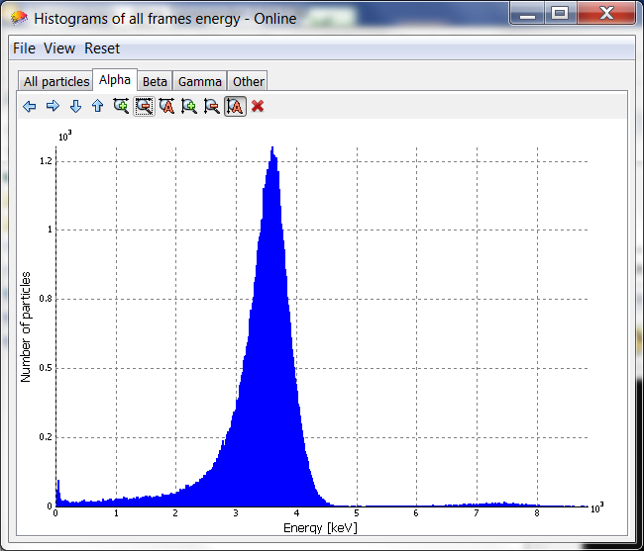
4. Energy of alpha particles emitted from americium
Histogram of energy
500 frames 200,000 frames

Slide 13
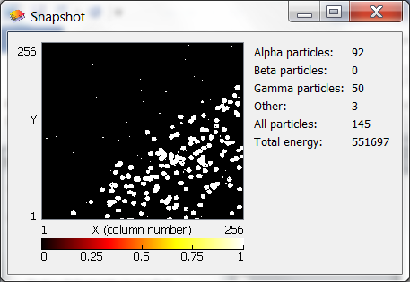
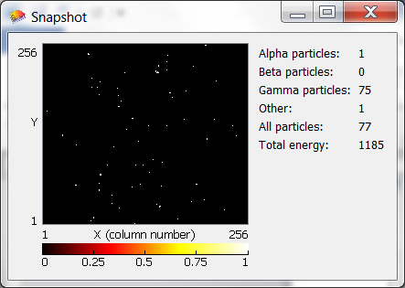
5. Absorption of alpha particles in paper and other materials
the edge of paper
The whole chip is covered.

Slide 14
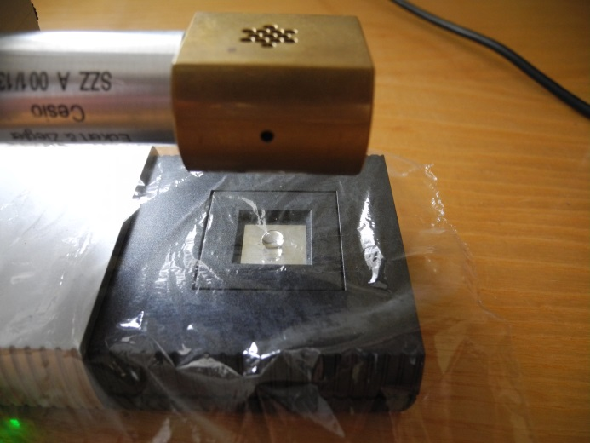
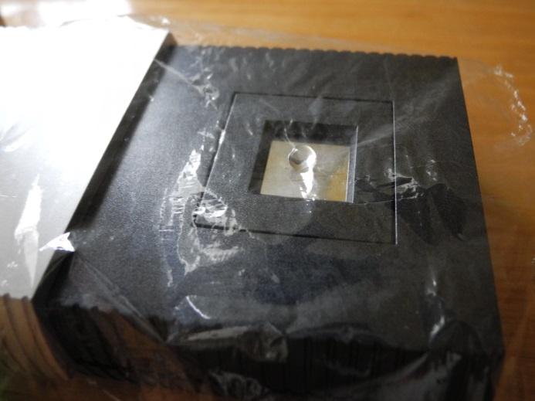
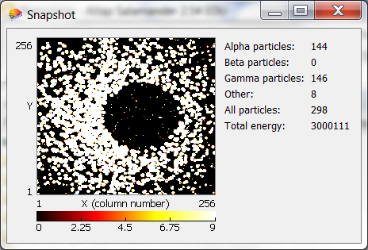
6. Absorption of alpha particles in water
food-wrapping film
Droplet of water

Slide 15
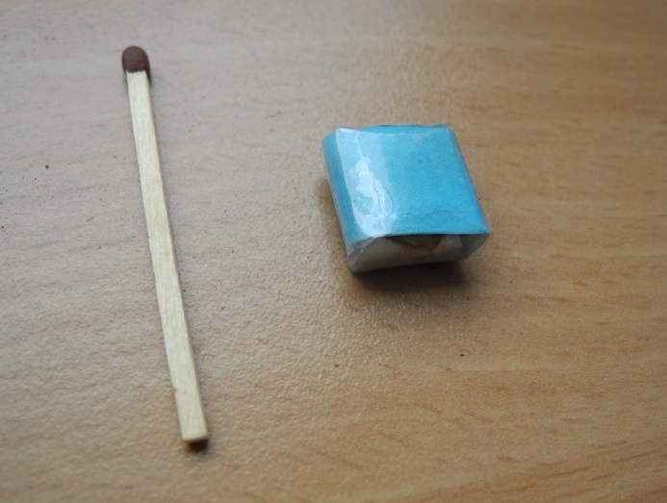
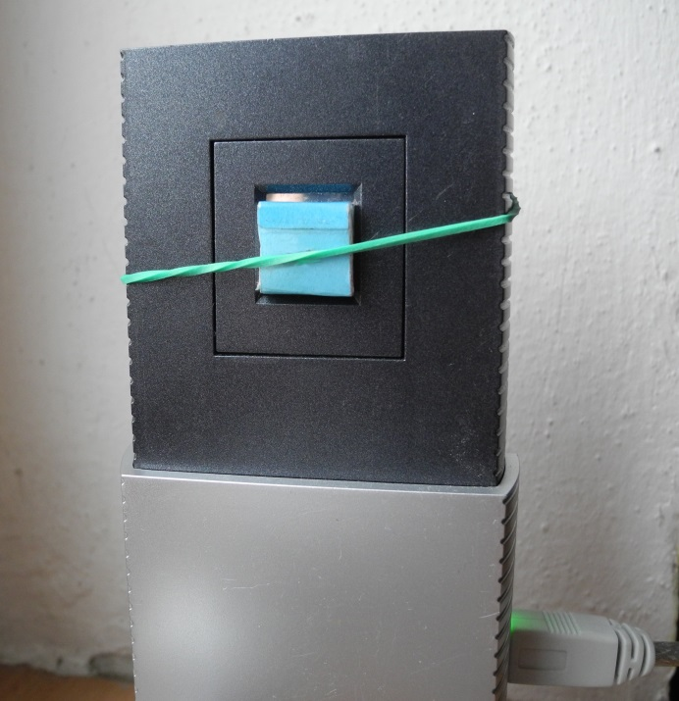
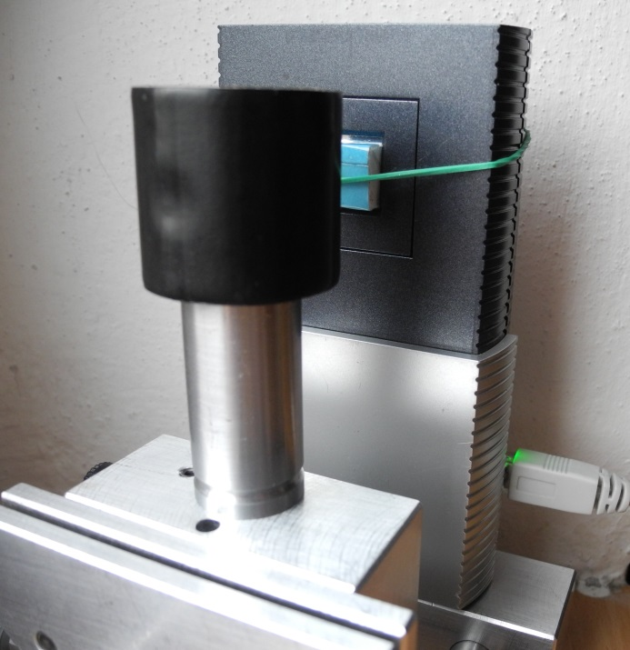
7. Nondestructive examination (X-ray)
Block of expanded polystyrene foam
What I hid inside?

Slide 16
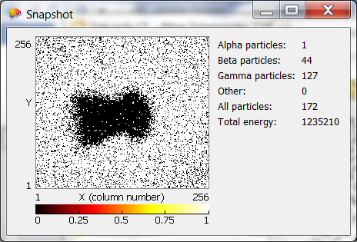
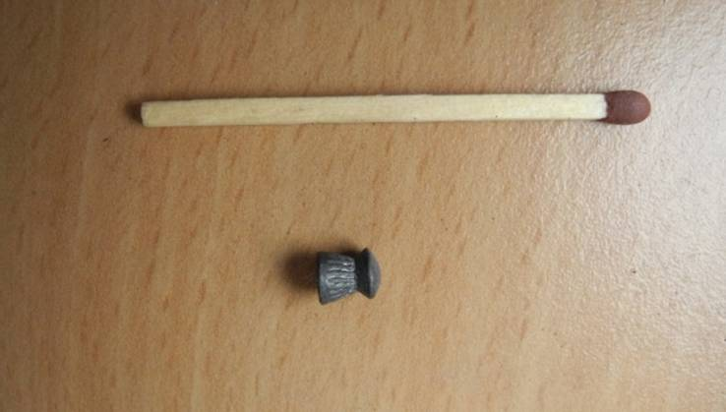
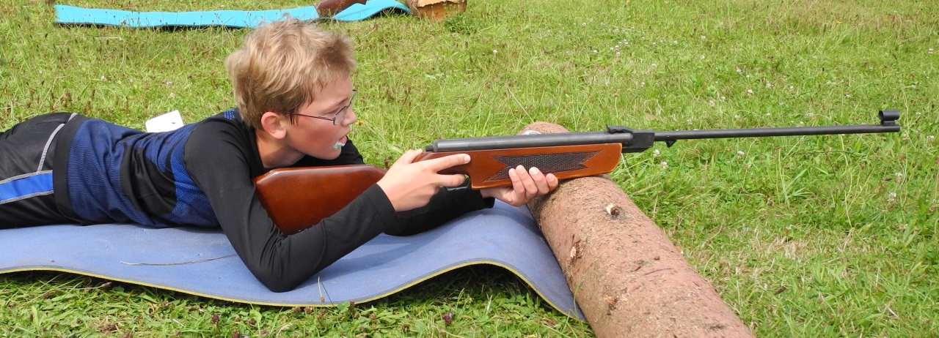
Solving mysteries…
An air gun pellet

Slide 17

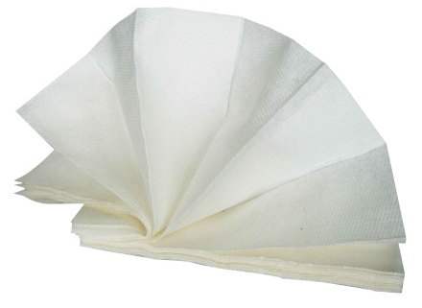
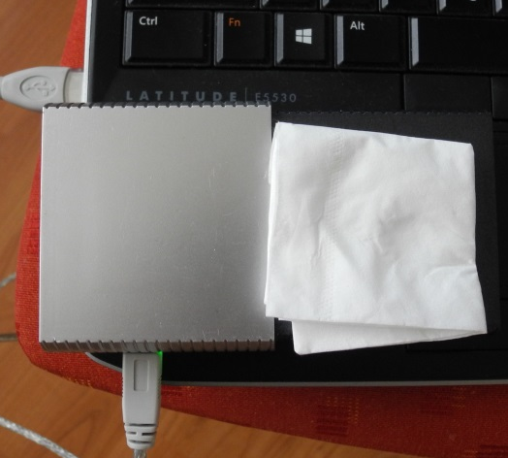
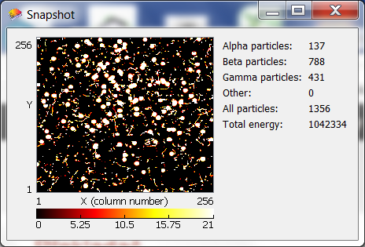
8. Radon is around us
Wiping the CRT monitor
50-minute measurement
Paper tissue

Slide 18
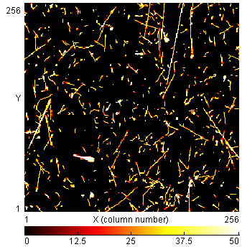
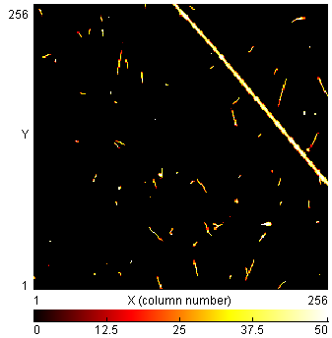
9. MEASUREMENTS AT 11km
- onboard commercial flight
10 min.
1 min.

Slide 19
Thank you for your attention
mx-10@jablotron.cz

