Slide 2
Introduction
MicroTCA evaluation
AdvancedTCA evaluation
Conclusions & Questions

Slide 3
Introduction
At CERN the first xTCA systems are being installed during the current Long Shutdown (LS1) while larger quantities are planned for the Long Shutdown 2 (2018).
    MicroTCA: CMS
    ATCA: ATLAS and potentially LHCb & Alice
xTCA evaluation project in Electronics support group for experiments (PH-ESE) group launched in 2011
  Technical evaluation of components for MicroTCA and ATCA systems as well as AC/DC rectifiers
  Development of tools (H/W and S/W) for the testing of commercial components
  Conduct market surveys
  Report and share results (xTCA Interest Group)
Next phase
  Try to standardize MicroTCA and ATCA shelves, power supplies, MCHs..
  Define acceptance test procedures
  Propose a selected set of equipment to the experiments
  Provide centralized support for these items

Slide 4
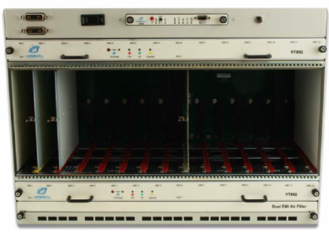
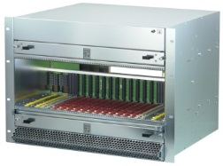
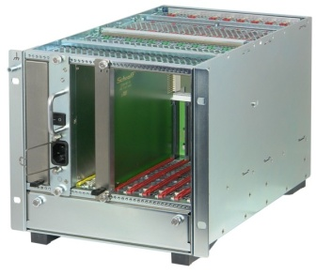

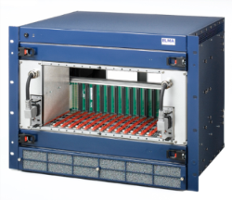
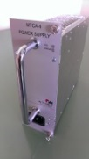
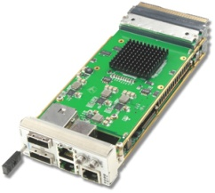
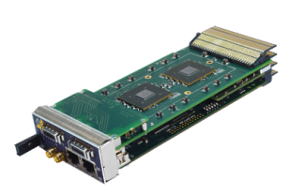
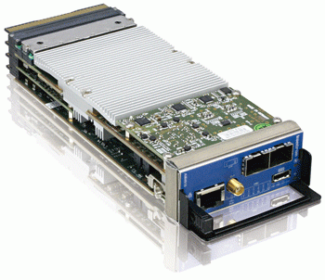
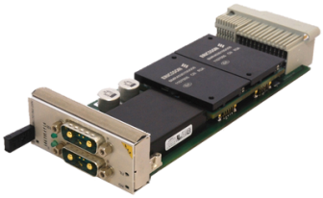
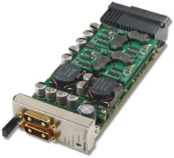
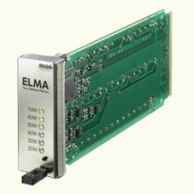
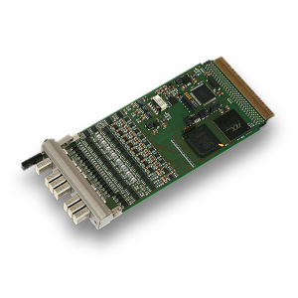
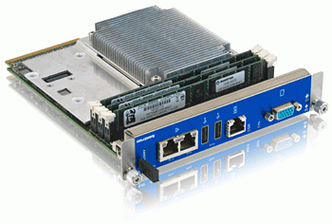
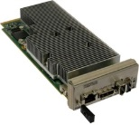
Introduction – MicroTCA Equipment (1/2)
MicroTCA Crates
Vadatech MTCA.0
VT892
Schroff MTCA.4
11890
Schroff MTCA.4 + AC/DC CM100
ELMA MTCA.4
043-012
Power Modules (PM)
MicroTCA Carrier Hubs (MCH)
NAT DC780
792W
Vadatech UTC010
792W
Wiener AC/DC
Prototype, 800W
Vadatech
UTC001
NAT
Kontron
AM4904
AMCs
ELMA Load Board
Processor
Kontron AM5030
ESD ADIO24
Processor
CCT AM310
4

Slide 5

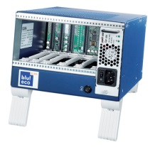
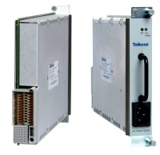
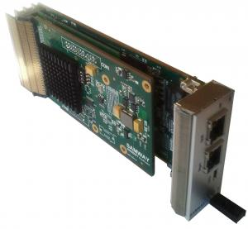

Introduction – MicroTCA Equipment (2/2)
MicroTCA Crates
Vadatech MTCA.0
VT892
Schroff MTCA.4
11890
Schroff MTCA.4 + AC/DC CM100
ELMA MTCA.4
043-012
ELMA MTCA.4
045-821
ELMA Blu!Eco
Power Modules (PM)
MicroTCA Carrier Hubs (MCH)
NAT DC840
840W
Vadatech UTC010
792W
Wiener AC/DC
1000W
Telkoor AC/DC
600W
Samway
Vadatech
UTC001
NAT
Kontron
AM4904
AMCs
ELMA Load Board
Processor
Kontron AM5030
ESD ADIO24
Processor
CCT AM310

Slide 6
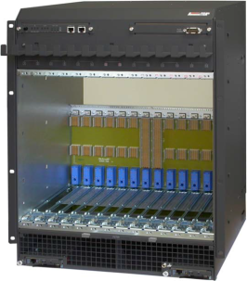
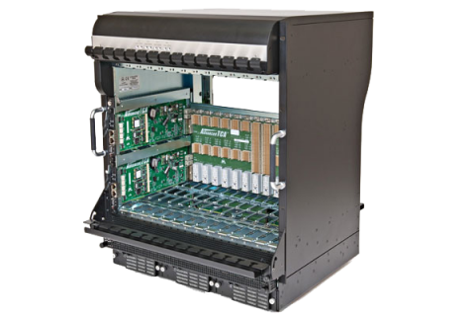
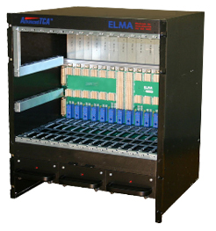
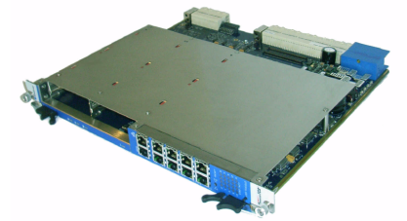
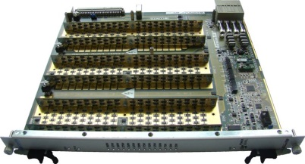
Introduction – AdvancedTCA Equipment
AdvancedTCA Crates
  Schroff 14-slot 13U ATCA
  11596-150
  ASIS 14-slot 13U ATCA
  144D422
  ELMA 14-slot 13U ATCA
  190186
AdvancedTCA blades
  Kontron AMC Carrier
  AT8901M
  Comtel load boards
  (Front and rear)

Slide 7
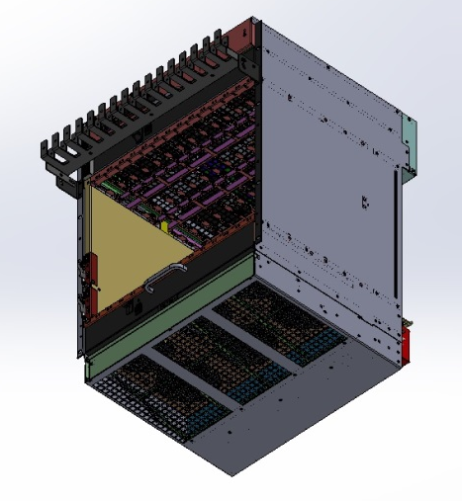
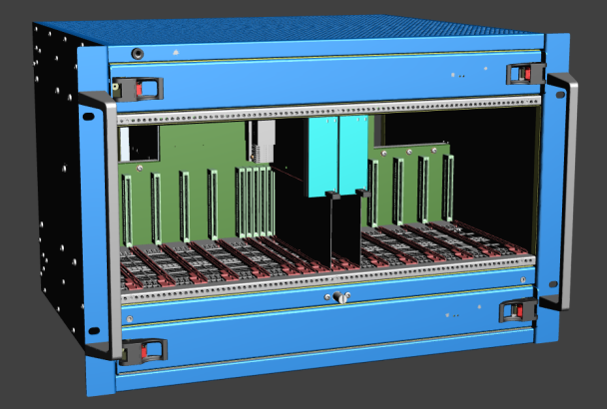
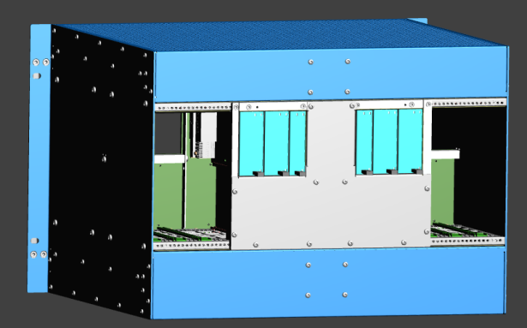
Introduction – Custom designs under development
AdvancedTCA
Commercially available shelves implement a front-bottom to rear-top airflow
In order to adapt the ATCA shelves cooling to the existing rack cooling system a modification of the mechanics is required
Vertically cooled shelf under development
MicroTCA
12 full size-double width AMCs, six RTMs, six PMs and two MCHs
Fully redundant and fully loaded
Vertical cooled
ATCA vertically cooled shelf
PM
PM
PM
PM
PM
PM
MCH
MCH

Slide 8
Introduction – Tests Performed
 | MicroTCA | ATCA
Electrical tests | Static regulation Dynamic regulation Ripple and noise Efficiency and PF Overcurrent protection
 | - AC/DC rectifiers | - AC/DC rectifiers
Cooling and mechanics | Cooling performance Mechanical aspect and layout Backplane alignment | Cooling performance Mechanical aspect and layout
Software (IPMI) | IPMI interoperability tests IPMI conformity Load sharing configuration | IPMI interoperability tests IPMI conformity

Slide 9
Introduction
MicroTCA evaluation
  Power Modules
  Schelves
  Interoperability
AdvancedTCA evaluation
Conclusions & Questions

Slide 10


MicroTCA evaluation (1/4) – Power Modules
Efficiency
Load Regulation
Ripple
$$η= \frac{P_{out}}{P_{in}}$$
Ripple measured at 90% of full load
$$\% Load Regulation=100\% \frac{V_{NOM}−V_{\max{LOAD}}}{V_{NOM}}$$

Slide 11
MicroTCA evaluation (2/4) – Power Modules
PM1 v1.2
 | Test Conditions | Measured | PM Specs
Maximum Power | Vi=-48V | 730W | 780W
Input Voltage |  | -48V to -53V | -40V to -60V
Load Regulation | Full power | 8.6% | 10%
Line Regulation | Full load, Vin: -40V to -53V | 2mV (max) before failure | Not reported
Efficiency | Vi = -48V, 1-100% of full power | 94% (max) | 95.5% (min)
Ripple | Full power | 20mV | Not reported
Voltage transient deviation | Load step from 25% to 75% of full load | ±0.5V | Not reported
PM1 v1.3
 | Test Conditions | Measured | PM Specs
Maximum Power | Vi=-48V | 780W | 780W
Input Voltage |  | -40V to -60V | -40V to -60V
Load Regulation | Full power | 8.6% | 10%
Line Regulation | Full load, Vin: -40V to -53V | 2mV (max) | Not reported
Efficiency | Vi = -48V, 1-100% of full power | 94% (max) | 95.5% (min)
Ripple | Full power | 20mV | Not reported
Voltage transient deviation | Load step from 25% to 75% of full load | ±0.5V | Not reported

Slide 12
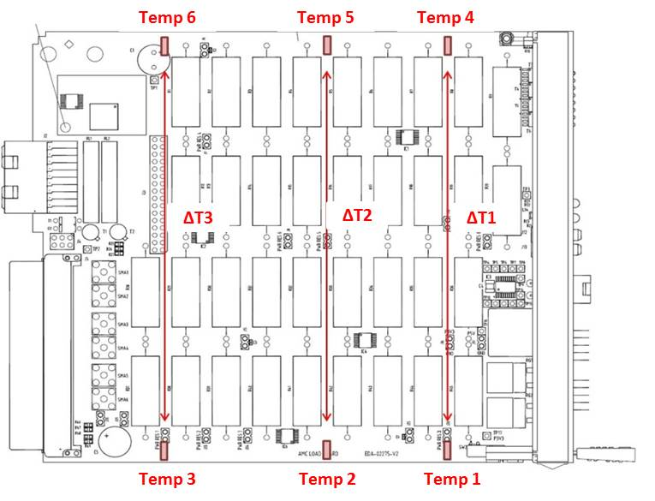
MicroTCA evaluation (3/4) - Shelves
  AMC Load Board
The aim is to evaluate the maximum vertical temperature variation
and cooling homogeneity between AMC and RTM slots.
  Load modules configured to dissipate their maximum power
  Fans are driven at maximum speed
  Temperature is sensed in six points
AMC vertical temperature variation
Fans specs
Max delta
CFM 60 x 10
AMC 25 °C
CFM 171 x 3 (AMC)
CFM 130 x 2 (RTM)
AMC: 19 °C
RTM: 14 °C
CFM 100 x 3 (AMC)
CFM 100 x 3 (RTM)
AMC: 47 °C
RTM: 23 °C

Slide 13
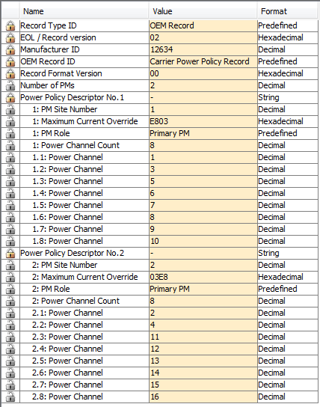
MicroTCA evaluation (4/4) – Interoperability
Example: Load Sharing Topology
Required to fully load the crate
More than one Primary PM
Each PM powers a defined set of FRUs
Load configuration defined in Backplane FRU Info
Power Module | PM Role | FRUs
PM1 | Primary | MCH1, CU1, AMC1 to AMC6
PM2 | Primary | MCH2, CU2, AMC7 to AMC12
Proper operation of the system depends on components used
and FW versions
Several equipment combinations tested (Shelves, MCHs, PMs)
Some no-systematic issues encountered
Significant improvements
  Power Policy Record editing in NatView

Slide 14
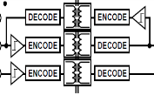
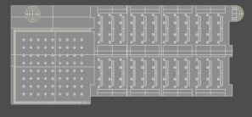
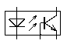
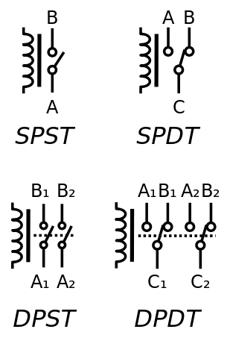

MicroTCA PM Test Pad (1/2)
So far the test architecture consisted of
  Commercial crate where load modules were hosted and used to perform test
  Load Sharing Topology: PM under test assigned to AMC slots. Auxiliary PM used to power CUs and MCH.
Limitation:
  Backplane influence on measurements (Ripple and noise are influenced by CU and shelf)
  The test is limited to the 12 AMC channels since the CU and MCH channels cannot be easily measured in a crate
  In the perspective of performing EMC measurements, this setup is not suitable for this kind of measurements
  Full automatic test procedure not possible
  Design a stand-alone test device to perform automatically static and dynamic regulation tests, efficiency and ripple and noise measurements.
EXTernal Power Supply
ISOLATION
I2C Isolator
MP&PP
Payload
channels
Payload Relays
PM IPMB_0 (A/B)
External LOAD
IPMB_L
MCH
PS1, EN, MP, PP
Local I2C
IO
Extender
Relay Control
uC
EXT GND
EXT GND
PM GND

Slide 15
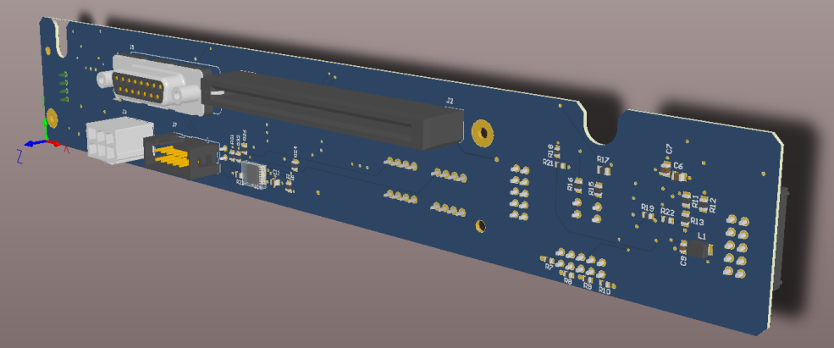
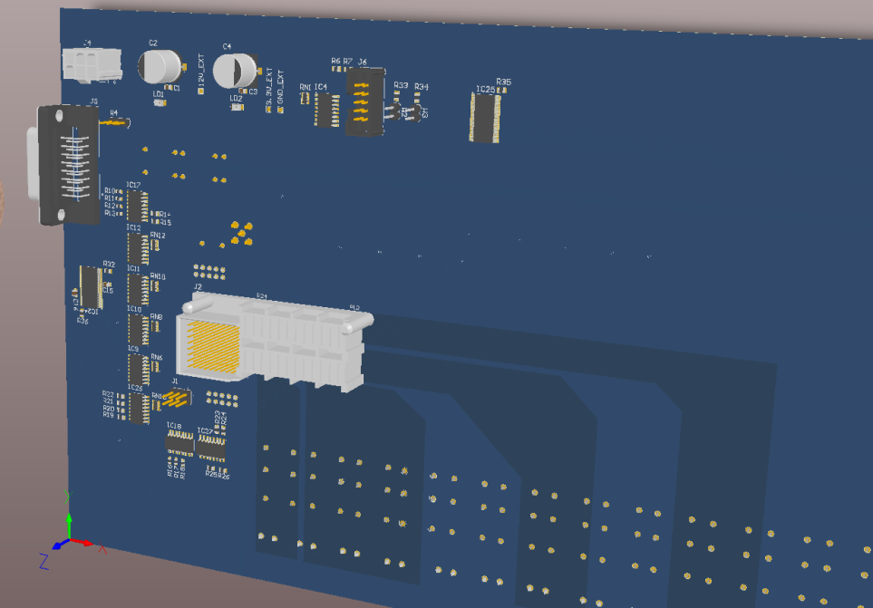
MicroTCA PM Test Pad (2/2)
Ready for manufacturing
MCH PCB CAD view
The test pad will provide:
Shelf environment simulation
Isolation between PM and test control circuitry
PP and MP voltages measurement features
Connection to an external electronic load
EMC measurements features (EMI receiver)
Noise rejection ratio across channels
IPMB-0 Analyzer
Cooling
Power Module PCB CAD view

Slide 16
Introduction
MicroTCA evaluation
AdvancedTCA evaluation
Conclusions & Questions

Slide 17
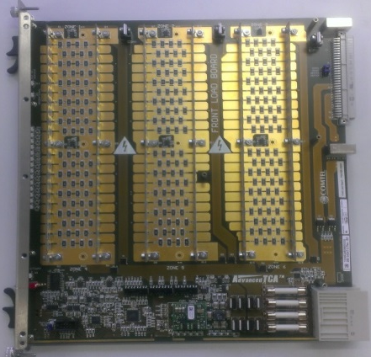
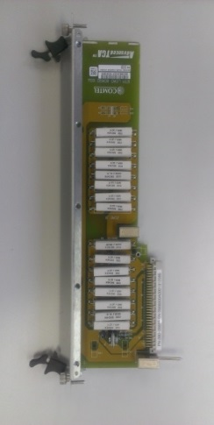
ATCA Evaluation
Test is performed with fans at maximum speed and:
  250W for front modules (Power Entry Module limitation)
  50W for rear modules
ΔT1
ΔT2
ΔT3
ΔR
Load boards
Chassis1
MAX front ∆T = 35 °C
Chassis2
MAX front ∆T = 23°C

Slide 18
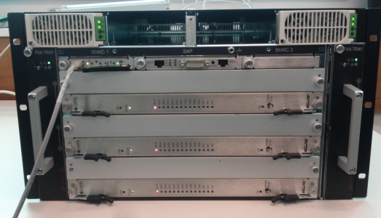
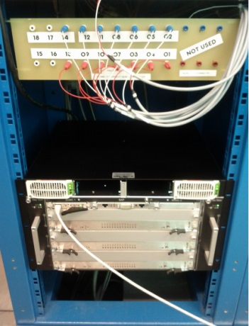
ATCA Evaluation – Specific case study
ATLAS is using a 6 slots ATCA shelf as single instance infrastructure for the trigger
upgrade.
  Shelf airflow direction is horizontal (left to right)
  The shelf will be located on the bottom side of the LHC rack
  Outside the turbine circulation
Test has been carried out on the table and inside the rack with the following load conditions:
  250W on each slot (200W front, 50W rear)
  350W on three slot (300W front, 50W rear)
Test showed that the temperature increase in the two cases was not excessive (+ 4°C)
However, it should not be scaled to full system.
(1)
(2)
Chassis outside the rack(1)
Chassis in the rack (2)

Slide 19
Introduction
MicroTCA evaluation
AdvancedTCA evaluation
Conclusions & Questions

Slide 20
Conclusions
Results obtained
Detailed test procedures defined
Test systems developed (Modules, systems and software)
xTCA standards, systems and equipment know-how gained
Comprehensive set of tests performed for MicroTCA: crates, PMs and MCH and ATCA.
Interaction with manufacturers (HW and SW modifications introduced)
Detailed evaluation reports published
(https://espace.cern.ch/ph-dep-ESE-BE-uTCAEvaluationProject/default.aspx)
Lessons learned
Some new products lacking maturity in MicroTCA format
Good communication with vendor support is essential
Evaluation program ongoing
PMs, MCHs, Shelves
PM Test Pad, DESY MMC, LAPP ANNECY IPMC
New project phase launched
Make equipment recommendations
Define technical specifications jointly with experiments in view of future equipment purchase and maintenance
Make reference equipment available to users for evaluation
Provide support service and tools to the xTCA community

Slide 21
Thank you
matteo.di.cosmo@cern.ch

Slide 22
Useful links
MicroTCA Evaluation Repository https://espace.cern.ch/ph-dep-ESE-BE-uTCAEvaluationProject/default.aspx
ATCA Evaluation Repository https://espace.cern.ch/ph-dep-ESE-BE-ATCAEvaluationProject/SitePages/Home.aspx
PICMG Website http://www.picmg.org/
MicroTCA Short Form Specification http://www.picmg.org/pdf/MicroTCA_Short_Form_Sept_2006.pdf
AMC Short Form Specification http://www.picmg.org/pdf/AMC.0_R2.0_Short_Form.pdf
ATCA Short Form Specification http://www.picmg.org/pdf/PICMG_3_0_Shortform.pdf
IPMI, IPMB Specification http://www.intel.com/content/www/us/en/servers/ipmi/ipmi-specifications.html
Polaris Tester http://www.polarisnetworks.net/atca-test-tool.html

