Slide 1
Extension of Bialas-Bzdak model for measuring the size of protons at LHC
T. Csörgő ^{1,2} and F. Nemes ^{1,3}
¹ Wigner Research Center for Physics, Budapest, Hungary
² KRF, Gyöngyös, Hungary
³ CERN
p+p @ ISR and @ 7 TeV LHC
Real extension of Bialas-Bzdak
New: focusing reBB on low t dσ/dt
arXiv:1204.5617
arXiv:1306.4217
arXiv:1311.2308

Slide 2




S-matrix Unitarity, Optical Theorem
Note: diffraction also measures
|Fourier-transform|² images of
sources of elastic scattering
ideal for femtoscopic studies
several similarities e.g. non-Gaussian sources etc
Black (grey) disc limit (important)
→ σ(b) ~ θ(R-b)

Slide 3

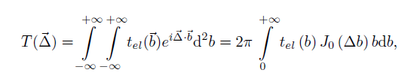


Diffraction in quark-diquark models
Bialas and Bzdak,
Acta Phys. Polon. B 38 (2007) 159
p= (q, d) or p = (q, (q, q))
σ(b) = b dependent prob. of interaction
→ connection to scattering centers
Structure of protons = ?
→ Diffractive p+p at ISR (23.5 – 62.5 GeV) and LHC (7 TeV).

Slide 4



Diffraction a la Bialas and Bzdak
The quark-diquark model of Bialas and Bzdak has been analytically integrated in a Gaussian approximation,
assuming that the real part of forward scattering is negligible.
Two different pictures: p = (q, d) or p = (q, (q,q))
Note: p= (q,q,q) model fails, quarks are correlated
W. Czyz and L. C. Maximon, Annals. Phys. 52 (1969) 59

Slide 5
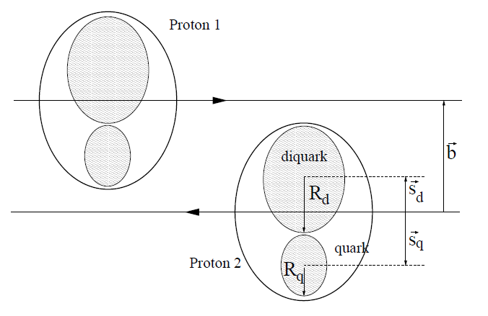
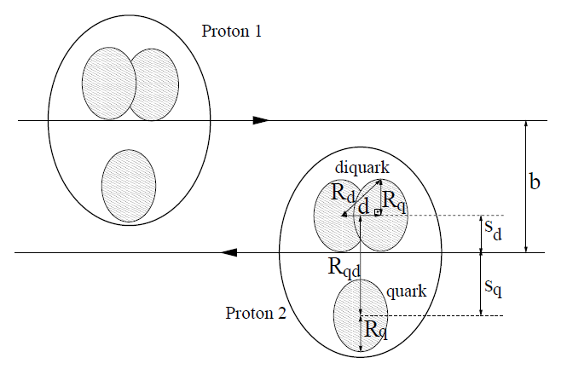
Diffractive p+p scattering
p = (q, d)
p = (q, (q,q))

Slide 6
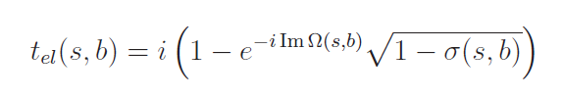

Real extended BB model for the dip
Bialas-Bzdak obtained
if Re (t_{el}) = 0
Real extension of an imaginary t_{el}
New parameter Im Ω added

Slide 7
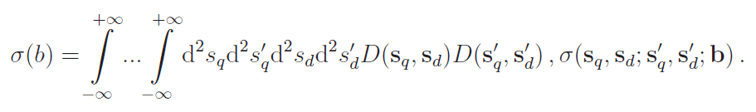
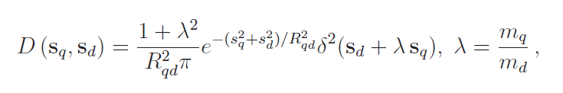
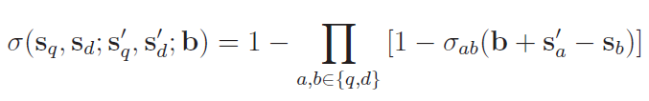


reBB model for the dip (2)
Bialas-Bzdak model is „realized”:
p = (q,d)
p= (q, (q,q))

Slide 8


reBB model: two choices
Similar to a constant ρ
but
not favored
by data
For small values of
α
we recover
our first
attempt, the
αBB model
This choice is also favoured by data
T. Cs., F. Nemes, arxiv:1306.4217

Slide 9
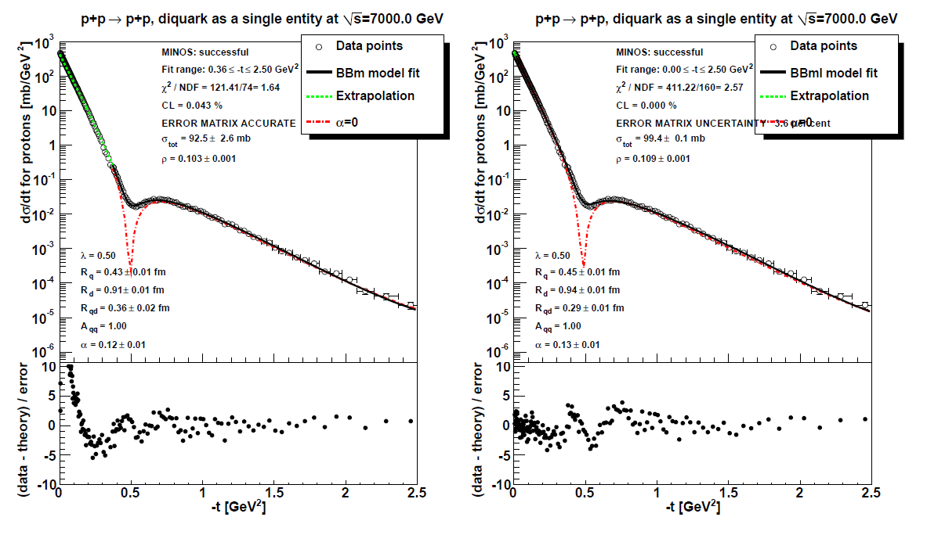
reBB model, fit range studies
fit: 0.36≤ –t ≤ 2.5 GeV², OK
fit: 0 ≤ –t ≤ 2.5 GeV², ~not OK

Slide 10
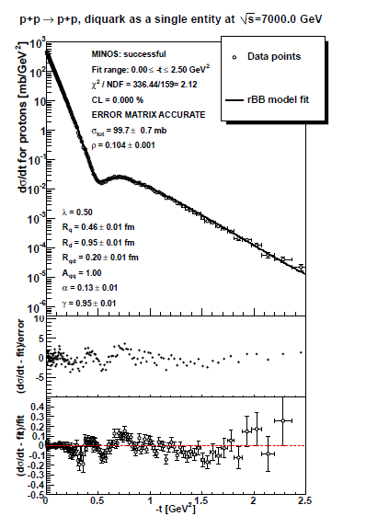

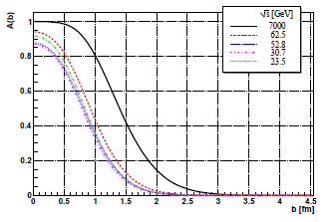


reBB model
Shadow profile function
fit: 0 ≤ –t ≤ 2.5 GeV², ~not OK

Slide 11
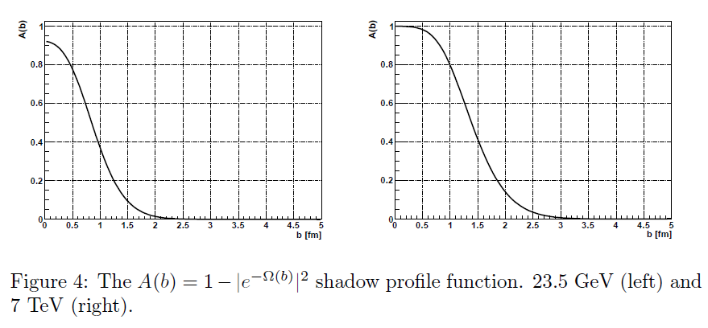
reBB shadow profile functions
Indication of saturation at 7 TeV: A(b) ~ 1 at low b.
~ max probability of interaction at low b

Slide 12
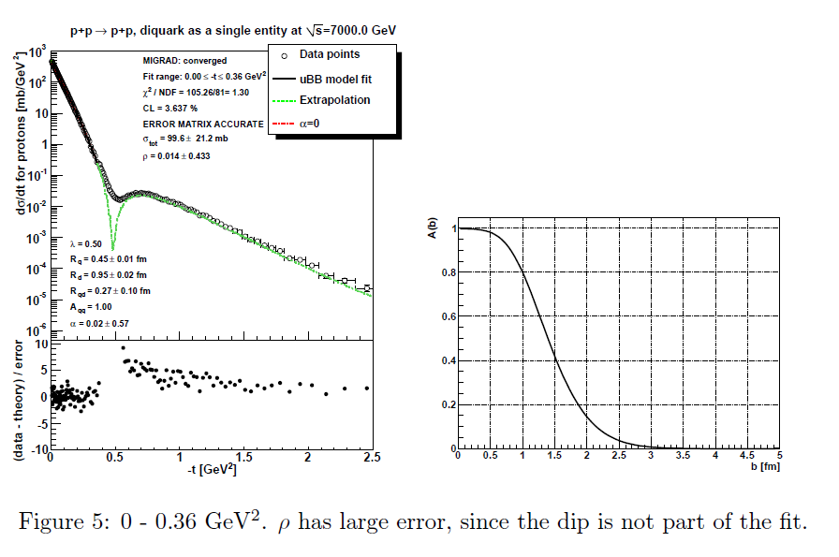
Focusing reBB on the low-t region
Connection to TOTEM talk
Saturation is apparent if fit range is limited to |t| < 0.36 GeV²

Slide 13
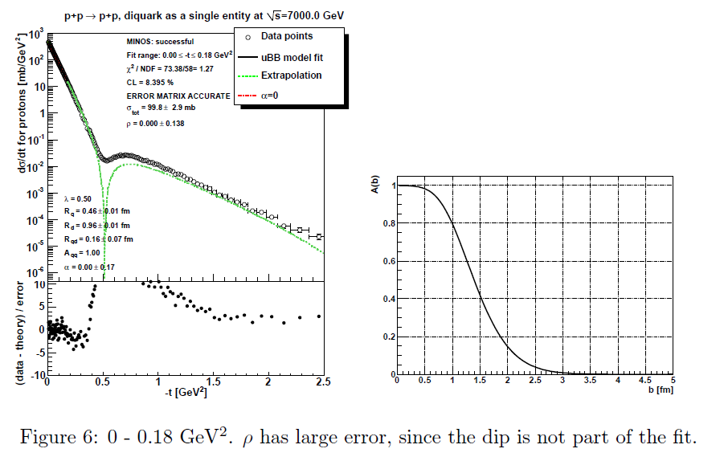
Focusing reBB on even lower -t region
Connection to TOTEM
Saturation still apparent, fit range |t| < 0.18 GeV²

Slide 14
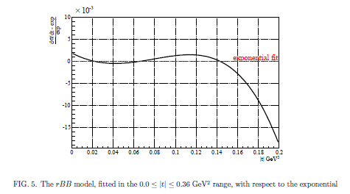
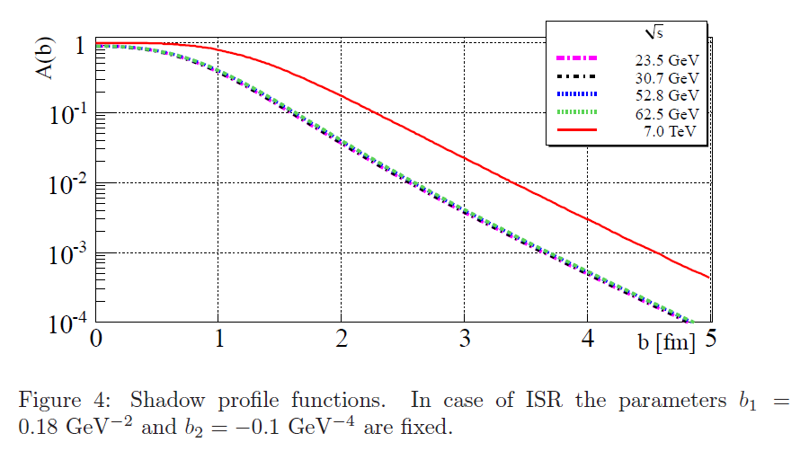
What have we learned?
Bialas-Bzdak
reBB and gGV models:
non-trivial structure at low-t
similar to non-Gaussian
HBT correlations
in femtoscopy
Glauber-Velasco
full saturation is not yet reached
but approaching
both in BB and GV models

Slide 15
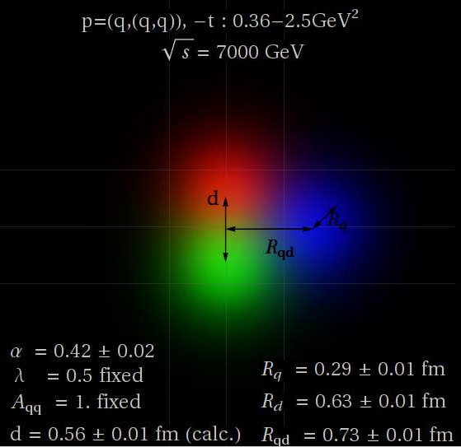
Imaging on the sub-femtometer scale
Thank you!

Slide 16
Backup slides – Questions?

