Slide 1

Overview of TOTEM results on total cross-section, elastic scattering and diffraction at LHC
WPCF
25/08/2014
S.Giani
CERN-CH
on behalf of the TOTEM Collaboration

Slide 2
Outlook & Contents
TOTEM EXPERIMENT
TOTEM PHYSICS LHC RUN I
TOTEM DETECTORS LS1 CONSOLIDATION
TOTEM PHYSICS LHC RUN II
TOTEM – CMS UPGRADE PROGRAMME

Slide 3
TOTEM EXPERIMENT

Slide 4
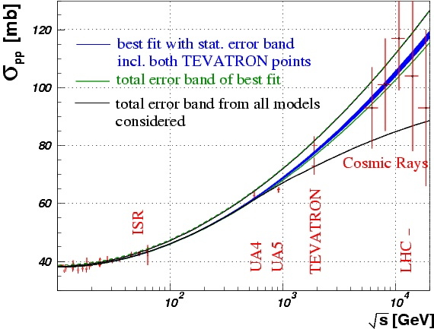
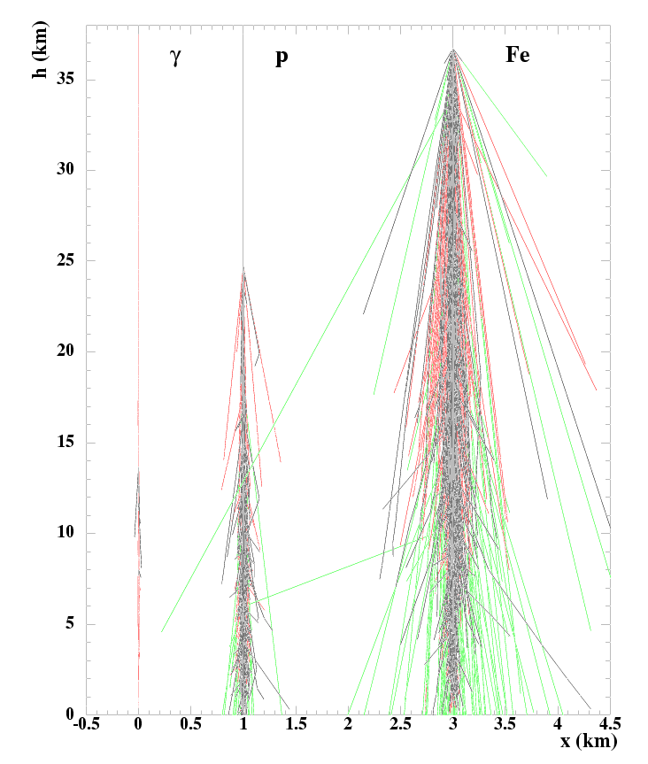
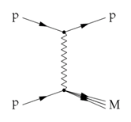
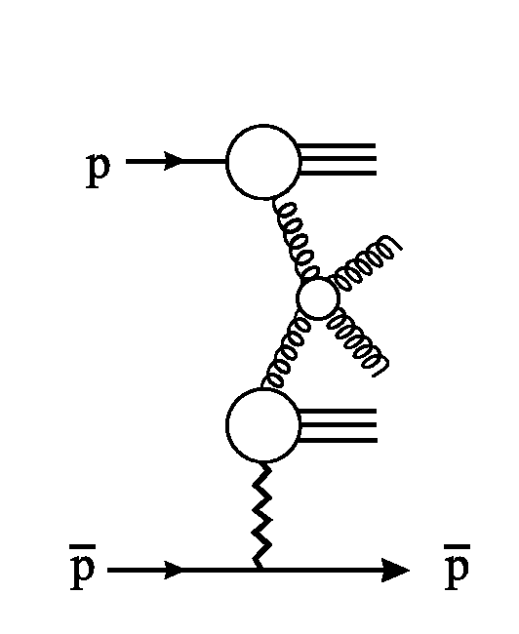
TOTEM Physics Overview
Total cross-section
Elastic Scattering
b
Forward physics
Diffraction: soft (and hard with CMS)
jet
jet

Slide 5
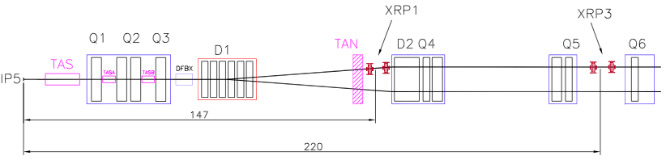
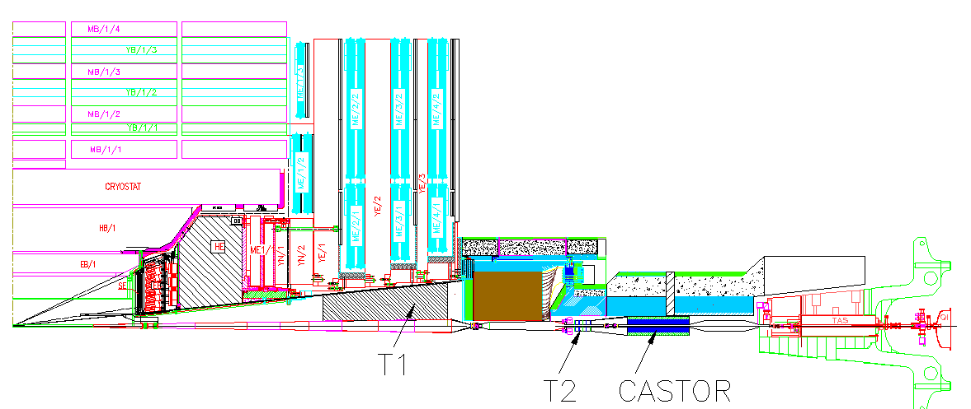
Experimental Setup @ IP5
Inelastic telescopes: charged particle
& vertex reconstruction in inelastic events
T1: 3.1 < η < 4.7
T2: 5.3 < η < 6.5
HF (CMS)
IP5
~ 10 m
T1
~ 14 m
CASTOR (CMS)
T2
Roman Pots: measure elastic & diffractive protons close to outgoing beam
IP5
RP147
RP220
Notes:
5

Slide 6
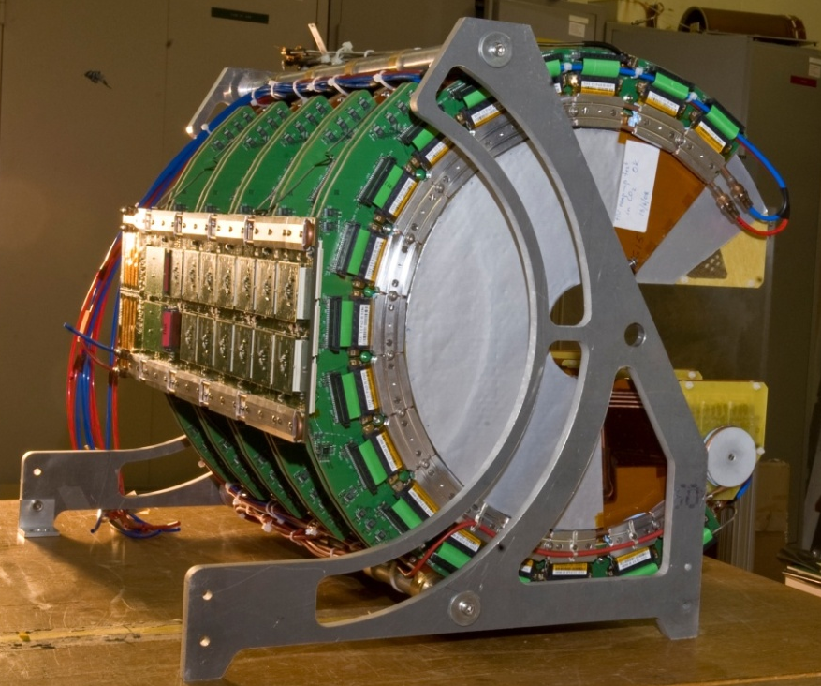
TOTEM Detectors
RP (Si)
RP (Si)
T2
(GEM)
T1
(CSC)

Slide 7
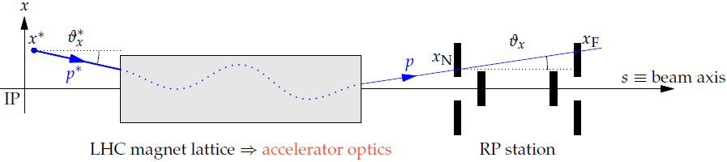
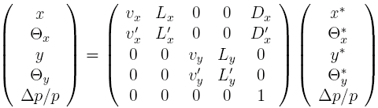
Proton Reconstruction @ LHC
(x*, y*): vertex position
(θ_{x}*, θ_{y}*): emission angle: t ≈ -p² (q_{x}^{* 2} + q_{y}^{* 2})
x = Δp/p: momentum loss (elastic case: x = 0)
Measured in RP
Values at IP5 to be reconstructed
RP
IP5
Product of all lattice element matrices
L_{x}, L_{y}: effective lengths (sensitivity to scattering angle)
v_{x}, v_{y}: magnifications (sensitivity to vertex position)
D_{x} : dispersion (sensitivity to momentum loss); D_{y} ~ 0
Reconstruction of proton kinematics = “inversion” of transport equation
Transport matrix elements depend on x ➔ non-linear problem (except in elastic case!)
Excellent optics understanding needed:
CERN-PH-EP-2014-066

Slide 8
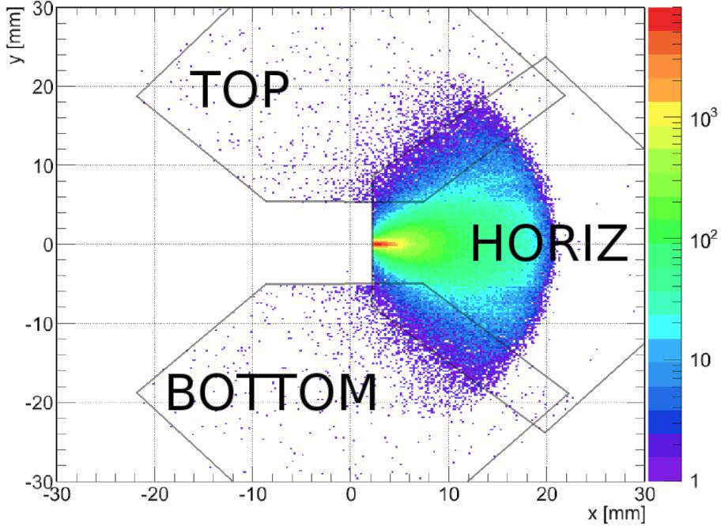
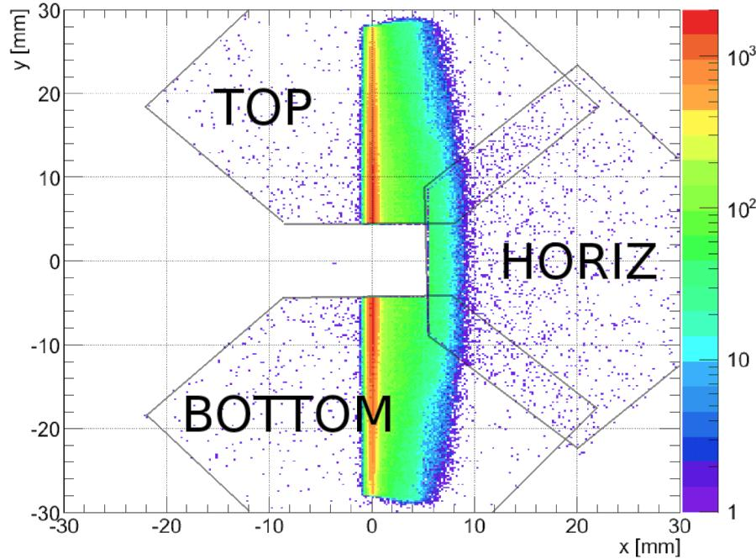
LHC Optics: RP sensitivity
Optics parameters: data full non-linear fit, harmonics, displacements,…
Hit maps of simulated diffractive events for 2 optics configurations
(b* = betatron function at the interaction point)
b* = 0.55 m (low b* = standard at LHC)
b* = 90 m (special development for RP runs)
t = -p² θ²
ξ = Δp/p
y = L_{y} Θ_{y} + v_{y} y*
x = L_{x} Θ_{x} + ξ D + v_{x} x*
L_{x} = 1.7 m, L_{y} = 14 m, D_{x} = 8 cm
diffractive protons: mainly in horizontal RP
elastic protons: in vertical RP near x ~ 0
sensitivity only for large scattering angles
L_{x} = 0, L_{y} = 260 m, v_{y} = 0, D_{x} = 4 cm
diffractive protons: mainly in vertical RP
elastic protons: in narrow band at x ≅ 0,
sensitivity for small vertical scattering angles
 | Beam width @ vertex | Angular beam divergence | Min. reachable |t|
β* ~ 0.5−3.5 m | small | large | ~ 0.3–1 GeV²
β* = 90 m | large | small | ~ 10⁻² GeV²

Slide 9
TOTEM Collaboration
Countries: 8
Institutes: 16
Collaborators: ~ 100
Authors: ~ 80
Construction: ~ 7 MCHF
M&O: ~ 0.5 MCHF/y

Slide 10
TOTEM PHYSICS LHC RUN I

Slide 11
2010 Data First p-p Elastic Scattering Events
√s = 7 TeV
β* = 3.5 m

Slide 12
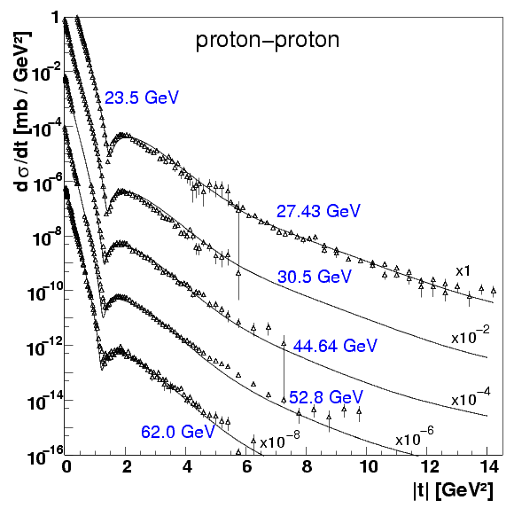
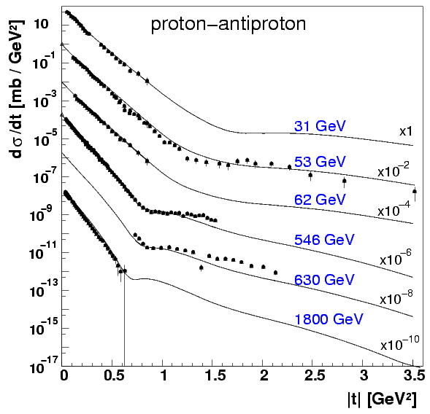
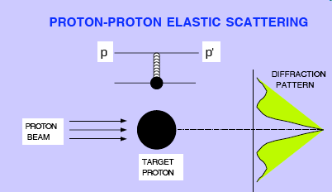
Elastic Scattering – from ISR to Tevatron
ISR
~1.4 GeV²
Diffractive minimum: analogous to Fraunhofer diffraction: |t|~ p² θ²
exponential slope B at low |t| increases
minimum moves to lower |t| with increasing s
→ interaction region grows (as also seen from σ_{tot})
depth of minimum changes
→ shape of proton profile changes
depth of minimum differs between p-p, p-pbar
→ different mix of processes

Slide 13
TOTEM Elastic Differential Cross-Section
√s = 7 TeV

Slide 14
Measurement of low-t Elastic Scattering
Data with β* 90m optics
Extrapolation to t = 0 and integration of elastic cross section:
25.4 ± 1.1 mb (> 90% of cross-section visible, <10% extrapolated)

Slide 15
Total Cross-Section
Optical Theorem:
luminosity from CMS
ρ from COMPETE fit:
Notes:
11:11

Slide 16
TOTEM Total Cross-Section [7TeV]

Slide 17
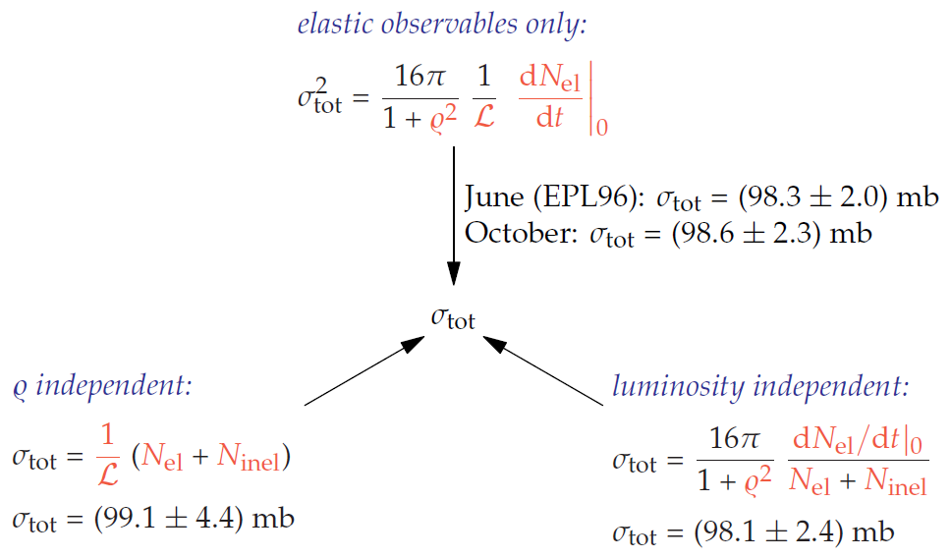
TOTEM Total Cross-Section Measurements
7 TeV
(r=0.14 [COMPETE extrapol.])
test validity of
optical theorem
at ~3.5 % level
[EPL96]: s_{tot} = (98.3 ±2.8) mb
[EPL101]: s_{tot} = (98.6 ±2.2) mb
(different beam intensities)
[EPL101]: s_{tot} = (99.1 ± 4.3) mb
[EPL101]: s_{tot} = (98.0 ± 2.5) mb

Slide 18
TOTEM Inelastic Cross-Section
T1 and T2 direct measurement
Inelastic events in T2: classification
tracks
tracks in both hemispheres
non-diffractive minimum bias
double diffraction
T2
T2
η
tracks in a single hemisphere
mainly single diffraction
M_{X} > 3.4 GeV/c²
η
Corrections to the T1, T2 visible events (eff., μ)
s_{inel, |h| < 6.5} = 70.5 ± 2.9 mb
η
Corrections for acceptance, gaps, DPE (MC/data)
➔
σ_{inel} = 73.7 ±0.1 ^{stat} ±1.7 ^{syst} ±2.9 ^{lumi} mb
Inclusive measurement based on Optical Theorem
➔ s _{inel} = s _{tot} – s _{el} = 73.1 ± 1.3 mb
s_{inel, |h| > 6.5} = 2.6 ± 2.2 mb
< 6.3 mb (95% CL)
s_{inel, |h| < 6.5} = 70.5 ± 2.9 mb

Slide 19
Elastic, Inelastic, Total Cross-Sections [7TeV]

Slide 20
Luminosity-independent Cross-Section [8TeV]
Elastic, Inelastic, Total cross-sections all measured “luminosity-independent”
July 2012 √s = 8 TeV β* = 90m
Published Physics Review Letters PRL 111 (2013)

Slide 21
Elastic, Inelastic, Total Cross-Sections [8TeV]

Slide 22
CMS-TOTEM Forward Charged Multiplicity
Joint CMS-TOTEM
data taking / trigger
1st common paper
CMS-TOTEM
[EPJ]

Slide 23
Extended-η Forward Charged Multiplicity

Slide 24
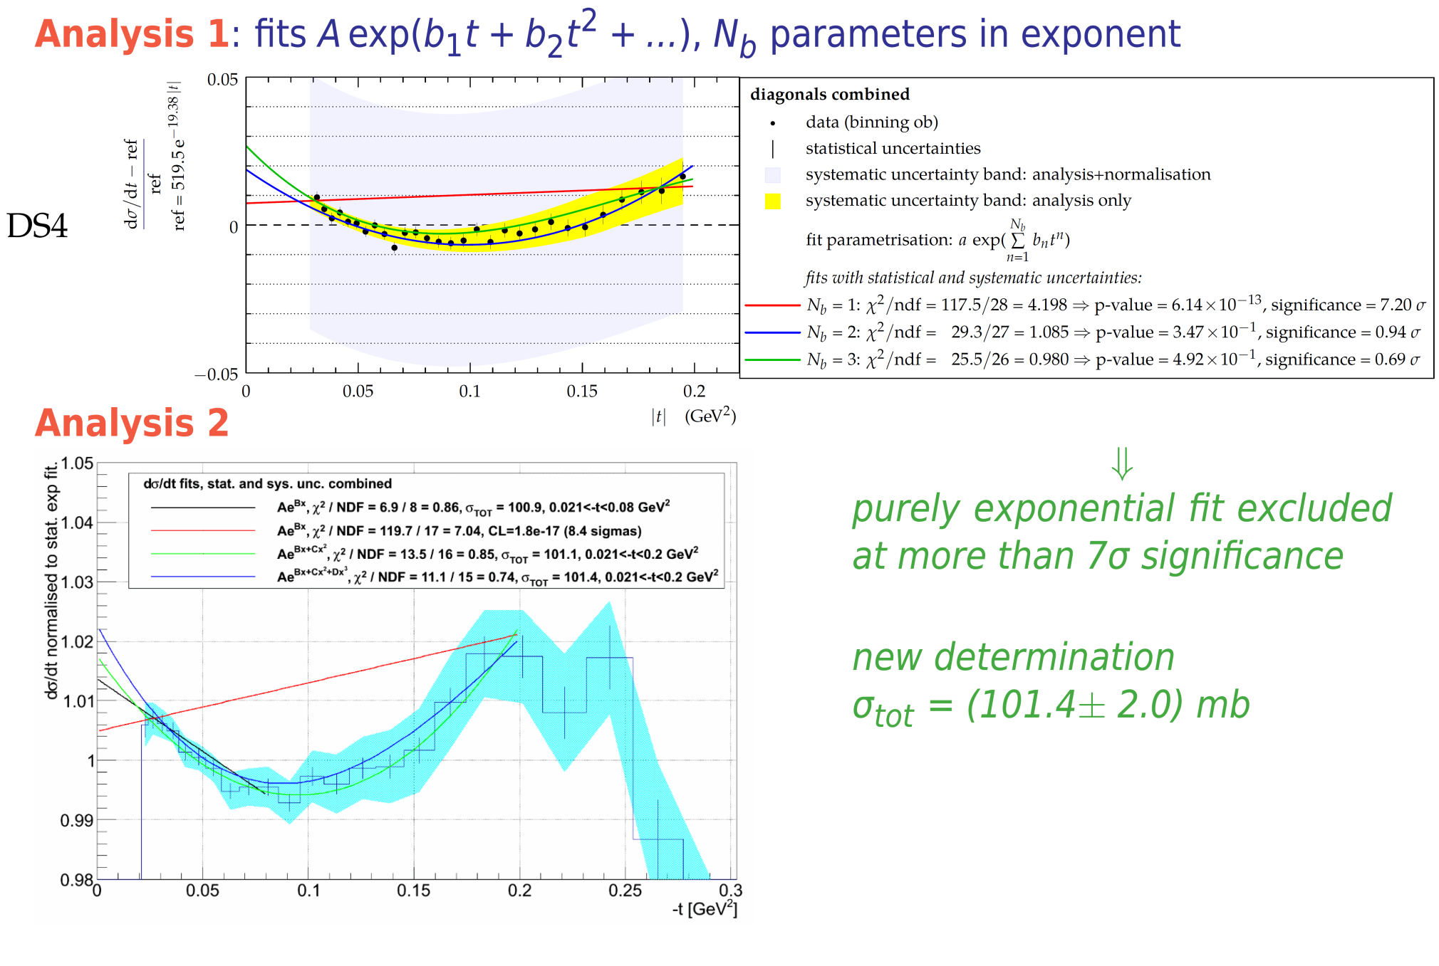
Non-perturbative QCD of Elastic Scattering
From Pomerons to diquark-quark models to coherent amplitudes of gluon exchange between fermionic lines
study amplitudes and central vs peripheral phase of nuclear elastic scattering

Slide 25
Coulomb-Nuclear Interference
Measure elastic scattering at |t| as low as 6 x 10⁻⁴ GeV²:
b* = 1000 m optics
RP approach to 3 s from the beam centre
Preliminary Results:
First observation of not constant hadronic slope B in pp elastic scattering
Simplified West-Yennie (SWY) interference formula ruled out by data
Evidence of Coulomb-hadronic interference at √s = 8 TeV
TOTEM data exclude centrality of elastic scattering in the form it was derived via SWY formalism
dσ / dt ∝ |F^{C+h}|² = Coulomb + interference + hadronic

Slide 26
TOTEM Publications
Proton-proton elastic scattering at the LHC energy of √s = 7 TeV , EPL 95 (2011) 41001
First measurement of the total proton-proton cross section at the LHC energy of √s = 7 TeV EPL 96 (2011) 21002
Measurement of the forward charged particle pseudorapidity density in pp collisions at √s = 7 TeV with the TOTEM experiment, EPL 98 (2012) 31002
Measurement of proton-proton elastic scattering and total cross-section at √s = 7 TeV, EPL 101 (2013) 21002
Measurement of proton-proton inelastic scattering cross-section at √s = 7 TeV, EPL 101 (2013) 21003
Luminosity-independent measurements of total, elastic and inelastic cross-sections at √s = 7 TeV, EPL 101 (2013) 21004
A luminosity-independent measurement of the proton-proton total cross-section at √s = 8 TeV, Phys. Rev. Lett. 111, 012001 (2013)
Double diffractive cross-section measurement in the forward region at LHC, Phys. Rev. Lett. 111 (2013) 262001 .
Measurement of pseudorapidity distributions of charged particles in proton-proton collisions at √s = 8 TeV by the CMS and TOTEM experiments CERN-PH-EP-2014-063, submitted to EPJ
The TOTEM Experiment at the CERN Large Hadron Collider JINST 3 (2008) S08007
Performance of the Totem Detectors at the LHC, Int. J. Mod. Phys. A
LHC optics determination with proton tracks measured in the Roman Pots detectors of the TOTEM experiment CERN-PH-EP-TOTEM-2014-002, submitted to New J. Phys

Slide 27
TOTEM DETECTORS
LS1 CONSOLIDATION

Slide 28
overview (schematic)
RPs Consolidation & Upgrade – LS1
Relocated stations from 147 m
Existing TOTEM RP-220 m (near-far)
New RP stations
New
Si pixel tracking detectors
in horizontal RPs + RP - RF shield
New
LHC component
New
timing detectors
New
LHC component
2 vertical RP
1 horizontal RP
TRACKING
Detector
2 vertical RP
1 horizontal RP
TRACKING
Detector
Near
2 vertical RP
top/bottom
1 horizontal RP
1 horizontal RP
TIMING Detector
1 horizontal RP
TIMING
Detector
Far
2 vertical RP
top/bottom
1 horizontal RP
outgoing
beam
TCL-4
shielding
TCL-6
Q6
~ 5-10 m
~ 5 m
All RPs can be operated simultaneously !
CMS ip5
~ 220 m

Slide 29
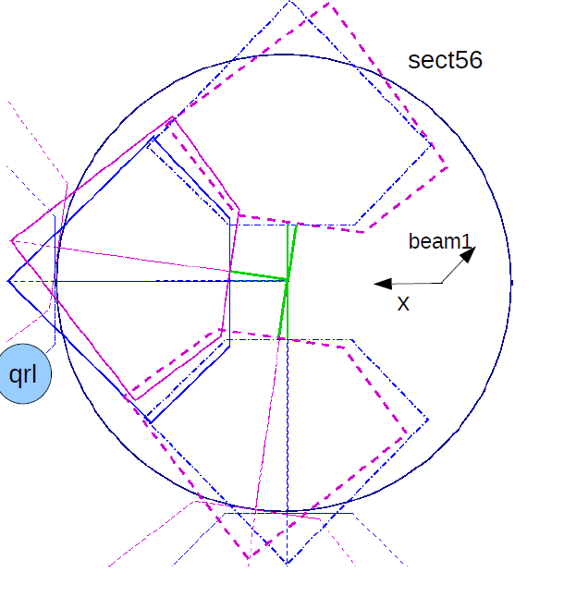
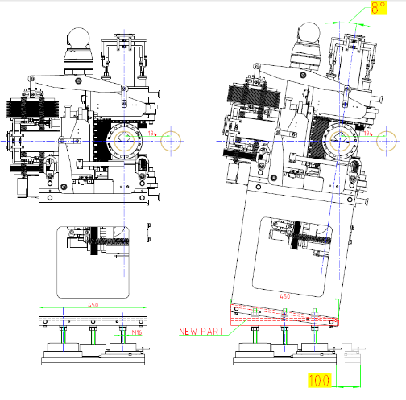
RPs Performance

Slide 30
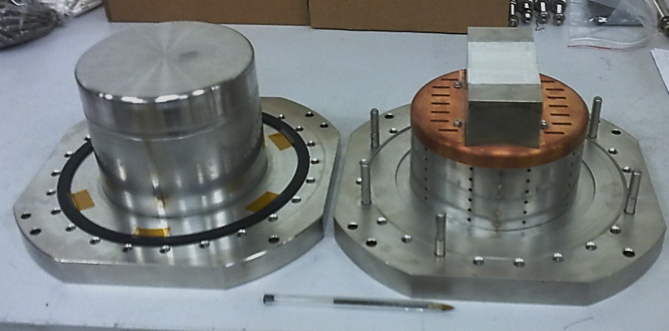
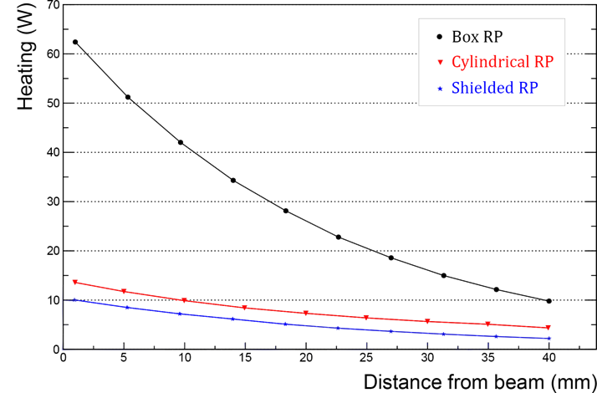
RPs Safety
  RF studies (impact on machine),
    RF shield for square pots of Run I,
    New ferrites to control induced RF,
    New Pots cylindrical with thin window
50 ns
I_{B}=0.6 A

Slide 31
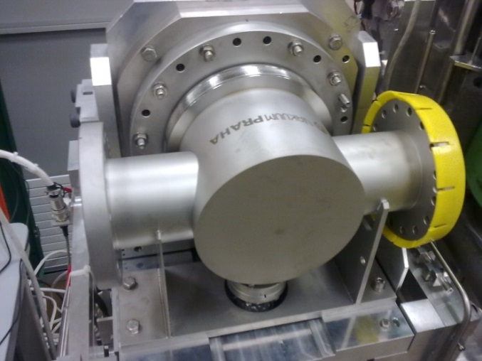
Technical Coordination - Progress
Location of new horizontal RP confirmed by LHC integration, vacuum and impedance groups.
6 horizontal vacuum chambers have been
produced and installed in LHC:
technology OK, all tests passed.
New ferrites (ring) simulated, designed,
produced, tested and integrated into RP.
RF shields (Faraday cage) produced;
mechanical and integration tests passed.
Four 220m RP stations refurbished (new ferrites and anti-collision switches), tested and already installed in the LHC tunnel.
Four 210m RP stations have been refurbished (new ferrites, RF shield, anti-collision switches), tested,
  under bakeout
  will be installed in the LHC in June (next weeks)
  within LHC schedule

Slide 32
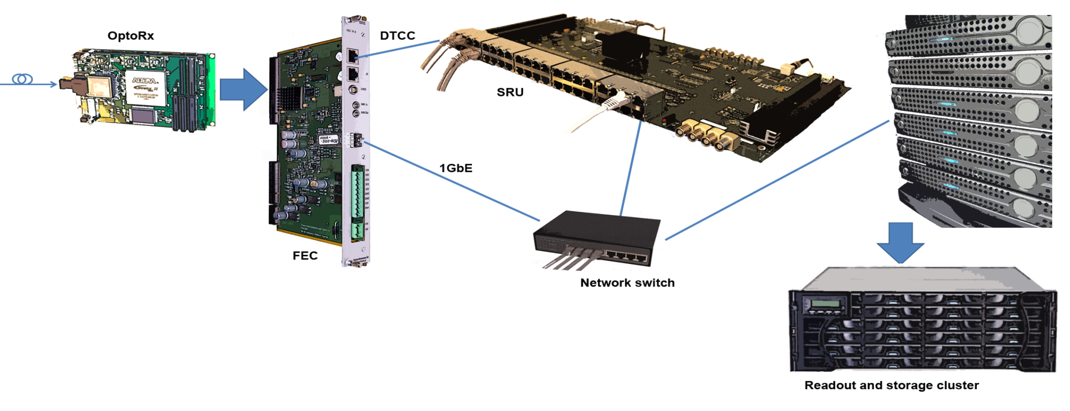
DAQ & Trigger
DTC (Data, Timing, Commands) to merge more than a FEC
CMS DAQ
interface
UDP link for standalone DAQ
Consolidated DAQ
Full compatibility with CMS DAQ [goal integration to exploit CMS HLT online]
Full compatibility with LHC Trigger Timing and Control (TTC)
Higher L1 trigger rate (20kHz trigger rate, ~20x w.r.t. previous DAQ system)
  measured on 1 FEC with 1 OptoRx through a standard PC.
Replacement of the VME back-end with Ethernet 1Gb links
Full TTC commands set, L1A and TTC clock distribution integrated in the system.
Hardware resources (FPGA) at different level enables real-time data filtering.

Slide 33
TOTEM PHYSICS LHC RUN II

Slide 34
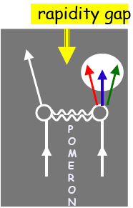
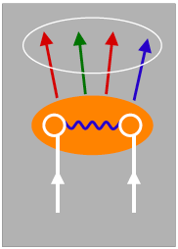
pp Interactions
Non-diffractive Diffractive
Colour exchange Colourless exchange with vacuum
quantum numbers
dN / d Δη = exp (-Δη) dN / d Δη = const
(η = -ln tg θ/2)
Incident hadrons acquire colour and break apart
Incident hadrons retain their quantum numbers remaining colourless
GOAL: understand the QCD nature of the diffractive exchange

Slide 35
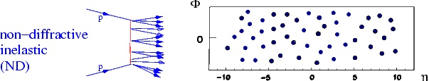
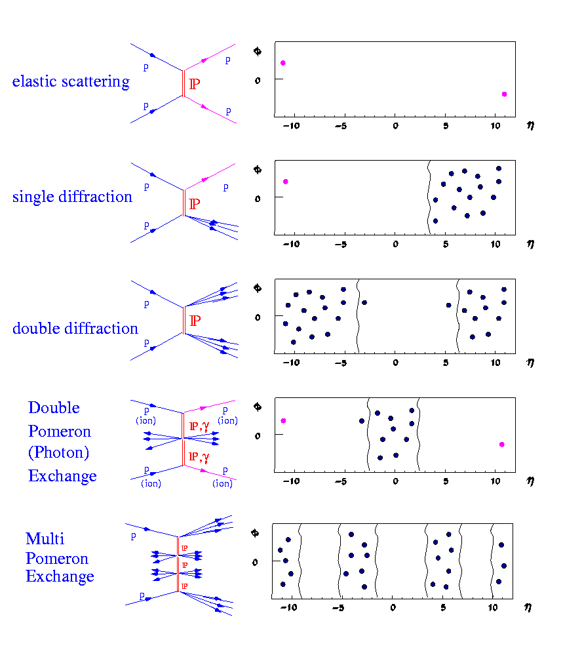
Inelastic and Diffractive Processes
~60 mb
Elastic Scattering
~25 mb
Diffractive scattering is a unique laboratory of confinement & QCD:
A hard scale + hadrons which remain intact in the scattering process.
Measure σ (M,ξ,t)
Single Diffraction
~10 mb
All the drawings show soft interactions.
In case of hard interactions there should be jets,
which fall in the same rapidity intervals.
M
Double Diffraction
~5 mb
Double Pomeron Exchange
M
~1 mb
<< 1 mb

Slide 36
Single Diffraction low ξ
Correlation between leading proton and forward detector T2
φ
SD
Rapidity Gap
Δη = -ln ξ
M_{X}² = ξ s
η
* Ongoing analysis on data of LHC Run I

Slide 37
Single Diffraction large ξ
Correlation between leading proton and forward detector T2
φ
SD
Rapidity Gap
Δη = -ln ξ
M_{X}² = ξ s
η
* Ongoing joint CMS-TOTEM jets analysis on data of LHC Run I

Slide 38
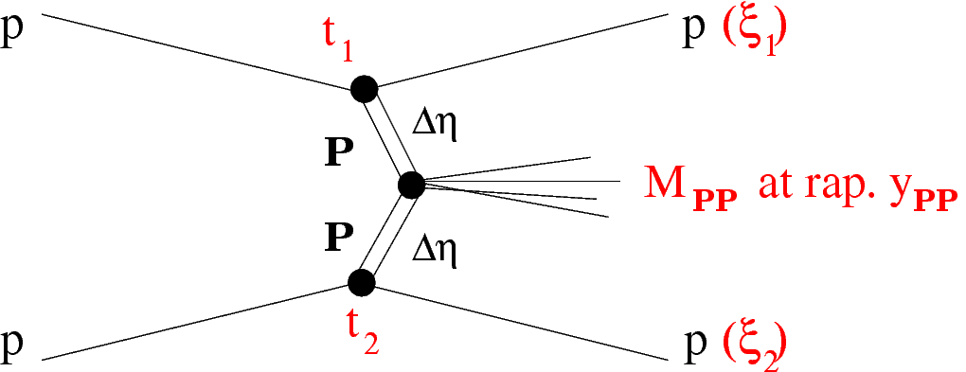
Double Pomeron Exchange
M_{PP}² = ξ₁ ξ₂s
DPE
Rapidity Gap
Δη = -ln ξ₁
-ln ξ₂
η = −ln tan θ/2
Use the LHC as a Pomeron-Pomeron (gluon - gluon) collider
*Central Diffraction **Central Exclusive Production

Slide 39
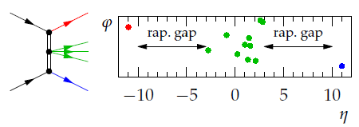
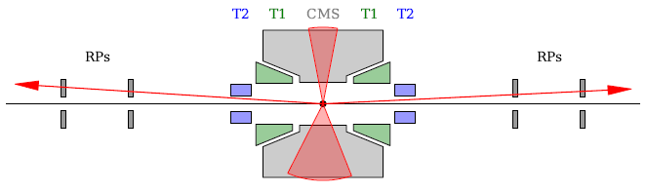
Diffractive Physics Program LHC Run II
TOTEM: standard measurement of elastic scattering
(from the largest to the smallest t)
and of the total and inelastic cross section at the new LHC energy
TOTEM+CMS: physics search on low mass spectroscopy (1-3GeV)
  gluonic states and glueball searches
  diffractive χ_{c} production
TOTEM+CMS: central-diffractive jet production
TOTEM+CMS: missing/escaping mass
Preliminary investigation of some physics channels in progress with the analysis of data from joint CMS-TOTEM high β* run (90m) , 8 TeV , July 2012

Slide 40
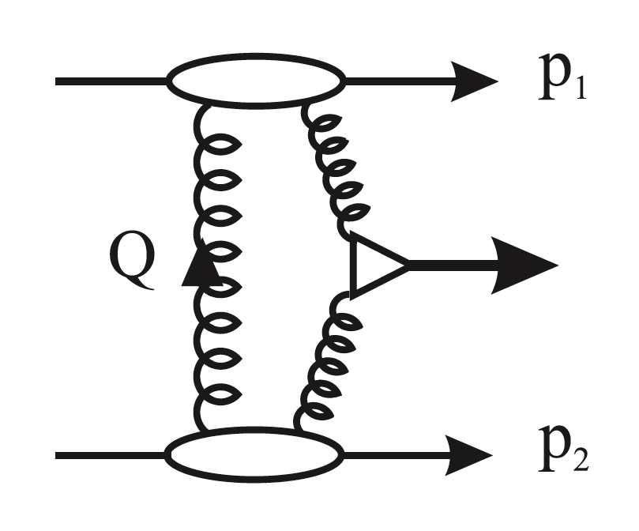
Central Exclusive Production (CEP)
(ξ₁)
M² = ξ₁ ξ₂ s
X at rapidity y_{X}
gg collider
also γγ fusion & photoproduction
(ξ₂)
exchange of colour singlets with vacuum quantum numbers
⇒ selection rules for system X: J^{PC} = 0⁺⁺, 2⁺⁺, … resonances, jets,?….
With double-arm proton detection:
β* = 90m runs: all M(pp), μ ∼ 0.05 - 0.5 ⇒ O(0.1-10 pb⁻¹/day)
low β* runs: M(pp) > ~ 350 GeV, μ ~ 30 - 50 ⇒ O(1 fb⁻¹/day)
Comparison/prediction from forward to central system:
M(pp) =? M(central), p_{T,z}(pp) =? p_{T,z}(central), vertex(pp) =? vertex(central)
Prediction of central particle flow topology from proton ξ's
(rapidity gaps): Δη_{1,2} = −lnξ_{1,2}
CMS & TOTEM common runs: access to O(pb) production cross-sections

Slide 41
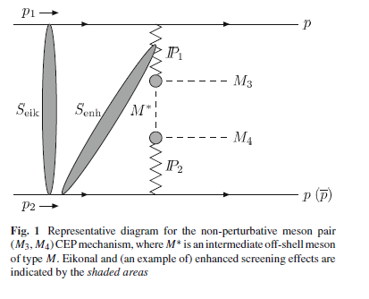
CEP low-Mass States & Glueballs
LHC: a unique lab to study CEP low M states
  small p_{T}’s of final state mesons
  ⇒ CMS tracking ΔM ∼ 10 MeV (<< ISR, RHIC, Tevatron)
  π/K/p separation using CMS tracker dE/dx
  proton tagging in β* = 90m runs ⇒ p_{T} ∼ 40 MeV
  RP proton tagging ⇒ no need to invoke rapidity gaps
  large η coverage & protons ⇒ exclusivity ensured with excellent S/B
  spin determination from decay angles & proton azimuthal correlations
X = low M resonance / meson pair
(ππ, KK, ρρ, ηη)
Small ξ ~10⁻³ 10⁻⁴ at LHC from RP vertices ⇒ pure gluon pair ⇒ masses ~ 1-3 GeV
Pomeron ≈ colourless gluon pair/ladder
⇒ Pomeron fusion likely to produce glueballs
Past luminosity: ∼ 0.003 pb⁻¹ ⇒ need × 300 (∼ 1 pb⁻¹) to produce resonances
Study of glueballs & χ_{c} in hadronic modes require × 3000 (∼ 10 pb⁻¹)
Increase in integrated luminosity in high β runs may be obtained :
    > Increasing bunch number (requires crossing angle for high β runs)
    > Increasing running time

Slide 42

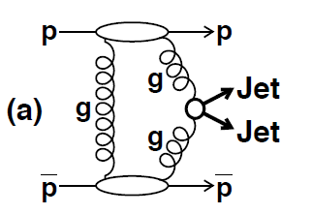


CEP Jets
_
_
J_{z}= 0 selection rule: gg → qq,bb suppressed by a factor 10²-10³
CEP dijets: unique possibility to observe enhanced gluon jets at LHC
  ⇒ clean probe of properties of gluon jets (multiplicity, particle correlations...).
cross-sections extremely sensitive to important & subtle QCD effects:
  generalized gluon PDFs, rapidity gap survival probabilities, “Sudakov” factors.
test model predictions:
study proton azimuthal correlations & CEP 3-jet topologies
  Durham model: gg → gqq (more Mercedes-like) & gg → ggg (“more back-to-back”).
_
Durham group (KHARYS MC)
Predictions for CMS-TOTEM selection:
(jets)
Past luminosity: ∼ 0.1 pb⁻¹ ⇒ need × 1000 (∼ 100 pb⁻¹) for sufficient statistics (∼ 10k)

Slide 43
Central Diffraction Missing Mass Searches
Check escaping-mass candidates
Pile-up protection
p_{CMS}(Particle Flow) ≠ p_{TOTEM}(pp)
M_{CMS}(Particle Flow + missing momentum) ≤ M_{TOTEM}(pp)
→ existence of tracks undetected by CMS
No tracks observed in forward detectors ‘allowed’ by rapidity gaps
More forward regions excluded by rapidity gaps → ‘allowed’ = ‘required’ ?
energetic gammas in T2, N*→p
detectors' 'inefficiency‘?
acceptance gaps between detectors?
high energy neutrinos?
neutral particle flow in T2 (under simulation)?
real escaping energy?
These depend on amount of missing energy
tracks observed
allowed
p₁
Rapidity Gap
Δη = -ln ξ₁
-ln ξ₂
p₂
T2 T1
CMS
T1 T2
no tracks observed
Notes:
11:40, N* can be argued

Slide 44
DPE pp candidates in Roman Pots. CMS, T1, T2 empty.
Exclusive Missing Mass Searches
T2 T1
CMS
T1 T2
allowed
p₁
Rapidity Gap
Δη = -ln ξ₁
-ln ξ₂
p₂
no tracks observed
If ξ ~1% logic applies to CMS tracker allowed & everything else forbidden
(then it could work also if pile-up).
Notes:
11:42

Slide 45

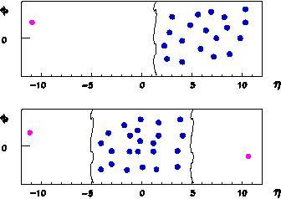
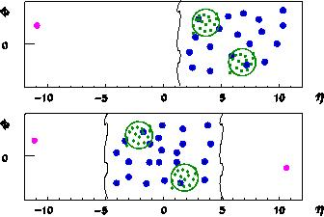
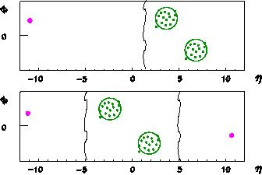
TOTEM + CMS Running Scenarios
pp->pX pp->pjjX pp->pjj (bosons, heavy pp->pXp pp->pjjXp pp->pjjp quarks,Higgs...)
soft diffraction (semi)-hard diffraction hard diffraction
Cross section Luminosity
β (m) 1540 90 2 0.5
L (cm⁻² s⁻¹) 10²⁹ 10³⁰ 10³² 10³⁴
TOTEM LHC runs Standard LHC runs

Slide 46
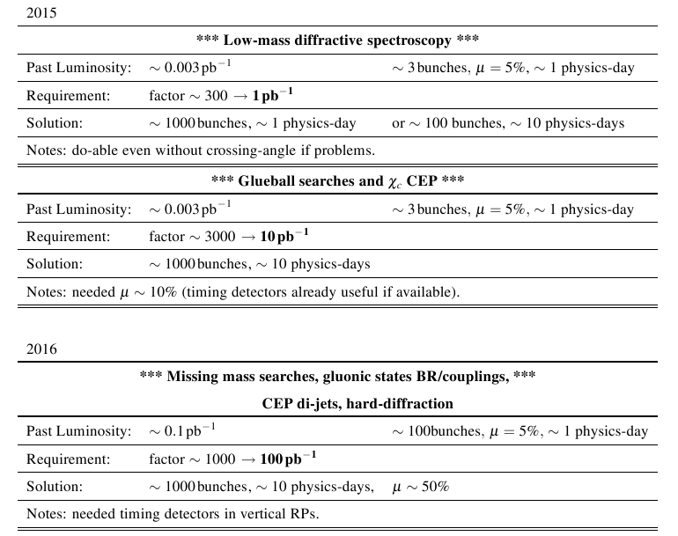
TOTEM + CMS Special Runs β* 90m

Slide 47
TOTEM – CMS
UPGRADE PROGRAMME

Slide 48
Timing Measurements in Vertical RPs
Integrated luminosity of 100 pb⁻¹ is necessary to probe O(pb) cross-sections for the study of :
High statistics hard diffractive processes in CD (jet physics)
Study of BR and quantum numbers of gluonic states candidates
Missing mass candidates with inclusive production cross section of O(pb)
Such integrated luminosity becomes reasonable for high β runs if a pile up μ ~ 0.5 is generated by increasing bunch population
⇒
Advanced forward physics in special runs with vertical pots requires presence of timing to identify the collision vertex
Signal and background scale with intensity
Remark: timing improves background reduction also in low pileup runs

Slide 49

TDR – Timing Vertical RP Project
Goal to use production technologies to implement it by end 2015
Status and progress on TDR preparation
Test beam campaigns during summer (PSI, PS, SPS)
Delivery of TDR to LHCC in September 2014

Slide 50
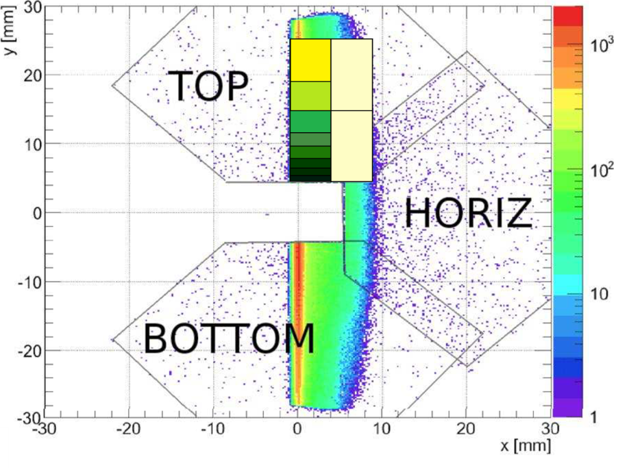
Vertical RPs Timing Detectors
Optimization driven by physics and technical choices
  Minimize number of channels without compromising the physics program
    Map plane with different size pads with same occupancy
    Minimum number optimized with simulation
Detector
  Dimensions: 10mm X 20mm
  10 pixels with dimensions adapted to
  track density
  A stack of 4 Planes improves the single
  plane timing resolution (1/2)
  Available on the market is 5X10 mm
  and 10X10 mm, 500 μm thick
  Diamond or Silicon
Timing Specifications
  Measure time of arrival of proton with a
  resolution better than 50ps

Slide 51

Title
MoU
CMS-TOTEM : full diffractive physics programme and related new physics searches O(fb) at standard high LHC luminosity.
CMS-TOTEM joint-upgrade MoU signed
Institution Board & Management Team
Tracking detectors Si pixels in RPs
Timing detectors in new horizontal RPs
10 ps requirement for high pile-up LHC
TDR

Slide 52
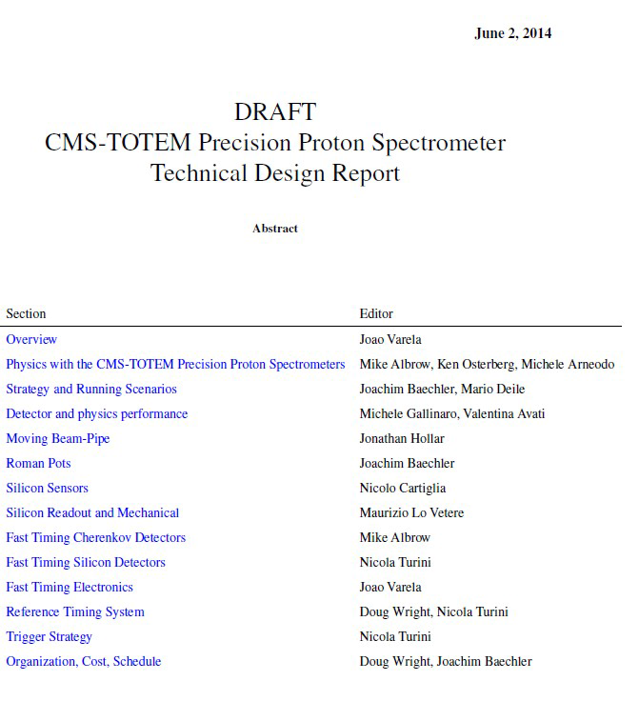
Title
TDR – CTPPS Project

Slide 53
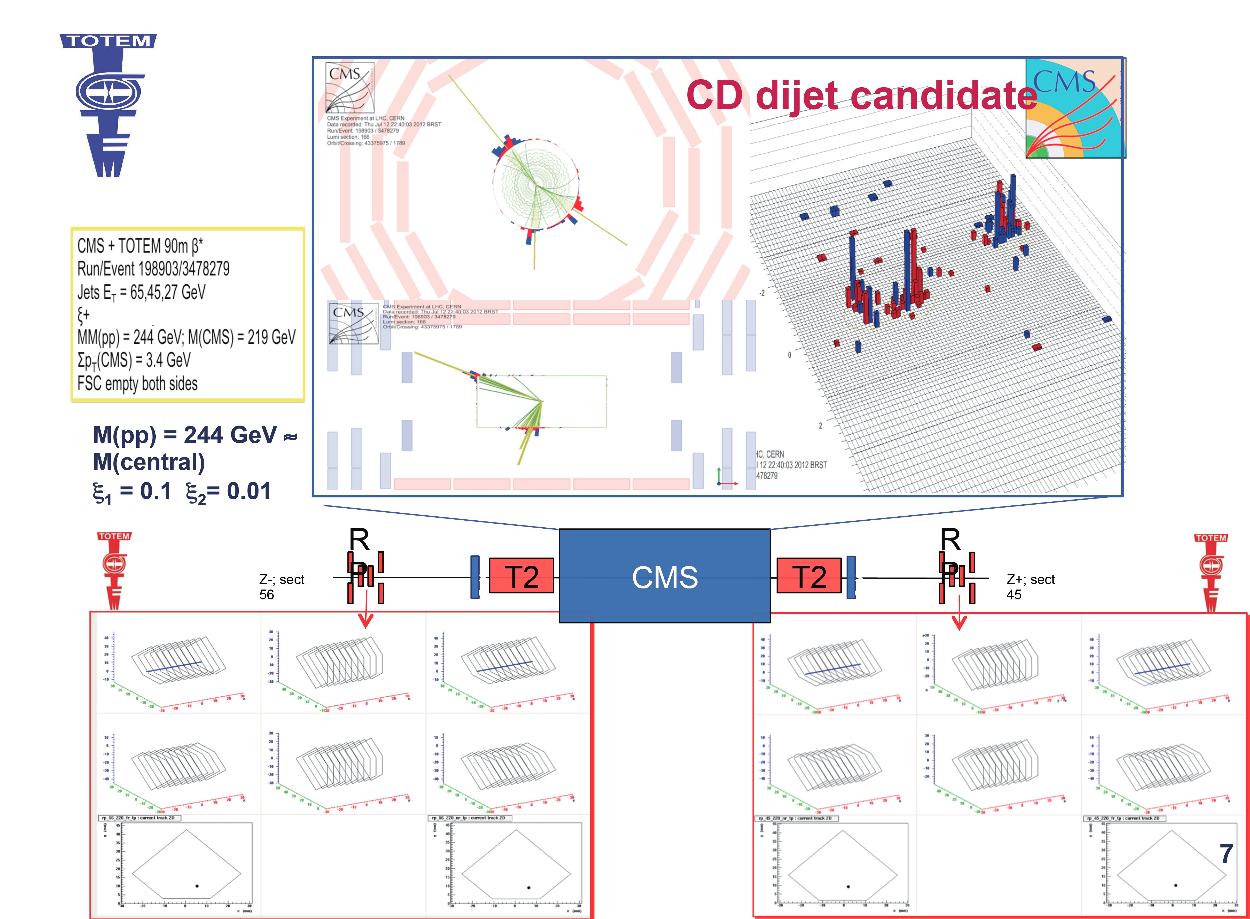
CMS-TOTEM di-Jets Analysis

