Slide 1
Two particle correlation effects and Differential HBT for rotation in heavy ion collisions.
Sindre Velle

Slide 2
Outline
Two particle correlation
Asymmetric sources
The DHBT method
FD model results
Conclusion

Slide 3
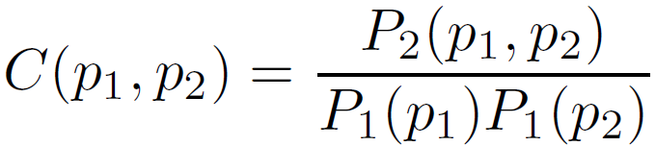

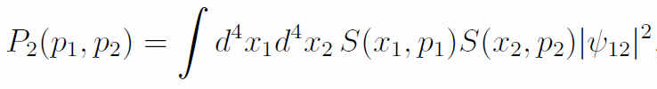
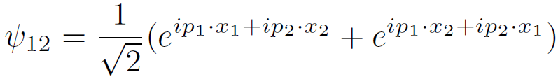
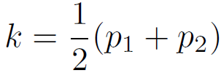

Two particle correlation calculation
Center of mass momentum
Relative momentum

Slide 4
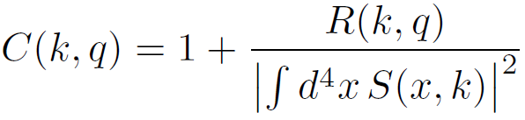


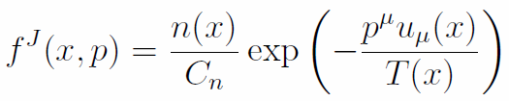
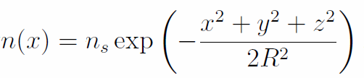
Jüttner distribution

Slide 5
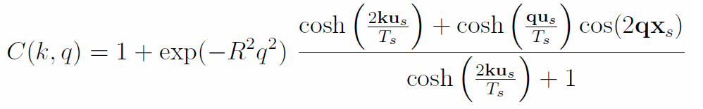
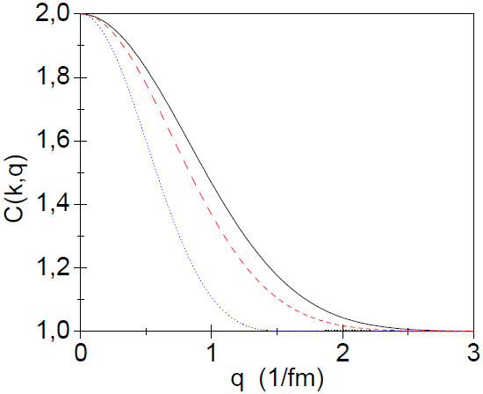
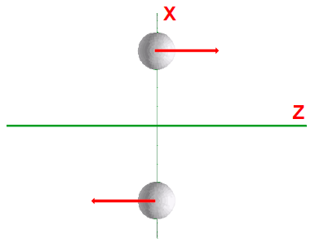
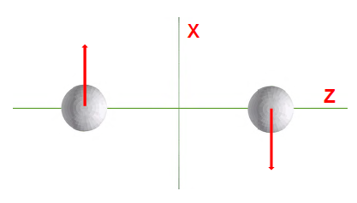
3. Two moving sources
q_{z}
q_{y}
q_{x}
Flow is mainly in x direction!
Detectable
The sources are symmetric ➔
Not sensitive to direction of rotation!

Slide 6
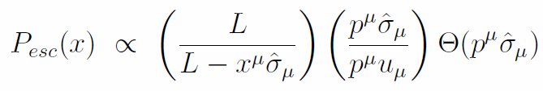
Asymetric sources
Symmetric sources not realistic
Define k-dependent freeze out layer
Emission probabilities

Slide 7
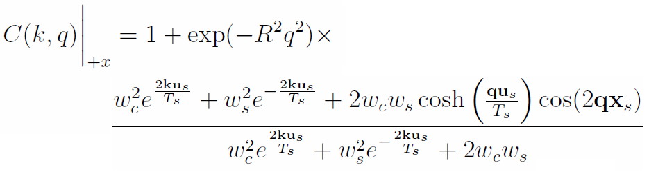
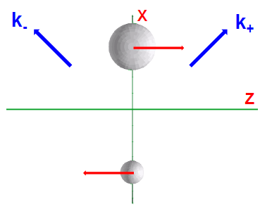




Inclusion of emission weights
And using and

Slide 8

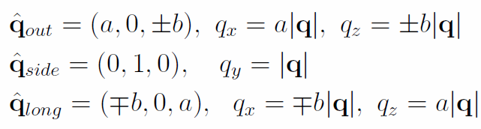
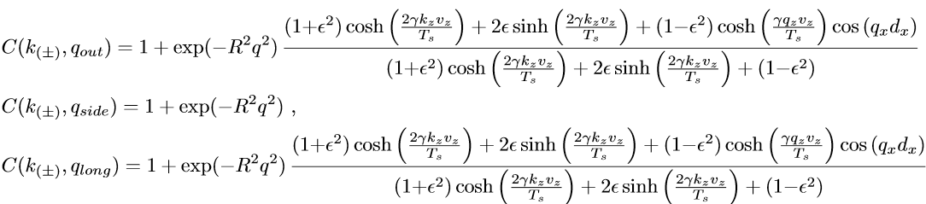
DHBT method

Slide 9
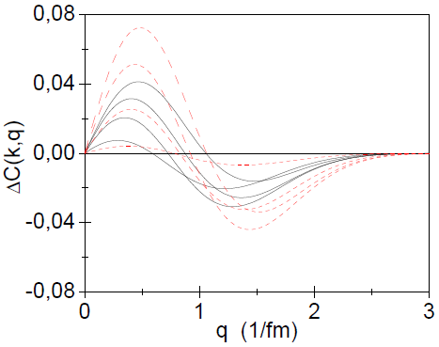
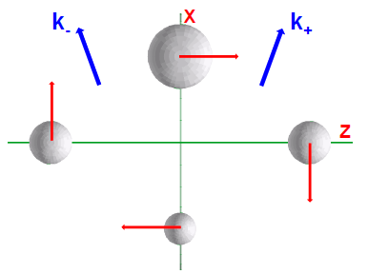
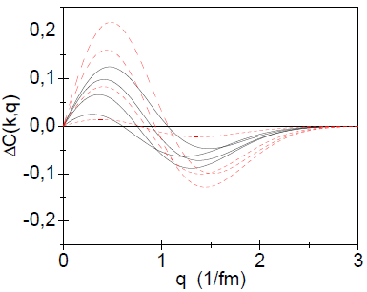
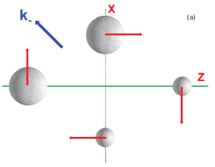
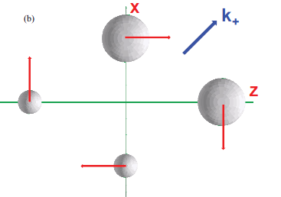
Vz=0.7c
d
c
Vz=0.5c
Sources c and d lead to bigger amplitude
For ±x-symmetric sources
without rotation ΔC(k,q)=0 !

Slide 10
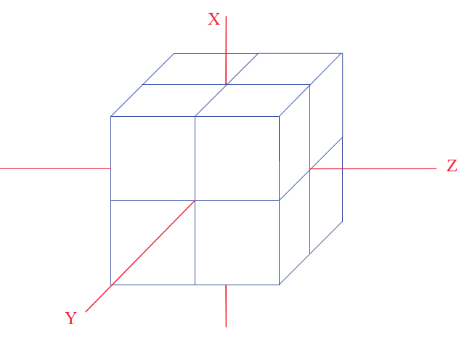

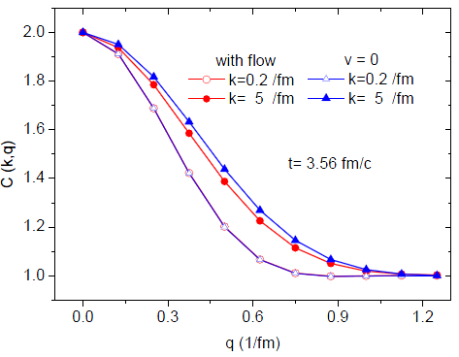
Results in our FD model
[L.P. Csernai, S. Velle, D.J. Wang, Phys. Rev. C 89, 034916 (2014)]
~ 10000 fluid cells → numerical,
& not symmetric source!
Two direction are chosen:
50 degrees
130 degrees
For pseudorapidity +/- 0.76

Slide 11
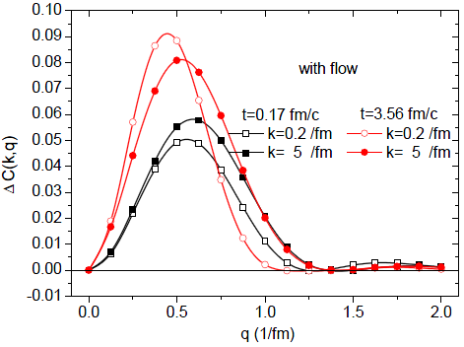
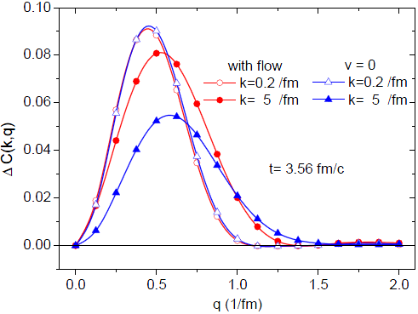
Big difference between
Initial and later time
Flow has a
big effect
for larger k

Slide 12
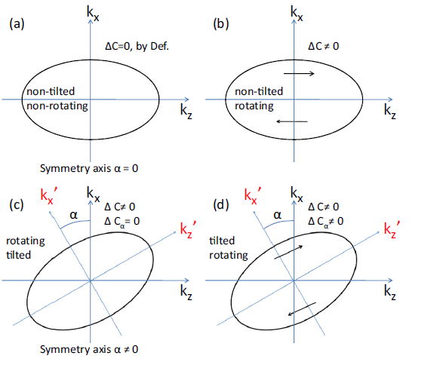


Seperate rotation and shape effects
We try to find, when there is no flow, the angle alpha such that

Slide 13
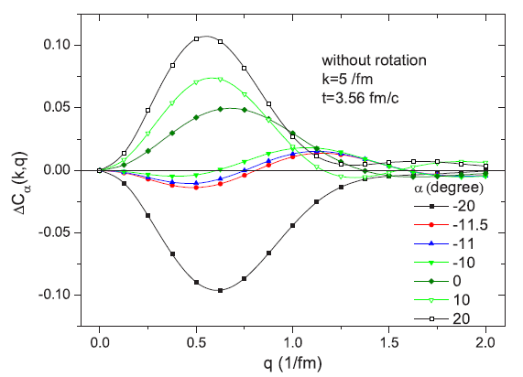
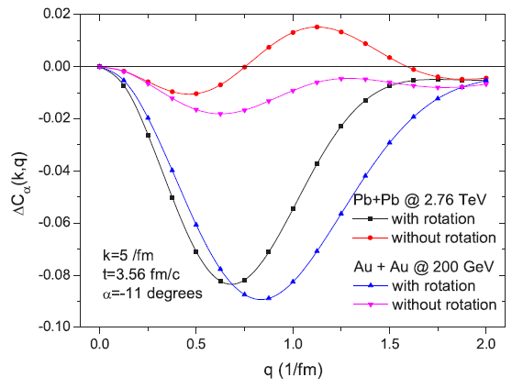
Find the proper symmetry axes of the emission ellipsoid.
The shape of the DCF changes characteristically with the angle α. Unfortunately, this is not possible experimentally, so the direction of the symmetry axes should be found with other methods, like global flow analysis and/or azimuthal HBT analysis.

Slide 14
Conclusion
Differential HBT analysis can give a good quantitative measure of the rotation in the reaction plane of a heavy-ion collision.
The flow has an effect on the correlation function.
To perform the analysis in the rotationless symmetry frame one should find the symmetry axis with azimuthal HBT.

Slide 15
Thank you for your attention.

