Slide 1
Beam energy dependence of the expansion dynamics in relativistic heavy ion collisions: Indications for the critical end point?
Roy A. Lacey
Stony Brook University

Slide 2
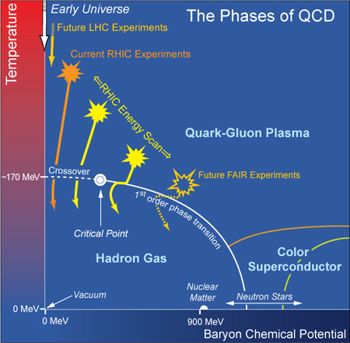

p
Quantitative study of the QCD phase diagram is a central
current focus of our field
Conjectured Phase Diagram
A Known known
Spectacular achievement:
Validation of the crossover
transition leading to the QGP
→ Necessary requirement for CEP
Known unknowns
Location of the critical End point (CEP)?
Location of phase coexistence regions?
Detailed properties of each phase?
All are fundamental to the phase diagram of any substance
Measurements which span a broad range of the (${\text{T},μ}_{B}$)-plane
are essential for detailed studies of the phase diagram

Slide 3
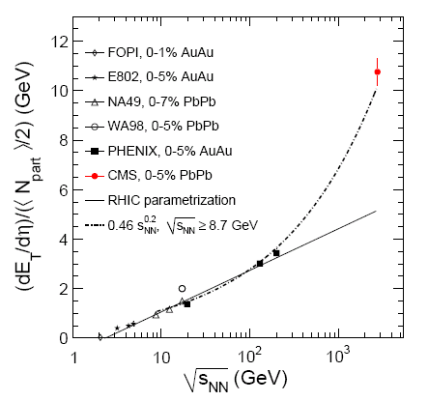
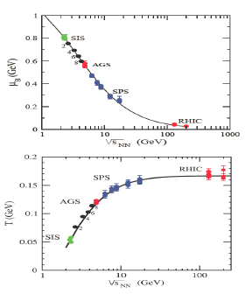




A Current Strategy
Exploit the RHIC-LHC beam energy lever arm
($μ_{B}$,T) at freeze-out
Energy scan
M. Malek, CIPANP (2012)
J. Cleymans et al.
Phys. Rev. C73, 034905
LHC → access to high T and small $μ_{B}$
RHIC → access to different systems and
a broad domain of the ($μ_{B}$,T)-plane
RHIC_{BES} to LHC → $\sim$360 $\sqrt{s_{NN}}$ increase
LHC + BES → access to an even broader domain of the ($μ_{B}$,T)-plane
Challenge → leverage signals from full span of energies

Slide 4
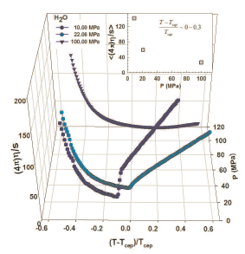
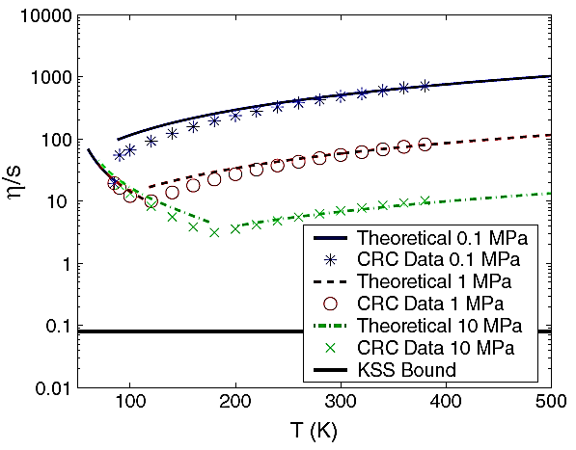
Possible signals
Lacey et. al,
Phys. Rev.Lett. 98 (2007) 092301
arXiv:0708.3512 (2008)
Csernai et. al,
Phys.Rev.Lett. 97 (2006) 152303
A. Dobado et. al,
Phys. Rev. D 79, 014002 (2009)
H₂O
Argon
At the CEP or close to it, anomalies in the dynamic properties of the medium can drive abrupt changes in transport coeﬃcients
Anisotropic flow (v_{n}) measurements are an invaluable probe

Slide 5
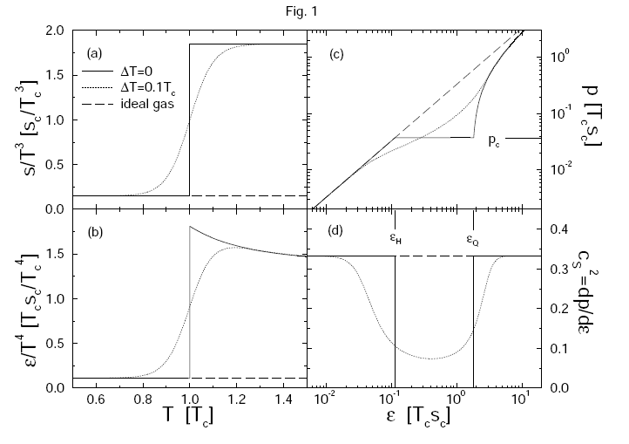
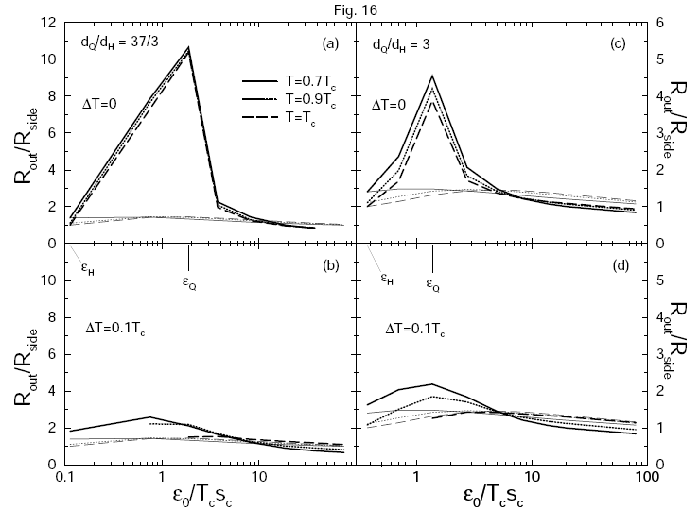
Possible signals
Collapse of directed flow
H. Stoecker, NPA 750, 121 (2005)
Dirk Rischke and Miklos Gyulassy
Nucl.Phys.A608:479-512,1996
Dirk Rischke and Miklos Gyulassy
Nucl.Phys.A608:479-512,1996
In the vicinity of a phase transition or the CEP, the sound speed is expected to soften considerably.
In the vicinity of a phase transition or the CEP anomalies in the space-time dynamics can enhance the time-like
component of emissions.
v₁ and HBT measurements are invaluable probes

Slide 6
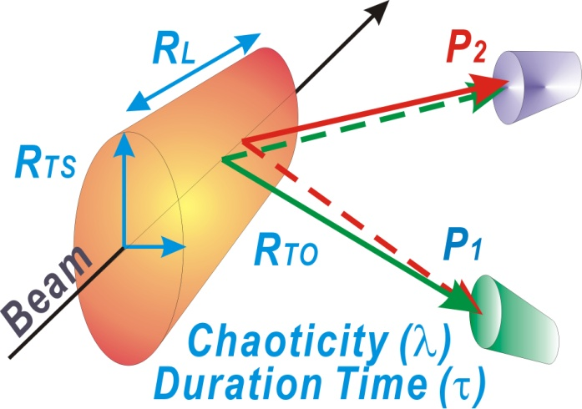
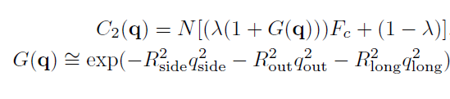
HBT measurements
Two particle Interferometry Studies
Fits to the correlation functions
→ HBT radii (R_{out}, R_{side}, R_{long}) as a function of centrality, m_{T}, etc

Slide 7
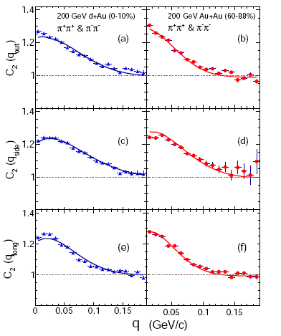
HBT measurements
Two particle Interferometry Studies
Fits to the correlation functions
→ HBT radii (R_{out}, R_{side}, R_{long}) as a function of centrality, m_{T}, etc

Slide 8
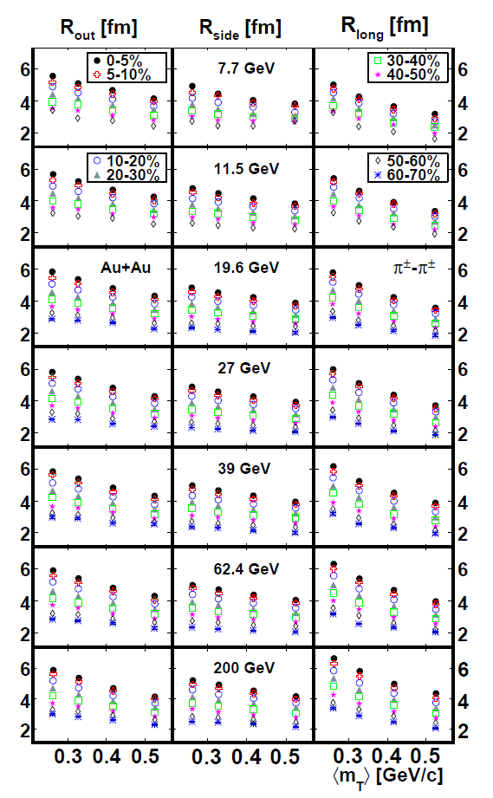
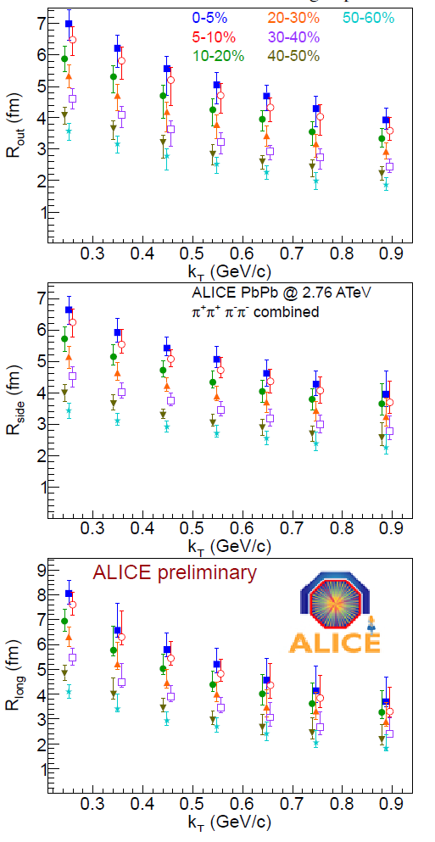
HBT Radii
STAR - 1403.4972
ALICE -PoSWPCF2011
Exquisite data set for combined RHIC-LHC results?

Slide 9
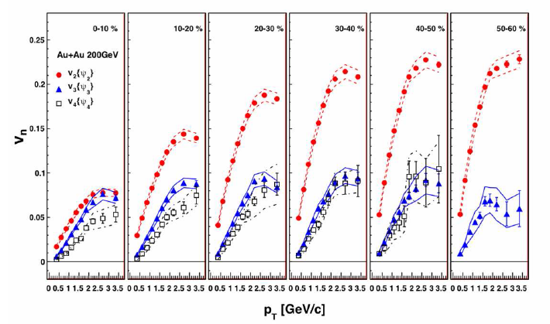
V_{n} measurements
y
Ψ_{n}
x
Measure distribution
relative to Ψ_{n}
Extensive set of v_{n} measurements at RHIC and the LHC

Slide 10
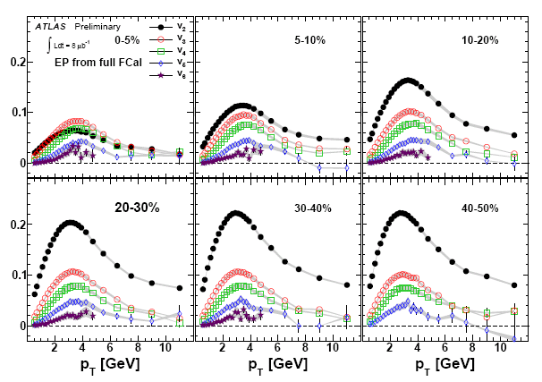
v_{n}(ψ_{n}) Measurements - ATLAS
ATLAS-CONF-2011-074
High precision double differential Measurements are pervasive

Slide 11
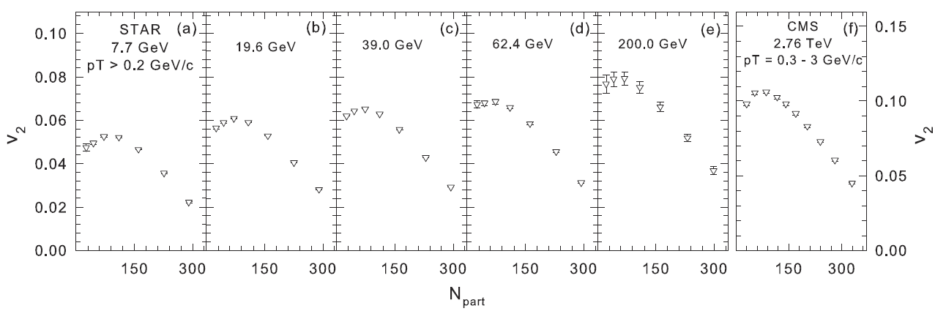

Anisotropy Measurements
arXiv:1305.3341
STAR - Phys.Rev.C86, 014904 (2012); Phys.Rev.C86, 054908 (2012)
CMS - Phys.Rev.C87, 014902 (2013)
Extensive set of measurements now span a broad range of beam energies (${\text{T},μ}_{B}$).

Slide 12
Essential Questions
Can the wealth of data be understood in a consistent framework?
If it can, what new insight/s are we afforded?
  Do we see indications for the phase transition / CEP?
YES!
Expansion dynamics is pressure driven and is therefore acoustic!
    This acoustic property leads to several testable scaling predictions for anisotropic flow and HBT
    – with implications
This constitutes an important development

Slide 13
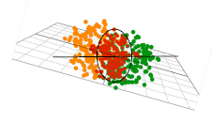
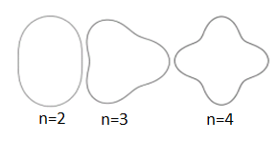


Scaling properties of expansion dynamics
Initial Geometry characterized by many shape harmonics (ε_{n}) → drive v_{n}
HBT scaling expectations:
Acoustic viscous modulation of v_{n}
Staig & Shuryak arXiv:1008.3139
V_{n} scaling expectations:
n² dependence
v_{n} is related to v₂
System size dependence
Each of these scaling expectations can been validated
η/s $∝β′$, $β′$’

Slide 14
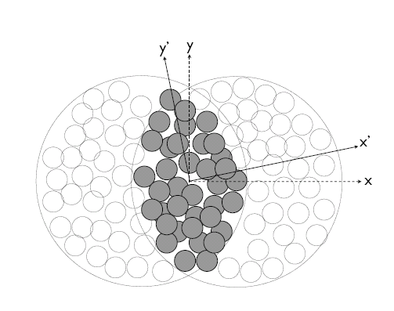
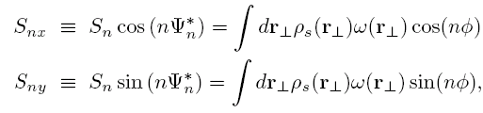
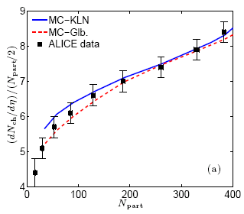


Geometric quantities for scaling
Geometry
Phys. Rev. C 81, 061901(R) (2010)
A
B
arXiv:1203.3605
σ_{x} & σ_{y} → RMS widths of density distribution
Geometric fluctuations included
Geometric quantities constrained by multiplicity density.

Slide 15

Scaling properties of HBT
Viscous Hydrodynamics – B. Schenke
Characteristic a$coustic scaling validated for$
$$viscous hydrodynamics$$
Freeze-out time varies
with initial size
Freeze-out transverse size proportional to initial transverse size

Slide 16
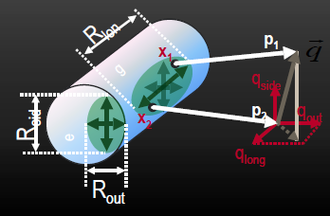
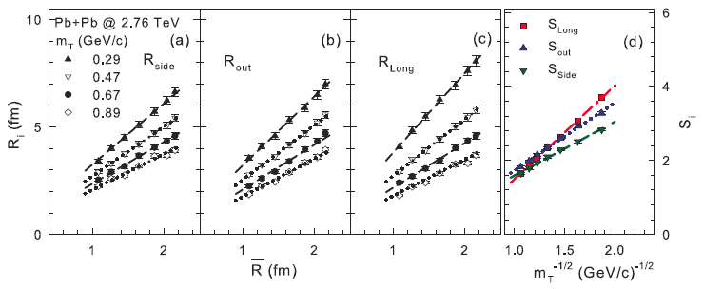
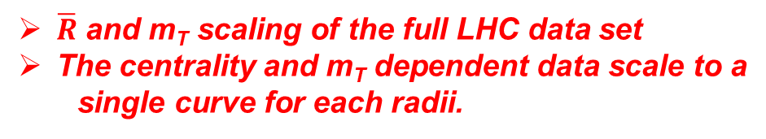
Acoustic Scaling of HBT Radii
$\overline{R}$ and m_{T} scaling of the full LHC data set
The centrality and m_{T} dependent data scale to a
single curve for each radii.

Slide 17
m_{T} Scaling of HBT Radii
PHENIX and STAR consistent arxiv:1403.4972
all radii linear
  R_{i}=a+b/√m_{T}
Useful to interpolate to common m_{T}

Slide 18

Acoustic Scaling of HBT Radii
$\overline{R}$ and m_{T} scaling of the full RHIC and LHC data sets
The centrality and m_{T} dependent data scale to a
single curve for each radii.
Qualitatively similar expansion dynamics at RHIC & LHC

Slide 19
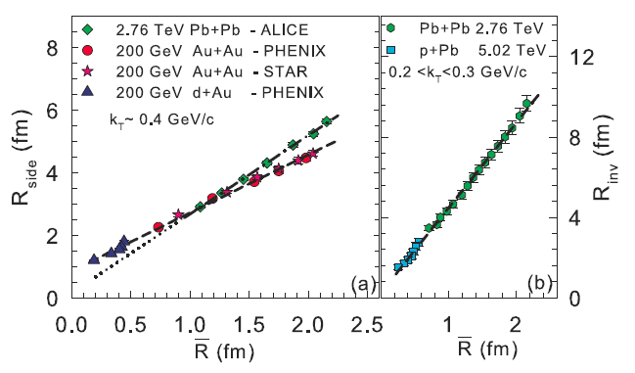
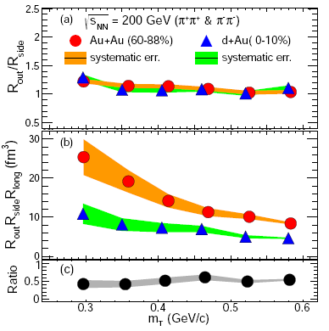
Acoustic Scaling of HBT Radii
arXiv:1404.5291
Similar m_{T} dependence
For Au+Au and d+Au
Larger expansion
rate at the LHC
  Exquisitely demonstrated for asymmetric systems → similar reaction dynamics
Expansion dynamics similar for Pb+Pb, Au+Au, p+Pb and d+Au
Final-State interactions dominate

Slide 20
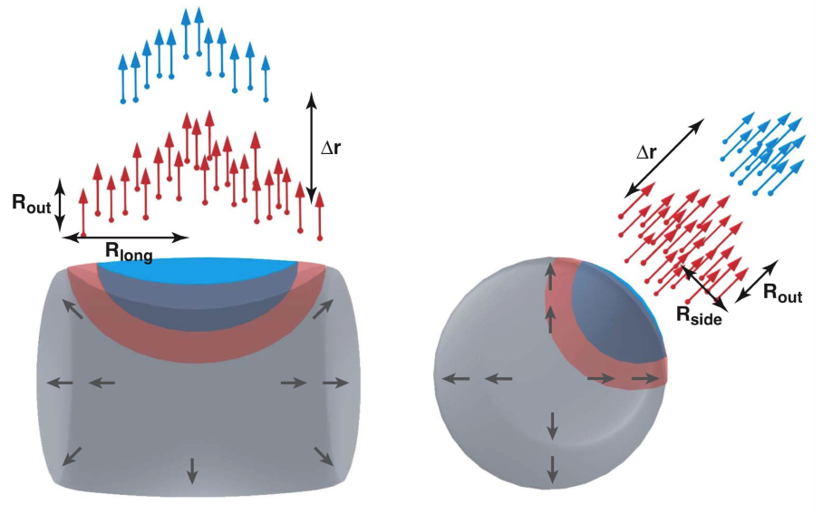
Reaction Dynamics and HBT Radii
Chapman, Scotto, Heinz, PRL.74.4400 (95)
Empirical
Observation
(R²_{out}-R²_{side}) sensitive to emission duration
Makhlin, Sinyukov, ZPC.39.69 (88)
Anticipate extended emission duration with phase transition/CEP

Slide 21

$√s_{NN}$ dependence of HBT signals
These non-monotonic patterns signal an important change in the reaction dynamics; CEP? Phase transition?
A similar non-monotonic pattern for η/s signals the CEP

Slide 22
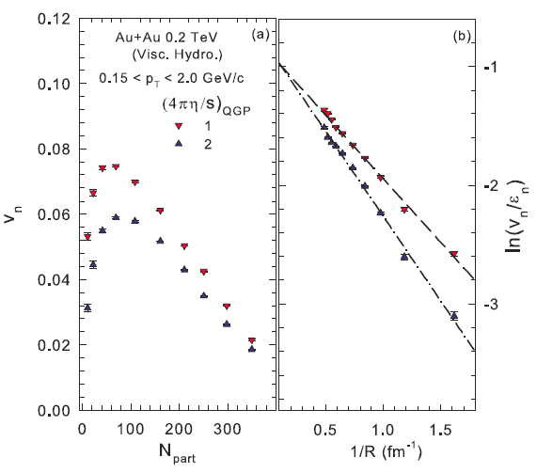


Scaling properties of flow
- Viscous Hydrodynamics
Characteristic a$coustic$
$$scaling validated for$$
$$viscous hydrodynamics$$
${β^{′}}^{′}shows clear sensitivity to$η/s
Viscous hydrodynamics can be used for calibration

Slide 23
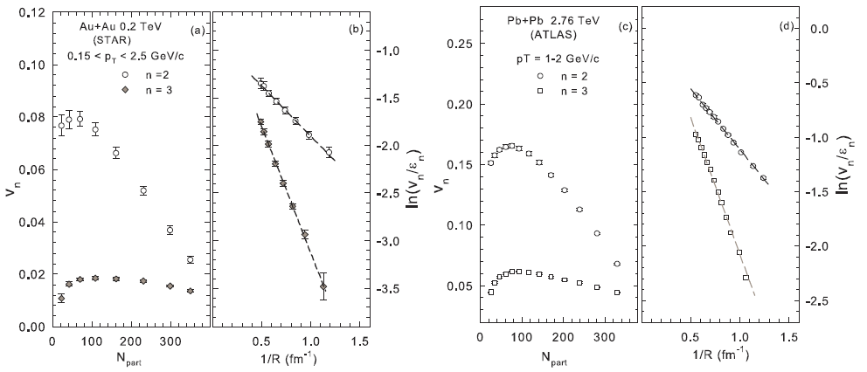
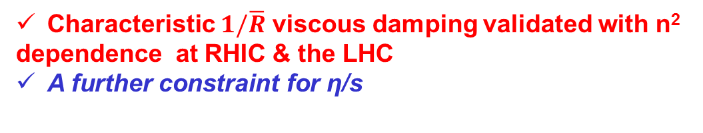

Scaling properties of flow
Acoustic Scaling – $\frac{1}{\overline{R}}$
Characteristic $1/\overline{R}$ viscous damping validated with n²
dependence at RHIC & the LHC
A further constraint for η/s

Slide 24

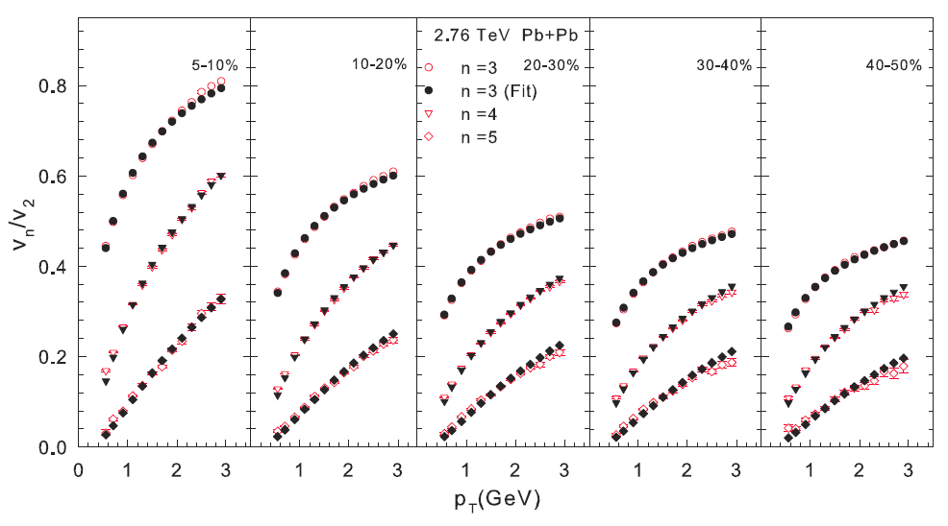
Acoustic Scaling - Ratios
arXiv:1301.0165
Characteristic (n² – 4) viscous damping validated
Constraint for η/s

Slide 25
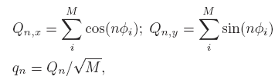
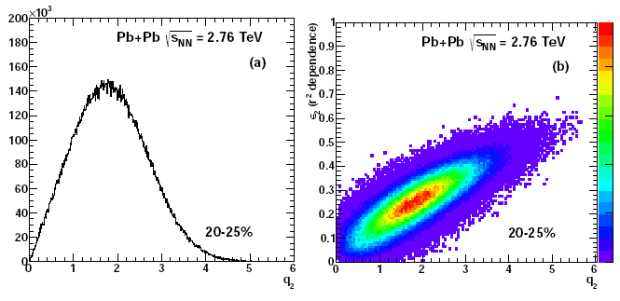
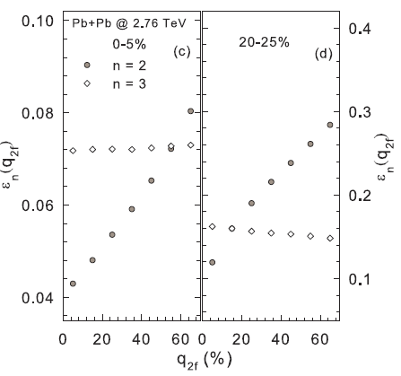

Shape-engineered events
Shape fluctuations lead to
a distribution of the Q vector
at a fixed centrality
Lacey et. al, arxiv:1311.1728
Cuts on q_{n} should change the magnitudes $\left\langle ∈_{n}\right\rangle$, $\left\langle v_{n}\right\rangle$, $\left\langle R_{n}\right\rangle$ at a given centrality due to fluctuations
These magnitudes can influence scaling
Note characteristic anti-correlation predicted for v₃(q₂) in mid-central events
Crucial constraint for initial-geometry models

Slide 26
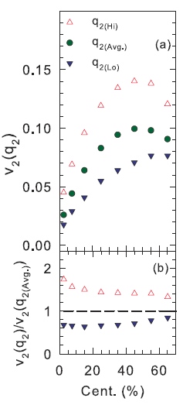

Shape-engineered events
ALICE data
Shape fluctuations lead to
a distribution of the Q vector
at a fixed centrality
Lacey et. al, arxiv:1311.1728
q_{2(Hi)}
q_{2(Lo)}
Cuts on q_{n} should change the magnitudes $\left\langle ∈_{n}\right\rangle$, $\left\langle v_{n}\right\rangle$, $\left\langle R_{n}\right\rangle$ at a given centrality due to fluctuations
Viable models for initial-state fluctuations should still scale

Slide 27
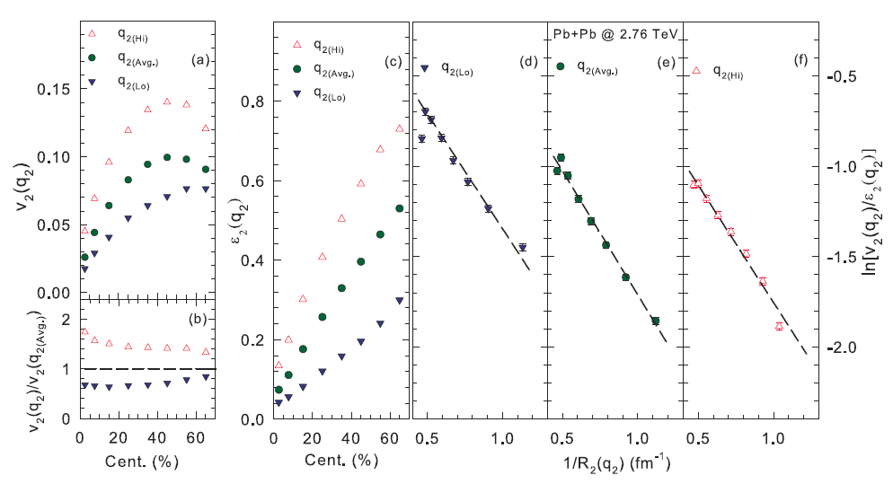

Scaling properties of flow
Acoustic Scaling of shape-engineered events
Lacey et. al, arxiv:1311.1728
Characteristic $1/\overline{R}$ viscous damping validated
for different event shapes at the same centrality
A further constraint for initial fluctuations model and η/s

Slide 28
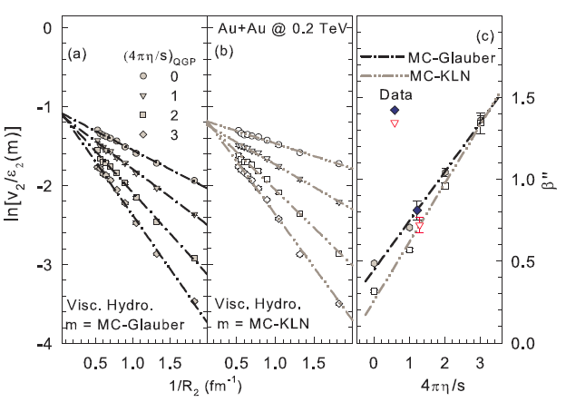
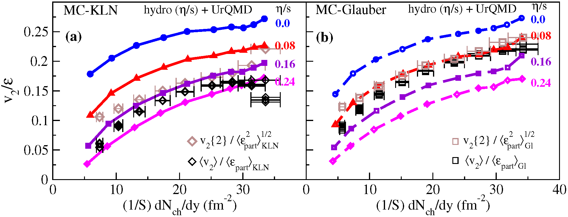

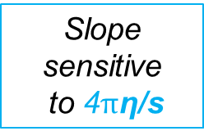
Extraction of η/s
Lacey et. al, arxiv:1311.1728
Song et al
η/s show 100% uncertainty due to “uncertainty” about the
initial geometry
η/s is a property of the medium and should not depend on initial
geometry
Slope sensitive
to 4$π$η/s
Characteristic $1/\overline{R}$ viscous damping validated in viscous hydrodynamics; calibration → 4πη/s ~ $1.3±0.2$
Extracted η/s value insensitive to initial conditions

Slide 29
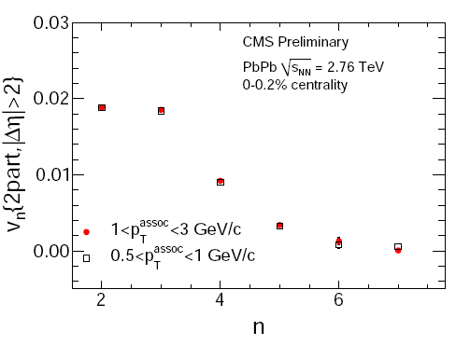

Extraction of η/s
arXiv:1301.0165 & CMS PAS HIN-12-011
Viscous Hydro
Slope sensitive
to η/s
n² scaling validated in experiment and
viscous hydrodynamics;
calibration → 4πη/s ~ 2$.2±0.2$

Slide 30


$√s_{NN}$ dependence of viscous coefficient
arXiv:1305.3341
STAR - Phys.Rev.C86, 014904 (2012); Phys.Rev.C86, 054908 (2012)
CMS - Phys.Rev.C87, 014902 (2013)
An extensive set of measurements now span a broad range of beam energies (${\text{T},μ}_{B}$).

Slide 31
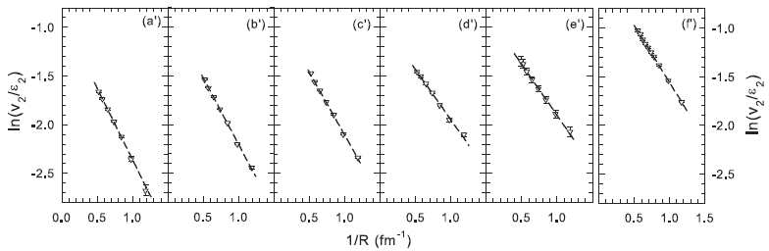
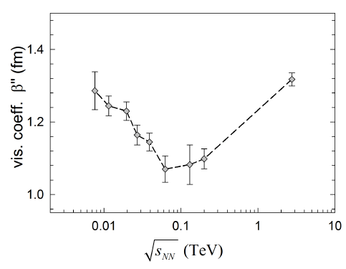
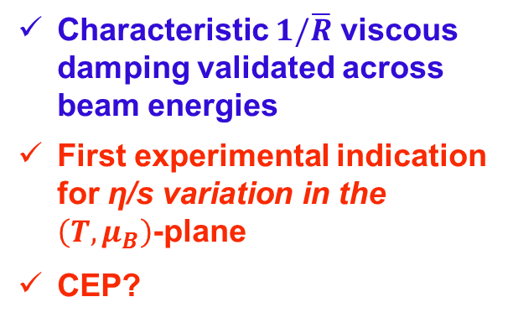

$√s_{NN}$ dependence of viscous coefficient
Acoustic Scaling – $\frac{1}{\overline{R}} Scaling for the Beam Energy Scan$
Lacey et. al, Phys.Rev.Lett. 112 (2014) 082302
7.7 GeV
19.6 GeV
39 GeV
62.4 GeV
200 GeV
2.76 TeV
Characteristic $1/\overline{R}$ viscous damping validated across beam energies
First experimental indication for η/s variation in the $\left(T,μ_{B}\right)$-plane
CEP?
Complimentary
signals for similar
$√s_{NN}$

Slide 32
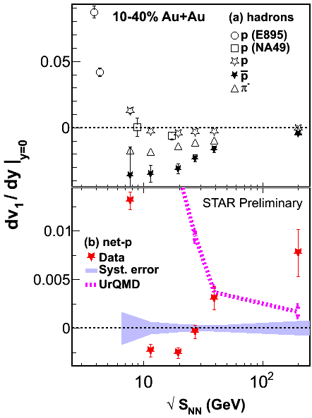
$√s_{NN}$ dependence of HBT signals
Lacey et. al, Phys.Rev.Lett. 112 (2014) 082302
STAR
Combined results
→ Strongest indications for the CEP to date!

Slide 33
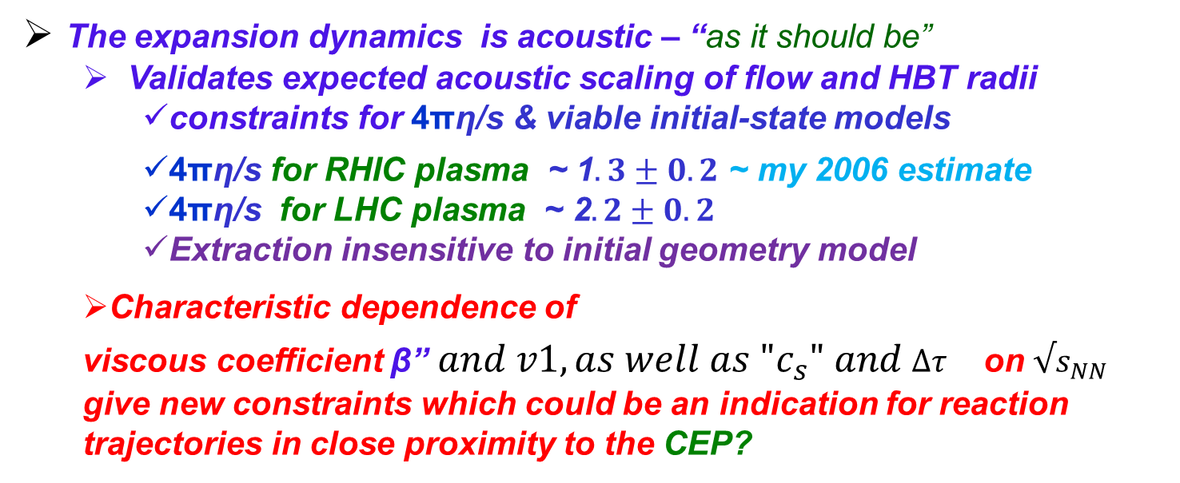
Epilogue
Acoustic scaling of anisotropic flow and HBT radii lend profound mechanistic insights, as well as new constraints for key observables
What do we learn?
The expansion dynamics is acoustic – “as it should be”
  Validates expected acoustic scaling of flow and HBT radii
    constraints for 4πη/s & viable initial-state models
    4πη/s for RHIC plasma ~ 1$.3±0.2$ ~ my 2006 estimate
    4πη/s for LHC plasma ~ 2$.2±0.2$
    Extraction insensitive to initial geometry model
  Characteristic dependence of
  viscous coefficient β” ${and v1, as well as "c}_{s}" and {∆τ }_{}^{}$on $√s_{NN}$
  give new constraints which could be an indication for reaction trajectories in close proximity to the CEP?

Slide 34
End

Slide 35
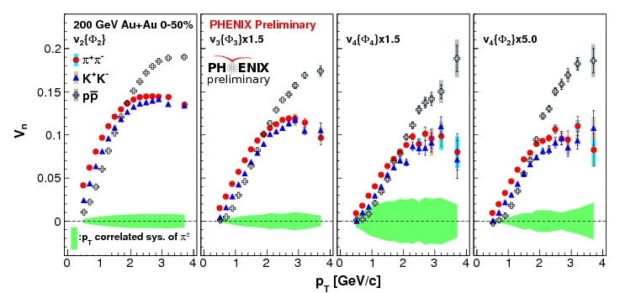
Flow is partonic & Acoustic?
arXiv:1211.4009
Note species dependence for all v_{n}
For partonic flow, quark number scaling expected
→ single curve for identified particle species v_{n}

Slide 36
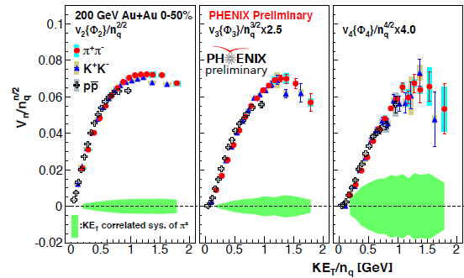
Scaling properties of flow
Acoustic Scaling – Ratios
v_{n} PID scaling

