Slide 1



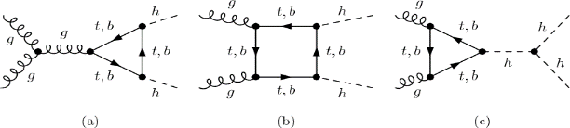
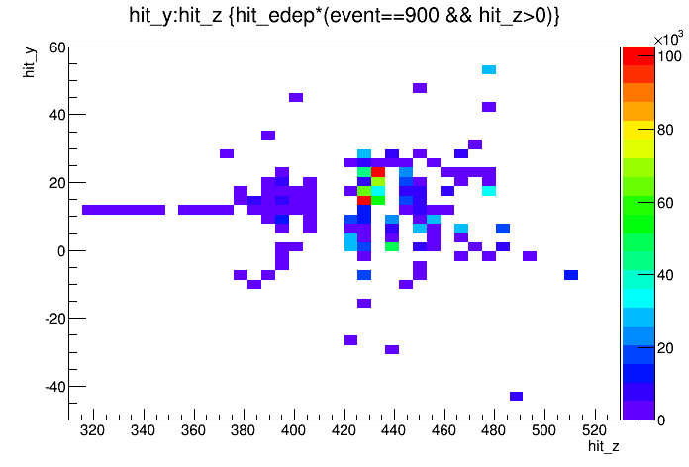
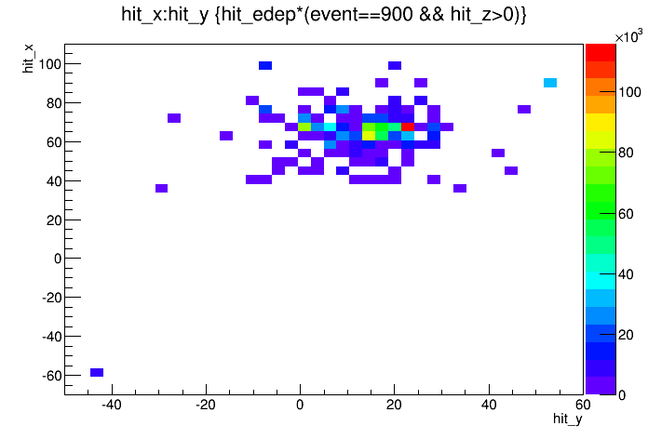
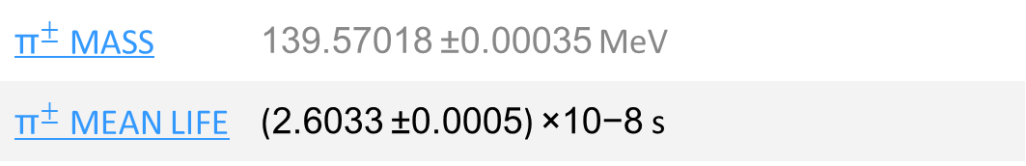
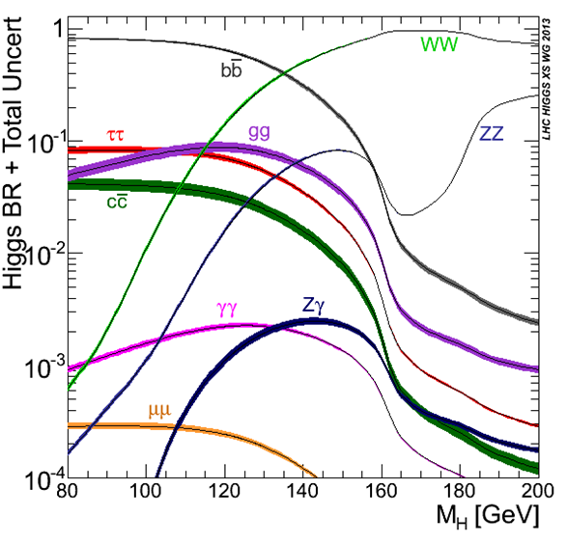
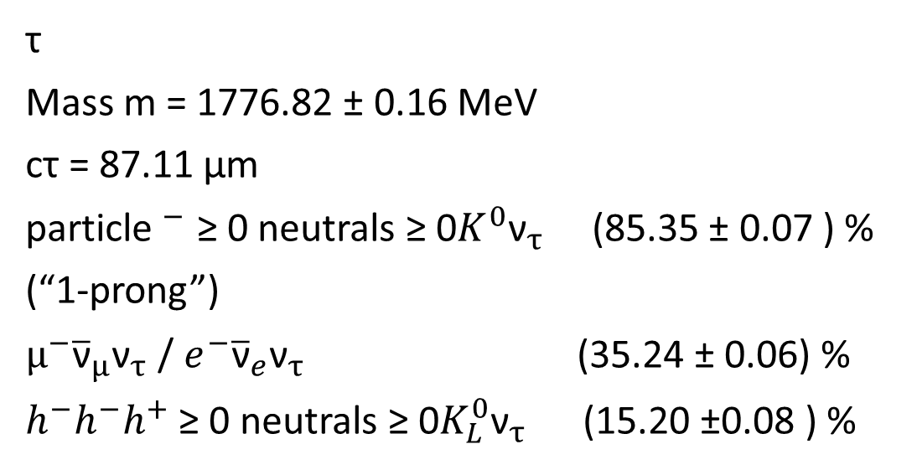
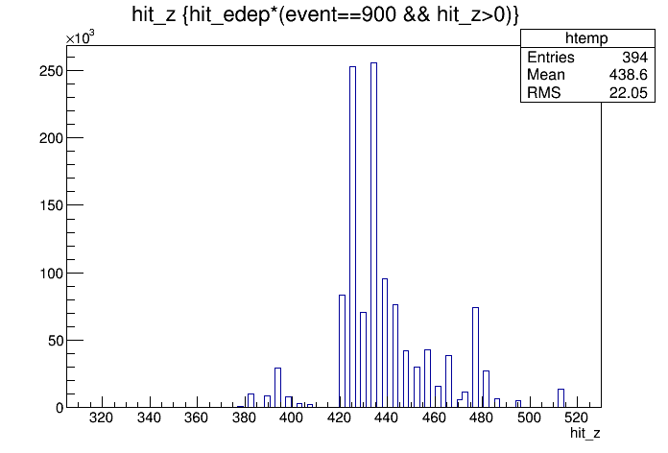
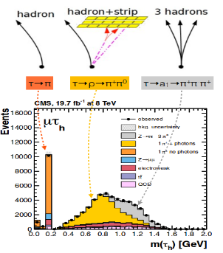
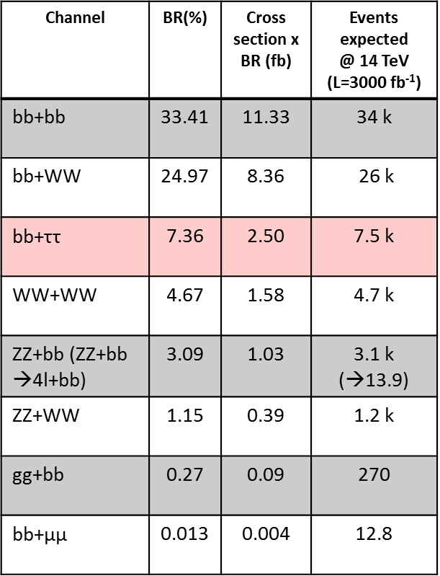
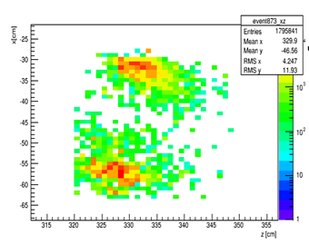
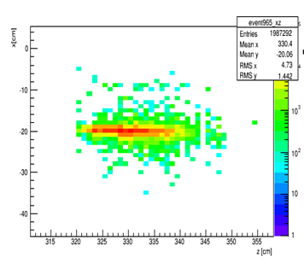

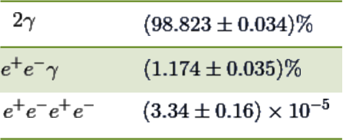
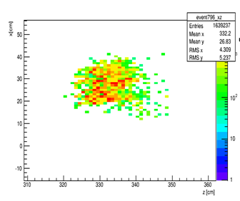
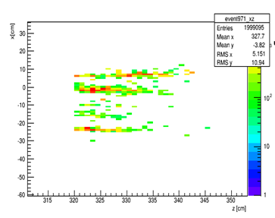
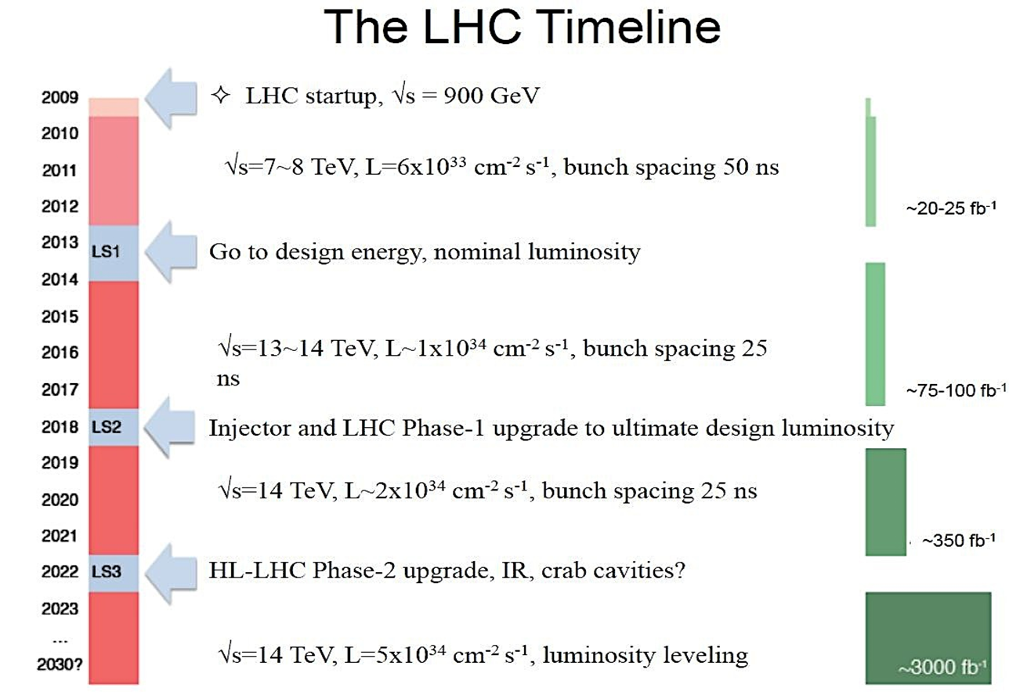
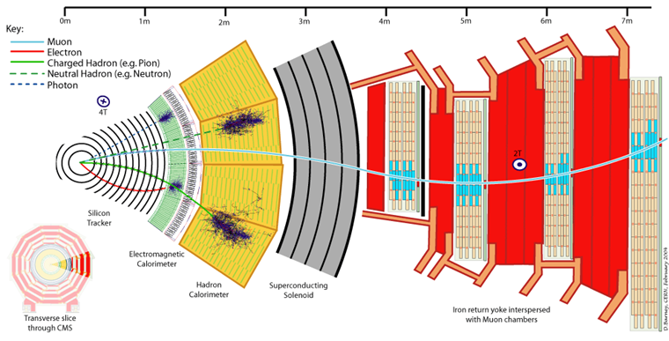
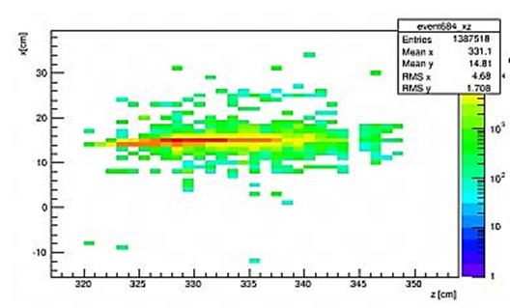
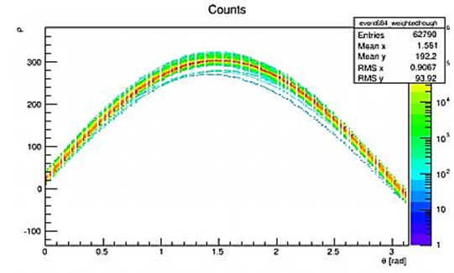
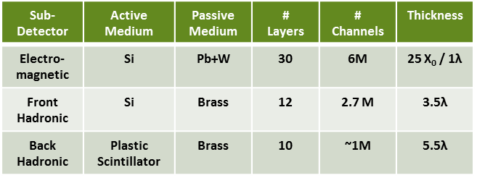
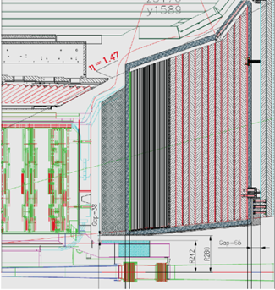
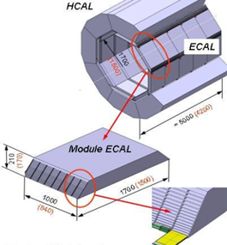
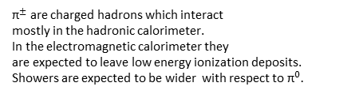


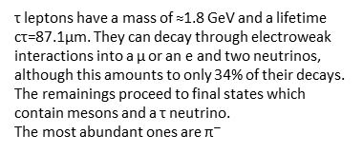
Towards τ Reconstruction In High Luminosity LHC(HL-LHC) With a High Granularity Endcap Calorimeter
A. Izadi Rad (Sharif University of Technology, Iran), P. Tereziu (Faculty of Natural Sciences, University of Tirana)
Supervisors: M. Mannelli, P. Silva (CERN-CMG)
Abstract
Towards τ reconstruction
The goal of our project is to contribute to the study of the performance
of the High Granularity Calorimeter (HGCal) designed to operate in
Phase II of the CMS detector at the High Luminosity LHC (HL-LHC).
τ leptons have a mass of ≈1.8 GeV and a lifetime
cτ=87.1μm. They can decay through electroweak
interactions into a μ or an e and two neutrinos,
although this amounts to only 34% of their decays.
The remainings proceed to final states which
contain mesons and a τ neutrino.
The most abundant ones are ${\text{π}}^{−}$
Higgs physics prospects at the HL-LHC
• In July 2012, ATLAS and CMS discovered a SM Higgs-like particle using ~25
fb-1 of 7-8 TeV pp data
• Nature of the particle not yet fully established :
spin, CP, couplings will benefit from high luminosity
${\text{π}}^{±}$ reconstruction
Fig.1
Fig.6
Fig.7
• Self coupling measurements will become feasible with higher energy and luminosity
properties
${\text{π}}^{±}$ are charged hadrons which interact
mostly in the hadronic calorimeter.
In the electromagnetic calorimeter they
are expected to leave low energy ionization deposits.
Showers are expected to be wider with respect to${ \text{π}}^{0}.$
Fig.8
Interesting channels of Higgs
-CMS work in progress
Spatial distribution of the energy deposits in the layers of HGCAL: Fig.6 y-z view, Fig.7 x-y view.
The total energy deposited per layer is shown in Fig.8
Fig.2
${\text{π}}^{0}$ reconstruction
Fig.9
Resolved
Fig.10
Partially resolved
Fig.3
Table 1
Neutral pions decay mostly to two photons. As the decay products interact electromagnetically it is detected in the electromagnetic calorimeter.
Due to interaction with the tracker material we may observe several
electromagnetic showers developing in parallel.
• The High Luminosity-LHC is expected to be crucial providing ~3${\text{fb}}^{−1}$ at 14 TeV
Higgs self coupling measurements
feasible only at HL-LHC
Fig.11
High energy, collimated
Fig.12
With conversions
Major detectors upgrades to cope
with higher radiation levels, higher
occupancy and required data rates:
-Replacement of critical components,
-Upgrades to trigger and electronics
Exploring the shower structure
Fig.4
By looking at the structure of energy deposit in the Calorimeter we can study :
- How collimated the shower is
- How many particles it contains
A Hough transform can be used for this purpose.
High Granularity Calorimeter (HGCal)
-High granularity calorimeter have been
proposed as future ILC/CLIC detectors
-Provide high resolving power for single
particles in dense jet environment
-At the HL-LHC it offers the prospect of
resolving single particles and jets in a
dense pileup environment
Fig.13
Table 2
Fig.14
The total accumulated in the maximum of the Hough transform can help us distinguish between single and multiparticle showers.
Single photons are expected to produce collimated, high energy showers while neutral pions tend to produce multiple-core showers of lower energy. We are exploring these properties for particle identification.
Fig.5
References
-CMS collaboration, Projected performance of an upgraded CMS detector at the LHC and HL-LHC, CMS-NOTE-13-002
-CALICE collaboration, Tracking within Hadronic Showers in the SDHCAL prototype using Hough Transform Technique, CAN-047
-CALICE collaboration, "Interactions of Pions in the CALICE Silicon-Tungsten Calorimeter Prototype", CAN-050

