Slide 1
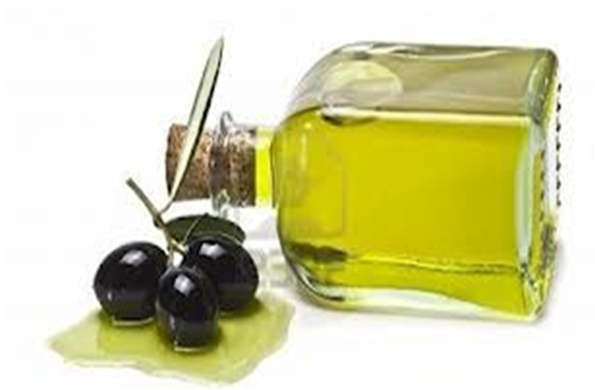

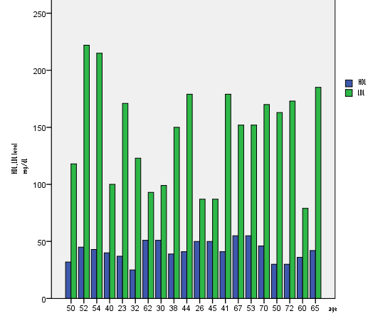
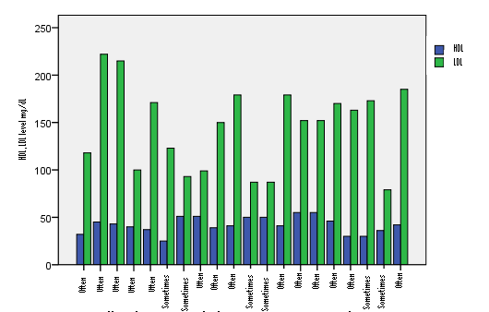
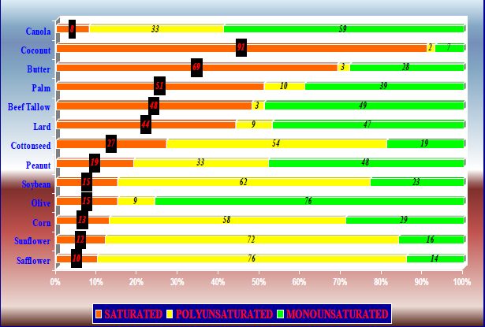
OLIVE OIL COMPOSITION AND HEALTH BENEFITS OF IT.
JONIDA CANAJ¹, KOZETA VASO², LORENA MEMUSHAJ³ ,OLJANA PINE⁴
Institute of Public Health, Department of Environment and Health, Albania e-mail : jonidacanaj@ymail.com
International Workshop on LHC, Astrophysics, Medical and Environmental Physics. Shkodra (Albania), 6-8 October 2014.
ABSTRACT
Evidence suggests that olive oil consumption is associated with a decreased prevalence of cardiovascular disease and certain cancers because of its composition. There are growing scientific evidences supporting the beneficial effects of the Mediterranean diet on human fitness. It has been observed that this type of diet lowers incidence of coronary heart diseases and of some types of tumors and prevents from development of cardiovascular diseases. The health properties of the Mediterranean diet were attributed to a large amount of plant foods consumption and to a regular use of olive oil, as the main source of fat.
The purpose of this study was to assess the relation about olive oil and the level of LDL and HDL in blood and to give information about beneficial effects of olive oil on human health.
The study was performed to determine the LDL and HDL in a group population and they filled out a questioner on the consumption of olive oil. It is shown that persons who often consume olive oil have low level of HDL cholesterol.
Key words: olive oil composition, health benefits of olive oil, diets.
INTRODUCTION
Olive oil has a peculiar fatty acid composition rich in oleic acid (56–84% of the total fatty acids) and linoleic acid (3–21%). In addition it contains a variety of minor constituents responsible for the unique organoleptic properties and stability to oxidation. Unsaponifiable fraction of olive oil is of a diverse chemical nature. The composition varies depending on cultivars, drupe ripening, climate and environment, time of harvesting and storage and processing techniques for the oil production. The highest concentration of these compounds is in the extra-virgin olive oil, obtained by the first cold pressing of the olive paste. The minor components are important not only from a commercial standpoint in order to assess the high quality and good palatability of the olive oil, but also for their potential beneficial impact on human health.
.Numerous studies indicate that monounsaturated fat is about as effective as polyunsaturated fat in lowering total blood cholesterol and LDL cholesterol, when substituted for saturated fat in the diet.
Plus, monounsaturated fat does not lower beneficial HDL cholesterol or raise triglycerides, unlike polyunsaturated fat, which, at high intakes, may lower HDL cholesterol. Dietary fatty acid composition influences plasma lipids and lipoproteins associated with the development of atherosclerosis and ischemic heart disease (IHD). The effect of dietary fatty acids on plasma total cholesterol, and on low density lipoprotein (LDL) and high density lipoprotein (HDL) cholesterol, has been subject to many studies and prediction algorithms have been developed.
METHOD
The purpose of the study was to assess the relation between olive oil and his benefits on health. To achieve this goal, a questionnaire was developed that assessed a group population knowledge and dietary behavior related to fat consumption. The main purpose was to study the level of low density lipoprotein (LDL) and high density lipoprotein (HDL) cholesterol and dietary behavior related to fat consumption.
An SPSS database file was created to include each of the variables in the questionnaire. Data were analyzed using SPSS v16.0.
RESULTS AND DISCUSSION
There were a total of 20 subjects volunteered for the study. The lower level of HDL cholesterol was 25mg/dL and the higher one was 55mg/dL. The lower level of LDL cholesterol was 79mg/dL and the higher one was 222mg/dL. It was shown that participants that consume very often olive oil, had lower level of LDL cholesterol than the others. If it will compare the level of HDL, LDL by the age, it is clear by the fig. nr .1 that there is not a relation because some young participants have high level of LDL and low level of HDL. The level of cholesterol is dependent on dietary fatty acids, especially rich in monounsaturated acids.
Figure nr. 1. It is shown the relation between the age and the level of HDL, LDL cholesterol
Figure nr. 2. It is shown the relation between the consumption and the level of HDL, LDL cholesterol.
CONCLUSIONS
Numerous studies indicate that monounsaturated fat is about as effective as polyunsaturated fat in lowering total blood cholesterol and LDL cholesterol, when substituted for saturated fat in the diet.
Olive oil is rich in monounsaturated acids, so is recommended to use in your daily diet. It is important that the participants in this study often consume olive oil.
REFERENCES
Altarejos A., Saldo S., Pérez-Bonilla M., Linares-Palomino P.J., van Beek T.A., Nogueras M., Sánchez A. (2005). Preliminary assay on the radical scavenging activity of olive wood extracts. Fitoterapia 76: 348–351.
Antolovich M., Prenzler P., Robards K. and Ryan D. (2000). Sample preparation in the determination of phenolic compounds in fruits. Analyst 125: 989–1009.
Figure nr.3. It is shown the percentage of fatty acid composition in different fats.

