Slide 1
Innovative Training Networks (ITN)
Marie Sklodowska-Curie Actions
19.02.2014
Barbara Bendaoud

Slide 2
1
Marie Curie programme overview
Requirements and rules
ITN
2
3

Slide 3

Marie Sklodowska-Curie Actions
Objective: Enhancing the skills of people behind research and innovation
Opportunities for:
Research training
Attractive career and knowledge-exchange opportunities
Part of
Horizon 2020‘s
„Excellent Science“
pillar

Slide 4
Key facts
Marie Sklodowska-Curie Actions
Budget | 6.16 billion € between 2014 and 2020
Research areas | Bottom up approach = free choice of research topic
Key features | Transnational mobility of researchers Collaboration of the academic and the industrial/non-academic sector Multidisciplinary research challenges
Structure | 5 different types of Marie Sklodowska-Curie Actions with yearly funding calls

Slide 5
Overview Actions
 | ITN | RISE | IF | COFUND | NIGHT
Full name | Innovative Training Networks | Research and Innovation Staff Exchange | Individual Fellowships | Co-funding for regional, national and international programmes | European Researchers’ Night
Focus | Setting-up training networks for the next generation of researchers | Co-funding of new or existing fellowship programmes | Recruitment of a single researcher for research and training | Research collaboration through staff exchange | Research awareness raising event focussed on the general public
Varieties | European Training Networks, European Industrial Doctorates, Joint Doctorates | Doctoral programmes, Fellowship programmes | European-, Reintegration- and Global Fellowships | Inter-sector stream, international stream | n/a
FP7 equivalent | ITN | IAPP and IRSES | IEF, IOF, IIF and RG | COFUND | NIGHT

Slide 6
1
Programme overview
Requirements and rules
ITN
RISE
IF
2
3
4
5

Slide 7
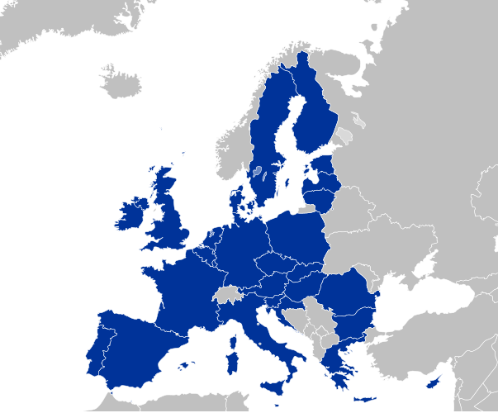
Eligible countries
  Member States (MS): the EU-28
  Associated countries (AC, to be confirmed): Switzerland, Israel, Norway, Iceland, Liechtenstein, Turkey, the Former Yugoslav Republic of Macedonia and Serbia, Albania, Montenegro, Bosnia & Herzegovina, Faroe Islands and Republic of Moldova
  Beyond the required minimum: Third countries, especially International Cooperation partner countries (ICPC)

Slide 8
Participants
Academic sector | Non-academic sector
Public or private higher education establishments Public or private non-profit research organisations International European interest organisations | Any socio-economic actor not included in the academic sector (e.g. SMEs, large enterprises…)
Participation levels
Beneficiaries | Partner organisations
Full partners with responsibility for the project Appoint, supervise, host and train researchers Directly claim costs | Associated via a letter of commitment Provide training and secondments opportunities Can be reimbursed by beneficiaries

Slide 9
Categories of researchers
Early-stage researchers (ESR)
  Early-stage researchers are post-graduate (or equivalent level) researchers in the first four years of their research careers at the time of recruitment

Slide 10

Mobility rule
Researcher shall not have resided or carried out their main activity in the host country for more than 12 months in the 3 years immediately prior to the reference date.

Slide 11
1
Programme overview
Requirements and rules
ITN
2
3

Slide 12
Innovative Training for Researchers (ITN)
Objective: Train a new generation of creative entrepreneurial and innovative early-stage researchers
 | European Training Network (ETN)
Participation | A network of a least three beneficiaries from different MS or AC, relevant participation from the academic and non-academic sector
Duration of recruitment | 3 – 36 month per ESR
Max. number of researcher-month | Max. 540 researcher-month
Project duration | Typically 48 month
Other | Not more than 40% of the contribution to hosts in the same country

Slide 13
Innovative Training for Researchers (ITN)
Variety | European Training Network (ETN) | European Industrial Doctorate (EID) | European Joint Doctorate (EJD)
Implementation | Recruitment of ESRSs Typically enrolment in a doctoral programme Training of these ERSs through research on individual, personalised projects and complementary courses and jointly organised workshops, covering scientific and transferable skills | Recruitment of ESRSs Enrolment of the ESRs in a doctoral programme is mandatory Training of these ERSs through research under supervision and courses and jointly organised workshops, including scientific and transferable skills ESRs must spend 50% of their time in the non-academic sector | Recruitment of ESRSs Enrolment of the ESRs in a doctoral programme is mandatory Training of these ERSs through research under supervision and courses and jointly organised workshops, including scientific and transferable skills

Slide 14
Project constellation ETN
Ind
Partner organisation
Ind
Beneficiaries
Uni
ESR
ESR
Uni
ESR
Training
events
Uni
ESR
ESR
Ind
ESR
ESR
Uni
Ind
Ind

Slide 15
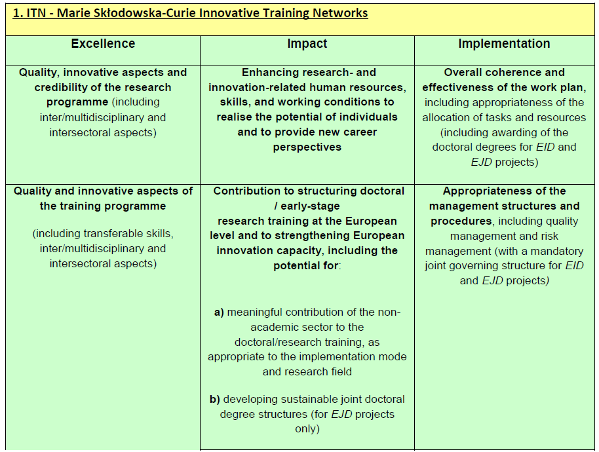
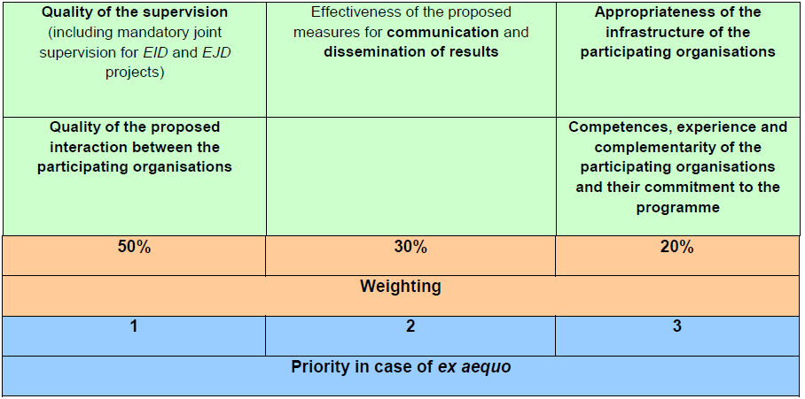

Slide 16
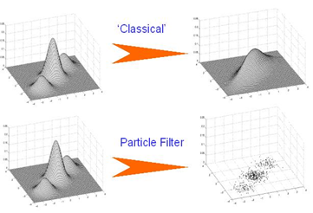
Example project I
Objective: Research and training in the field of sensor data processing. The research programme will focus on the development of novel methods for real-time signal and data processing, based on data collected form sensors or networks of sensors.
Project partners: 2 large industrial companies (one of them coordinator), 2 SMEs, 3 universities and 1 research institute from 4 different countries
522 researcher month, recruitment of 13 Early-Stage Researchers and 2 Experienced Researchers plus 6 Visiting Researchers
EC contribution: 3,2 million €
Duration: 48 month
Notes:
Adhesives that emply man made materials to mimic the efficient attachment mechanisms of marine organisms

Slide 17
Funding rates
Researcher unit costs person/month |  |  | Institutional unit costs person/month
Living allowance | Mobility allowance | Family allowance | Research, training & networking costs | Management and indirect costs
3,100 € | 600 € | 500 € | 1,800 € | 1,200 €

Slide 18
Main differences with FP7
No more ERs! Only ESRs!
Even stronger focus on innovation and
industrial participation
Overhead and management no in one flat-rate
allowance
Different proposal structure, less pages about 40 => 30
Different evaluation criteria, stronger focus on Impact
ETN: No additional changes
EID: No more than two beneficiaries allowed
EJD (compared with IDP): Now three partners
instead of one

Slide 19

Next call
  Call publication: 11 December 2013
  Deadline: 9 April 2014
Notes:
Budget increased by almost 50%

Slide 20

  For more information:
  Barbara Bendaoud
  +49 (211)65 85 19 19
  Barbara.bendaoud@pnoconsultants.com

