Slide 1
LS1 Status Report
LS1@LHCC – 117th LHCC
Frédérick Bordry
5th March 2014

Slide 2
LS 1 from 16th Feb. 2013 to Dec. 2014
16th Feb.
5th March
2013
2014
2015
F
M
A
M
J
J
A
S
O
N
D
J
F
M
A
M
J
J
A
S
O
N
D
J
F
M
A
LHC
SPS
PS
PS Booster
beam to beam
available for works
Physics
Beam commissioning
Shutdown
Powering tests

Slide 3
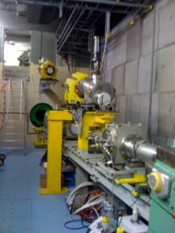
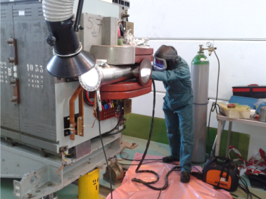
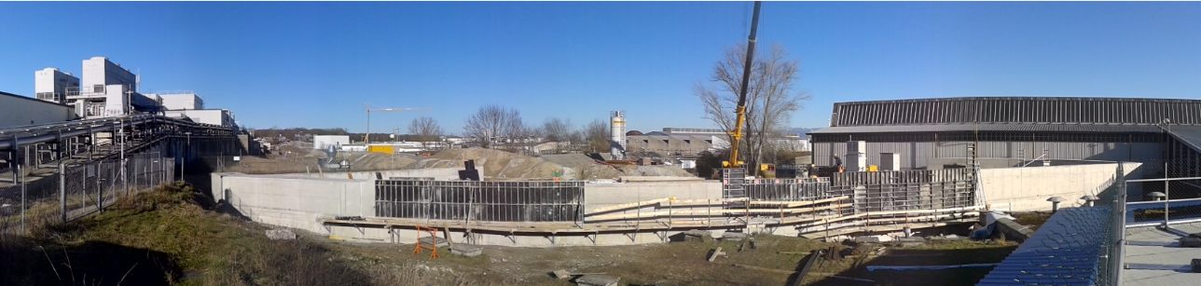
LHC Injectors dashboards
  - Full maintenance of all the equipment being completed
  - New access system being commissioned
PS & PSB main activities:
Consolidation of the PS Main Units completed,
New PS ventilation system commissioning started,
PSB dump replacement being completed…
PSB beam dump
  Septum 16 External Shielding in progress
PS Main Magnets

Slide 4
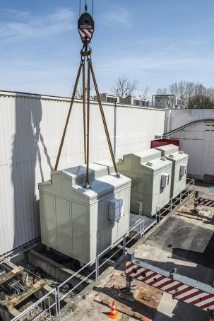
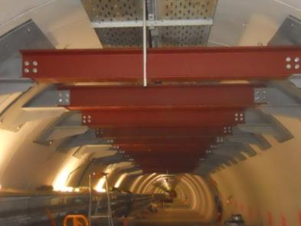
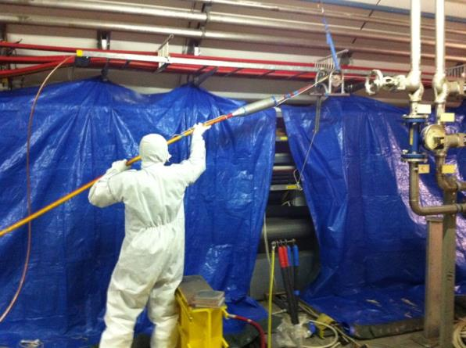
LHC Injectors dashboards
SPS main activities:
LSS1: Irradiated cabling campaign is on-going
Re-installation of the machine will start on March,
Transformers exchange complete,
TT10 vault repair completed…
TT10 vault
LSS1 -irradiated cabling campaign
SPS transformer installation

Slide 5
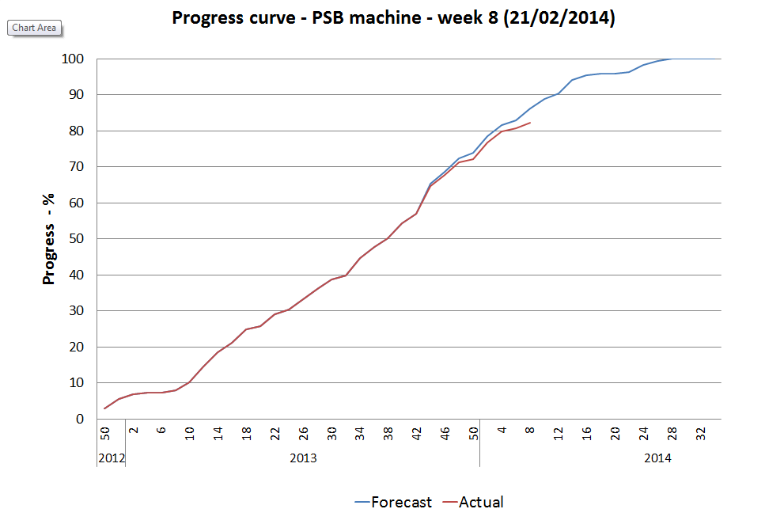
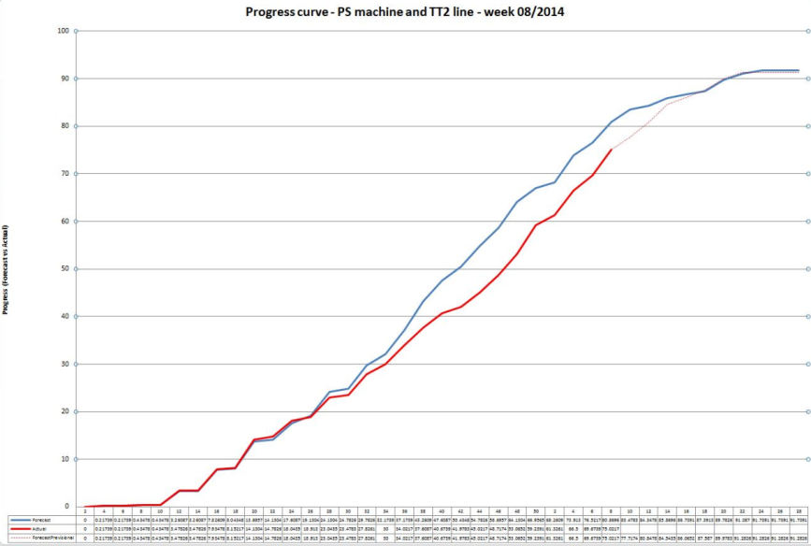
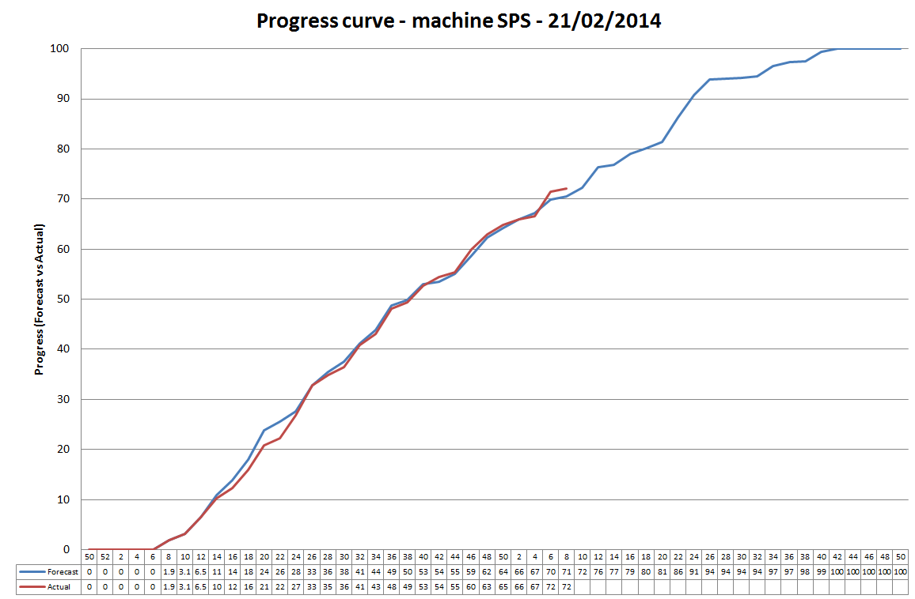
LHC Injectors dashboards
PSB
PS
SPS

Slide 6
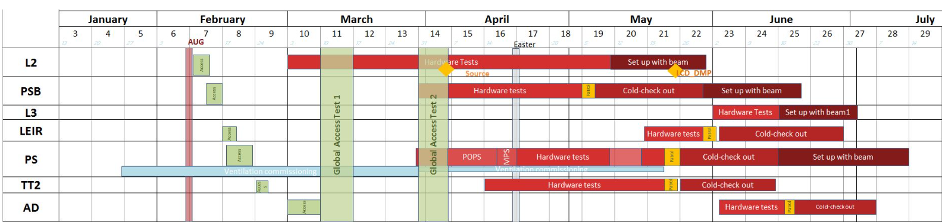
LHC Injectors start-up
LHC-injectors … getting ready for hardware tests
  Full commissioning of the new access system is starting
  PS &PSB : hardware tests will start in April
  Beam for late spring in Linac 2  summer in PS

Slide 7
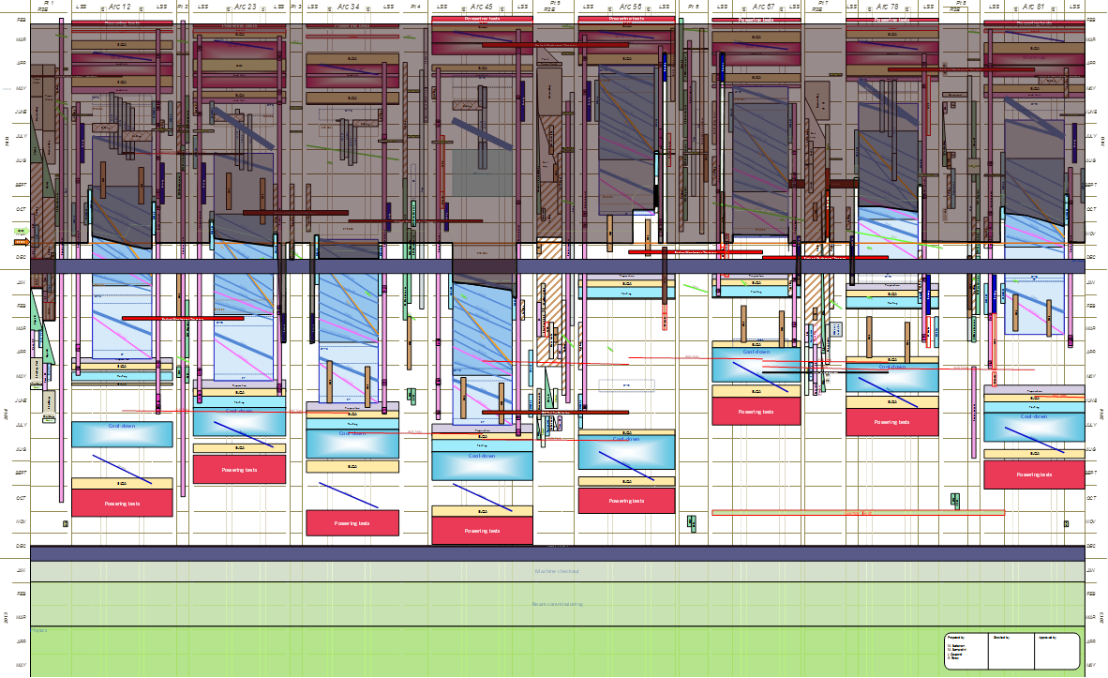
116th LHCC Meeting (4th December 2013)

Slide 8
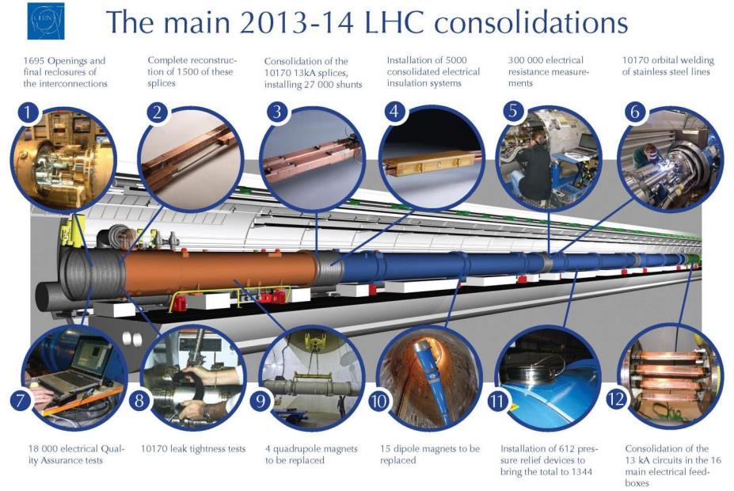
Opening:100%
98 % done
96 % done
85 % done
85 % done
70 % done
Closure: 50%
3000
3
85 % done
40 % done
Done
Done
Done
90 % done

Slide 9
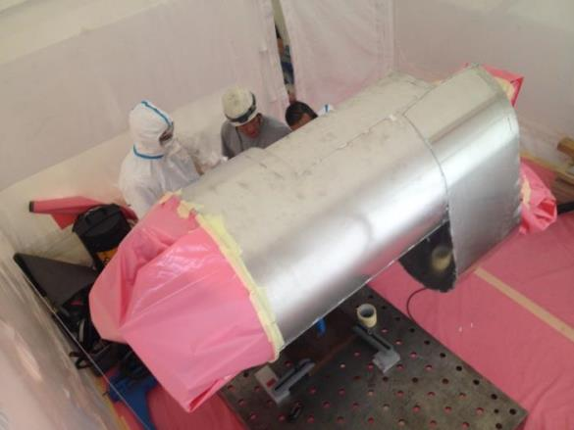
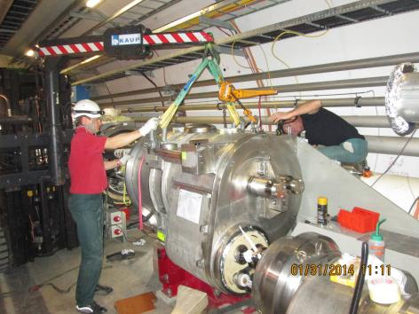
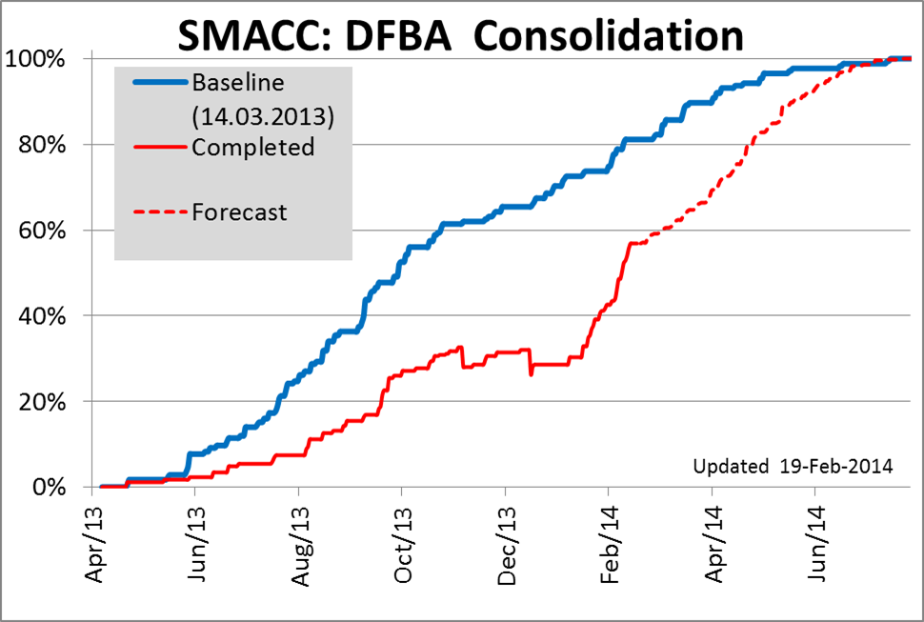
SMACC progress – report on DFBA
DFBA consolidation
  Leaks were found on the lower gimbal bellow in 2 DFBAs
    Shuffling modules were extracted and transport to surface for repair
      Both back in tunnel
  Teams reinforced – schedule is not an issue anymore
DFBAK lower gimbal bellow repair on surface
DFBAK shuffling module back

Slide 10
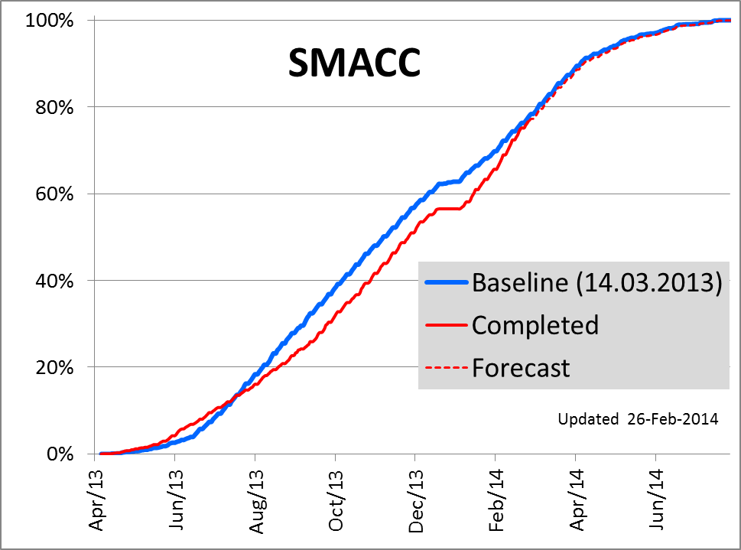
SMACC Dashboards
3 weeks
Superconducting Magnets and Circuits Consolidation (SMACC).

Slide 11
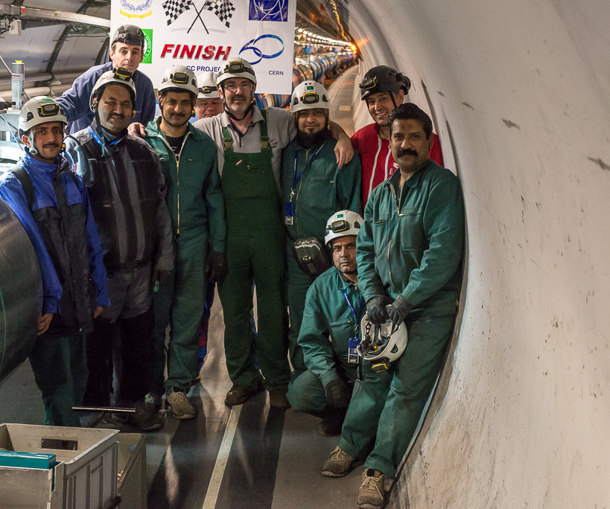
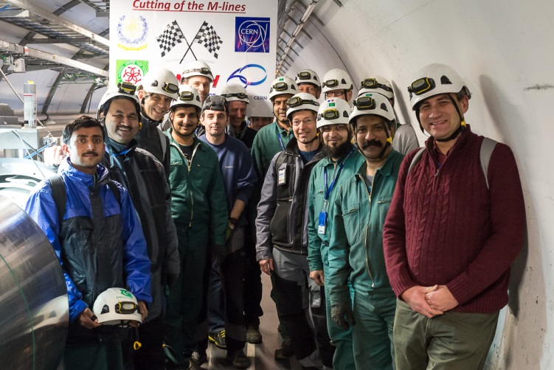


Last M line opening (S45)
6th of February 2014
Operator responsible : JM Hubert
Pictures by M Struik

Slide 12
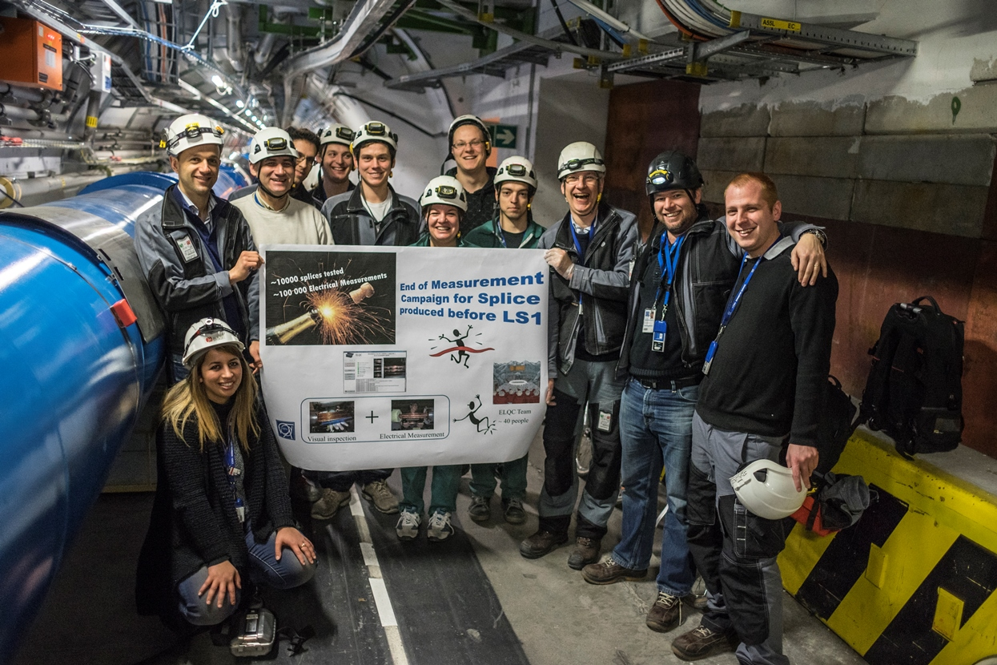

Slide 13
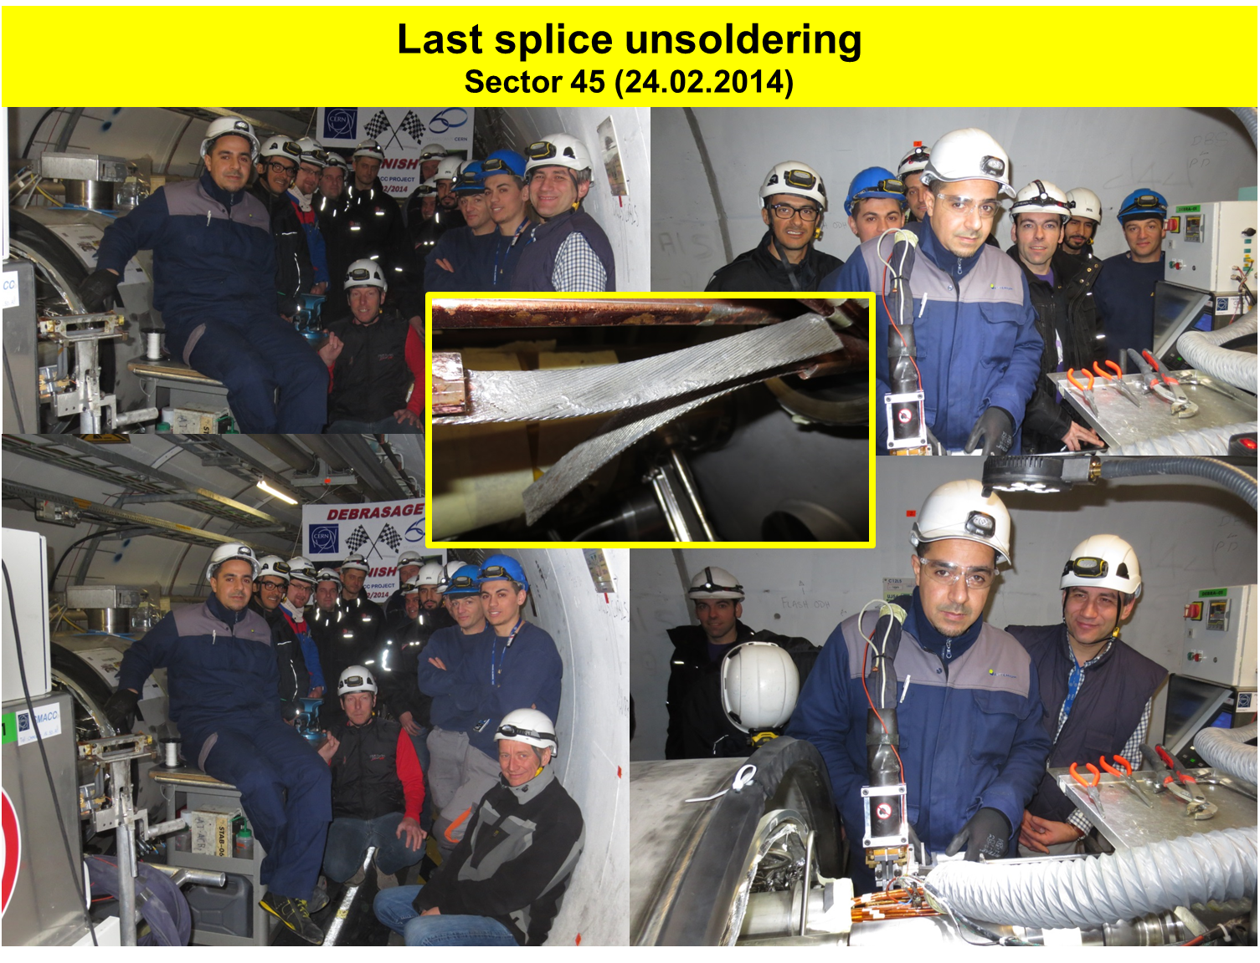

Slide 14
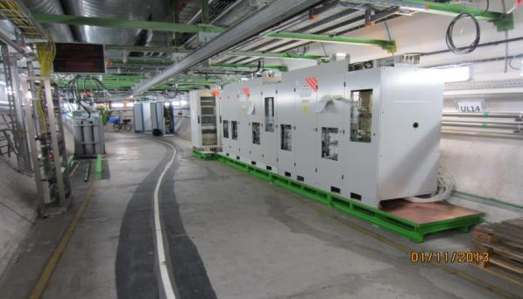
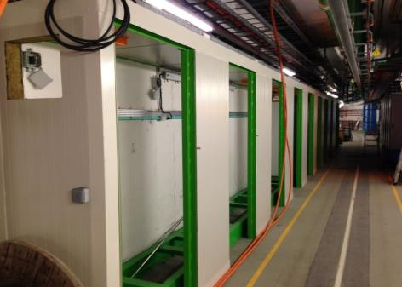
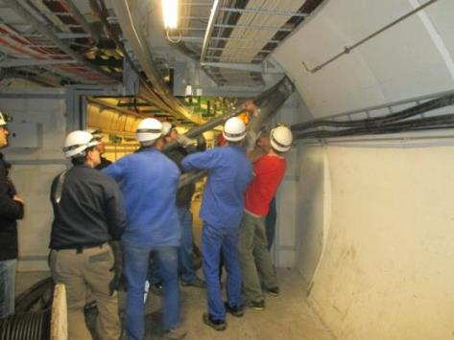
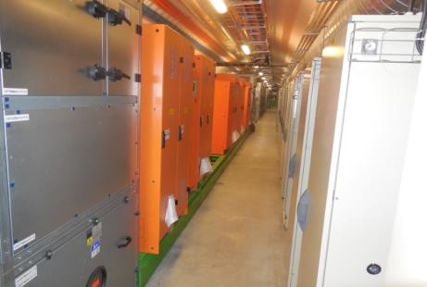
R2E progress
Point 1
  All equipment are reinstalled and reconnected
  Commissioning in progress
Point 5 & Point 7
  Major cabling campaign in progress
UL16 power converters
UL55 safe-room
WCC installation @ P5
TZ76

Slide 15
R2E dashboards

Slide 16
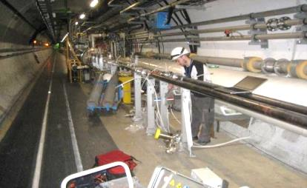
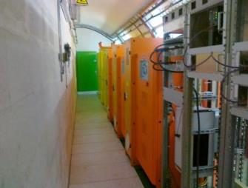
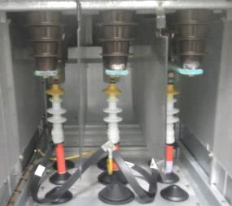
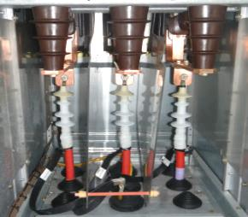
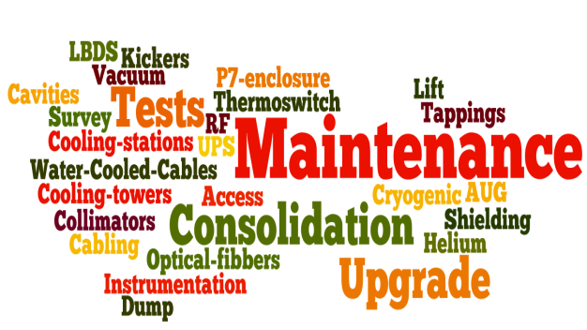
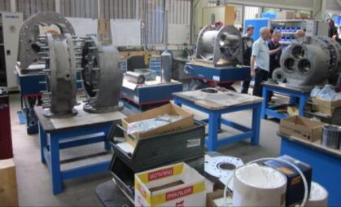
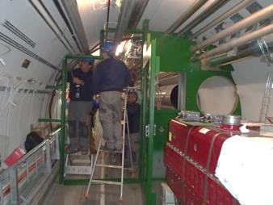
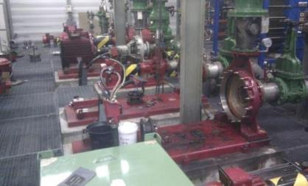
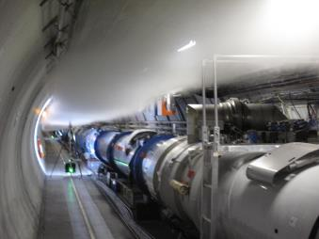
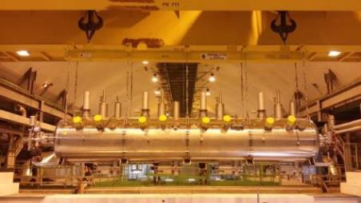
The other activities
Vacuum
UPS-RE82
18 kV & 3.3 kV circuit breakers
Before
After
Cryo plant
P7 enclosure
Pumping station
Helium spill test
ACS transport
Courtesy of Katy Foraz

Slide 17
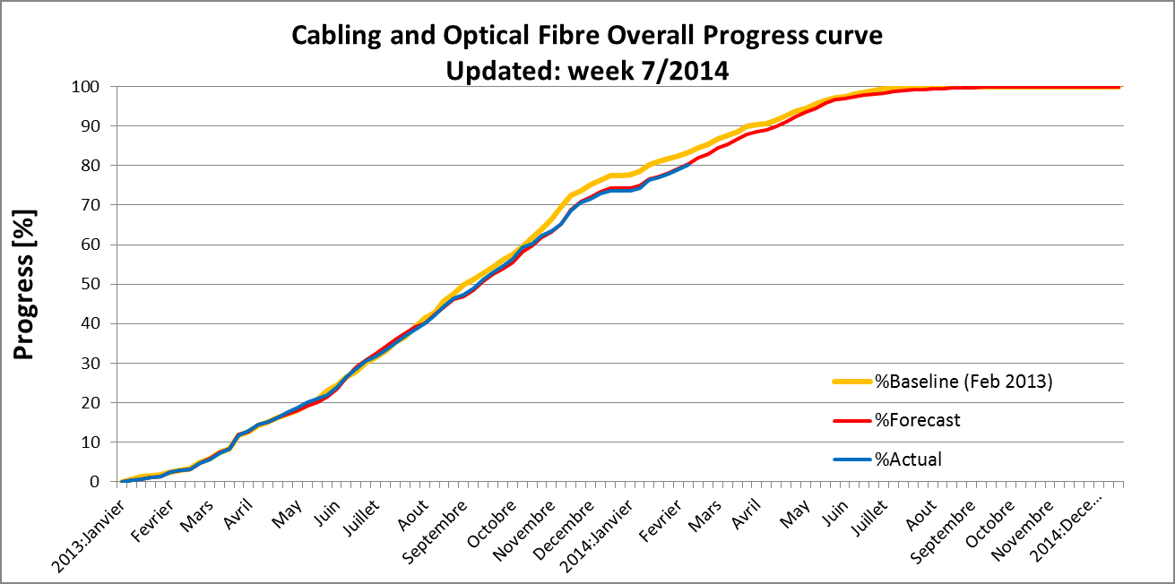
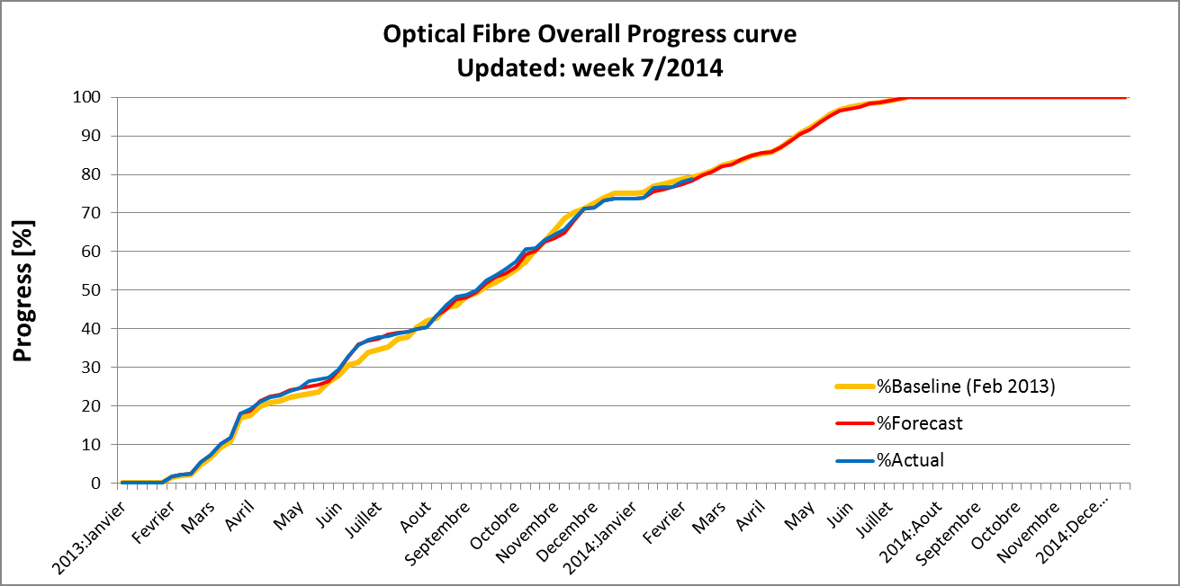
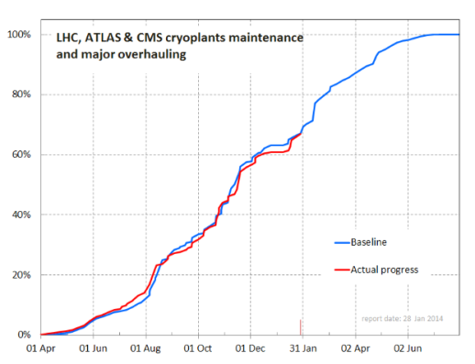
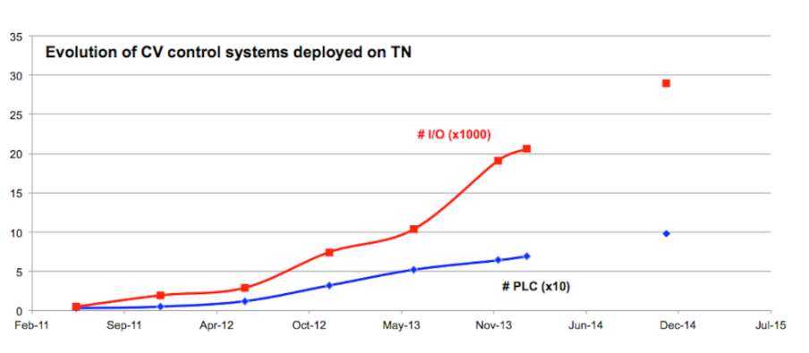
Infrastructure dashboards

Slide 18
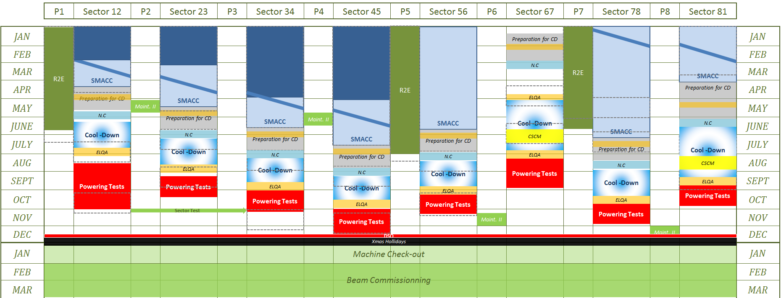
From
Schedule: version 3.0 to 3.1
Under approval
Schematic view of version 3.1, now includes
  DFBA repairs at P6 and P8
  CSCM in sectors 67 and 81
  a margin of 2 weeks after flushing for N.C. solving
  The sector test from P2 to P3
Courtesy of Katy Foraz

Slide 19
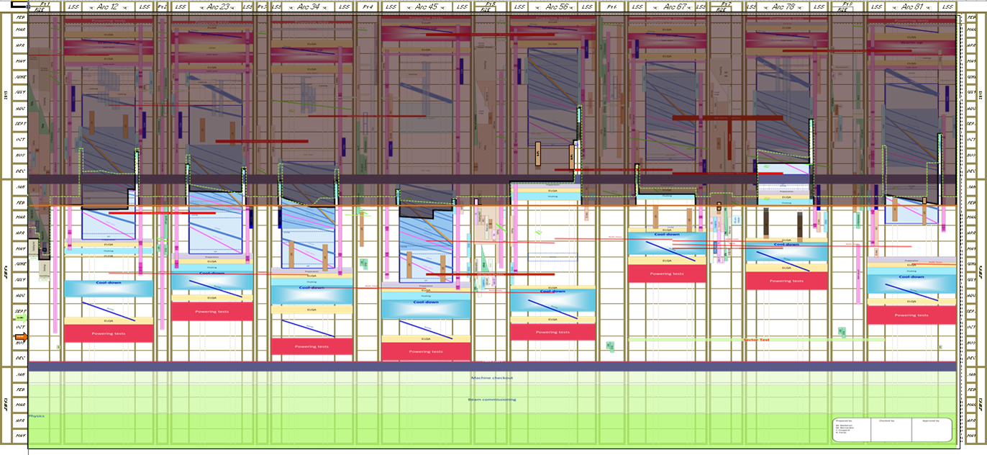
Conclusion
LHC injectors getting ready for hardware tests
LHC: all signals are green for beam on January 2015
http://cern.ch/ls1dashboard

Slide 21
LHC schedule beyond LS1
Only EYETS (19 weeks) (no Linac4 connection during Run2)
LS2 starting in 2018 (July) 18 months + 3months BC (Beam Commissioning)
LS3 LHC: starting in 2023 => 30 months + 3 BC
injectors: in 2024 => 13 months + 3 BC
Run 2
LS 2
Run 3
LS 3
Run 4
LS 4
Run 5
LS 5
LHC schedule approved by CERN management and LHC experiments spokespersons and technical coordinators
Monday 2nd December 2013

