Slide 1
Introduction to WP12: Normal Conducting High-Gradient

Slide 2
Where are we with X-band and high-gradient?
Accelerating gradients above 100 MV/m now routinely and reproducibly achieved.
Industry is now supplying X-band klystrons.
Micron-precision technology spreading rapidly in industry.

Slide 3
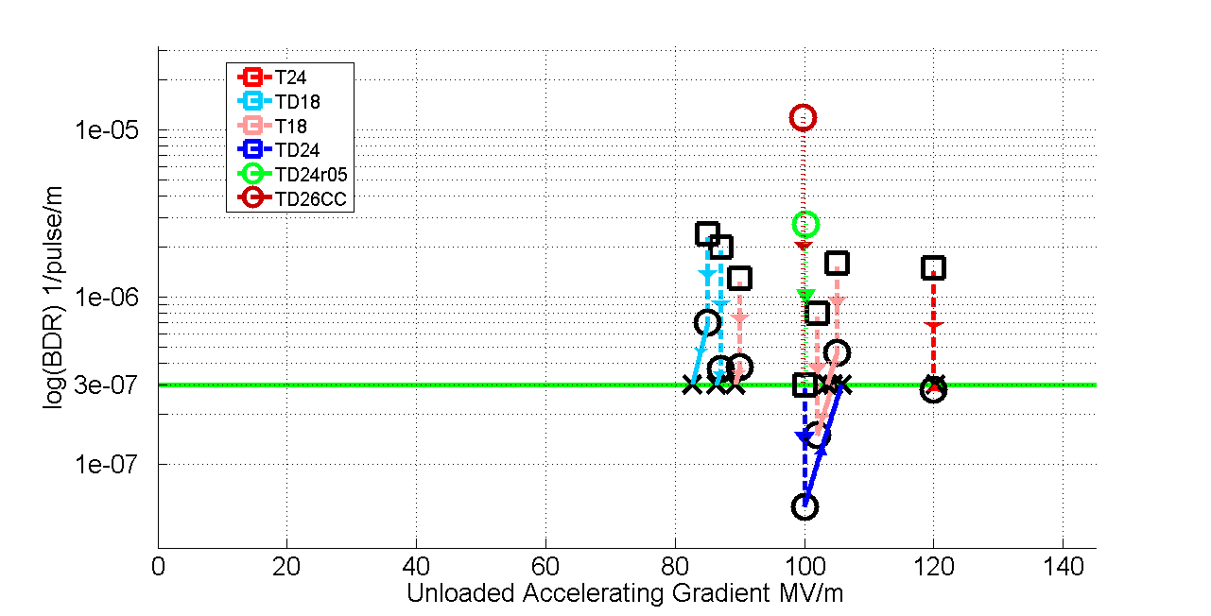
Accelerating structure performance summary
We are able to now predict very accurately the accelerating gradient a particular design will have.

Slide 4
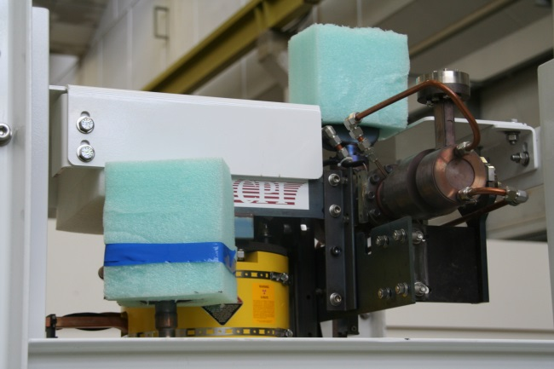
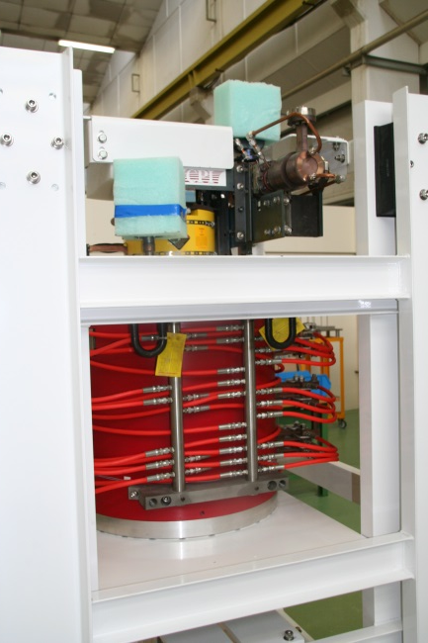
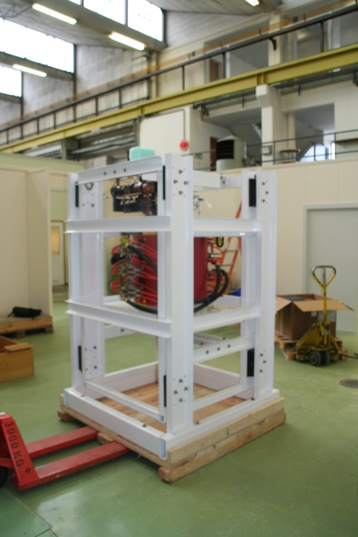
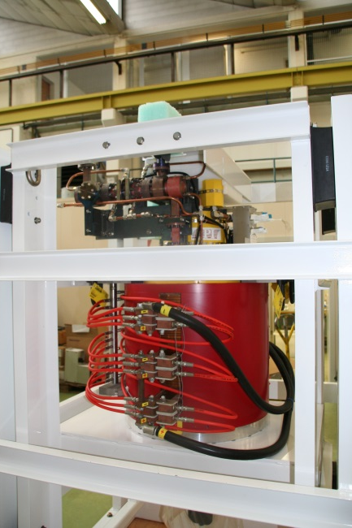
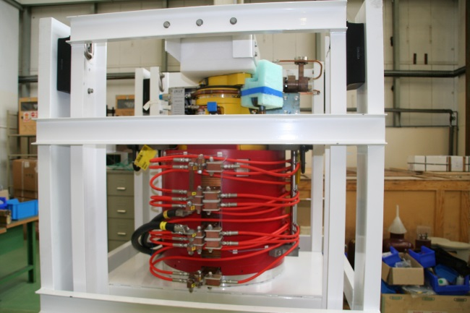
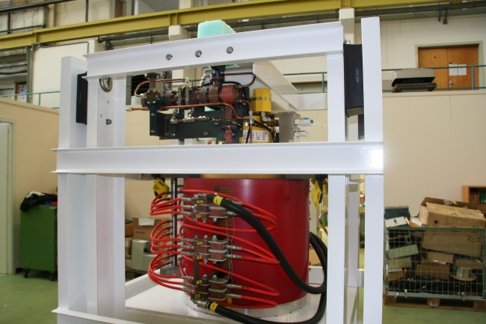
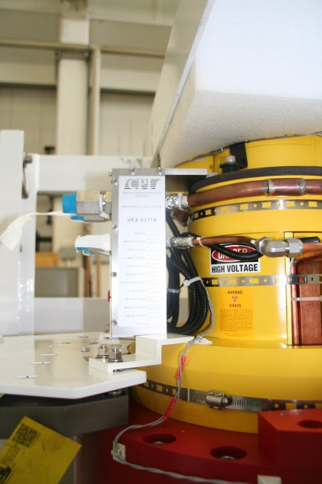
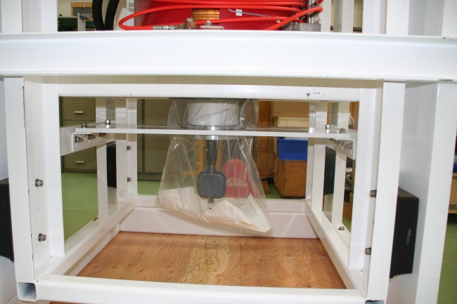
CPI unpackaging

Slide 5
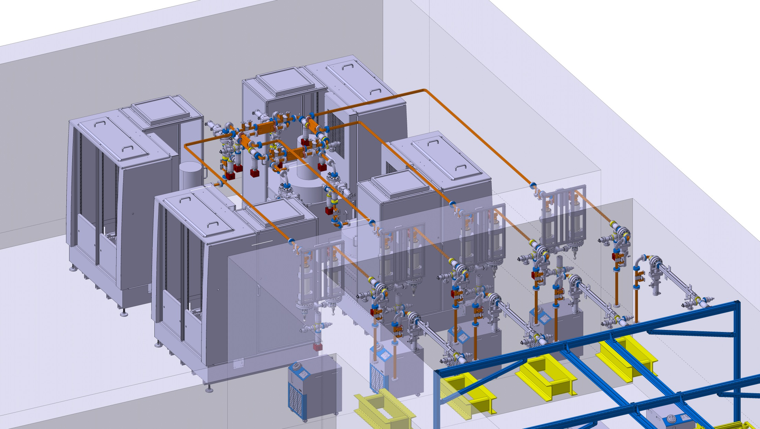
Xbox3. 3D layout/integration almost finished

Slide 6
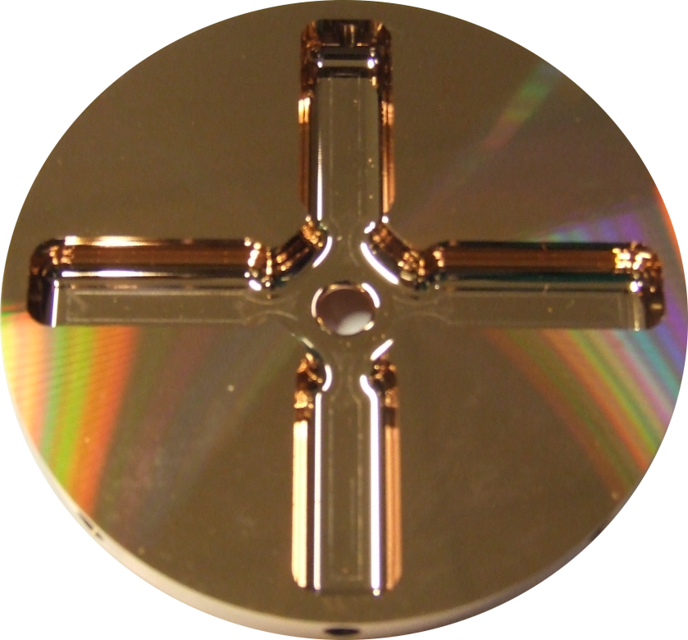
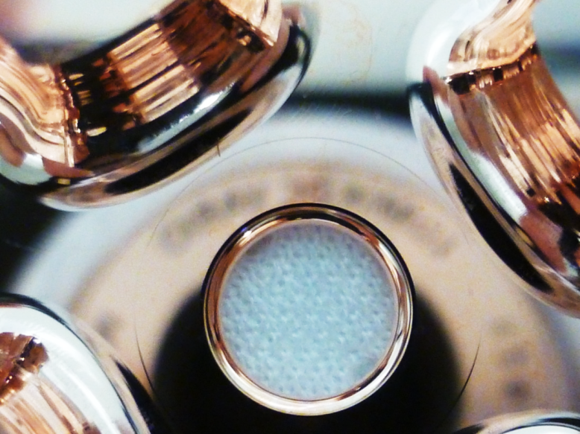
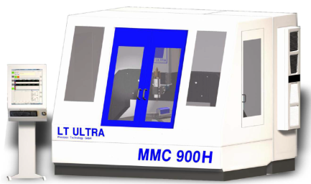
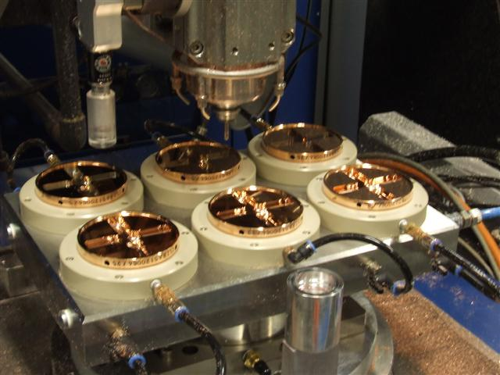
Micron precision turning and milling

Slide 7
Where are we going with X-band and high-gradients?
Deepen the technological base
  New X-band klystron design from SACLAY
  Instrumentation and electronics from PSI
  Test-stand optimization from Uppsala
  Alternative design of HOM supression from Manchester
Broaden the use in accelerators
  Crab cavity/deflector development from Lancaster and STFC
New applications
  Medical linacs
  XFELs

Slide 8
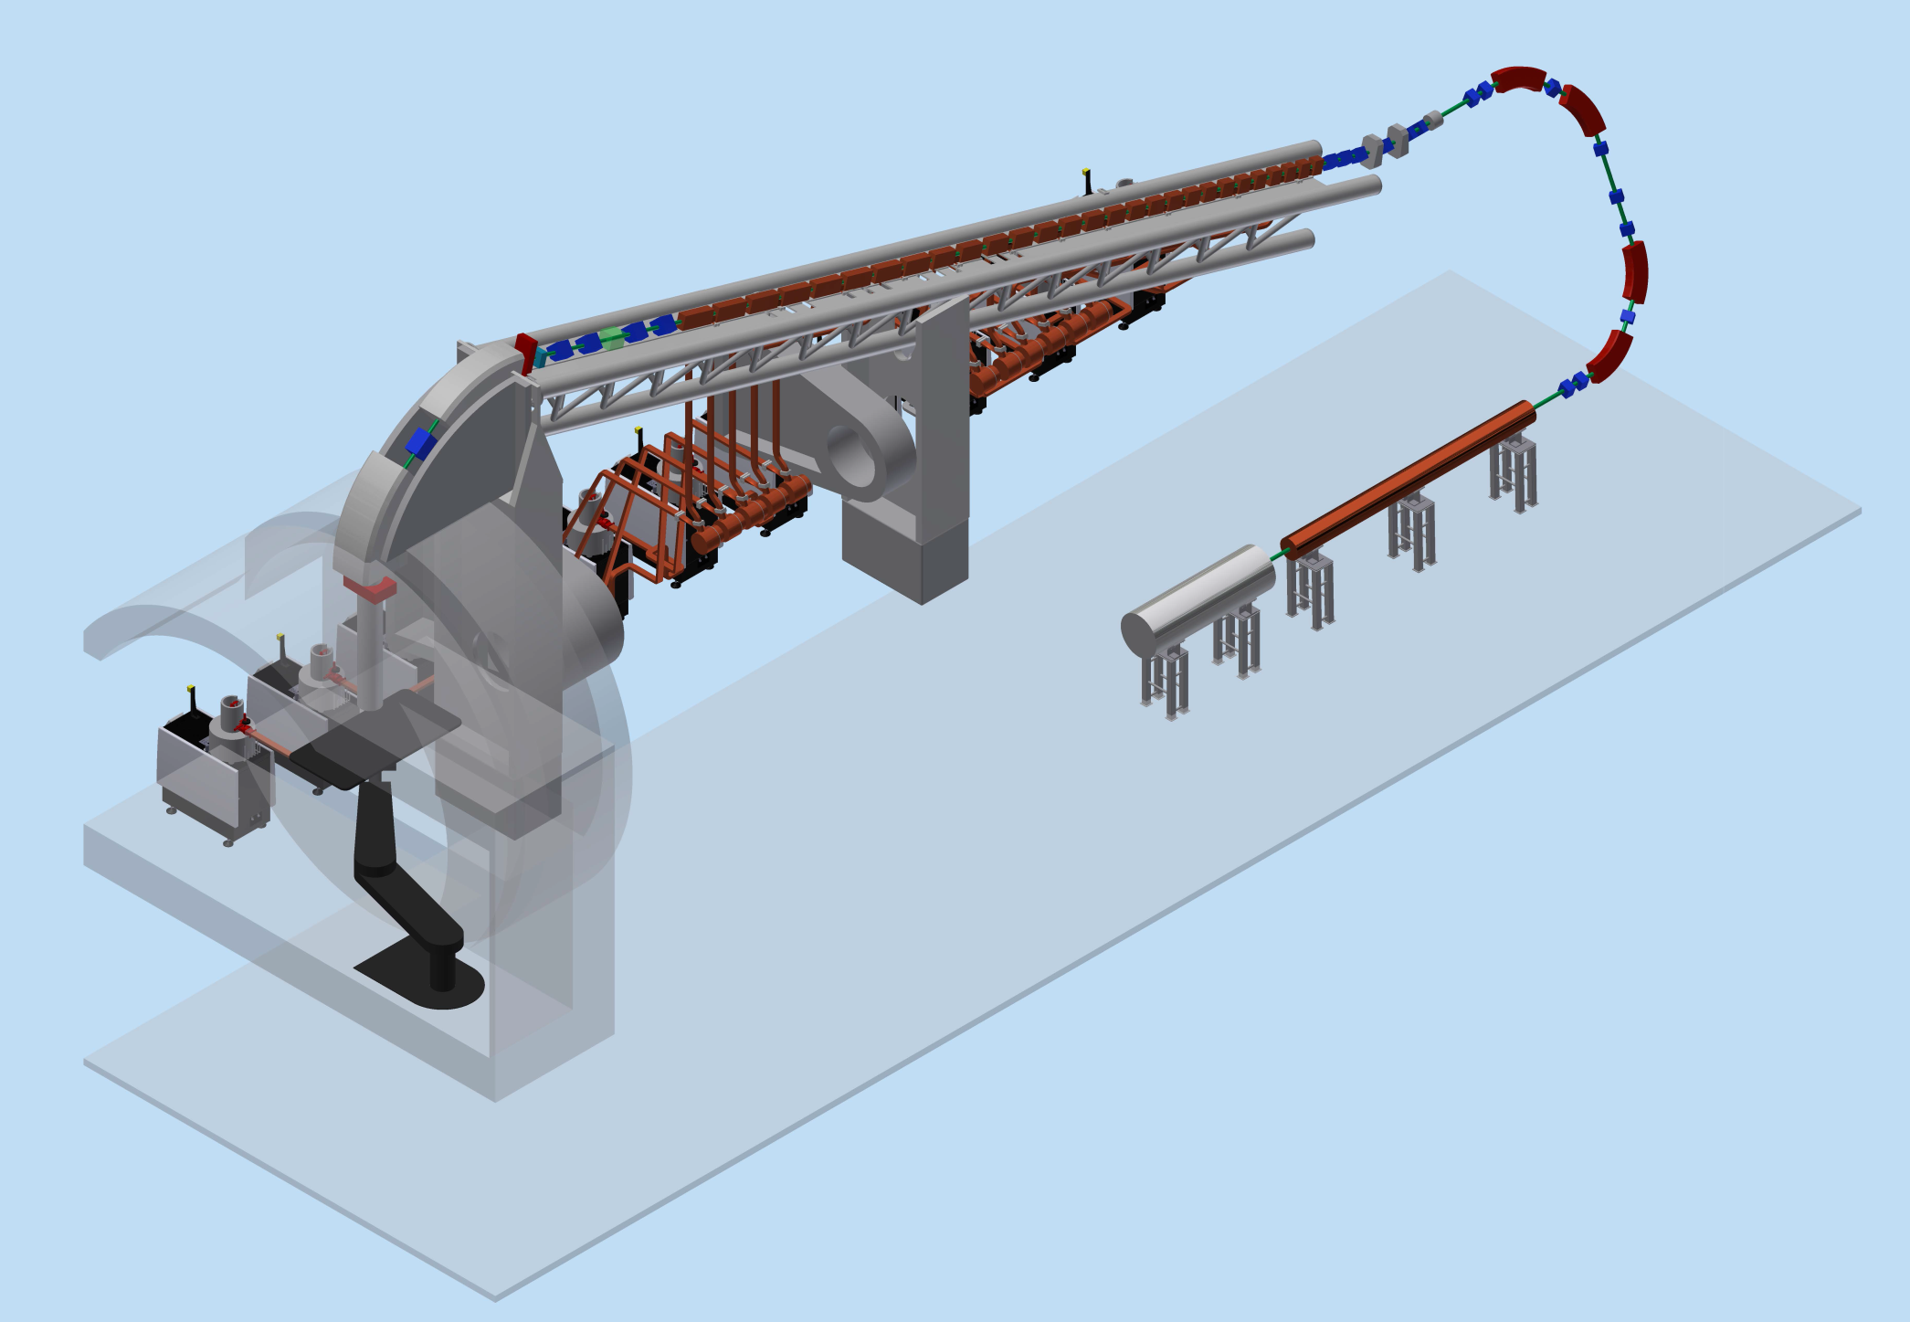
TULIP-2.0 at 3 GHz with E₀ ≅ 50 MV/m
new 3 GHz bwTW structure
11m 5-6 m
60 MeV
≤ 230 MeV
3 GHz SCDTL
ENEA
5 MeV

Slide 9
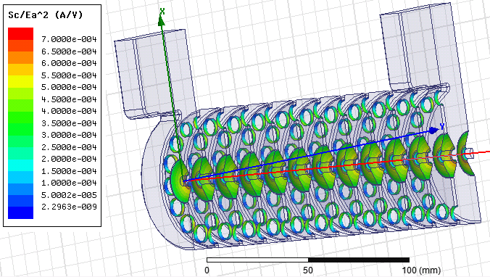
RF design of the full structure is done
The Sc/Ea^2 < 7e-4 A/V constraint is respected

Slide 10
FERMI@Elettra: present layout and energy upgrade
Present layout
1.5 GeV
FEL-1 & FEL-2
Beam input energy
≥ 750 MeV
New FEL beamline
≤ 1 nm
X-band linac extension
X-band linac extension
Effective accelerating length 40 m
Accelerating gradient 60 MV/m
Beam energy gain on crest 2.4 GeV
Injection energy .75 GeV
3.15 GeV
N.B. The new layout could also provide two electron beams
at the same time (@25 Hz) with different energies

Slide 11
HORIZON2020-Work Programme 2014 - 2015
Research & Innovation Action
INFRADEV-1-2014: Design studies
Project: “X-band technology for FELs (XbFEL)”
Participants:
Elettra – Sincrotrone Trieste
CERN
Ankara University
Australian Synchrotron - ALS
Uppsala University
SINAP Shangai
Cockcroft Institute
Solaris-Jagiellonian University- Krakow (new)
VDL
Other organizations that have manifested interest:
PSI - SwissFEL
MAXLab

Slide 12

