Slide 1
Follow-up of ACE on Structures
with emphasis on issues addressed in the ACE review and recent developments

Slide 2
Outline
Accelerating structures
Design, high-power limits
Production
High-power testing
PETS
Simulation and design
High-power testing
Organizational

Slide 3
Design, high-power limits
Nominal CLIC structure has not changed – still CLIC_G! Optimization procedure has been applied to 500 GeV CLIC (next talk).
Intensified effort to improve high-power constraints:
Empirical approach - Continuing effort to analyze data as it becomes available.
Theoretical approach - Collaboration forming for breakdown theory, modeling and dedicated experiments: Surface physics simulations (HIP Finland) for breakdown trigger and input for plasma simulations. Plasma simulations (IPP Greifswald, IAP Ukraine) for coupling to rf and damage mechanism. Diagnostics (IAP Ukraine, CERN). Electron tracking missing, some work started at SLAC.

Slide 4
Summary of high-gradient tests
Sc = Re{S} + Im{S}/6
A. Grudiev

Slide 5
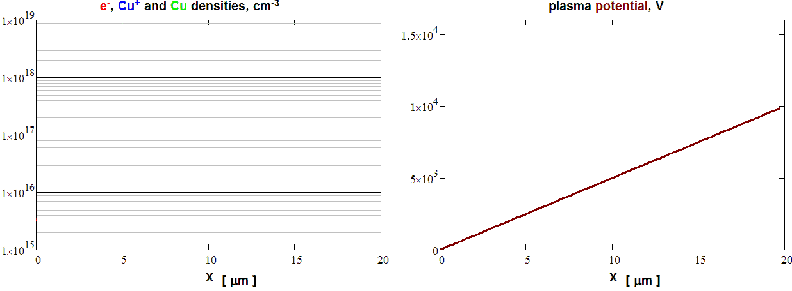
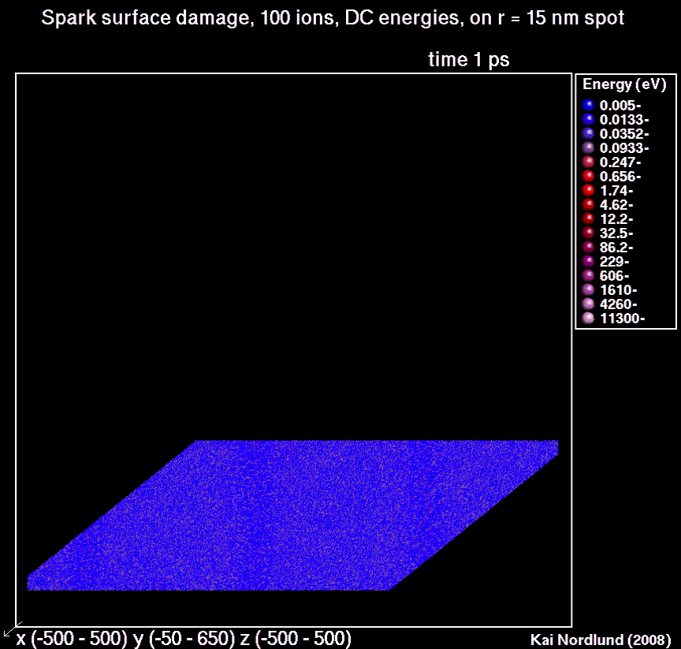
Towards integrated modeling of arcing
MPI Greifswald
K. Matyash
R. Schneider
HIP, Helsinki
H. Timko
F. Djurabekova
K. Nordlund
Integrated Particle-in-Cell and Molecular
Dynamics modeling of arcing
electric field concentrated in sheath
triggered by electron field emission
energetic particles create surface damage
explains experimentally observed cluster
emission
scaling studies on the way
Cern PhD student position applied for
Helga Timko

Slide 6
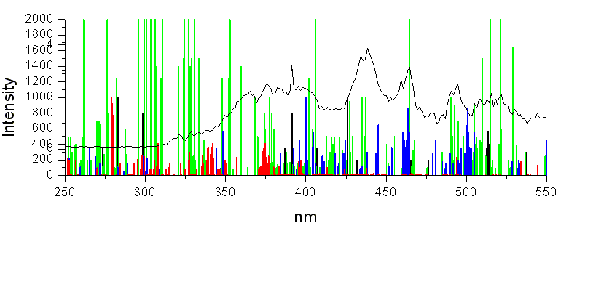
Plasma Diagnostics: Optical Emission
Spectroscopy
Experimental data from the measurements on CLIC DC spark setup
Analysis and interpretation of data ( IAP NASU)
Main results : There are high intensity optical line (copper, nitrogen, oxygen)
It is necessary to take into account plasma processes
Institute of Applied Physics National Academy of Sciences of Ukraine, Sumy

Slide 7
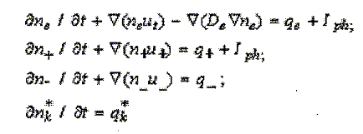
Theoretical research and simulation on electron and ion beam
formation in DC-spark and RF-breakdown
Particle balance equation
Poisson equation
A
Lorentz equation
Intensity of radiation
C
PLASMA
Institute of Applied Physics National Academy of Sciences of Ukraine, Sumy

Slide 8
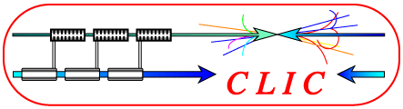

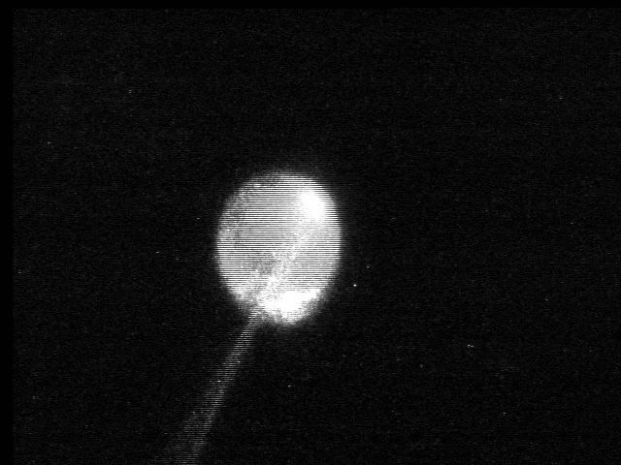
RF and DC test stand instrumentation for breakdown research
Jan W. Kovermann, CERN, RWTH Aachen
Measurements in RF and DC experiments are needed to develop and support breakdown models and simulations
Neutral Cu lines,
T(plasma) ~ 8000K – 16000K (prelim.)
A breakdown emits electromagnetic radiation from infrared to x-rays:
An analysis of that radiation can reveal information about the processes during a breakdown
A time-resolved acquisition can additionally help to discover the chronological sequence of these processes
The measured values like plasma temperature, composition, density and their time development will be used as input for a breakdown model and corresponding simulations
Complementary experiments like RF diagnostics of the plasma are under development
Breakdown in RF structure

Slide 9
Leading candidate alloys of today
S. Heikkinen
 | Estimated material limit without safety margin (CLIC target value ΔT = 56K) | Machinability | Exposure to Elevated Temperatures (brazing) | Breakdown resistance
Oxygen-Free Copper C10100 E-cond: 101 % IACS (all states) | Cold worked ΔT = 48 K Brazed 34 K ≤ ΔT ≤ 48 K | Good for all temper states and structure concepts | Generally mechanical properties decrease after brazing. Thermal fatigue strength not necessary with the same ratio. Tests under way (RF SLAC and Laser CERN) | Shown by a number of experiments
Copper Zirconium C15000 E-cond: 94 % IACS (cold worked) 80 % IACS (brazed) | Cold worked ΔT = 77 K Brazed 48 K < ΔT ≤ 77 K | Good for all temper states and structure concepts | Brazed state’s thermal fatigue strength better than of cold worked pure Cu. E-conductivity decreases after brazing to 80% of pure Cu. | DC-spark experiments suggest similar or slightly lower performance than for pure Cu. RF to be confirmed.
GlidCop® Al-15 E-cond: 93 % IACS (all states) | All temper states ΔT = 74K | Slightly worse than the above materials. Quadrants have been demonstrated. | No significant change of properties after brazing. (brazing requires some extra care compared to other alloys) | See CuZr

Slide 10
High-power testing program
KEK-SLAC-CERN collaboration on structure development is very solid now.
Master schedule – covers fabrication and testing, at CERN, KEK and SLAC. By structure type and by test area.
Recent test result highlights.

Slide 11
CLIC test structures
VG1 family
CLIC G family
C10 family
30 GHz
Structures:
5 Disk undamped
(1 CERN, 4 KEK)+ 1 reversed structure test
3 Disk damped
(1 CERN,2 KEK)
5 Quadrant damped
(2 CERN, 3 KEK)
End of foreseen program
Structures:
2 Disk undamped 11.4 GHz
2 With damped compact coupler 11.4 GHz
2 Disk damped 11.4 GHz
1 Disk undamped 12 GHz
1 Disk damped 12 GHz
Structures:
2 vg07 undamped (SLAC)
4 vg1.35 undamped
(2 SLAC; 2 KEK)
4 vg1.35 damped
(2 CERN; 2 KEK)
2 vg2.25 undamped (SLAC)
2 vg3.3 undamped (SLAC)
Structures:
1 Speed bump (underway)
1 reversed speed bump
1 TM02
1 T24 scaled version
End of foreseen program
Objectives:
Repeatability/statistic on 4 tests structures
Comparison of damped/undamped structures
Comparison of technology disk/quadrant
Objectives:
Reach CLIC nominal performances (100 MV/m @10-7 BDR) with a large efficiency structure (28%)
Comparison of damped/undamped structures
Test of the damped coupler
First 12 GHz structure to be test in TBTS
Objectives:
Study of the scaling for different iris aperture/thickness and group velocity for constant impedance structures
Direct Comparison of damped/undamped constant impedance structures
Objectives:
Study of frequency scaling
Breakdown physics study
Detailed analysis of RF pulses
R. Zennaro

Slide 12
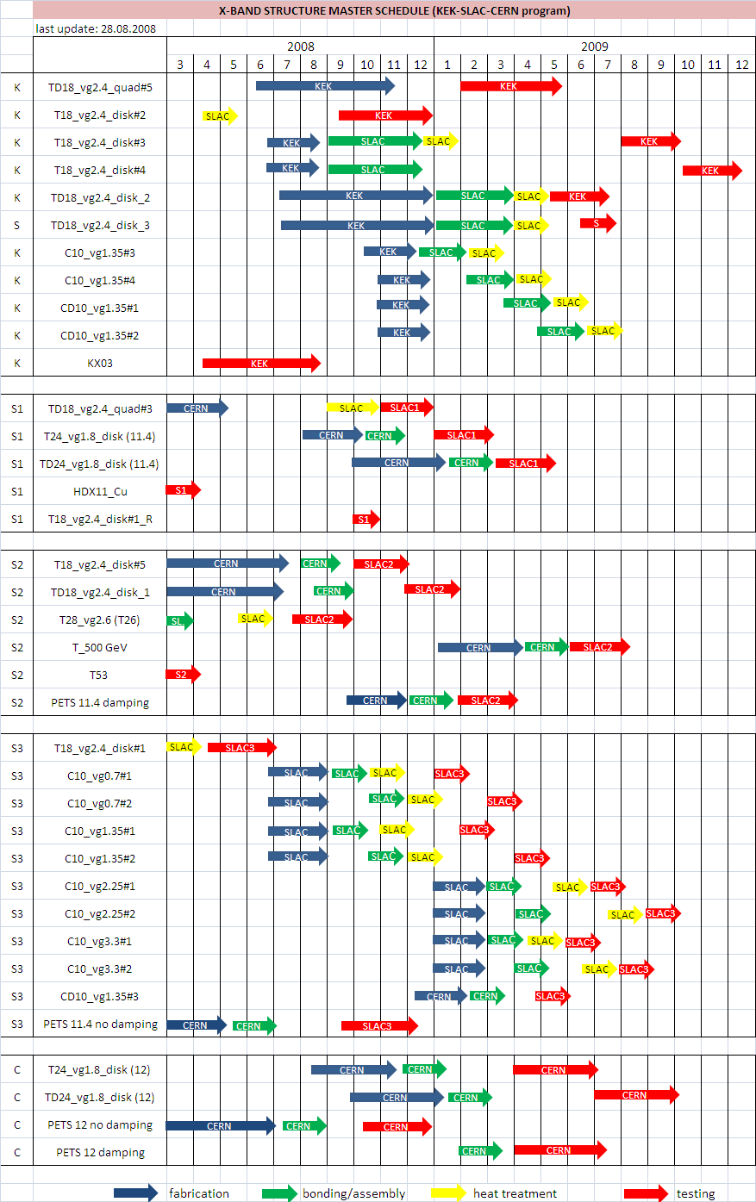
X-band structure master schedule (1/2)
G. Riddone

Slide 13
X-band structure master schedule (2/2)
G. Riddone

Slide 14
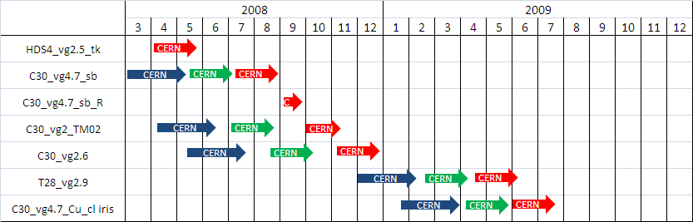
30 GHz structure master schedule
G. Riddone

Slide 15
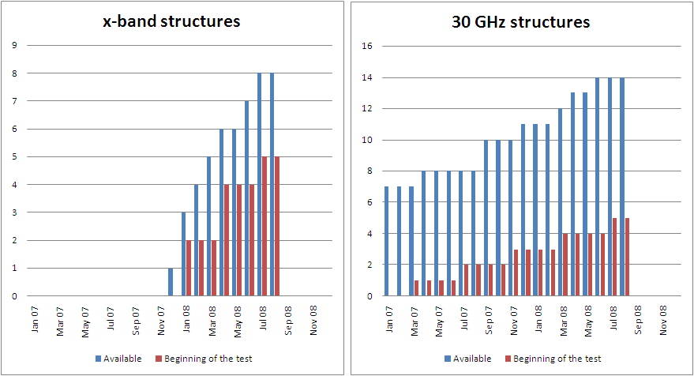
Dashboard
G. Riddone

Slide 16
Items
Report from KEK
Structure fabrication
  Quad
    Quad bars for a structure ordered
    Chamber design in progress
  Disk-damp design
    Mechanical design proposed, waiting for SLAC response
Nextef
  Combined power >100MW for 260ns
    One breakdowns / an hour or so at mostly near combiner
  at acc. Structure >75MW
    Sometimes breakdowns are observed.
    The system to identify the BD at structure is in progress.
  Start on Sep. 9
T. Higo

Slide 17
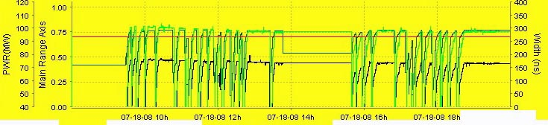
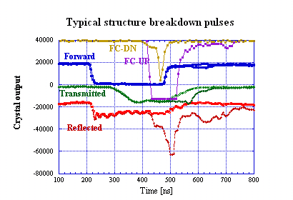
Nextef status
System processing
System stopped
Stable run period
Pulse width
Combined
To structure
Power level is ~75MW at structure input with 260ns.
Waveguides are under conditioning.
Structure breakdowns are identified as shown in the left figure.
Figure shows breakdown pulse and penultimate.
We start with stopping system trigger after large reflected pulse and/or Faraday cup current burst.
Pulse recording and analysis system is under preparation.
T. Higo

Slide 18
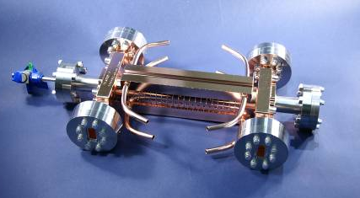
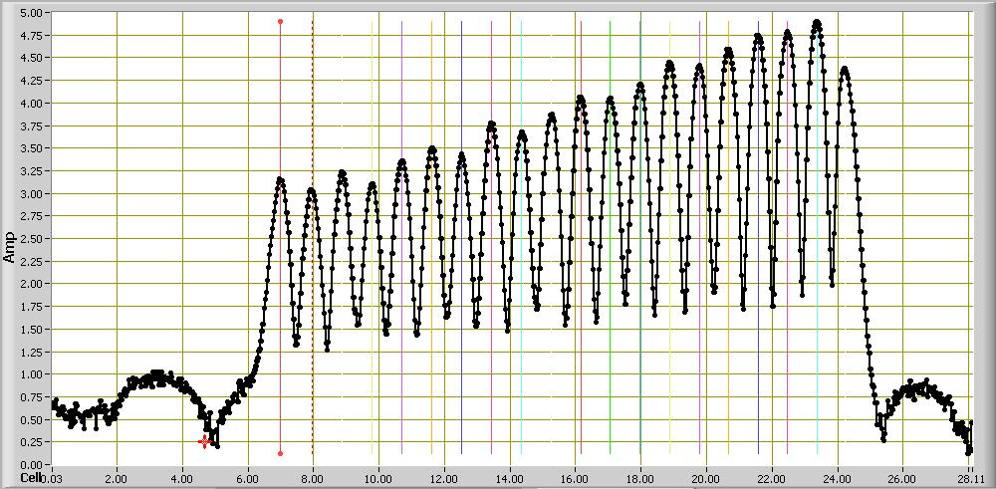
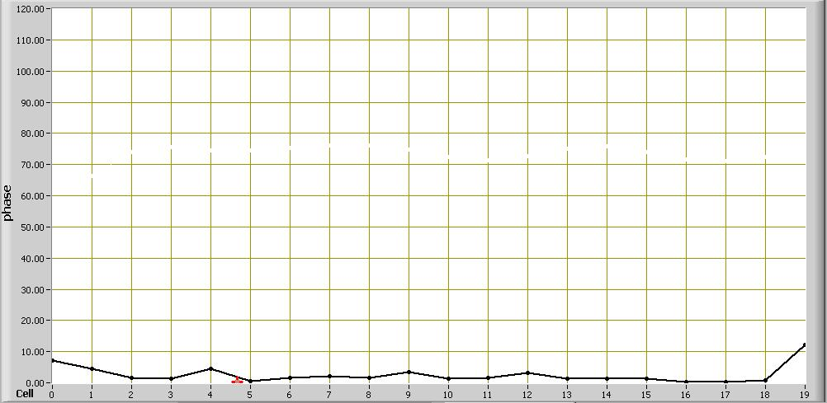
T18 Structure Profile
F. Wang
Freq.: GHz | 11.424
Cells | 18+input+output
Filling Time: ns | 36
Length: cm | 29
Iris Dia. a/λ(%) | 15.5~10.1
Group Velocity: v_{g}/c (%) | 2.61-1.02
S₁₁/ S₂₁ | 0.035/0.8
Phase Advace Per Cell | 2π/3
Power Needed <E_{a}>=100MV/m | 55.5MW
Unloaded E_{a}(out)/E_{a}(in) | 1.55
E_{s}/E_{a} | 2
Pulse Heating ΔT: K (75.4MW@200ns) | 16.9-23.8
High Power Test Time: hrs | 1400
Total Breakdwon Events | 2148
Field
Amplitude
The structure is designed by CERN, built at KEK, assembled and bonded in SLAC and tested at SLAC (NLCTA).
Cumulated
Phase Change
120°

Slide 19
BKD Rate Characteristics at Different Conditioning Time
RF BKD Rate Gradient Dependence for 230ns Pulse at Different Conditioning Time
RF BKD Rate Pulse Width Dependence at Different Conditioning Time
After 900hrs RF condition BKD rate has a gradient dependence ~
and pulse width dependence ~
F. Wang

Slide 20
BKD Distribution along Structure at Different Stage Based on the Time of RF Signal
F. Wang

Slide 21
Major themes of the T18 test
NLC/JLC fabrication excellent, although cell 7 shows how careful we have to be (assuming there isn’t something fundamental).
Using quantitative high-power limits during design successfully produced high gradient structure even if limits are not exactly known yet. Improved limits will of course make process more effective.
Showing effect of waveguide damping is top priority now.
The other T18s will be very useful. Is behavior in cell 7 fundamental? Reversed test.
The CERN,KEK, SLAC collaboration is working super well.

Slide 22
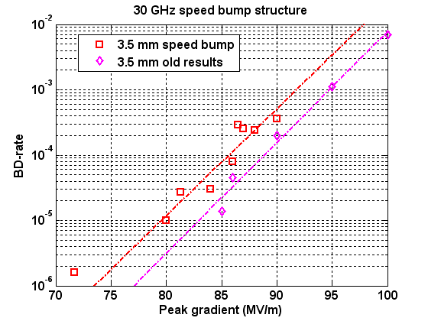
30 GHz Speed bump results 70 ns
S. Doebert
Structure reached very similar performance as the old 3.5 mm structure
(about 3 % difference lower in gradient for fixed breakdown rate)

Slide 23
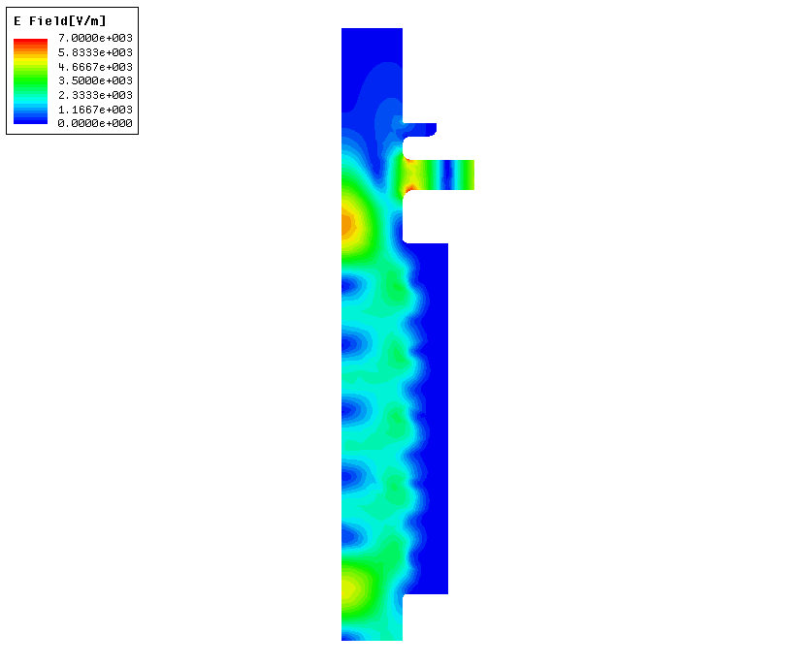
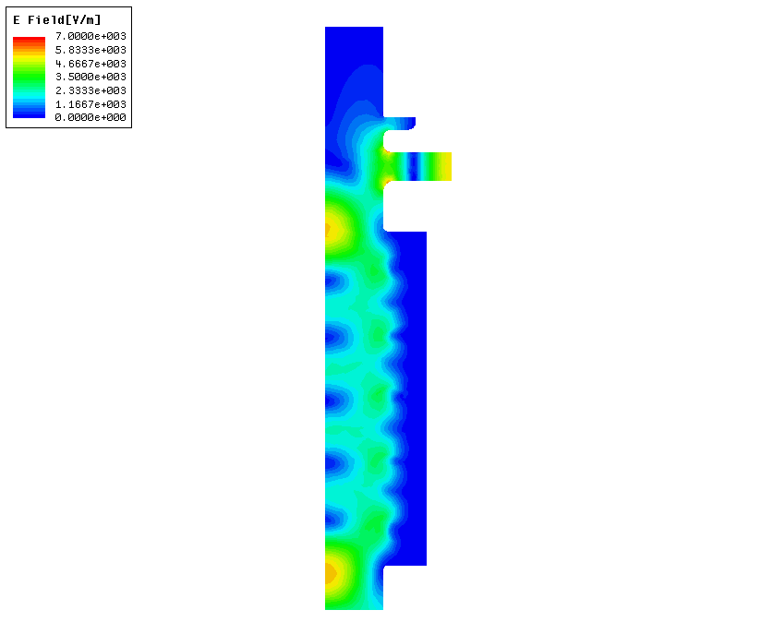
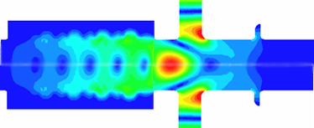
PETS testing strategies
PETS testing in “waveguide mode” (SLAC)
PETS power production from the drive beam (CERN)
RF high power source
RF power in
RF power out
RF power
Drive beam
Objective: to demonstrate the reliable production of the nominal CLIC RF power level throughout the deceleration of the drive beam.
Objective: to understand the limiting factors for the PETS ultimate performance.
Access to the very high power levels (300 MW) and nominal CLIC pulse length.
High repetition rate – 60 Hz.
I. Syratchev

Slide 24
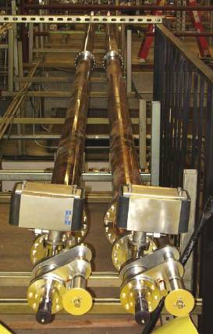
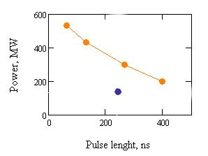
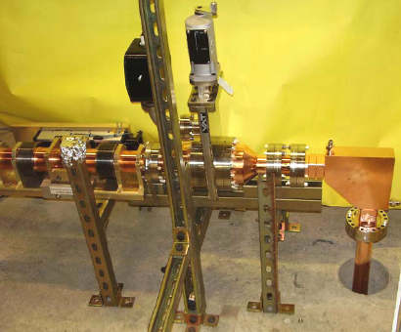
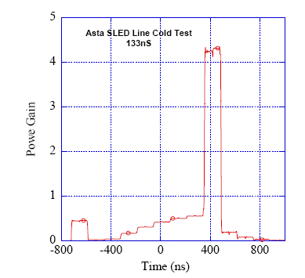
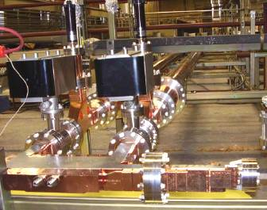
Accelerating Structure Test Area at SLAC
ASTA [1] is a new generation general purpose test stand, which will allow processing the various types of the high power RF equipment at X-band. The facility can provide a very versatile pulse length and power level.
The ASTA pulse compressor with variable delay in delay-lines
Experimental area
ASTA layout
Gate valve
Rf Phase
shifter
RF pulse @ power in the ASTA compressed arm
Uncompressed arm
3dB hybrid
SLED II with variable length and iris reflection
Two klystrons
50 MW@1.5us
CLIC PETS
The ASTA pulse compressor with variable iris
The uncompressed arm has a variable phase shifter and a gate valve
Typical RF pulse envelope in the ASTA compressed arm. The SLED II operates in dual mode regime
I. Syratchev

Slide 25
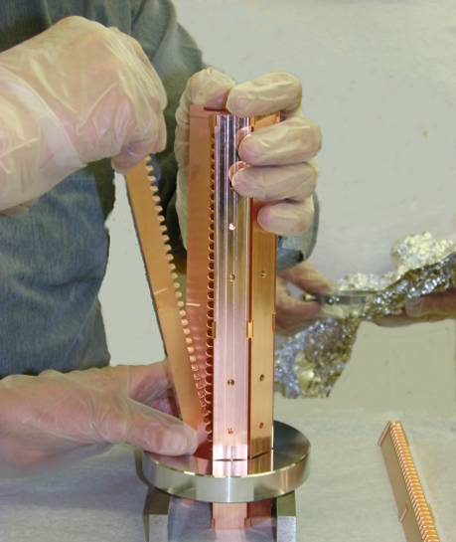
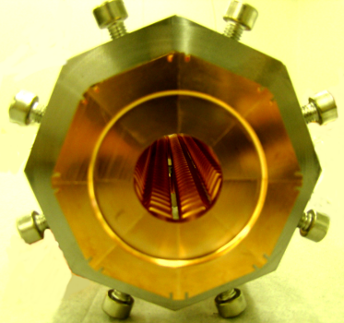
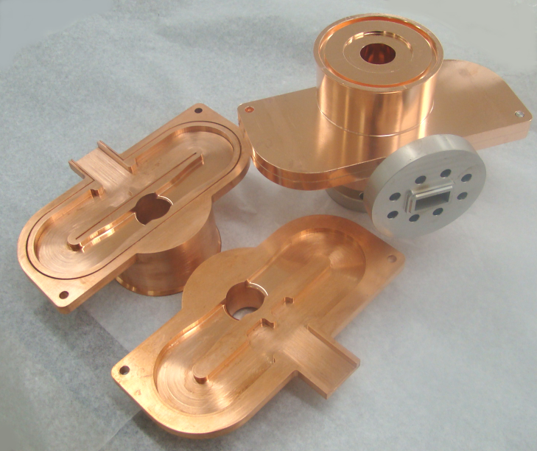
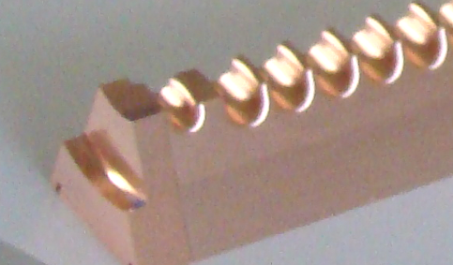
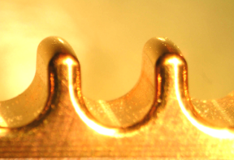
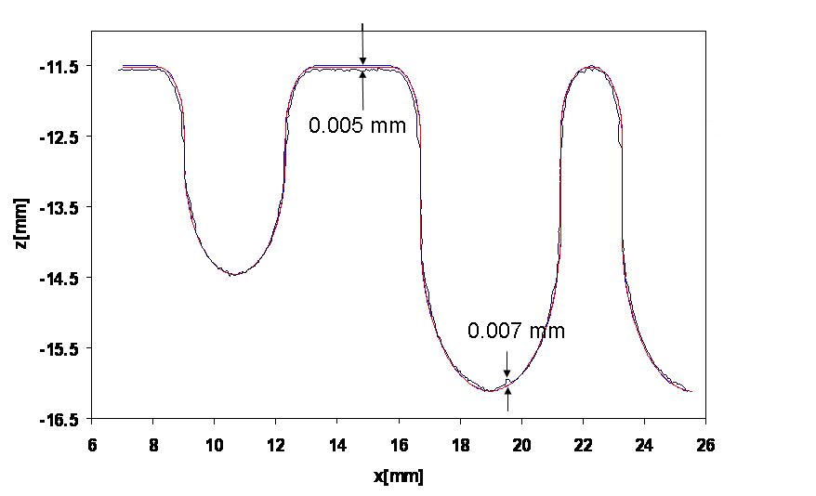
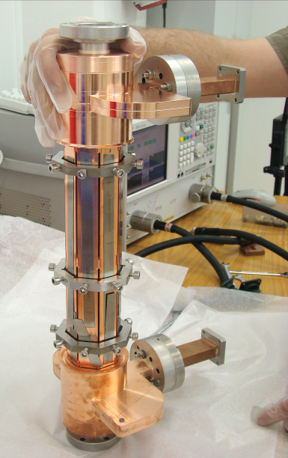
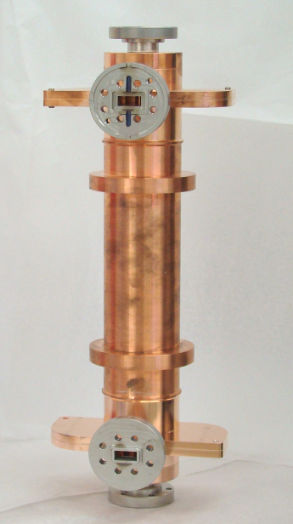
11.424 GHz PETS ( design scaled from the CLIC 12 GHz PETS). RF acceptance test.
Assembly of the eight PETS bars.
Special matching cell
PETS couplers
The bars fabricated using high speed milling
Tolerance by design: ± 0.015mm
PETS during RF check
PETS before the last EB welding
Reflection, dB
Transmission, dB
Frequency, GHz
The 11.424 GHz PETS RF measurements: diamonds - reflection, circles – transmission.
I. Syratchev

Slide 26
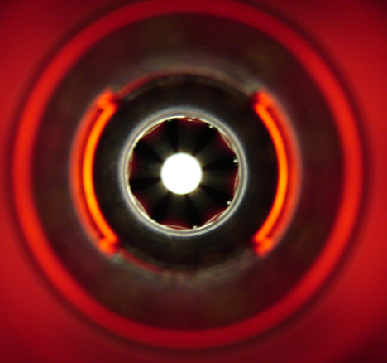
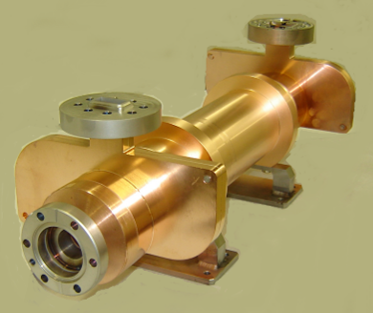
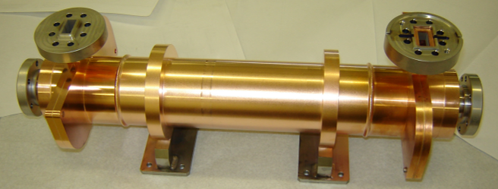
11.424 GHz PETS after final assembly.
11. 424 GHz PETS measurements after final assembly
I. Syratchev

Slide 27
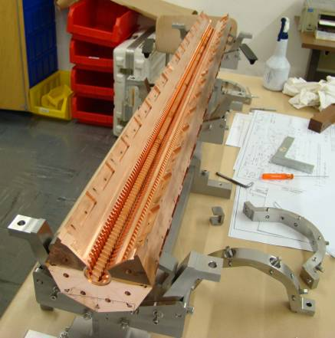
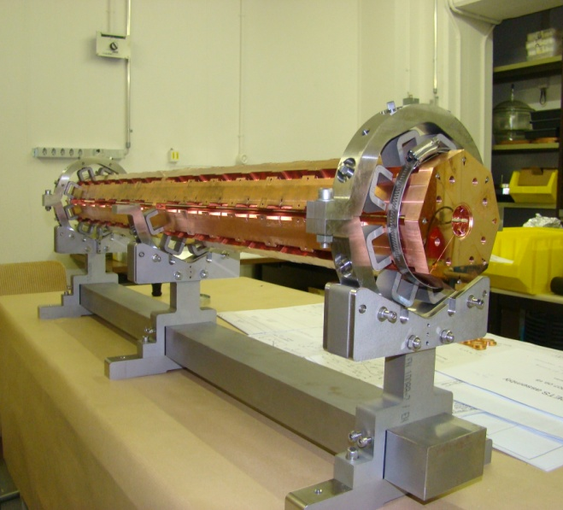
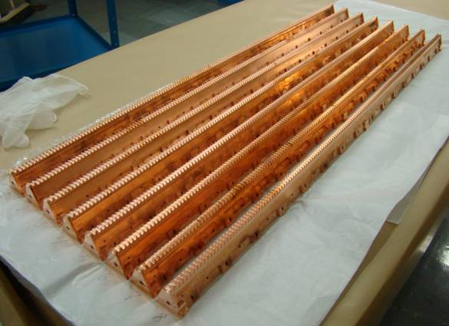
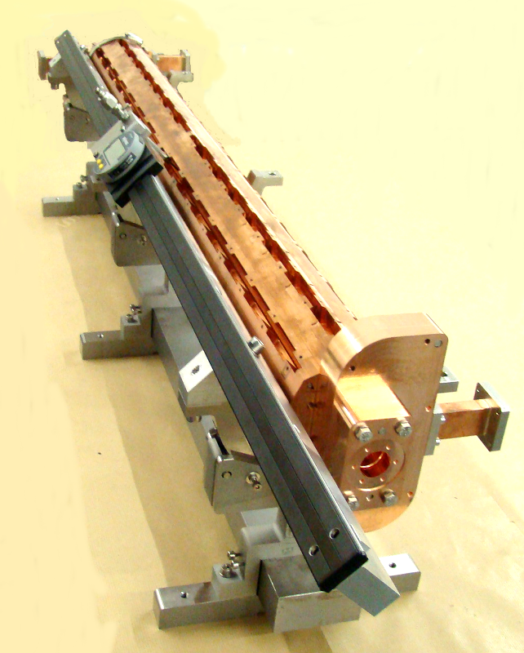
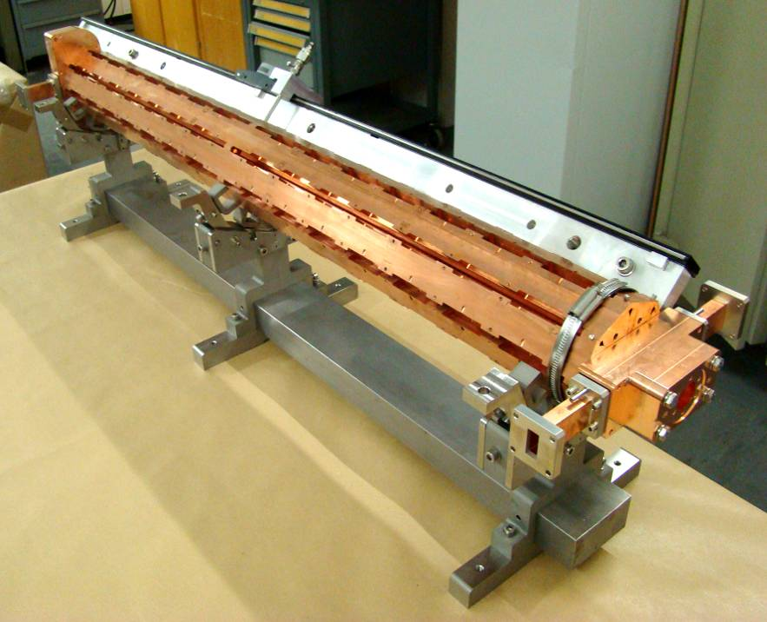
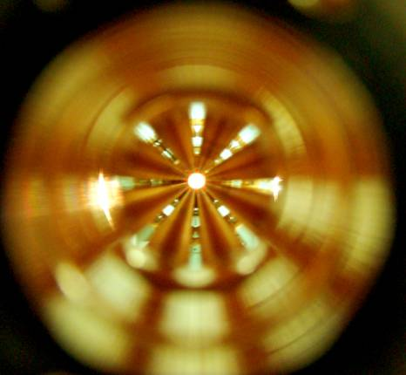
12 GHz PETS test assembly for RF measurements
PETS octants assembly
8 bars, as received from VDL
PETS equipped with the power couplers and electronic ruler with pick-up antenna for the phase advance measurements.
I. Syratchev

Slide 28
12 GHz PETS RF measurements results
TBTS PETS RF Measurement results
Ohmic efficiency budget:
Assuming theoretical losses in the PETS regular part, the power coupler ohmic efficiency is 0.986 (cf HFSS results – 0.99).
Group delay:
Measured:
Coupler-to-coupler, D_{C} = 2.0 ns
The whole PETS D_{P} = 9.36 ns
Active length: D_{p}-D_{C} = 7.36 ns
Calculated:
D=L _{active}/(βC) = 1.015/(0.459*C)= 7.35 ns
I. Syratchev

Slide 29
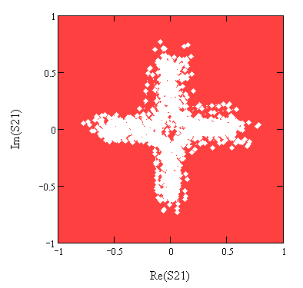
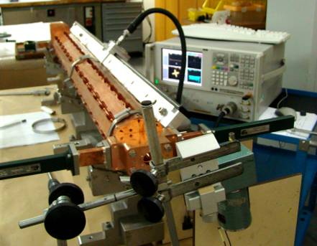
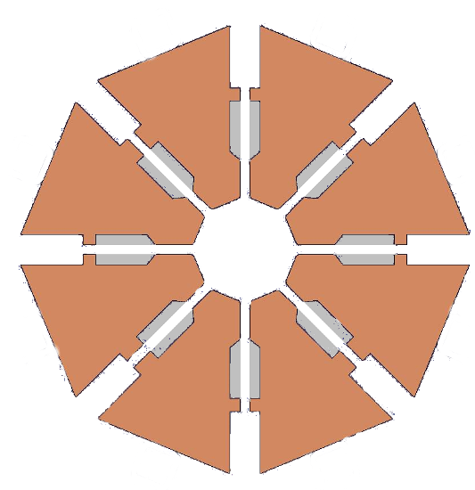
The S21 vector readings measured during the antenna movement.
Sliding antenna raw data
-10 MHz
-5 MHz
Sliding antenna measurements (F=11.992 GHz)
-30 MHz
01 August 2008
0 MHz
+5 MHz
+10 MHz
Antenna (loop) is positioned at the centre of one of the eight slot. The distance between the edge of antenna and the slot opening is ~ 1mm.
Coupling: -45 dB
I. Syratchev

Slide 30
Raw data (example)
The phase at the position of each of the measured local peak
Sliding antenna results
The interleaved (all cells) phase slope
The phase slope linear fit:
Phase, degrees
The phase advance per cell now can be calculated as:
φ _{cell} = 90 - Δφ;
- 30 MHz
local peak
Amplitude
Cell number
Readings number
Reconstructed ‘local’ dispersion curve
ΔF, MHz φ/cell
-30 89.53
Speed of light line
-10 89.91
Power, norm
-5 90.02
0 90.13
+5 90.24
+10 90.37
PETS detuning MHz
+30 90.78
The measured synchronous frequency of the TBTS PETS is 11.983 GHz at air and 25 ⁰C (9 MHz lower the nominal one)
For the measured TBTS PETS detuning (9 MHz), the power production efficiency of 99.6% is expected.
I. Syratchev

Slide 31
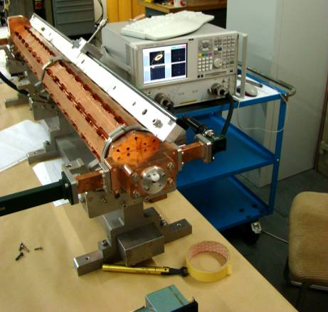

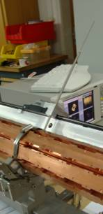
Bead pull measurements
- 30 MHz
- 20 MHz
- 12 MHz
- 10 MHz
Bead position in PETS
(bead diameter 3mm)
- 8 MHz
0 MHz
+ 10 MHz
+ 20 MHz
bead
Post pull measurements
The bead/post pull measurements confirmed the sliding antenna results.
The 90⁰ phase advance/cell is established at the frequency detuned by ~7-8 MHz from the designed one.
- 30 MHz
- 20 MHz
- 10 MHz
post
0 MHz
+ 10 MHz
+ 20 MHz
I. Syratchev

Slide 32
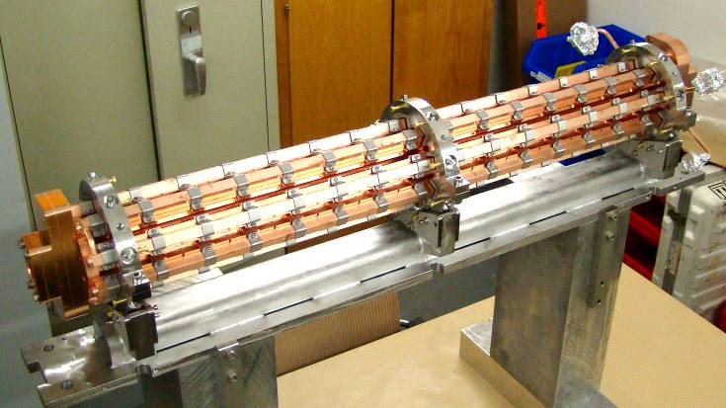
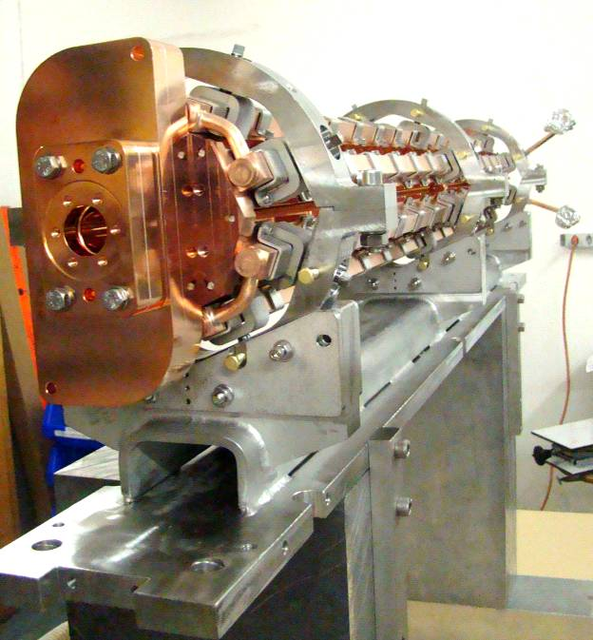
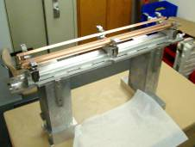
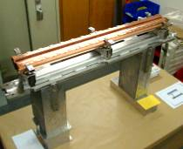
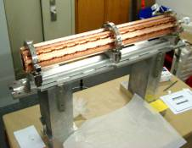

12 GHz TBTS PETS final assembly
I. Syratchev

Slide 33
12 GHz PETS RF measurements results
TBTS PETS RF Measurement results after final assembly
Ohmic efficiency budget:
Assuming theoretical losses in the PETS regular part, the power coupler ohmic efficiency is 0.992 (cf HFSS results – 0.99).
Group delay:
Measured:
Coupler-to-coupler, D_{C} = 2.0 ns
The whole PETS D_{P} = 10.05 ns
Active length: D_{p}-D_{C} = 7.47 ns
Calculated:
D=L _{active}/(βC) = 1.015/(0.459*C)= 7.35 ns
I. Syratchev

Slide 34


PETS tank under vacuum leak test
(29.08.2008)
I. Syratchev

Slide 35



12 GHz attenuator
Port 2
Port 3
Port 4
Port 1
Expected PETS power production with re-circulation (low current mode)
CLIC
nominal
6.0 A
5.0 A
4.0 A
3.5 A
240 ns
CLIC
nominal
I. Syratchev

Slide 36



PETS simulations at SLAC with computer code ATAU
The wake simulated with GDFIDL (red) and ATAU (blue)
I. Syratchev

Slide 37
CLIC Chart

Slide 38

Structure development organization

Slide 39

G. Riddone

Slide 40

G. Riddone

