Slide 1
7th FIM₄R meeting
23-24 April 2014
ESRIN
Frascati

Slide 2
Meeting agenda
Agenda page online with material:
https://indico.cern.ch/event/301888/
A written summary will be produced of this event

Slide 3
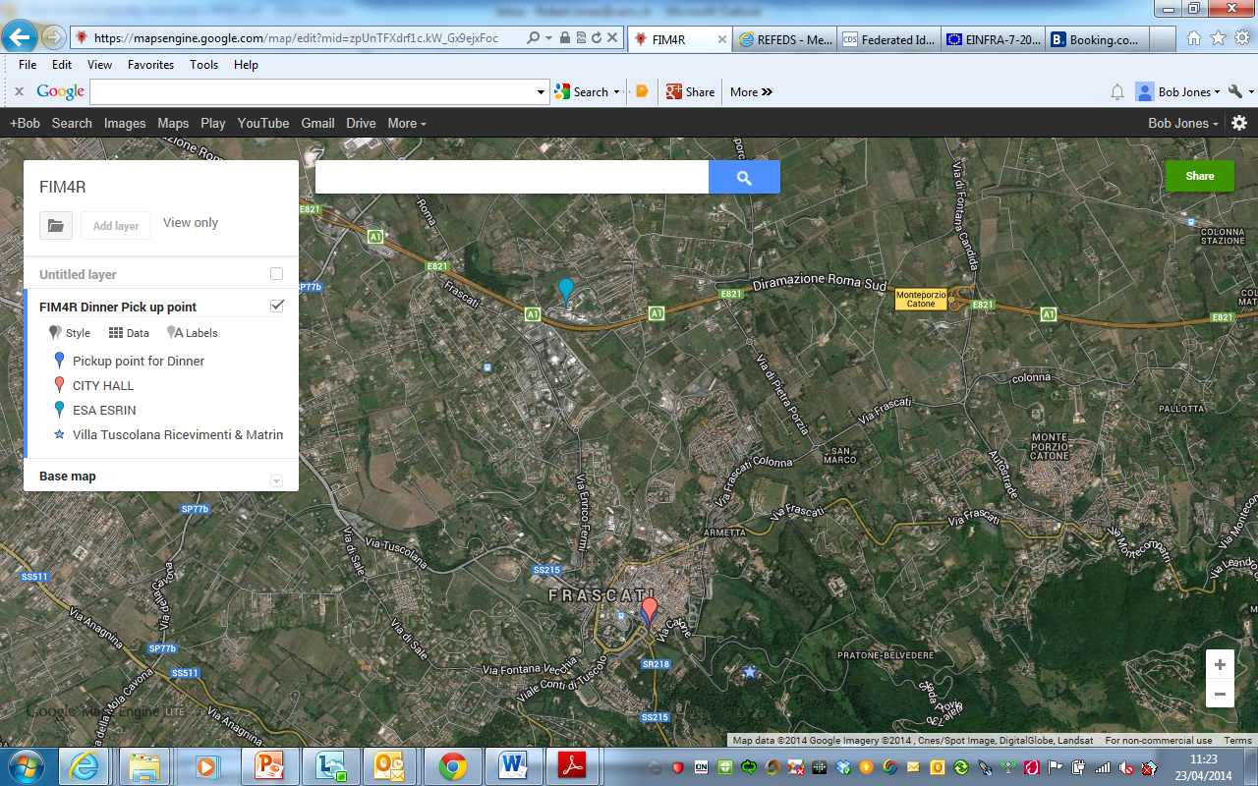
Dinner pick-up at 19:30

Slide 4
This afternoon
Objective: User Communities view of the progress made since the first publication of the Federated Identity Management for Research Collaborations paper and priorities for the future
Roundtable introductions
Summary of Terena AAI workshop (Licia Florio)
Operational Security (Romain Wartel)
Coffee
Working with service providers in the future
H2020 – how do we work together?
End of the session: 17:30
ESA shuttles to Frascati 17:30 & 18:15 (outside main gate)

Slide 5
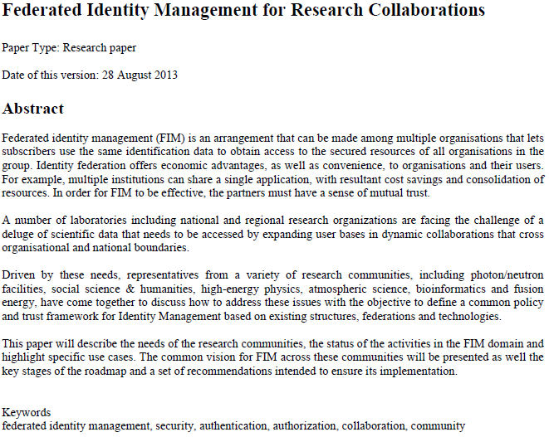

Requirements from the research communities
Status of the activities & use cases
Common vision across these communities
Key stages of a roadmap
Set of recommendations
https://cdsweb.cern.ch/record/1442597/files/CERN-OPEN-2012-006.pdf
Authors: Daan Broeder, Bob Jones, David Kelsey, Philip Kershaw, Stefan Lüders, Andrew Lyall, Tommi Nyrönen, Romain Wartel, Heinz J Weyer

Slide 6
The FIM₄R Vision
A common policy and trust framework for Identity Management based on existing structures and federations either presently in use by or available to the communities.
This framework must provide researchers with unique electronic identities authenticated in multiple administrative domains and across national boundaries that can be used together with community defined attributes to authorize access to digital resources.

Slide 7
Prioritisation of FIM₄R requirements
User friendliness (high)
  Support for citizen scientists and researchers without formal association to research labs or univ
Browser & non-browser federated access (high)
Bridging communities (medium)
  Bridging is a central issue with an efficient mapping of the respective attributes
Multiple technologies with translators including dynamic issue of credentials (medium)
Implementations based on open stds and sustainable with compatible licenses (high)
Different Levels of Assurance with provenance (high)
  Credentials need to include the provenance of the level under which it was issued
Authorisation under community and/or facility control (high)
Well defined semantically harmonised attributes (medium)
Flexible and scalable IdP attribute release policy (medium)
  Bi-lateral negotiations between all SPs and all IdPs is not a scalable solution
Attributes must be able to cross national borders (high)
  Data protection considerations must allow this to happen.
Attribute aggregation for authorisation (medium)
  Attributes need to be aggregated from different sources of authority including federated IdPs and community-based attribute authorities.
Privacy and data protection addressed with community-wide individual ids (medium)

Slide 8
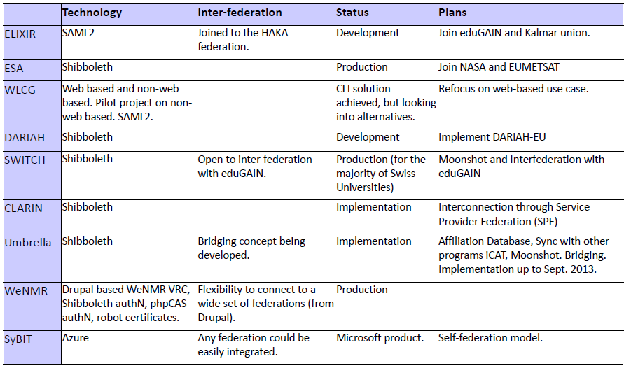
Technologies being piloted by resource communities
More details tomorrow

Slide 9
Research Infrastructures need a service
Risk Analysis - implications of having a malicious SP in a federation
Traceability - identifying the cause of any security incident
Security Incident Response – including all IdPs and SPs
Transparency - essential to gain the trust of the users and service providers
Reliability and Resilience - of the framework services
Smooth Transition - of the existing production systems to a federated identity management model
Easy integration with local SP environment - SPs are likely to want to support multiple means of authentication
Specific requirements - from some communities

