Slide 1
Future Magnets
Report from WP10
Philippe Fazilleau (CEA)
Lucio Rossi (CERN)

Slide 2
WP10 main scopes
Develop a 10 kA-class cable in HTS (High Temperature Superconductor) suitable for accelerator (collider) magnets,
        Large current to reduce magnet protection issues,
        Cable properties suitable for accelerator (AC losses, coupling/persistent currents, mechanical behavior…)
        Uniformity of properties over long lengths
Design, Manufacture and test a first accelerator quality, small prototype, dipole
        Bore diameter 40 mm
        Outside diameter, 99 mm to be inserted in Fresca2
        Length > 400 mm
        Field 5 T, good homogeneity (< 10⁻⁴)

Slide 3
WP10 structure
Task 10.1: Coordination & communication
    (L. Rossi – CERN / P. Fazilleau – CEA Saclay)
Task 10.2: Conductors
    (L. Bottura – CERN / C. Senatore– UniGeneva)
Task 10.3: Magnet prototype
    (M. Durante– CEA Saclay / G. Kirby– CERN)
Task 10.4: Tests (stand-alone configuration)
    (G. Volpini – INFN LASA / M. Bakjo– CERN)

Slide 4
WP10 collaboration
Several institutes:
CERN (L. Rossi, L. Bottura, A. Ballarino, G. Kirby, M. Bajko)
CEA Saclay (M. Durante, P. Fazilleau),
INPG (P. Tixador),
INFN LASA (G. Volpini, M. Sorbi),
KIT (W. Goldacker, A. Kario),
University of Geneva (C. Senatore),
University of Twente (M. Dhallé),
University of SouthHampton (Y. Yang),
Tampere University of Technology (Antti Stenvall)
Danish Technological Institute (N. Zangenberg)
Industrial:
Bruker EST (A. Usoskin)

Slide 5
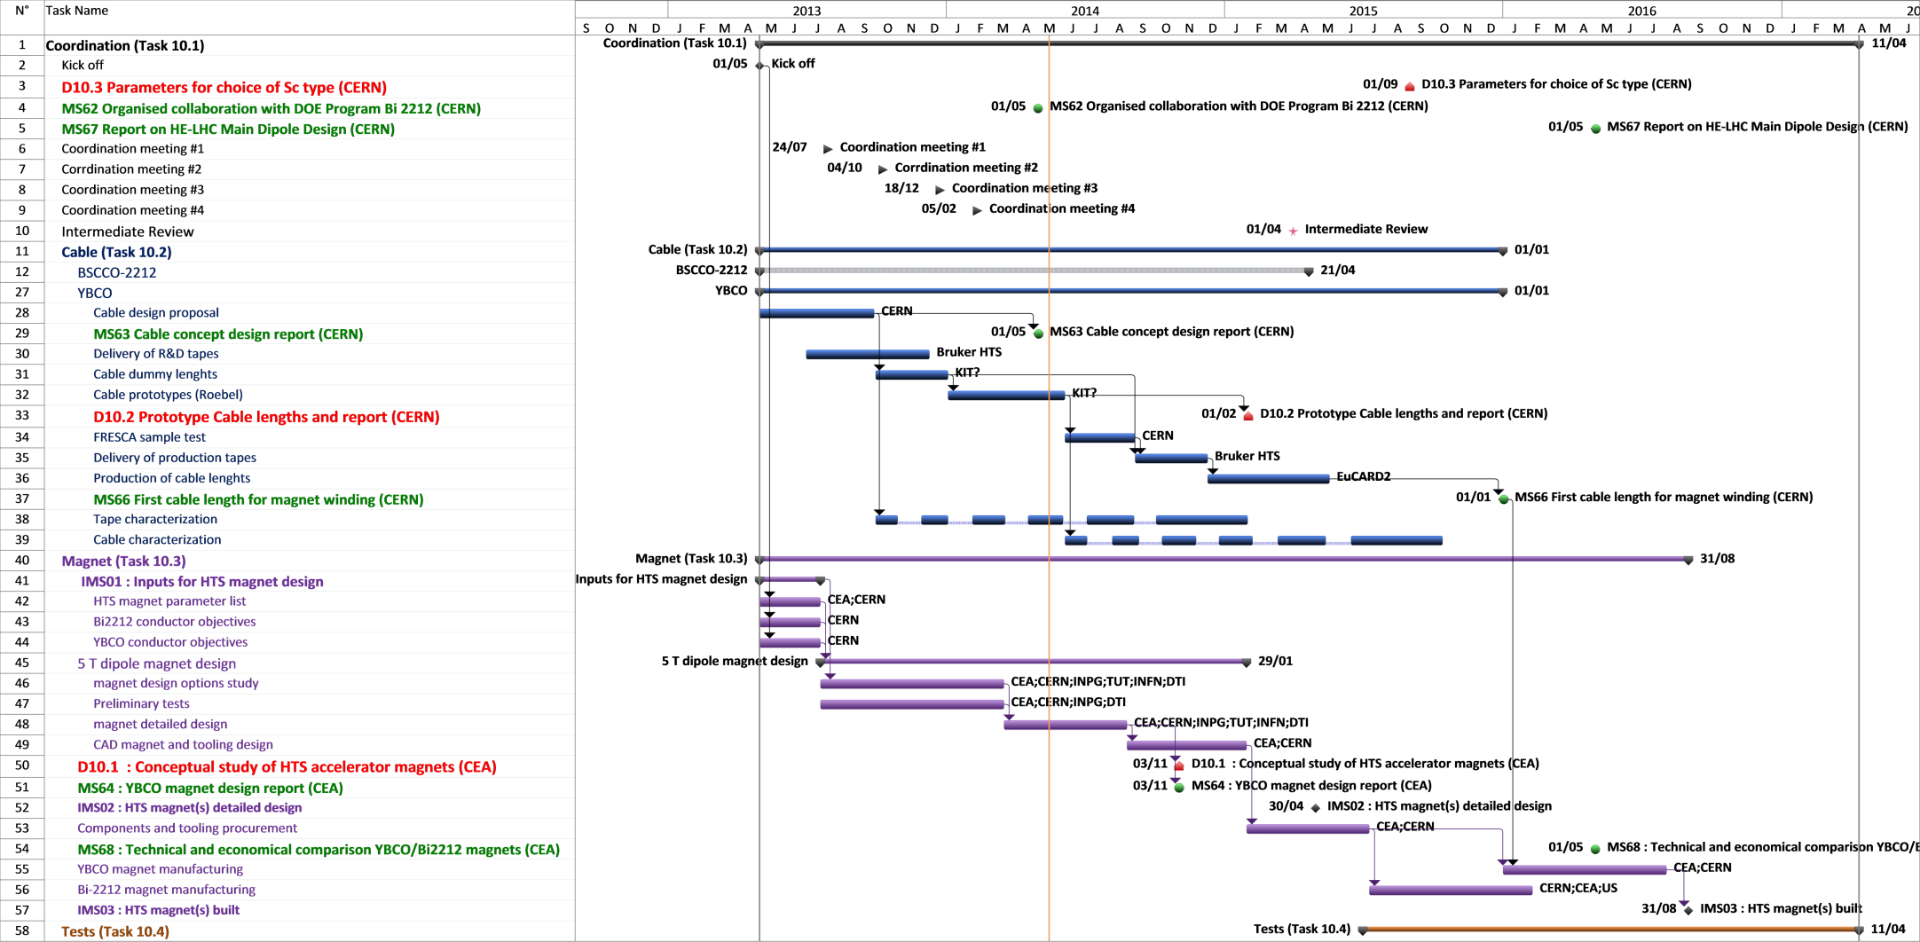
Planning
MS62
“Organized collaboration
with DOE Program Bi2212”
Led by task 1
Slight delay as we changed it to a tripartite agreement (EuCARD, Japan, US)
MS63
« Cable concept design report »
Led by task 2
Report on time, may 2014

Slide 6
Task 1 progress
Coordination & communication
Meetings:
  Regular coordination video-meetings with task leaders/deputies (5 for the first year),
Visit to industry (BEST)
Video-meetings with the USA labs (NHMFL, LBNL, FNA, BNL and OST)
Visit to Japan (Riken, Univ. of Kyoto and KEK)
Visit to CERN of Fujikura (japanese cable provider)
WP10 website https://espace.cern.ch/EuCARD2-Future-Magnets/SitePages/Home.aspx
Preparation of MS / Annual report
Tripartite agreement – Memorandum on Cooperation - (MS62) is being signed:
  EuCARD collaboration + Japan (KEK, Riken, Kyoto univ.) +US (NHMFL, LBNL, FNAL)
  Intensifies exchange of scientific information and technological innovation,
  Provide a ground for interchange of scientific and technical personnel
  Organize a series of Workshop on Accelerator Magnets with HTS Technology (WAM-HTS)
  Three Workshop for Accelerator Magnets in HTS planned in the framework of this agreement :
  High-current HTS cables (DESY, Hamburg, Germany, 21-23 may 2014
  Dipole magnet technology (University of Kyoto, Japan, november 2014)
  US workshop (2015, to be planned)

Slide 7
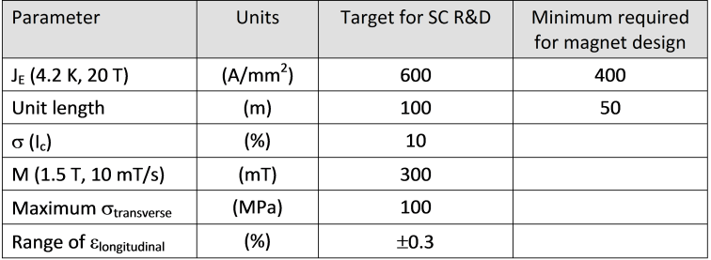
Task 2 progress
Conductors
Review of HTS material performance and issues:
  state-of-the-art,
  definition of appropriate performance targets for the R&D work
# 675 A/mm² @ 15 T
# 750 A/mm² @ 12 T

Slide 8
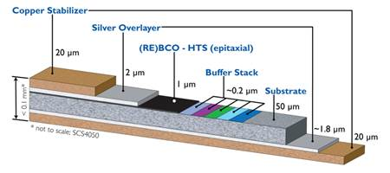
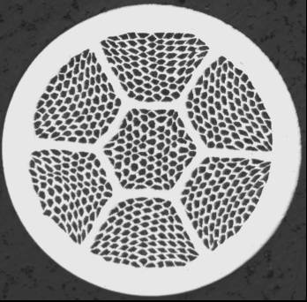
Task 2 progress
Conductors
2. HTS material R&D directions
YBCO
Main focus of the EU program
Produced by Bruker EST (beneficiary of EuCARD²)
Available from others suppliers (Superpower, AMSC, Fujikura, Sunam, SuperOx)
Anisotropic : Jc (B⊥) # 0,1-0,3 Jc (B//)
Tape: 4, 12 mm (10 mm) width => dedicated cable needed
Very robust: hastelloy layer
React and wind technique
Bi-2212
Backup option for WP10
BSC Collaboration supported by DOE (US)
Isotropic properties
Round wire -> Rutherford cable
Very sensitive to mechanical strain
Wind and React technique
Reaction # homogeneous 900 ° C under 100 bar with 1 bar of O₂

Slide 9
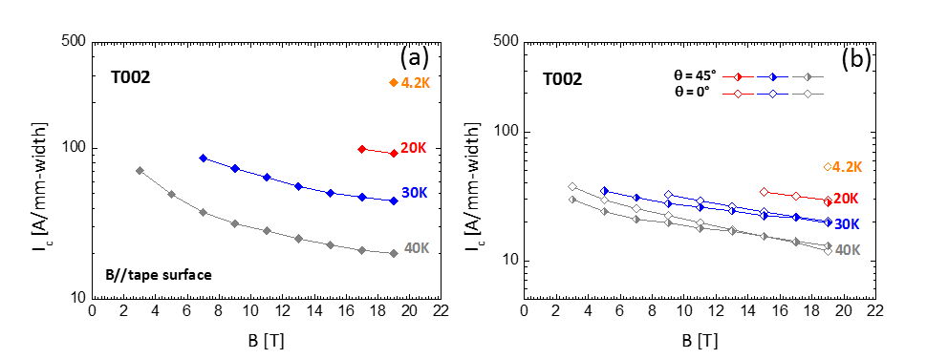
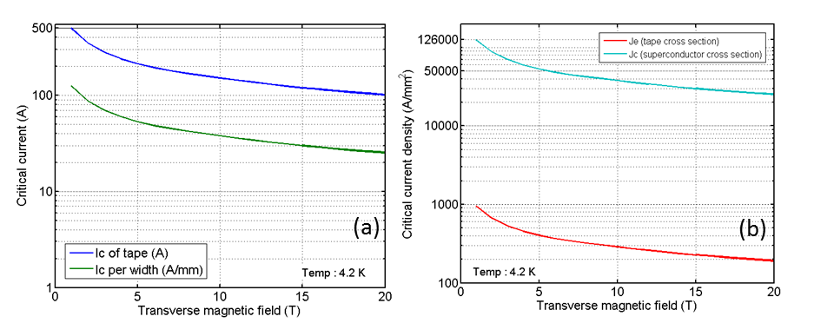
Task 2 progress
Conductors
3. Characterization of the critical surface
Courtesy of C. Senatore
Univ. of Geneva
JE = 1,73 kA/mm²
@ 19 T; 4,2 K
dependence of critical current (UniGeneva / INPG)
Temperature range is between 4.2K and 77 K
3 field orientations ⊥(0°), //(90°), skew (45°)
2 tapes provided by BEST T002C (150 µm / 3.8 µm) and T003 (130 µm / 1 µm)
JE = 366 A/mm²
@ 19 T; 4,2 K
T002-C
3,8 µm
REBCO thickness
T003
1 µm
REBCO thickness
Courtesy of P. Tixador
INPG
T002-C vs T003 has:
Higher critical current (and JE)
55 A/mm.width vs 27 A/mm.width @ 4.2 K 19 T,
Lower layer Jc
15 kA/mm² vs 25 kA/mm² @ 4.2K 19 T
JE = 207 A/mm² @ 19 T; 4,2 K

Slide 10
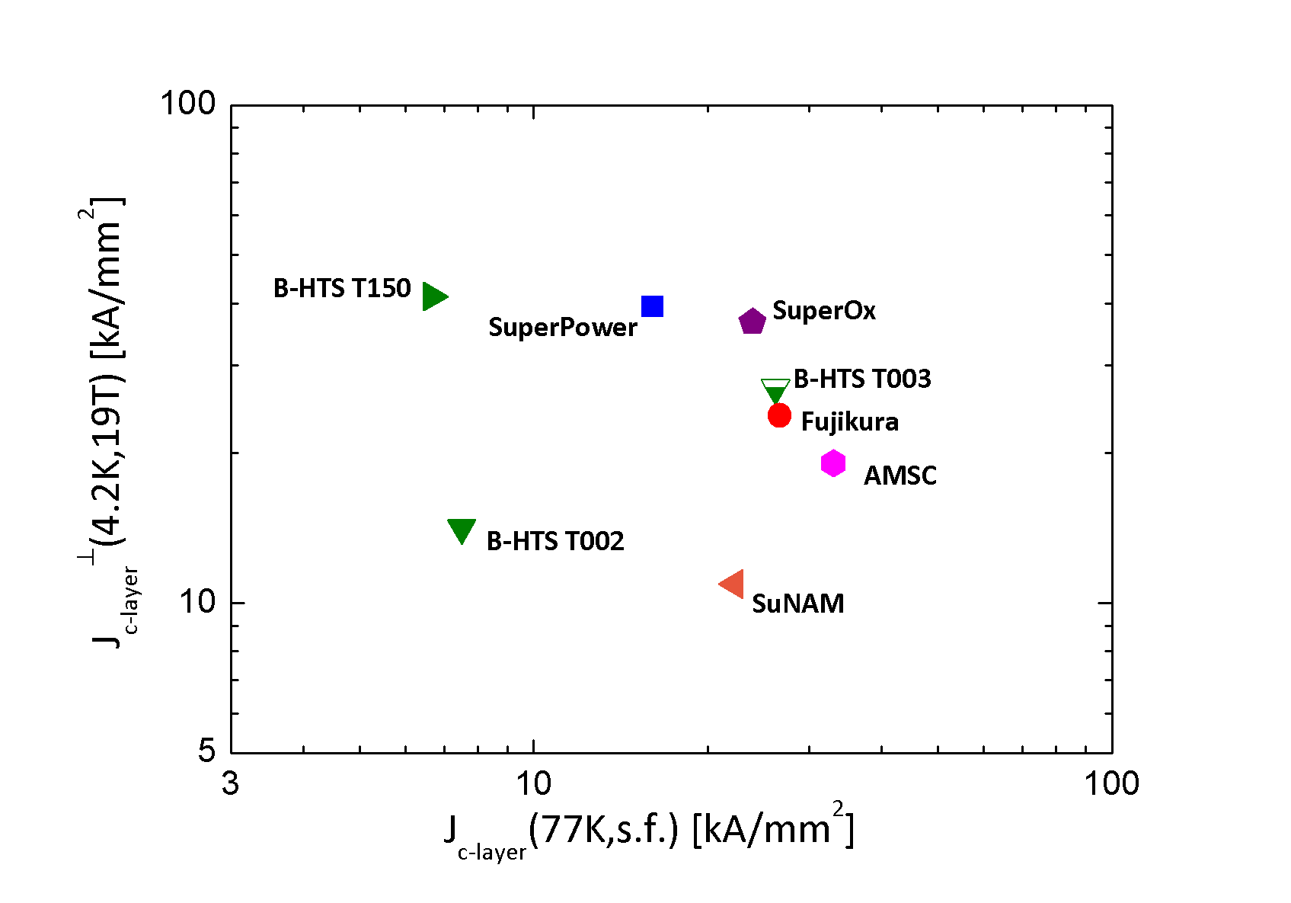
Task 2 progress
Conductors
3. Characterization of the critical surface
Courtesy of C. Senatore
Univ. of Geneva
Comparison of the layer critical current density for the first two samples (T002 T003) of REBCO tapes provided by Bruker-HTS (UniGeneva)
Jc (77 K, sf) vs Jc(4,2K, 19T)
Very good electrical performances
efforts to improve the tape performance by the introduction of artificial pinning centres

Slide 11
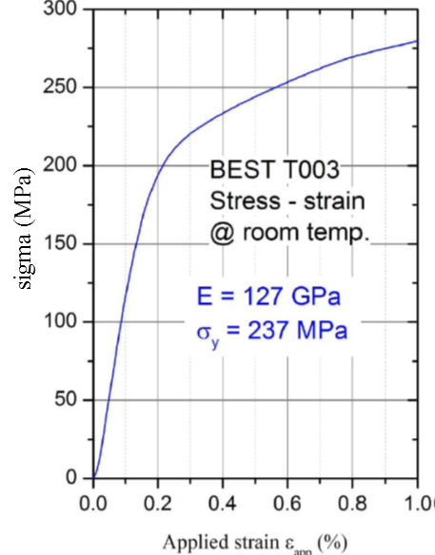
Task 2 progress
Conductors
4. Tolerance to longitudinal strain and transverse
Ic vs axial strain
(4,2 K/14 T - 77K/sf)
Stress vs axial strain
(Room temp)
Anomalous temperature dependence
Irreversible degradation of Ic when strain exceeds 0,2% at 4,2 K
Occurs above 0,4% at 77 K
Under investigation
Courtesy of M. Dhallé
Univ. Of Twente

Slide 12





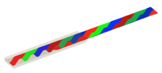
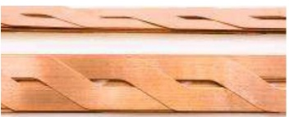
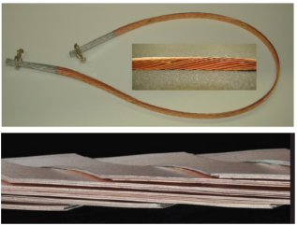
Task 2 progress
Conductors
5. Review of YBCO cable configurations
Roebel cable
  Taken as baseline (high JE, high compaction, fully transposed)
  Old type of cabling (electrical machinery) revisited,
  Based on punched tapes,
  Produced by KIT partner of task 2 and New Research Industry –NZ

Slide 13
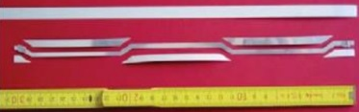
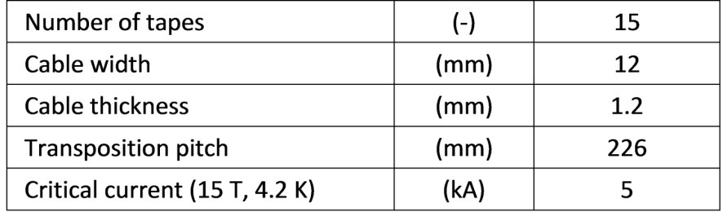

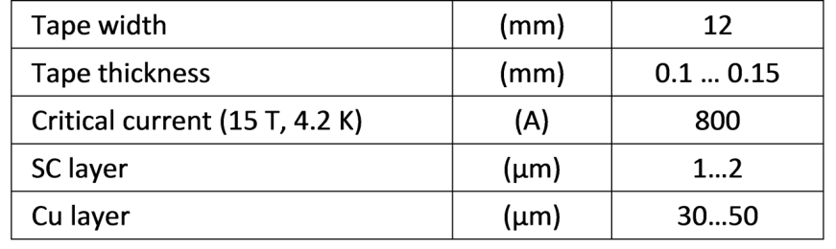
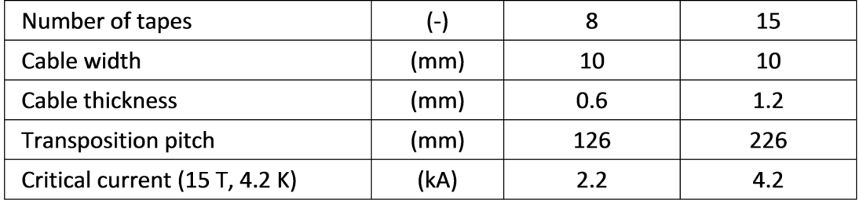
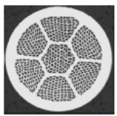
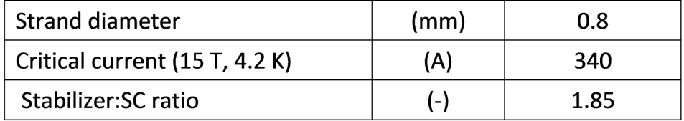
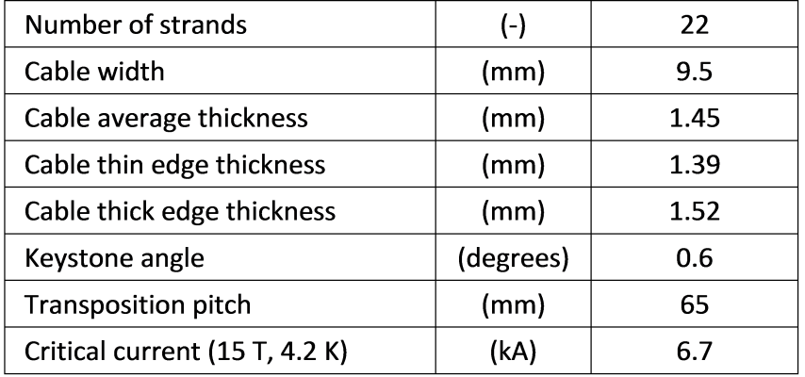
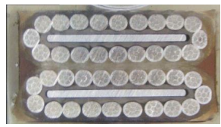
Task 2 progress
Conductors
6. Definition of baseline cables to be used for magnet design
YBCO from tape . . . . to . . . . Roebel cable
Cos θ design
Bi2212 from strand . . . to . . . Rutherford cable

Slide 14
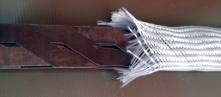
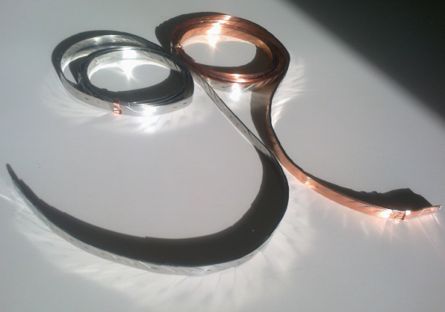
Task 2 progress
Conductors
7. Dummy Roebel cables production
Winding, impregnation, insulation tests:
CERN: 2*2,4 m stainless steel dummy cable 300 mm twist pitch, 15 tapes,
CERN: 2*2,4 m copper plated stainless steel dummy cable 300 mm twist pitch, 15 tapes,
KIT: 3 m long, 12 mm wide, 226 mm twist pitch, 15 tapes, 1 cu + 1 SS

Slide 15
Task 3 progress magnet prototype
Specification of target performances for the HTS dipole magnet
Driven by task 3, conjointly with task 2 (conductor) and task 4 (tests)
The result of the work is a parameter list taken as a frame for all the studies

Slide 16
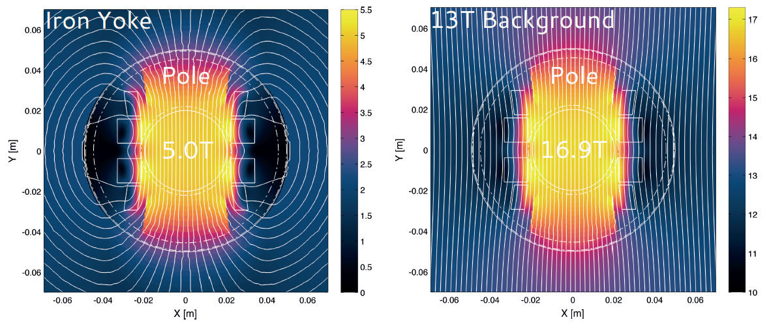
Task 3 progress magnet prototype
2. Magnetic design studies
« Aligned Block » design for YBCO Roebel conductor (CERN)
New type of coil layout
Optimisation of the angular dependence of the critical surface of the REBCO conductor (anisotropic)
Tapes oriented in the direction of the field lines, such that the critical current of the cable can be maximized
Courtesy of J. Van Nugteren
CERN

Slide 17
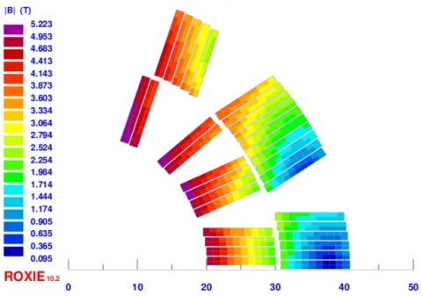
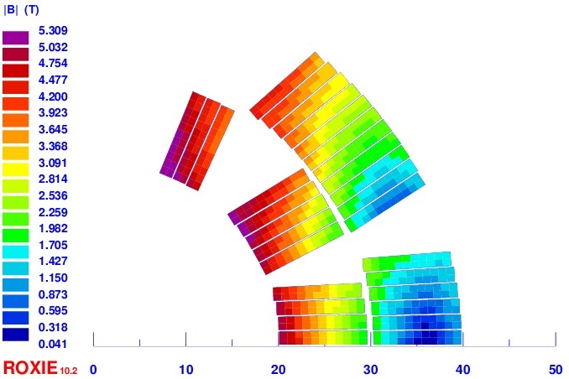
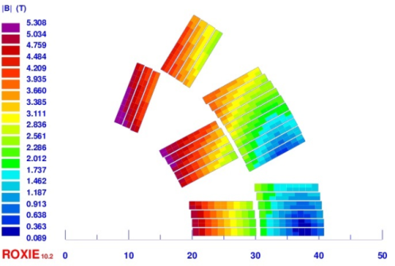
Task 3 progress magnet prototype
2. Magnetic design studies
« cos θ » design for YBCO Roebel or Bi2212 keystoned Rutherford (CEA)
Room for mechanical support needs smaller cables: 10 mm YBCO & 9,5 mm Bi2212
JE consistent with the target performances # 450 A/mm²
Je = 450 A/mm²
Roxie code
2D model
7 blocks
Je = 437 A/mm²
5 blocks
Je = 460 A/mm²
6 blocks
Courtesy of C. Lorin
CEA Saclay
Bi2212 design with yoke
YBCO design with yoke

Slide 18
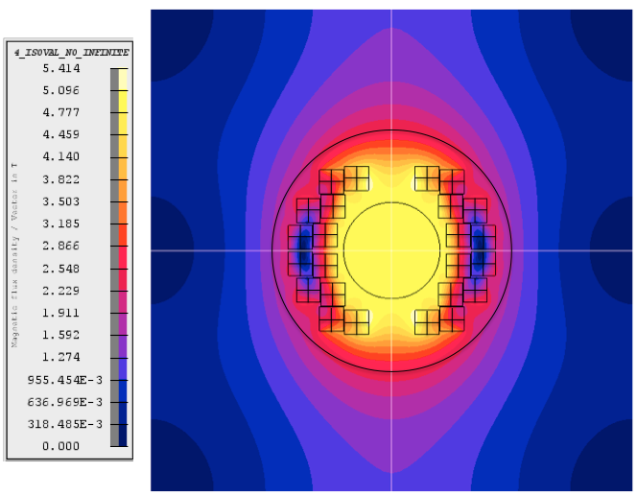
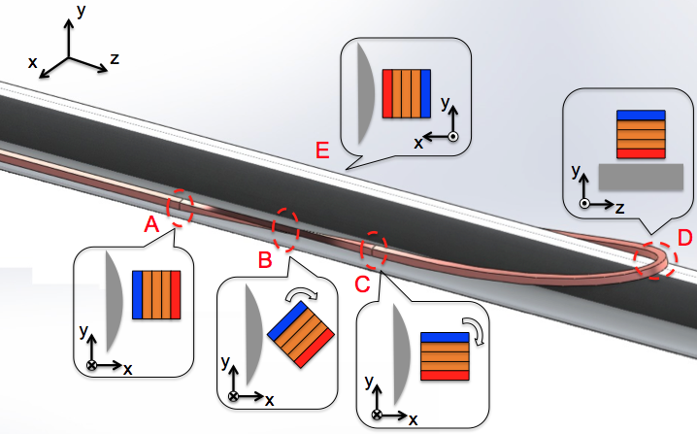
Task 3 progress magnet prototype
2. Magnetic design studies
« stack » design for YBCO tapes(INPG)
96 block-coils 5*5 mm²
Transposition of the cables in the ends (study on-going)
JE # 400 A/mm²
Je = 397 A/mm²
Transposition of a stack

Slide 19
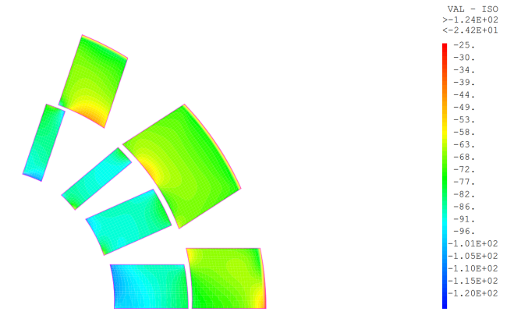
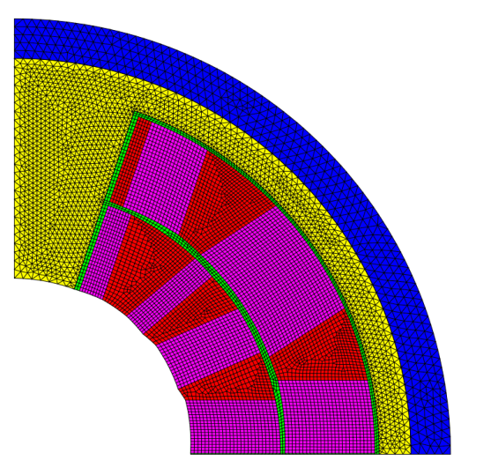
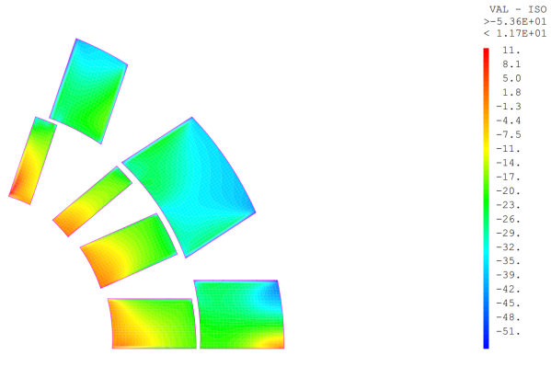
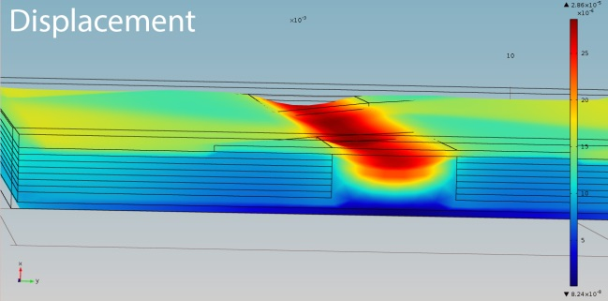
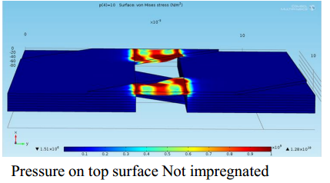
Task 3 progress magnet prototype
3. Mechanical studies
« cos θ » magnet study (CEA)
Roebel mechanical behavior (CERN)
Azimuthal stress
CAST3M FEM code
2D model
Radial stress
Courtesy of C. Lorin
CEA Saclay
ANSYS FEM code
3D model
Courtesy of G. Kirby
CERN

Slide 20
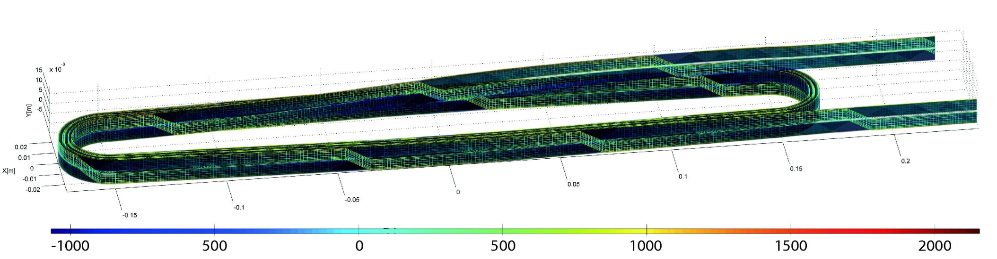
Task 3 progress magnet prototype
4. Transient cable model (CERN)
YBCO tapes are like very wide mono filaments: current distribution needs to be known precisely in a Roebel cable
Large field errors due to the position of the current being poorly defined
Electrical model of the cable incorporating the dynamic nature of the current position in the tape has been coded
Courtesy of J. Van Nugteren
CERN

Slide 21
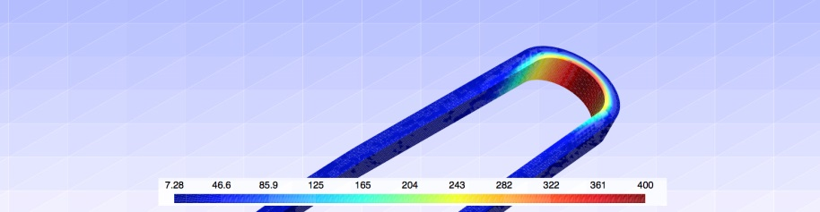
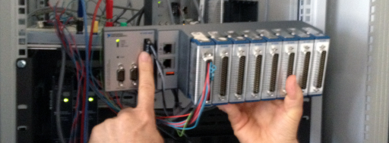
Task 3 progress
magnet prototype
5. Protection and detection
Quench model being developped (started in EuCARD) (TUT); prediction of voltage and temperature development and current sharing between the copper stabilizer and the superconducting YBCO layer.
Extensive Data AcQuisition system (DAQ) has been purchased and delivered to CERN (10 kHz/220 channels); it will be connected to different kind of sensors (Hall probes, voltages taps, pick-up coils, acoustic?, optics?)
Temperature profile in Feather-M0 during a quench
Courtesy of A. Stenvall
TUT

Slide 22
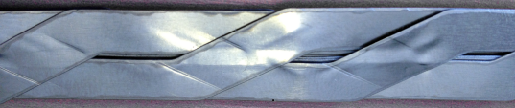

Task 3 progress magnet prototype
6. Various tests on Roebel cable (CERN)
Bare cable pressure tests; they show impregnation is essential.
Winding tests; some stress concentration may appear, under investigation.
Cable harway bend tests; the first tests show the minimal radius is 2 m.
Insulation tests;
Impregnation tests; a number of issues (chemical attack, temperature limit, thermal contraction stresses) needs to be addressed.
SS Roebel cable after compression
up to 150 MPa
SS Roebel cable bend test
Glass sleeve
Kapton
SS Roebel impregnated with CTD 101 resin

Slide 23
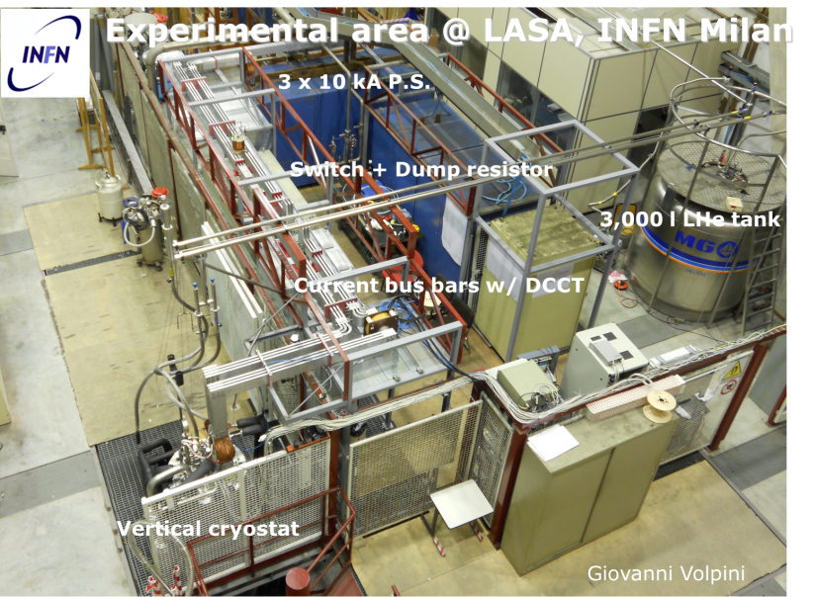
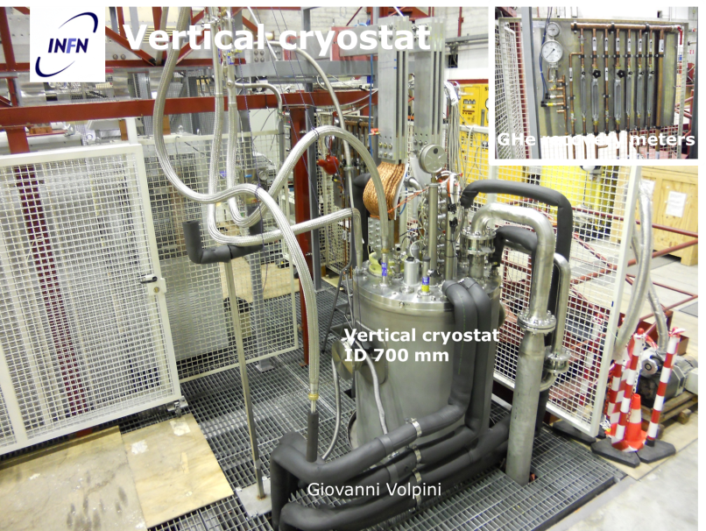
Task 4 progress
Tests
A cryostat is being specified for internal projects at INFN; could profitably be used for the HTS magnet test.
Selection of the current leads has started: resistive (several suppliers in the 10 kA class) or HTS (custom-made products) CL.
Safety analysis: maximum pressure under different scenarios, involving both malfunctions of the magnet and/or of the test station

Slide 24
Plan for the coming year
Task 1
Preparation of Workshops,
Regular coordination meeting,
Following and preparation of MS/DLs and annual report
Task 2
Study and need of transposition and stabilizer
Winding properties of the HTS cable,
Manufacturing process for long length,
D10.2 “Prototype Cable lengths and report“ May 2015, This is the first unit length of 10 kA class HTS cable, usable for characterization and short winding tests.
Task 3
Complete mechanical design. Study the maximum attainable stress level for each configuration.
Compare the different designs.
Realisation of the first prototypes,
D10.1 “Conceptual study of HTS accelerator magnets” November 2014, The report will contain all key elements of the novel magnet design, considering electromagnetics, mechanical, thermal, stability and protection aspects.
MS64 “YBCO magnet design report” November 2014.
Task 4
MS65 “Test Station Kick-Off ” July 2015.

Slide 25
Conclusions
All tasks are at work and in the planning.
Technical challenges exist but are being adressed.
For each task the work to do has been clearly specified.

