Slide 1
ESR2
High-Z sensor materials on Medipix3RX
Erik Fröjdh^{1,2}, Rafael Ballabriga², Michael Campbell²
Mid Sweden University
CERN
ARDENT WORKSHOP 2014 - SCHWARZENBRUCK

Slide 2
outline
Summary of research activities
Comparison between CdTe, CZT and Silicon bump bonded to Medipix3RX
  Measurement setup
  Calibration
  Energy resolution
  Flat field at 25 keV
  Single pixel energy resolution
  First look at MTF with CZT assemblies
  Conclusions
  Future work

Slide 3
 | Timepix3
Pixel matrix | 256 x 256
Pixel size | 55 x 55 μm²
Technology | CMOS 130 nm
Measurement modes | Simultaneous 10 bit TOT and 18 bit TOA 18 bit TOA only 10 bit PC and 14 bit integral TOT
Readout type | Data driven Frame based (both modes with zero suppression)
Dead time | >475 ns (pulse processing + packet transfer)
Maximum count rate | 85.3 Mhits / s
Minimum time resolution | 1.56 ns
Power pulsing | Yes
Minimum threshold | ~500 e-

Slide 4
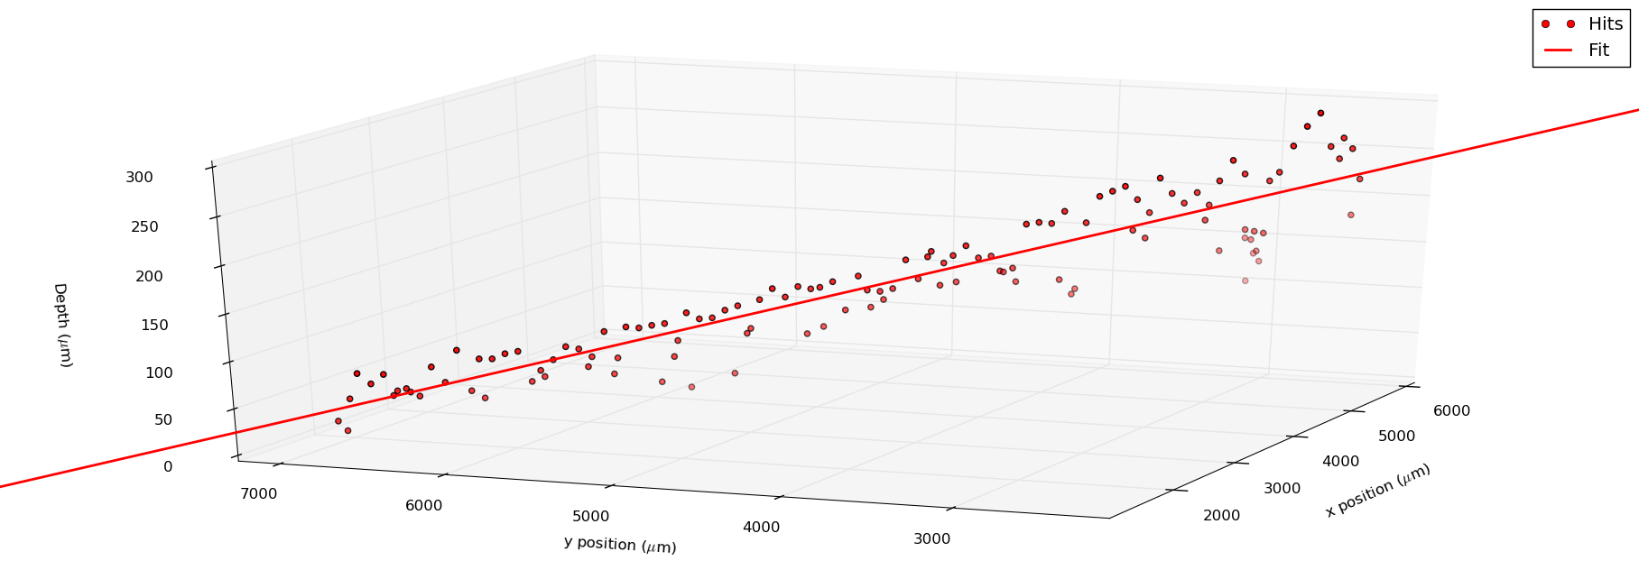
Note: Not to scale!
Bias 100V, Ikrum 5, with time walk correction

Slide 5
Research activities and conferences since the last workshop
IEEE Conference in Seoul
  Dosimetry workshop: Measurement of backscattered radiation in a CT room using Dosepix
  RTSD: Spectral resolution and optimized threshold equalization of a charge summing hybrid pixel detector
Beam time in Legnaro for Gempix and Timepix (with converters)
Geant4Medipix: A simulation framework for hybrid pixel detectors
First measurements with Timepix3
  Oral presentation at the 16th iWoRID conference in Trieste, Italy
  Co author on two poster presentations
Characterization of CdTe and CZT bump bonded to Medipix3RX
  Including 2 weeks in the X-ray lab in Sundsvall and a planned test beam at the ANKA synchrotron
RQR, Medical beam quality measurements using Dosepix. In collaboration with IRA, Lausanne
  Presented as a poster on the IRPA 2014 conference in Geneva

Slide 6
List of publications
PEER reviewed
E Frojdh, R Ballabriga, M Campbell, M Fiederle, E Hamann, T Koenig, X Llopart, D de Paiva Magalhaes and M Zuber, Count rate linearity and spectral response of the Medipix3RX chip coupled to a 300m silicon sensor under high flux conditions , JINST Vol 9, April 2014
M De Gaspari, J Alozy, R Ballabriga, M Campbell, E Fröjdh, J Idarraga,c, S Kulis, X Llopart, T Poikela, P Valerio and W Wong, Design of the analog front-end for the Timepix3 and Smallpix hybrid pixel detectors in 130 nm CMOS technology ,JINST Vol 9, January 2014
Frojd, E.; Frojdh, C.; Gimenez, E.N.; Krapohl, D.; Maneuski, D.; Norlin, B.;O’Shea, V.; Wilhelm, H.; Tartoni, N.; Thungstrom, G.; Zain, R.M., Probing Defects in a Small Pixellated CdTe Sensor Using an Inclined Mono Energetic X-Ray Micro Beam , Nuclear Science, IEEE Transactions on , vol.60, no.4, pp.2864,2869, Aug. 2013
R Ballabriga, J Alozy, G Blaj, M Campbell, M Fiederle, E Frojdh, E H M Heijne, X Llopart, M Pichotka, S Procz, L Tlustos andWWong, The Medipix3RX: a high resolution, zero dead-time pixel detector readout chip allowing spectroscopic imaging , JINST Vol 8, February 2013
E. Fröjdh, C. Fröjdh, E.N. Gimenez, D. Maneuski, J. Marchal, B. Norlin, V. O’Shea, G. Stewart, H. Wilhelm, R.M Zain and G. Thungström, Depth of interaction and bias voltage depenence of the spectral response in a pixellated CdTe detector operating in Time-OverThreshold mode subjected to monochromatic Xrays ,JINST Vol 7, March 2012
D. Maneuski, V. Astromskas, E. Fröjdh, C Fröjdh, E.N. Gimenez, J. Marchal, V. O’Shea, G. Stewart, N. Tartoni, H. Wilhelm, K.Wraight and R.M. Zain Imaging and spectroscopic performance studies of pixellated CdTe Timepix detector , JINST Vol 7, January 2012
S. Reza, W.S. Wong, E. Fröjdh, B. Norlin, C. Fröjdh, G. Thungström and J. Thim Smart dosimetry by pattern recognition using a single photon counting detector system in time over threshold mode , 2012 JINST Vol 7, January 2012
E. Fröjdh, B. Norlin, G. Thungström and C. Fröjdh X-ray absorption and charge transport in a pixellated CdTe detector with single photon processing readout , JINST Vol 6, February 2011
E. Fröjdh, A. Fröjdh, B. Norlin, C. Fröjdh, Spectral response of a silicon detector with 220m pixel size bonded to MEDIPIX2 , NIMA:, Volume 633, Supplement 1, May 2011, Pages S125-S127
A. Fröjdh, E. Fröjdh, G. Thungström, C. Fröjdh, B. Norlin, Processing and characterization of a MEDIPIX2-compatible silicon sensor with 220m pixel size , NIMA, Volume 633, Supplement 1, May 2011, Pages. S78-S80,

Slide 7
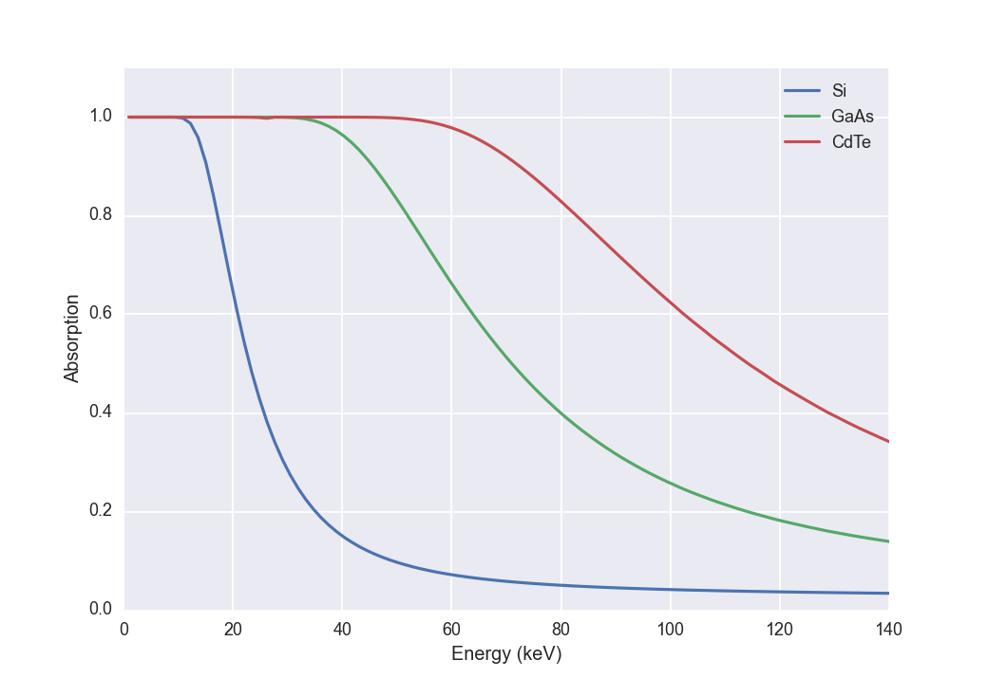
Motivation for high-z materials
Absorption in 1 mm

Slide 8
Fluorescence in high-z materials
Mean free path of fluorescence photon [μm]
Fluorescence yield [%]
Energy fluorescence photons [keV]
Z
The mean free path of the fluorescence photons is in the same order of magnitude as the pixel pitch
The fluorescence yield increases with the atomic number
Table: L. Tlustos, PhD thesis

Slide 9
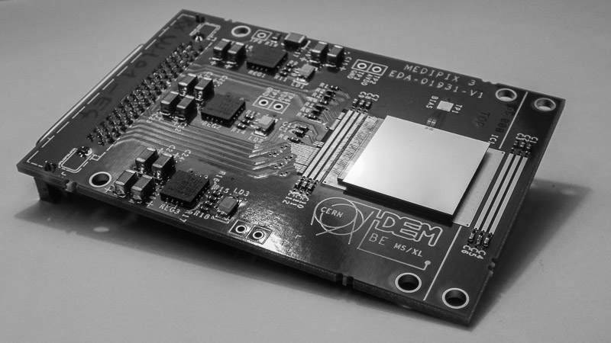
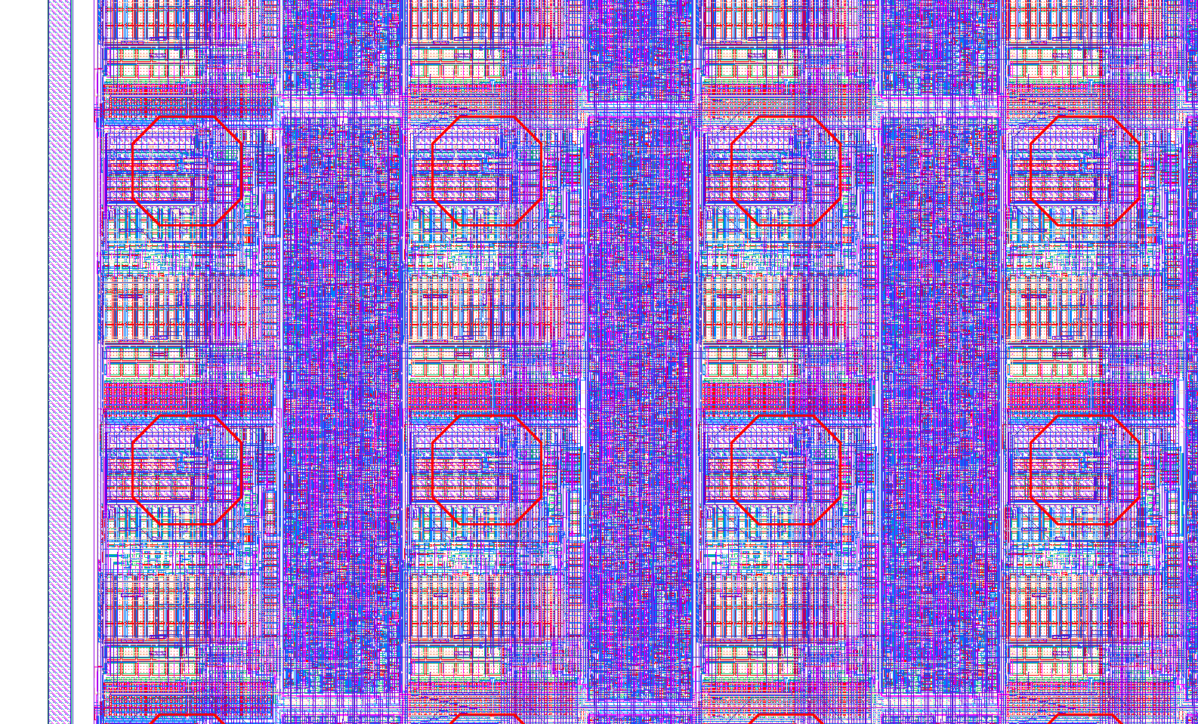
Medipix3rx
256x256 pixels
55x55 um pitch
Charge summing over dynamically allocated 2x2 pixel clusters
2x12bit counters and 2 thresholds per pixel
5 bit Threshold adjustment dac
Highly configurable
  4 different gain modes
  Single pixel or charge summing
  Electron or hole collection
  Intrinsic 55um pixel pitch or 110um pixel pitch using eight thresholds per pixel
110μm
Layout of 2x2 pixels

Slide 10
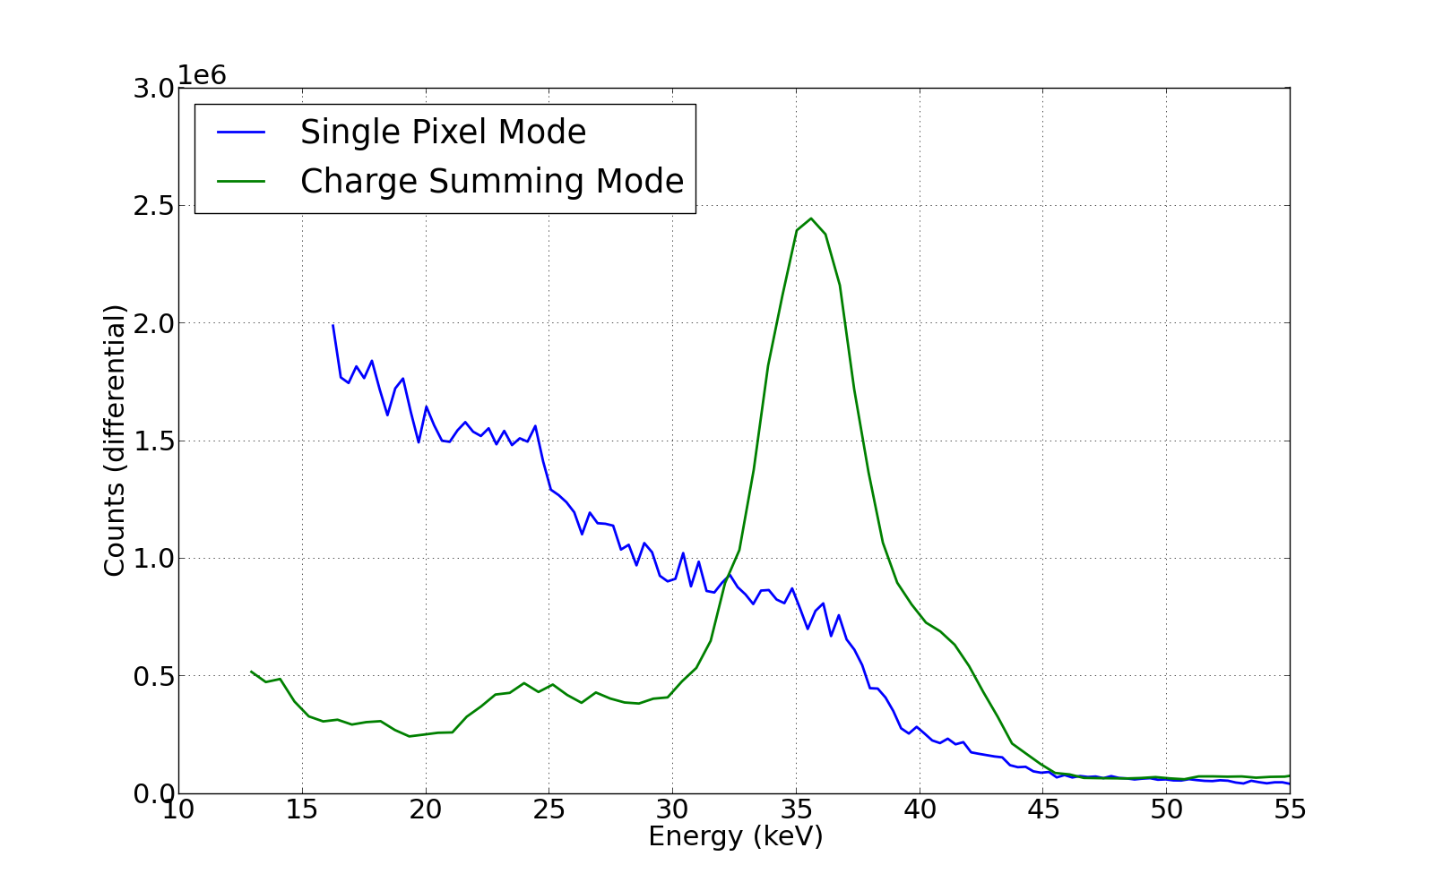
Medipix3: charge summing
2mm tick cdte sensor 110um pitch

Slide 11
Sensors
 | W109_C3 | W1127_I6 | W146_F9 | W146_F10
Material | Silicon (n-on- p) | CdTe | CZT | CZT
Pixel size | 55 um | 110 um | 110 um | 110 um
Thickness | 200 um | 2 mm | 2 mm | 2 mm
Bias voltage | -60 V | -600V | -600V | -600V
Leakage current | < 2 uA | ~4uA | < 0.5 uA | < 0.5 uA

Slide 12
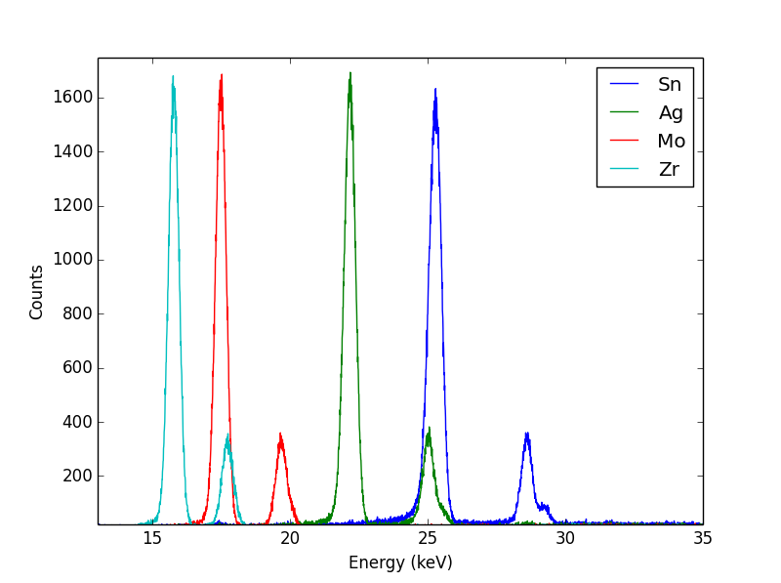
Calibration – CSM
1. Verification of input spectrum
 | kα
Zirconium | 15.7
Molybdenum | 17.5
Silver | 22.2
Tin | 25.3
Amptek X-123CdTe Spectrometer

Slide 13
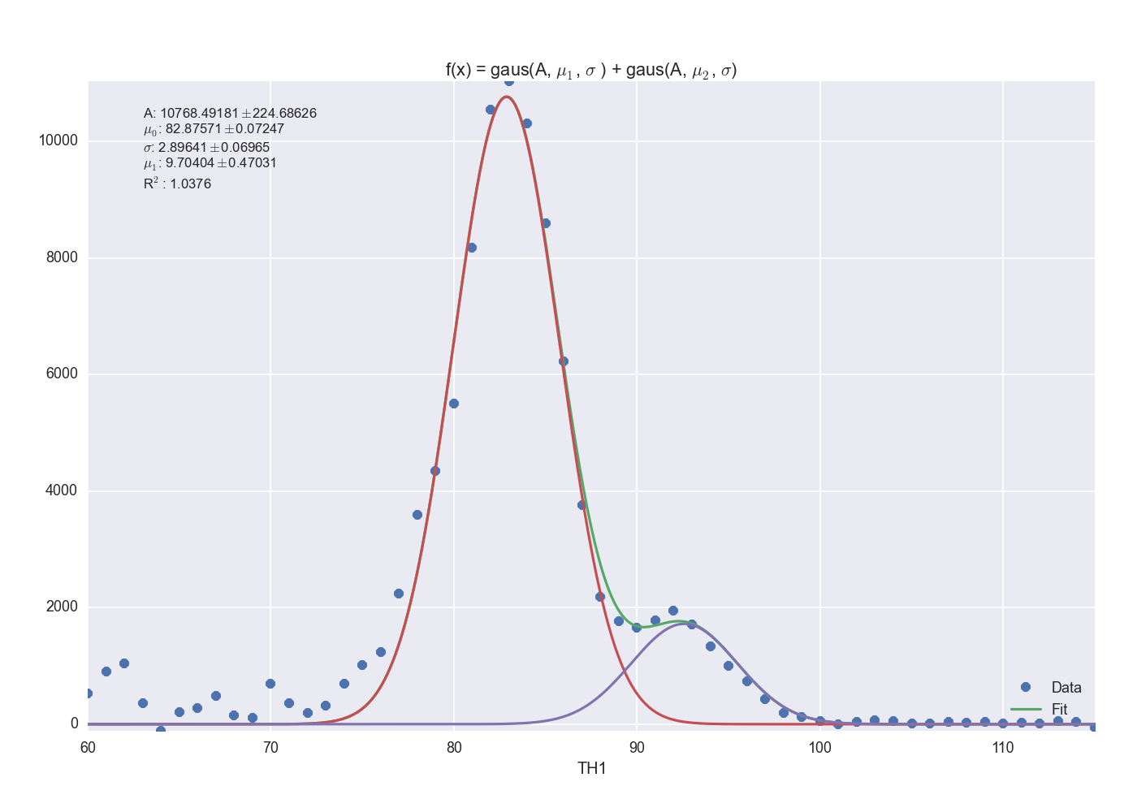
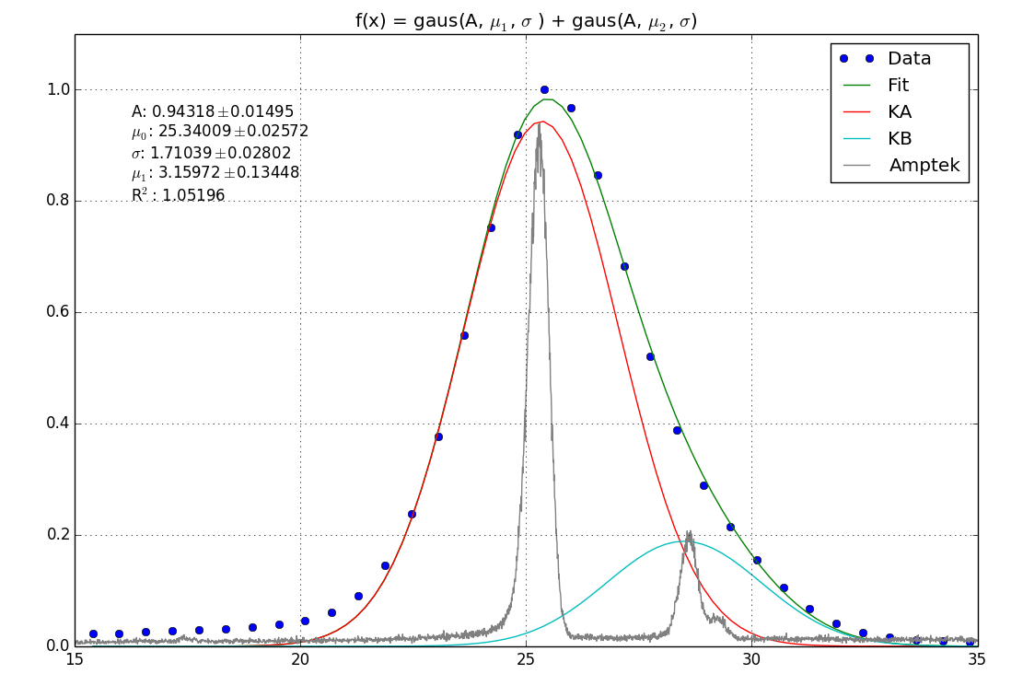
Calibration – csm
2. fit of the peak with two Gaussians
Si
CZT
keV
Same sigma is used and the ratio between the kα and kβ peak is 0.22 for CZT and 0.16 for Silicon

Slide 14
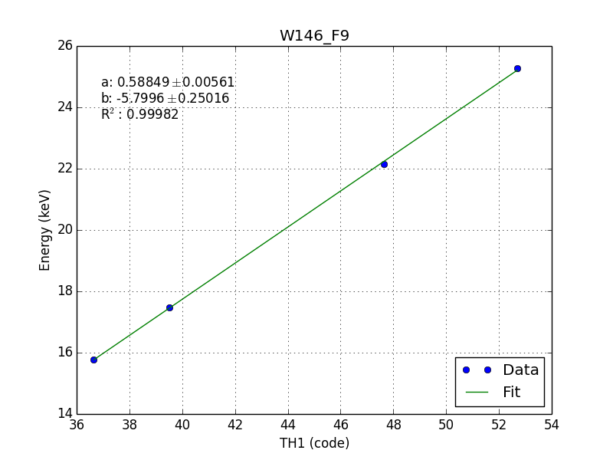
Calibration – csm
3. Linear fit to the four peak positions

Slide 15
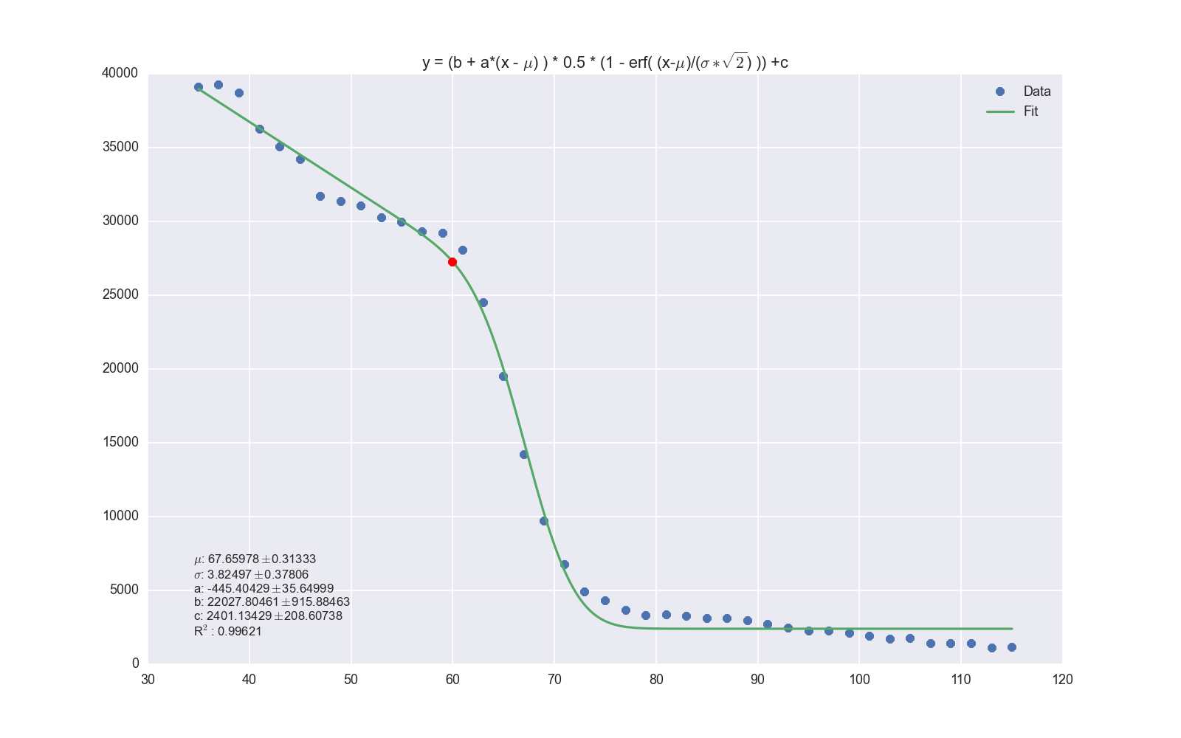
Calibration – SPM
2. fitting the differentiated spectrum with an error function

Slide 16
Energy resolution
CSM, fwhm (kev)
 | 15.7 | 17.5 | 22.2 | 25.3
W109_C3 (Silicon) | 2.25 | 2.26 | 2.55 | 2.65
W109_C3 (Silicon)* | 2.25 | 2.31 | 2.34 | 2.43
W146_F9 (CZT) | 3.73 | 3.97 | 4.31 | 4.51
W146_F10 (CZT) | 4.32 | 4.44 | 5.17 | 5.24
W146_F10* (CZT) | 4.67 | 4.91 | 5.15 | 5.32
W1127_I6 (CdTe) | 3.12 | 3.09 | 3.53 | 3.69
*HGM/High Equalized at 7000e⁻⁻

Slide 17
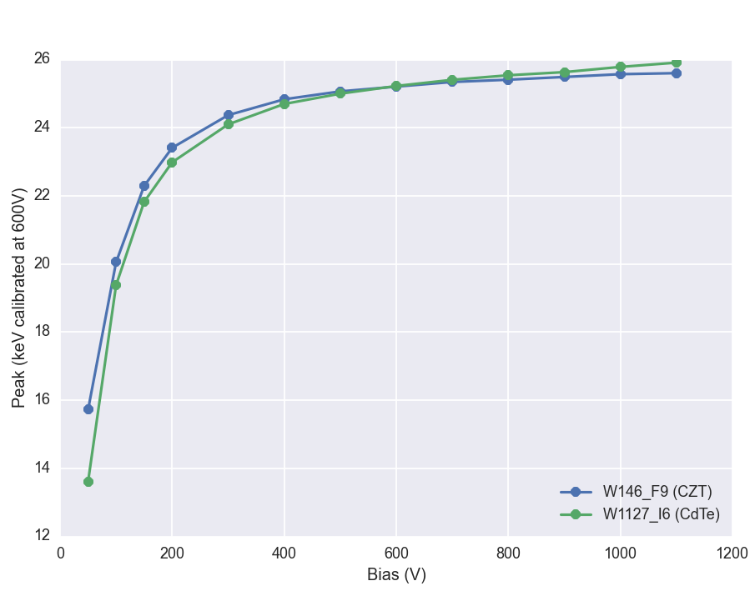
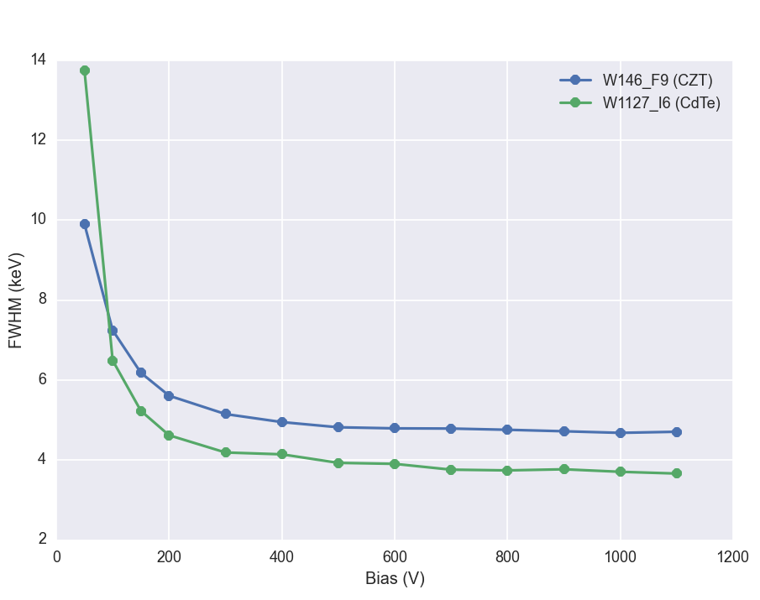
Dependence on bias voltage
25kev Sn fluorescence
Both materials show similar characteristics

Slide 18
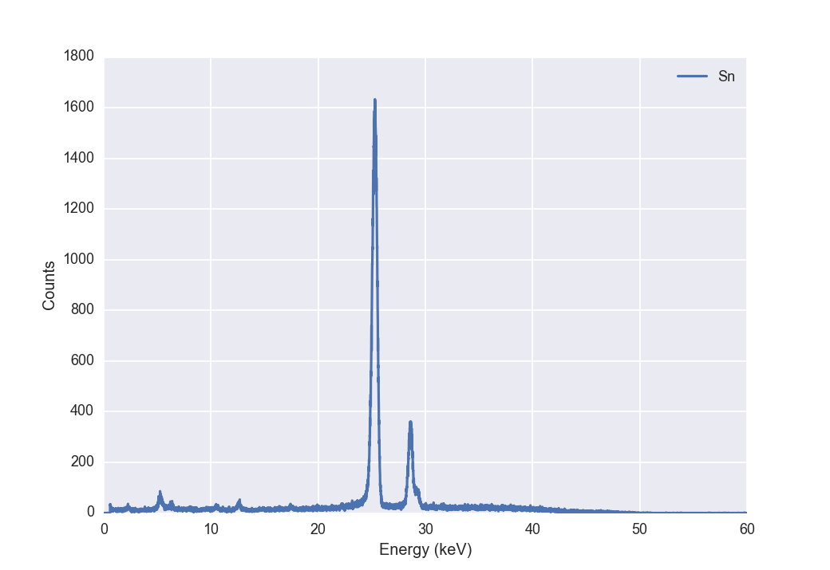
Flat field
Fluorescence from Sn (25keV)
Threshold at ~ 9 keV
Threshold mismatch should have only a small influence on the number of counts.
HGM, Moderate
TH1
Amptek X-123CdTe

Slide 19
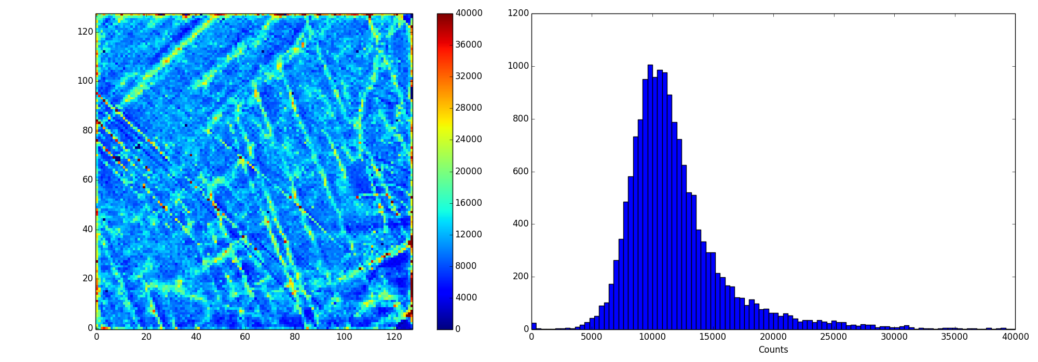
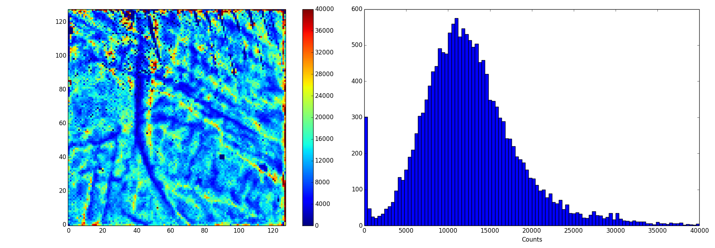
Flat Field
μ = 12003
σ = 4798
σ/μ = 39.97%
W146_F9
μ = 12657
σ = 4863
σ/μ = 38.42%
W146_F10
Note! Poisson limit σ ~ 110

Slide 20
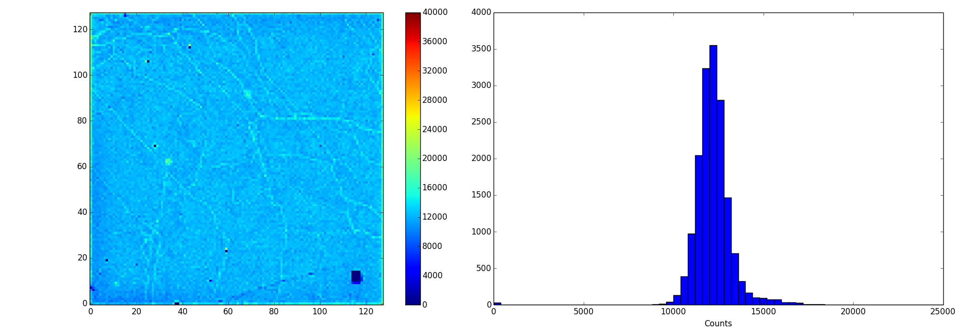
Flat Field
μ = 12003
σ = 4798
σ/μ = 39.97%
W146_F9
μ = 12203
σ = 1109
σ/μ = 9.09%
W146_F10
Note! Poisson limit σ ~ 110

Slide 21
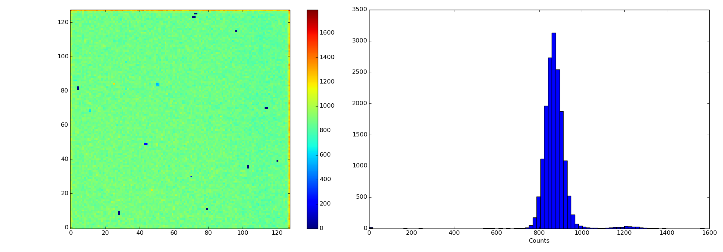
Flat field
Less statistics due to lower absorption
μ = 874
σ = 59.5
Poisson
limit = 29.5
W109_C3
No edge pixels
σ = 39.2
μ = 12203
σ = 1109
σ/μ = 9.09%
W146_F10
Note! Poisson limit σ ~ 110

Slide 22
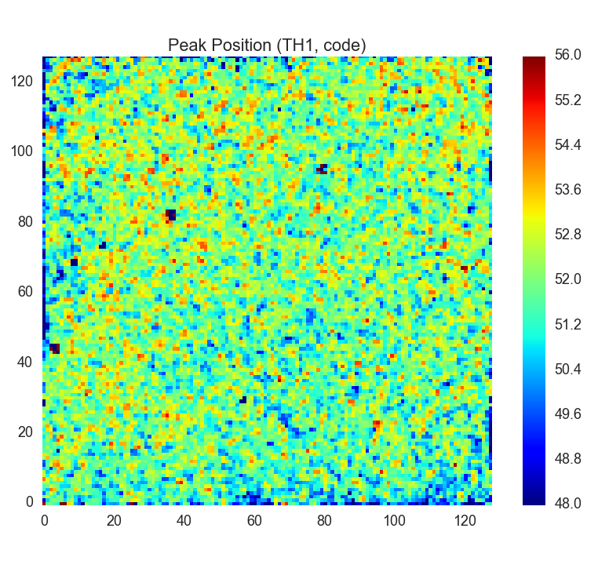
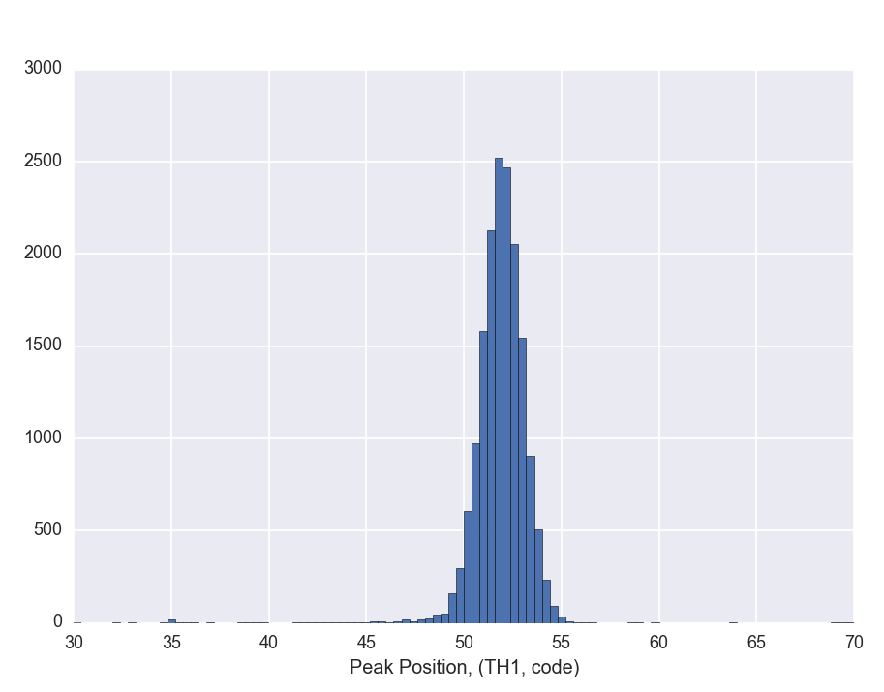
Peak position (CZT)
CSM, 25kev Sn fluorescence
σ = 2.24 TH1 step
σ = 1.32 keV

Slide 23
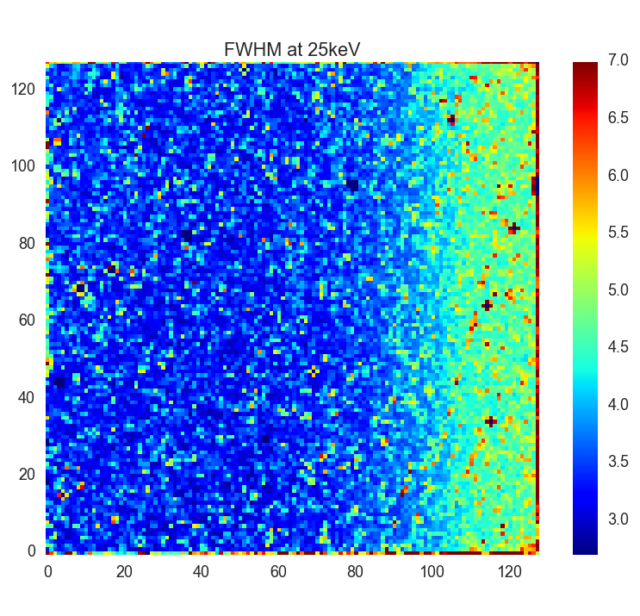
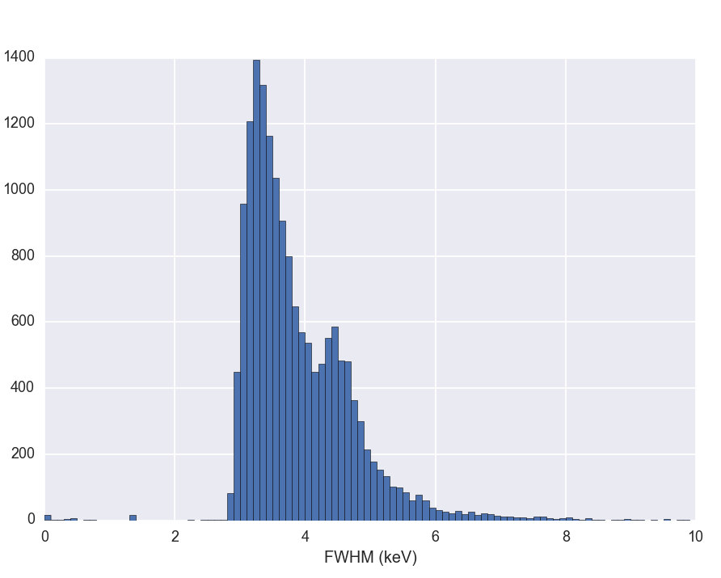
Energy resolution (CZT)
CSM, 25kev Sn fluorescence
μ = 3.89 keV
σ = 0.97 keV
Note: The increased noise on the right side is minimized in Medipix3RXv2 respin

Slide 24
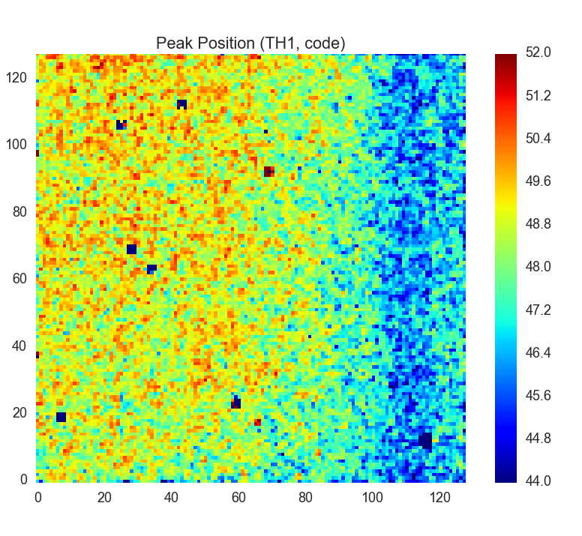
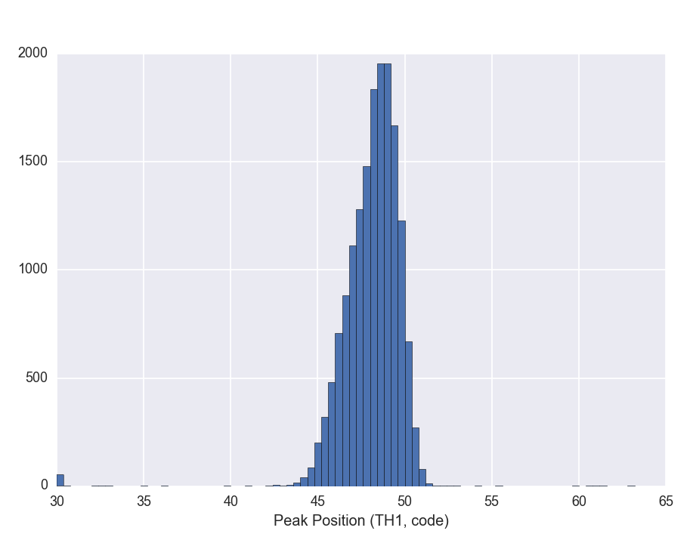
Peak position (Cdte)
CSM, 25kev Sn fluorescence
σ = 1.93 TH1 step
σ = 1.12 keV

Slide 25
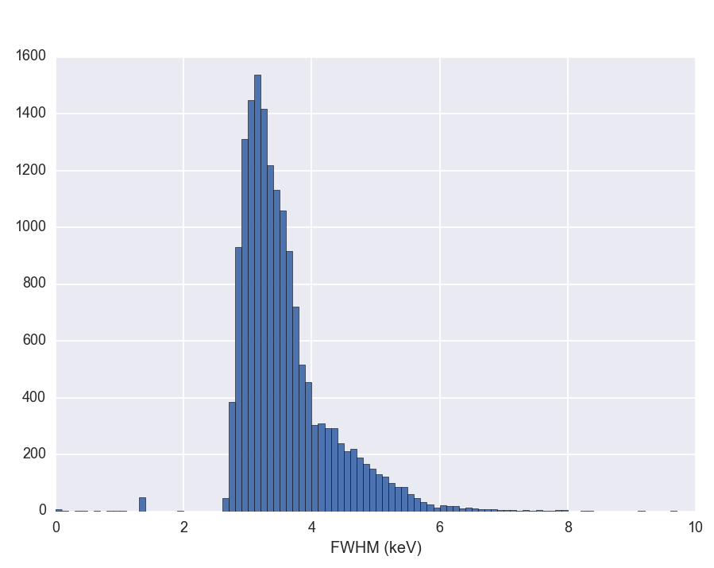
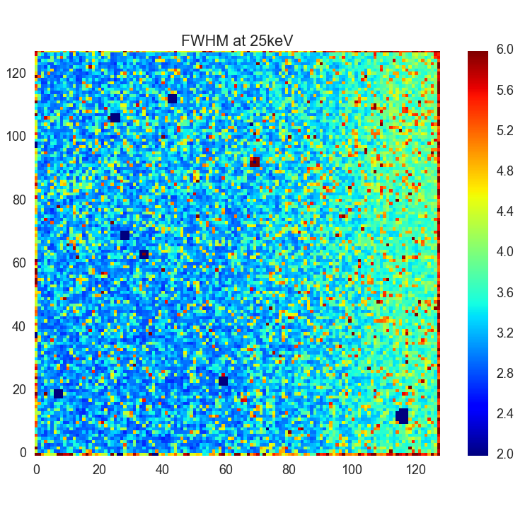
Energy resolution (CdTe)
CSM, 25kev Sn fluorescence
μ = 3.56 keV
σ = 0.73 keV

Slide 26
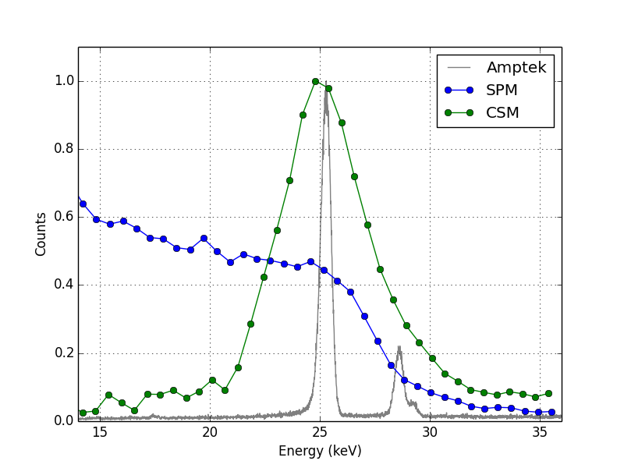
Peak/edge position (czt)
SPM, 25kev Sn fluorescence

Slide 27
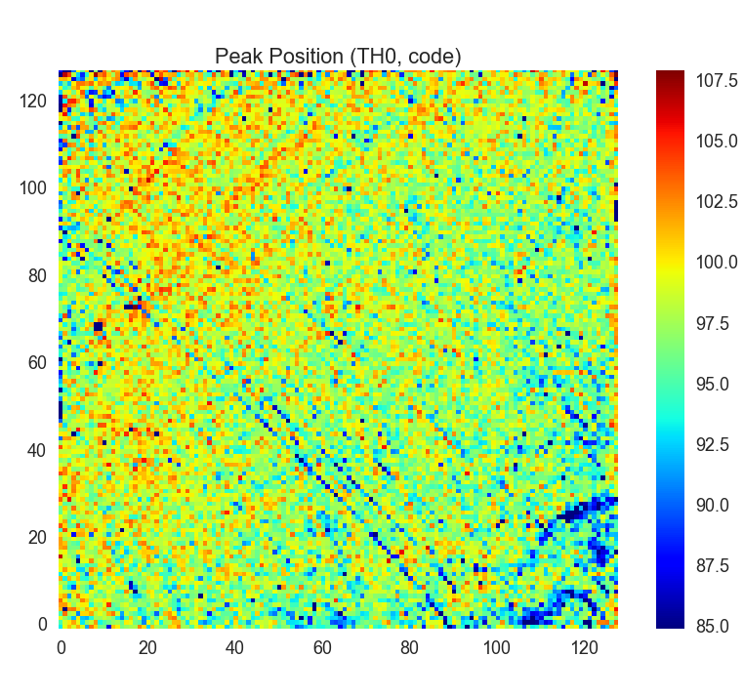
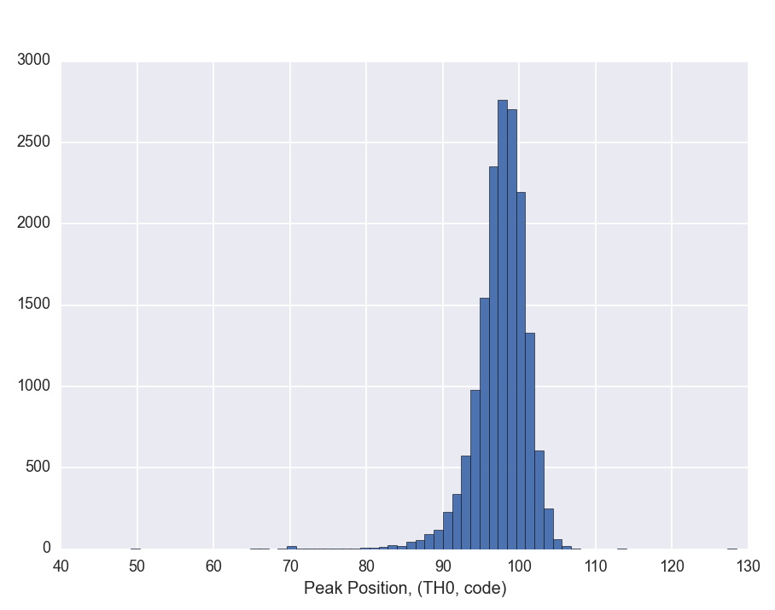
Peak/edge position (czt)
SPM, 25kev Sn fluorescence
σ = 5.36 TH0 step (Note! the gain is ~2x of TH1 )
σ = 1.63 keV

Slide 28
Peak/edge position (czt)
SPM, 25kev Sn fluorescence
SPM
Counts, 25keV, CSM
CSM

Slide 29
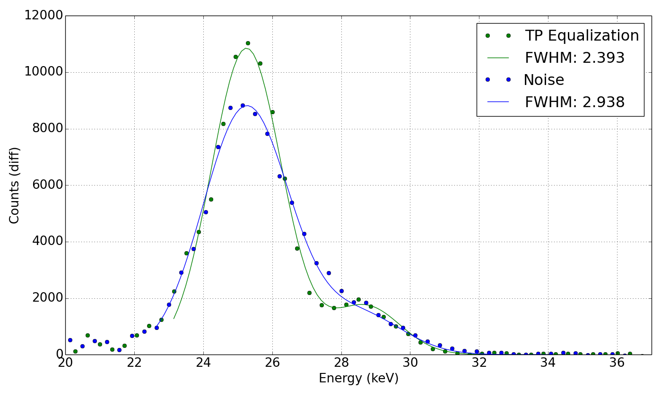
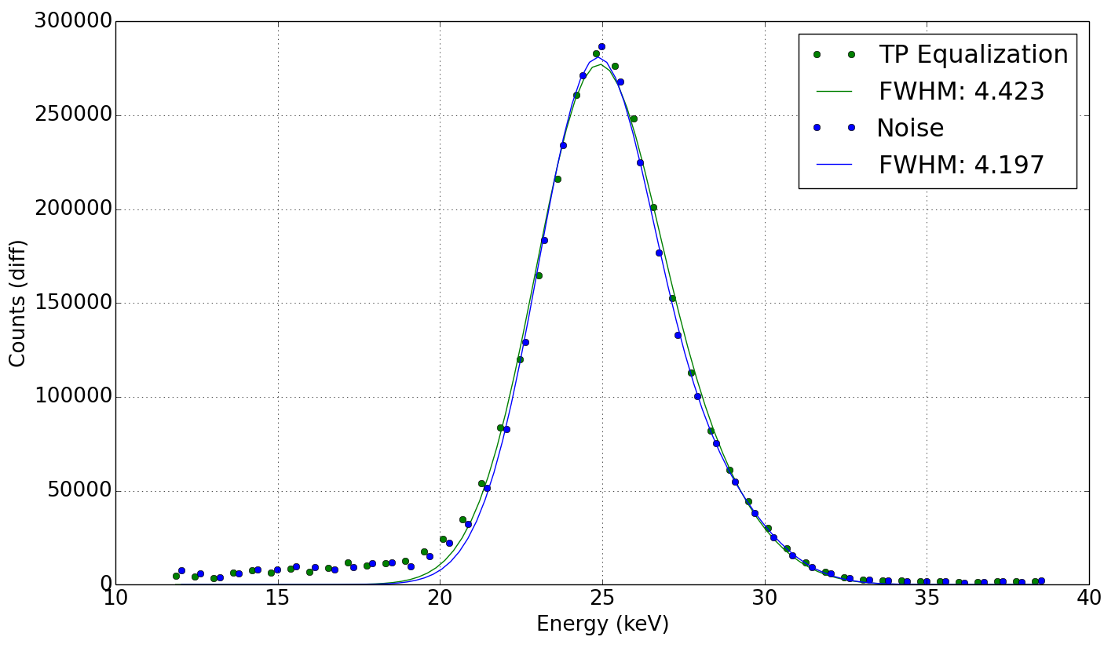
Noise vs. tp equalization
Silicon
CZT
No improvement In energy resolution for CZT

Slide 30
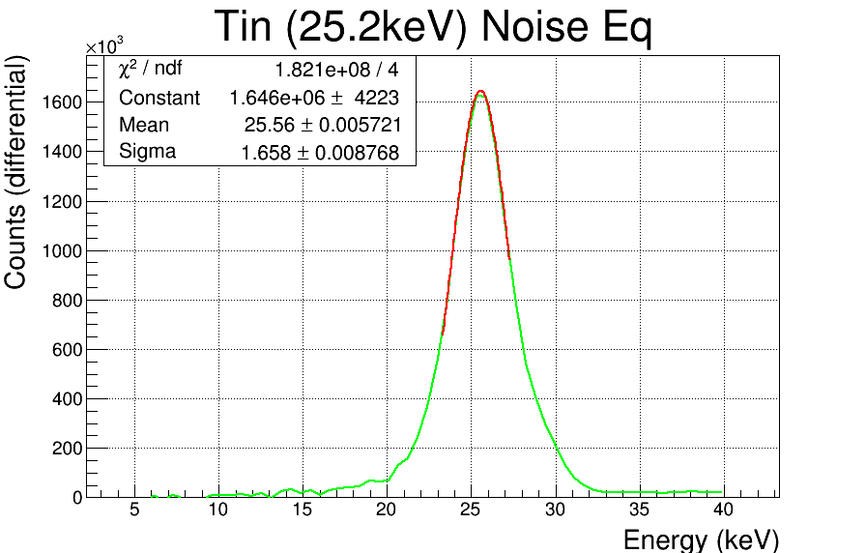
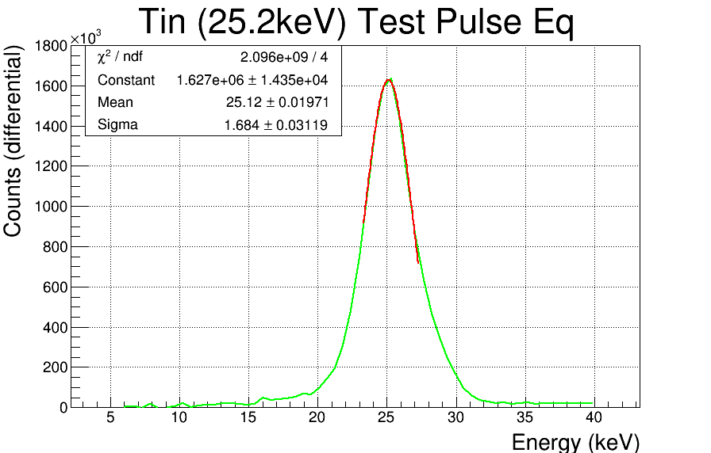
Noise vs. tp equalization
No improvement In energy resolution for CdTe, even a slight degradation.

Slide 31
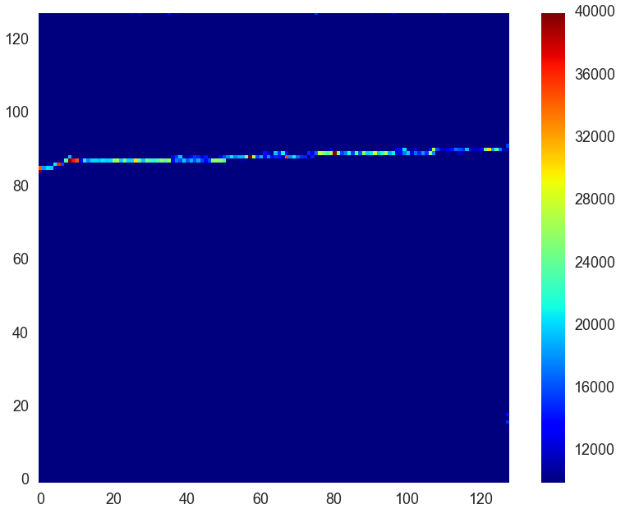
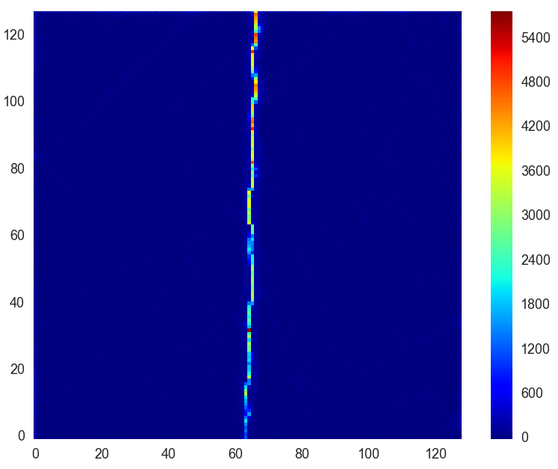
Line images, czt
W146_F0, CSM
Measurements using a tungsten slit reveals displacement of charge. This is believed to be the main cause of the count rate differences in the sensor.

Slide 32
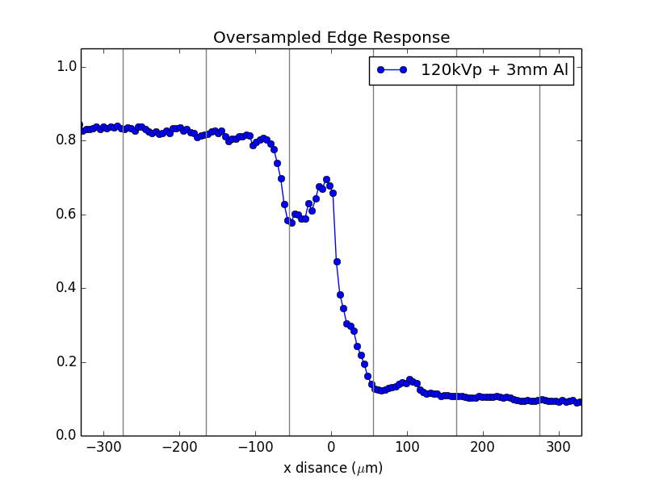
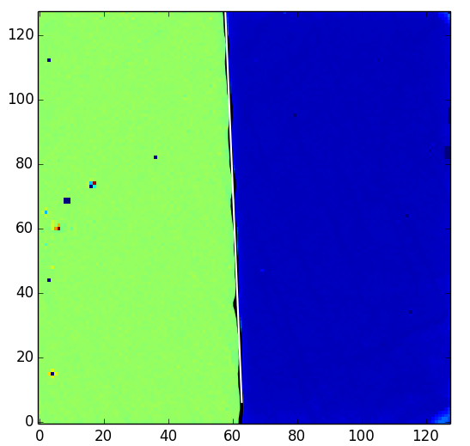
Slanted edge mtf
Tungsten edge
120kVp + 3mm Al

Slide 33
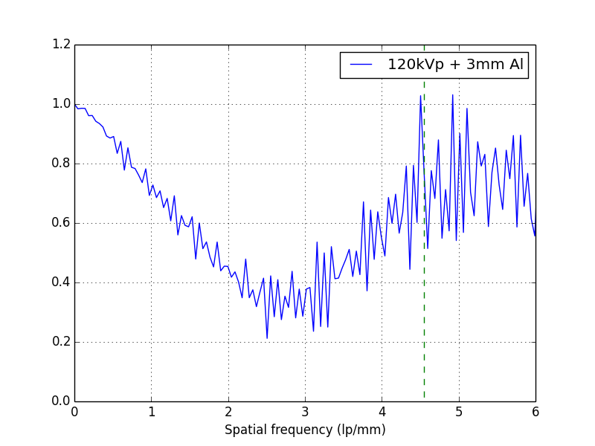
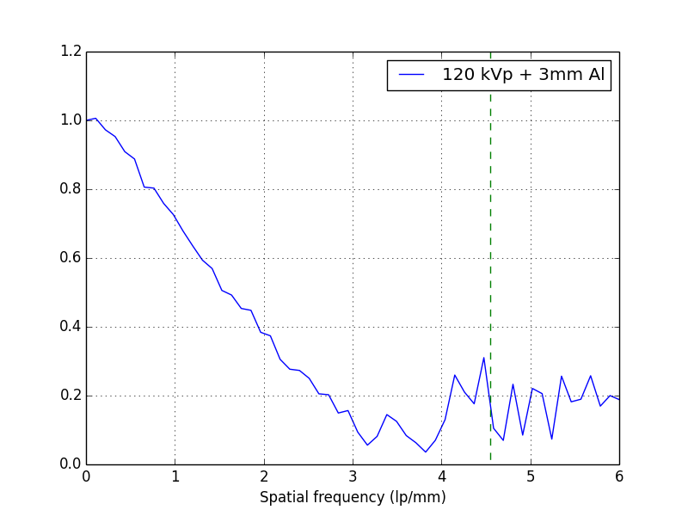
Slanted edge mtf
Tungsten edge
120kVp + 3mm Al

Slide 34
conclusions
Both CdTe and CZT displays good energy resolution across the sensor
The lack of improvement in energy resolution using a test pulse calibration suggest gain differences induced by the sensor for both CdTe and CZT
Large count rate differences are observed in the CZT sensors, probably caused by charge displacement due to an inhomogeneous electrical field
Imagining performance is greatly affected by this charge displacement

Slide 35
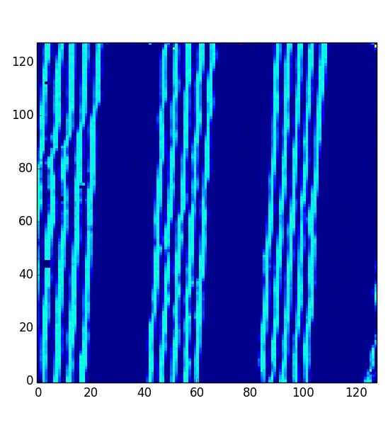
Future work
Long term stability and polarization
Improvements in the equalization procedure.
  Precise TP measurement.
  Ideas to use radiation
Low energy response (3-8 keV)
High energy response (120-662 keV)
NPS, MTF, DQE
ACKNOWLEDGEMENTS:
This research project has been partly supported by the Marie Curie Initial Training Network Fellowship of the European Community’s Seventh Framework Programme under Grant Agreement PITN-GA-4 2011-289198-ARDENT”.

