Slide 1


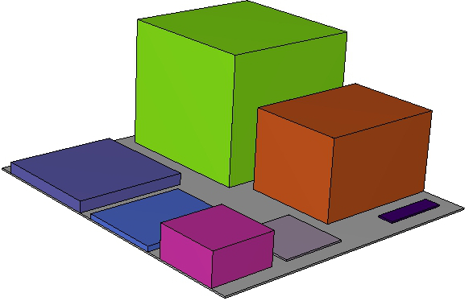
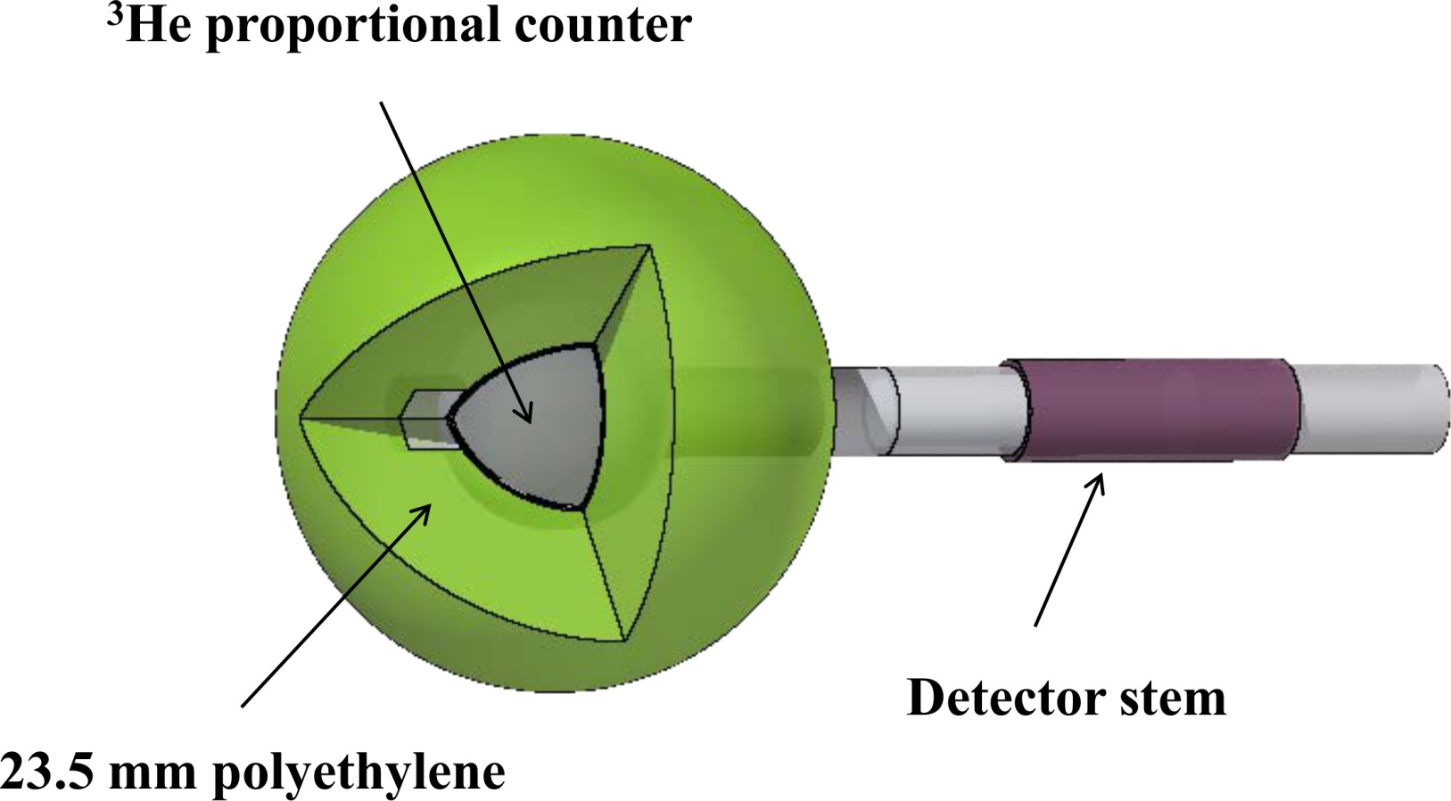
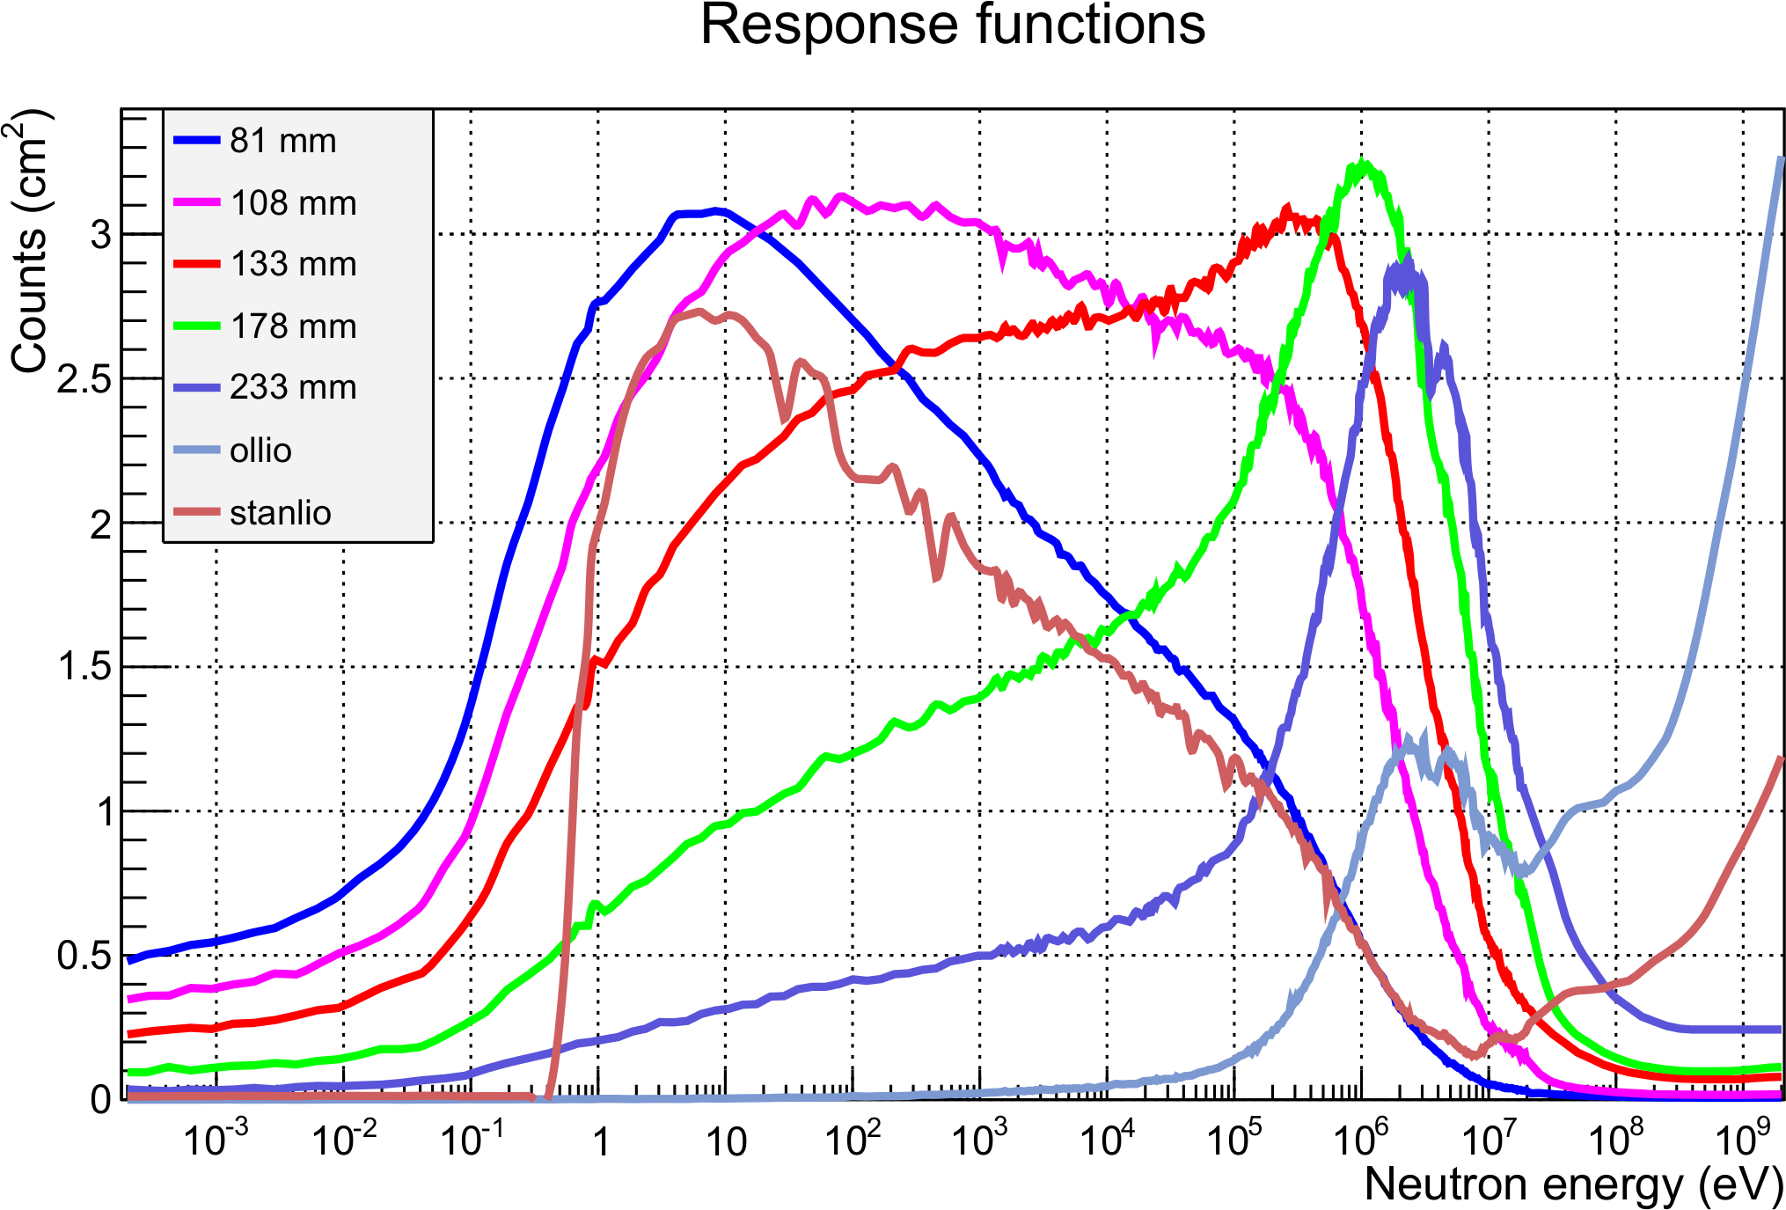
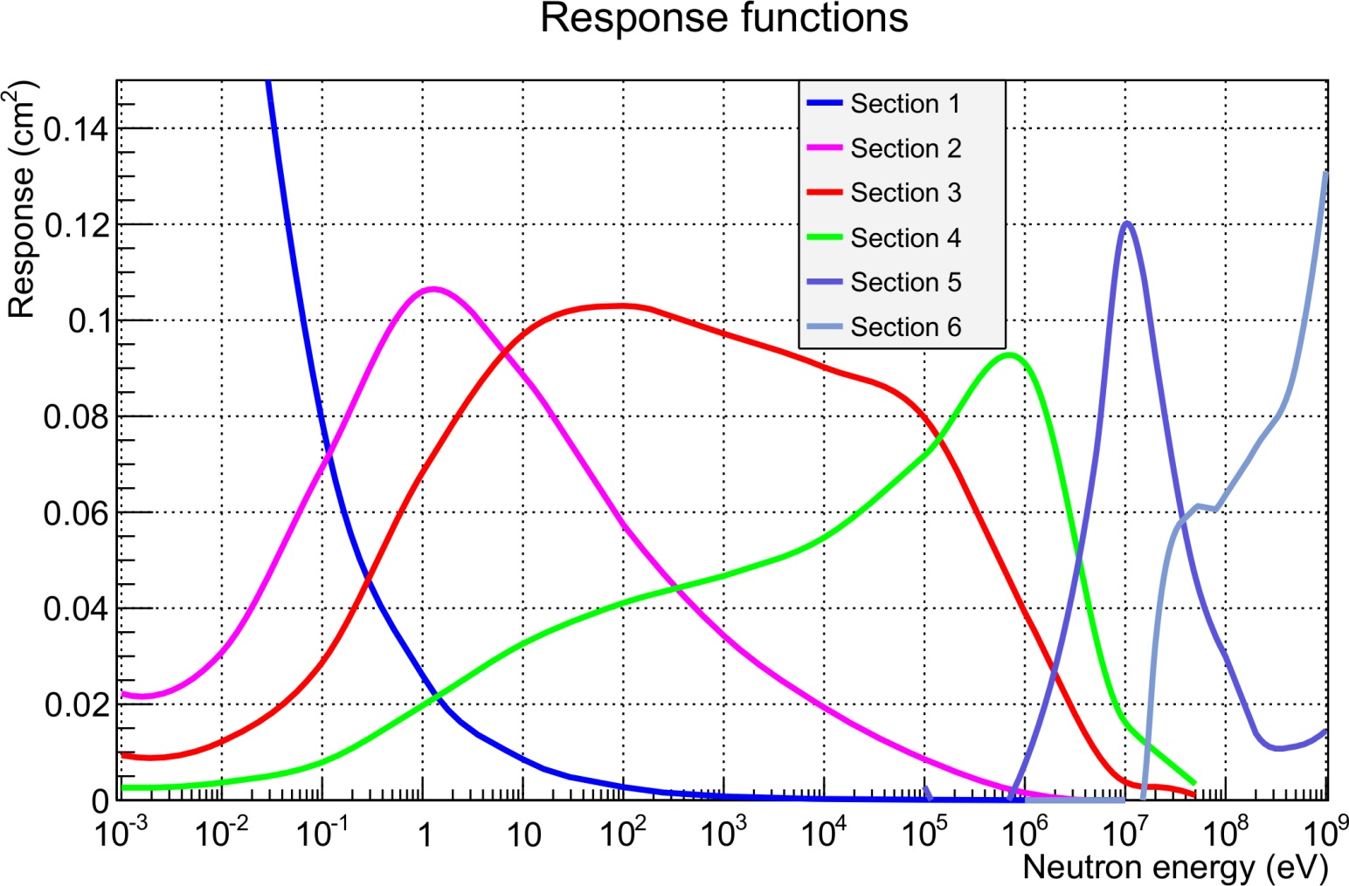
Design of novel GEM-based neutron spectrometer
E. Aza^{1,2*}
¹ CERN, 1211 Geneva, Switzerland, ² AUTH, Department of Physics, 54124 Thessaloniki, Greece,
A directional neutron spectrometer has been designed and simulated with FLUKA [1,2]. It consists of six sections, each one measuring in a different neutron energy range, with a total area of 400 cm². Counts from each section can be measured simultaneously by a read-out detector attached to the section-board and therefore the neutron spectrum information can be acquired in a single acquisition via an unfolding method. The detected neutron energy ranges from 10⁻³ eV to 1 GeV.
Entrance B
The BSS (Bonner Sphere neutron Spectrometer)
The new spectrometer
The CERN BSS [3] consists of 7 spheres: five polyethylene spheres with outer diameter of 81, 108, 133, 178 and 233 mm, complemented by two other spheres, nicknamed “Ollio” and “Stanlio”, where cadmium and lead inserts were introduced in order to increase the sensitivity for energies up to the GeV range. Every sphere is sensitive to a different neutron energy, depending on the moderating material, so that charged particles from ³He(n,p)³H reaction are detected with the ³He proportional counter. The inner geometry of the 81 mm sphere is shown in Fig. 1.
A novel spectrometer has been designed with FLUKA as a replacement of the BSS for certain applications, employing the same detection principles and Unfolding procedure, but with the advantages of giving the spectrum information in one acquisition and weighing a lot less. The read-out detector with be a Triple GEM [7], attached right under the conversion board.
4
3
6
5
1
2
empty
Fig.3: Layout of the spectrometer
Fig.1: A ³He detector is placed at the centre of the polyethylene sphere., counting the number of charged particles from the ³He(n,p)³H reaction.
The dimensions of each section are shown in Table 1. The detection methods are:
Thermal neutron conversion (¹⁰B)
Moderation and thermal neutron conversion (¹⁰B+PE)
Recoil proton from ¹⁰B(n,p) (PE, PE+Al)
.
A response function corresponds to each sphere, indicating the number of counts * cm² for different imping neutron energies. The 7 response functions were recalculated with the new FLUKA version (2011). The results are shown in Fig. 2. The main disadvantages of this system is time consumption and transportability.
Table 1: Characteristics of the sections
 | Height (mm) | Area (cm²) | Energy region | Material
Section 1 | 0.001 | 4 | thermal | ¹⁰B
Section 2 | 20 | 16 | epithermal | ¹⁰B + PE
Section 3 | 50 | 48 | epithermal | ¹⁰B + PE
Section 4 | 80 | 81 | intermediate | ¹⁰B + PE
Section 5 | 0.7 | 50 | fast | PE
Section 6 | 3.2 | 30 | fast | PE + Al
Section 7 | - | 16 | background | empty
The corresponding response functions are shown in Fig. 4.
Fig.2: BSS fluence responses as a function of the impinging neutron energy, as calculated via FLUKA simulations.
Data unfolding
The neutron spectrum at a specific position is acquired via an unfolding method, which requires the count rate measured by each sphere, the response functions and a guess spectrum for this position. Common codes dedicated to this so-called “unfolding method” are MAXED [4], GRAVEL [5] and FRUIT [6].
Fig.4: Simulated response functions for each section. The detected neutron energy ranges from 10⁻³ eV to 1 GeV.
Response
functions
References
Guess
spectrum
Unfolding
code
Neutron
spectrum
[1] A. Ferrari et al., FLUKA: a multi-particle transport code, CERN-2005-10, INFN/TC_05/11, SLAC-R-773, 2005
[2] G. Battistoni et al., The FLUKA code: Description and benchmarking, Proceedings of the Hadronic Shower Simulation Workshop 2006, Fermilab 6-8 September 2006, M. Albrow, R. Raja eds., AIP Conference Proceeding 896, pp. 31-49, 2007
[3] C. Birattari et al., A Bonner Sphere Spectrometer with extended response matrix, NIMA 620, 2010
[4] [11] P. Goldhagen et al., Spectrum unfolding, sensitivity analysis and propagation of uncertainties with the maximum entropy deconvolution code MAXED, NIMA 476, 2002
[5] M. Reginatto et al., UMG code package version 3.2. PTB, 2003
[6] R. Bedogni et al., FRUIT: an operational tool for multisphere neutron spectrometry in workplaces, NIMA 580, 2007
[7] F. Sauli, GEM: A new concept for electron amplification in gas detectors, Nuclear Instruments and Methods in Physics Research A386, p 531, 1997
Count rate
*Corresponding author: eleni.aza@cern.ch This work was supported by the ARDENT Marie Curie Initial Training Network project, funded by the European Commission 7th Framework Program under Grant Agreement 289198.

