Slide 1



ESR-3 Silvia Puddu
29-09-2014

Slide 2
A fast overview on my (thesis) subject:
Beam Operation
losses
Neutron production
Material activation
Hadron beam monitoring:
Charged particle beam
  GEM @ CERF http://dx.doi.org/10.1088/1748-0221/9/06/P06006
  GEM @ CNAO
Decommissioning
Fe-55 measurements with GEMPIX

Slide 3
CNAO measurements
Scientific activity 2014

Slide 4
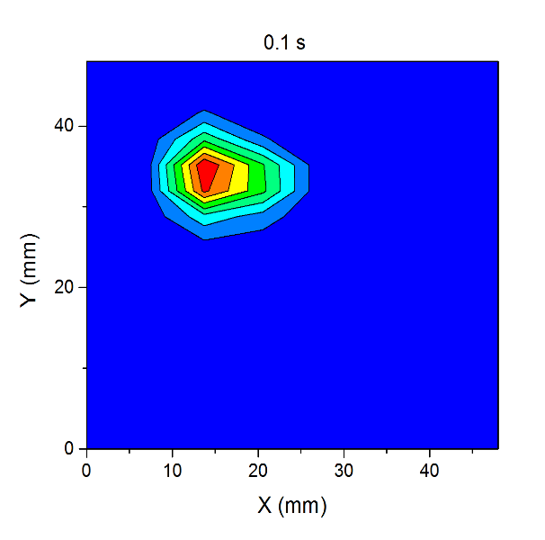
Paint procedure:
The cancer area is scanned with the hadron beam along the X-Y axis
The dose is uniform over the treated area
The scan is possible also in the Z direction (not in this study)
Offline Triple GEM [1, 2] reconstruction of the paint procedure.
43 frames of 100 ms.
Negligible dead time [3]

Slide 5
Beam characteristics
 | Carbon Beam |  | Proton Beam
X-Y scanned area (cm²) | 2x2 | 4x4 | 2x2
Energy (MeV/nucl) | 252 | 252 | 132.95
Depth in H₂O (mm) | 125 | 125 | 125
Intensity (part/spot) | 5e6 | 1e6 | 1e8

Slide 6
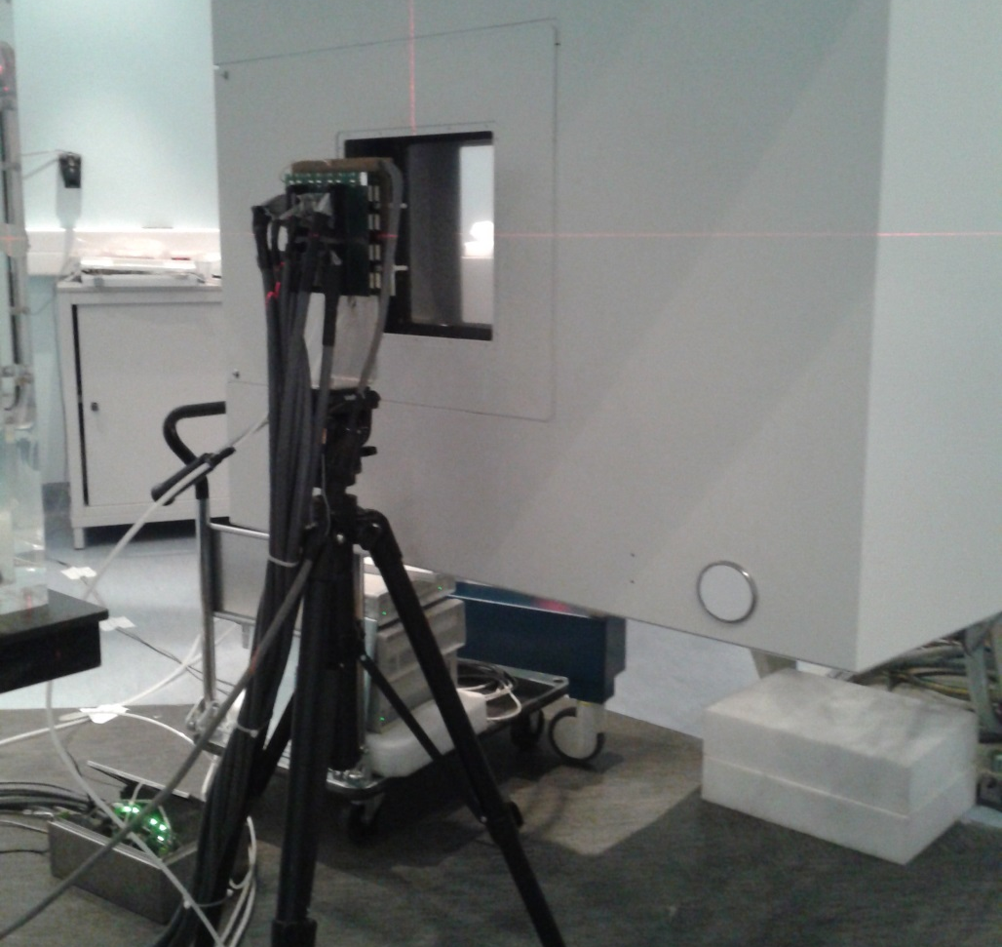
Detectors and set up for CNAO measurements
2 GEM detector are been tested as beam monitor in the beam line:
  2x2 mm² pad organised in a circular anode (active area ~3x3 cm²)
  3x6 mm² pad organised in a square anode (active area ~5x5 cm²)
The radiochromic foils were positioned in front of the GEM
GEM
beam

Slide 7
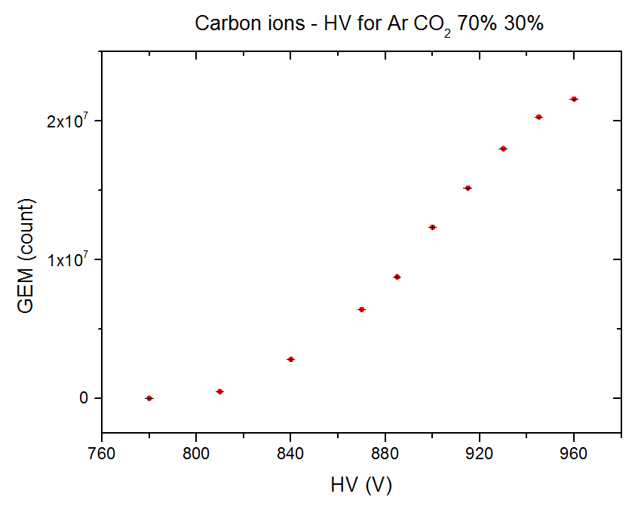
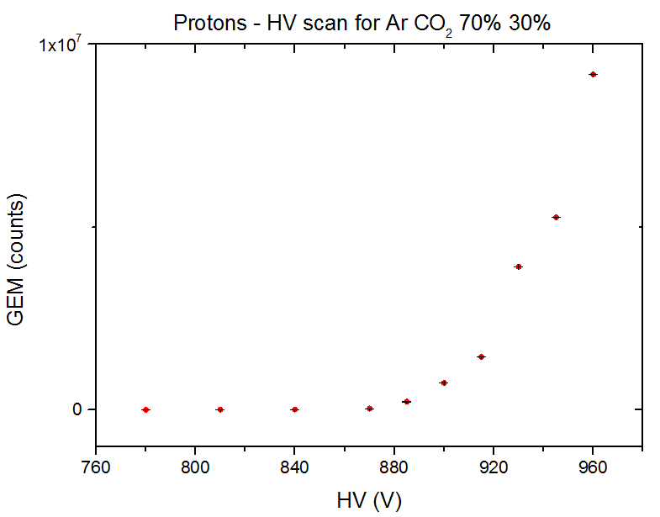
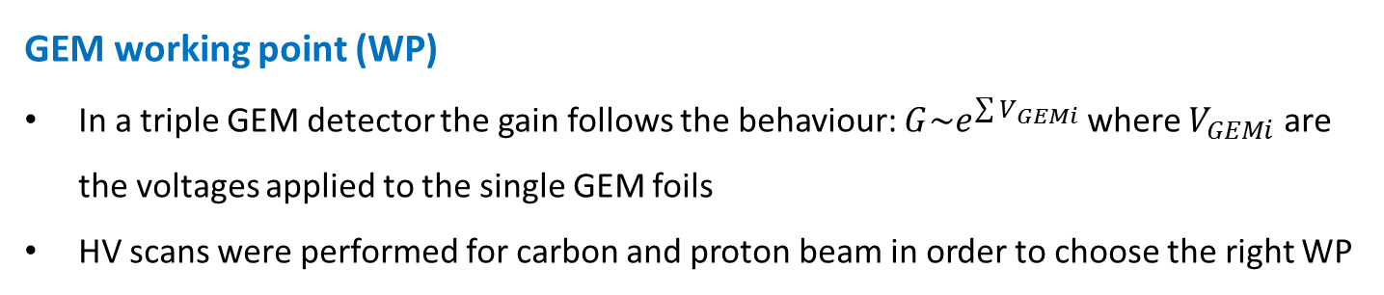
GEM working point (WP)
In a triple GEM detector the gain follows the behaviour: $G\sim e^{\sum{V_{GEMi}}}$ where $V_{GEMi}$ are the voltages applied to the single GEM foils
HV scans were performed for carbon and proton beam in order to choose the right WP
WP = 960 V
WP = 960 V

Slide 8
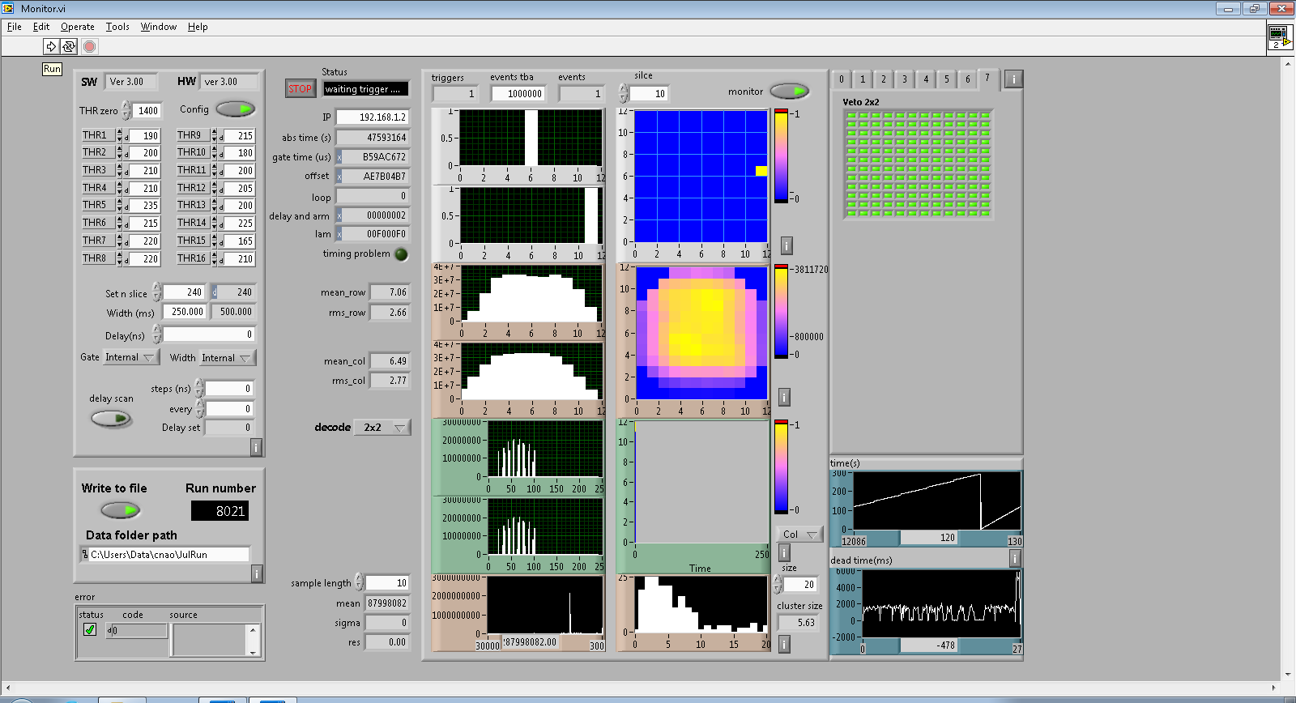
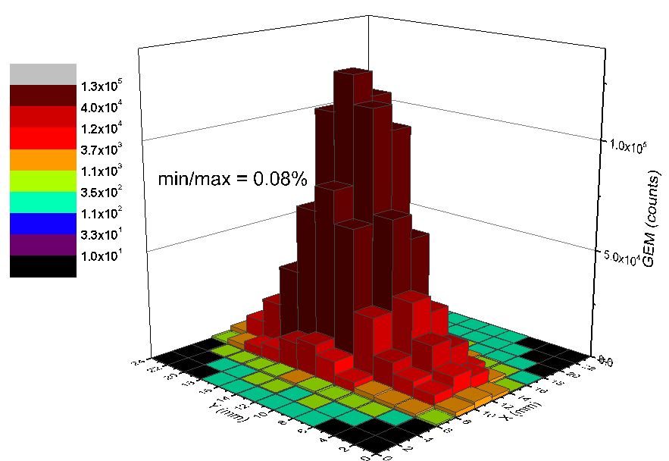
Paint procedure reconstruction with triple GEM
The paint procedure can be recorded and reconstructed offline through the data acquisition system [4, 5]
The result of the complete scan procedure is shown in the acquisition program
A
C
B

Slide 9
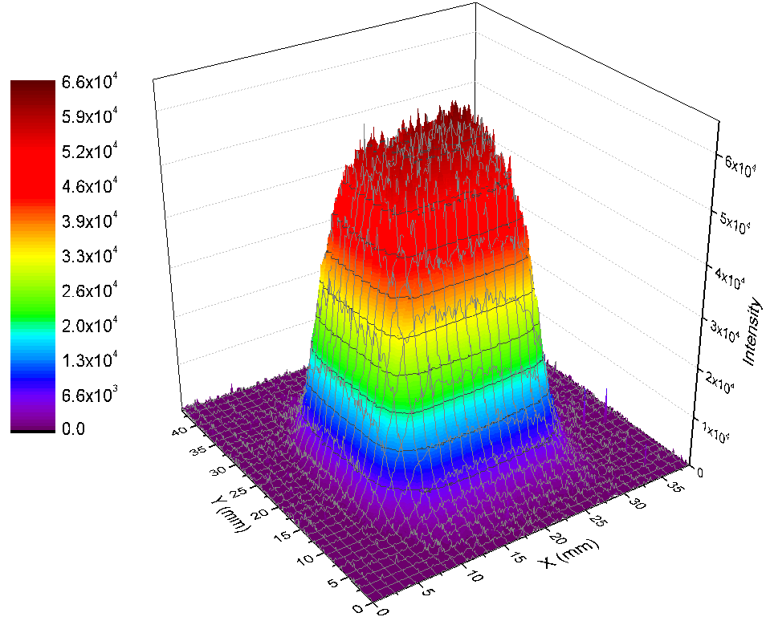
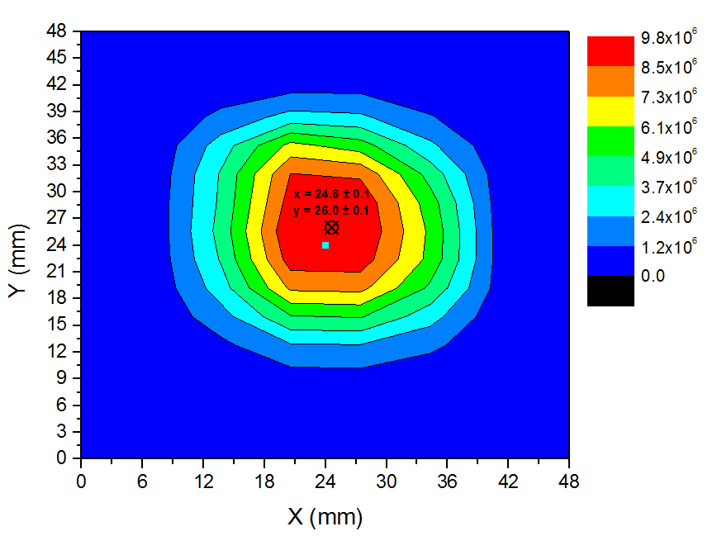
Radiochromic foil & GEM 3x6 mm² pads.
Beam 126 mm depth in water, 5e6 part per spot. Paint 2x2 cm²

Slide 10
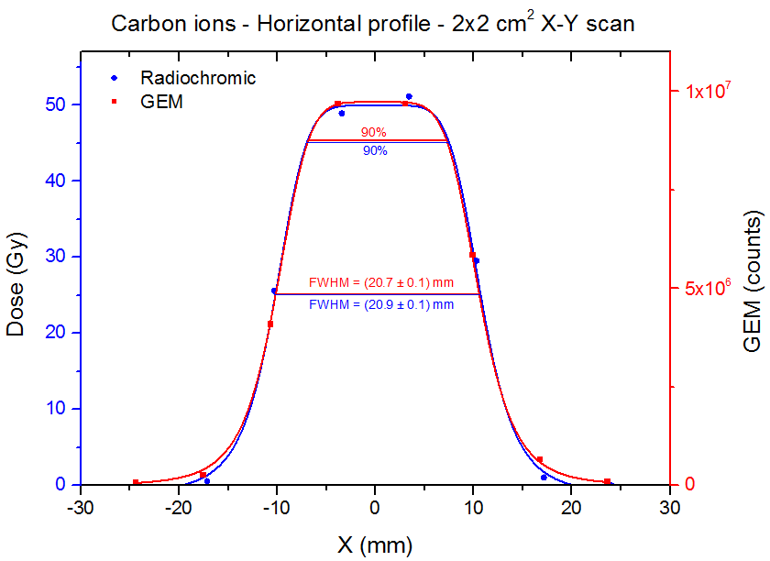
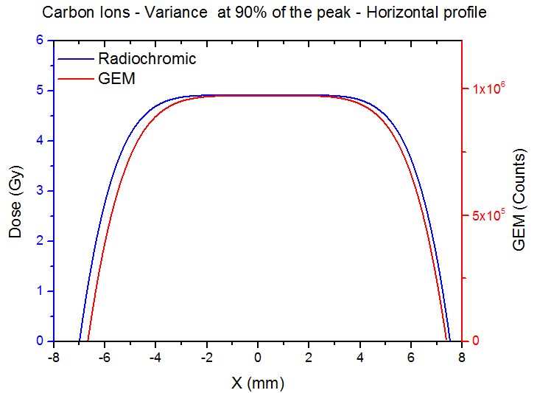
Pad 3x6 mm² X-Y scan 2x2 cm²
Left: horizontal profile for Radiochromic and GEM
Right: Variance at 90% of the max high (from fit)

Slide 11
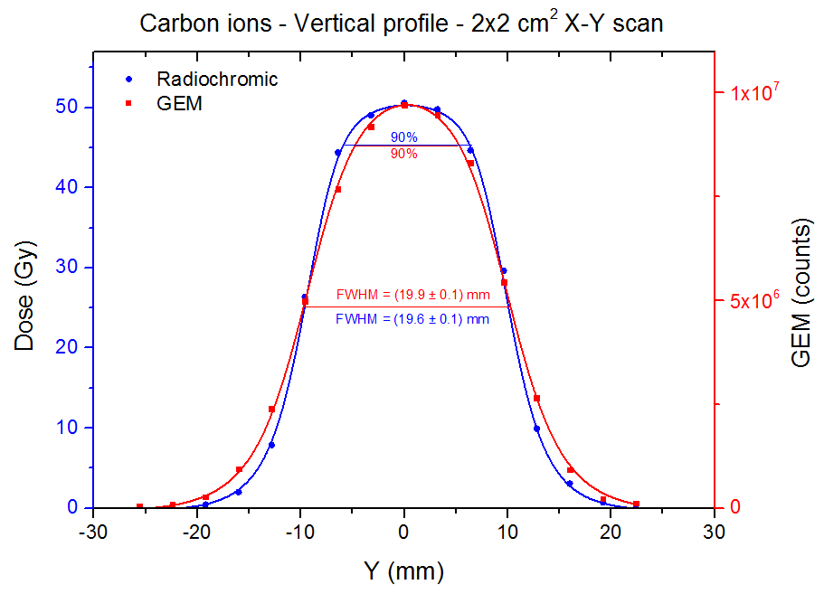
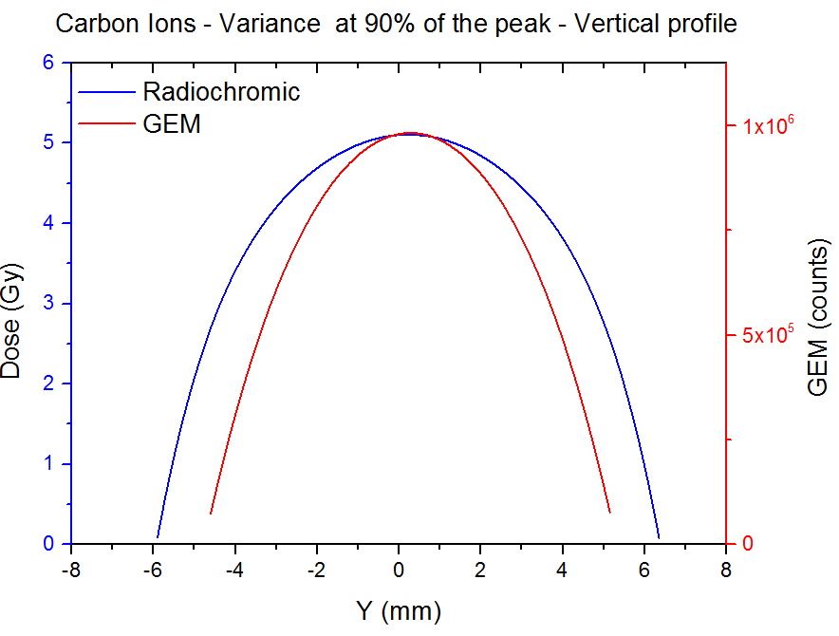
Pad 3x6 mm² X-Y scan 2x2 cm²
Left: Vertical profile for Radiochromic and GEM
Right: Variance at 90% of the max high (from fit) for Radiochromic and GEM

Slide 12
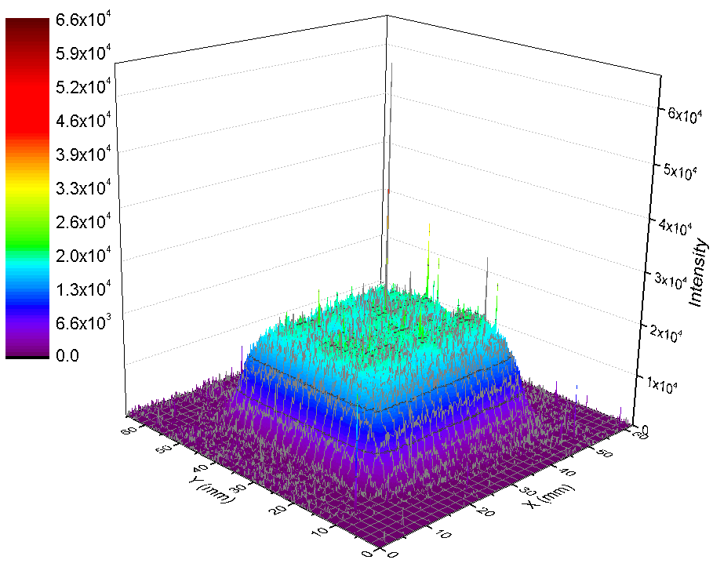
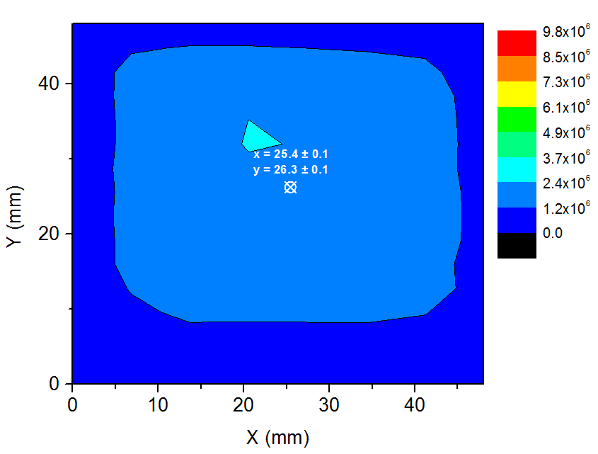
Radiochromic foil & GEM 3x6 mm² pads.
Beam 126 mm depth in water, 1e6 part per spot. Paint 2x2 cm²

Slide 13
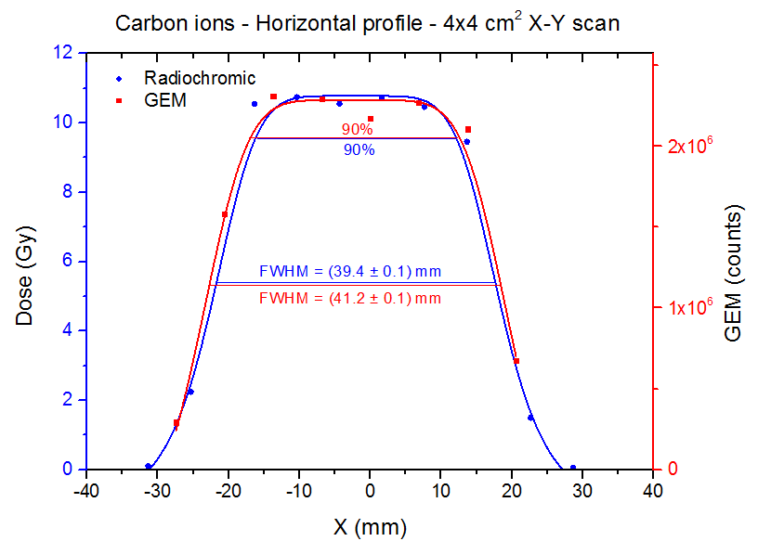
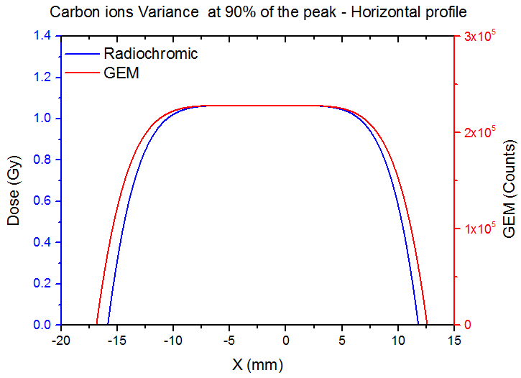
Pad 3x6 mm² X-Y scan 4x4 cm²
Left: horizontal profile for Radiochromic and GEM
Right: Variance at 90% of the max high (from fit)

Slide 14
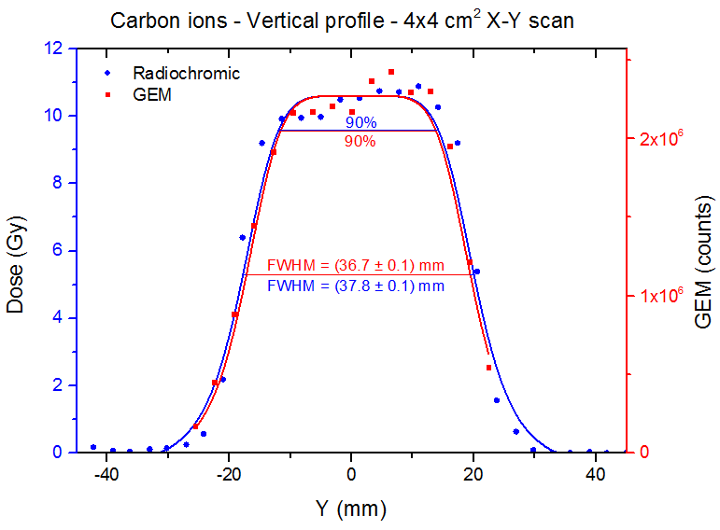
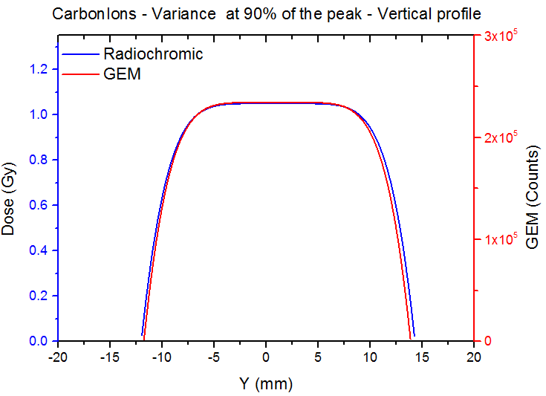
Pad 3x6 mm² X-Y scan 4x4 cm²
Left: Vertical profile for Radiochromic and GEM
Right: Variance at 90% of the max high (from fit) for Radiochromic and GEM

Slide 15
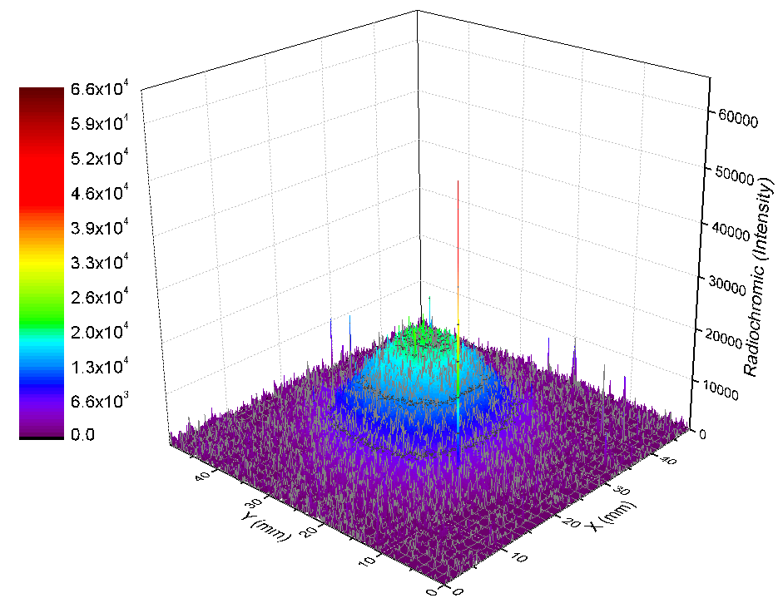
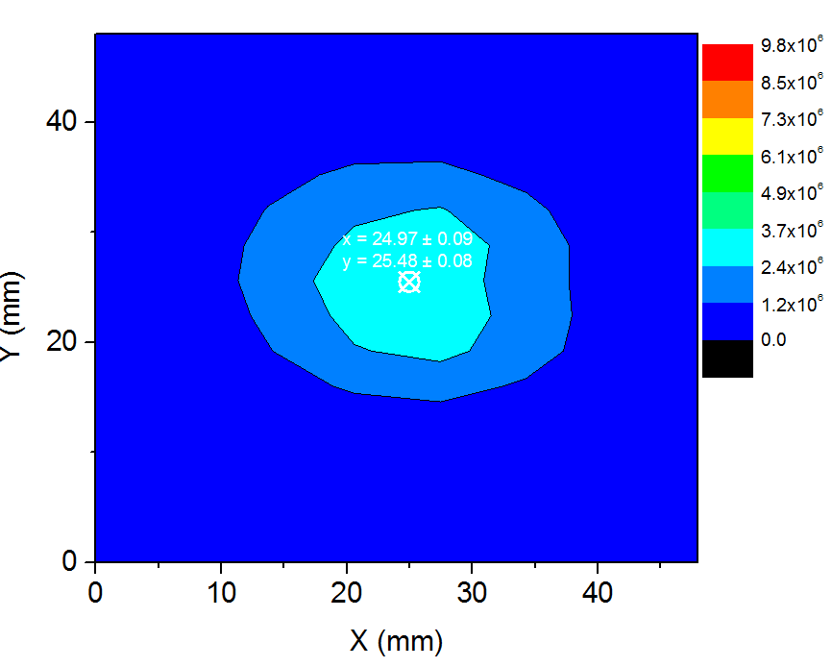
Radiochromic foil 3x6 mm² pads.
Beam 126 mm depth in water, 1e7 part per spot. Paint 2x2 cm²

Slide 16
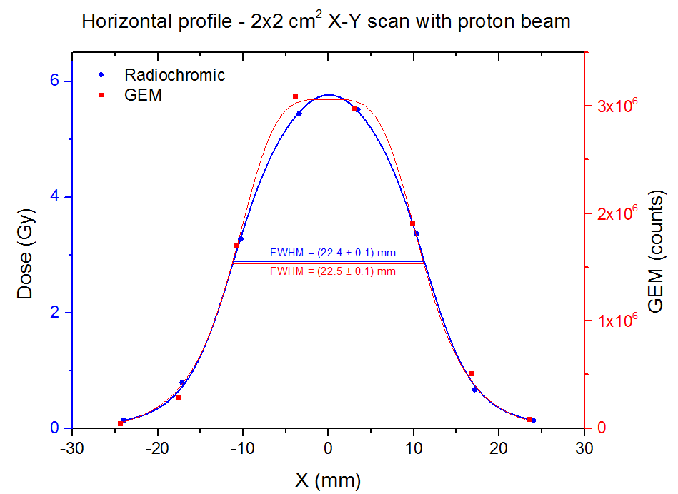
Pad 2x2 mm² X-Y scan 2x2 cm²
Left: horizontal profile for Radiochromic and GEM
Right: Variance at 90% of the max high (from fit)

Slide 17
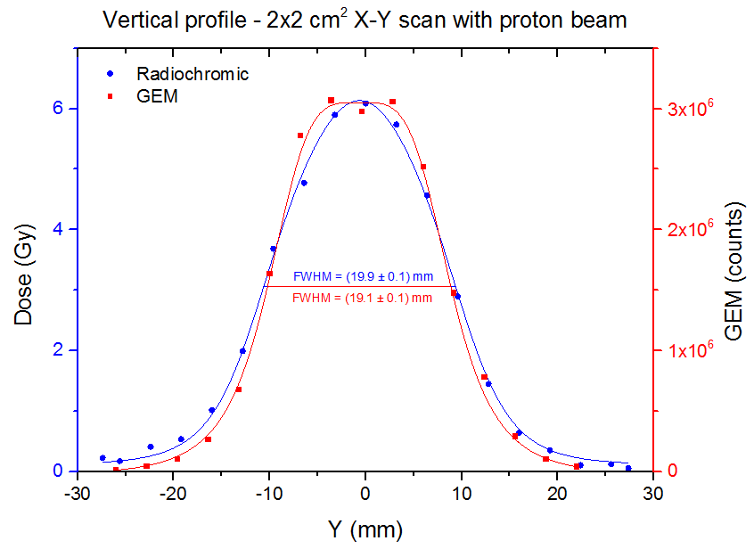
Pad 2x2 mm² X-Y scan 2x2 cm²
Left: Vertical profile for Radiochromic and GEM
Right: Variance at 90% of the max high (from fit) for Radiochromic and GEM

Slide 18
Conclusions:
The read out system can register the timing of the paint procedure with negligible dead time
The timing, the profiles and the image of the complete procedure are shown on line
The offline analysis shown a good agreement with the radiochromic foils

Slide 19
References:
[1] F. Sauli, GEM: A new concept for electron amplification in gas detectors, Nuclear Instruments and Methods in Physics Research A386, p 531, 1997
[2] M. Alfonsi et al., The triple-Gem detector for the M1R1 muon station at LHCb, N14-182, 2005 IEEE-NSS
[3] E. Aza et al., The triple GEM detector as beam monitor for relativistic hadron beams, JINST 9 P06006, 2014
[4] W. Bonivento et al., Development of the CARIOCA front-end chip for the LHCb muon detector, Nuclear Instruments and Methods in Physics Research A491, pp. 233–243, 2002
[5] F. Murtas et al., Applications in beam diagnostics with triple GEM detectors, Nucl. Instrum. Meth. A
617 (2010) 237.

Slide 20
Radioactive waste
Scientific activity 2014

Slide 21
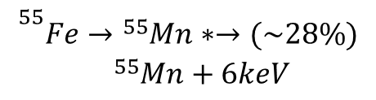
Motivation
Materials in accelerator environment are activated by radiations [1]
In order to treat this materials after the decommissioning, it is necessary a characterization to know the nuclide population
Gamma emitters are easily recognised by γ spectrometry
The challenge is to measure the ⁵⁵Fe amount
A detector with high efficiency to ⁵⁵Fe and high γ rejection to is needed
$${}_{}^{55}{\begin{aligned}Fe→{}_{}^{55}{Mn}∗→(\sim 28\%) \\ {}_{}^{55}{Mn+6keV}\end{aligned}}$$

Slide 22
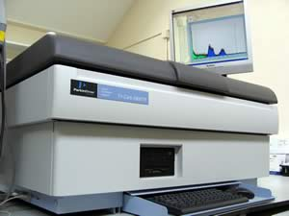
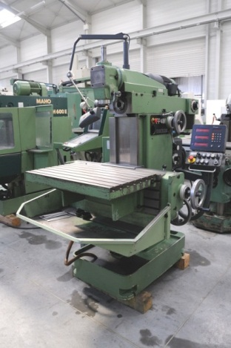
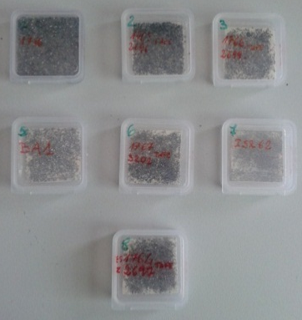
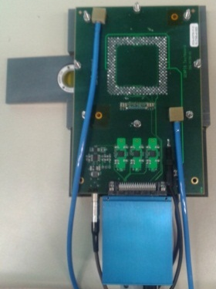
12 samples
Ext. Lab
GemPix
Fraiseuse DECKEL FP4M
Vitesse de rotation broche : 400tr/mn
Vitesse d avance : 40mm/mn
Type de fraise utilisee : Fraise d ebauche carbure monobloc MTC TiAIN 6mm Garant (ref SFS 205712 6°)
Boxes supplied by SMIPA s.r.l
Dimension: 38x38x4 mm³
Weight: ± 0.15%
Measurements for Fe-55 concentration with GEMPIX:
Drift gap 11 mm
Support conceived for measurements with samples and calibration sources
Comparison with PSI laboratories measurements (Radio Chemcal Analysis – RCA)

Slide 23
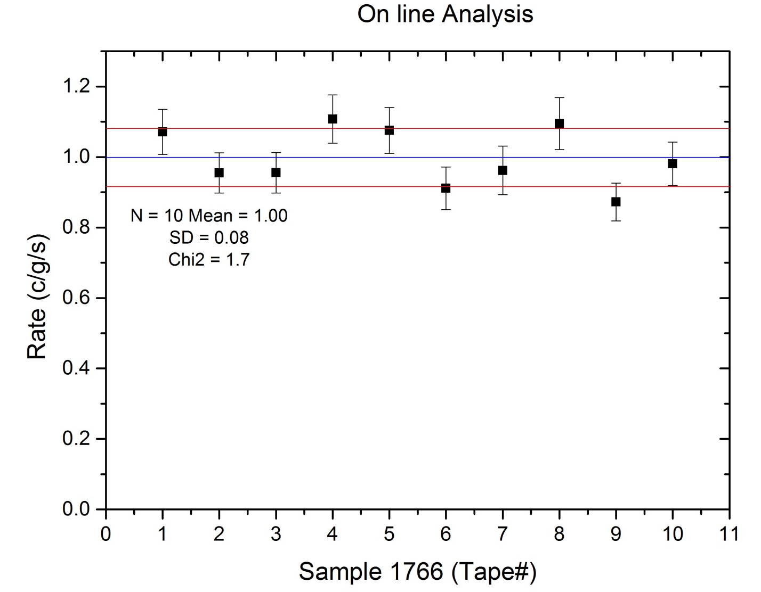
Sample reproducibility
Dust obtained from
1 Sample → 10 tapes
Analysed with GEMPIX
With on line analysis.

Slide 24
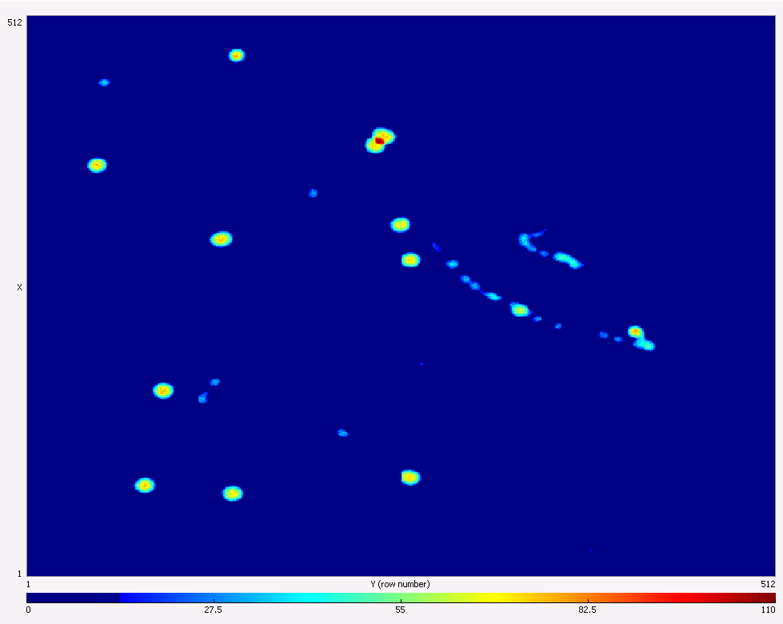
Detector calibration
Gate: 1 s
HV 1200 V
Gas flux: 3.5 l/h
THR:
0: 393
1: 398
2: 497
3: 420
Clk: 24
Ikrum: 5
Polarization: -
X-ray candidates
Bck

Slide 25
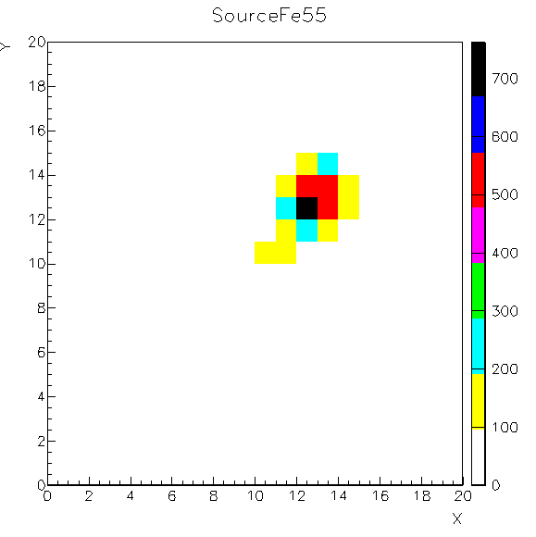
Detector Calibration: cluster diameter
Calibration with Fe-55 source
X min: 11
X max: 15
Y min:11
Y max: 16

Slide 26
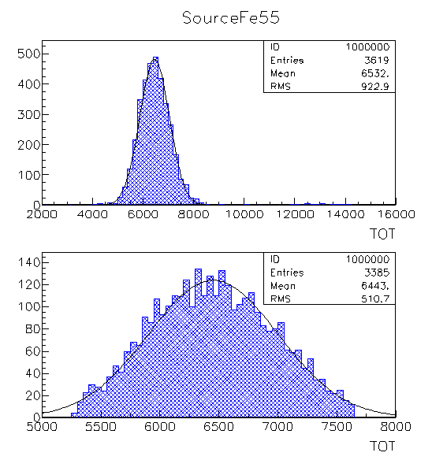
Detector calibration: TOT
Calibration with Fe-55 source: TOT without size cut
Calibration with Fe-55 source: TOT with size cut
TOT = 6451 ± 551

Slide 27
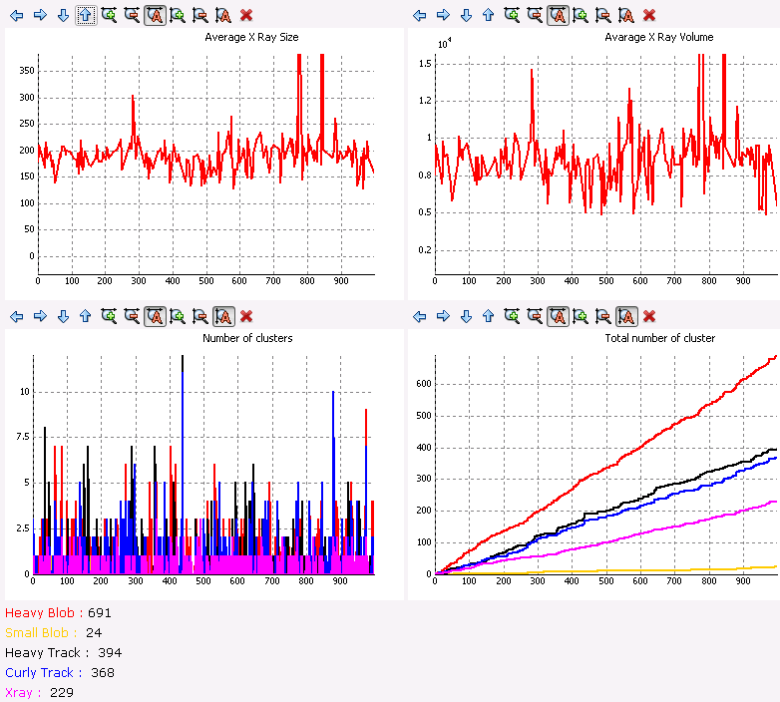
On line analysis
Once that the calibration values are set in the Python script, the online analysis is done

Slide 29
Conclusions:
The GEMPix can better discriminate the x-rays working on cluster recongnition and TOT
With the python script it is possible to have an on line results after a calibration with a source
The last result seems to be in good agreement with the external laboratory (PSI)
The procedure is faster and cheaper than the usual RCA

Slide 30
References:
[1] F.P. La Torre et al., Radiological Hazard Classification of materials in CERN’s accelerators, CERN technical note 2012 1184236

