Slide 1


Kevin Loo: ESR 8
Third Annual ARDENT Workshop

Slide 2
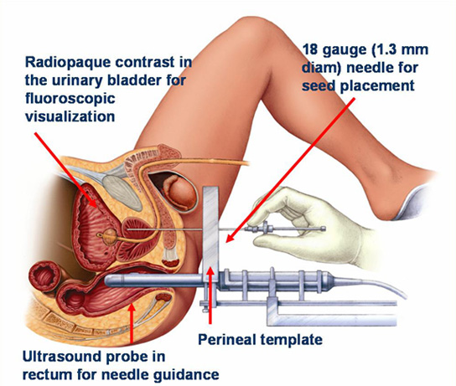
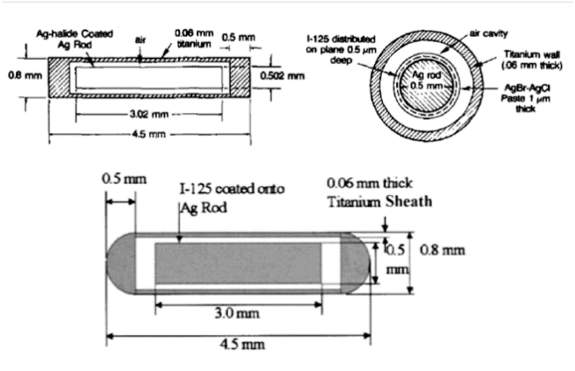
BrachyView: major progress update
“Application of Medipix detectors for medicine and radiation safety”
Three major studies completed for feasibility study of pinhole application of Timepix detectors
Two publications in 2013
3rd nearing draft completion – under revision with supervisors
4th major set of data being finalised

Slide 3
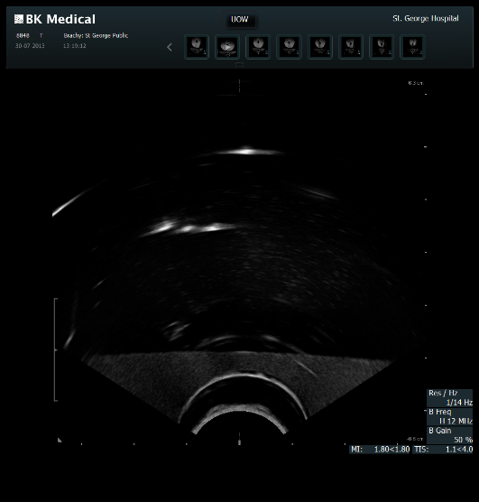
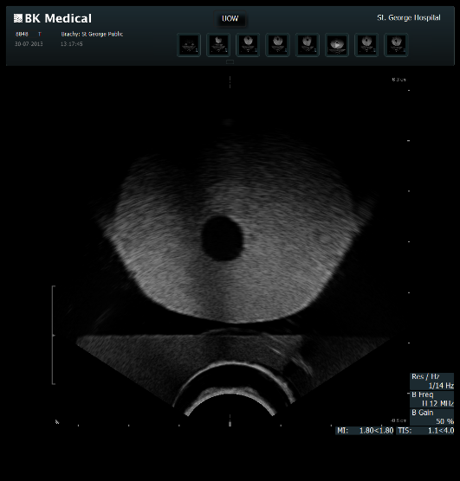
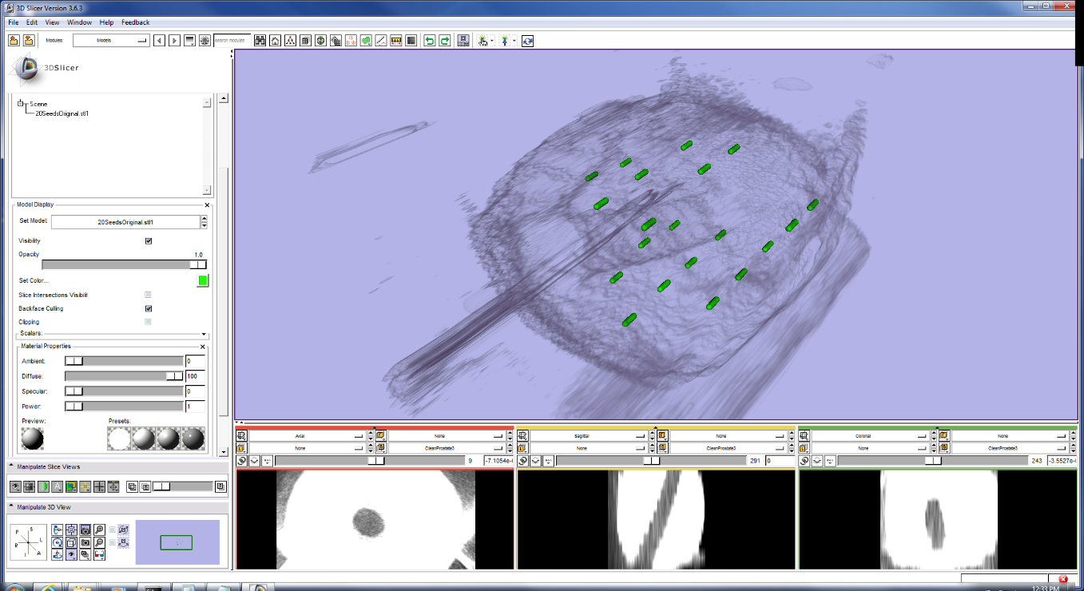
Multiple seed study
20 seed data fused with clinical CT scan (and even ultrasound data)
More detailed error analysis shows little uncertainty in BrachyView approach
However, still reliant on single detector set-up
Development of 3D visualisation software shows much potential
Includes supervision and advising Masters and PhD students in Australia

Slide 4
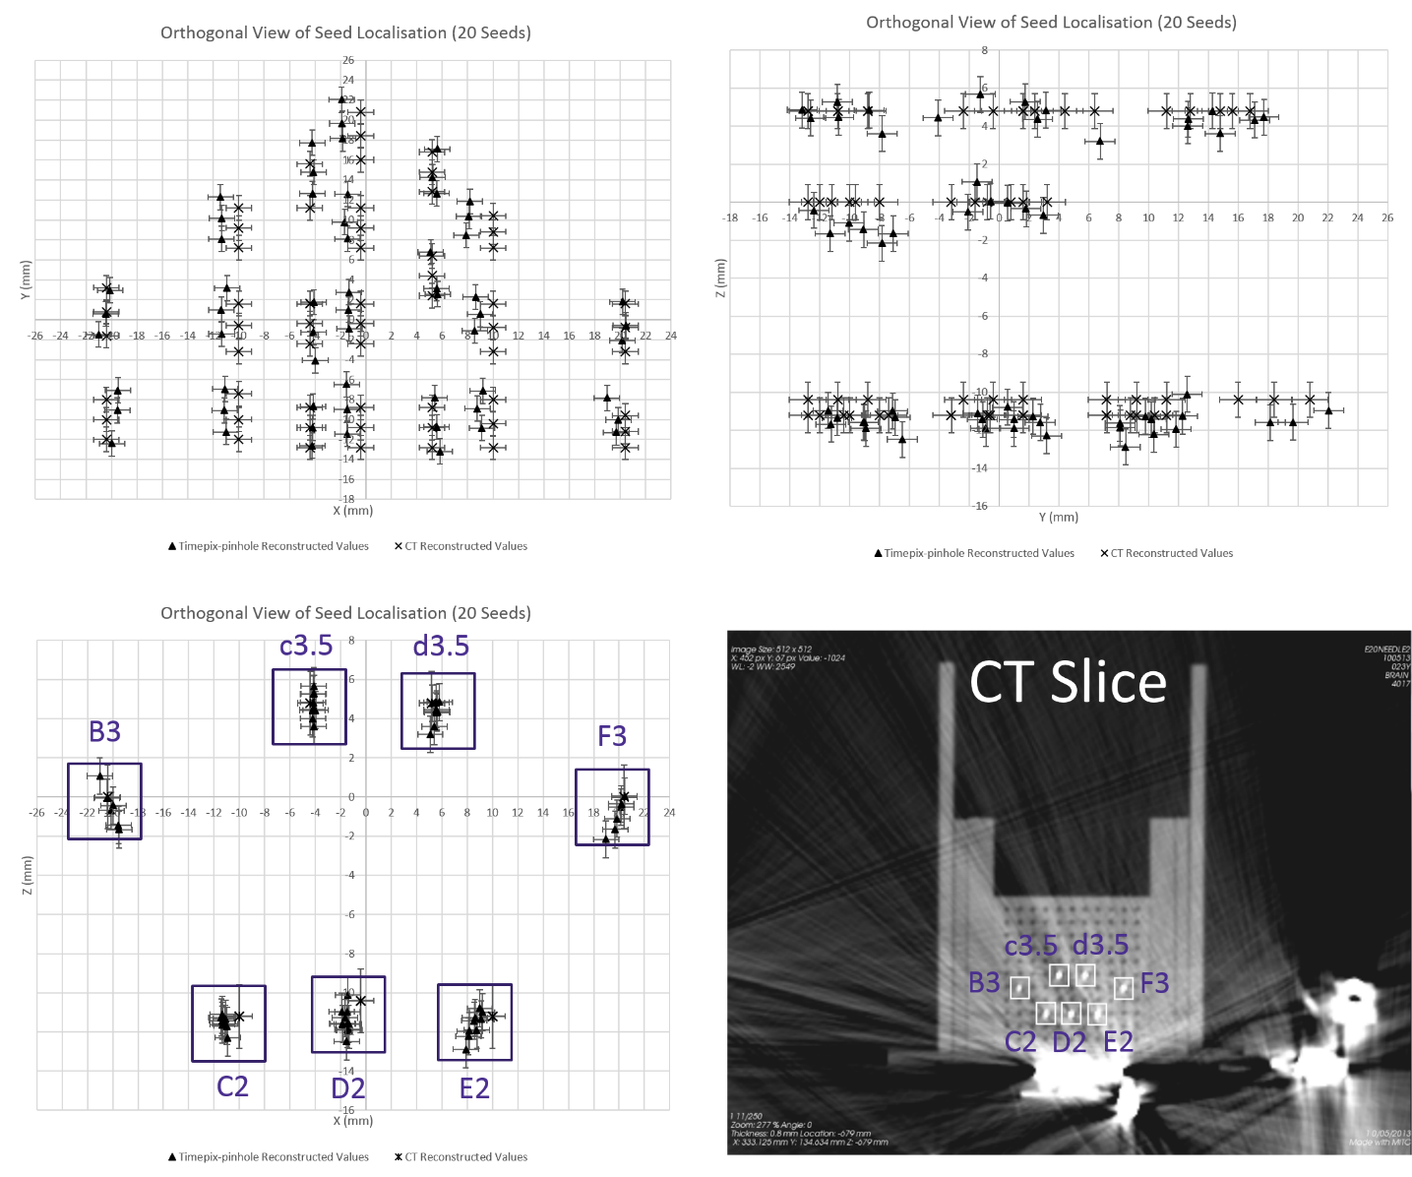
Multiple Seed study

Slide 5
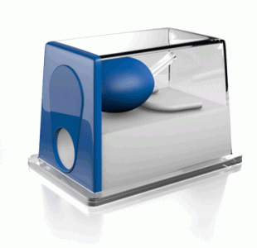
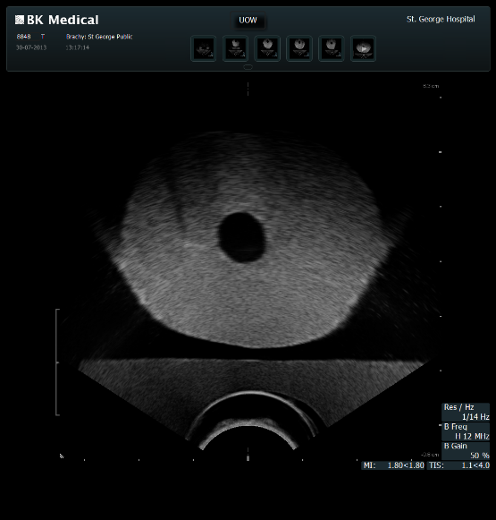
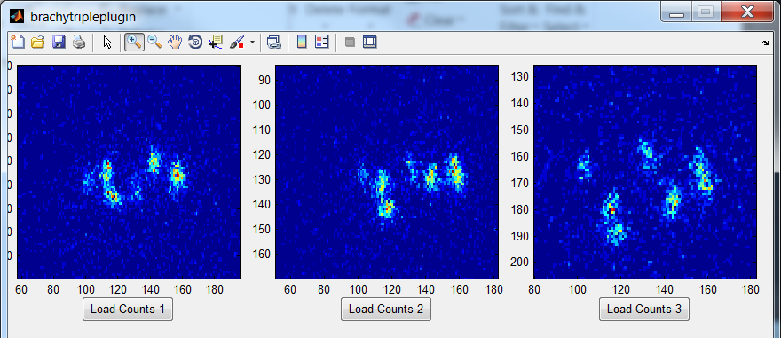
Gel phantom study
Use medical ultrasound phantom and real TRUS data
Data shows some systematic error, possibly due to uncertainty in detector position
Currently under analysis

Slide 6
Gel phantom

Slide 7
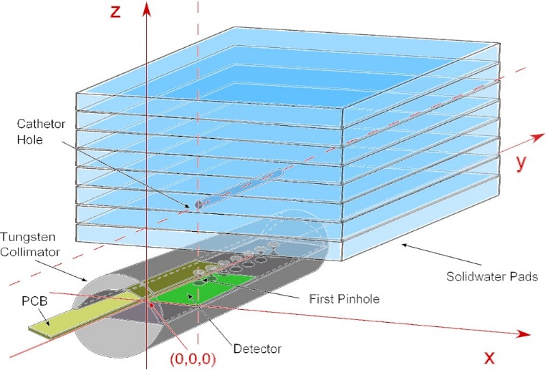
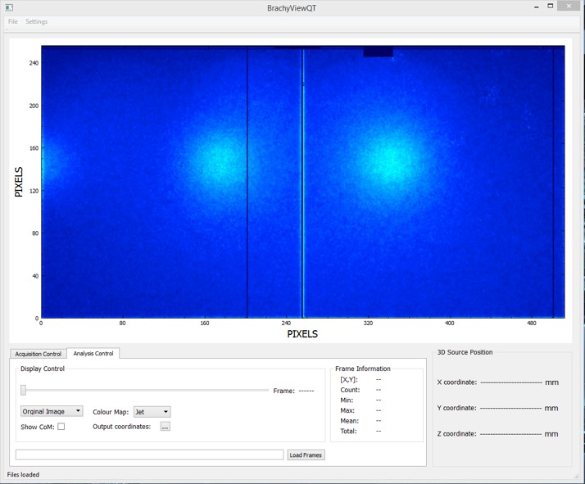
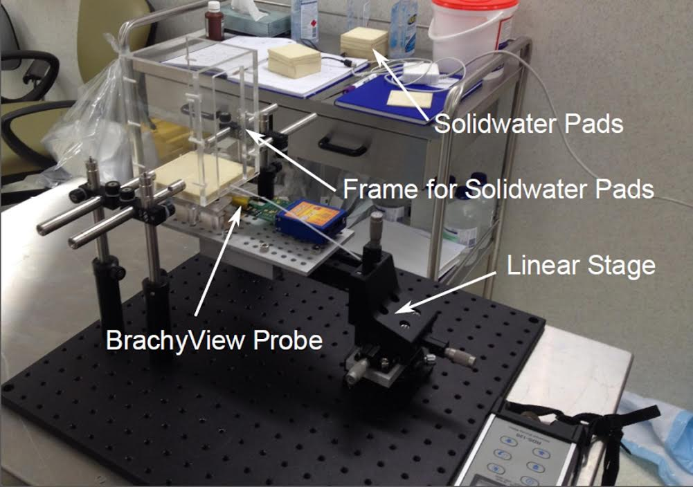
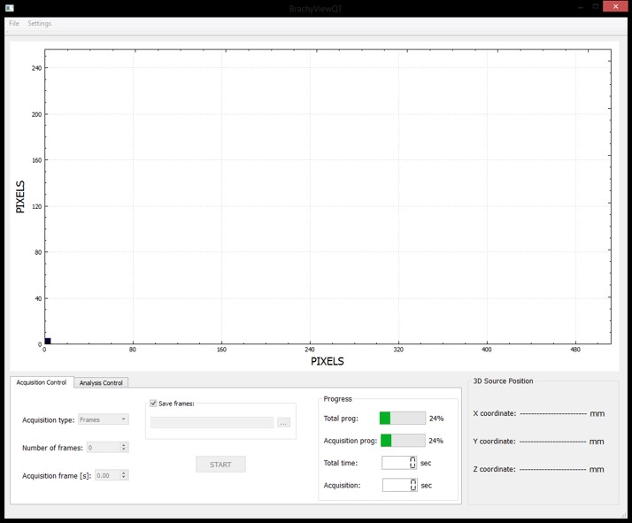
Software Development
Interface with Pixelman to create standalone BrachyView software
Currently in development with PhD student Saree Alnaghy (HDR division)

Slide 8
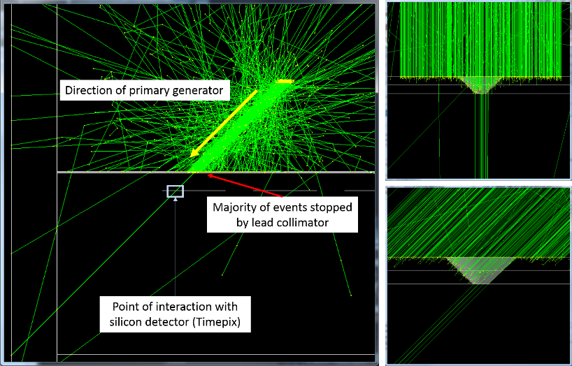
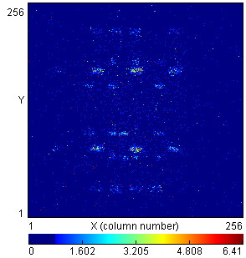
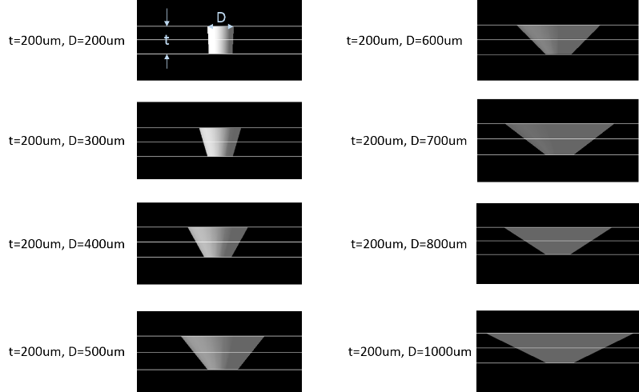
GEANT4 Study
Pinhole characterisation
Good preliminary results, but more statistics needed

Slide 9
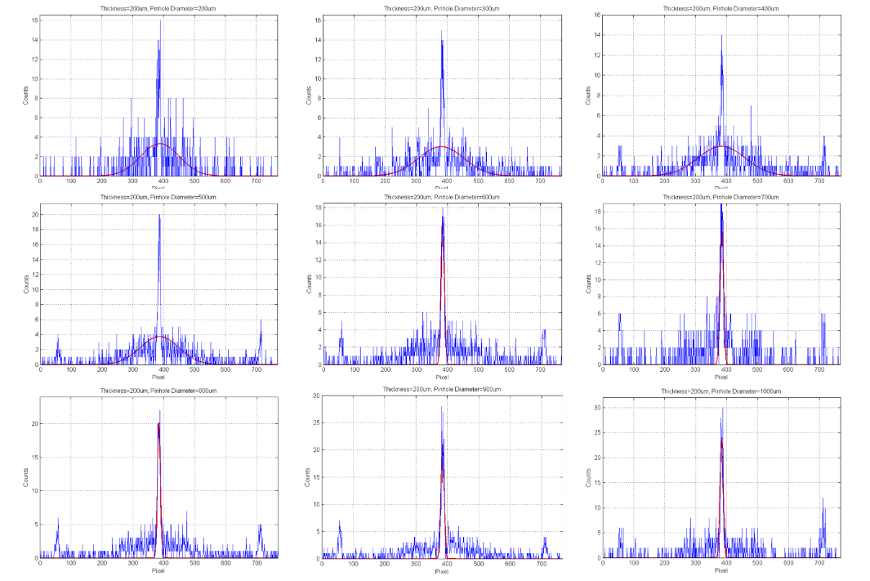
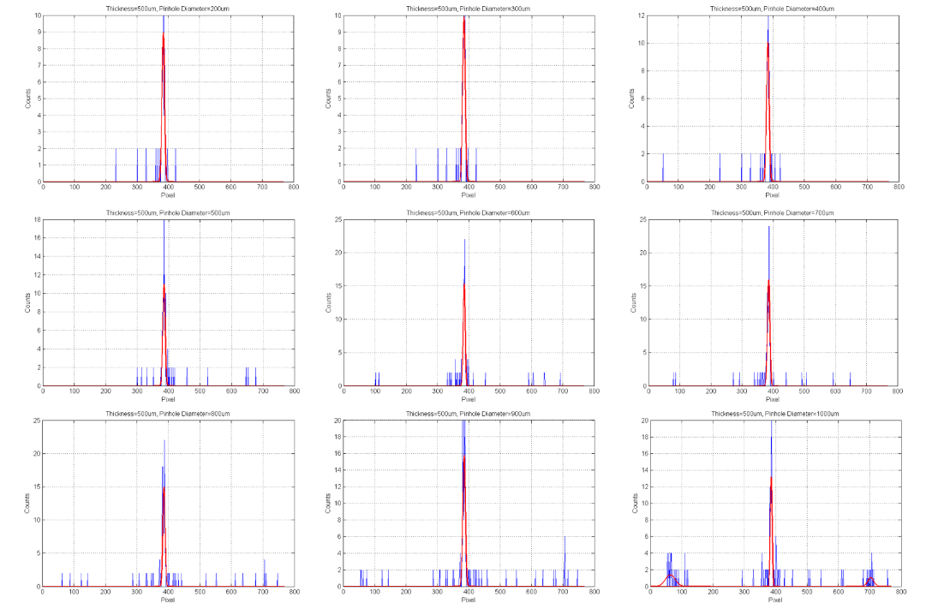
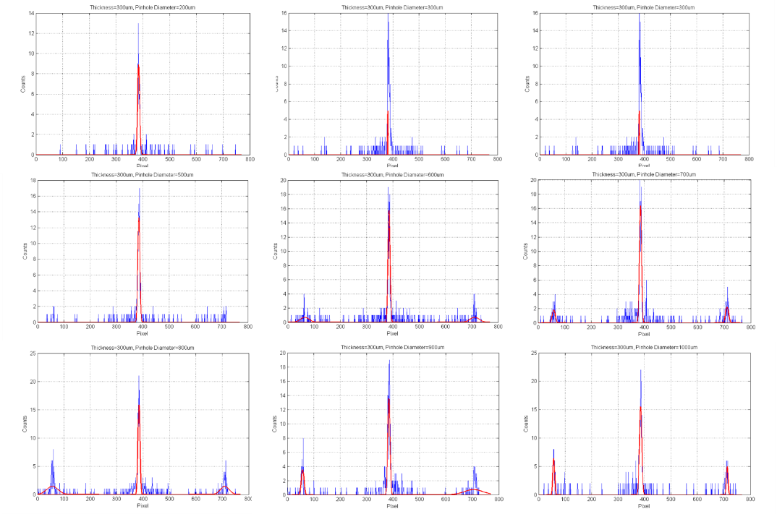
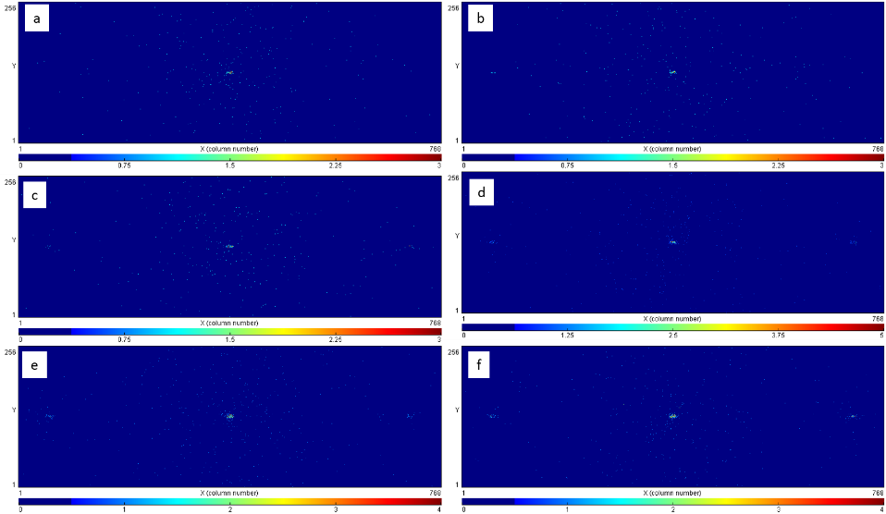
GEANT4 Study

Slide 10
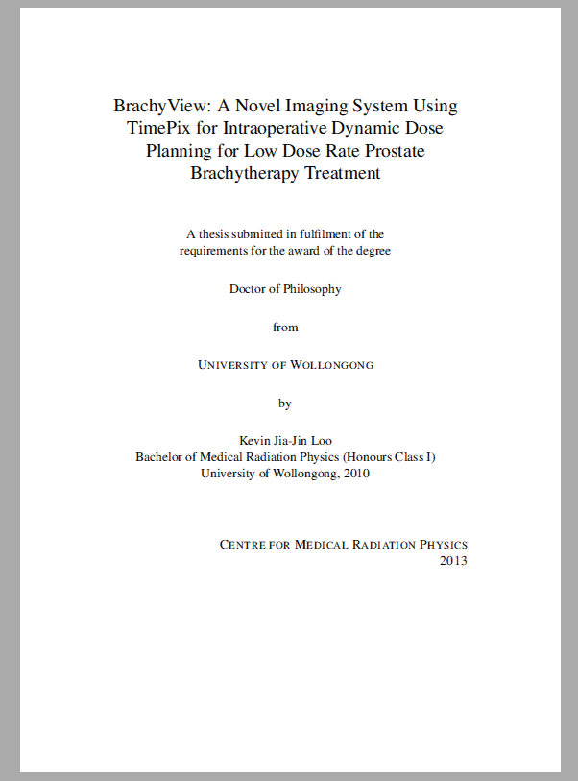
Thesis
Thesis due early 2015
Third draft under review by principal supervisors
Structure:
  Introduction/Lit Review
  BrachyView Design
  Simulation studies
  Experimental pinhole studies
  Tomographic studies
  Soft tissue diagnostic study

Slide 11
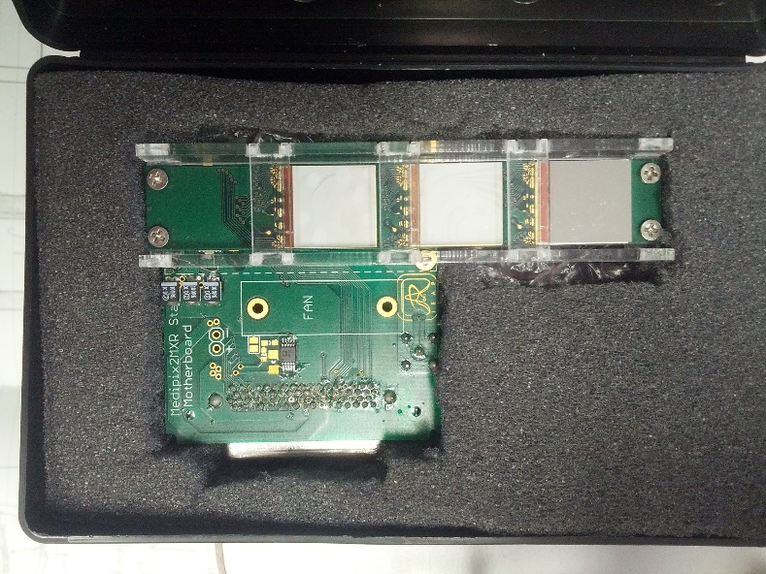
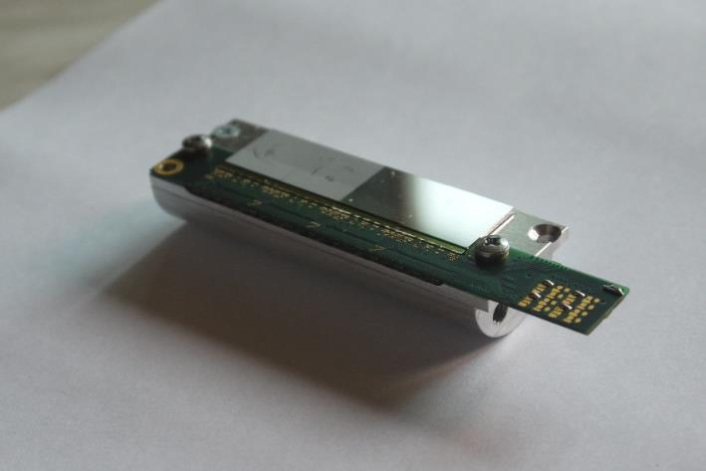
Future Work
Development of functional quad detector using 4 x 300 um Si sensors
Earlier prototypes tested successfully
Pinhole characterisation should also be performed (can compare with MC results)
V1.1: triple detector, gaps between each sensor for wire bonds, 2012
V2.0: quad detector based on gapless design, new wire bonding technique
V2.1

Slide 12
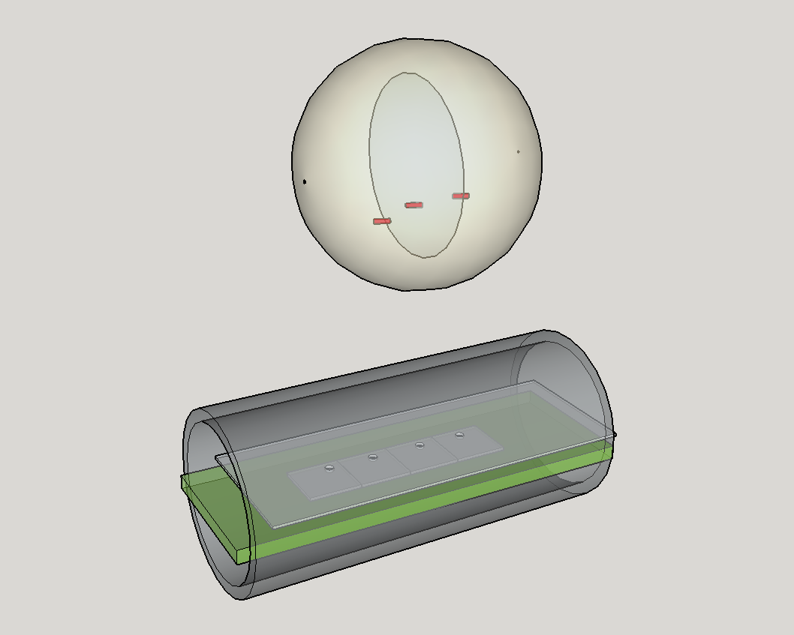
Future Work: BrachyView Probe
Reverse-engineering of BrachyView Probe
Implanted I-125 seeds
24 mm TRUS probe
Quad detector (14x52 mm²)
Pinholes in lead
collimator

Slide 13
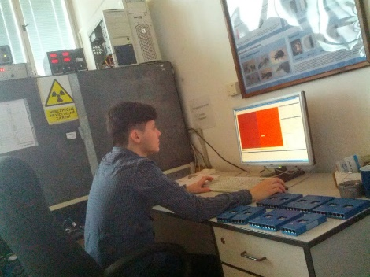
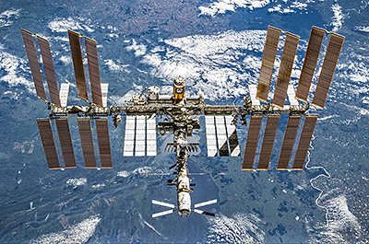
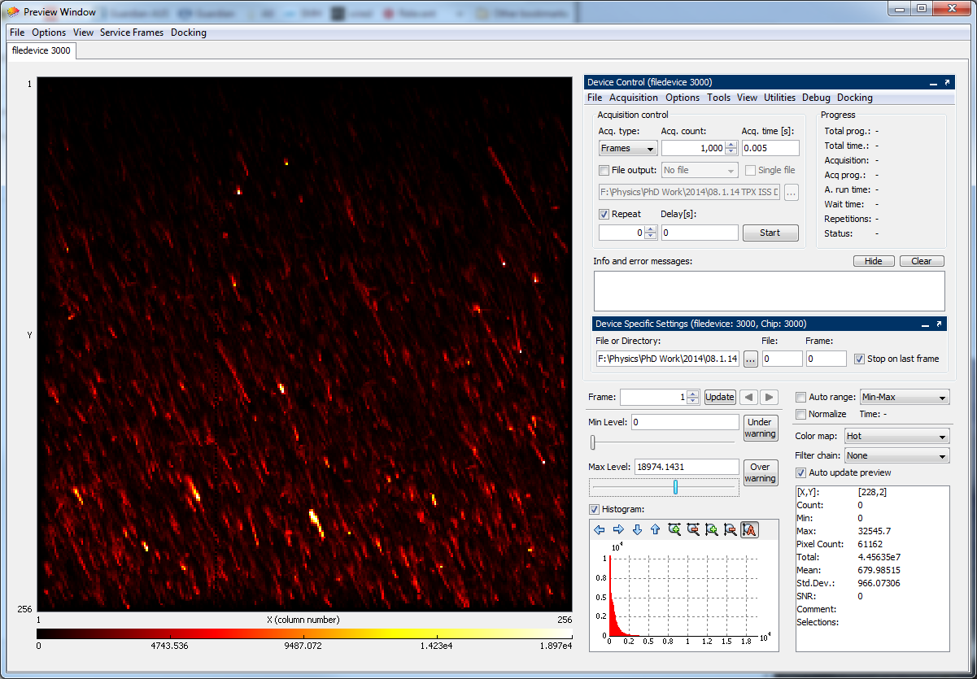
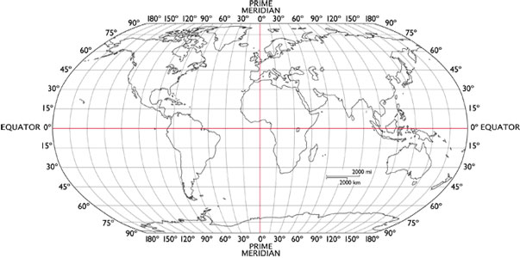
Future Work
Not related to BrachyView:
  Assisting ESR 7 with data analysis taken from ISS
  Obtaining detector calibration and looking at particle fluence as a function of orbit position and time
  Currently in progress

Slide 14


Road Map 2015
Finalise PhD thesis (and graduate!!!)
Prototype a fully functional BrachyView probe and continue collaborations with medical centres
Refine source localisation process (software and hardware developments)
Train other students in the use of Medipix and fundamentals of radiation detection and protection using semiconductor devices
  Educational tool
  Undergraduate, Masters students (CMRP, UOW)
Obtain experience in fields outside medical imaging (e.g. working with ESR 7)

Slide 15
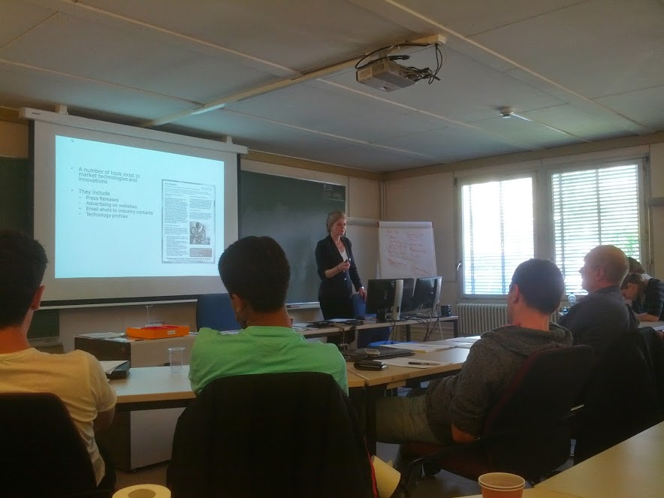


Conferences, Training, Secondments
ARDENT Business and Administration: 19-23 May, 2014
CMRP, UOW: 7 June – 8 July, 2014
FUTURE
IEEE NSS-MIC: 8 – 15 November, 2014 [‘Image quality in adaptive and multimodality imaging’ short course]
Business and Administration internship: early 2015, IBA Dosimetry

Slide 16
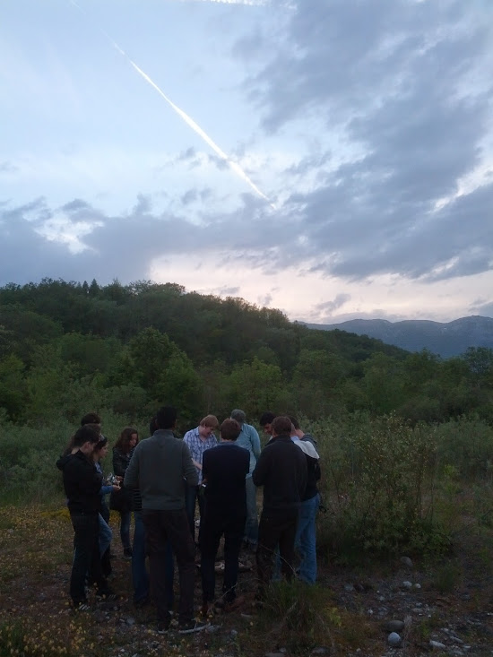
THANK YOU!

