Slide 1
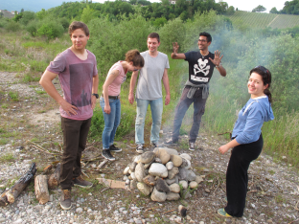
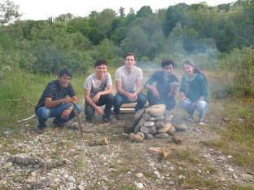
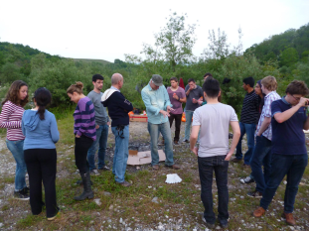
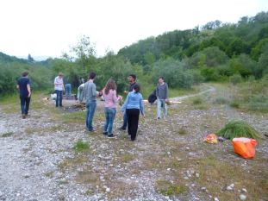
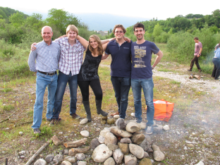

Francesca Bisello
ESR 10
III ARDENT
Annual Workshop
29/09-02/10/2014
IBA Dosimetry

Slide 2

Outline
Outline
Research Activities
Conferences
Training and Secondments
I. Research Activities
II. Conferences
III. Trainings and Secondments

Slide 3

Research
Activities

Slide 4
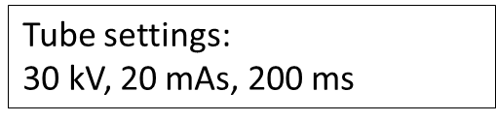
Dosepix Characterization
General overview
Outline
Research Activities
Conferences
Training and Secondments
Dosepix detector as Quality Assurance tool in diagnostics

Slide 5
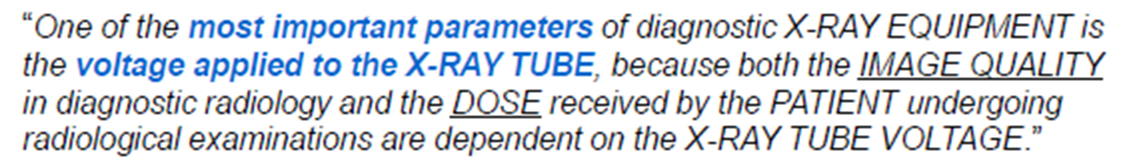
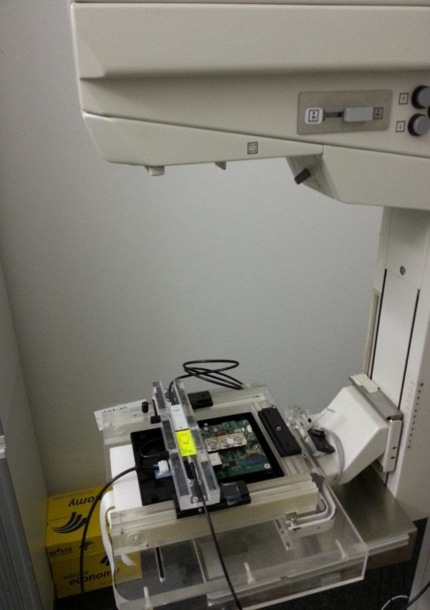
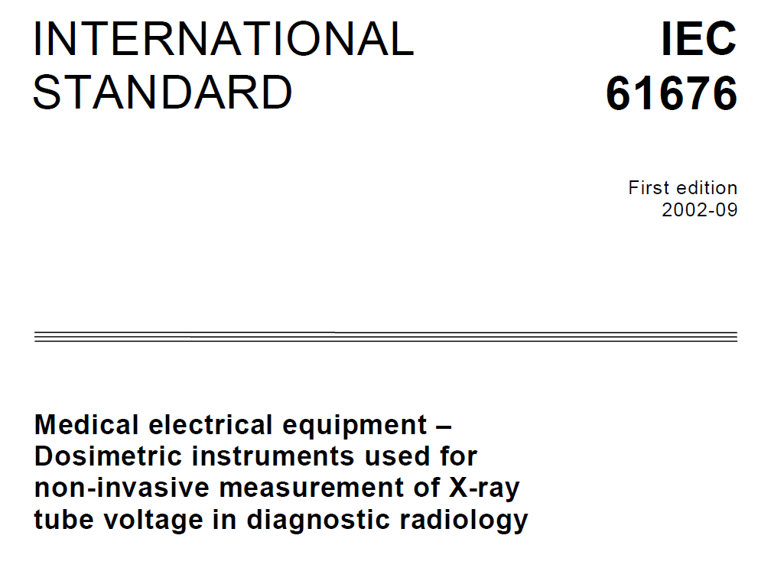
Dosepix Characterization kVp-meter in mammography
Outline
Research Activities
Conferences
Training and Secondments

Slide 6
Dosepix Characterization
Sum up of activities
Outline
Research Activities
Conferences
Training and Secondments
October 2013 – October 2014:
Dosepix as kVp-meter in mammography
Radiation Tolerance studies
Temperature characterization

Slide 7
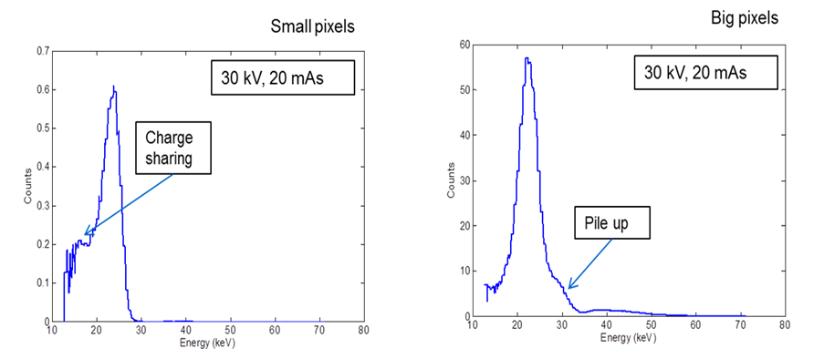
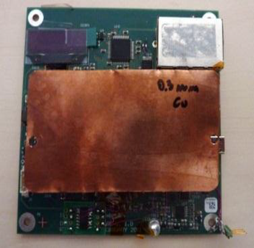
Dosepix Characterization kVp-meter in mammography
Outline
Research Activities
Conferences
Training and Secondments
Image quality and dose depend on the xRay tube voltage
Big Pixels
Tube setting:
30 kV, 20 mAs
Mo-Mo
Tube setting:
30 kV, 20 mAs
Mo-Mo

Slide 8
Dosepix Characterization kVp-meter in mammography
Outline
Research Activities
Conferences
Training and Secondments
kVp: fitting the end point of the spectrum
Additional filtration: 0.3mm Cu
Counts/big pixel/s: 1.5 · 10⁴ Hz [ count rate without filtration : 5· 10⁴ Hz ]

Slide 9
Dosepix Characterization
RadiationTolerance studies
Outline
Research Activities
Conferences
Training and Secondments
10-28/02/2014
Secondment at CERN
Radiation Tolerance Studies
Measurement Session:
Accumulated dose for the test:
5 kGy in step of 200 Gy
Tube settings:
40 kV, 2 mA dose rate 4.83 Gy/min

Slide 10
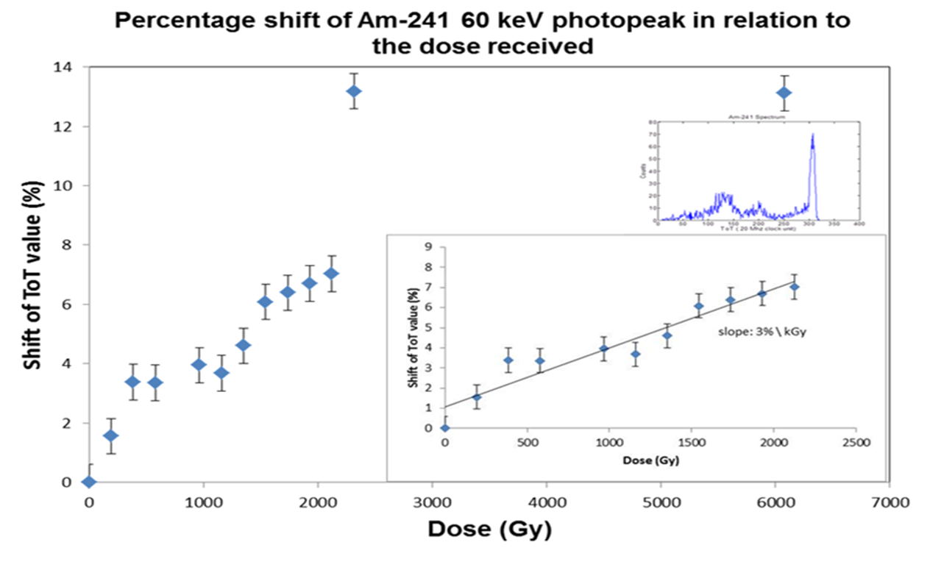
Dosepix Characterization
Radiation Tolerance studies
Outline
Research Activities
Conferences
Training and Secondments

Slide 11

Dosepix Characterization
Radiation Tolerance studies
Outline
Research Activities
Conferences
Training and Secondments
Poster Presention IEEE 2014, 8-15 November 2014
“Investigation on the radiation tolerance of Dosepix detector”
F. Bisello, W.S. Wong , E.Frojdh , J.Alozy I. Ritter, A.Zang, M. Campbell, J.C.Celi, G.Anton and T.Michel
  Deeper analysis of effect around mammographic energies
  Investigations in damages in the sensor or in the chip

Slide 12
Dosepix Characterization
Temperature Characterization
Outline
Research Activities
Conferences
Training and Secondments
First Measurement Session: CERN (secondment)
Addidtiona Investigations: IBA Dosimetry
Measurement Session:
Range required by the regulation: 15°- 35 °C
Instability < 1%

Slide 13
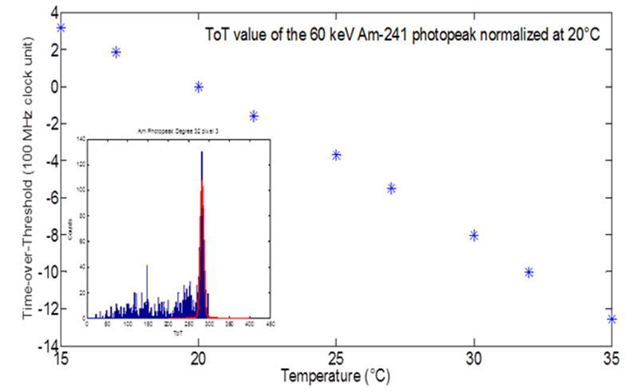
Dosepix Characterization
Temperature Characterization
Outline
Research Activities
Conferences
Training and Secondments

Slide 14
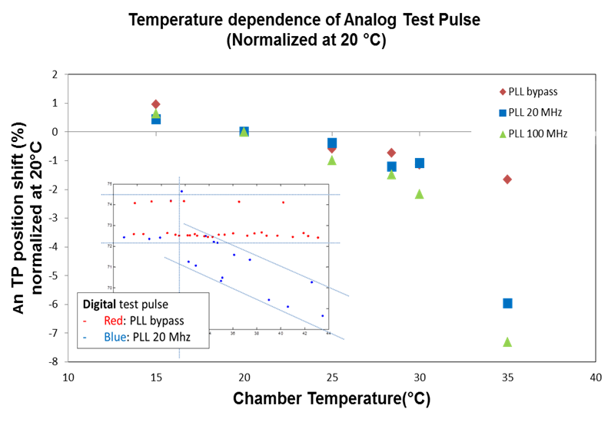
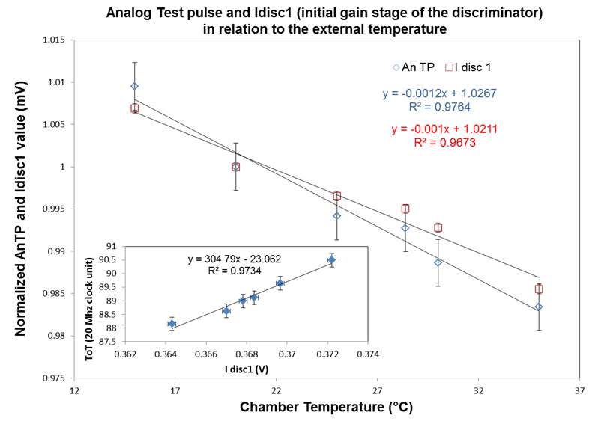
Dosepix Characterization
Temperature Characterization
Outline
Research Activities
Conferences
Training and Secondments
Source of instability (I):
PLL circuit
Source of instability (II):
Bias current of initial gain stage of the discriminator

Slide 15
Dosepix Characterization
Temperature Characterization
Outline
Research Activities
Conferences
Training and Secondments
Next steps:
Evaluate the possibility to bypass the PLL circuit
Find other more stable configurations for the analog front end

Slide 16
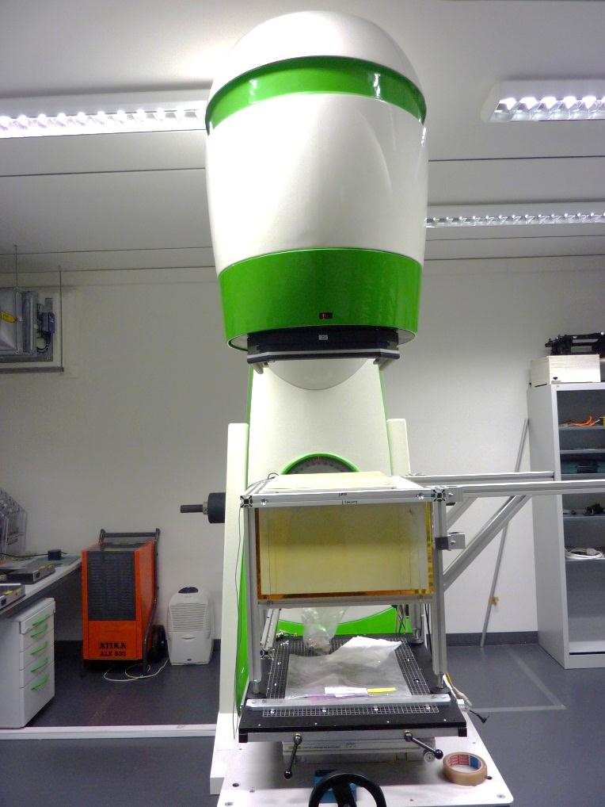
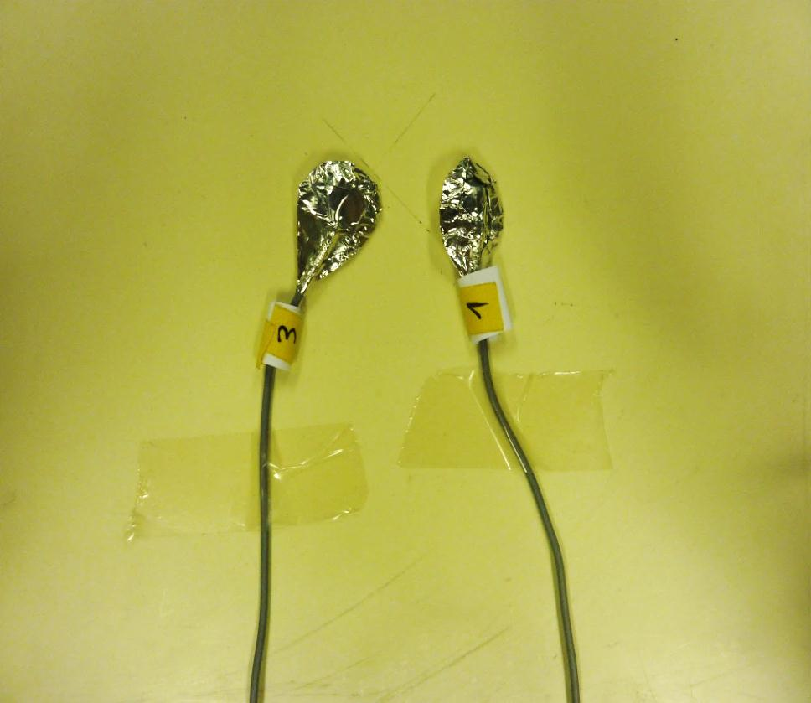
Other Activities
SFD diodes
Outline
Research Activities
Conferences
Training and Secondments
Machine and Plan QA
Small Field
external Radiotherapy

Slide 17
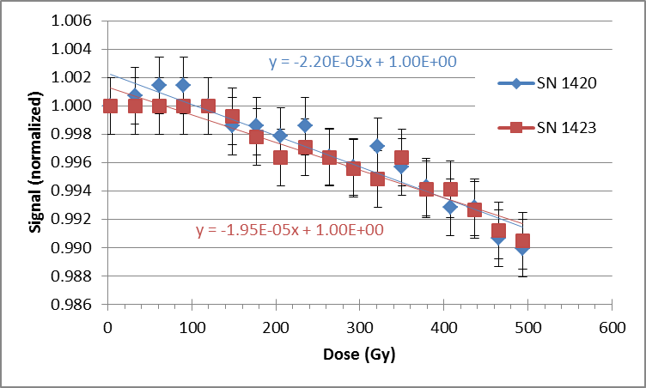
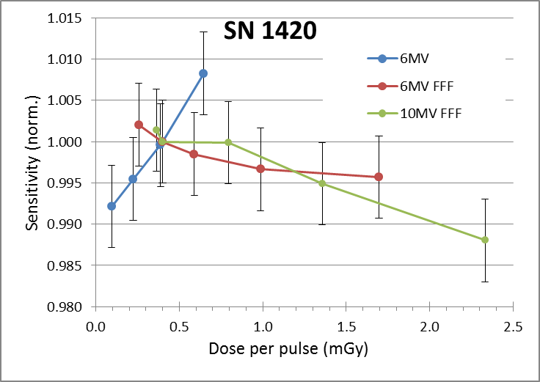
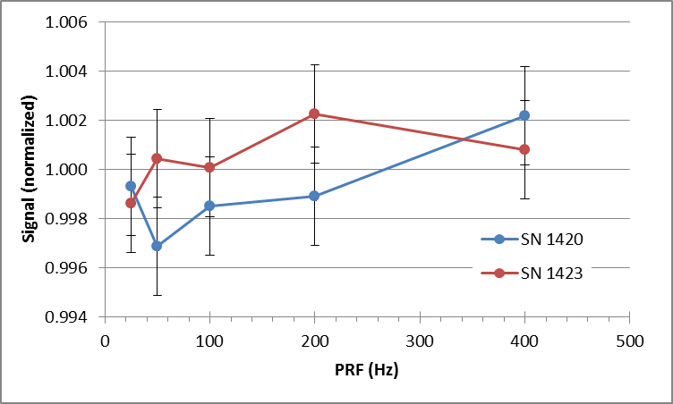
Other Activities
SFD diodes
Outline
Research Activities
Conferences
Training and Secondments
Studies on sensitivity dependence from:
Dose
Dose per pulse
Dose rate

Slide 18

Other Activities
SFD diodes
Outline
Research Activities
Conferences
Training and Secondments
Oral Presentation, RESMDD14, 8-10 October 2014
“Development of silicon monolithic arrays for dosimetry in external
beam radiotherapy”
F. Bisello, M. Bucciolini, M. Bruzzi, D. Menichelli, M. Scaringella, C. Talamonti, M. Zani^{1,2}

Slide 19
Conference
Trainings
Secondments

Slide 20
Conferences 2014
Outline
Research Activities
Conferences
Training and Secondments
DPG Mainz, 25th March 2014
Oral Presentation
“Characterization of the Dosepix detector under clinical conditions ”
RESMDD Florence, 8-10 October 2014
Oral Presentation
“Development of silicon monolithic arrays for dosimetry in external beam radiotherapy”
IEEE 2014 Seattle, 8-15 November 2014
Poster Presentation
“Investigation on the radiation tolerance of Dosepix detector”

Slide 21
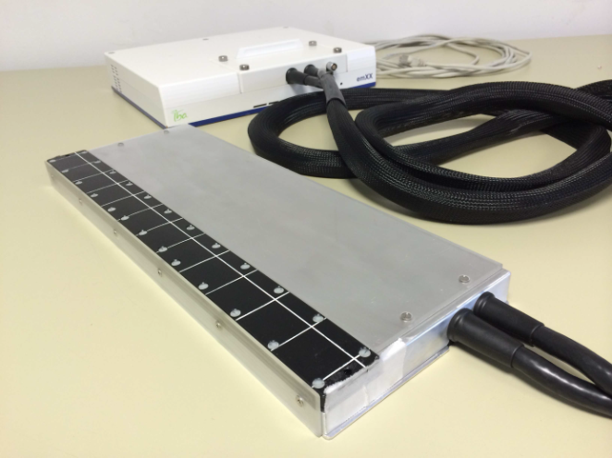

Planned Training and
Secondments
Outline
Research Activities
Conferences
Training and Secondments
Business and Administration training, ST Microelectronics
Secondment at the UPENN University Hospital, Phyladelphia
(tentative: 16-28 November 2014):
  Measurements on plan QA with silicon monolithic array
  Trainings on clinical quality assurance routine (to be defined)

Slide 22
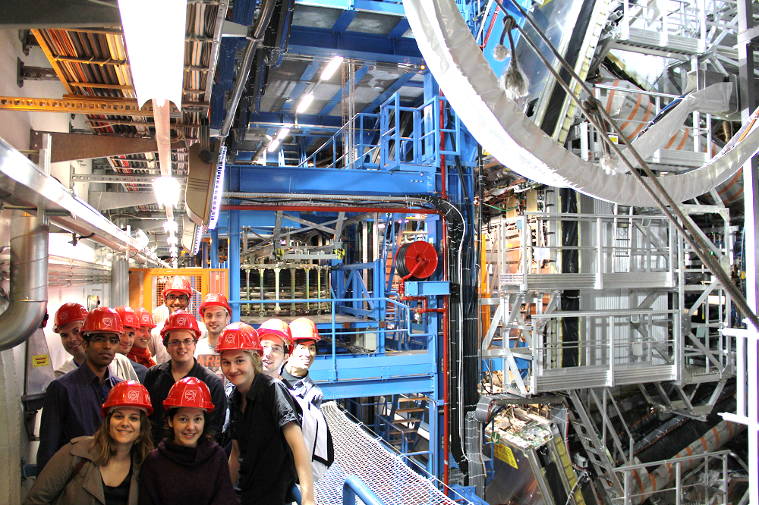
Thank you
very much
for your attention

