Slide 1
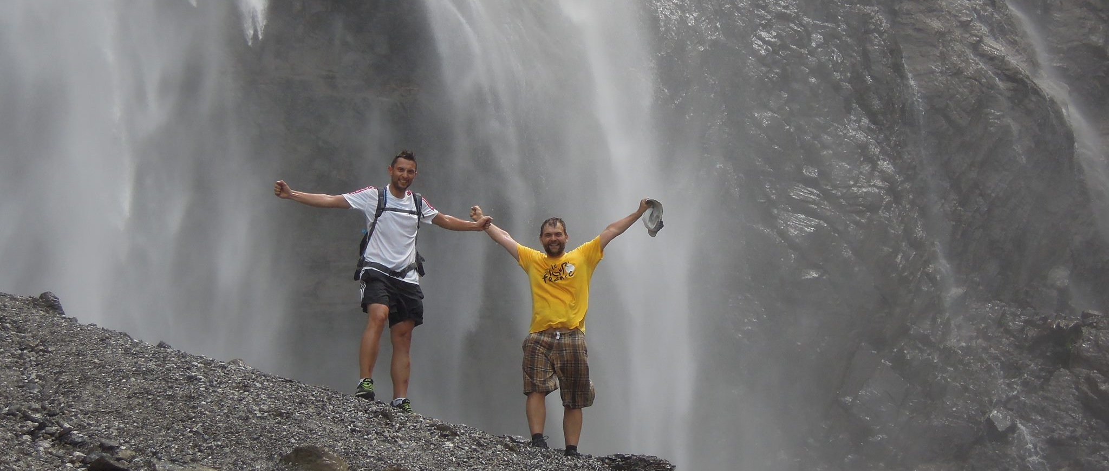
Early Stage Researcher 9: Activities November 2013 – September 2014
Benedikt Bergmann
Institute of Experimental and Applied Physics, Czech Technical University in Prague, Czech Republic
Schwarzenbruck – 30.09.2014

Slide 2
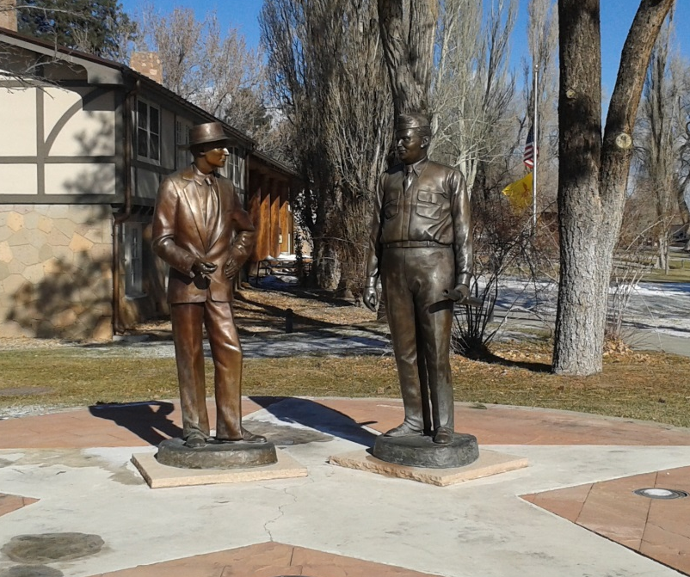
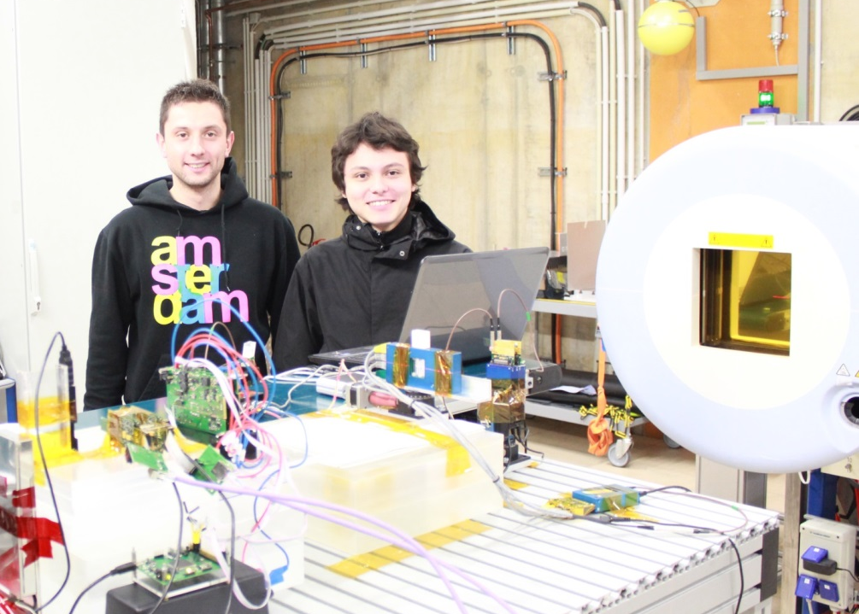
Experimental ACTivitieS
“All life is an experiment. The more experiments you make the better.“
- Ralph Waldo Emerson
LANSCE – Dec. 1-8, 2013
HIT – Jan. 20-24, 2014

Slide 3

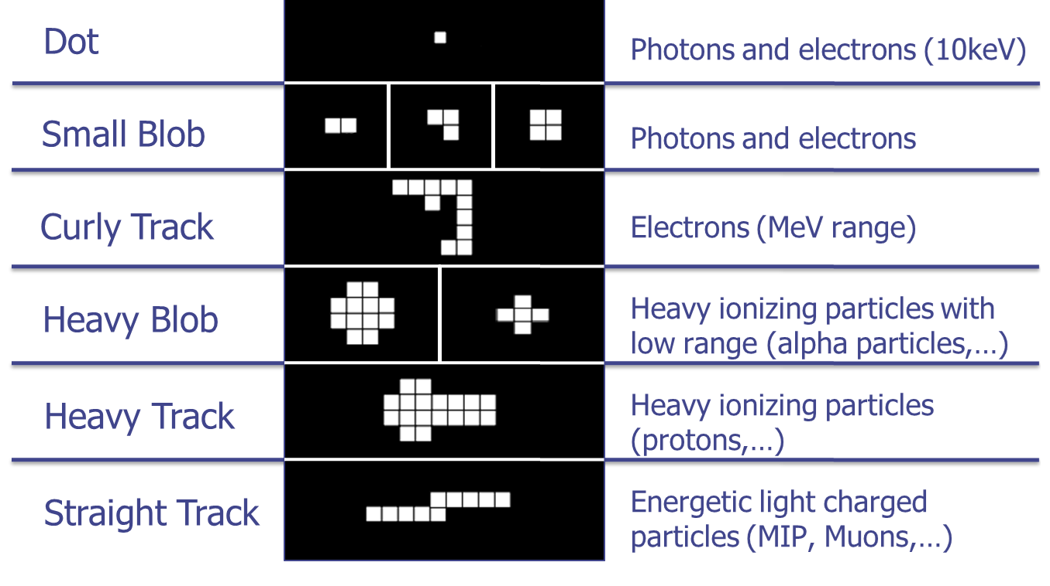
Reminder:
Pattern Recognition – Definition of Cluster Categories
Notes:
Dot , small blob indicating low energy transfer!
Heavy track and heavy blob indicating HET to the sensor layer!

Slide 4
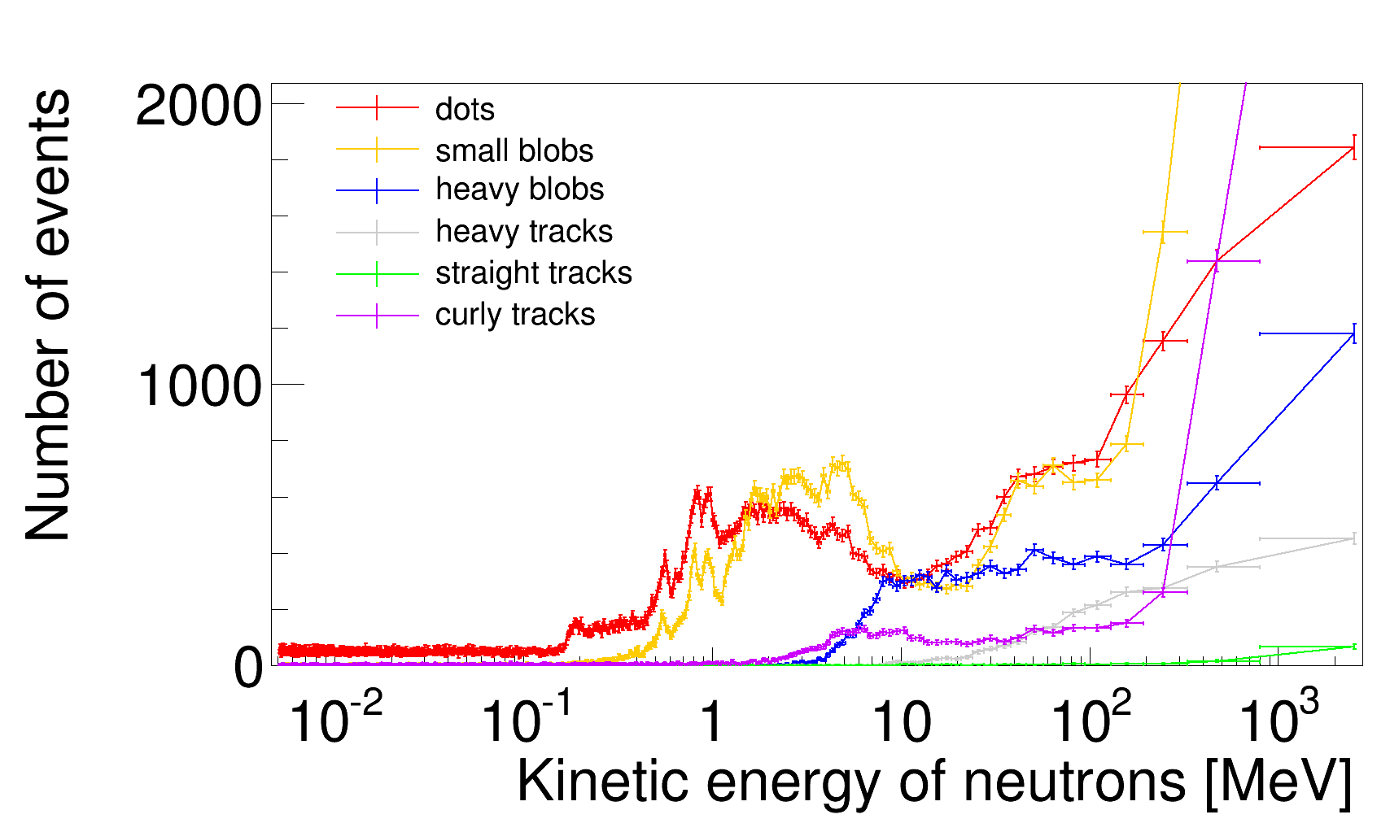
Experimental Activities:
Los Alamos Neutron Science Center – Detector Response
²⁸Si(n,p)²⁸Al and ²⁸Si(n, α)²⁵Mg-reactions appear
Resonances of elastic scattering of neutrons on silicon nuclei
Notes:
For me: Check, if there is a correlation between the appearance of curly tracks and the inelastic scattering to the first excited level of silicon!
+ compare measured peaks with the cross section for it!
Number of different cluster types as a function of kinetic neutron energy!

Slide 5
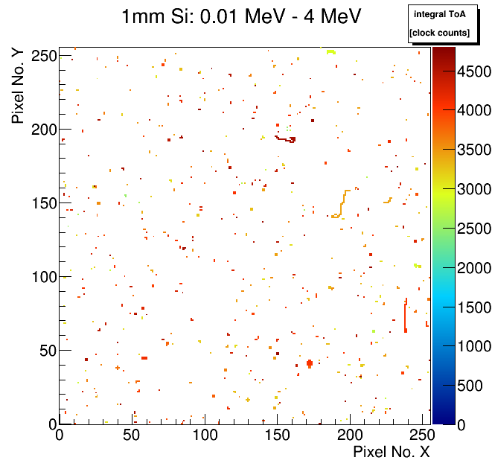
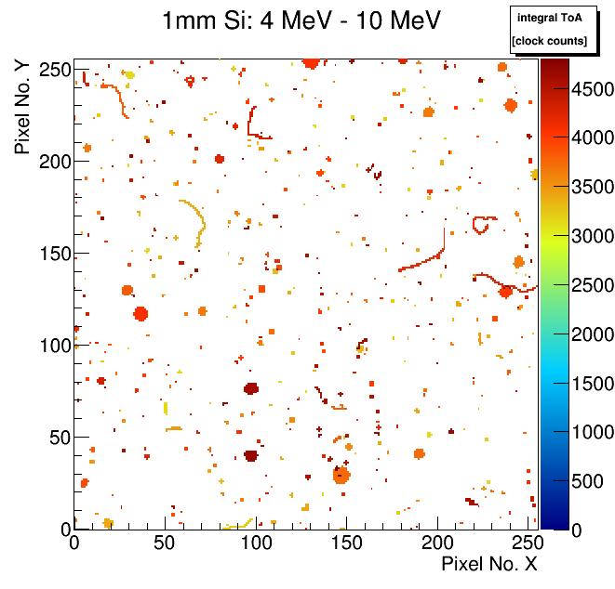
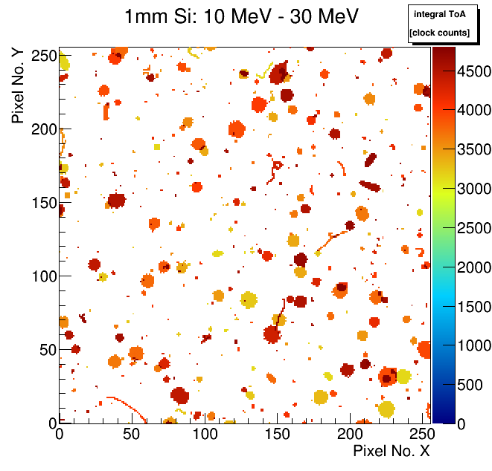
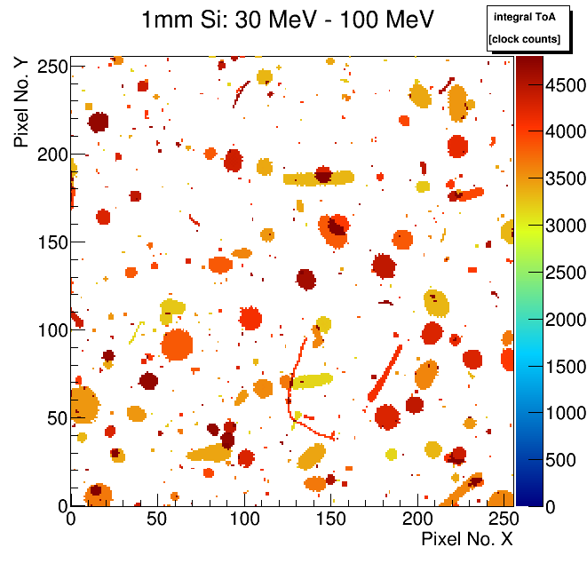
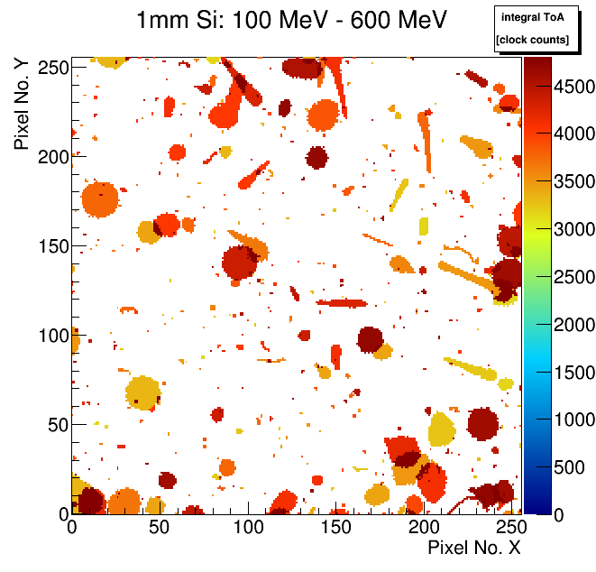
Experimental Activities:
Los Alamos Neutron Science Center – Representative Events
Above 4 MeV: nuclear interaction appear
Above 30 MeV: HETP are getting more and more asymmetric and bigger with increasing energy
Above 10 MeV: tracks with delta electrons are detected

Slide 6
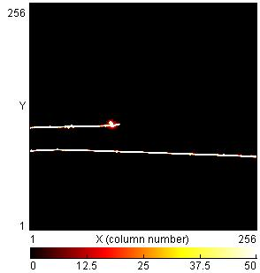
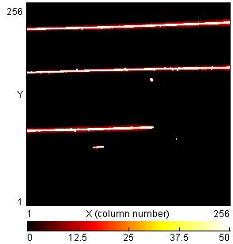
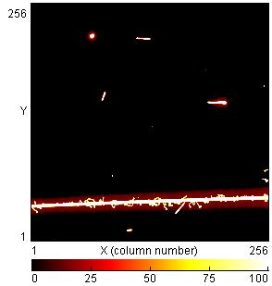
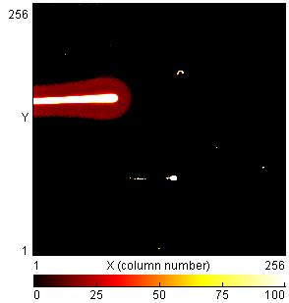
Experimental Activities:
German Center for Cancer Research (DKFZ) in Heidelberg
P - 100 MeV
C - 300 MeV/A
He - 115 MeV/A
O - 104 MeV/A
Beam time organized by ARDENT framework (~ 17 h used)
  Protons, Carbon ions, Oxygen ions, Helium ions
  LET range: 1.3 keV/µm to 85.3 keV/µm
  For each particle type the detector has been irradiated under 0°, 60° and 90°

Slide 7
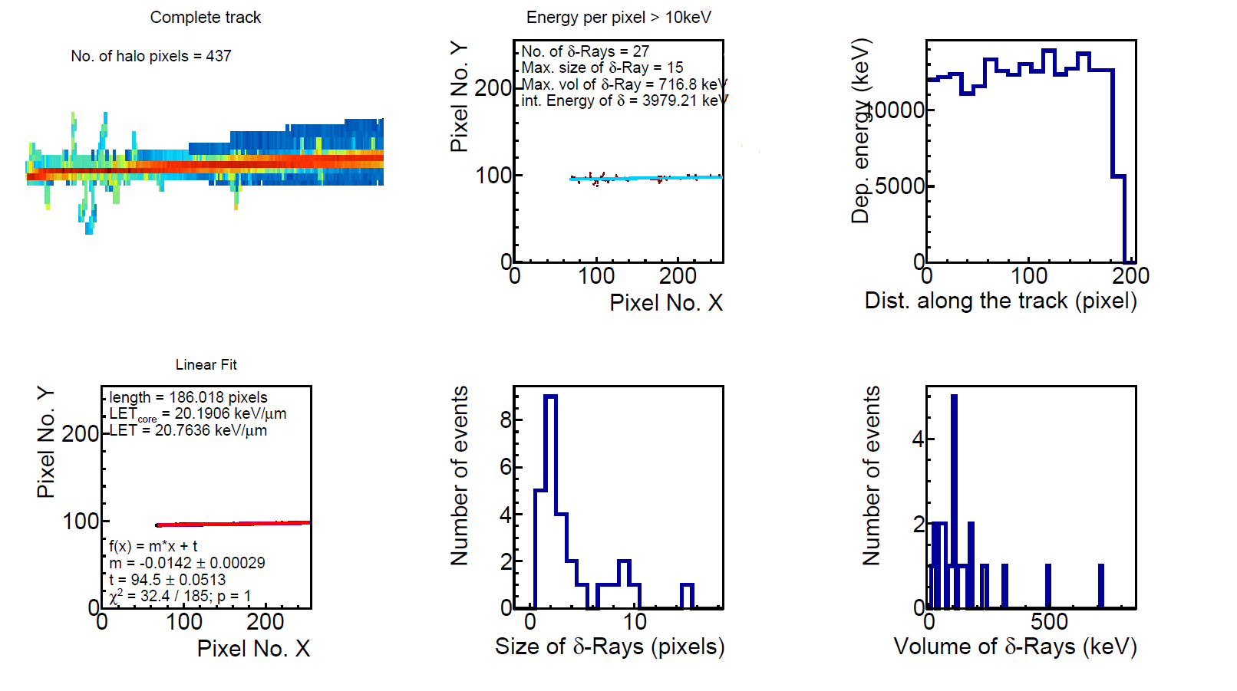
Experimental Activities:
German Center for Cancer Research (DKFZ) in Heidelberg
Directional information
Bragg behavior
Core of the track
Removal of the low energy halo
Delta electrons
Particle type and velocity information
Analysis of tracking capability

Slide 8
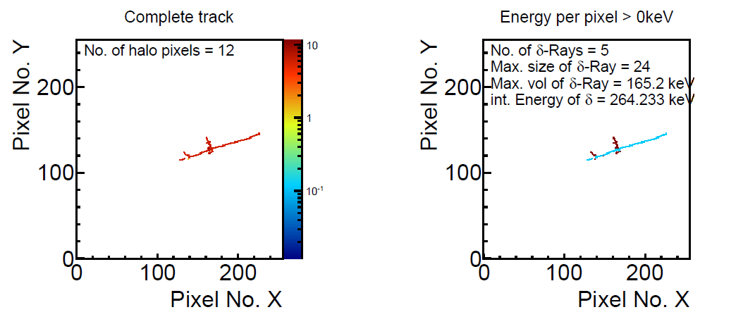
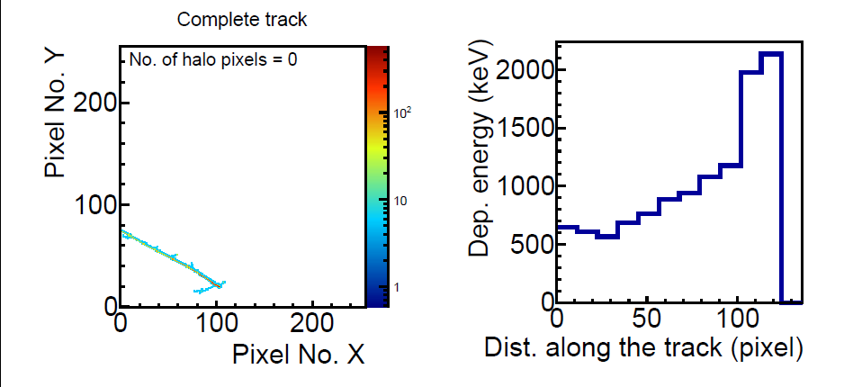
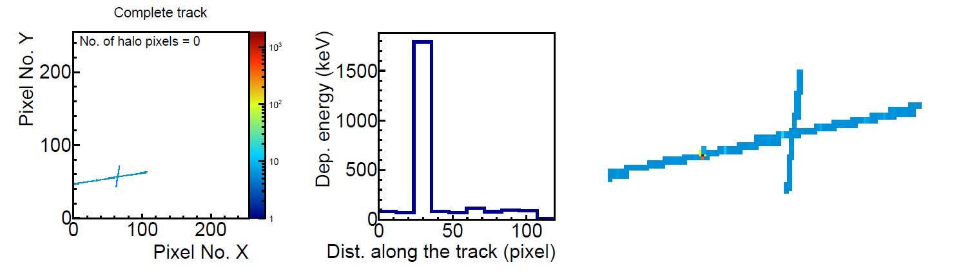
MoEDAL data evaluation:
Application of the Event-by-Event Data Analysis
Typical events:
  Low LET (MIPs, highly energetic electrons), more or less accompanied by delta electrons
Identification of delta electrons in the xz-plane
LET = 0.12 keV/µm
LET = 1.68 keV/µm
Bragg - event
Magnification of the track

Slide 9
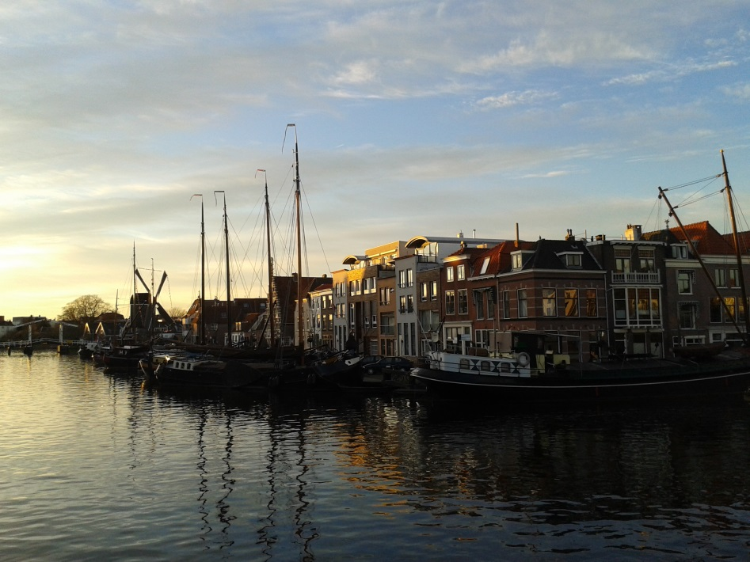
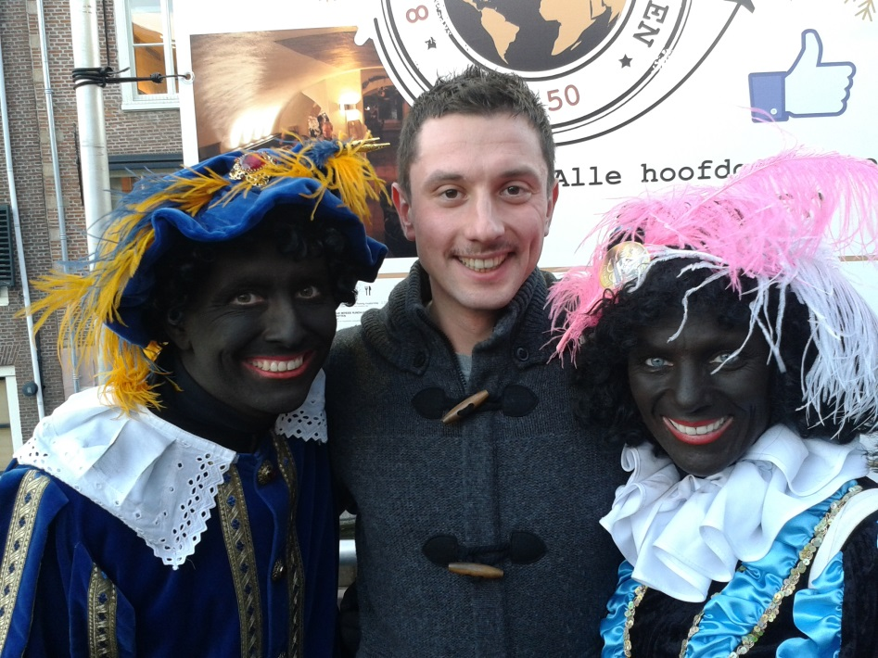
SECONDMENT at ESA-ESTEC
Simulations with the GRAS package (GEANT4 Radiation Analysis for Space Applications)
Noordwijk, Oct. 28 – Nov. 29, 2013

Slide 10
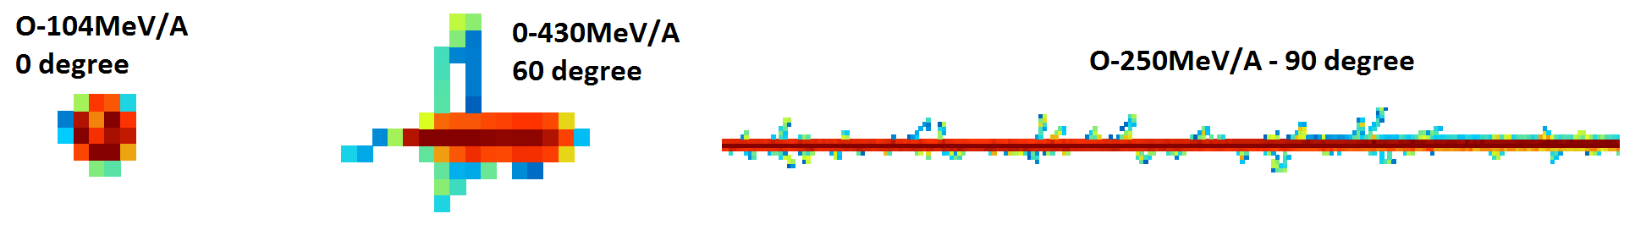
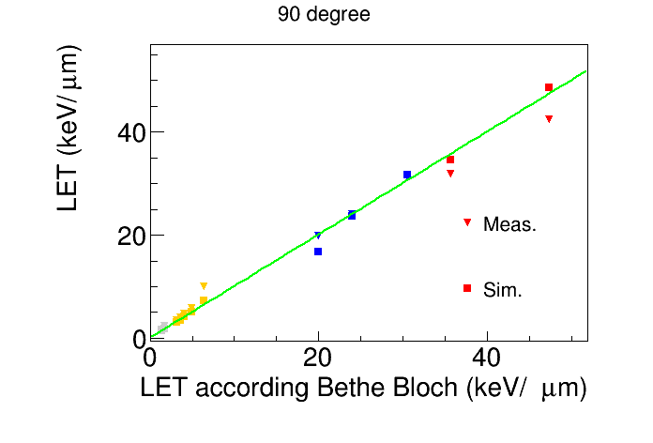
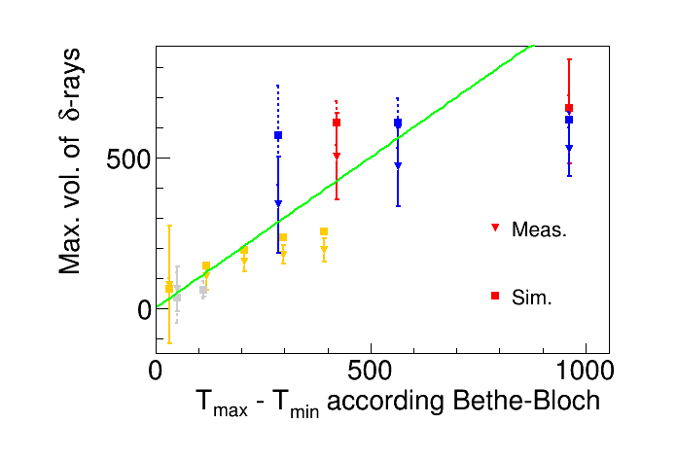
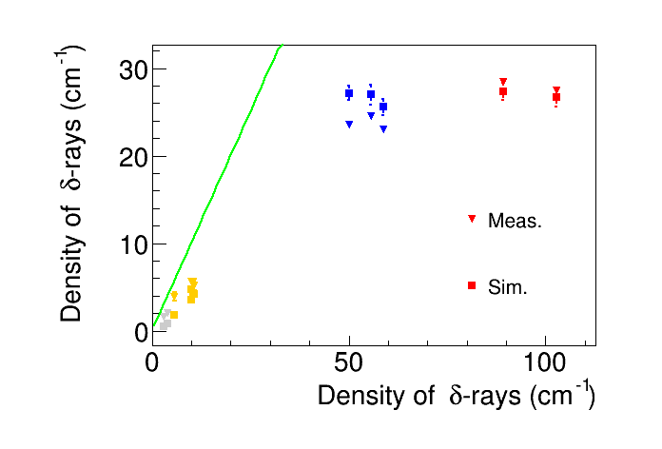
Secondment in ESA-ESTEC:
Simulations for Heavy Ions – Output and Comparison
Examples of simulated tracks
Comparison with the measurement (LET responses, delta electron properties)

Slide 11
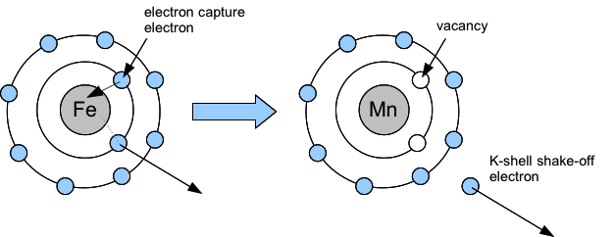
Double Vacancy Creation in FE-55 electron Capture Decay
Project together with Thilo Michel: Data evaluation and simulations with ROSI (LSCAT, EGS4)
89%*1.3*10⁻⁴

Slide 12
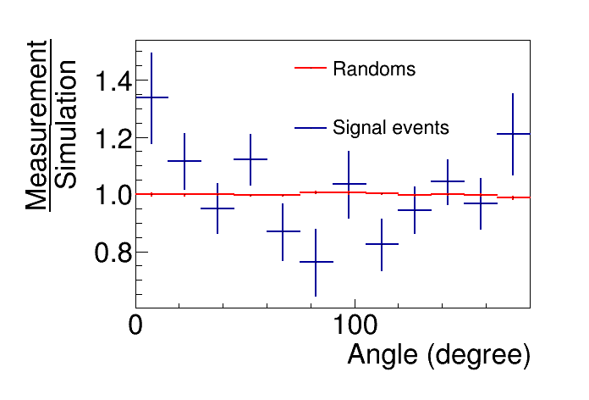
What Do We Want to Measure?
Probability of the creation of 2 K-shell vacancies (first results published in Phys. Rev. C in January 2014):
With the TPX-pixel detectors - for the first time - also the angular correlation function between the subsequently emitted X-rays (hypersatellite, satellite) can be measured:
Coincident experiment: Events outside the coincidence window (not correlated) were used to test the evaluation (Randoms) and the accuracy of the simulation and set-up.

Slide 13
Attended Trainings, Conferences, Business Trips, ...
Medipix meeting, Febr. 19-20
  Presentation: "Neutron Time-of-Flight, Proton and Heavy Ion Measurements with a Timepix Detector“
Training course on Business and Administration, May 19 – 23, 2014
Czech Language Training – ongoing
Publications:
  T. Michel, B. Bergmann, J. Durst, M. Filipenko, T. Gleixner, and K. Zuber, "Measurement of the double K-shell vacancy creation probability in the electron-capture decay of 55Fe with active-pixel detectors", Phys. Rev. C 89, 014609, 2014
  B. Bergmann, R.O. Nelson, J.M. O'Donnell, S. Pospisil, J. Solc, H. Takai, Z. Vykydal, "Time-of-Flight Measurement of Fast Neutrons with Timepix Detectors", JINST 9 C05048, 2014

Slide 14
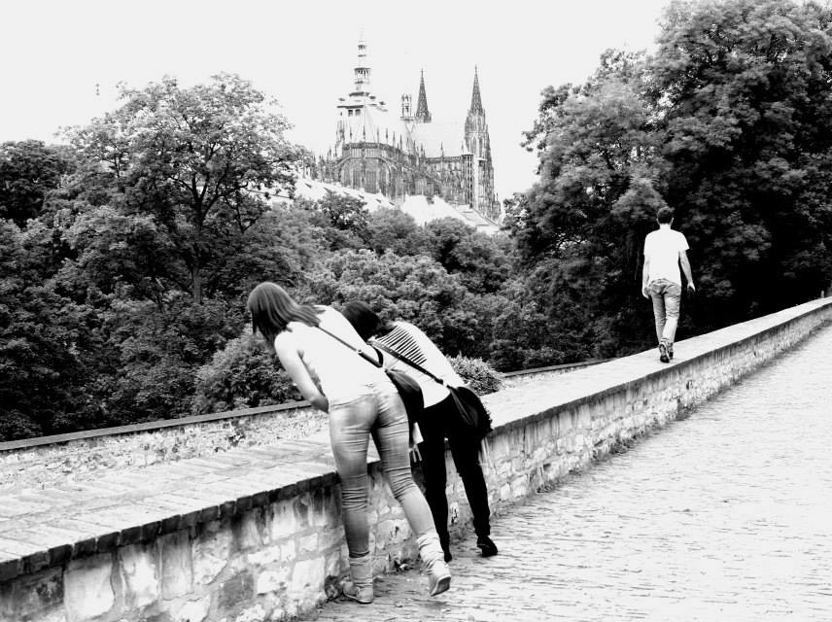
“... whatever you do you have to keep moving forward!“ – M.L. King Jr.
FUTURE PLANS

Slide 15
Trainings, conferences, business trips, ...
MMND conference in Port Douglas, Oct. 20 – 25, 2014
Poster presentation at IEEE in Seattle, Nov. 8 – 15, 2014
Business and administration secondment at IBA (dates not yet fixed - beginning 2015)
(secondment or travel at/to ESA-ESTEC)
Beam time in Los Alamos Neutron Science Center (proposal prepared and submitted by our colleagues from Brookhaven National Lab)
Anticipated publications:
  „Measurement of the Angular Distribution of the Coincident Hypersatellite Satellite X-ray Emission in the Electron Capture Decay of Fe-55“
  IEEE proceeding
  Paper on tracking with TPX detectors
  Ph.D. thesis

Slide 16
Thank you for your attention!

