Slide 1
ESR 15: Chris Cassell

Slide 2
Table of Contents
Attended workshops
Outreach
Experimental Campaigns
Details of Experiments
Secondments
Simulations
Space Charge Effect
Publications

Slide 3
Attended Workshops
14-15 April, 2014: Accelerator-based Neutron Production workshop, INFN Laboratori Nazionali di Legnaro
  Interesting, but a bit specific to the given topic
2-4 June, 2014: Position Sensitive Neutron detectors Workshop, Aachen, Germany
  Presented a poster on time-based neutron/gamma discrimination with LUPIN-II

Slide 4
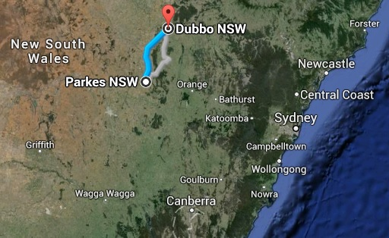
Outreach
23 November 2013 & 24 March 2014: Liceo Omodeo, Mortara, Italy
  Presentation on Radioactive Decay (Nov 2013)
  Calculation of exposure of CR-39 to Radon (March 2014)
3-7 June 2013: Dubbo, Australia
  Overview of a researcher’s job, including (by necessity) a short lecture on basics of nuclear physics
  Involved 20 students from 2 High Schools (Parkes and Dubbo)

Slide 5
Experimental Campaigns
The LUPIN-II is a neutron REM counter based on a cylindrical BF³ proportional counter
Uses a fast LOGAMP and unique acquisition method to allow it to cope with intense Pulsed Neutron Fields
An ADC samples the current through the counter at 10MHz, then acquires for a user set time window during a neutron burst
The current is integrated over the time window to find the total charge of the window. This is then divided by a Charge Calibration Factor (CCF) to find the number of interacting neutrons. From this the dose is determined using a Ambient dose Equivalent calibration factor.

Slide 6
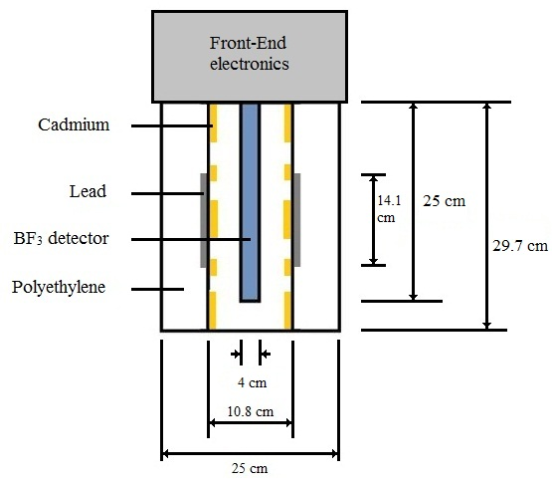
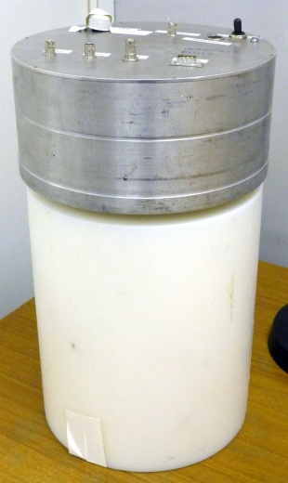
Experimental Campaigns
BSS measurements at Proton therapy centre Essen
Planned measurement at RCNP facility in Japan

Slide 7
Essen Measurements
Measurements were taken in 4 positions inside and 2 positions shielded from a treatment room at the proton therapy facility in Essen
  Both a conventional system and the LUPIN-II were used to measure
  Due to a problem, the LUPIN-II results are currently unable to be used (working on fixing this)

Slide 8
RCNP Measurements
Measurements are planned in Japan from 23 November to 1 December 2014
  Neutrons of 100 and 300 MeV will be measured with the LUPIN-II system
  These will be used to verify simulations of the LUPIN-II response function
  It is also planned, if possible, to obtain measurements of the exponential die away of the signal for these energies, to compare to simulations

Slide 9
Secondments
September - August, 2014: CERN/PSI, Switzerland
  Secondment to learn about unfolding of BSS data for neutron spectroscopy
  Learned about MAXED and Gravel codes at CERN, and about using WinBUGS for Bayesian parameter estimation and its use in unfolding at PSI
Planned:
February, 2015: Jablotron, Czech Republic
  Secondment to learn about administration

Slide 10
Unfolding
Unfolding with MAXED, GRAVEL and WinBUGS
  MAXED and GRAVEL are both black-box methods
  MAXED uses the maximum-entropy method while GRAVEL uses the least-squares method
  WinBUGS uses Bayesian Parameter Estimation methods, and does not require a guess spectrum
  WinBUGS just provides the Bayesian analysis, the model has to be developed by the user
  Equations describing each of the regions of the spectrum (Thermal, Epitermal, Photo-Evaporation and High energy) are given in ^{[1]}
  Currently see the Thermal and 2 high energy peaks, but Epithermal region is problematic
  It is forseen to go to PSI to get help from Dr. Eike Hohmann to correct this
  [1] Reginatto, M. ‘What can we learn about the spectrum of high-energy stray neutron fields from Bonner sphere measurements?’, Radiation Measurements 44 (2009) 692–699

Slide 11
Geant4 Simulations
Response function of LUPIN-II moderator
Time Profile of a neutron burst in various REM moderators
Simulations built with Geant4.10.00.p01
Using standard physics list + Bertini model

Slide 12
Response Function
The current LUPIN-II moderator was compared to various alternate configurations, with a shorter geometry (25 cm height) and with different thicknesses of Lead
Verification is planned with measurements from RCNP, Osaka, Japan

Slide 13
Time Profile
Concept is to determine the dependence of the time profile of a neutron burst on the energy of the incident neutrons
Different energies are to be simulated and the time from creation to the time of detection to be recorded
Spherical and Cylindrical moderators are to be simulated in both the standard and extended range configuration (i.e. with and without Lead)

Slide 14
Time Profile (Preliminary)
Time (S)
Time (S)
Time profile for 100 keV (left) and 10 MeV (Right) neutrons incident on the moderator of a cylindrical extended range REM counter

Slide 15
Space Charge Effect
When measuring a high-intensity burst of radiation, large amounts of localised charge is generated inside the proportional counter within a REM counter
The charge generated may cause subsequent interacting particles to be partially shielded from the electric field, reducing the multiplication factor
This ‘Space Charge Effect’ can be accounted for using the analytical method described in ^{[2]}
Analytical method describes the change in the multiplication factor as a function of the number of interacting neutrons
  [2] Rios, I., González, J., Mayer, R.E., “Total Fluence Influence on the Detected Magnitude of Neutron Burst using Proportional Detectors”, Radiation Measurements (2013), doi: 10.1016/j.radmeas.2013.01.007.

Slide 16
Space Charge Effect
Using the analytical method, a compensation algorithm was developed

Slide 17
Publications
Aza, E., Caresana, M., Cassell, C., Charitonidis, N., Harrouch, E., Manessi, G.P., Pangallo, M., Perrin, D., Samara, E., and Silari, M., “Instrument intercomparison in the pulsed neutron fields at the CERN HiRadMat facility,” Radiation Measurements 61C (2014), pp. 25-32, DOI: 10.1016/j.radmeas.2013.12.009
Aza, E., Caresana, M., Cassell, C., Colombo, V., Damjanovic, S., Gilardoni, S., Manessi, G.P., Pangallo, M., Perrin, D., and Silari, M., “Comparison of the performance of different instruments in the stray neutron field around the CERN proton synchrotron,” in: Proceedings of the 12th Neutron and Ion dosimetry symposium (NEUDOS), Aix-en-Provence, 3-7 June 2013, Rad. Prot. Dos., doi:10.1093/rpd/nct215 (2013).
Caresana, M. Cassell, C. Ferrarini, M. Hohmann, E. Manessi, G. P. Mayer, S. Silari, M. Varoli, V. ‘A new version of the LUPIN detector: improvements and latest experimental verification’, Review of Scientific Instruments 85, 065102 (2014); doi: 10.1063/1.4879936
Planned
Cassell, C. Ferrarini, M. Rosenfeld, A. Caresana, M. ‘A novel technique for compensation of space charge effects in the LUPIN-II detector’
  -> Completed, awaiting corrections
Caresana, M. Cassell, C. Guatelli, S. Manessi, G.P. Rosenfeld, A. Silari M. ‘A Time based analysis of neutron interactions in REM counter moderators’
  -> Introduction written, awaiting simulation results and verification
Cassell, C. Ferrarini, Manessi, Silari M.G.P. Guatelli, S. M. Rosenfeld, A. Caresana, M. Rosenfeld, A. ‘Time based discrimination of neutron and gamma signals in the LUPIN-II’
  -> writing underway

Slide 18
Thanks for your attention!

