Slide 1
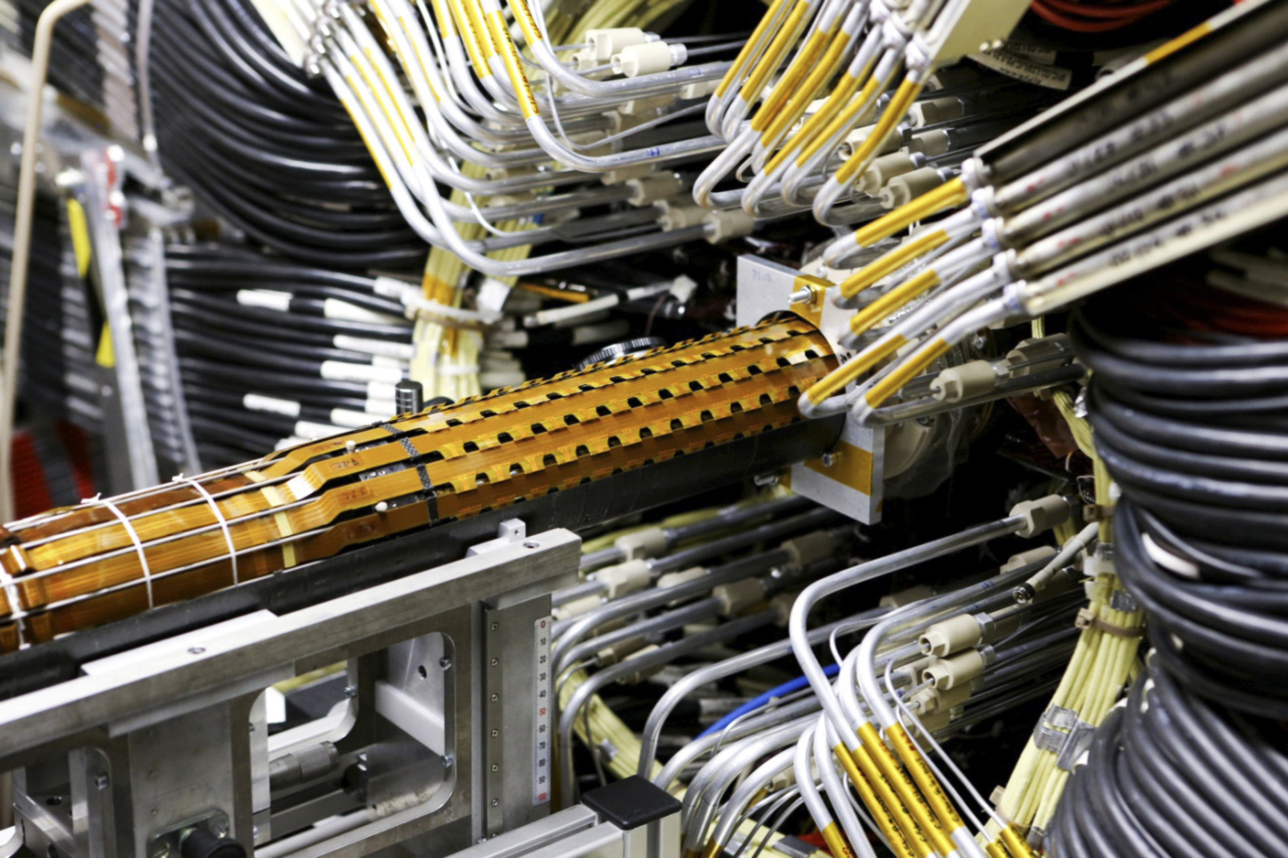
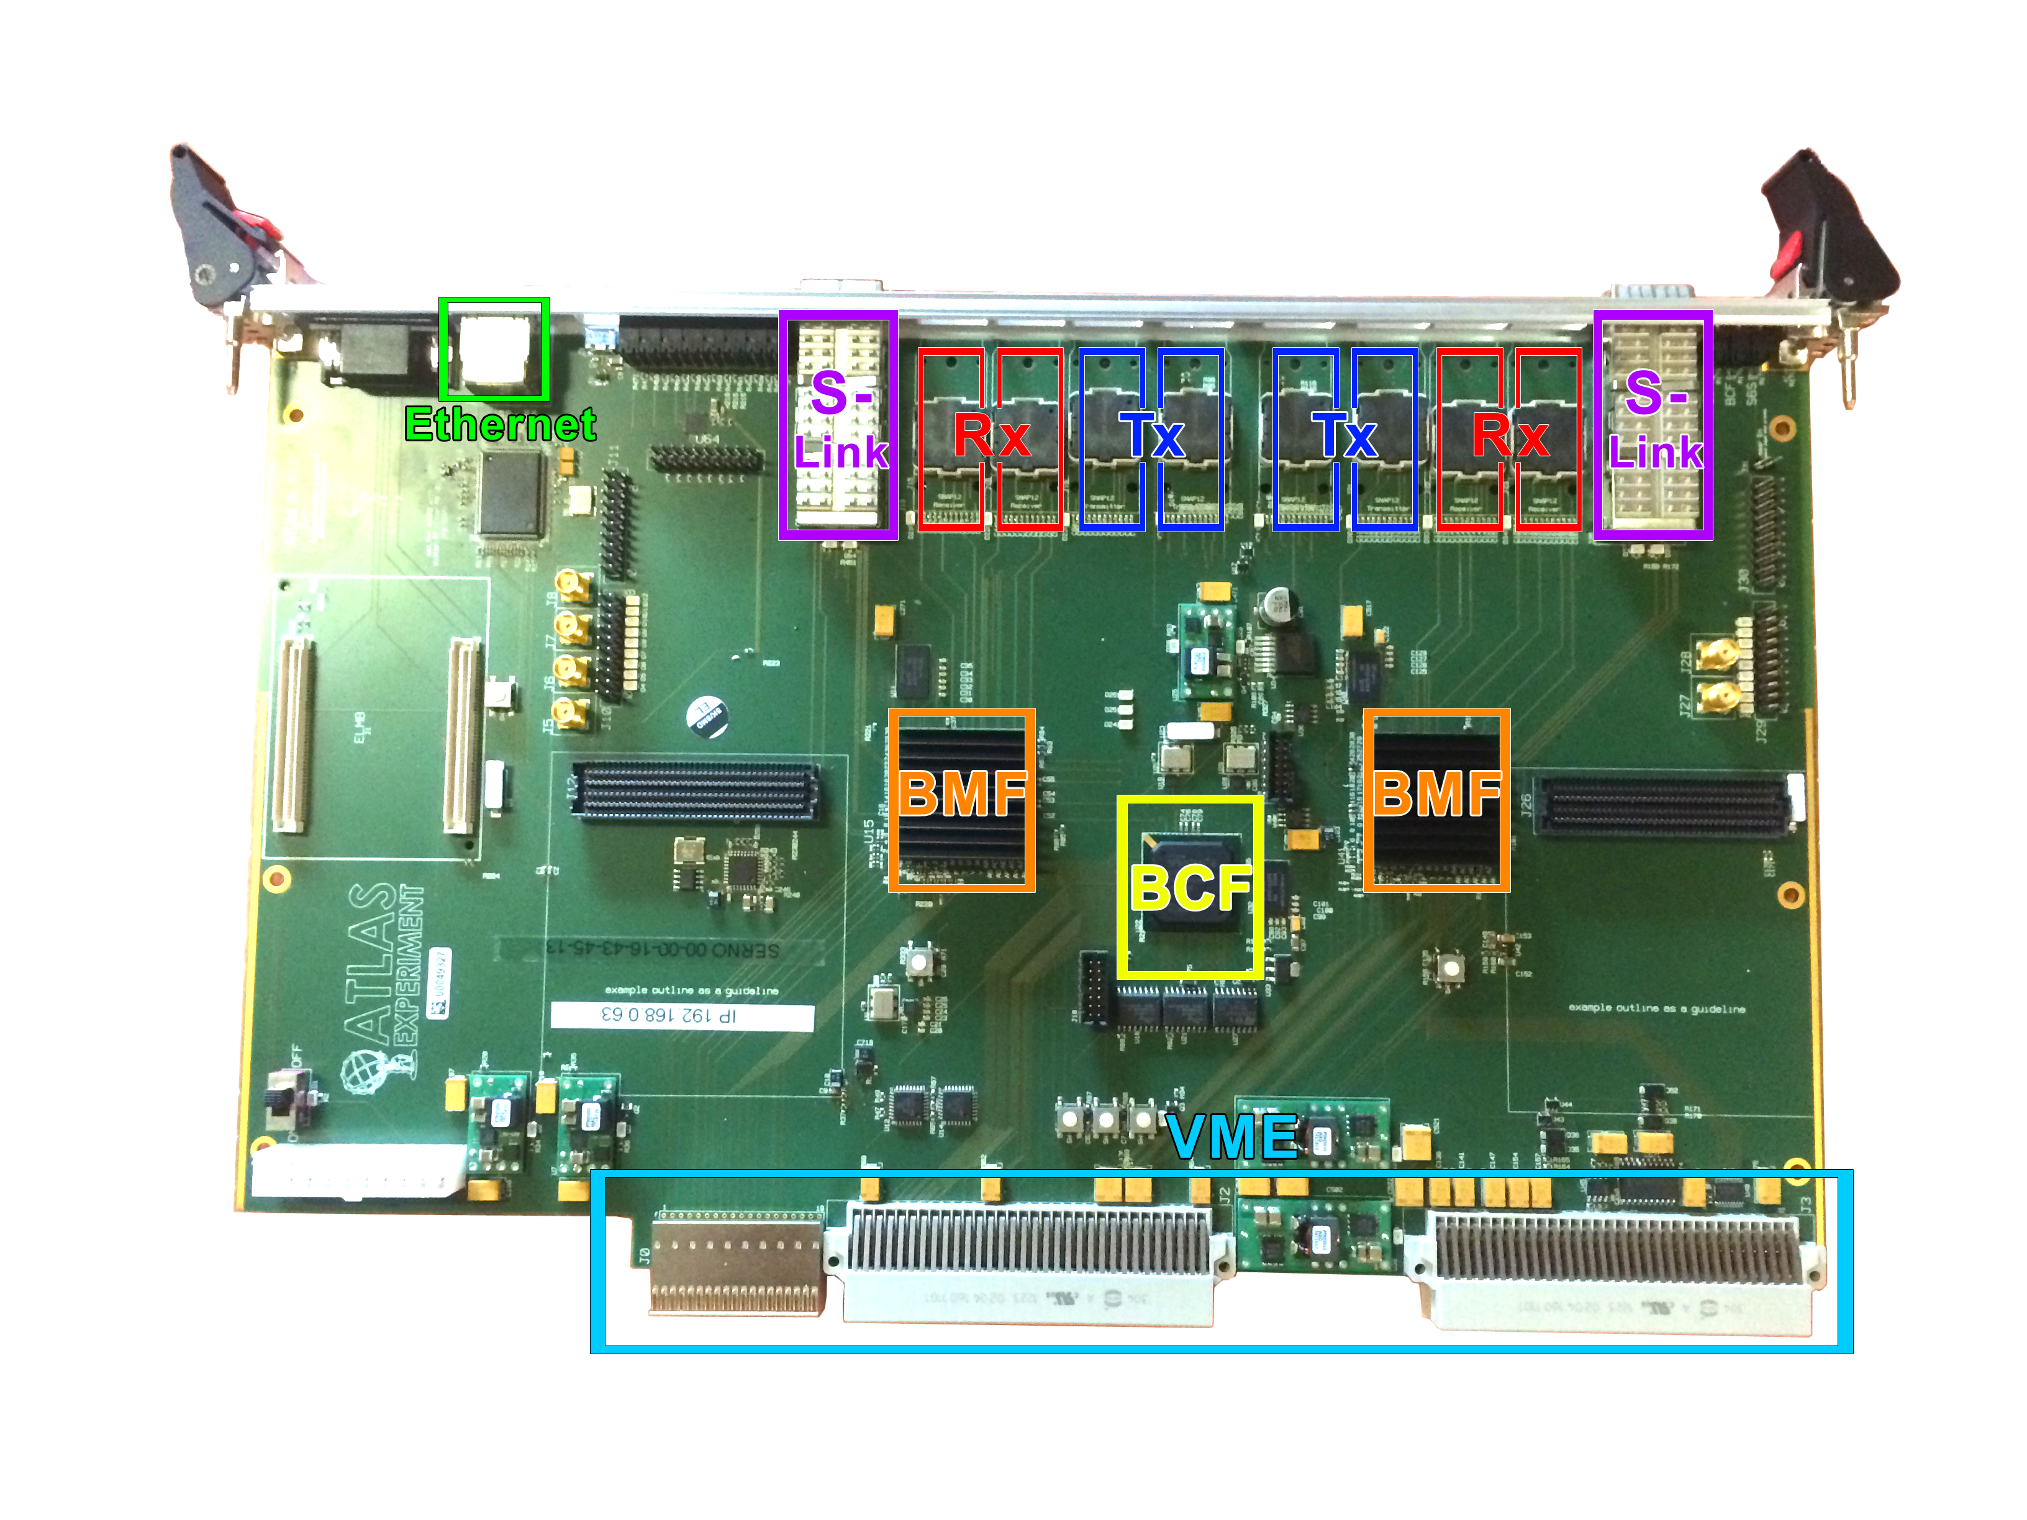
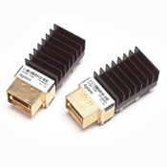
Firmware development and testing of the ATLAS IBL Back Of Crate card
Pixel 2014 Poster session – Niagara Falls, Canada
The Insertable B-Layer
The Insertable B-Layer (IBL) is the new and innermost tracker layer of the ATLAS detector. It was inserted in the PIXEL detector in May 2014 and is currently being commissioned.
The IBL is a silicon pixel detector hosting two types of sensors: planar and, for the first time, 3D sensors. It consists of 14 staves equipped with 32 Front-End read-out chips (FE-I4) bump-bonded to the sensor tiles.
Every FE contains 26880 pixels. For the read-out chain, every FE pair is referred to as a “module”.
Read-out chain
The Back of Crate card
The new IBL Back of Crate (BOC) card is equipped with three Xilinx Spartan-6 FPGAs for signal processing:
BOC Control FPGA (BCF): slow control interfaces from the ROD and the Gigabit Ethernet connection.
Two BOC Main FPGAs (BMF): signal processing and monitoring of incoming data.
The BOC-ROD communication is via VME.
The detector interface is instead handled by commercial SNAP12 plugins.
Transmitters (Tx): 40 - 80 - 160 Mbps.
Receivers (Rx): 160 Mbps.
The connection to the higher level read-out uses S-Link, QSFP transceiver modules: four links dedicated to the ATLAS Fast Tracker (FTK), four to the ATLAS Read-Out Subsystem (ROS).
Modules on staves are electrically connected to optoboards that handle the electrical-optical conversion.
The signal from the optoboards runs through optical fibers to a card pair consisting of the Back Of Crate (BOC) card and the Read Out Driver (ROD) card.
The ROD handles the detector calibration and data taking, the BOC behaves as interface with the detector and to the higher level read-out (ROS).
The BOC card also distributes the LHC clock from the Timing-Trigger Control Interface Module (TIM) to the ROD and to the detector.
An Ethernet connection allows remote access to the cards.
Signal processing
BPM encoded commands and triggers to the modules are sent from the ROD through the downlink path. The detector timing is adjusted using coarse and fine delay blocks. For debug purposes, internal data generation is implemented.
The incoming data is phase aligned for a correct decoding. The search for word boundaries in the 8b10b encoding looks for specific patterns. The aligned data is decoded and forwarded to the ROD. Data monitoring functions are available to measure the signal quality.
Fine delay implementation
The fine delay is needed for adjusting the timing of the detector. It can be adjusted in steps of maximum 100 ps, while the duty-cycle of the signal should not exceed (50±2)%.
A variable output delay is obtained changing the IODELAY2 (Delay-Setting on the plot) by using partial reconfiguration.
Each channel for each board has been tested (32ch. x ~50), on the right the results. The delay increases linearly with the setting of the output delay and the duty cycle is only minimally affected as it is shown in the upper plot for a single channel measurement. Over all cards and channels the average slope of the delay is (34.7 ± 0.7) ps per setting.
Loopback tests
BOCs needed to be qualified without the detector, allowing to disantangle eventual errors after the connection.
For these testing purposes two loopback tests have been performed: a direct loopback and one in the cavern with the optoboard.
Tx
Optical fibre
Mean: 34.68 ps / Setting
RMS: 0.7 ps / Setting
Rx
Stream of data generated inside the Tx FIFO
No BPM encoding
8b10b encoding
Tx
Optoboard
Loop
PCB
FE emulator
Rx
To detect issues in the communication, directly related to the readout, a FE emulator was implemented to test the full readout chain without detector.
Run and Configuration mode
Hit generation on trigger both manual and automatic
Reading and writing Global Registers
The number of hits sent out from the emulator after a trigger is editable by using the manual mode or automatically generating a random hits distribution.
On the right the OCCUPANCY histogram shows sufficient uniformity of the automatic hit distribution generated after 100000 triggers with 188 hits each.
FIFO data stream
BPM encoding
8b10b encoding
Image from Marius Wensing
In both cases no errors have been registered on the transmission performances of the BOC.
Maria Elena Stramaglia, for the ATLAS Collaboration

