Slide 1

High Resolution
Digital Flat-Panel X-ray Detector
Based on Large Area CMOS Image Sensor
Korea Electro-technology Research Institute
Advanced Medical Device Research Center
Chorong Kim, Bokyung Cha, Keedong Yang, ryunkyung Kim, Sungchae Jeon
PIXEL 2014, Niagara Falls (Canada), 5 September 2014

Slide 2
Outline
Introduction
CMOS X-ray detector module
X-ray characteristics
Future works
Summary

Slide 3
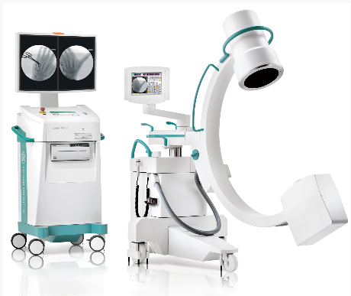
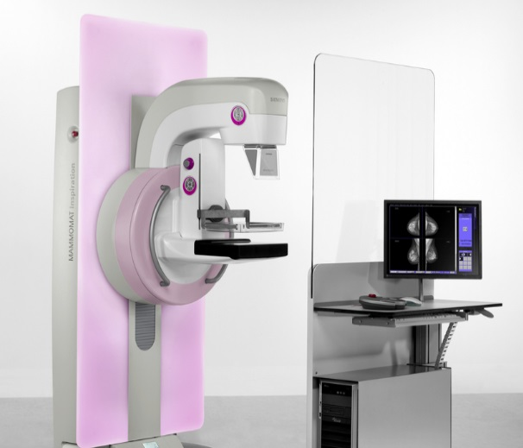
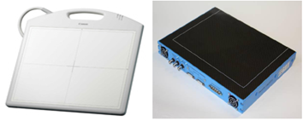
Introduction (1)
X-ray digital flat panel detectors
  Digital flat panel detectors are used for clinical applications such as mammography and fluoroscopy.
  Most flat detectors are based on indirect conversion
  via scintillator and an active pixel matrix of a-Si photo diodes
  Recently, CMOS image sensor also studied actively.
Fluoroscopy
Mammography
X-ray
scintillator
Visible light
photodiode
(a-si or cmos)
readout
www.ziehm.com/en/products/ziehm-vision-r
www.healthcare.siemens.co.kr/mammography
data
< Indirect Conversion >
Flat detectors

Slide 4
Introduction (2)
Advantages of CMOS process for flat panel detector
  CMOS process enables integration of many additional features.
    On-pixel amplification
    Various pixel circuits from 3 transistors(3-TR) up to 100 transistors per pixel
    Integrating detectors with CMOS readout circuits
    ( e.g. A/D conversion, Logic)
  Electronic shutter
    global shutter, rolling shutter, non-destructive reads
  Overcome the size limitation through advanced process technology
    No more problem with producing large area CMOS image sensor.
⇒ We study on a high resolution X-ray detector
to acquire high quality images for real-time display based on CMOS sensor.

Slide 5
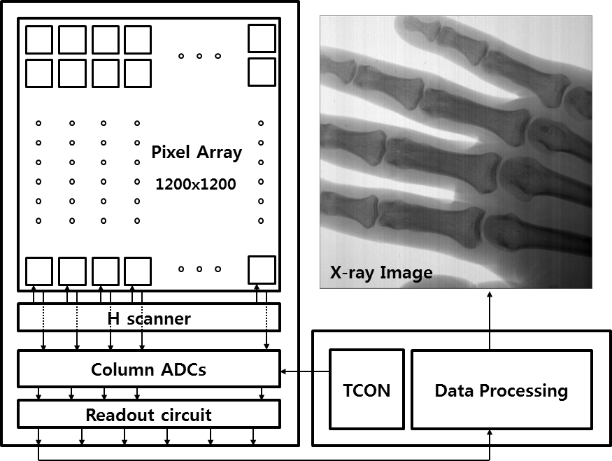
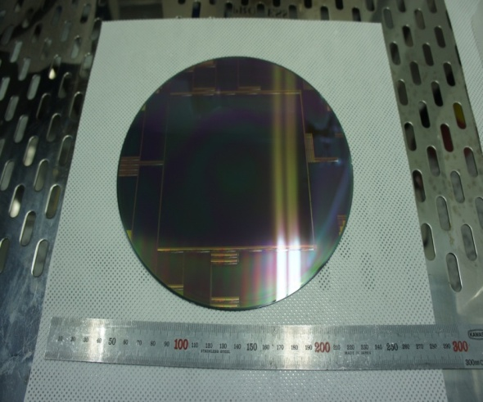
Main Features of CMOS X-ray Detector Module
Detector area : 12 x 12 [cm²]
Pixel size : 100 x 100 [um²]
Full well capacity : 4.4 Me-
Pixel matrix : 1200 x 1200
TowerJazz 0.35 um CMOS process
Three-side-tileable structure
Column-paralleled ADCs
14 bit digital outputs
2x2 pixel binning
30 frame per second in full-resolution
Rolling shutter method
Power supply : 3.3 V, 3.9V, 3.0V, 0.6V
Number of Pads : 752 pads on bottom side
1200x1200
Pixel Array

Slide 6
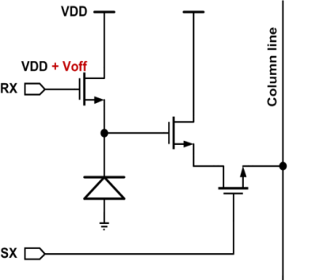
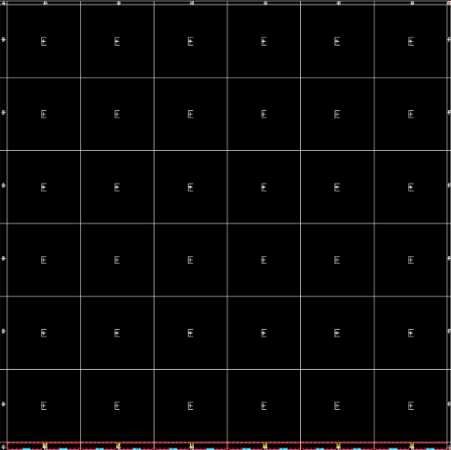
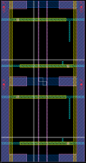

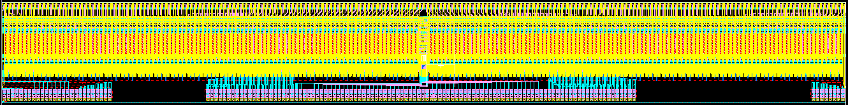
Large Area CMOS Image Sensor
Large-area CMOS Sensor with Stitch Process
  3-TR Active Pixel Sensor.
  Stitch process for large die size
  Segment Design : 9 segments from A to I
    E segment consists of 200 x 200 pixel arrays.
    It repeats 36 times to produce 1200 x 1200
    arrays.
    Row driver and column-paralleled ADCs
    are located in H segments. It also repeats
    6 times on the bottom side of sensor.
    Other segments are empty area.
  According to readout
  structure, we define ‘Bank’;
  E + H segments.
< Wafer top layout >
BANK
Pixel
A
B
C
D
E
F
(200 x 200)
< readout top layout >
G
H
I
Notes:
readout and charge collection node are the same
Segment Design

Slide 7
Readout structure
EVEN ROW
BK1
BK2
BK3
BK4
BK5
BK6
2x2
PIXEL
ODD ROW
Basic structure
  2 x 2 pixel array and 2 channel ADCs for binning mode.
The column-parallel Extended Counting ADC(EC-ADC) is used in a large area CMOS X-ray detector to enhance bit-depth.
  1st order ΣΔ-ADC(SD-ADC) output upper 3 bit conversion.
  Residue is converted by 12 bit SAR-ADC.
In full-resolution mode, each pixel data is converted
by each column ADCs.
In binning mode, 2 x 2 pixel is selected simultaneously and all pixel charge are summed at even column ADC (ADC<0>).
-> the sensitivity increases four times in binning mode.
1 Bank includes 200 channel ADCs and 125 pads are placed per bank. So, 18bit ADC raw data of 6 banks output at the same time.
Input Buffer
BIN SW
SD-ADC
<0>
SD-ADC
<1>
SA-ADC
<0>
SA-ADC
<1>
6
12
6
12
Sense Amplifier
< 2-Channel Readout Structure >

Slide 8
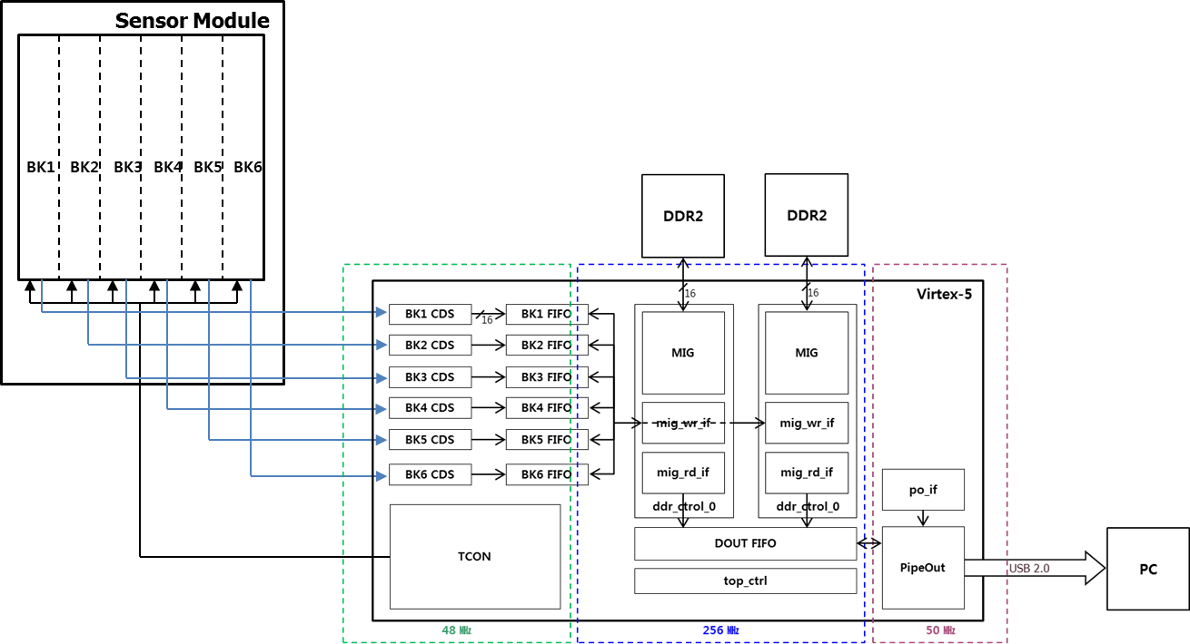
Sensor Control Logic
Two External memories are used.
While reading 1 frame data(2.5MB) to host pc from one memory via USB2.0, controller writes sensor data at another one.
Digital error correction and Digital CDS
Line memory is divided into 6 banks.
The data via USB is
displayed on the UI program.
Timing control signals asserts to each bank.
Data from bank1 to bank6 is stored at external memory in order.

Slide 9
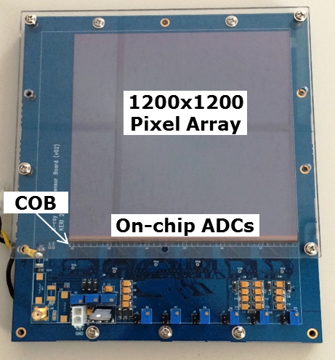
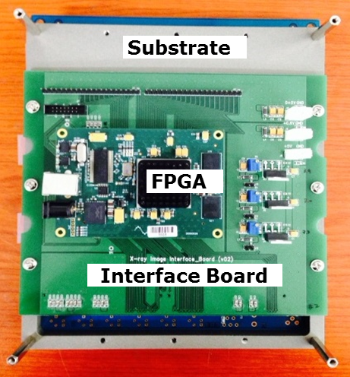
CMOS X-ray Detector Module (1)
< Front >
< Back >

Slide 10
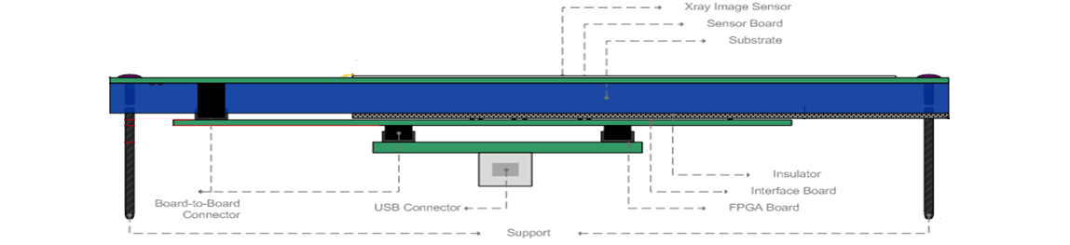
CMOS X-ray Detector Module (2)
< Side >
After dicing, the sensor is attached to the PCB board using low temperature cure epoxy.
Sensor board, interface board, and FPGA board are directly connected via board-to-board connector.
A substrate covered between the sensor and interface board prevents a sensor board from bending, and also insulates.

Slide 11
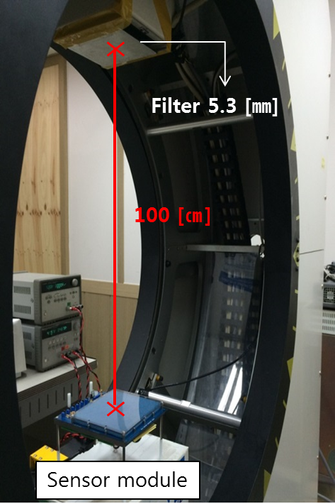
X-ray Characteristics (1)
Test Conditions
  Distance from focal spot to sensor surface : 100 [㎝]
  Filter thickness: 5.3 [㎜]
  Tube voltage : 75 [kVp] (fixed)
  Tube current : 10 to 125 [㎃]
    The intensity of X-ray is linearly proportional
    to the tube current, not the tube voltage.
    We can obtain linearly incremented intensities.
  On-chip ADC condition setup
    Full-Resolution / Binning Mode
  Scintillator
    DRZ-Standard(GOS)
    Cut the scintillator to fit the sensor size and
    place it on the sensor.

Slide 12
X-ray Characteristics (2)
Dose Measurement
  Measured by exposing sensor to x-ray for 1 sec while changing tube current from 10 to 125 [㎃].
  Calculating dose in proportional to x-ray exposure time on the pixel.
    In full-resolution mode, integration time is 24 [㎳].
    In binning mode, integration time is 12 [㎳].
Tube Current [mA] | Dose [mR] | FULL | BIN
10 | 19.1 | 0.4584 | 0.2292
12 | 24 | 0.576 | 0.288
16 | 31 | 0.744 | 0.372
20 | 38.8 | 0.9312 | 0.4656
24 | 48.3 | 1.1592 | 0.5796
32 | 61.8 | 1.4832 | 0.7416
40 | 77.4 | 1.8576 | 0.9288
50 | 96.8 | 2.3232 | 1.1616
64 | 123.7 | 2.9688 | 1.4844
80 | 153.9 | 3.6936 | 1.8468
100 | 190.3 | 4.5672 | 2.2836
125 | 304.1 | 7.2984 | 3.6492

Slide 13
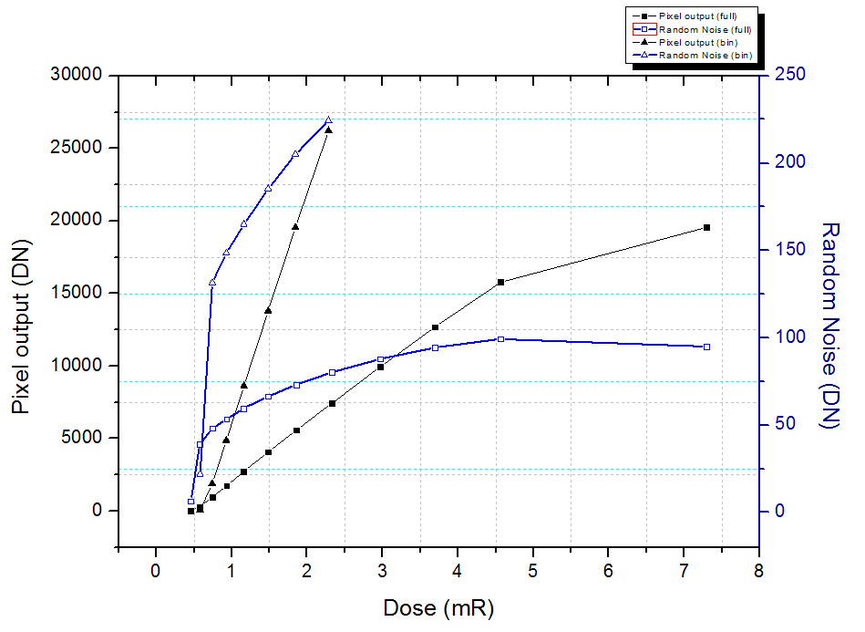
X-ray Characteristics (2)
Optoelectrical response and random noise of CMOS X-ray Sensor
Optoelectrical characteristics
  full-resolution : the output is linear 0.46 to 4.5 mR
  binning : the output is linear 0.58 to 2.4 mR
Random noise
  full-resolution : 6.38 [DN] at 0.46 [mR]
  Binning : 21.8 [DN] at 0.58 [mR]

Slide 14
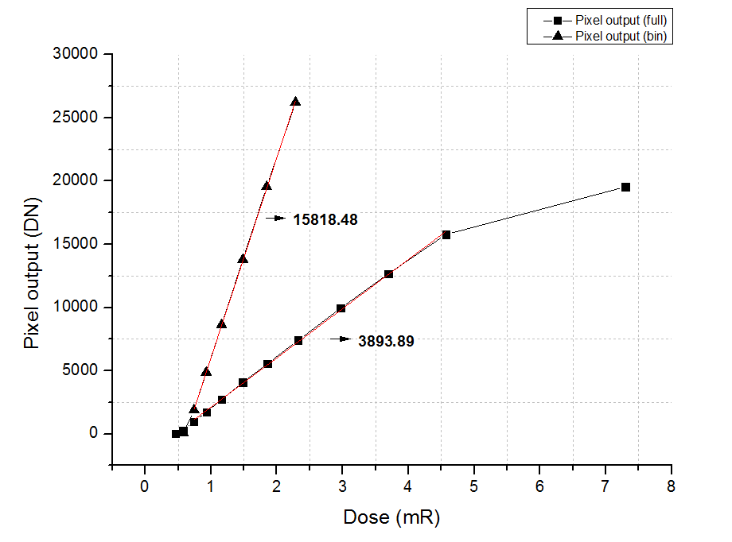
X-ray Characteristics (3)
Sensitivity of CMOS X-ray Sensor
 | [㎶]
1 LSB | 63.258915
  Full-Resolution : 3893.89 [DN/mR] (≒ 0.246 [V/mR] )
  Binning : 15818.48 [DN/mR] (≒ 1.001 [V/mR] )
  The sensitivity in binning mode is the quadruple of that in full-resolution mode.

Slide 15
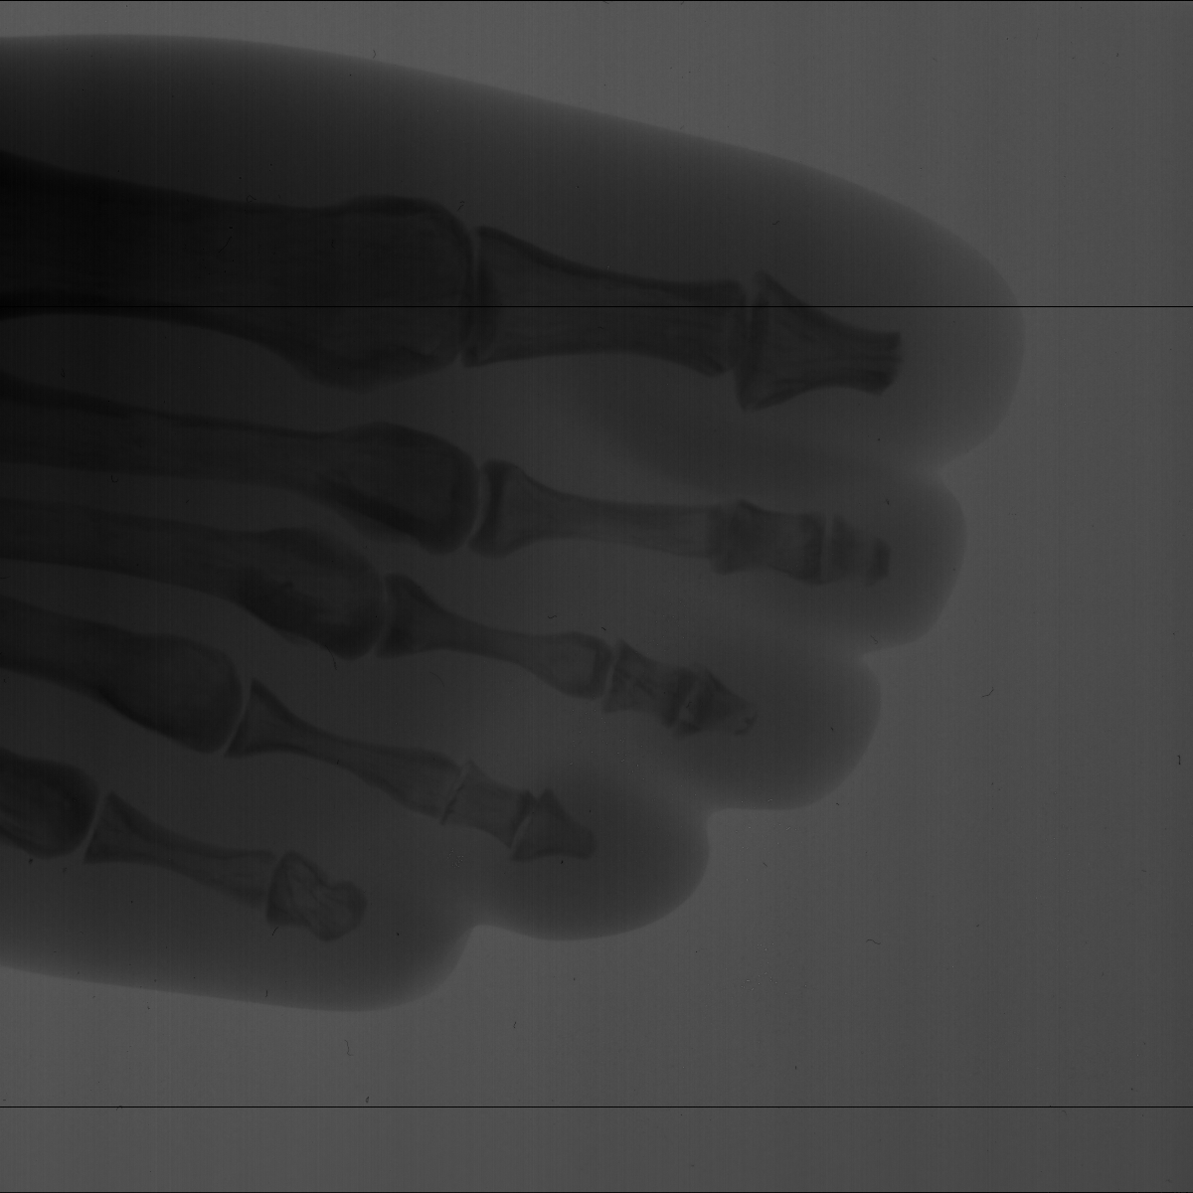
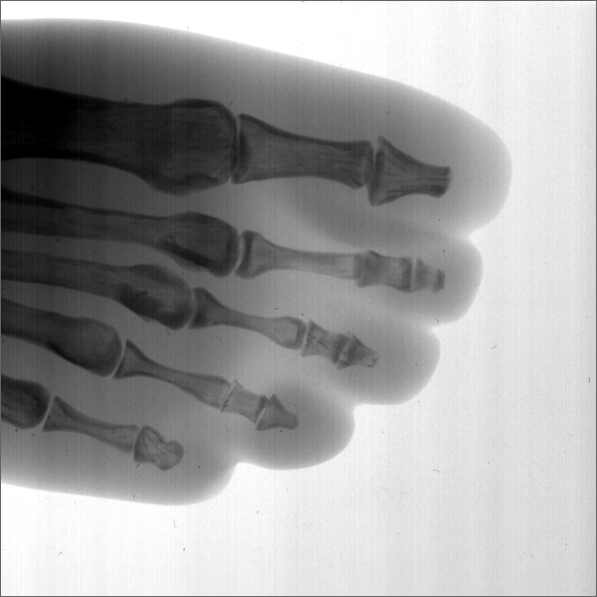
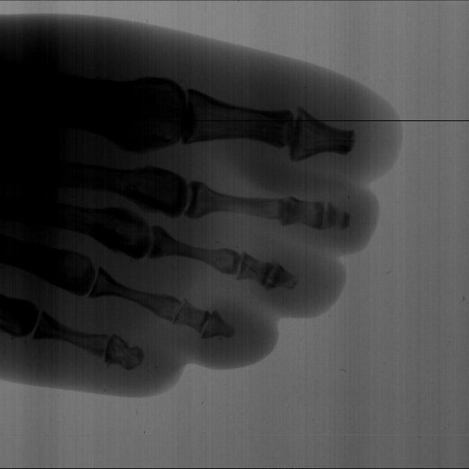
X-ray Images (1)
X-ray exposure condition : 75 [kVp] / 64 [mA]
Foot Phantom
Raw data
Contrast Adjusted data
Full-Resolution Mode
Binning Mode

Slide 16
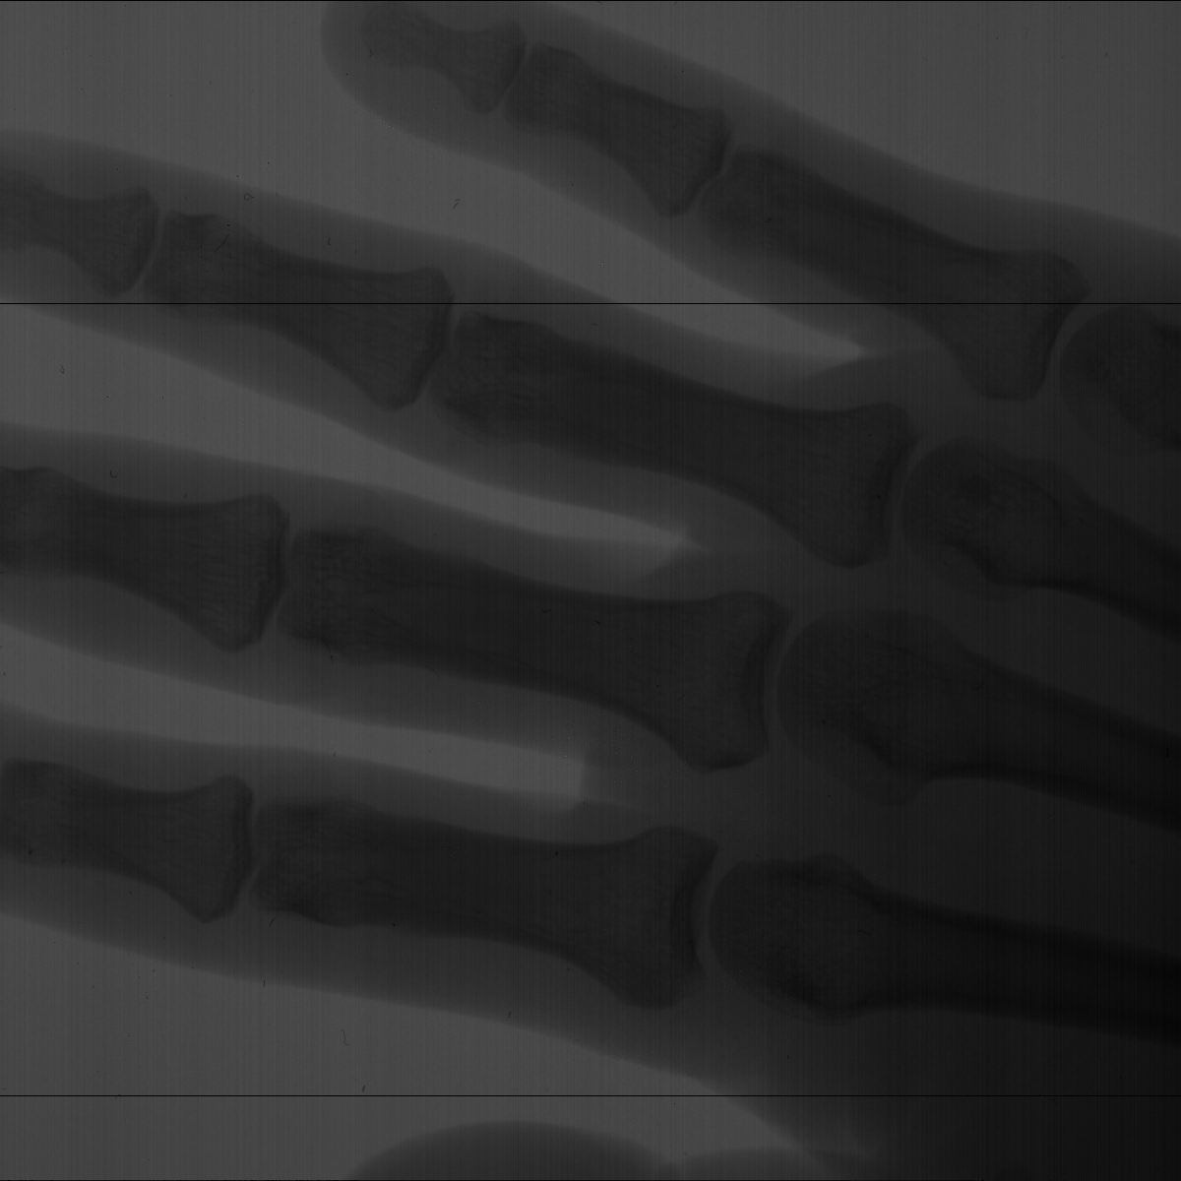
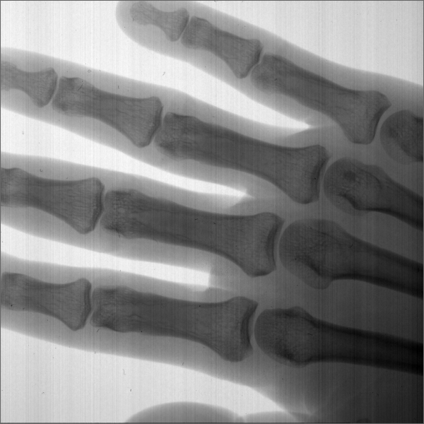

X-ray Images (2)
Hand Phantom
X-ray exposure condition : 75 [kVp] / 64 [mA]
Raw data
Contrast Adjusted data
Shaking hand (16 frame)
⇒ Based on consecutive images in full-resolution mode, image lag is negligible.

Slide 17
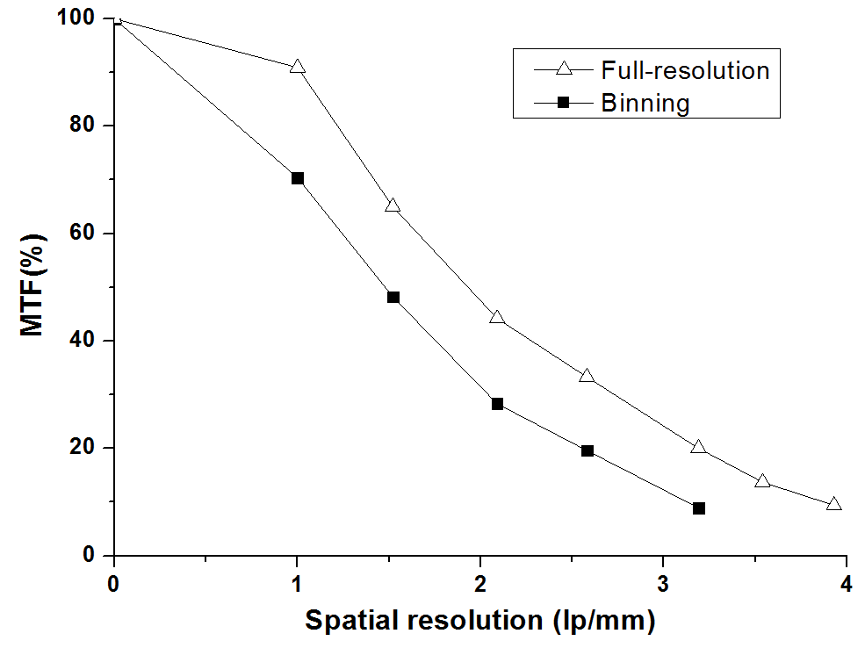
Spatial Resolution
MTF (Modulation Transfer Function)
  In full-resolution Mode, MTF at 2.54 lp/mm is 33.3%.
  In binning Mode, MTF at the same lp/mm is 19.6%.
  Since effective pixel pitch is reduced in binning mode, MTF is also decreased.
< Captured images of line pair set and Calculated MTF >

Slide 18
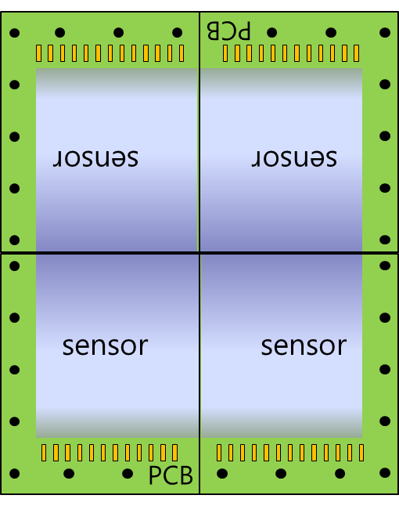
Future Works
Single CMOS X-ray detector
  Optimization of on-chip ADC operation to enhance image quality.
  Image post-processing
  Thallium-doped CSI (CSI:TI) scintillator direct deposition on the sensor
    Scintillators based on CSI:TI have good absorption properties and
    good light collection.
    We plan to make a sample to get high spatial resolution.
Tiled CMOS X-ray Detector
  Four single detectors are tiled to expand detector area.
  ( 48 x 48 [cm²] )
  Also, we plan to develop control system that manage
  each four sensors’ operation and data acquisition.

Slide 19
Summary
We developed high-resolution CMOS X-ray detector based on several advantages of CMOS process.
  A large-area 1200x1200 array CMOS image sensor with full mode(30fps) and binning mode(60fps) for mammography and fluoroscopic imaging application.
Also, we measured results such as X-ray linearity as a function of dose, spatial resolution and X-ray images of the objects for performance evaluation with GOS scintillators
  The more detailed characterization of our developed X-ray CMOS image sensor will be evaluated under practical mammography and fluoroscopic application conditions.
We plan to enhance the performance of a ingle x-ray detector and to develop tiled x-ray detector process.

Slide 20
Thank you for your attention !

