Slide 1
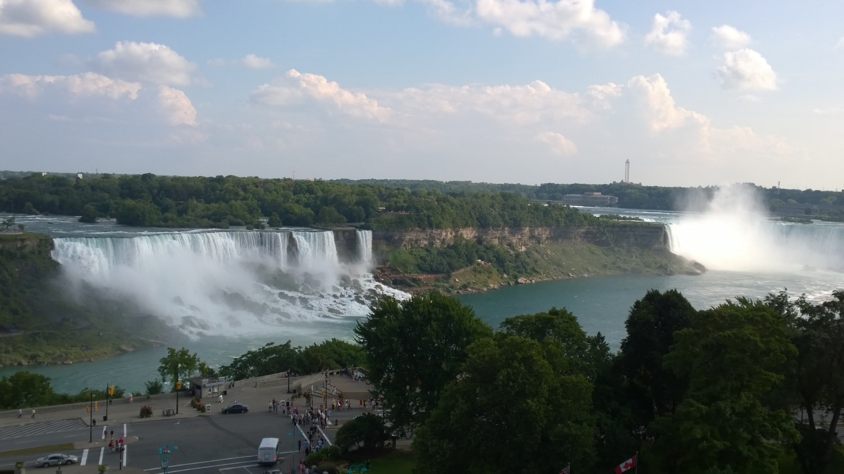
Cornell Integrating Pixel Array Detector Development for
Synchrotron X-ray Light Sources
Hugh Philipp
Pixel 2014

Slide 2
Outline
General comments detector development for synchrotron radiation sources
High-speed imager (KECK PAD)
High dynamic range imager (MMPAD)

Slide 3
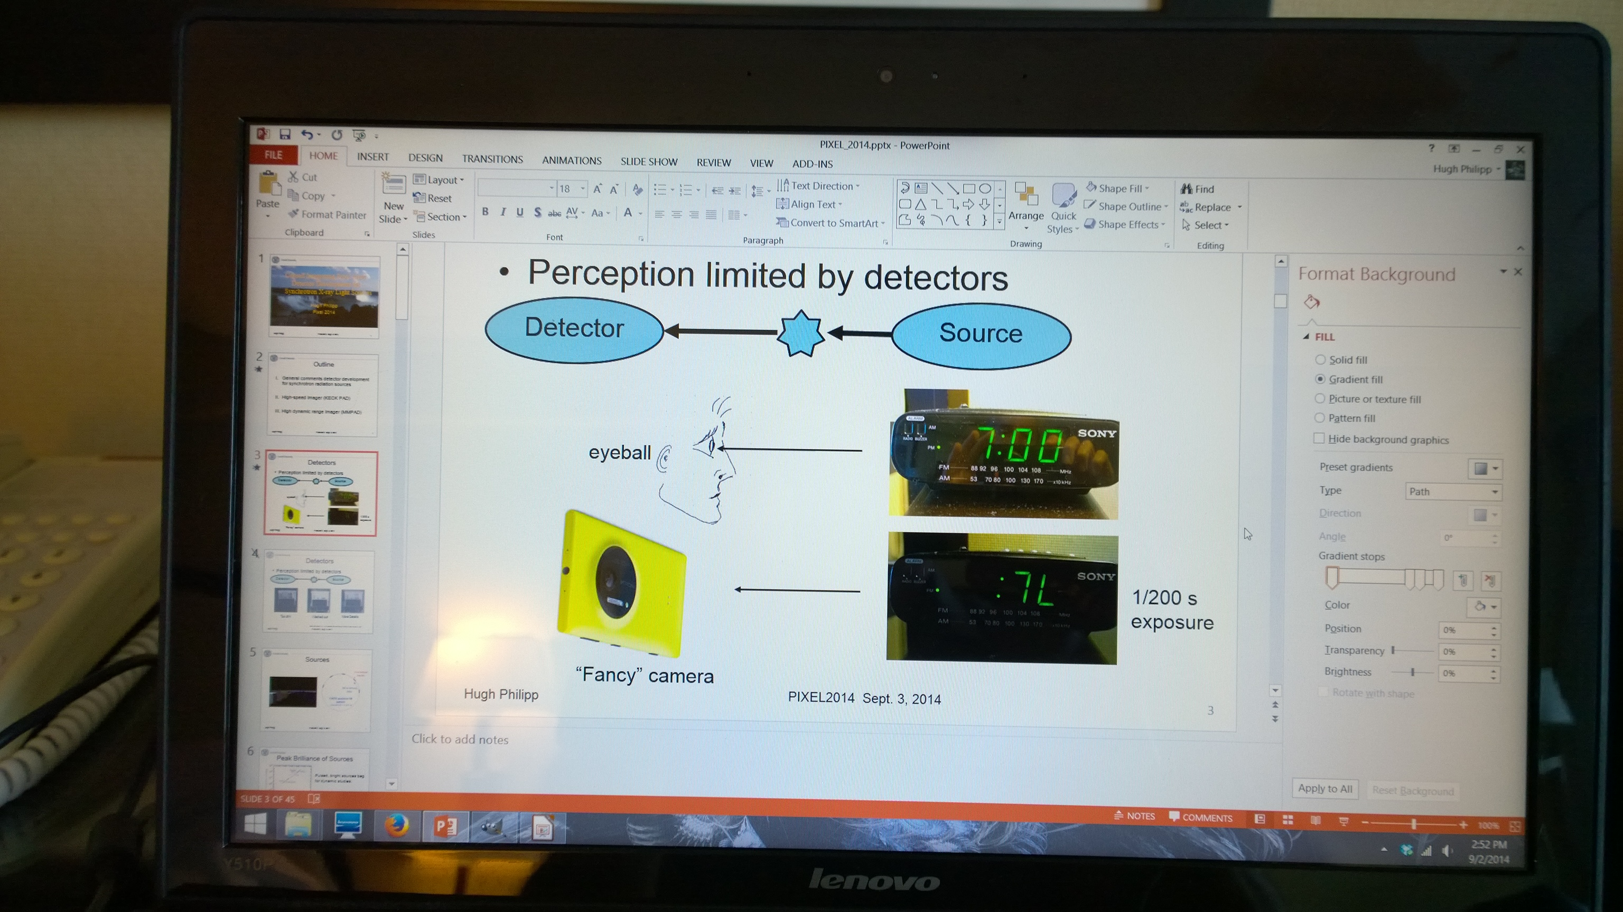
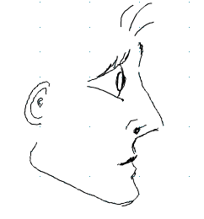
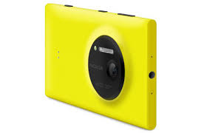
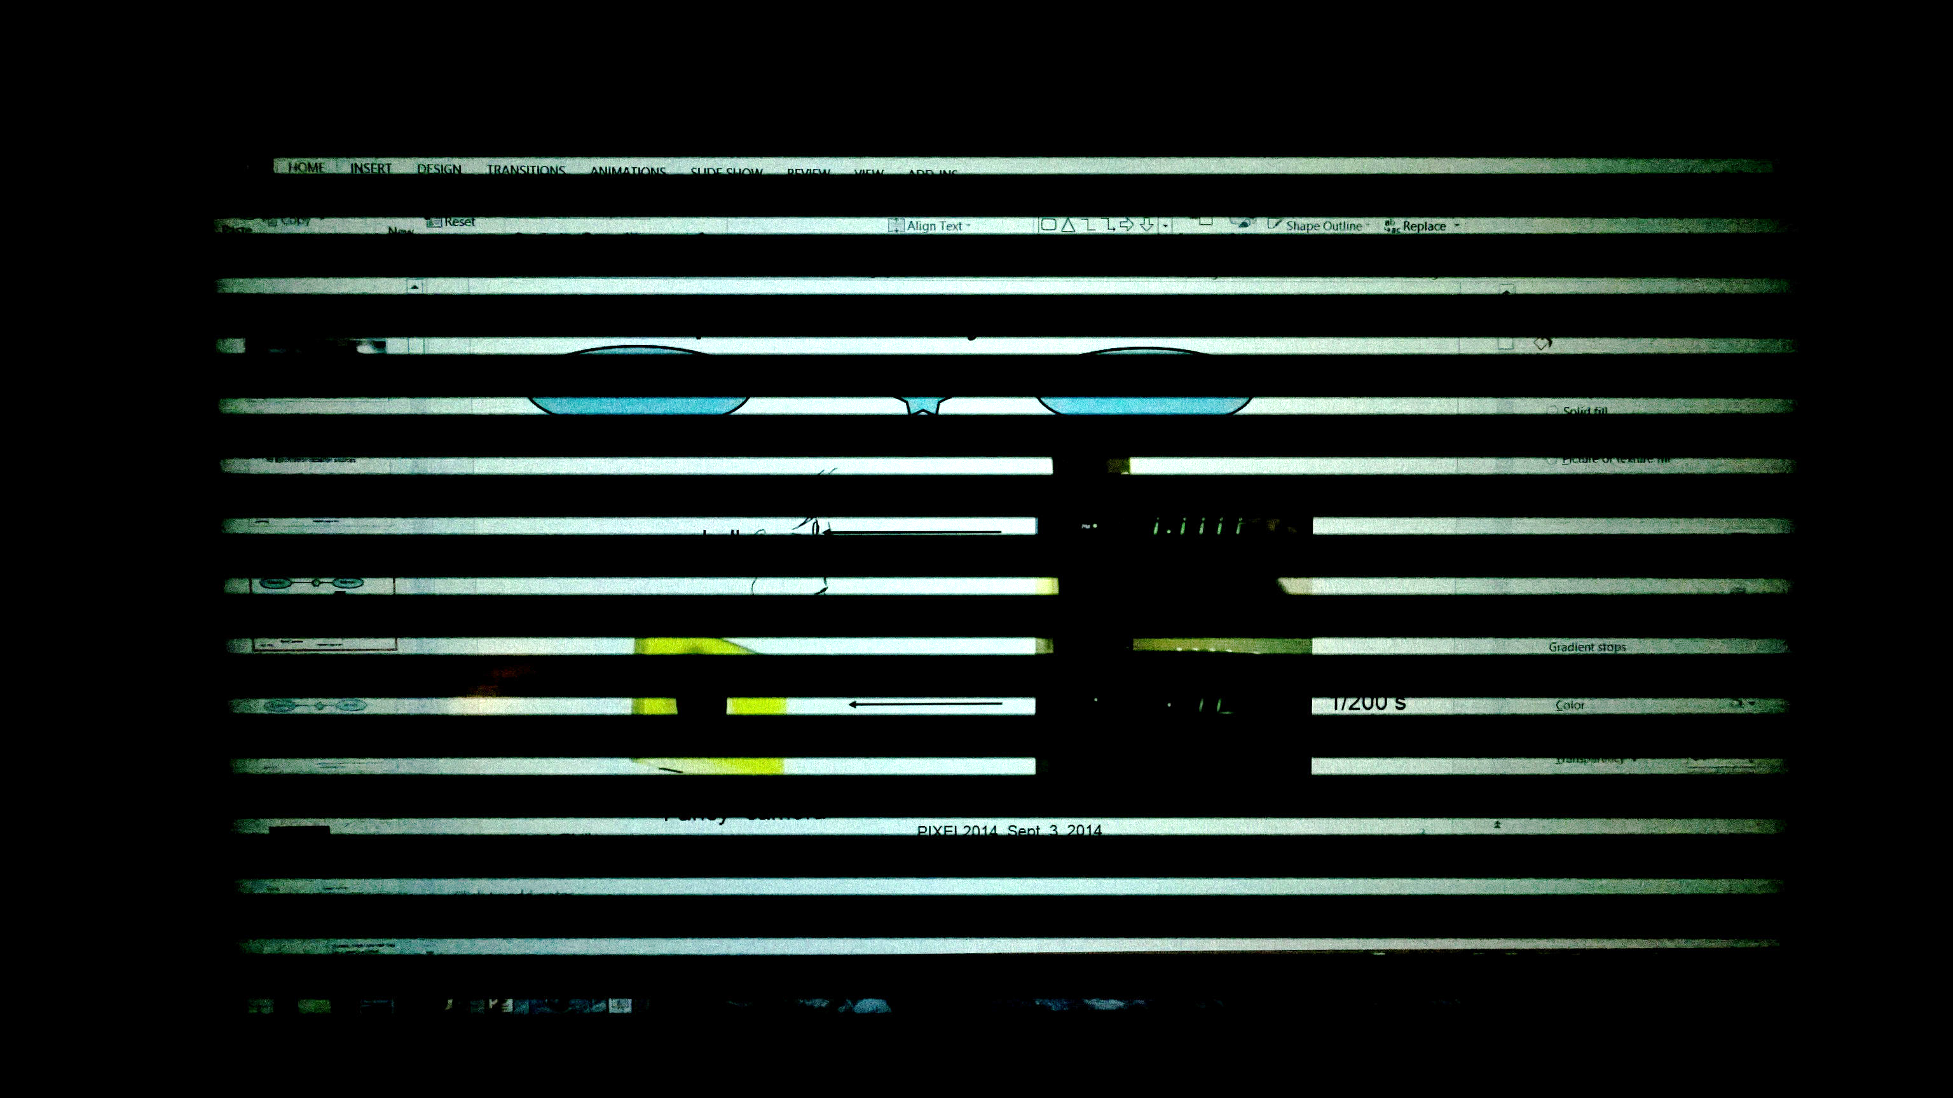
Detectors
Perception limited by detectors
Detector
Source
eyeball
1/3200 s
exposure
“Fancy” camera
My laptop

Slide 4
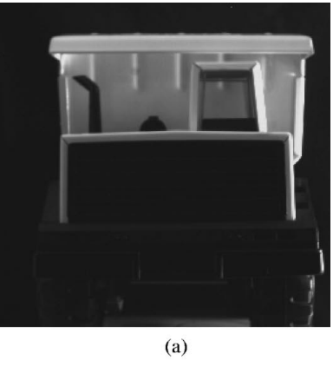
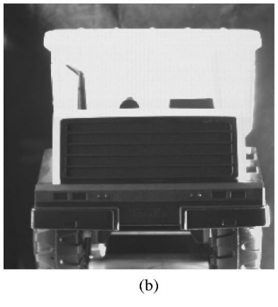
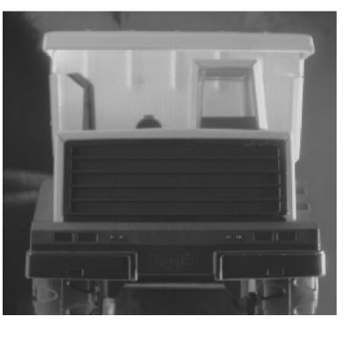
Detectors
Perception limited by detectors
Detector
Source
Too dim
Washed out
More Details
Images from Decker, et al, IEEE JOURNAL OF SOLID-STATE CIRCUITS, VOL. 33, NO. 12, 1998

Slide 5
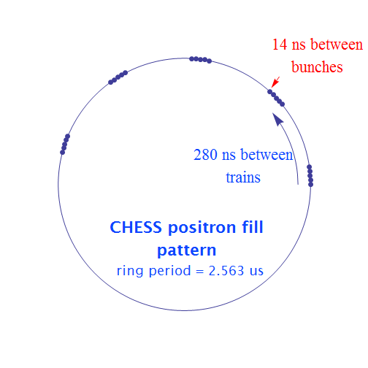
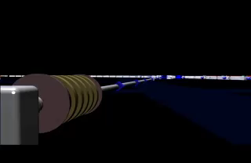
Sources
Cornell High Energy Synchrotron Source (CHESS)

Slide 6
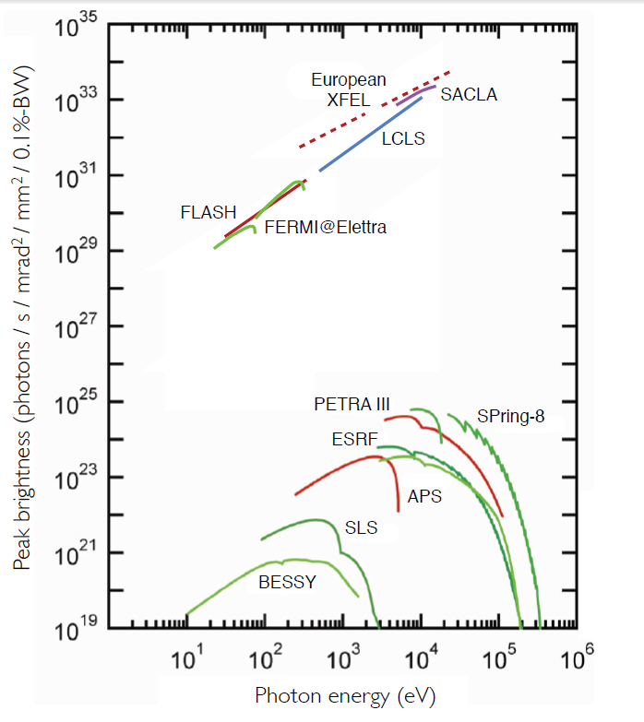
Peak Brilliance of Sources
Pulsed, bright sources beg
for dynamic studies.
Figure From: Zhirong Huang, BRIGHTNESS AND COHERENCE OF
SYNCHROTRON RADIATION AND FELs, 4th International Particle
Accelerator ConferenceShanghai, China, May 12-17, 2013
SLAC-PUB-15449

Slide 7
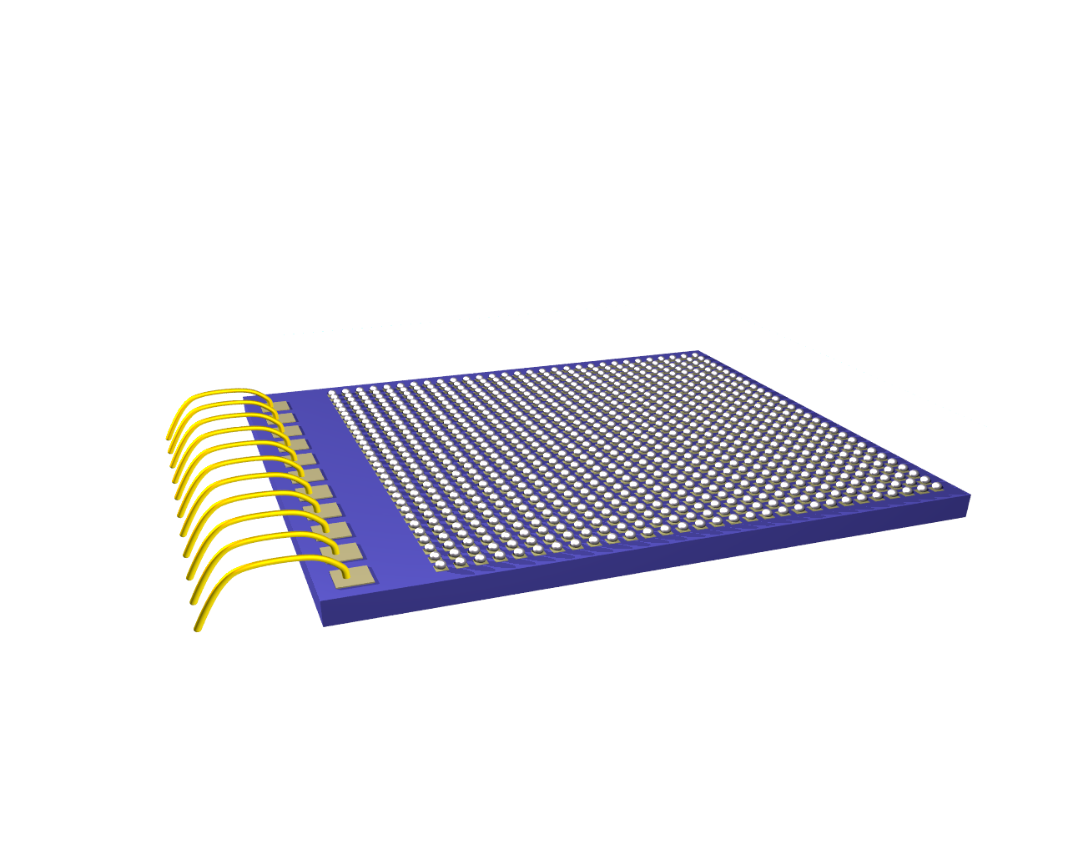
How to make detectors that maximize science ?
Last 15 years: Rise of the PADs.
Wire bonds
CMOS ASIC / ROC

Slide 8
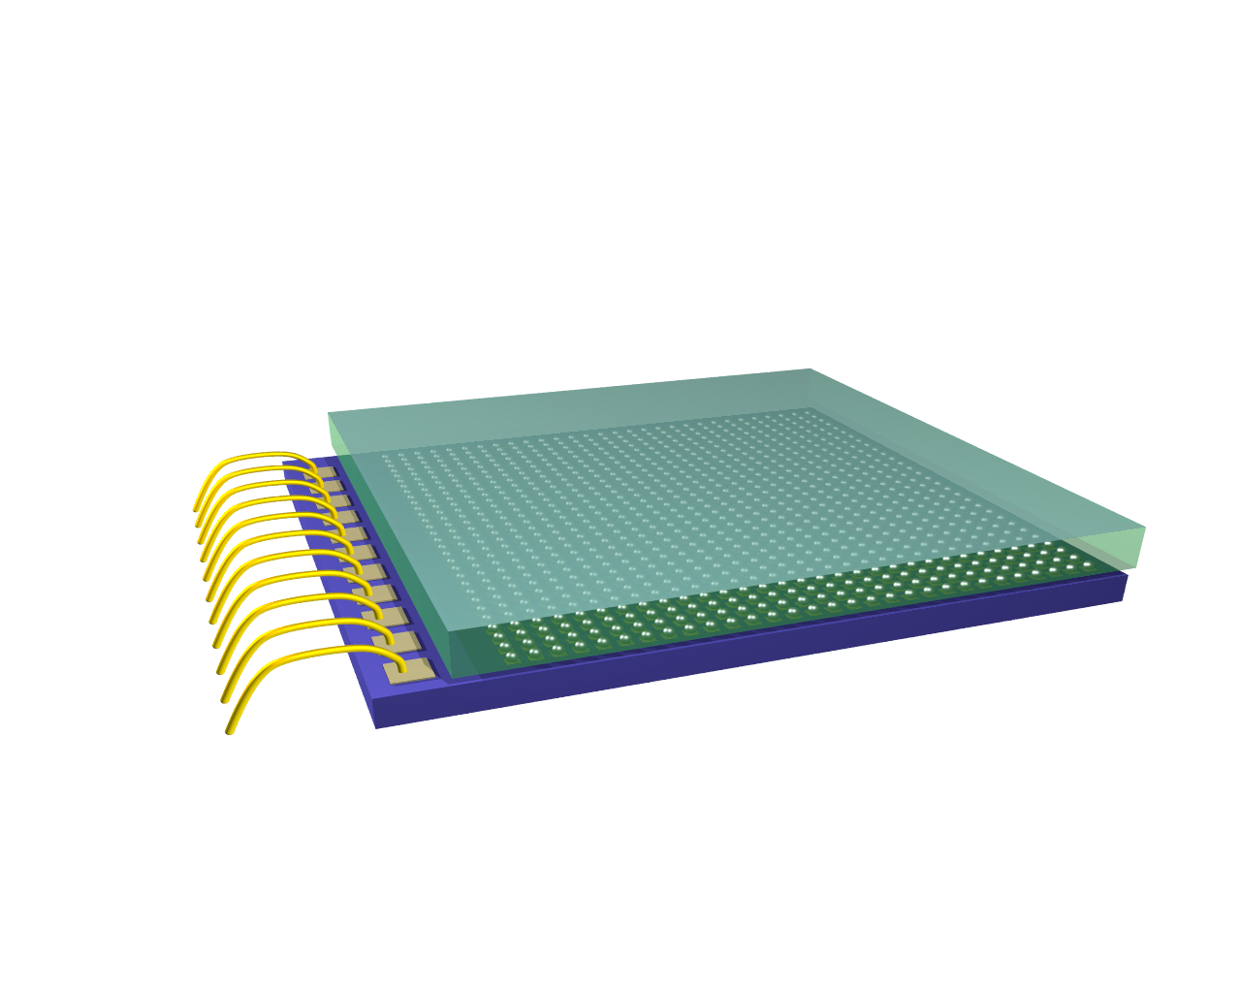
How to make detectors that maximize science ?
Last ~15 years: Rise of the PADs.
Wire bonds
Diode
CMOS ASIC / ROC
HV bias

Slide 9
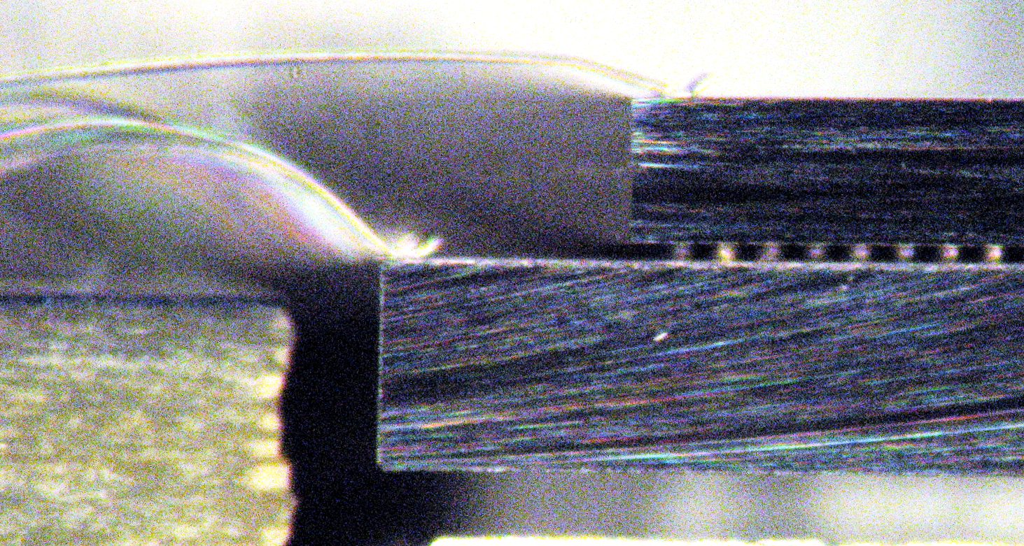
How to make detectors that maximize science ?
Last 15 years: Rise of the PADs.
HV bias
Bumps
Wire bonds
Diode
CMOS ASIC / ROC
Image: KECK detector

Slide 10
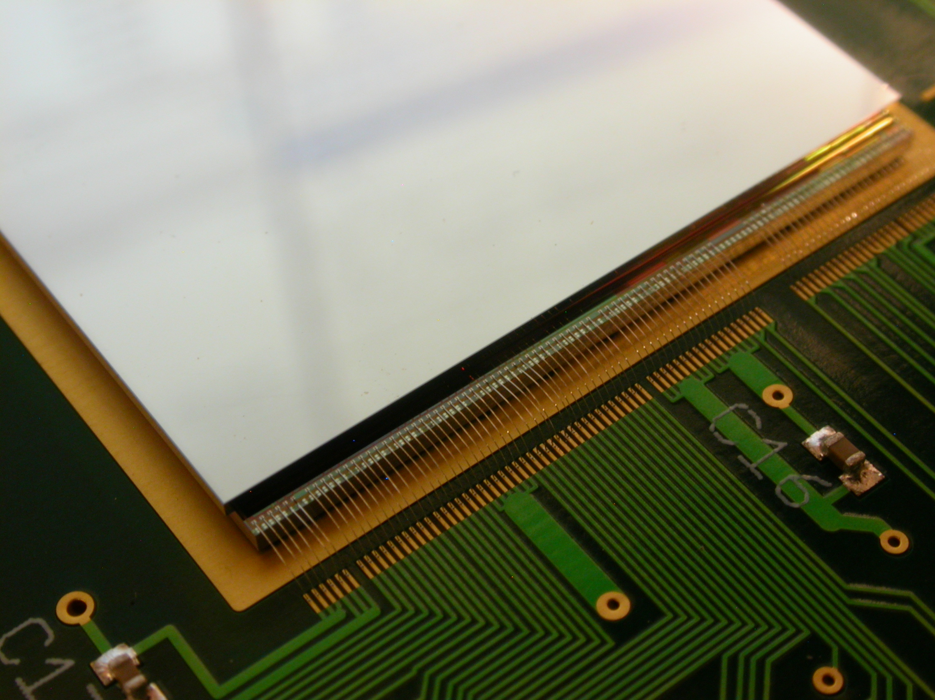
How to make detectors that maximize science ?
Last 15 years: Rise of the PADs.
Image: CS-PAD prototype detector

Slide 11
High Speed Imaging

Slide 12
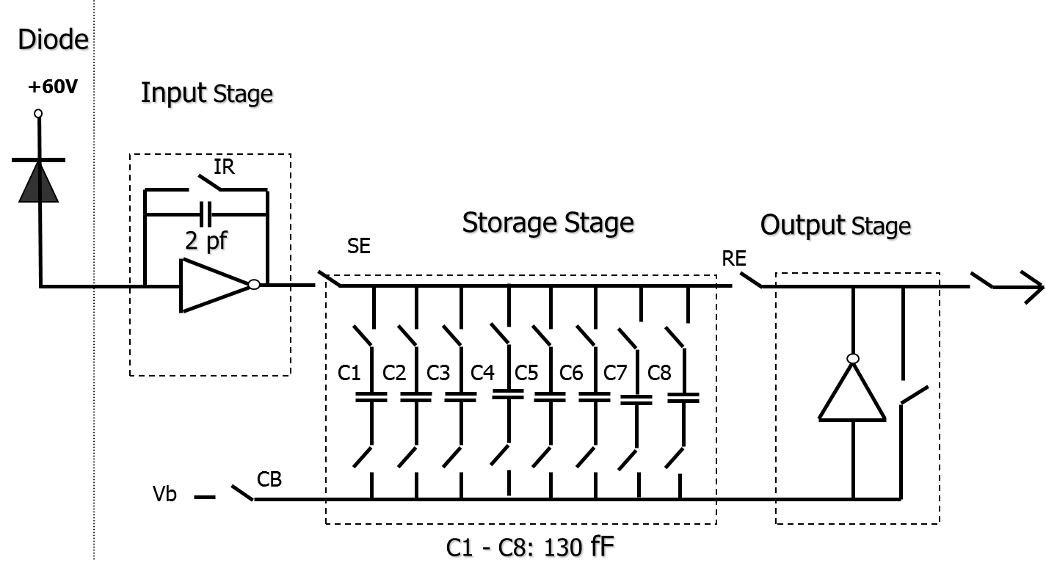
First µs imaging with PAD
Pixel schematic
G. Rossi, et al, J Synchrotron Rad. (1999). 6, 1095-1105.

Slide 13
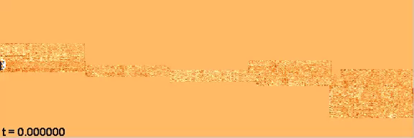
First µs imaging with PAD
1.3 ms time sequence (composite of 34 sample positions)
5.13 μs exposure time (2.56 μs between frames)
168 frames in time (21 groups of 8 frames)
A. MacPhee, et al, Science (2002). 295, 1261-1263.

Slide 14
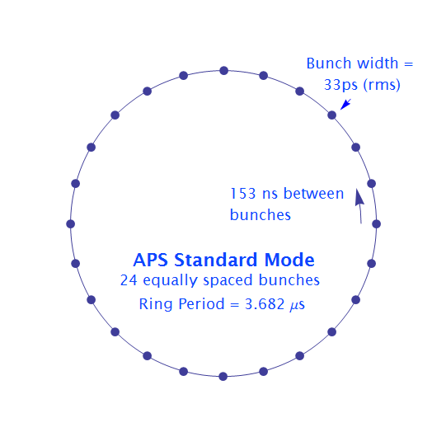
Want: Successive Single Bunch Imaging
  Standard Operating Mode:
  24 single bunches
  153 ns between bunches
  Bunch length 33 ps (rms)

Slide 15
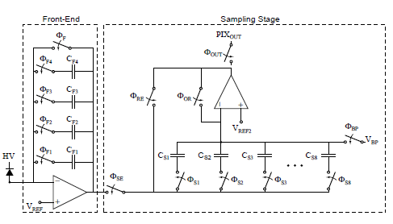
Keck PAD
Pixel Schematic
Upgraded design to do single bunch imaging.
Storage caps
150 µm x 150 µm
Notes:
Second detector in tiled format: Keck PAD
More typical well capacity
In-pixel frame storage for burst-mode imaging down to 100 ns between frames
At present 8 storage caps/pixel; upgrade to 30
Each pixel has 4 integration caps
Use to adjust gain
Additionally signal can be re-accumulated onto each for imaging cyclical process
80 ns between frames would be possible

Slide 16
Keck PAD
Read time | 860 µs/stored frame
Storage caps/pixel | 8
Read noise | 1 photon @ 8 keV (high gain) 4 photons @ 8 keV (low gain)
Well capacity | ~1100 8-keV photons (high gain) ~ 7300 8-keV photons (low gain)
Notes:
Second detector in tiled format: Keck PAD
More typical well capacity
In-pixel frame storage for burst-mode imaging down to 100 ns between frames
At present 8 storage caps/pixel; upgrade to 30
Each pixel has 4 integration caps
Use to adjust gain
Additionally signal can be re-accumulated onto each for imaging cyclical process
80 ns between frames would be possible

Slide 17
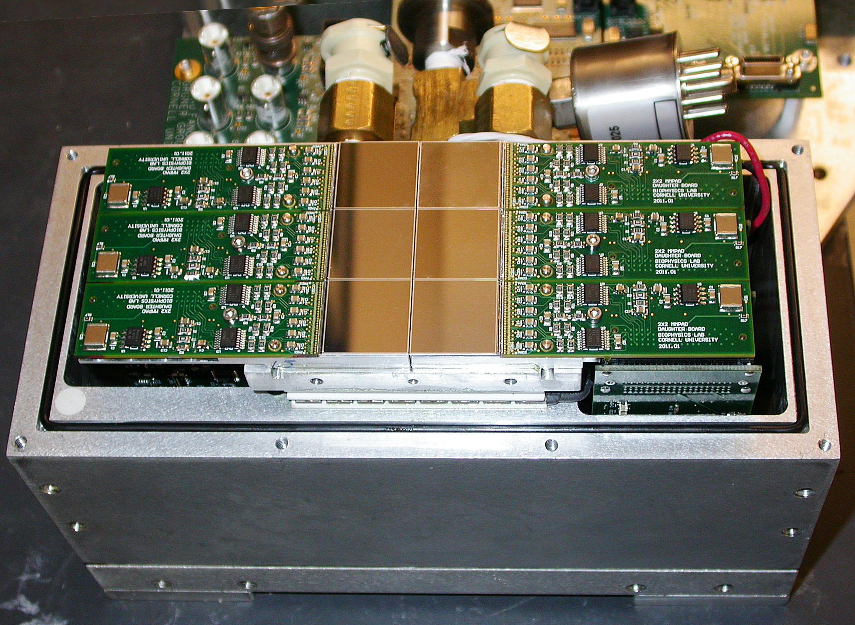
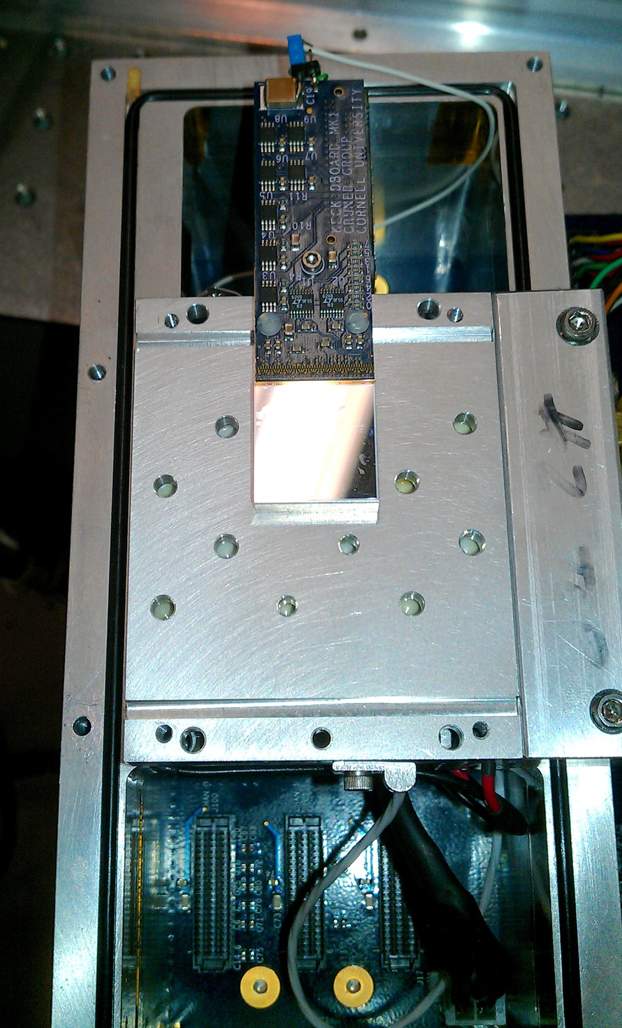
Keck PAD 3x2 array
Pixel: 150x150 microns
Single module: 128x128 pixels
Detector: 3x2 modules

Slide 18
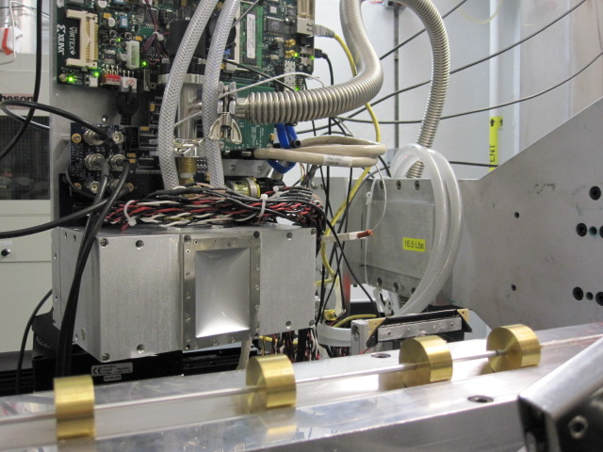
Keck PAD 3x2 array

Slide 19
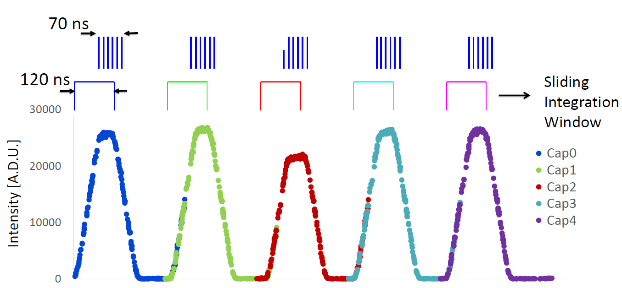
Single bunch train test
280 ns
Fill pattern
Integration window
3x10⁴
2x10⁴
Intensity [ADU]
10⁴
0
480
680
880
1080
1280
1480
1680
1880
Delay [ns]

Slide 20
Kolsky Bar
Specimen:
Mg Alloy AZ31
10 keV
Notes:
In-situ exposures as short as 70ns use bunch trains at CHESS – used to look at high strain rate mechanical deformation / dynamic loading.
Need: Beam parameters – 10 keV, 2% bandpass, 2x10^13 photons/s/mm2. Etc.
3mm diameter kolsky bars.
sample: Mg alloy, AZ31, grain size 3um
movie of deformation.
diffraction patterns.
what the diffraction patterns tell us.

Slide 21
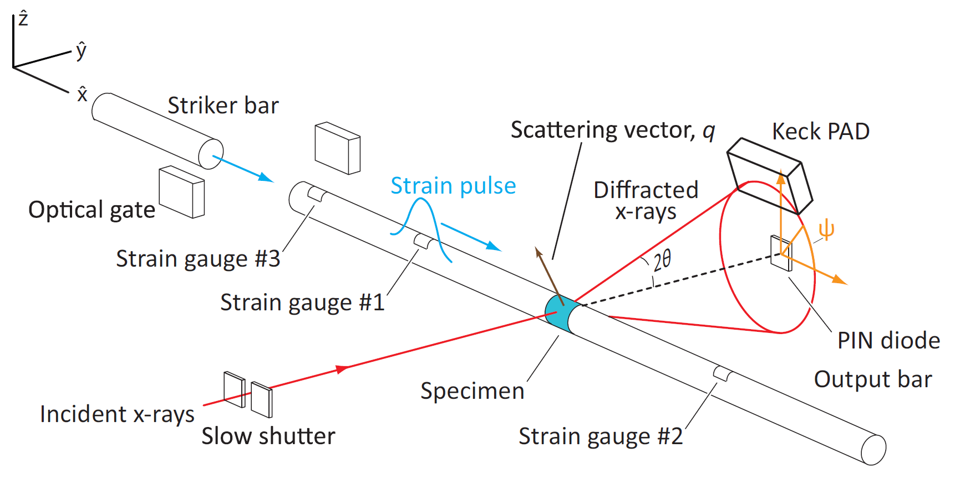
Kolsky Bar
Specimen:
Mg Alloy AZ31
10 keV
Lambert et al., Time-resolved x-ray diffraction techniques for bulk polycrystalline materials under dynamic loading, submitted article, Review of Scientific Instruments
Notes:
In-situ exposures as short as 70ns use bunch trains at CHESS – used to look at high strain rate mechanical deformation / dynamic loading.
Need: Beam parameters – 10 keV, 2% bandpass, 2x10^13 photons/s/mm2. Etc.
3mm diameter kolsky bars.
sample: Mg alloy, AZ31, grain size 3um
movie of deformation.
diffraction patterns.
what the diffraction patterns tell us.

Slide 22
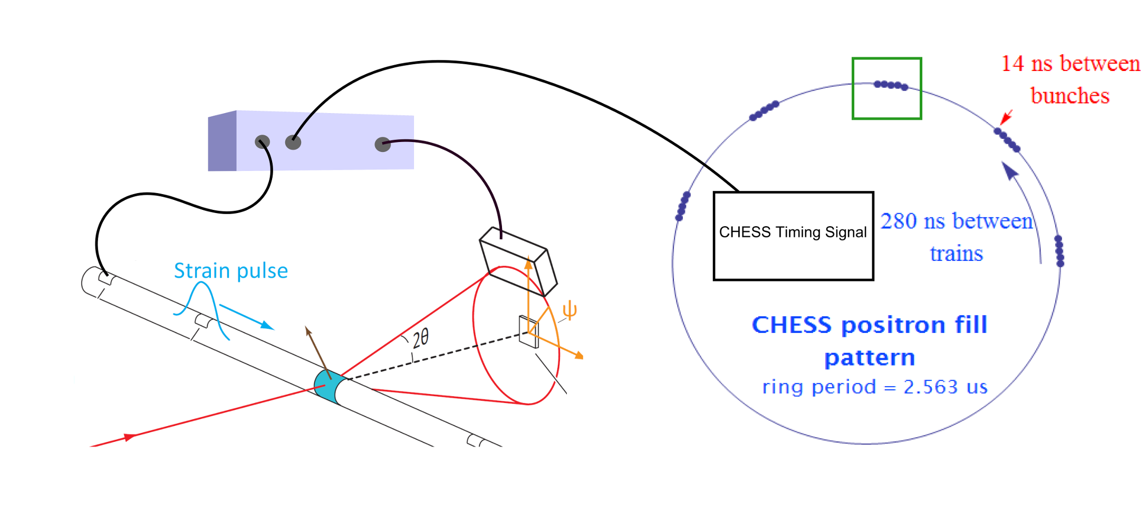
Kolsky Bar
Can pick out single bunch train
Delay Generator
Triggering by CHESS timing signal inhibited until
strain gauge pulse
Notes:
In-situ exposures as short as 70ns use bunch trains at CHESS – used to look at high strain rate mechanical deformation / dynamic loading.
Need: Beam parameters – 10 keV, 2% bandpass, 2x10^13 photons/s/mm2. Etc.
3mm diameter kolsky bars.
sample: Mg alloy, AZ31, grain size 3um
movie of deformation.
diffraction patterns.
what the diffraction patterns tell us.

Slide 23
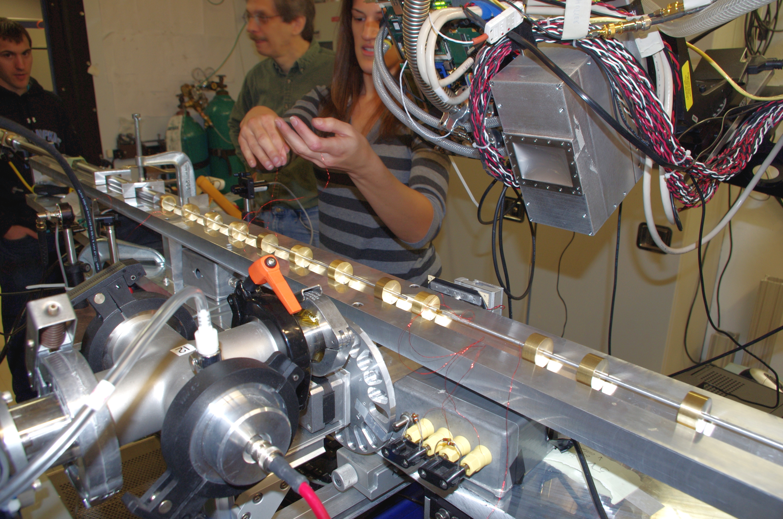
Kolsky Bar
Notes:
In-situ exposures as short as 70ns use bunch trains at CHESS – used to look at high strain rate mechanical deformation / dynamic loading.
Need: Beam parameters – 10 keV, 2% bandpass, 2x10^13 photons/s/mm2. Etc.
3mm diameter kolsky bars.
sample: Mg alloy, AZ31, grain size 3um
movie of deformation.
diffraction patterns.
what the diffraction patterns tell us.

Slide 24
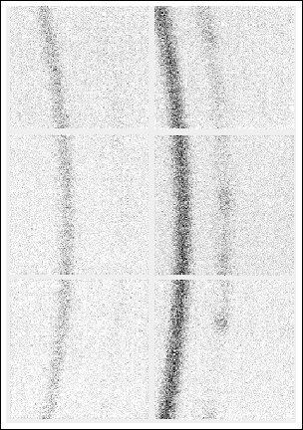
Time-resolved study of metals under stress
detector
striker bar
incident bar
x-rays
sample
output bar
~ 5 µs integration time
(2 x CHESS ring period )
~ 7.5 µs frame period.
Peak intensity ~ 6 x-rays/pix average.
Notes:
Also used in time-resolved study of metals under stress
CHESS beamline G3
Kolsky bar used to compress magnesium sample with high strain rate
Frame detector at 5 microsecond exposures, separated by 100 ns
Watch evolution of diffraction pattern during compression event
We plan to do more experiments of this type investigating dynamics in other materials

Slide 25
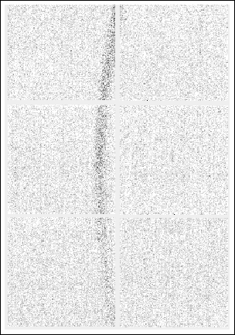
Time-resolved study of metals under stress
detector
striker bar
incident bar
x-rays
sample
output bar
Single bunch train imaged diffraction.
70 ns per image
Peak intensity ~ 1 x-rays/pix average
Notes:
Also used in time-resolved study of metals under stress
CHESS beamline G3
Kolsky bar used to compress magnesium sample with high strain rate
Frame detector at 5 microsecond exposures, separated by 100 ns
Watch evolution of diffraction pattern during compression event
We plan to do more experiments of this type investigating dynamics in other materials

Slide 26
Limitations of Current KECK setup
Silicon diode not efficient at higher energies.
Charge collection time from diode limited to 10s of nanoseconds.
Only 8 storage caps in a pixel.

Slide 27
Limitations of Current KECK setup
Silicon diode not efficient at higher energies.
Charge collection time from diode limited to 10s of nanoseconds.
Only 8 storage caps in a pixel.
Higher Z detectors
Next version, 27 caps

Slide 28
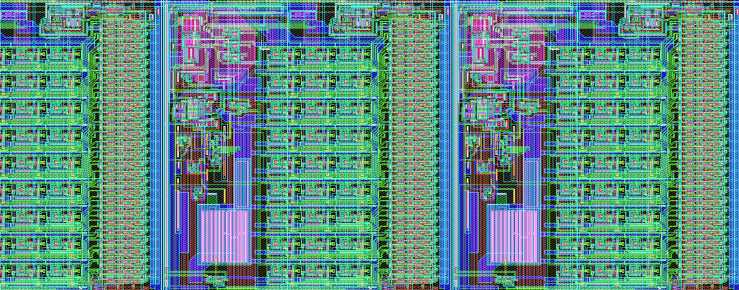
KECK 2
Coming soon…
Better single photon signal to noise.
More storage caps.
Other cool stuff.

Slide 29
High Dynamic Range

Slide 30
Mixed-mode PAD (MMPAD)
Read time (frame rate) | 0.86 ms (1.1 kHz)
Read noise (RMS) | 0.16 photons @ 8 keV
Well capacity | 4.7 x 10⁷ photons/pix/frame @ 8 keV
Sustained count rate | >10⁸ ph/pix/s
Instantaneous count rate | >> 10¹² ph/pix/s (e.g. ~200 ph/storage ring pulse)
Notes:
- The first detector I’ll talk about is the mixed-mode PAD
- Combine analog and digital readout to extend the dynamic range
- How does it work? Integrate onto 50 fF feedback cap
- When that fills up at 200 photons, Charge removal circuit triggered
- CHARGE REMOVAL IS DEADTIME-LESS
- Read out counter value and analog residual, merge
- Digital portion = count rate limit
Punchline: fast framing, high dynamic range
Note that charge removal circuit operates at 2 MHz (500 ns charge removal time)
Size of charge removal chunk is flexible. Externally programmable.
****CHARGE REMOVAL IS DEAD-TIME-LESS***
Funded to upgrade for XFEL operation.

Slide 31
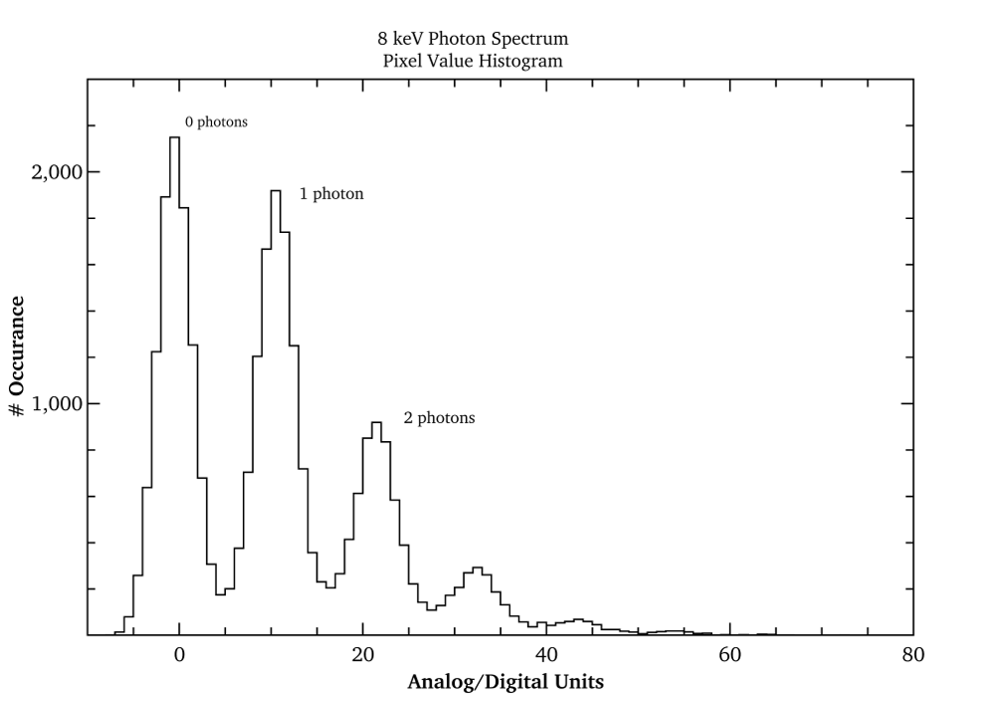
High Single Photon SNR Essential

Slide 32
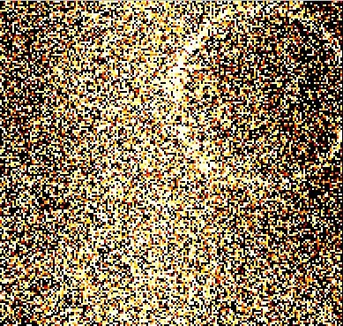
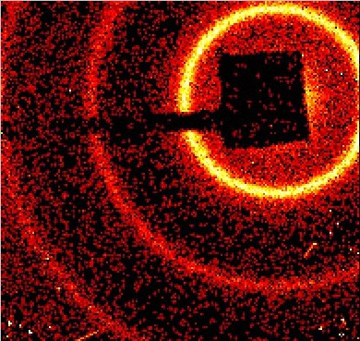
High Single Photon SNR Essential
Systematics can add up in large data sets.
Some large data analysis requires good single photon measurement.
Raw Sum
Sum w / threshold
CS-PAD
AgBe diffraction
Sum of 1000 frames
10 ms/frame
~30 photons/frame
<10⁻³ ph/pix/frame in outer ring
*See also Philipp et al., JINST (2011) 6, C11006
32

Slide 33
High Single Photon SNR Essential
Systematics can add up in large data sets.
Some large data analysis requires good single photon measurement.
Sum w / threshold
CS-PAD
AgBe diffraction
Sum of 1000 frames
10 ms/frame
~30 photons/frame
<10⁻³ ph/pix/frame in outer ring
10⁻³ ph/pix/frame
Order of magnitude less
*See also Philipp et al., JINST (2011) 6, C11006
33

Slide 34
High Single Photon SNR Essential
Systematics can add up in large data sets.
Some large data analysis requires good single photon measurement.

Slide 35
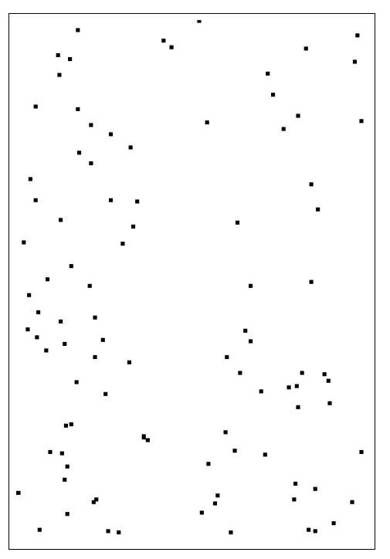
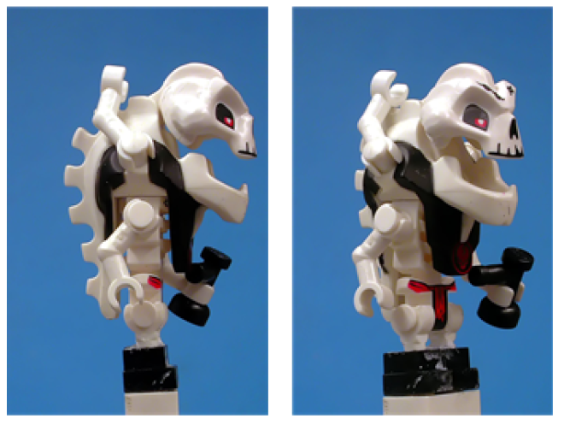
High Single Photon SNR Essential
Systematics can add up in large data sets.
Some large data analysis requires good single photon measurement.
…
Maximizing time resolution -> sparse data.

Slide 36
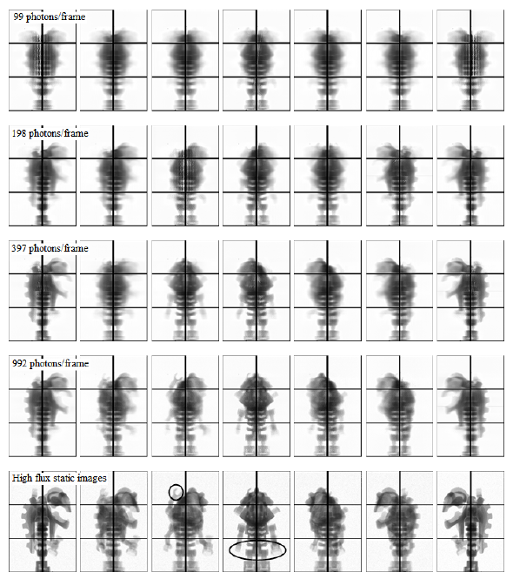
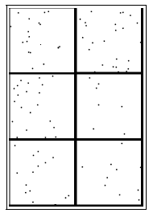
High Single Photon SNR Essential
Data Frame – unknown sample orientation.
EMC
Sparse data:
1 frame: 9.1 x 10⁻⁴ ph/pix
~10⁷ frames
K. Ayyer et al., Optics Express 2014
36

Slide 37
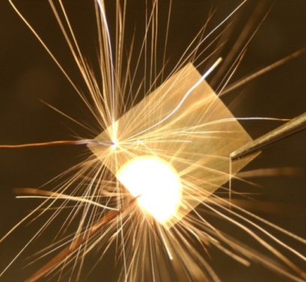
High frame rate diffraction @ CHESS A2
Collaborators: Hufnagel group @ Johns Hopkins
Goal: study lattice changes in inter-metallic foils undergoing an exothermic reaction
Energy: 15 keV
7
50
# of photons
# of photons
0
0
Notes:
Example of high frame rate experiment: dynamic studies of reactive metal foils
Done at A2 with Hufnagel
Goal: study metallic foils undergoing an exothermic reaction – like thermite
Samples were heated uniformly at various rates to induce different incubation periods before reaction
Detector was frames rapidly during heating to collect diffraction patterns before the reaction, during incubation and as the reaction progressed.
Update expt sketch

Slide 38
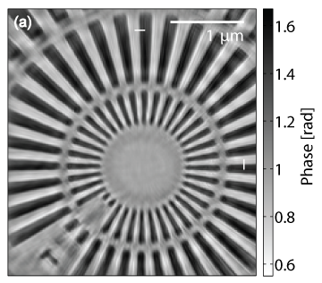
Ptychography @ PETRA III P10
Reconstructed object phase
Example 100 ms frame
Energy: 7.9 keV
Integration time: 100 ms/frame
Image reconstruction resolution: 25 nm horizontal, 26 nm vertical
Collaborators:
  Adrian Mancuso, Klaus Giewekemeyer, Andy Acquila (European XFEL)
Giewekemeyer et al., Journal of Synchrotron Radiation, in press
Notes:
- Last experiment was inherently low-flux. Class of experiments that does use full dynamic range: coherent diffractive imaging
- Illuminate sample with coherent beam, scattering patterns with inherently wide dynamic range are fed into an iterative algorithm to reconstruct object phase and absorption contrast
- MMPAD has been used in a few ptychogrphy experiments
- This one done at PETRA III P10 with collab from Euro XFEL
- Sample: tantalum Siemens star test pattern, 500 nm thick
- Scanned over 900+ positions
- Reconstructed to 25 nm resolution
- Single 100 ms exposure; color scale is log; single photons at edge, 10^6 photons in center
Attenuation factor of 4.3 used during dataset shown
Advantageous to capture q=0 data – review paper
Radiation damage
Add DOI for paper.

Slide 39
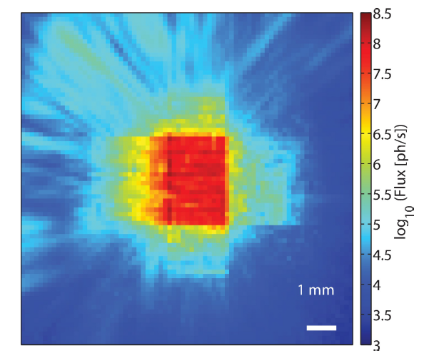
Ptychography @ PETRA III P10
No attenuators, > 10⁸ photons/pixel/s
Giewekemeyer et al., Journal of Synchrotron Radiation, in press
Notes:
To demonstrate high-flux capability: direct measurement of KB-focused beam, no attenuators, no sample
Central portion of image shown
2x10^8 ph/pix/s with no saturation or signal loss
How we know that’s right: checked against ion chambers, Pilatus @ lower fluence (i.e. attenuators in), linear behavior for MMPAD as attenuators are removed.

Slide 40
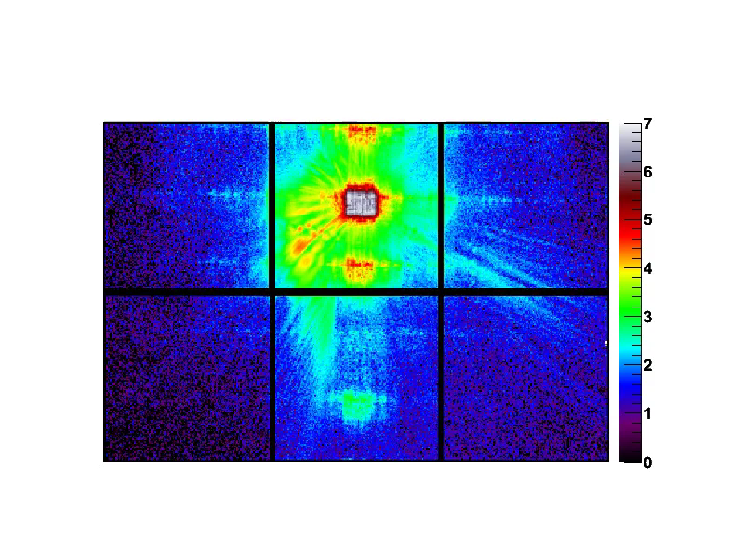
High Dynamic Range
Log (# of photons)
Notes:
Why is high dynamic range important? What is high dynamic Range?

Slide 41
Limitations of MMPAD
Charge dump of 200 8-keV photon equivalent limited to ~ 1 MHz.
Working on next generation detector suitable for XFELs.

Slide 42
Limitations of MMPAD
Charge dump of 200 8-keV photon equivalent limited to ~ 1 MHz.
Working on next generation detector suitable for XFELs.
  HOW?
  Speeding up the charge dump on the front end.
  Matching the charge collection time from the diode with the front-end.

Slide 43
Conclusions
Matching detector capabilities to sources: experimental opportunities.
The MMPAD and Keck PAD address critical needs.
We are always looking for scientific and detector development collaborations.

Slide 44
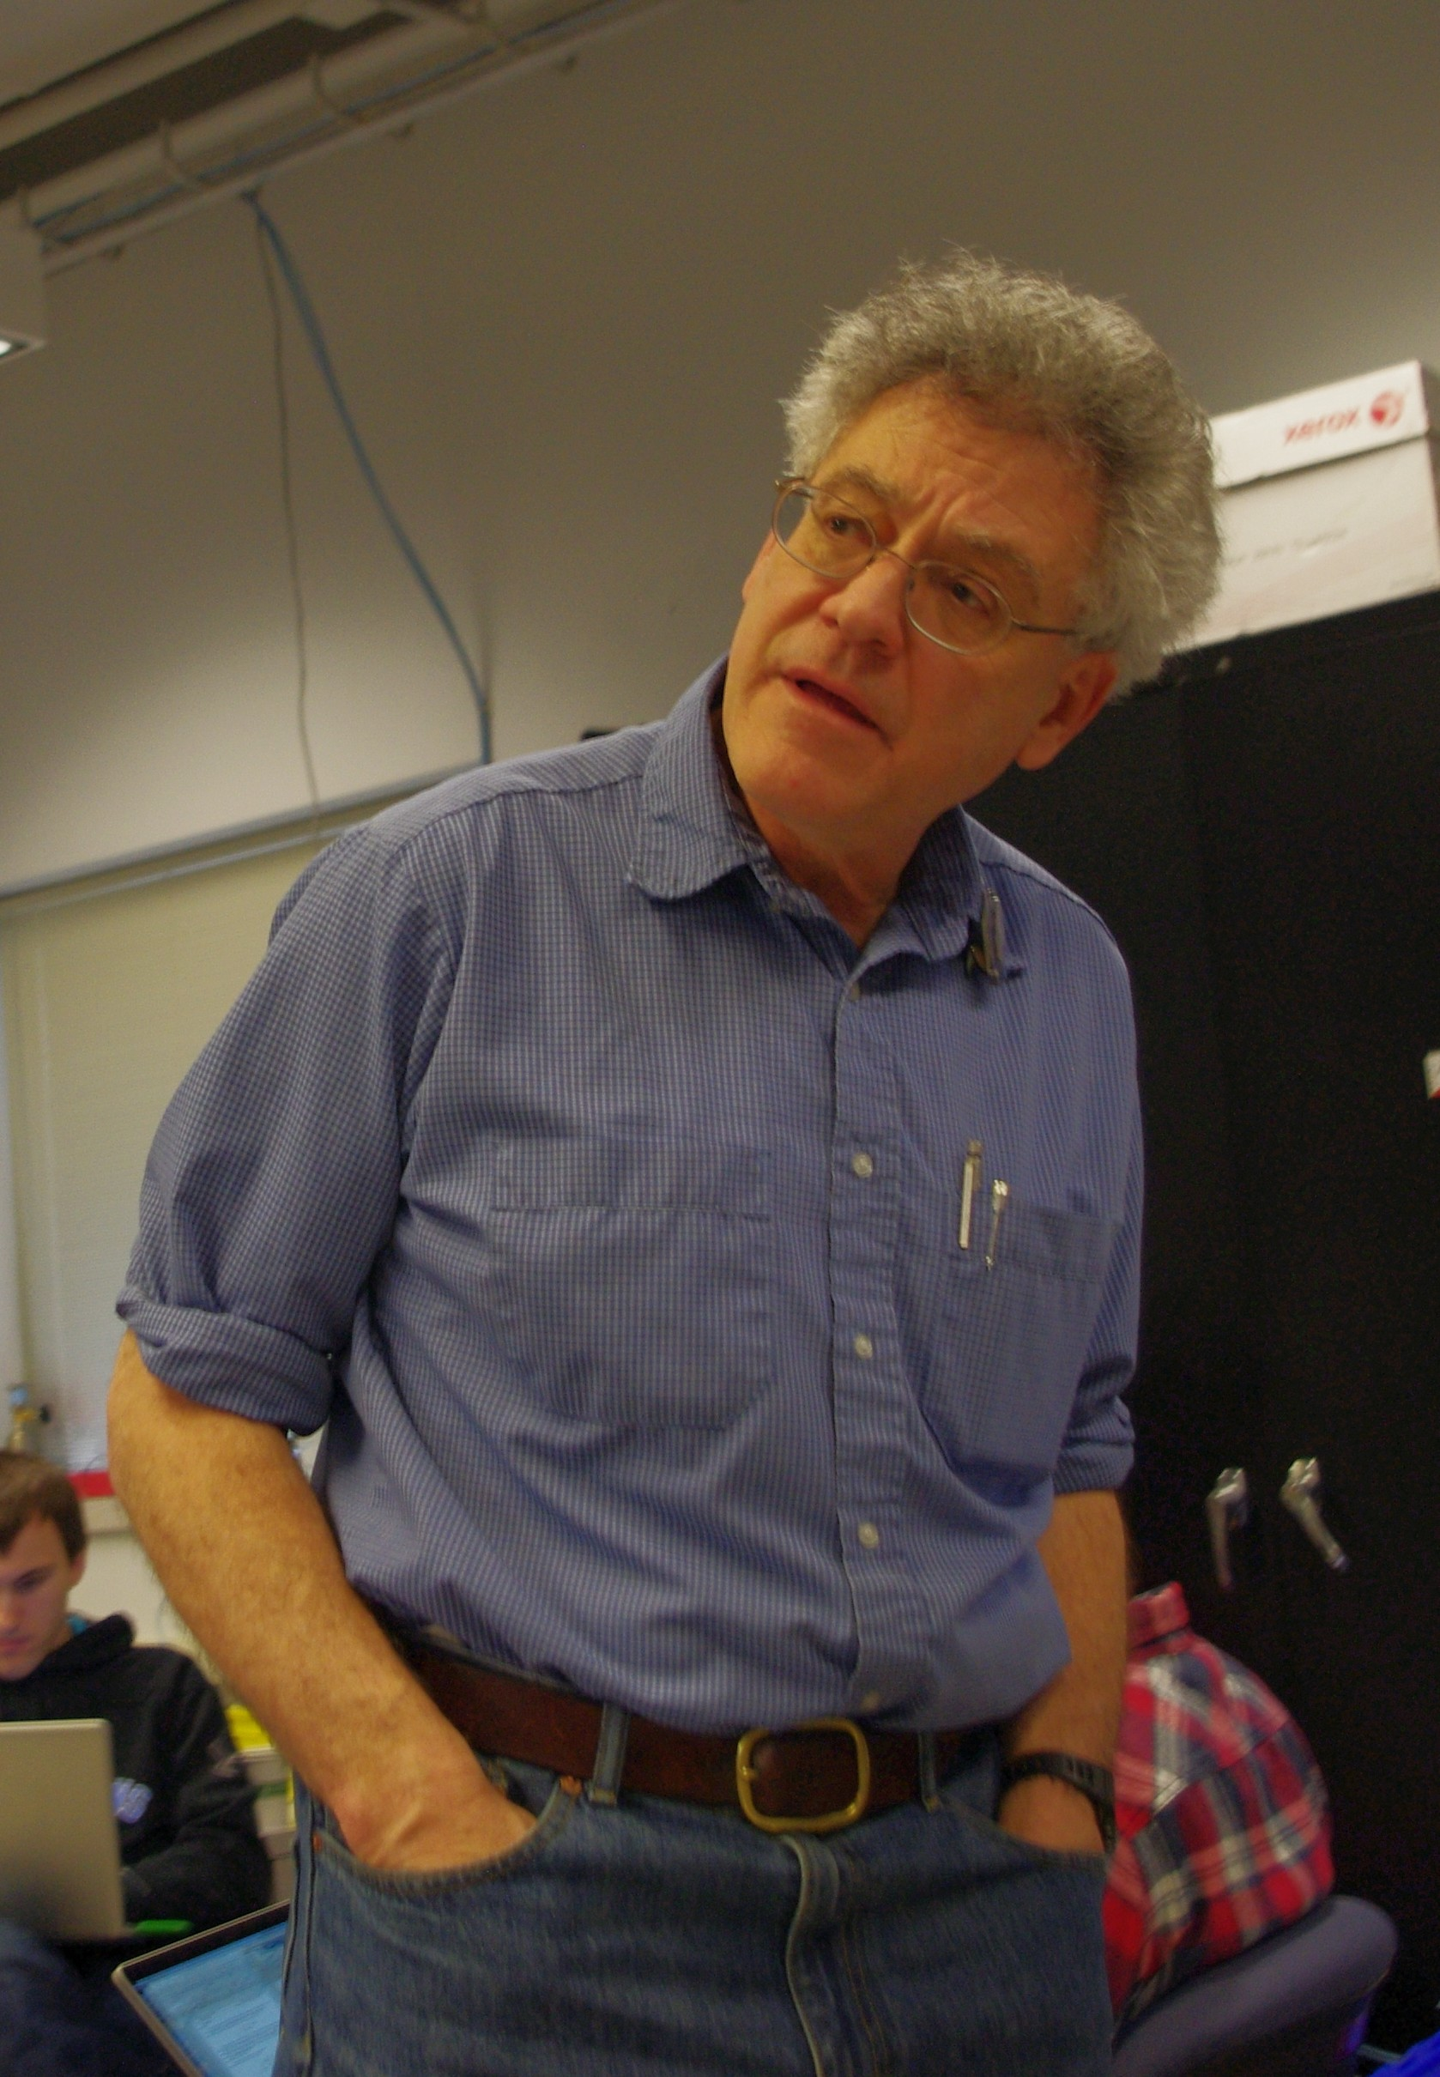
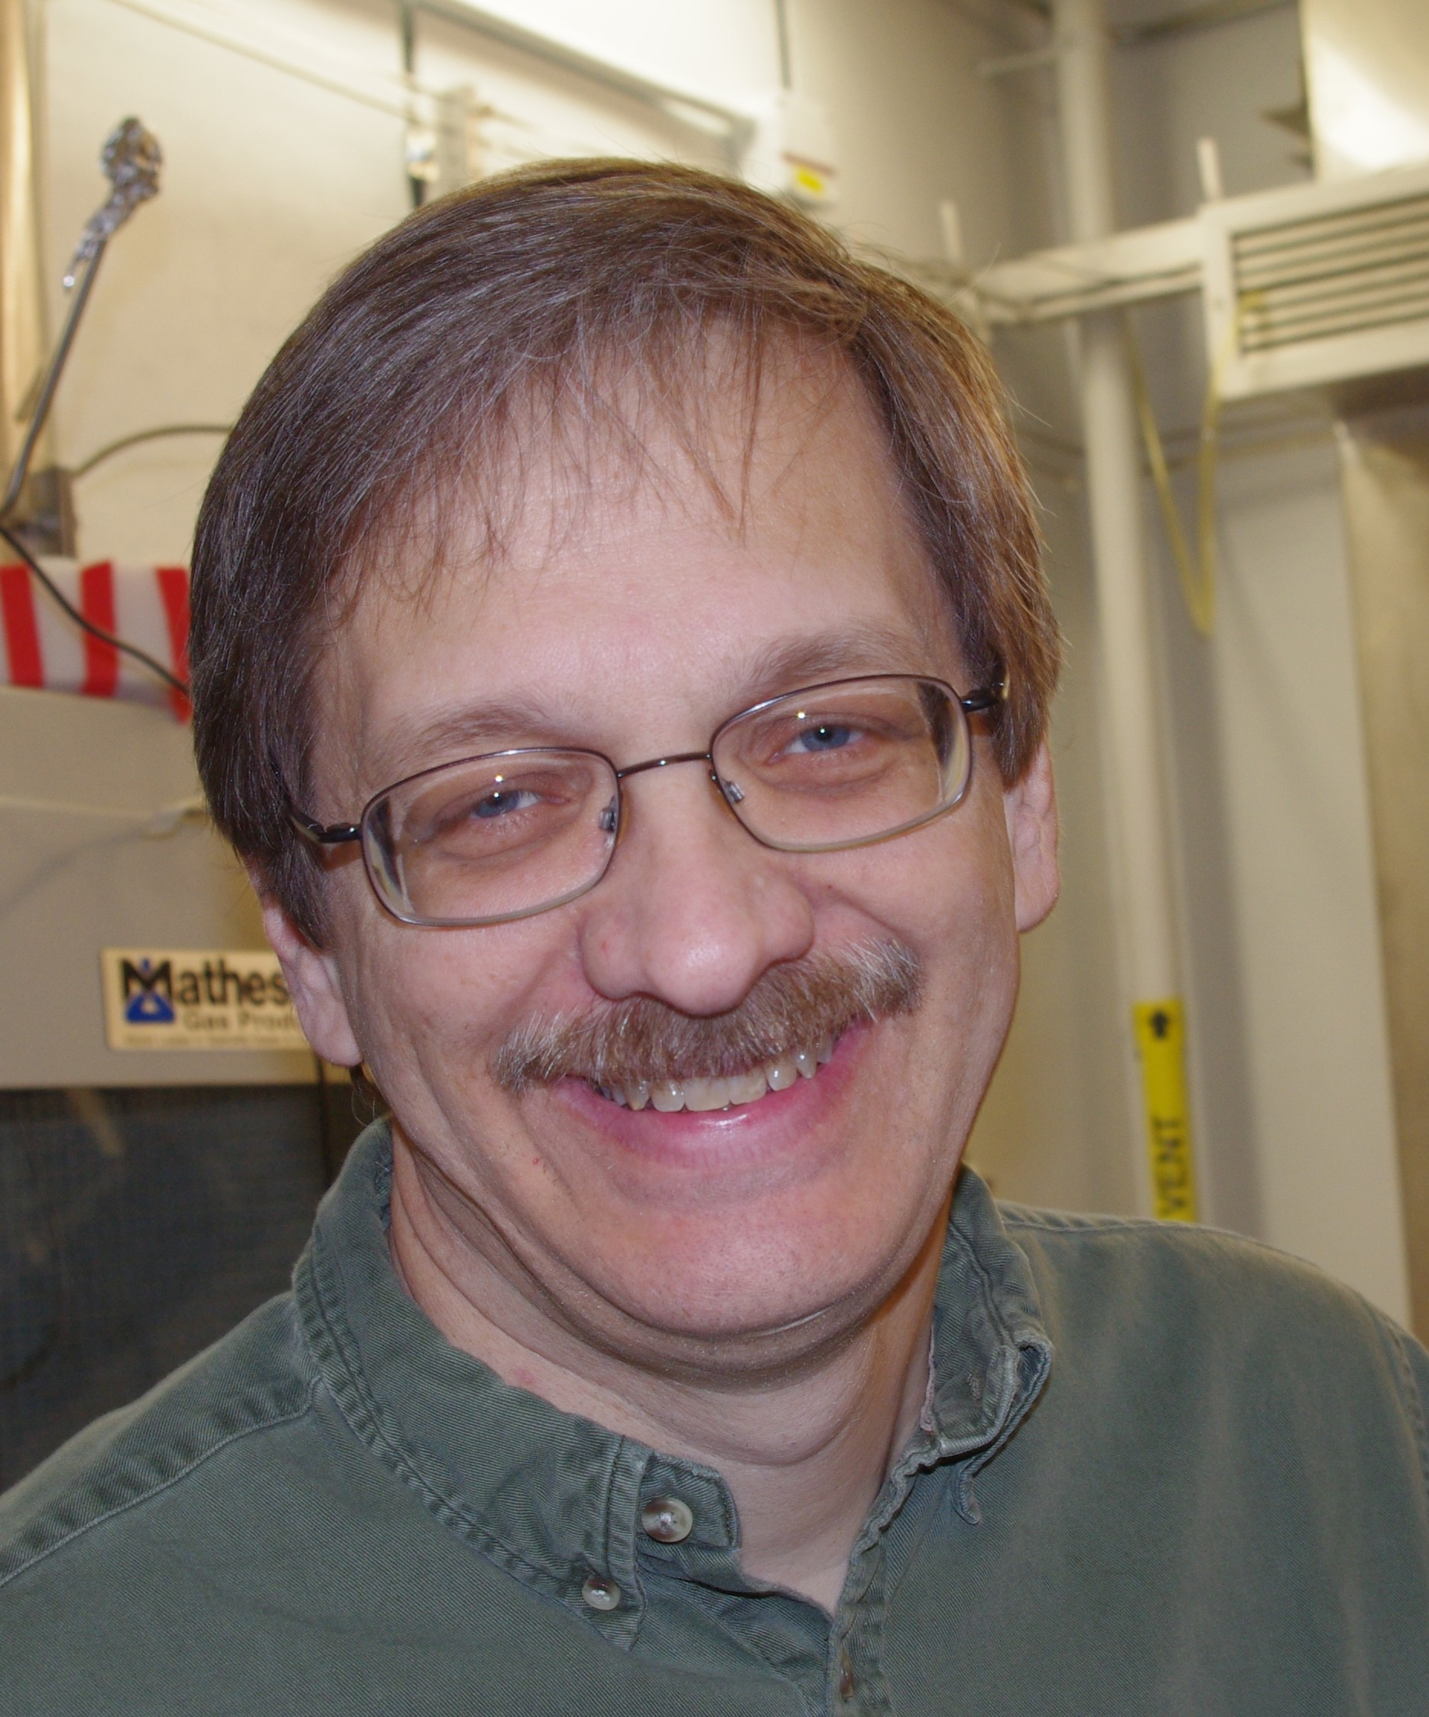
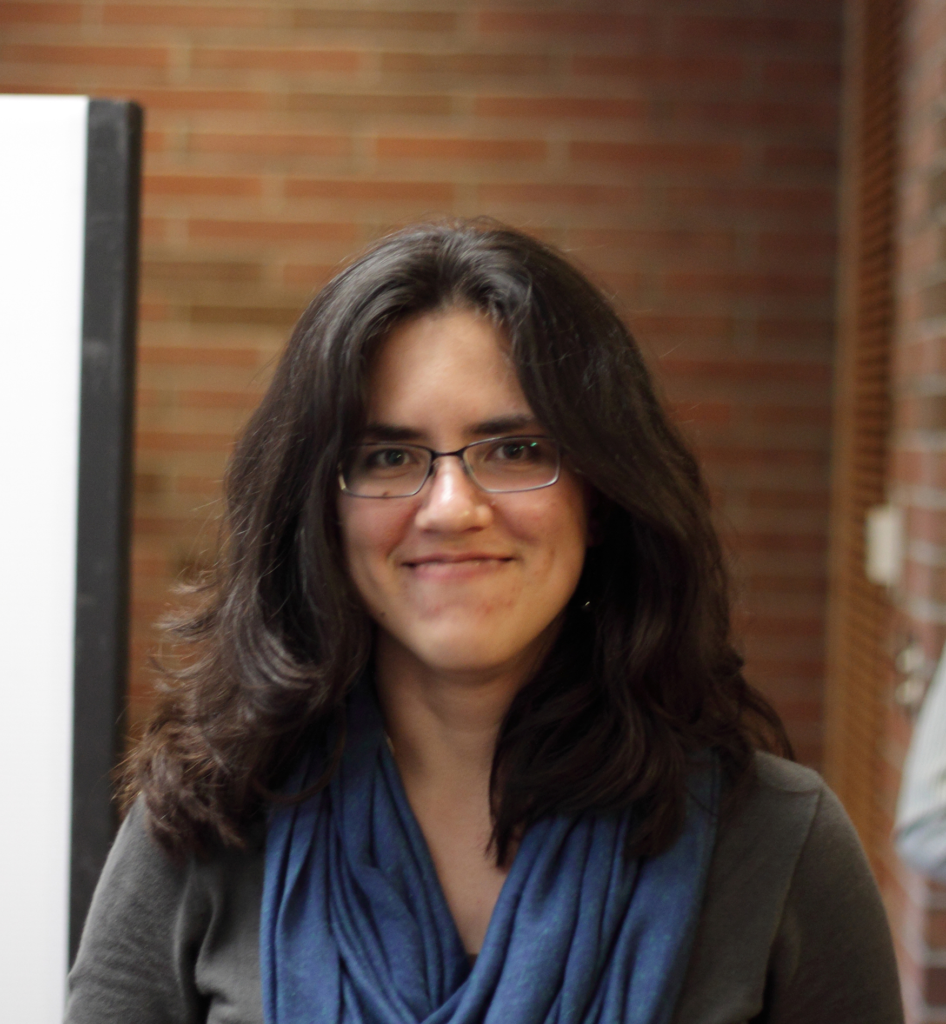
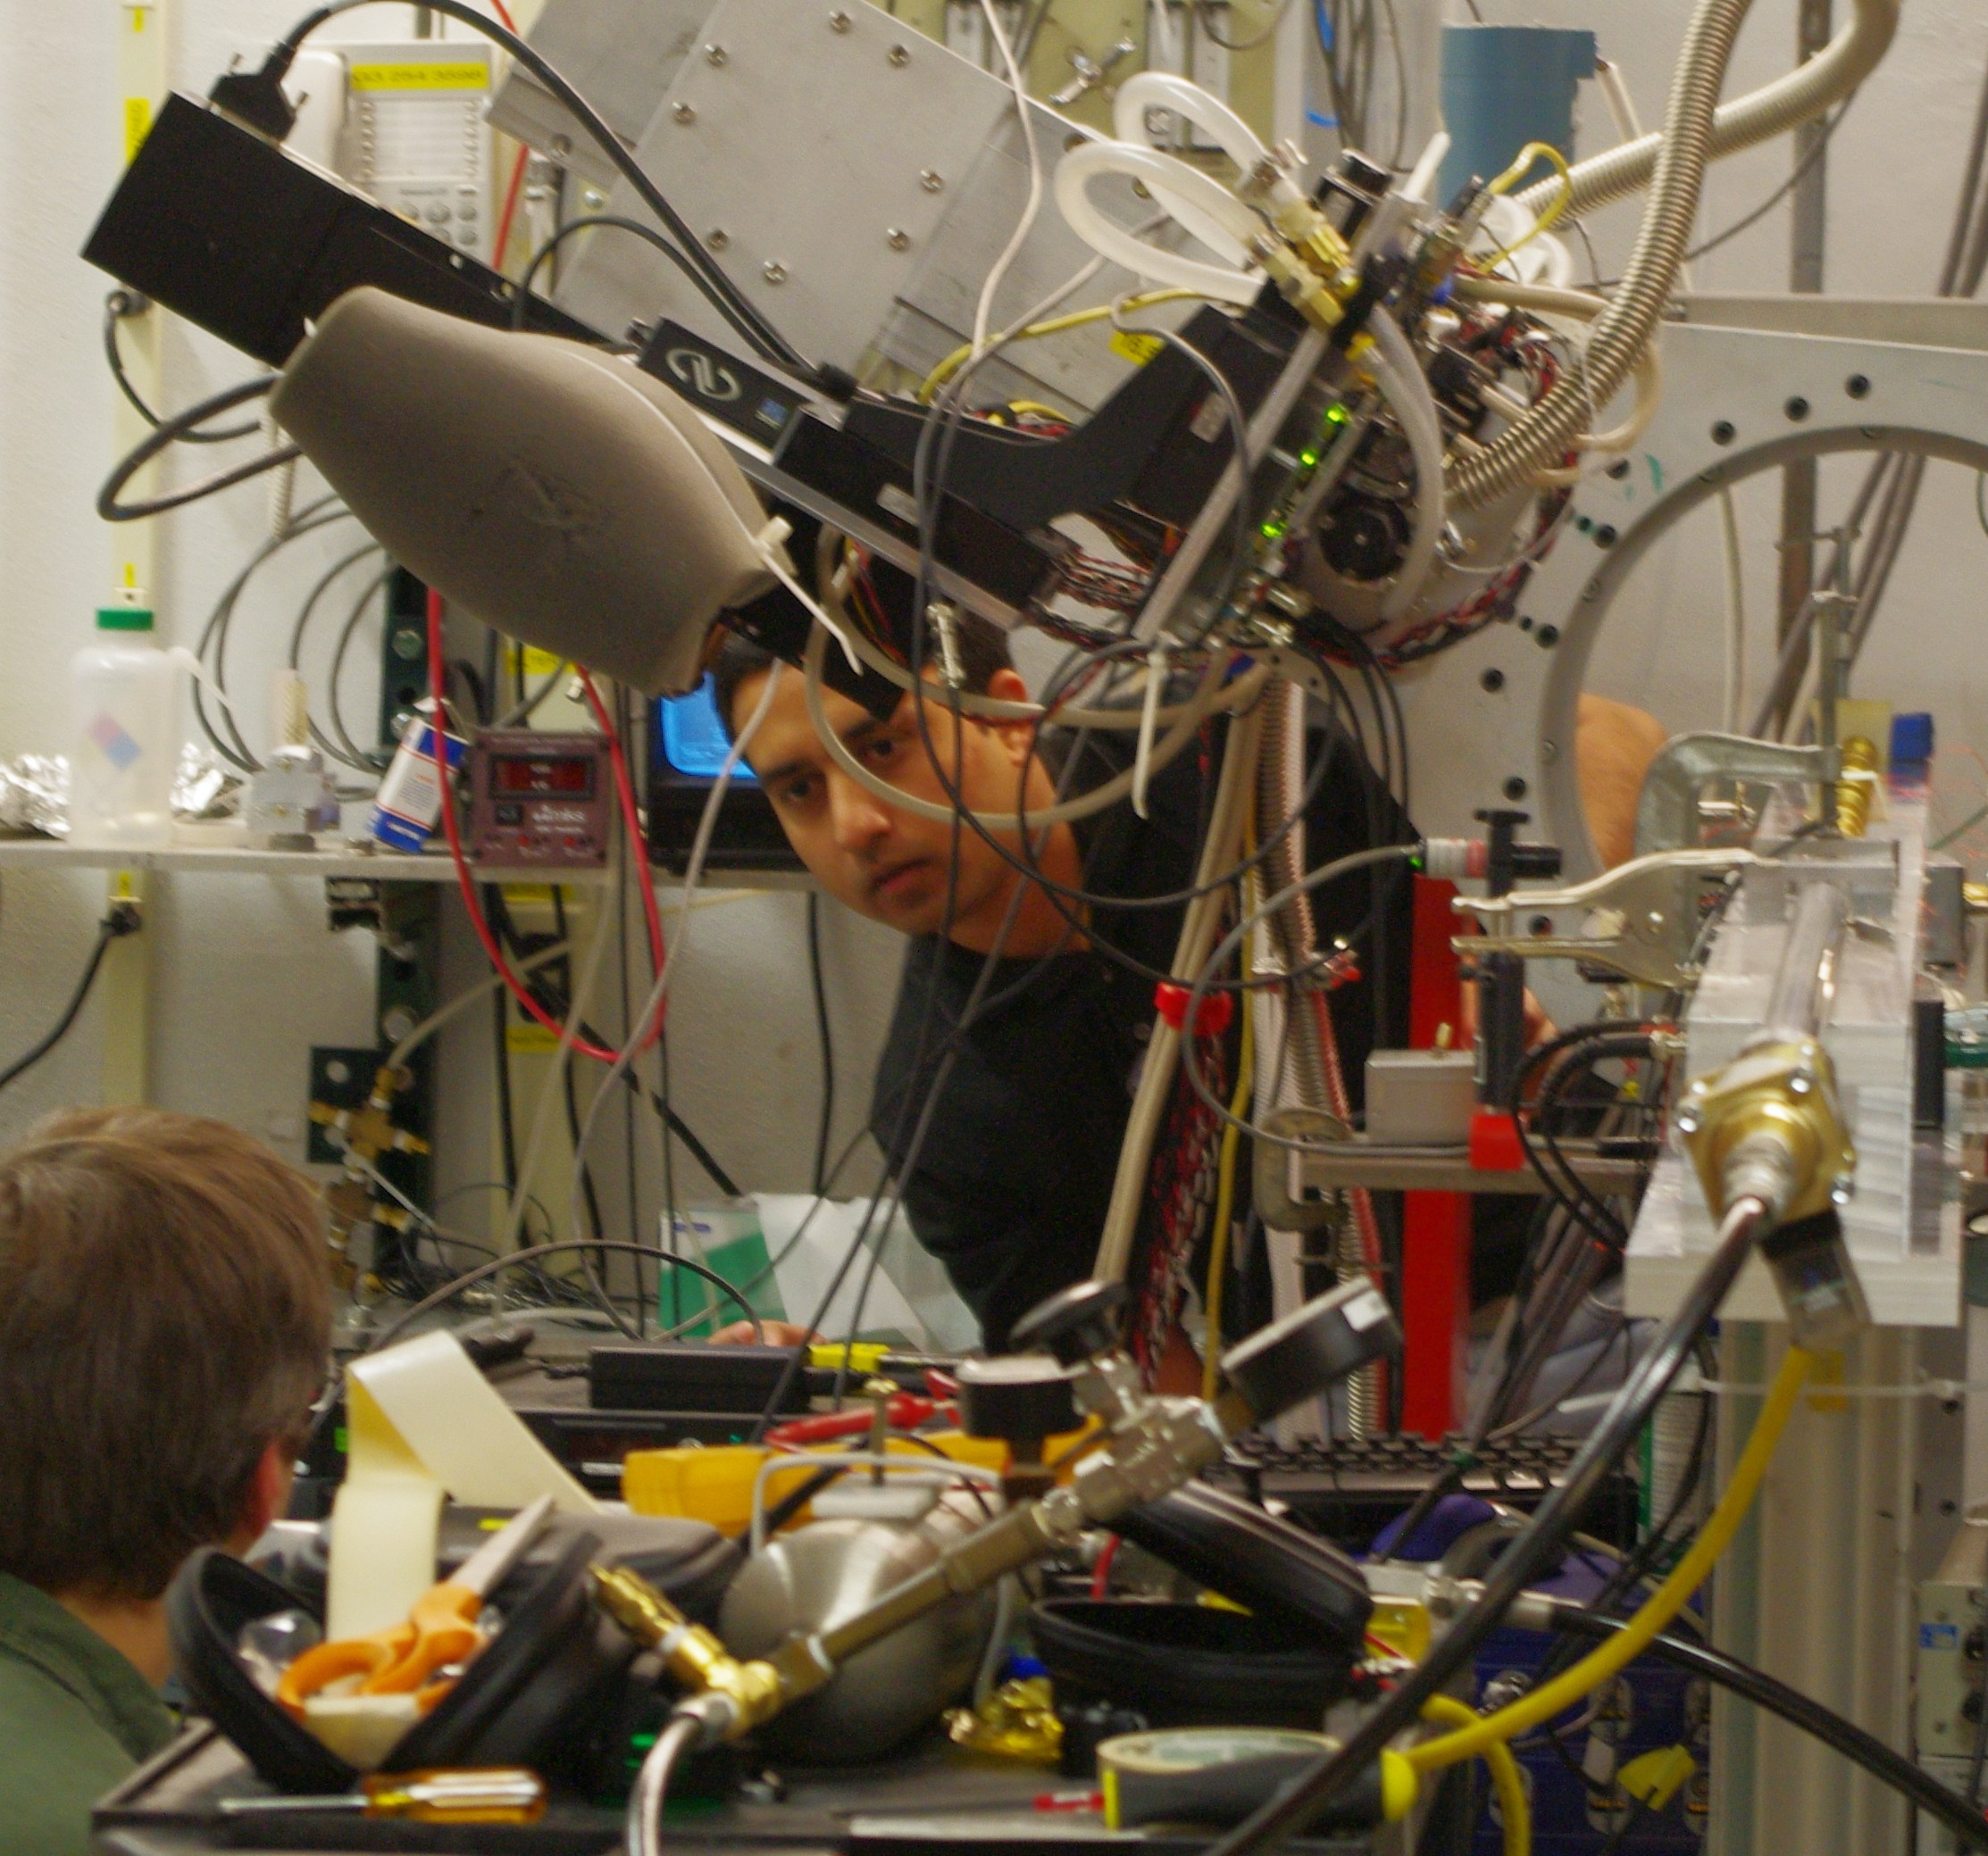
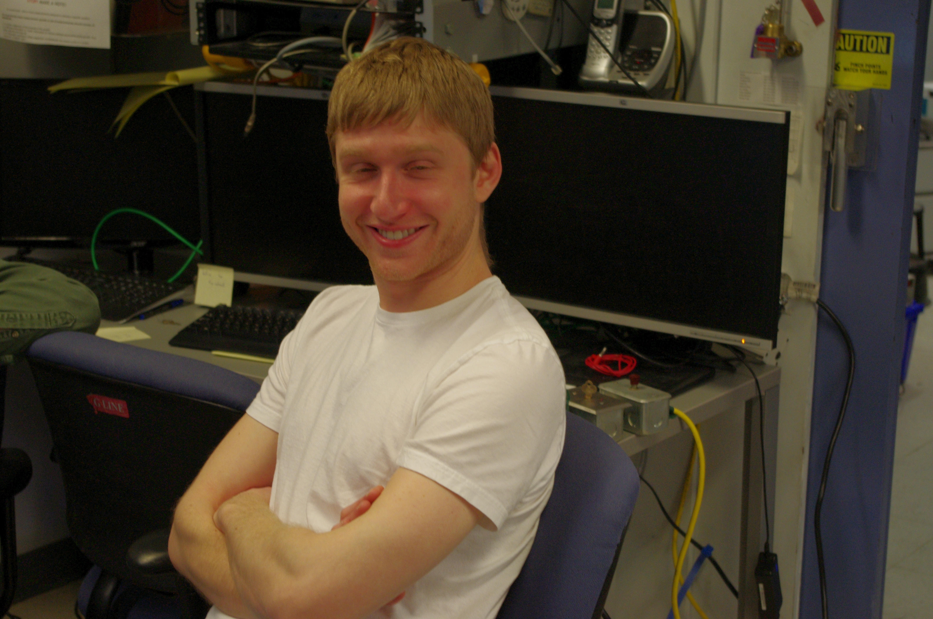
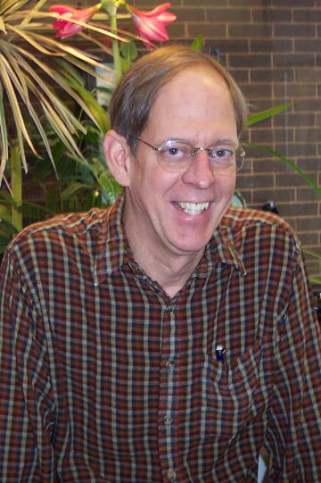
Acknowledgments
Research supported by:
the Keck Foundation, DOE, NIH, NFS.
Collaborators:
CHESS: Darren Dale, Arthur Woll.
PETRA III: Michael Sprung, Sergej Bondarenko
European XFEL: Adrian Mancuso, Klaus Giewekemeyer, Andrew Acquila
Johns Hopkins: Todd Hufnagel group & collaborators from Army Research Office
Past group members:
Chen Shen, Lucas Koerner, Dan Schuette, Alper Ercan, Matt Renzi, Marianne Hromalik, Sandor Barna, Guiseppe Rossi, Eric Eikenberry
Sol Gruner
Mark Tate
Prafull Poruhit
Kate Shanks
Joel Weiss
Darol Chamberlain
+Julian Becker

Slide 45
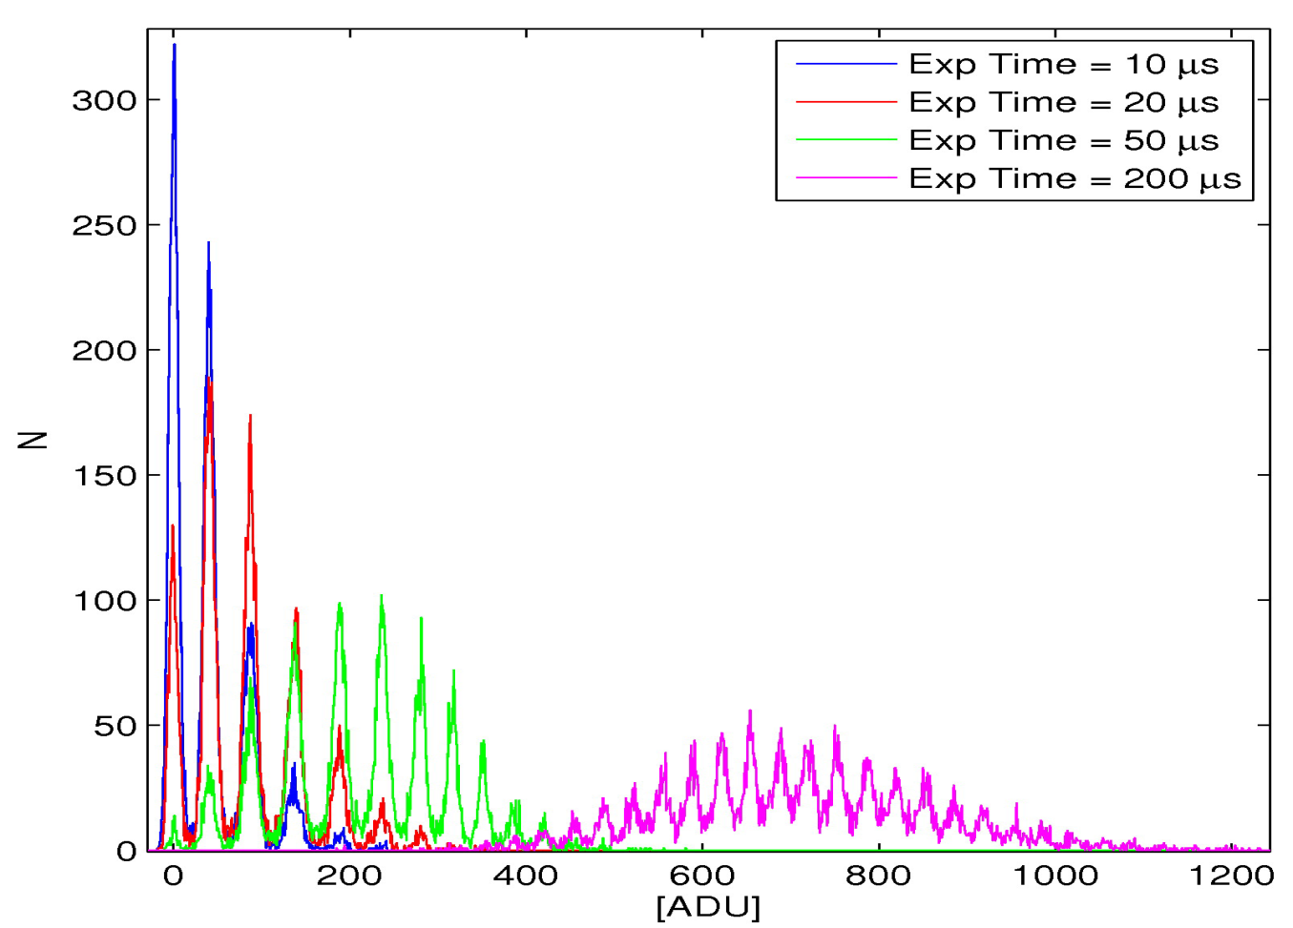
Single Module CSPAD
8 keV Photon Energy Histogram
Counting Photons in a Pixel
# e-/hole pairs = total energy in pixel / 3.65 eV
0 photons
1 photon
2
3
False Positive Rates
Threshold set to -
3 σ : 1x10⁻³
4 σ : 3x10⁻⁵
5 σ : 1x10⁻⁶
20
1
Thresholding:
Allows suppression of read noise and dark current at low fluence.
False positive rate set by S/N
Set software threshold
Notes:
Ramp Comparator ref voltage to digitize
False positive rates are calculated based on Gaussian noise distribution.

