Slide 1
Overview of HV/HR-CMOS Pixel Sensors
Ivan Peric

Slide 2
HVCMOS Introduction

Slide 3
HVCMOS detectors
HV CMOS detectors - depleted active pixel detectors implemented in CMOS process
The sensor element is an n-well diode in a p-type substrate
Pixel electronics is based on a charge sensitive amplifier with continuous reset (suitable for high time resolution) – the electronics is placed inside the n-well sensor electrode
PMOS
NMOS
deep n-well
p-substrate

Slide 4
HVCMOS detectors
High voltage is used to deplete a part of the substrate, the main charge collection mechanism is drift (Part of the signal originates from the undepleted region and is collected by diffusion)
PMOS
NMOS
deep n-well
Drift
Potential energy (e-)
Depletion zone
Diffusion
p-substrate

Slide 5
HVCMOS detectors
Charge collection time measured with laser: Drift signal arrives within ~ns; diffusion ~100ns
Our strategy: use standard CMOS features for small prototypes
Improvements are possible within dedicated runs
PMOS
NMOS
deep n-well
Drift
Potential energy (e-)
Depletion zone
Diffusion
p-substrate

Slide 6
Improved HVCMOS Structures
HRCMOS

Slide 7
HVCMOS with high resistive substrate
Standard substrate resistivity is 10-20 Ωcm – MIP signals are about 1800e
Several vendors offer free choice of substrate resistivity (within engineering runs): AMS for H35 and H18 technology, Lfoundry, STM, TJ, etc.
The use high resistivity substrates can improve SNR (depleted region is larger)
AMS H35 standard
Uniformly doped substrate 20 Ω cm
60V bias: Signal 1800e (~45% drift)
Uniformly doped substrate 80 Ω cm
Signal: ~ 2600e-4200e (60-80% drift) (estimation)
Particle
Particle
Deep-n-well
Deep-n-well
Primary signal
100%-Signal collection: drift
Primary signal
100%-Signal collection: drift
+-
+-
+-
Depleted 12 µm
+-
+-
+-
Depleted 24µm
(@ equal bias voltage)
Depleted 48µm
(@ equal field, doubled bias voltage)
+-
+-
+-
+-
+-
+-
+-
+-
Secondary signal
Partial signal collection: diffusion
+-
+-
+-
>20 um
+-
+-
+-
+-
+-
Signal loss: recombination
+-
+-
+-
+-
+-
Signal loss
+-

Slide 8
Isolated PMOS
Isolated PMOS
Shallow N-well in deep P-well (possible in Lfoundry, TJ, probably AMS)
Eliminates PMOS to sensor crosstalk, allows more freedom when pixel electronics is designed
Standard HVCMOS
HVCMOS with isolated PMOS
NMOS
PMOS
NMOS
PMOS
LV
LV
Deep p-well
Shallow n-well

Slide 9
HRCMOS
Isolated PMOS allows separation of sensor and electronics
Similar structure as MAPS in TJ
NMOS
PMOS
NMOS
PMOS
LV
HV
HRCMOS
NMOS
PMOS
Deep p-well
Shallow n-well

Slide 10
HVCMOS Projects

Slide 11
Mu3e

Slide 12
Mu3e Detector
Search for particle event µ+ -> e+e-e+
High muon decay rate 10⁹/s
Low momentum resolution 0.5 MeV/c
Vertex resolution 100 µm
Time resolution 100 ns (pixels) (1 ns scintillator fiber)
Four pixel layers 80x80μm² pixel size, 275 MP
Pixel detector thickness: ~50 μm
Cooling with helium
Pixel detector area: 1.9 m²
Heidelberg, PSI, Zürich, Genf
Recurl pixel layers
Outer pixel layers
Scintillator tiles
Inner pixel layers
Scintillating fibres

Slide 13
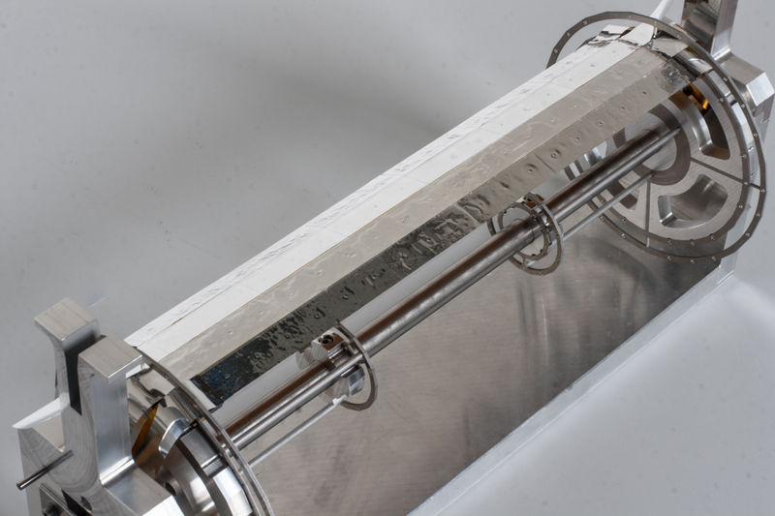
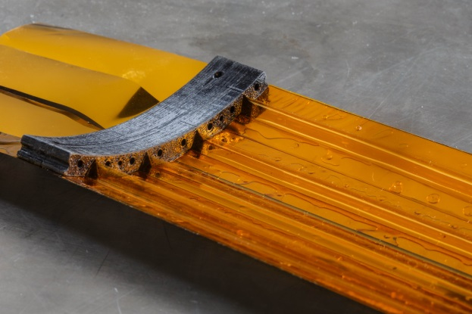
Mu3e Detector
Thinned chips
Kapton PCB &
Supporting structure
Pixels – active region
1cm
~0.5 mm
EoC logic

Slide 14
Structure of the detector
Concept: Every pixel has its own readout cell, placed on the chip periphery
CSA
Hit flag
Priority scan logic
RAM/ROM
Pixel contains a charge sensitive amplifier
Comparator
and Thr tune DAC
Read
Time stamp
Data bus
Readout cell function – time stamp is stored when hit arrives
Hit data are stored until the readout
Priority logic controls the readout order
RO cell size in 0.18 µm AMS technology ~ 7 µm x 40 µm
(with comparator and threshold-tune DAC)
One RO cell
/pixel
Row/Col Addr + TS

Slide 15
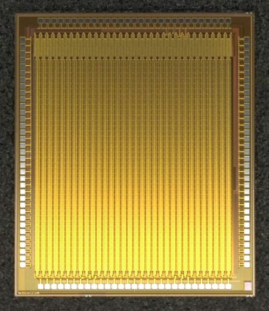
MuPixel
One pixel
3 mm
92µm
Readout cell

Slide 16
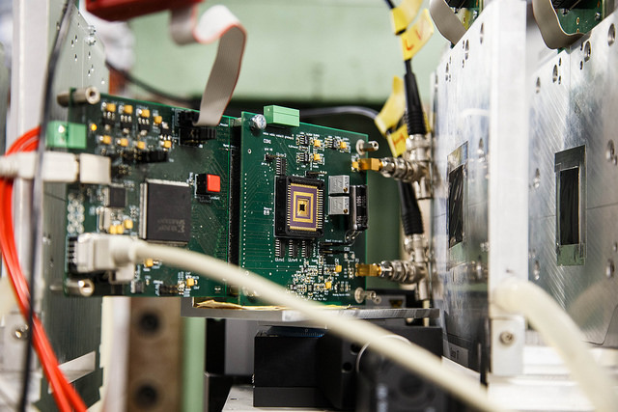
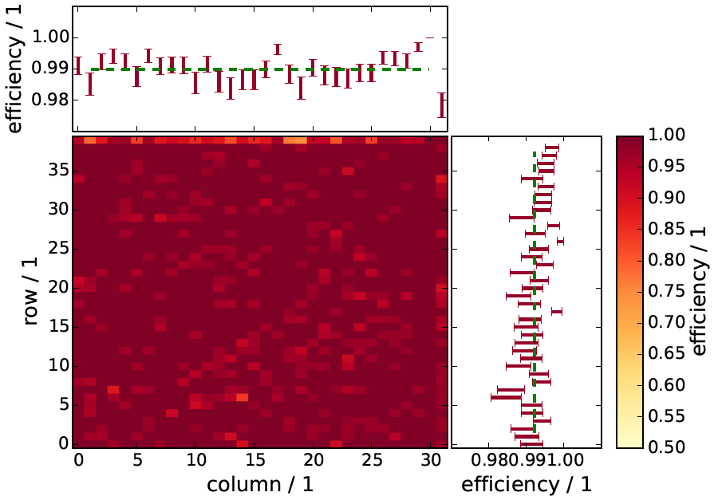
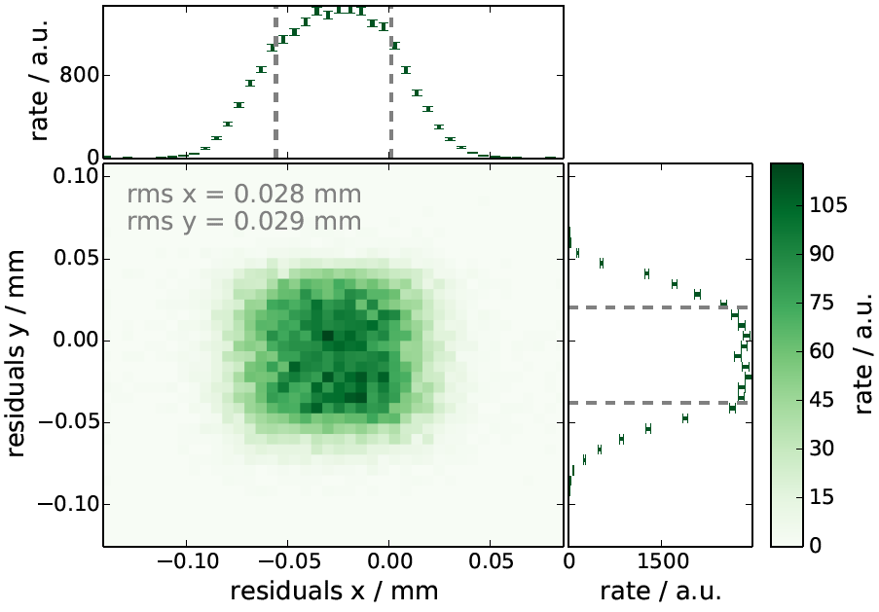
MuPixel test beam
Test-beam measurement February 2014 DESY
Result analysis: Moritz Kiehn, Niklaus Berger, PI Heidelberg
99% efficiency measured

Slide 17
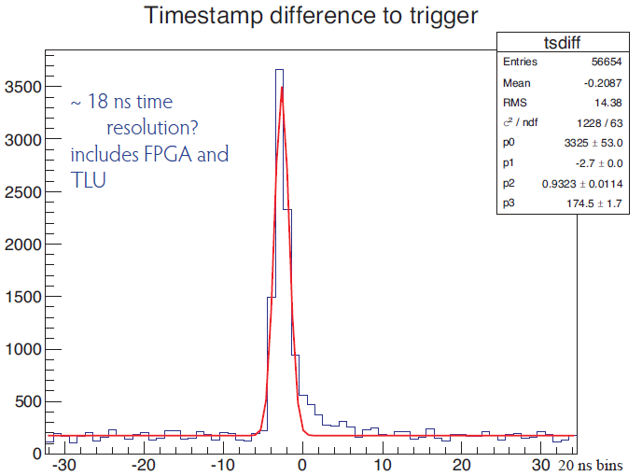
MuPixel test beam
Test-beam measurement October 2013 DESY
Time resolution: 18ns (sigma) (not corrected for the pixel to pixel delay dispersion and charge sharing)
18ns sigma
Probably caused by indirect hits

Slide 18
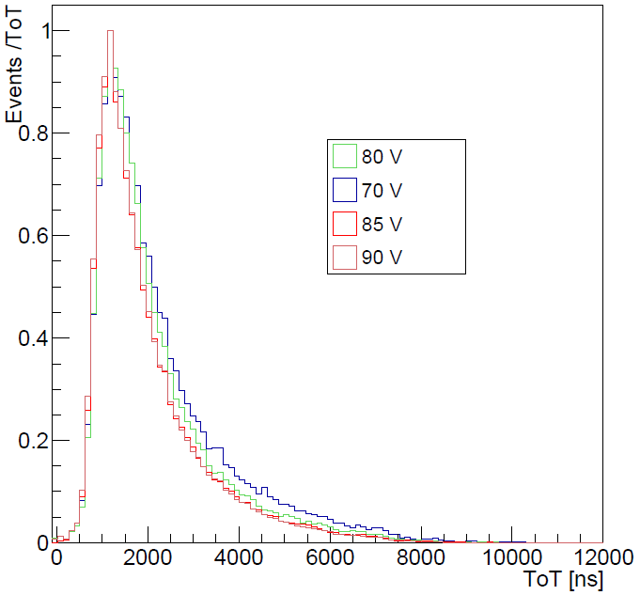
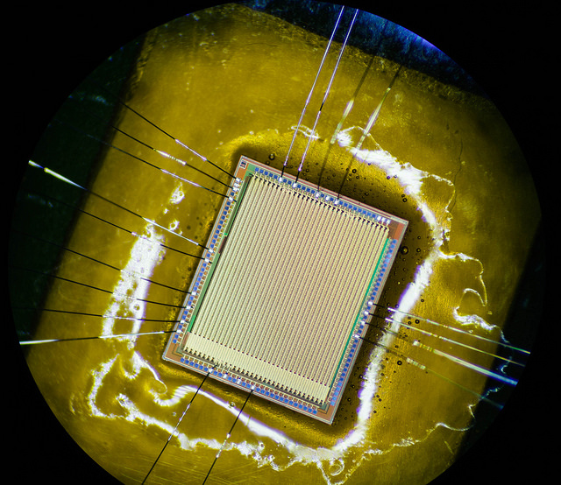
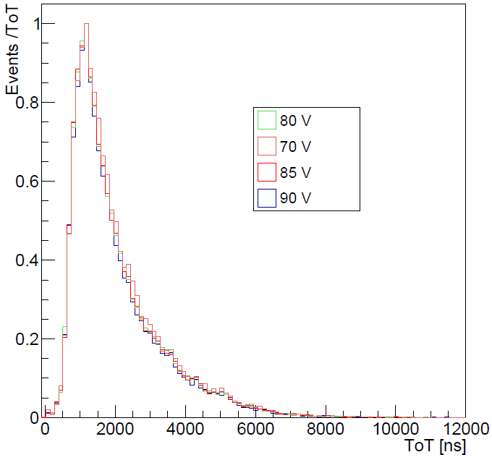
Thin detectors
Chips have been thinned to < 100 μm and successfully tested
THICK
450 MeV pion signals
THIN

Slide 19
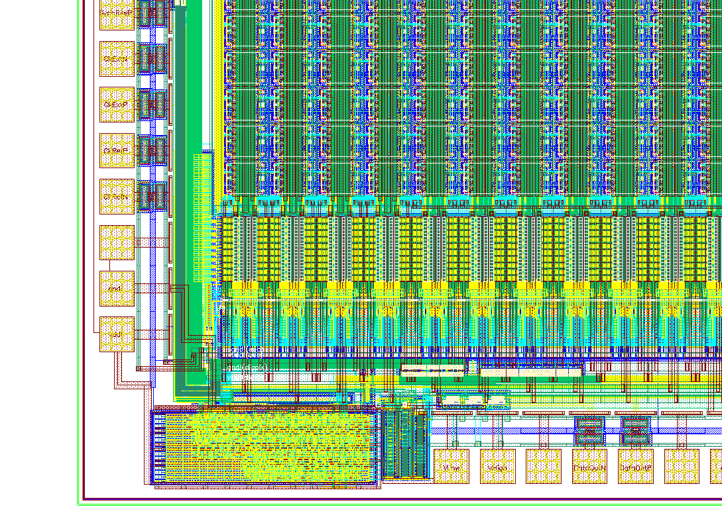
New prototypes
April 2014 a chip version (MuPix6) with improved threshold-tuning circuitry and two stage amplification produced
August 2014 new chip version (MuPix7) with high speed serial transmission (up to1.6GBit/s) submitted
The chips have been ordered thinned to < 50 μm

Slide 20
ATLAS Pixels
CPPM Marseille, CERN, University of Geneve, INFN Genova, Bonn University, LBNL Berkeley, University of Göttingen, Jozef Stefan Institute Ljubljana, University of Glasgow, University of Liverpool, IFAE Barcelona, Heidelberg University…

Slide 21
Developments for ATLAS Pixels
Plan: make a large size CMOS pixel sensor demonstrator that can be readout via FEI4 ASIC
Many collaborating institutions (ATLAS HV/HRCMOS pixel collaboration or “smart pixel” collaboration)
Several concepts: passive sensor in CMOS, active CMOS sensor bump bonded to FEI4, capacitively coupled CMOS sensor (CCPD)
Pixel size either the same as in FEI4 or smaller
Here presented: CCPD concept
Pixels either with discriminator (“digital sub-pixel encoding”) or with amplifier only (transmission of analog signals)
Readout pixel
Size: 50 µm x 250 µm
TOT = sub pixel address
Different pulse shapes
+
Size: 33 µm x 125 µm

Slide 22
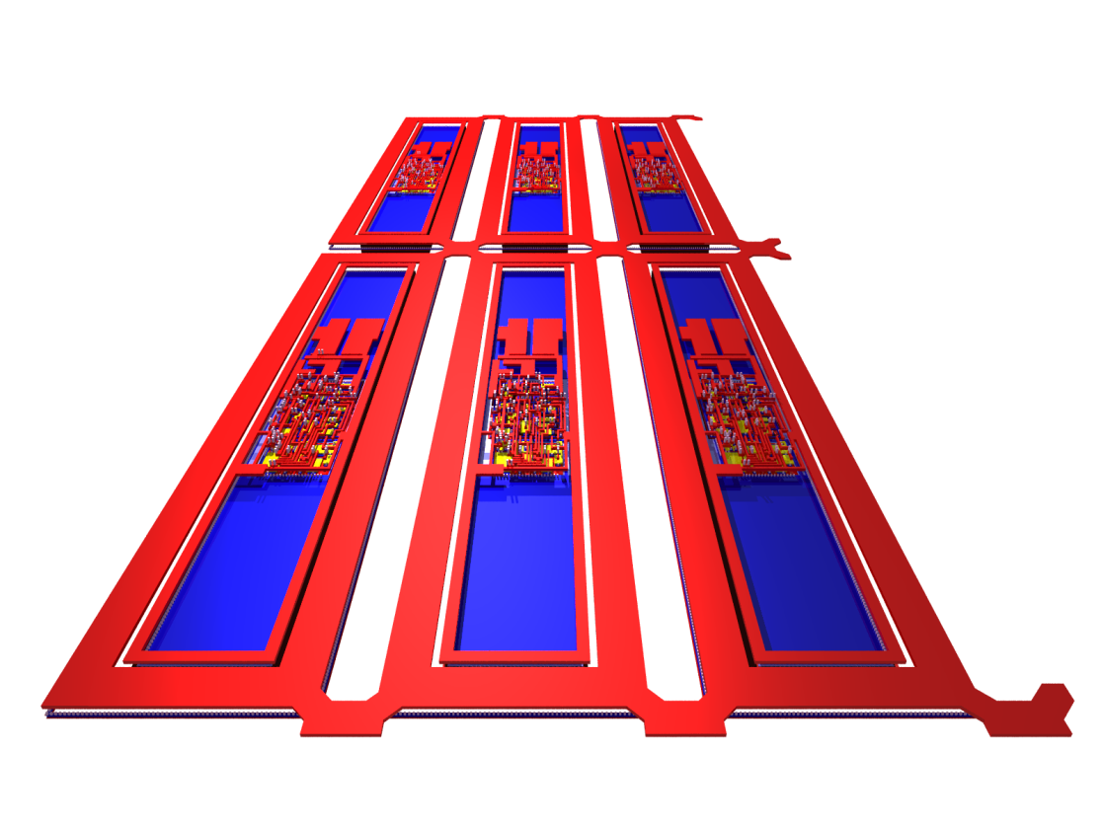
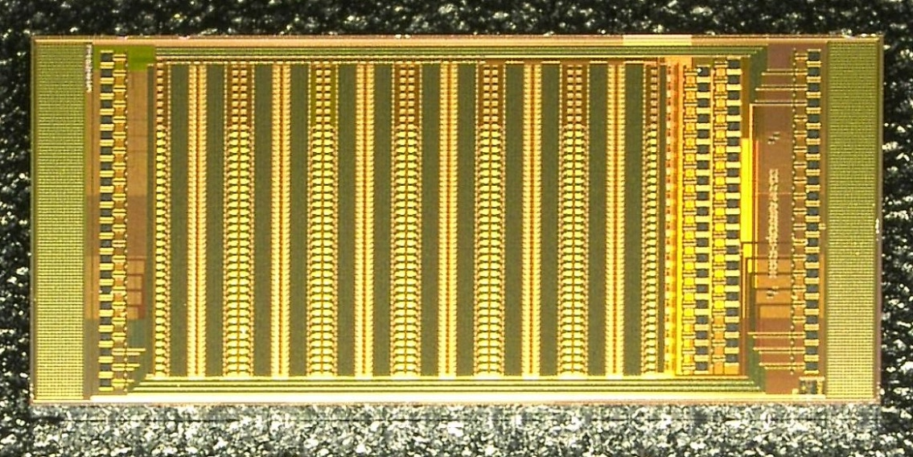
CCPD detector (HV2FEI4)
The digital outputs of three pixels are multiplexed to one pixel readout cell
+
Size: 33 µm x 125 µm
CCPD Pixels
2
2
3
3
1
1

Slide 23
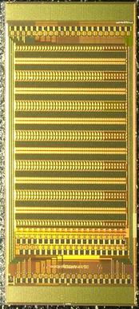
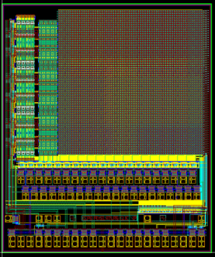
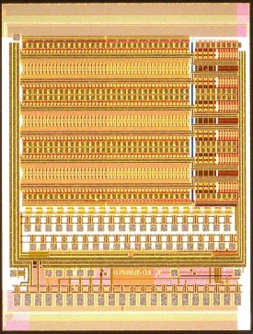
CCPD – Prototypes in AMS H18
November 2011: CCPDv1
November 2012: CCPDv2
November 2013: CCPv3/CLICPIX
June 2014: CCPv4
4mm
CCPDv1
CCPDv2
CCPDv3
CCPDv4

Slide 24
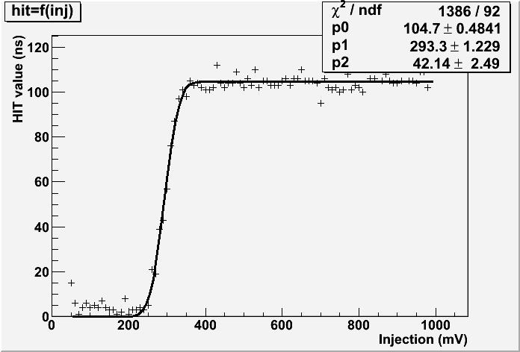
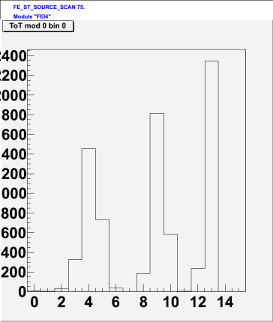
Results
1) CCPDv1: SNR after neutron irradiation at Jozef Stefan Institute 10¹⁵ n_{eq}/cm² ~20 (5C, -55V bias) (Signal ~ 1180e) (measured 2014) (Unirradiated chip @ -50V bias: 1600e)
2) CCPDv2: works after 862 Mrad (x-ray irradiation CERN) (noise at room temperature 150e)
3) CCPDv1: sub pixel encoding works measured for one pixel – still needs optimization
1)
2)
3)

Slide 25
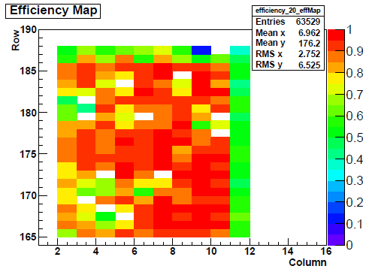
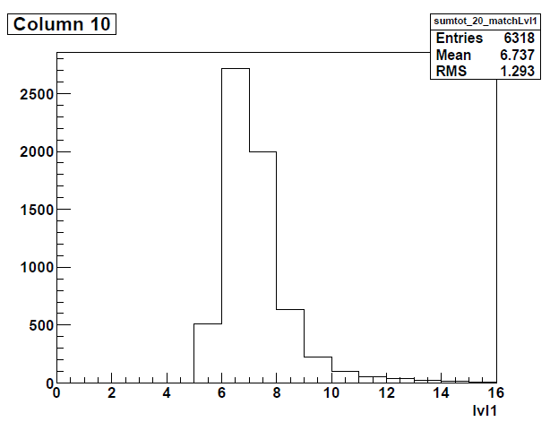
Results
4) CCPDv2 and v1: one successful test beam measurement in 2013(DESY): efficiency >90% in the regions with high threshold (Analysis University of Göttingen) (New testbeam in August – results soon)
2)

Slide 26
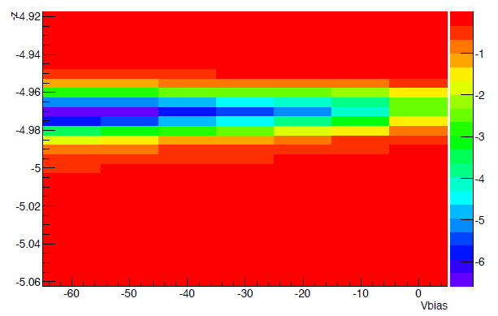
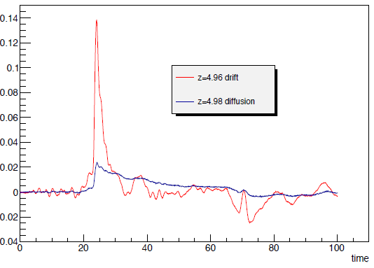
Results
5) Edge TCT measurements (University of Geneve)
Depleted layer thickness around 15 μm
Signal collected within first 3ns
15μm

Slide 27
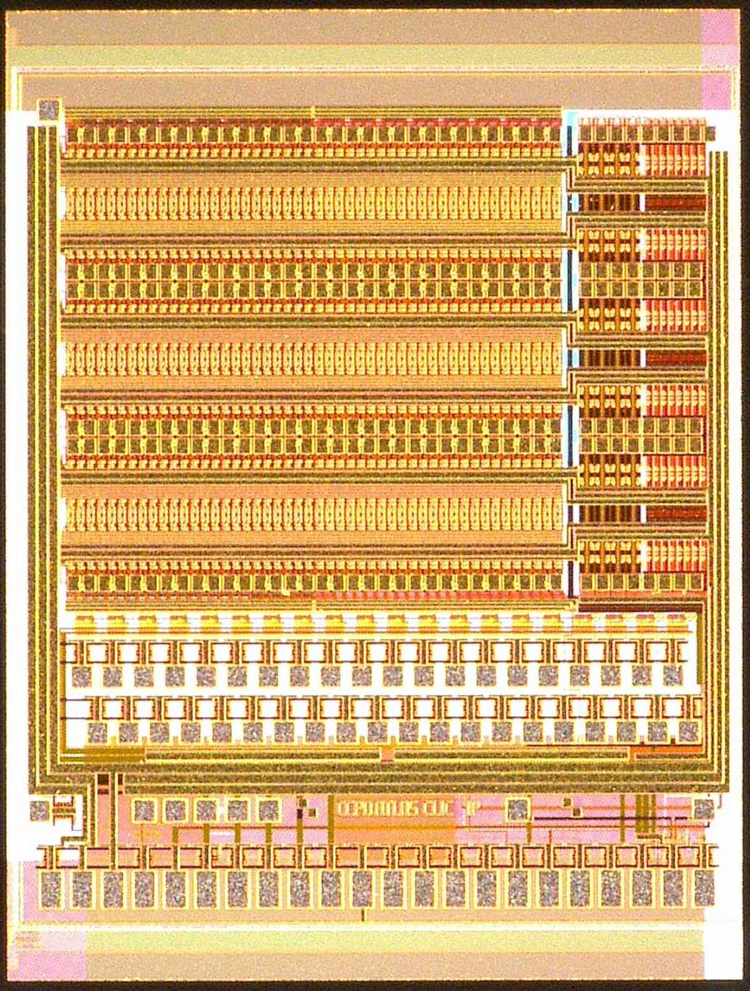
New Prototype
June 2014: CCPv4
Improved designs for lower noise and better sub pixel encoding
Pixel structures implemented in CCPDv4:
SAmp: Digital pixels with the current-mode amplitude coding – several improvements
Stime: Digital pixels with voltage-mode amplitude coding or the pulse length coding
N: “NewPixels” – the pixels with separated electronic and electrode, sub pixel size 25 μm x 125 μm (contain comparator)
A: New: Analog pixels - size 25 μm x 350 μm – contain only amplifier. New analog summing scheme

Slide 28
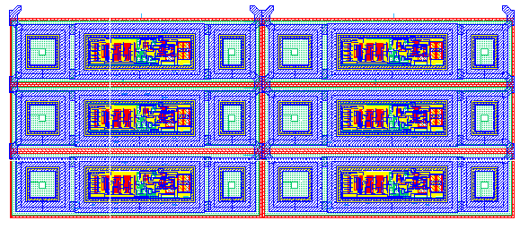
Standard pixels: layout
SAmp
STime
One pixel
+
33um

Slide 29
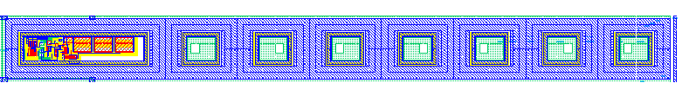
Analog pixel: layout
Analog pixels
25um
+
s1
s3
s2
s2

Slide 30
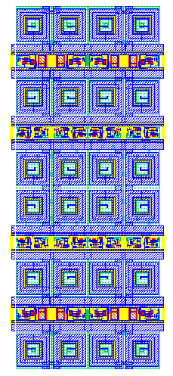
New pixels: layout
+
N-Well
~25 µm
One pixel
~125 µm

Slide 31
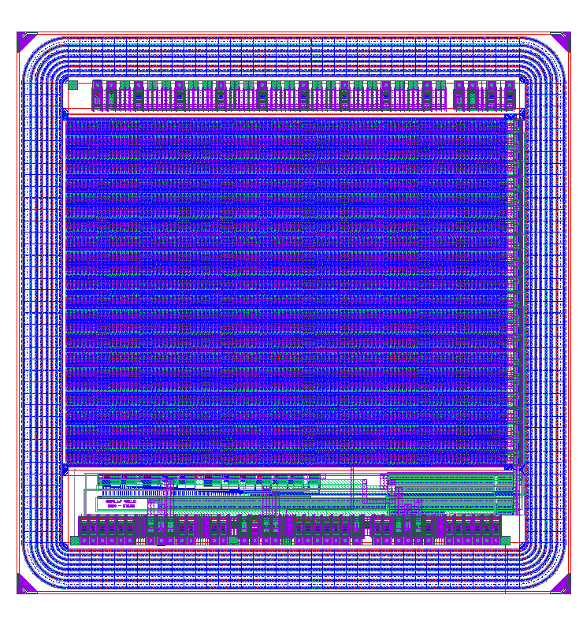
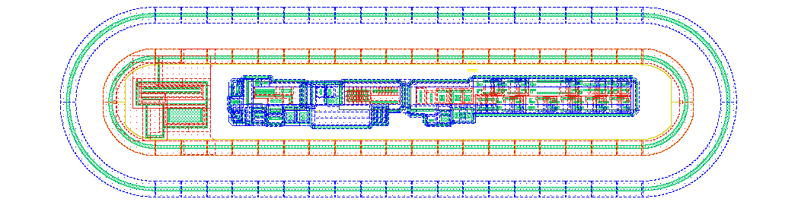
Another developments
Another developments:
STM, TJ, XFAB, Espros, Toshiba…
Development in Lfoundry
Advanced HVCMOS and HRCMOS designs
High resistive substrate
(Bonn, CPPM, Heidelberg)
Development in Global Foundry process
3D integration possible
(CPPM)
Back Side Metal
TSV
Tier 1
(thinned wafer)
M1
M2
M3
M4
M5
M1
M2
M3
M4
M5
M5
M4
M3
M2
M1
M5
M4
M3
M2
M1
HVCMOS
Tier 2

Slide 32
CLIC

Slide 33
Development for CLIC
CLIC requirements – little material, high spatial and time resolution
Option: capacitively coupled pixel detector
Test detector has been produced (CCPDv3) that can be readout with CLICPIX chip
Pixel size: 25 µm x 25 µm
Every HVCMOS pixel has its own readout cell
Size: 25 µm x 25 µm
Readout pixel
Size: 25 µm x 25 µm

Slide 34
CCPDv3
CLIC pixels – excellent SNR
Noise for small pixels (25 μm x 25 μm) with analog readout 30e
Kα
Threshold 200e
Kβ

Slide 35
ATLAS Strips

Slide 36
HVCMOS for ATLAS strip layers
The development is coordinated by ATLAS strip WP1
Presently two CMOS technologies are investigated: AMS H35 and TJ (LF development is planned)
Heidelberg: AMS (and LF)
The foundries offer inexpensive engineering runs with high resistive substrates and low cost production

Slide 37
HVCMOS for ATLAS strip layers
One of possible concepts: Strips are segmented into (long) pixels. Every pixel has its own readout cell, placed on the chip periphery
The periphery generates pixel addresses with a constant delay respecting the hit
Redundant address lines used to cope with simultaneous hits
Strip readout chip (like ABCN) replaced by a purely digital chip (based on existing digital parts)
CSA
Present scheme
ABCN chip
1
1
Pixel contains a charge sensitive amplifier
1
1
Possible HVCMOS scheme
Digital chip
0
1
2
0
2
3
0
1
1
2
3
3

Slide 38
Segmented strip detector with lossy constant-delay-multiplexing
A
B
C
D
Output 1
Output 2

Slide 39
Segmented strip detector with lossy constant-delay-multiplexing
y2
y3
A
B
C
D
Output 1
Output 2

Slide 40
Segmented strip detector with lossy constant-delay-multiplexing
y2
y3
0
A2
1
B3
2
C
D
Output 1
Output 2

Slide 41
Segmented strip detector with lossy constant-delay-multiplexing
y2
y3
0
A
1
B
2
C
D
Output 1
A2
Output 2
B3

Slide 42
Segmented strip detector with lossy constant-delay-multiplexing
A
B
C
D
Output 1
Output 2

Slide 43
Segmented strip detector with lossy constant-delay-multiplexing
y5
A
B
C
D
Output 1
Output 2

Slide 44
Segmented strip detector with lossy constant-delay-multiplexing
y5
0
A
B
0
C5
1
D
Output 1
Output 2

Slide 45
Segmented strip detector with lossy constant-delay-multiplexing
y5
0
A
B
0
C5
1
D
Output 1
C5
Output 2

Slide 46
Segmented strip detector with lossy constant-delay-multiplexing
A
B
C
D
Output 1
Output 2

Slide 47
Segmented strip detector with lossy constant-delay-multiplexing
y1
y4
A
B
C
D
Output 1
Output 2

Slide 48
Segmented strip detector with lossy constant-delay-multiplexing
y1
y4
0
A1
1
B
C
D4
2
Output 1
Output 2

Slide 49
Segmented strip detector with lossy constant-delay-multiplexing
y1
y4
0
A1
1
B
C
D4
2
Output 1
A1
Output 2
D4

Slide 50
Segmented strip detector with lossy constant-delay-multiplexing
A
B
C
D
Output 1
Output 2

Slide 51
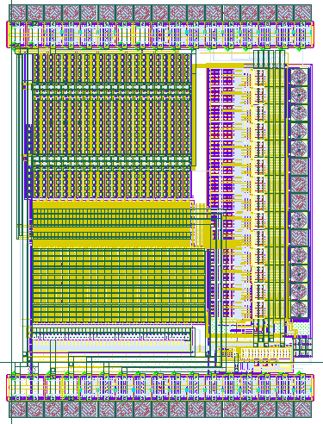
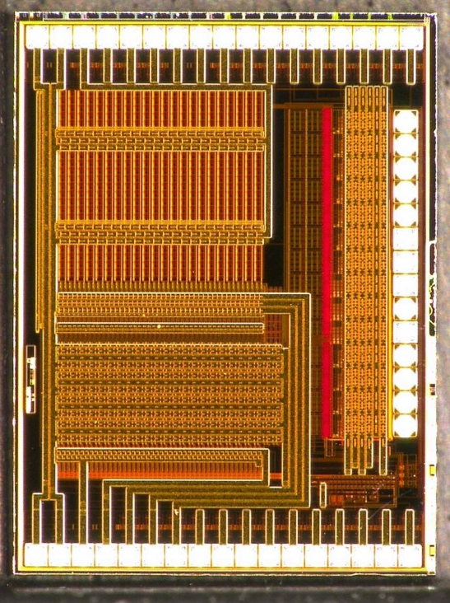
HVStrip test chip in AMS H35
Pixels
Comparator block
Config. register
Readout block

Slide 52
Chip-Top
pix
pix
Comp out rising edge
40MHz clock
Synchronizer
Active pixels
Sync hit
amp
amp
Parity in
xor
Parity out
pix
pix
Comp out
demux
clock
Sync hit
amp
amp
Addr
Digital RO
Addr
Addr
Address line 1
Address line 2
Normal comp.
cn
ctw
cn
ctw
cn
ctw
cn
ctw
TWC comp.
Comparator (time walk compensated)
Comparator (normal)
Analog multiplexer
SR1
SR2
Digital RO
Digital RO
Digital RO
Digital RO
6-bit address, hit1,ParOut
serializer
serializer
6-bit address, hit2,ParOut
320MHz clock
40MHz clock
config
config

Slide 53
Time Walk Compensation
The idea: Adding of low-pass filter decreases the noise without increasing the power consumption
=> Better SNR, lower threshold
However: a slow output signal leads to a time-walk
Time walk is caused 1) by the fluctuations of the input signal and 2) by the low and signal-dependent response speed of the electronics
Can we compensate for time walk, without decreasing the shaping time constants?
Tsha
Th
Sig
TW
Tsha
Cdet
Iamp

Slide 54
Time Walk Compensation
Imagine a comparator which has the output zero-to-one transition speed, that depends on the input signal “overdrive”
High amplitude signal – faster threshold crossing but slower 0-1 transition
Low amplitude signal – slower threshold crossing but faster 0-1 transition
Result: the threshold-crossing- and the transition time skews compensate each other
Second comparator generates time-walk free signal
Slow down
Higher amplitude
2
Slow down
Lower amplitude

Slide 55
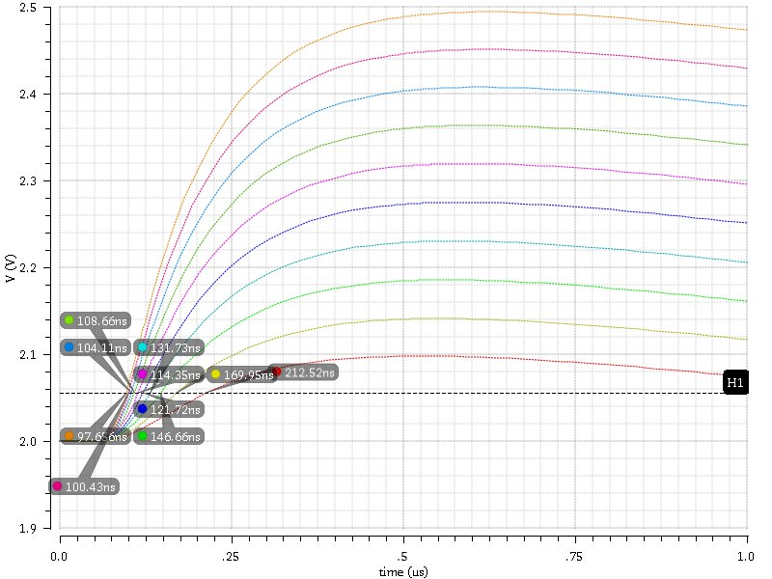
Time Walk Compensation
Noise=7.9mV, Thr=55mV, Bias current=5µA, Pixel size = 50x500µm, amplifier power 50mW/cm²
3600e
Shaper Output
TW 116ns
900e

Slide 56
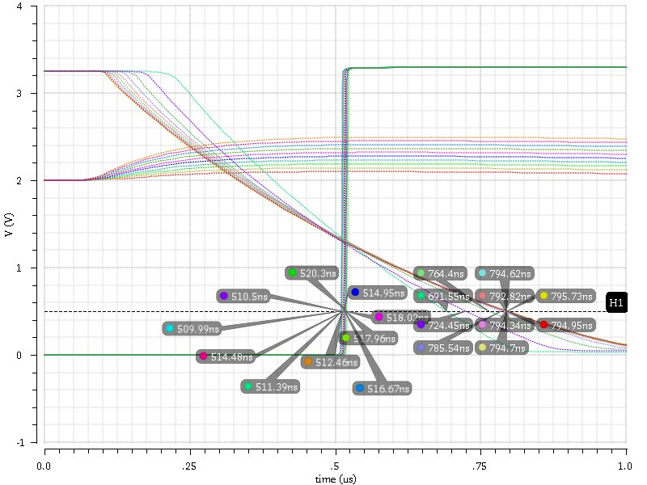
Time Walk Compensation
Noise=7.9mV, Thr=55mV, Bias current=5µA, Pixel size = 50x500µm, amplifier power 50mW/cm²
3600e
900e
Comparator Output
TW 8ns

Slide 57
Summary
HVCMOS sensors are options for ATLAS pixels, ATLAS strip-layers, CLIC and Mu3e experiments
Mu3e:
Several test chips have been successfully tested
Trigerless readout, time resolution <100ns
Efficiency of ~99% have been measured in test beam
Chips have been thinned to <100μm and they work
ATLAS:
We are developing prototypes that can be readout using FEI4
Many parallel CMOS developments
Here presented: capacitively coupled pixel sensors in AMS technology – segmented pixels
We measure good SNR (~20) after 10¹⁵ n_{eq}/cm^{2,} detectors work after 800MRad
Test-beam results are still preliminary, efficiency >90% in the regions with low threshold
We are planning to improve the SNR by implementing of sensor on high resistive substrates
CLIC:
HVCMOS CCPD with 25μm x 25μm pixels capacitively readout with CLICPIX has been successfully tested
High SNR measured, first test beam measurement done in August
ATLAS strip layers
HVCMOS and HRCMOS sensor are an option for ATLAS strip layers
HVCMOS sensor prototype (segmented strips) has been produced in AMS H35 technology
Hit information transmitted digitally via several address links to the digital readout chip (based on the digital part of ABCN chip) constant delay multiplexing

Slide 58
Thank you!

Slide 59
Backup slides

Slide 60
Segmented strip detector with lossy constant-delay-multiplexing
FFs:
2304
ROM
FF
Addr
Demux with en
3-bit adder
8
3
in
1
f
a
f
f
en
m
inc
3
3
8
f
3
a
f
3
3
chan
8
8
Chan0-14
Addr
8
Pipeline
structure
in
1
f
a
f
f
en
m
inc
f
a
f
Hit loss when more than 8 hits/BC/segment
a
Chan15
Chan16-30

Slide 61
HRCMOS in LFoundry
~50V
1.8V
0V
N
Collection electrode
~50V
Electronics
P-Substrate
>10um
0V
P-substrate depleted
PW depleted
NW depleted

Slide 62
Isolated HVCMOS in LFoundry
1.8V
0V
1.8V
Electronics
Collection electrode
-50V
P-substrate depleted
NW depleted

Slide 63
ATLAS New Type
ATLAS Type New Pixel
The N-well housing electronics is at fixed potential, it can attract signals, efficiency not clear, however for tracks under angles can be good
Advantages – no crosstalk between electronics and sensor, CMOS logic and comparators possible (FEI4-like trigger-electronics can be implemented), substrate at 0V
Smaller sensor capacitance
Pixel size 25µm x 125µm, four pixels couple to one FEI4 channel
Danger: punch-trough between sensor and electronic n-well, it limits the maximum HV
To FEI4
HV capacitor
+HV
Sensor nwell
Electronics nwell
+HV
15u
1.8V
+HV
15u
10u
Depleted
Depleted
0V
Substrate

Slide 64
Standard pixels with time encoding
Based on SAmp version with standard feedback
Two operation modi:
1. voltage mode amplitude decoding
2. pulse length encoding
Mode 1: voltage amplitude defined by external voltages: Vplus (high level), Vminus1/2/3 (low level when hit in column 1, 2 or 3)
In the case of double hits – summed amplitude is the mean value of the corresponding amplitudes
Mode 2: Pulse length is determined by the DAC setting VNTime1/2/3
In the case of double hits, MAX of two lengths will be produced
Motivation for 1: voltage mode amplitude encoding is less susceptible to mismatch
Motivation for 2: time information (pulse length) can be transmitted to FEI4 without any added noise. Even in the case of glue non-uniformity time information is transmitted correctly.
Pulse length encoding - principle
CCPD
FEI4
mV
Amp
Comp1
Comp2
Amp
Comp
V

Slide 65
CCPDv4
Pixel structures implemented in CCPDv4
SAmp: Standard pixels (as in CCPDv3-1, contain comparator and tune DAC) with the current-mode amplitude coding – several improvements
Stime: Standard pixels with (new) voltage-mode amplitude coding or the pulse length coding
N: “NewPixels” – the pixels with separated electronic and electrode, sub pixel size 25um x 125um (as in CCPDv3 contain comparator and tune DAC)
A: New: Analog pixels - size 25um x 350um – contain only amplifier - electronics similar as in CLIC pixels (CCPDv3). New analog summing scheme.
SAmp
STime
Analog pixels
25um
33um
s1
s3
s2
s2

Slide 66
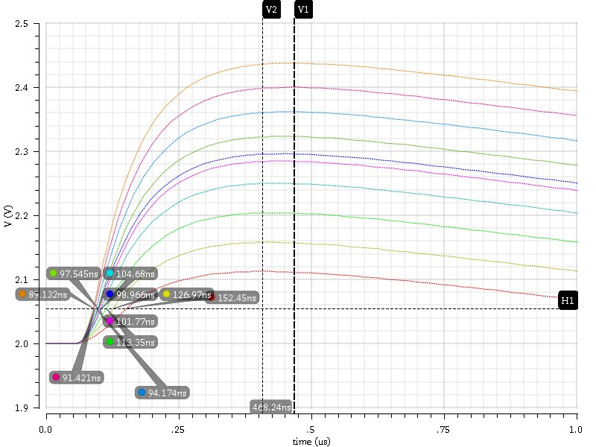
Time Walk Compensation – AMS 350 nm
Noise=8.8mV, Thr=55mV, Bias current=10µA, Pixel size = 50x250µm, Ifoll=10, amplifier power 200mW/cm²
Max 3600e:468ns
3600e
Shaper Output
TW 62ns
TW 62ns
Max 900e:408ns
900e

Slide 67
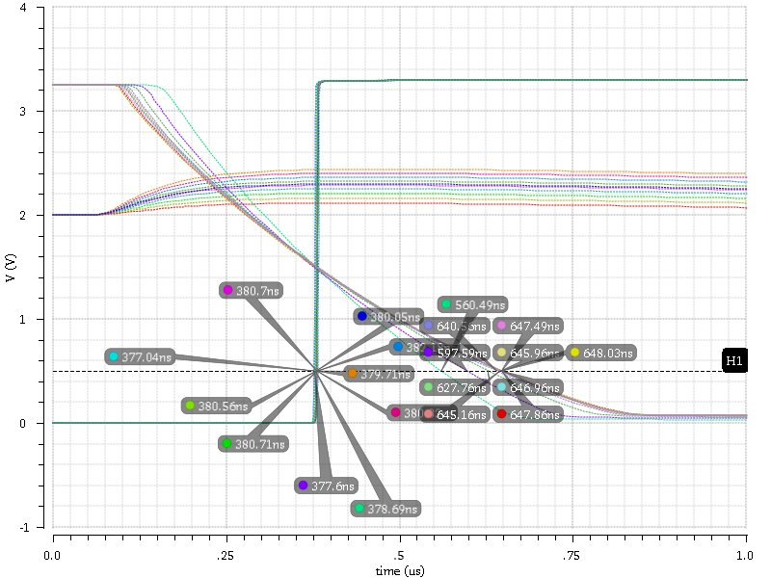
Time Walk Compensation – AMS 350 nm
Noise=8.8mV, Thr=55mV, Bias current=10µA, Pixel size = 50x250µm, Ifoll=10, amplifier power 200mW/cm²
3600e
900e
Comparator Output
TW 4ns

Slide 68
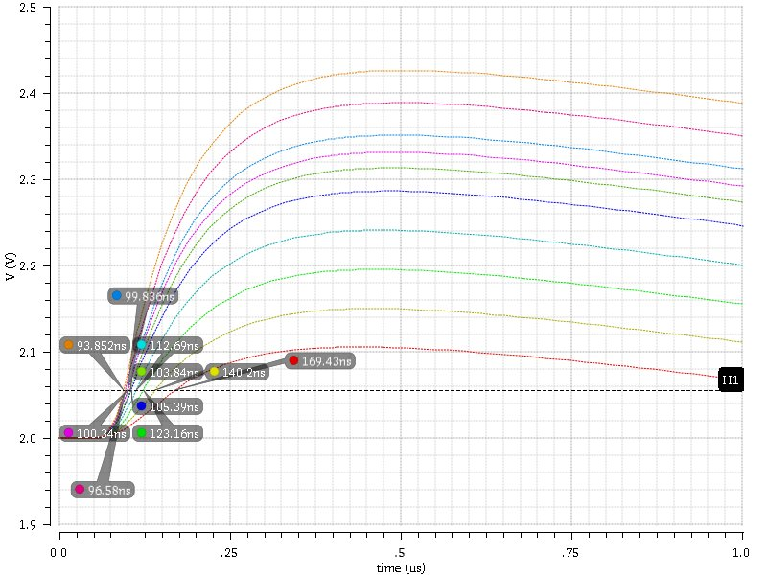
Time Walk Compensation
Noise=8.0mV, Thr=55mV, Bias current=10µA, Pixel size = 50x500µm, Ifoll=7, amplifier power 100mW/cm²
3600e
Shaper Output
TW 75ns
900e

Slide 69
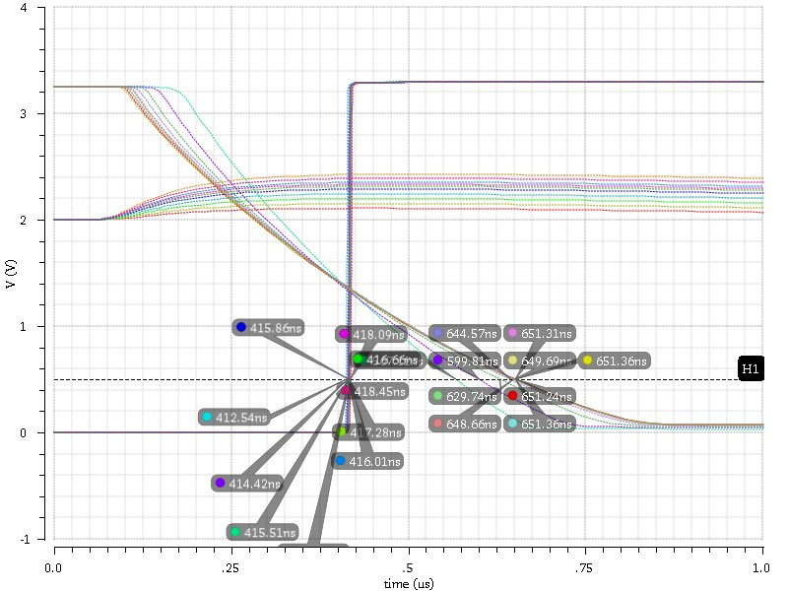
Time Walk Compensation
Noise=8.0mV, Thr=55mV, Bias current=10µA, Pixel size = 50x500µm, Ifoll=7, amplifier power 100mW/cm²
3600e
900e
Comparator Output
TW 5ns

Slide 70
AMS TSV process

Slide 71
TSV – bask side RDL
AMS offers through silicon vias and wafer bonding (so far only for H35, from end of 2015 for H18 as well)
Backside redistribution layer and backside pads are possible
TSV pitch 260 µm
Very important for the module construction
Bump
Read out Chip
CMOS Side
M4
M3
M1
Transistor
nwell
Sensor
Backside RDL
VIAT_TSV
Wire bond pad
(PAD_TSV)
RDL
(MET4_TSV)
Wire bond

Slide 72
Pixel detectors
…
Capacitive signal transmission
Capacitive signal transmission
Wire bonds for sensor chip
Wire bond for sensor bias
CMOS pixel sensor
several reticles
(e.g. 4 x 2 cm)
CMOS pixel sensor
several reticles
(e.g. 4 x 2 cm)
Pixel sensor
(diode based)
(e.g. 8 x 2cm)
Wire bonds for RO chips
Wire bonds for RO chips
Wire bonds for RO chips
Readout chip
Readout chip
TSVs
Readout chip
PCB
Wire bonds for sensor chip
CMOS pixel sensor
CMOS pixel sensor with backside contacts
Pixel sensor
Readout chips
Readout chips
Backside contact
PCB
PCB
PCB
Detector as it is done now:
Diode based pixel sensor bump-bonded to readout ASICs
Present development:
CMOS pixel sensor capacitively coupled to readout ASICs
With TSVs
CMOS pixel sensor with backside contacts
capacitively coupled to readout ASICs

Slide 73
Pixel detectors with TSVs
Capacitive signal transmission
Bumps or capacitive signal transmission
…
CMOS pixel sensor
several reticles
(e.g. 4 x 2 cm)
Contacts for the readout chip are fed through the sensor substrate
Readout chip
TSVs
Pixel sensor
Pixel sensor
Readout chips
Readout chip
2x2cm
Type B: sensor- and readout chip contacts on the back side of the sensor chip
Sensor reticle
2x2cm
Sensor reticle
2x2cm
TSVs for sensor- and readout chip contacts
TSV
Type A: sensor contacts on the back side of the sensor chip

Slide 74
Detectors is advanced CMOS: HRCMOS

Slide 75
Standard MAPS
NMOS transistor in p-well
N-well (collecting region)
P-type epi-layer
P-type substrate
Energy (e-)
Charge collection (diffusion)
MAPS

Slide 76
INMAPS in Tower-Jazz
Pixel
PMOS in a shallow p-well
NMOS shielded by a deep p-well
N-well (collecting region)
P-doped epi layer
INMAPS

Slide 77
Depleted INMAPS - HRCMOS
Pixel
PMOS in a shallow p-well
NMOS shielded by a deep p-well
N-well (collecting region)
HRCMOS

Slide 78
Advanced MAPS with back-plane electrode
2V
Depleted
P-well
Ohmic connection
P-type
N-diffusion

Slide 79
Advanced MAPS with back-plane electrode
2V
50V
P-well
No ohmic connection
P-type depleted
N-diffusion

Slide 80
Advanced MAPS with back-plane electrode
2V
50V
P-well
P-type depleted
N-diffusion

Slide 81
Segmented strip detector with lossy constant-delay-multiplexing
FFs:
2304
ROM
FF
Addr
Demux with en
3-bit adder
8
3
in
1
f
a
f
f
en
m
inc
3
3
8
f
3
a
f
3
3
chan
8
8
Chan0-14
Addr
1
8
Pipeline
structure
in
1
f
a
f
f
en
m
8x8
inc
f
a
f
Pixel size 40 x 800
Segmented strip
Output width 8x8
Constant delay
Small periphery (~2%)
Pad-area dominates
Hit loss when more than 8 hits/BC/2cm²
a
Chan15
Chan16-30

Slide 82
Segmented strip detector with lossy constant-delay-multiplexing
FFs:
6912
n
n
f
n
f
n
f
in
n
3
in
addr
1
f
a
f
f
en
inc
3
3
8
f
3
a
f
3
3
chan
8
8
Chan0-14
n
n
f
n
f
n
f
in
n
Pipeline
structure
1
f
a
f
f
en
8x8
inc
f
a
f
Pixel size 40 x 800
Segmented strip with binary row encoding
Output width 8x(8+n)
Constant delay
Small periphery (~2%)
Pad-area dominates
Hit loss when more than 8 hits/BC/2cm²
a
Chan15
Chan16-30

Slide 83
Chip-Top
17 top pads
22
14 test pads
Active Pixels
400um
Bias DACs
Test pix.
2
40um
Test FETs
Test dio.
Comp
AmpOut, CompOutN/TW
Dig. RO
Hit address
Conf
RO Cell
17 bottom pads

