Slide 1
Preliminary results of Geant4 Electromagnetic Code Review
John Apostolakis/CERN, Andrea Dotti/SLAC, Krzysztof Genser/FNAL,
Soon Yung Jun/FNAL, Boyana Norris/Univ. of Oregon and ANL
J. Apostolakis
Adapted from report by K. L. Genser at US ASCR/HEP Meeting, FNAL Feb

Slide 2
Outline
Initial Scope of Review
EM Related Classes
Tested Applications and Test Tools
Results for selected Classes/Functions
Other Observations/Suggestions
Plans
Summary
Coordinated by K. Genser (FNAL)

Slide 3
Scope, Initial Plans, Timeline
Plan as formulated in Spring of 2013
  Review of performance aspects of a subset of ElectroMagnetic (EM) and closely related classes of Geant4 code with the initial goal to assess if the code is written in a computationally optimal way and to see if it could be improved, keeping in mind
    correctness, performance, maintainability and adaptability
    Multi-Threading aspects
    potential issues related to parallelization and/or migration to GPUs
    issues or potential improvements related to future migration to C++11
  The review should initially concentrate on the most CPU costly classes and functions
  After the initial phase it may be needed or useful to expand the scope of the review to other related areas or aspects of the code
Intermediate report at G4 Collaboration Meeting (Sept. 2013)

Slide 4
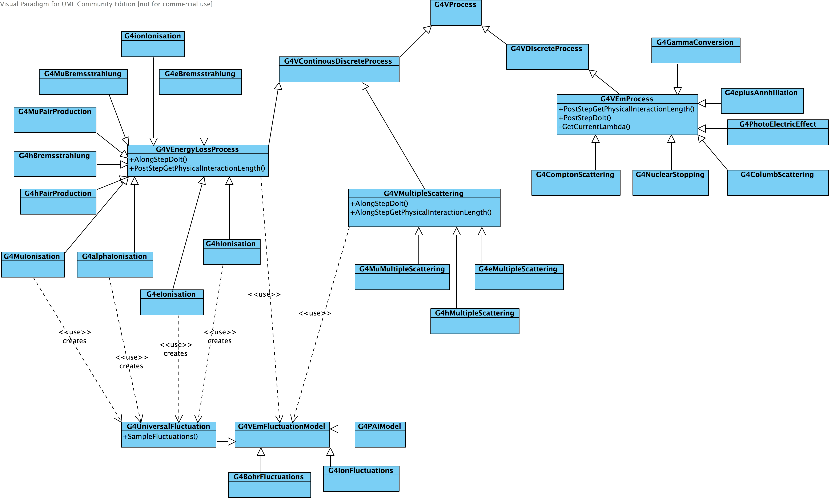
G4VProcess Class Diagram

Slide 5
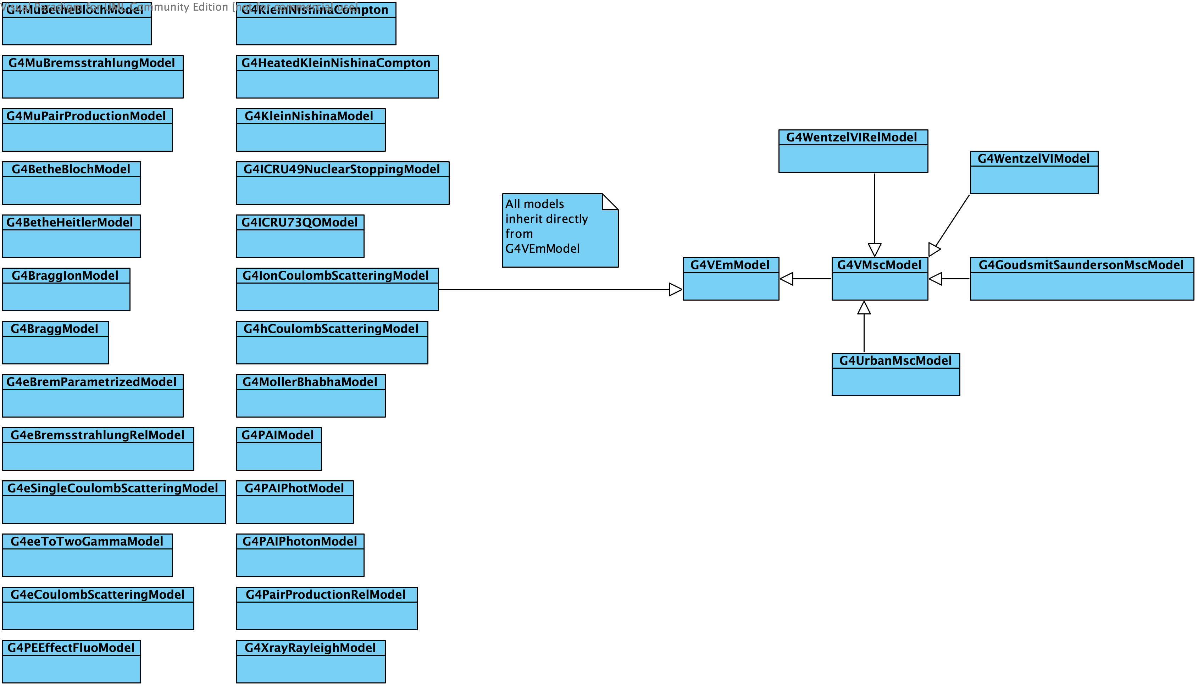
G4VEmModel Class Diagram

Slide 6
Initial List of Functions to be reviewed
G4PhysicsVector, esp. (Compute)Value
  G4PhysicsLogVector, esp. FindBinLocation
G4VProcess, esp. SubtractNumberOfInteractionLengthLeft
G4VEmProcess, esp. PostStepGetPhysicalInteractionLength, GetCurrentLambda, PostStepDoIt
G4VEnergyLossProcess esp. PostStepGetPhysicalInteractionLength, AlongStepDoIt, GetLambdaForScaledEnergy, AlongStepGetPhysicalInteractionLength
G4VMultipleScattering esp. AlongStepDoIt, AlongStepGetPhysicalInteractionLength
G4VEmModel, G4VMscModel, G4UrbanMscModel(95) esp. ComputeGeomPathLength, ComputeTruePathLengthLimit, SampleCosineTheta, SampleScattering

Slide 7
Geant4 Versions/Tested Application
Geant4 v9.6.r07 was the basis of the initial work; working with v10 now
Settled on SimplifiedCalo as ‘standard candle’ to study effects of code transformations:
  Allows concentration on EM code as the importance other factors is minimal
    if not doing full Geant4 profiling most of the test were done with FTFP_BERT physics list ;50GeV e-; no magnetic field
  we have made sure that, while testing our changes, the final random number stayed the same after we modified the original code

Slide 8
Test Cluster and Tools
5 nodes x (4x8 Core) AMD Opteron Processor 6128 (CPU 2000 MHz) cluster
  L1/L2/L3 Cache Sizes: 128KB/512KB/12288KB
  64 GB memory on each node
gcc v4.4..8
FAST (sampling) profiler for standard profiling/benchmarking
  https://oink.fnal.gov/perfanalysis/g4p/admin/task.html
  Added new table to the standard profiling data to be used as an input to TAU and similar tools
TAU (Tuning and Analysis Utilities) Performance System; also used HPCToolkit and Open|SpeedShop

Slide 9
Results for Selected
Classes/Functions

Slide 10
G4UniversalFluctuations::
SampleFluctuations
G4UniversalFluctuations::SampleFluctuations
  Tested getting array of random numbers – existing API:
G4double rannums[nb];
G4Random::getTheEngine()->flatArray(nb,rannums);
for (G4int k=0; k<nb; k++) lossc += w2/(1.-w*rannums[k]);
  About 10% faster in unit test at the SampleFluctuations level when the pointer to the engine was also cached
Reduced number of divisions to SampleFluctuations, e.g. factorizing constants
resulted in ~ 3% improvement in unit test
Reported a potential small bug in the algorithm; author agreed & fixed.
Notes:
replaced
for (G4int k=0; k<nb; k++) lossc += w2/(1.-w*G4UniformRand());
(G4UniformRand() is a macro:
G4Random::getTheEngine()->flat(); returning one random number)
with
G4double rannums[nb];
G4Random::getTheEngine()->flatArray(nb,rannums);
for (G4int k=0; k<nb; k++) lossc += w2/(1.-w*rannums[k]);

Slide 11
G4UrbanMscModel & G4Poisson
G4UrbanMscModel
  Inlined shorter functions of (about 1.5% overall effect; comparable to the original time spent in those functions)
    SampleDisplacement()
    LatCorrelation()
    ComputeTheta0(double, double)
    SimpleScattering(double, double)
  noted “parallel” usage of G4Exp & std::exp functions
Inlined G4Poisson free function
  gained 30+% CPU in a unit test and about 2% overall

Slide 12
G4PhysicsVector (in v9.6.r07)
G4PhysicsVector (“container class” used heavily e.g. via G4PhysicsTable)
  in order to collocate the data which is used together, replaced three main data members (“data”, “bin”, “secDerivative”) of std::vector<G4double> type) with one std::vector<G4xyd>
    G4xyd – a helper class with three G4double data members, operator<, and default () and 3 argument constructors(c’tors), (G4double x,G4double y,G4double d)
    i.e. replaced three vectors with one vector of structs to localize access
  initialized all data members in the constructors (c'tors), removed copy c'tor and (assignment) operator= as the default ones supplied by the compiler should be correct eliminating the need to maintain the hand written code
  modified derived classes accordingly
  replaced some ifs with the ?: (ternary) operator
  replaced hand-coded binary search in
  G4LPhysicsFreeVector::FindBinLocation with std::lower_bound

Slide 13
G4PhysicsVector (v9.6.r07 vs. v10)
The overall effect of transforming G4PhysicsVector in v9.6.r07 was about 1.5% performance improvement as measured using standard profiling/benchmarking tools used to profile production/reference Geant4 releases;
  the G4PhysicsVector::Value function itself used to take about 3% of the total execution time (pythia higgs events)
  the timing improvement did not occur in that function itself but in other areas, mainly in CLHEP::MTwistEngine::flat likely due to cache effects
No CPU effect in Geant4 v10 for the equivalent transformation
  in G4 v10, FindBinLocation was moved to the base class and inlined by the author (an if was used to detect the type (using an enum) of the underlying classes)
    after inlining FindBinLocation G4PhysicsVector::Value function itself takes about 6% of the total execution time now (pythia higgs events)
    noted a potential typo in one of the type enums (looks confusing, but seems harmless)

Slide 14
G4Physics2DVector
G4Physics2DVector
    investigated changing the type of the underlying container to float
      in unit tests it gave ~13% degradation on CPU, ~12% improvement on an NVIDIA GPU
  changed the underlying container std::vector<std::vector<G4double>*> to
  std::vector<std::vector<G4double> > which allowed to remove copy c'tor, operator= and destructor
  used std::lower_bound in FindBinLocation and inlined the function
  based on the ~13% improvement in a unit test, expected a minimal overall performance improvement, but the result was more than ~5% degradation despite G4Physics2DVector::Value function taking only ~0.3% of the execution time, again likely due to cache effects; seems to be confirmed by the cache miss data; no partial specialization in stl
  Data layout may be more important than the algorithms
    Profiling/benchmarking after each change is important
      stack analysis alone may not be sufficient to study cache effects

Slide 15
G4VEnergyLossProcess derived classes
In G4VEnergyLossProcess which is a G4VContinuesDiscreteProcess all derived classes except G4eIonization and G4IonIonization should probably be derived from G4VDiscreteProcess
  i.e. AlongStepGetPh…Int…Lenght and AlongStepDoIt are not necessary.
    The isIonisation flag is set to true in the constructor of G4VEnergyLossProcess, but it is overridden by in the derived classes
  this may avoid unnecessary calls to AlongStepGetPh…Int…Lenght at each step
G4VEmProcess and G4VEnergyLossProcess
  looks like they originated from a common source and evolved
  have quite similar functions some of which could be factorized

Slide 16
Other Aspects covered
Looked at the impact of inlining and optimization (using gcc)
  the optimized and inlined code is much faster (even by a factor of ~4 for the full SimplifiedCalo) from the non optimized/non inlined one
    due to optimizations, even seemingly local code changes can modify the resulting final executable quite significantly (based on an inspection using GNU objdump)
Done call chain and vectorization analysis

Slide 17
Various Observations
Changing underlying data structures may have an impact bigger than the fraction of the CPU taken by the functions using them
Some compilers produce code significantly (up to ~30%) faster compared to gcc
  partially due to use of different math libraries
  we may need to revisit this number for G4 v10 as many math functions changed
puzzled by operator== and operator!=
  they test for identity not equality (same address in memory vs. equal values)
    quite common pattern not only in the EM code

Slide 18
Suggestions (1/3)
Eliminate unneeded code: less maintenance and (likely) improve performance
  eliminate custom written copy constructors, assignment operators and destructors when the compiler supplied ones are correct
  use the ?: (ternary) operator when possible
  consider using Standard Library algorithms when available (usually more efficient)
    e.g. std::lower_bound instead of hand written binary search (e.g. in the FindBinLocation functions

Slide 19
Suggestions - cont’d (2/3)
Institute routine code inspections
  e.g. by a person chosen by the author of the code to be released
Review the use and generation of random numbers; consider
  routine use of the array interface
  caching of the pointer to the engine
  pregenerating the numbers (locally or globally)
  adding API returning 1/randomnumber

Slide 20
Suggestions – cont’d (3/3)
Consider making G4PhysicsVector data members “read only” (and initialize them in the constructor) to help with the MT code (if one can accommodate data retrieval from a file in an appropriate way)
    rewrite deriving (from G4PhysicsVector) G4PhysicsOrderedFreeVector to use another data member as it modifies its data members after creation

Slide 21
Plans
Collect more TAU results
  to support some of the findings/conclusions
  to analyze for other potential findings
Quantify CPU effects of some of the code changes, done both by the authors or the reviewers, e.g.:
  Inlining of G4PhysicsVector::FindBinLocation
  Refactoring G4UniversalFluctuations::SampleFluctuations
  double check using G4xyd helper in G4PhysicsVector
Finish the review and write/deliver the report to the Electromagnetic Working Group/G4 Collaboration
  patch release time scale?

Slide 22
Summary/Selected Findings
Completed first pass through the EM code
  some areas were even revisited for G4 version 10.
  concentrated mainly on major features potentially impacting performance
Gained about 3.5% in CPU by inlining G4Poisson & shorter functions in G4UrbanMscModel
Other Findings
  “Typo” like issues identified in several places of the code
    suggests a need for regular ’routine’ code inspection
  Close similarities between G4VEmProcess and G4VEnergyLossProcess
  Some G4VEnergyLossProcess classes should probably inherit from G4VDiscreteProcess (G4VEmProcess?)
  Prevalent use of RNG API to get one value via macro
    using an array interface decreases the number of calls and paves the way for further improvements;
    cashing the pointer to the engine will help too.

