Slide 1



Open charm hadron measurement
in p+p and Au+Au collisions
at √s_{NN}= 200 GeV in STAR
Yifei Zhang
(for the STAR Collaboration)
Lawrence Berkeley National Lab
Quark Matter 2011, Annecy, France
May 23 – 28, 2011

Slide 2
Outline:
Motivation
D⁰ and D* measurement in p+p collisions at 200 GeV
D⁰ measurement in Au+Au collisions at 200 GeV
Charm cross section, R_{AA}
Summary and outlook
2

Slide 3
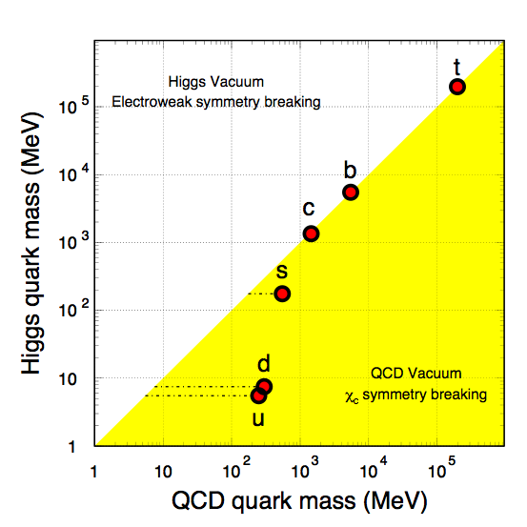
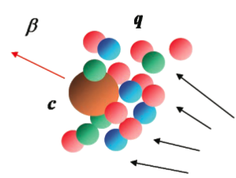
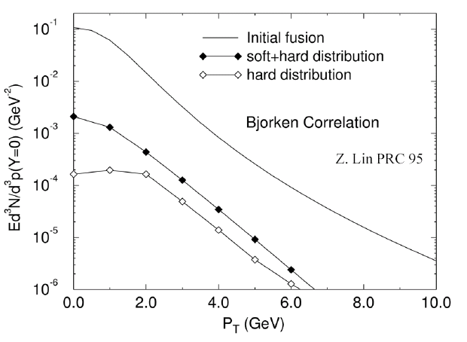
Why study heavy quarks?
X. Zhu, et al, PLB 647, 366(2007)
- Higgs mass: electro-weak symmetry breaking (current quark mass).
- QCD mass: Chiral symmetry breaking (constituent quark mass).
- Strong interactions do not affect heavy
quark mass.
Study properties of the hot and dense medium at the early stage of heavy-ion collisions.
Test pQCD at RHIC.
Charm collectivity => Light flavor thermalization.
M. Gyulassy & Z. Lin, PRC 51 (1995) 2177
3

Slide 4
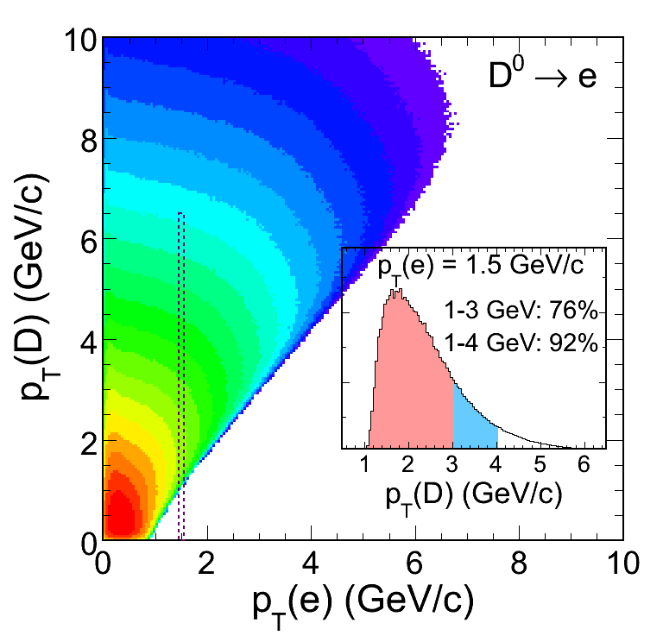
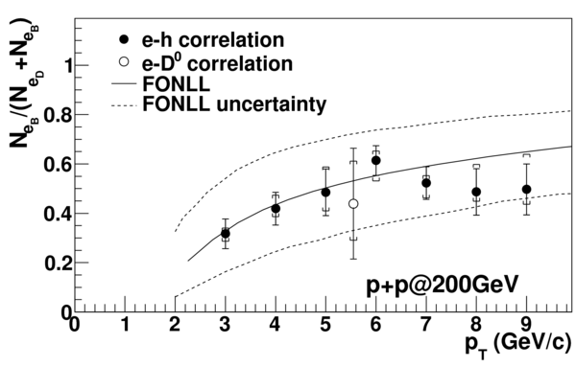
Why measure D mesons?
Known limitations in semi-leptonic channel.
1) Kinematics smearing due to decay.
2) Suffering from charm and bottom contributions.
PRL 105 (2010) 202301
Both FONLL calculation and experimental data from electron channel are with large uncertainties.
Direct measurement of D meson provides clean information of charm quark.
4

Slide 5
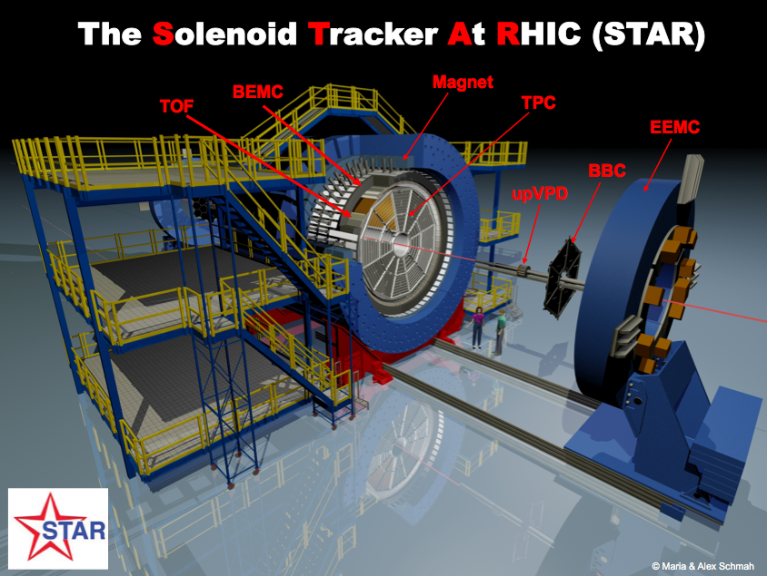
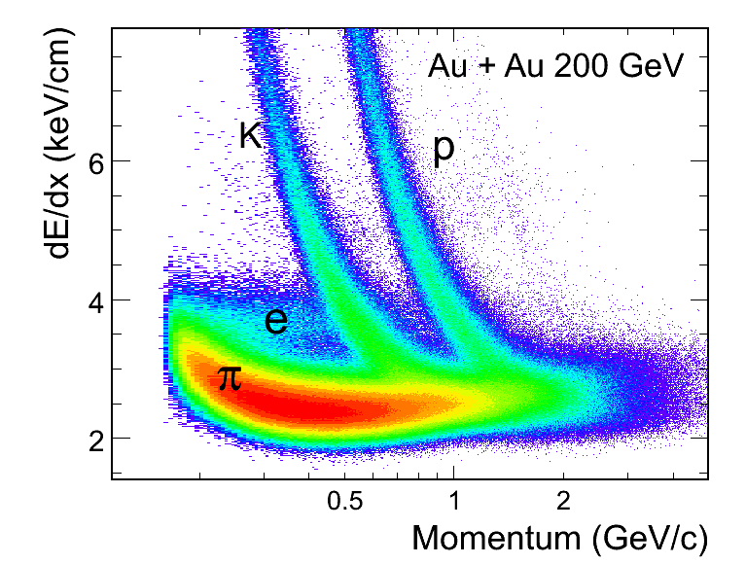
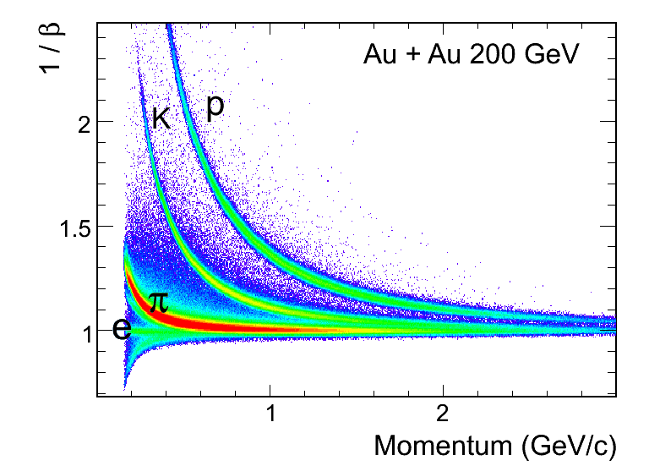
STAR detector and Particle ID
Large acceptance
|η|<1, 0<φ<2π
Year 2009 72% of full TOF
Year 2010 100% of full TOF
Time Projection Chamber
dE/dx, momentum
Time Of Flight detector
particle velocity 1/β
5

Slide 6
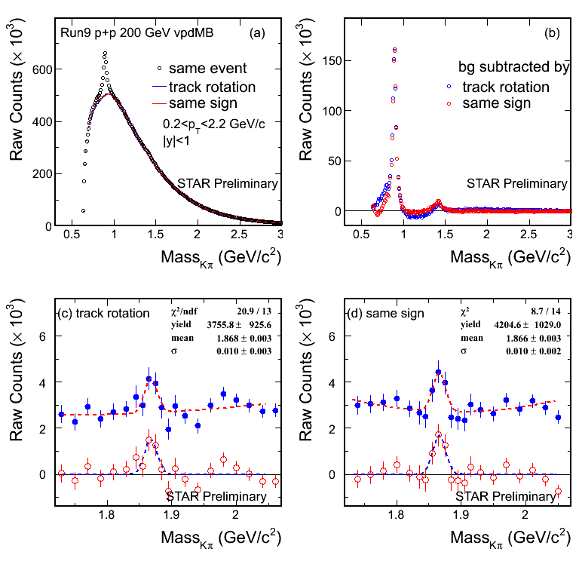
D⁰ signal in p+p 200 GeV
K*⁰
B.R. = 3.89%
p+p minimum bias 105 M
4-σ signal observed.
Different methods reproduce combinatorial background.
Consistent results from two background methods.
PDG mass = 1864.5 ± 0.4 MeV
K₂*(1430)
6

Slide 7
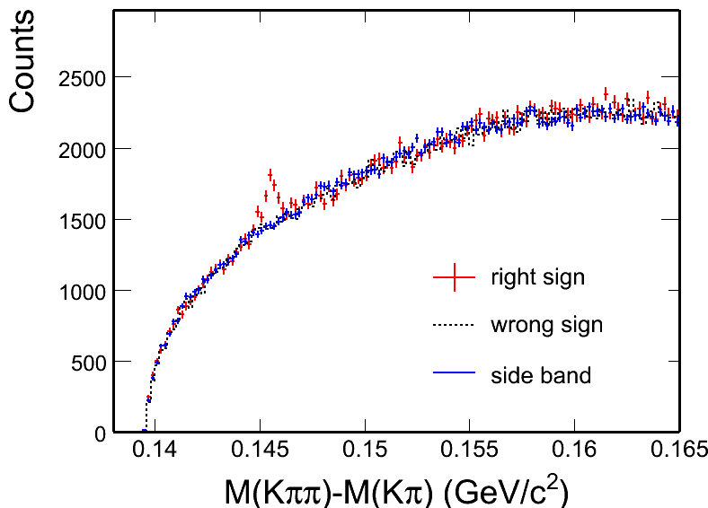
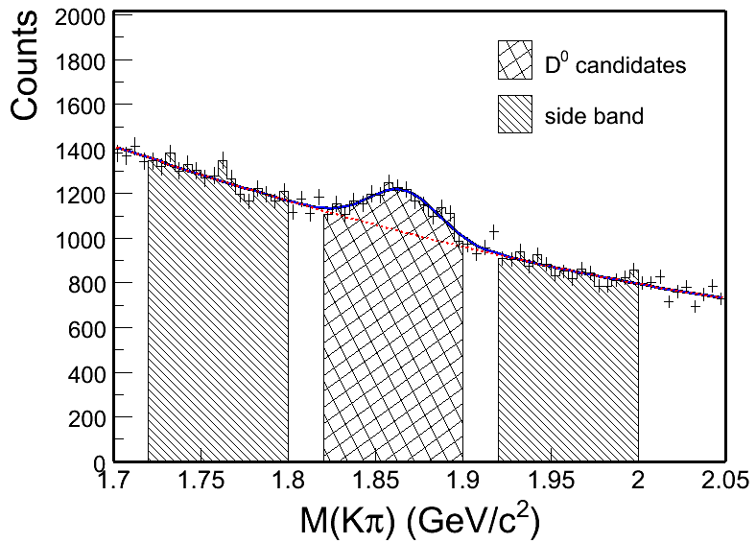
D* signal in p+p 200 GeV
STAR Preliminary
B.I.~Abelev, et al., PRD 79 (2009) 112006.
Background combinations:
Wrong sign:
D⁰ and π⁻, D⁰ and π⁺
Side band:
1.72< M(Kπ) < 1.80 or
1.92 < M(Kπ) < 2.0 GeV/c²
Minimum bias 105M events in p+p 200 GeV collisions.
Two methods to reconstruct combinatorial background: wrong sign and side band.
8-σ signal observed.
7

Slide 8
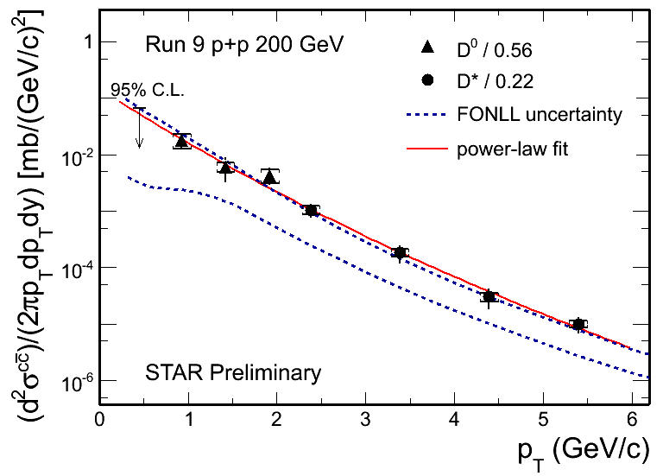
D⁰ and D* p_{T} spectra in p+p 200 GeV
D. Tlusty poster - #328
D⁰ scaled by N_{cc} / N_{D0} = 1 / 0.56^{[1]}
D* scaled by N_{cc} / N_{D*} = 1 / 0.22^{[1]}
Consistent with FONLL^{[2]} upper limit.
Xsec = dN/dy|^{cc}_{y=0} × F × σ_{pp}
F = 4.7 ± 0.7 scale to full rapidity.
σ_{pp}(NSD) = 30 mb
The charm cross section at mid-rapidity is:
202 ± 56 (stat.) ± 40 (sys.) ± 20 (norm.) μb
The charm total cross section is extracted as:
949 ± 263 (stat.) ± 253 (sys.) μb
[1] C. Amsler et al. (Particle Data Group), PLB 667 (2008) 1.
[2] Fixed-Order Next-to-Leading Logarithm: M. Cacciari, PRL 95 (2005) 122001.
8

Slide 9
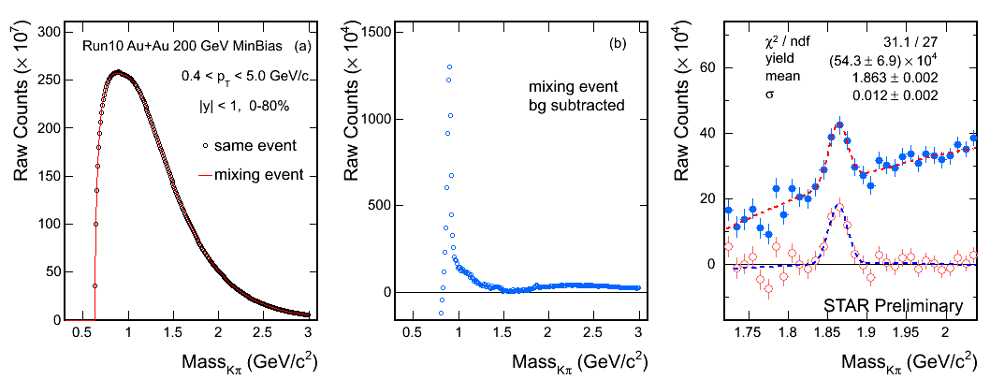
D⁰ signal in Au+Au 200 GeV
Year 2010 minimum bias 0-80% 280M Au+Au 200 GeV events.
8-σ signal observed.
Mass = 1863 ± 2 MeV (PDG value is 1864.5 ± 0.4 MeV)
Width = 12 ± 2 MeV
9

Slide 10
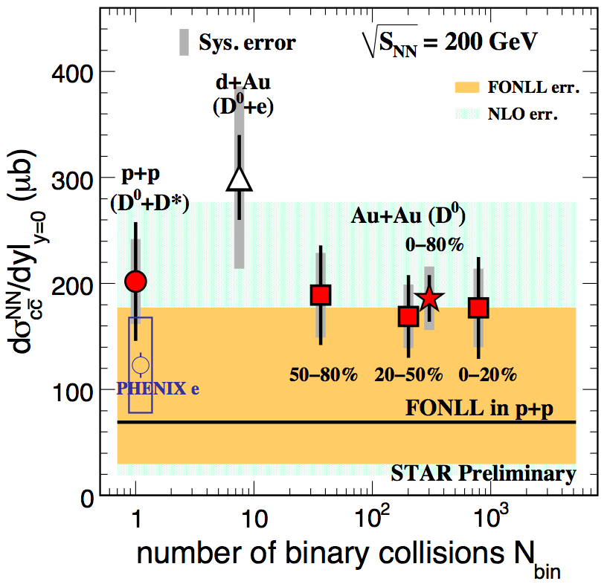
Charm cross section vs N_{bin}
All of the measurements are consistent.
Year 2003 d+Au : D⁰ + e
Year 2009 p+p : D⁰ + D*
Year 2010 Au+Au: D⁰
Assuming N_{D0} / N_{cc} = 0.56 does not change.
Charm cross section in Au+Au 200 GeV:
Mid-rapidity:
186 ± 22 (stat.) ± 30 (sys.) ± 18 (norm.) μb
Total cross section:
876 ± 103 (stat.) ± 211 (sys.) μb
[1] STAR d+Au: J. Adams, et al., PRL 94 (2005) 62301
[2] FONLL: M. Cacciari, PRL 95 (2005) 122001.
[3] NLO: R. Vogt, Eur.Phys.J.ST 155 (2008) 213
[4] PHENIX e: A. Adare, et al., PRL 97 (2006) 252002.
Charm cross section follows number of binary collisions scaling =>
Charm quarks are mostly produced via initial hard scatterings.
10

Slide 11
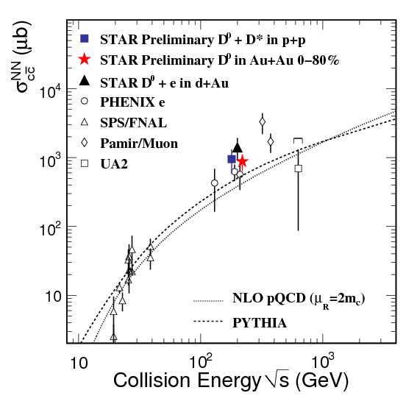
Charm cross section vs √s_{NN}
Compared with other experiments, provide constraint for theories.
11

Slide 12
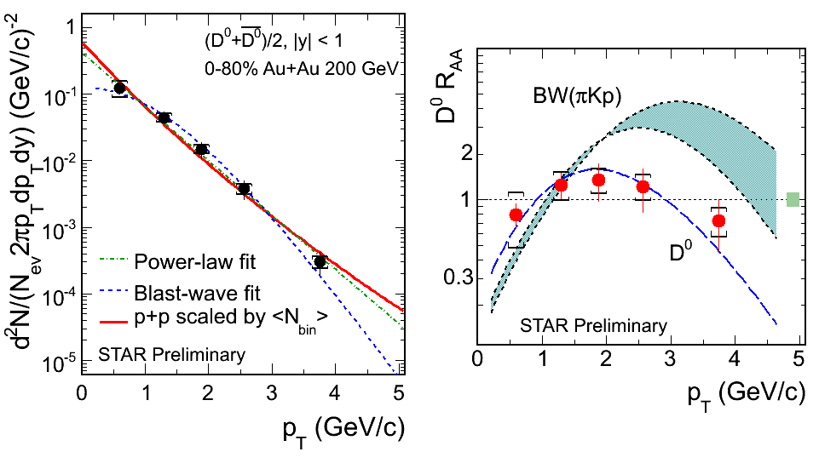
D⁰ R_{AA} vs p_{T}
BW (πKp): B. I. Abelev, et al., Phys. Rev. C 79 (2009) 34909.
D⁰ Au+Au 0-80% divided by p+p with <N_{bin}> scaled.
No obvious suppression at p_{T} < 3 GeV/c.
Blast-wave predictions with light hadron parameters are different from data.
=> D⁰ freeze out earlier than light hadrons.
12

Slide 13
Summary
D⁰ and D* are measured in p+p 200 GeV up to p_{T} = 6 GeV/c.
D⁰ is measured in Au+Au 200 GeV up to p_{T} = 5 GeV/c.
The charm cross section per nucleon-nucleon collision in mid-rapidity is measured to be
p+p: 202 ± 56 (stat.) ± 40 (sys.) ± 20 (norm.) mb
Au+Au: 186 ± 22 (stat.) ± 30 (sys.) ± 18 (norm.) mb
Charm cross sections at mid-rapidity follow number of binary collisions scaling, which indicates charm quarks are mostly produced via initial hard scatterings.
D⁰ nuclear modification factor R_{AA} is measured. No obvious suppression observed at p_{T} < 3 GeV/c.
Blast-wave predictions with light hadron parameters are different from D⁰ data, which indicates that D⁰ decouples earlier from the medium than light hadrons.
13

Slide 14
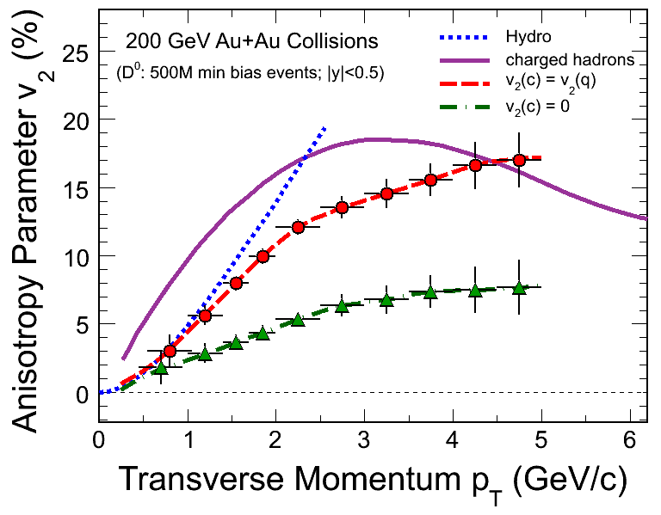
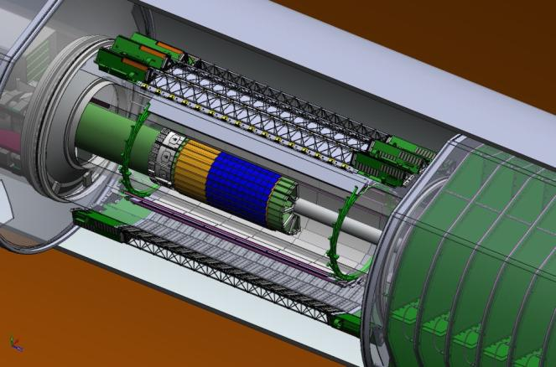
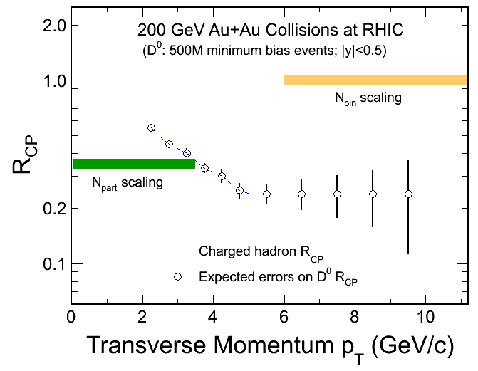
Outlook
TPC
SSD
IST
PXL
FGT
STAR Heavy Flavor Tracker Project.
Reconstruct secondary vertex.
Dramatically improve the precision of measurements.
Dca resolution: < 20 μm at p_{T} > 2 GeV/c.
Address physics related to heavy flavor.
v₂ : thermalization
R_{CP}: charm quark energy loss mechanism.
14

Slide 15
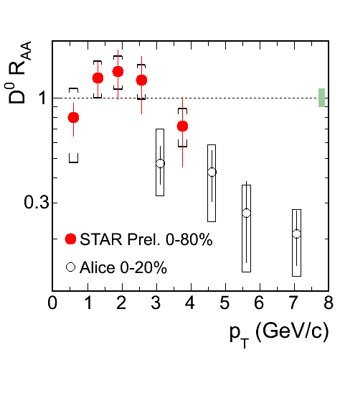
D⁰ R_{AA} compared with Alice result
15

Slide 16
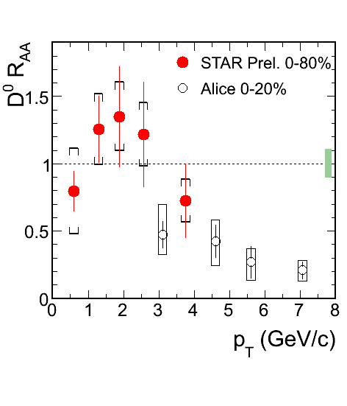
D⁰ R_{AA} compared with Alice result
16

Slide 17
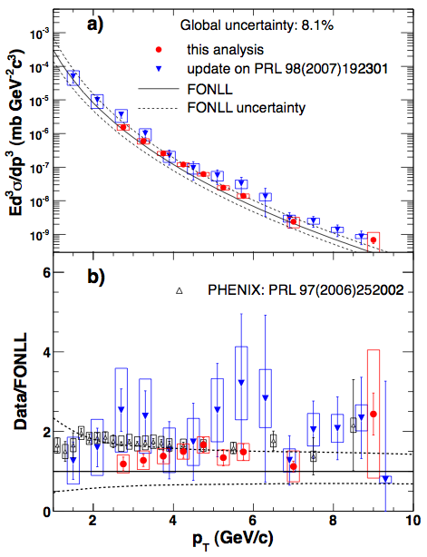
Data consistent with theory
Both D-meson and NPE measurements are consistent with FONLL upper bound.
H. Agakishiev, et al., PRD 83 (2011) 052006
17

Slide 18
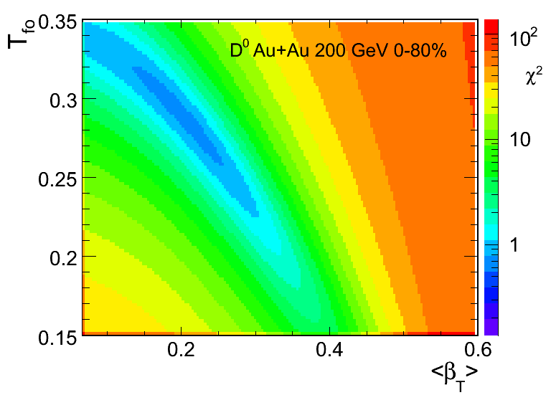
Blast-wave contor
18

Slide 19
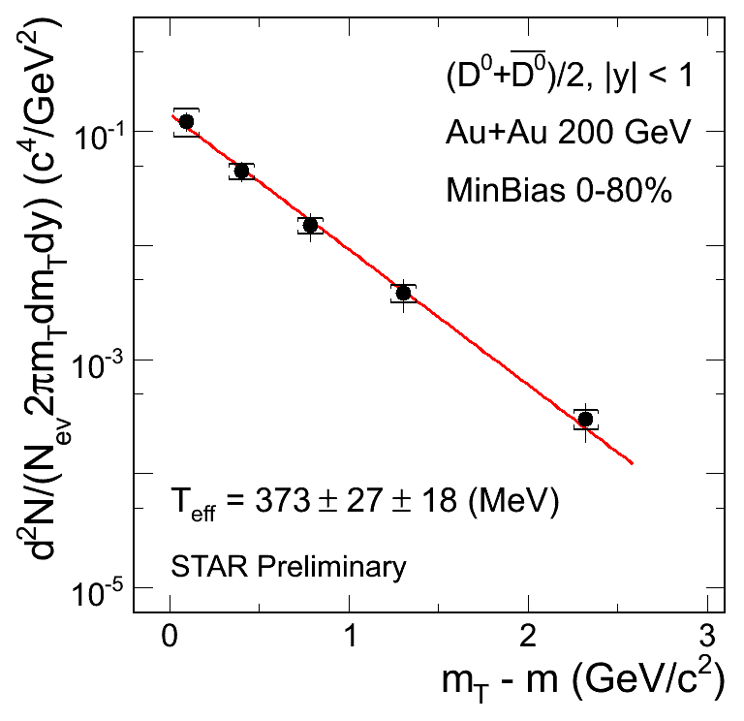
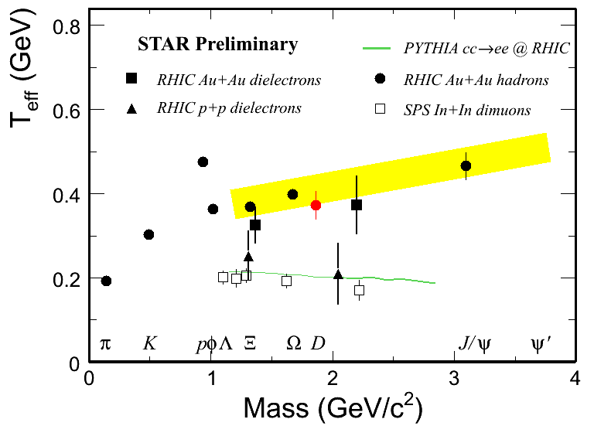
D⁰ m_{T} slope
T_{eff} = T_{fo} + m×β²
Partonic collectivity?
Does charm follow the trend of strangeness? Or smaller velocity?
Interactions between charm and medium?
19

