Slide 1
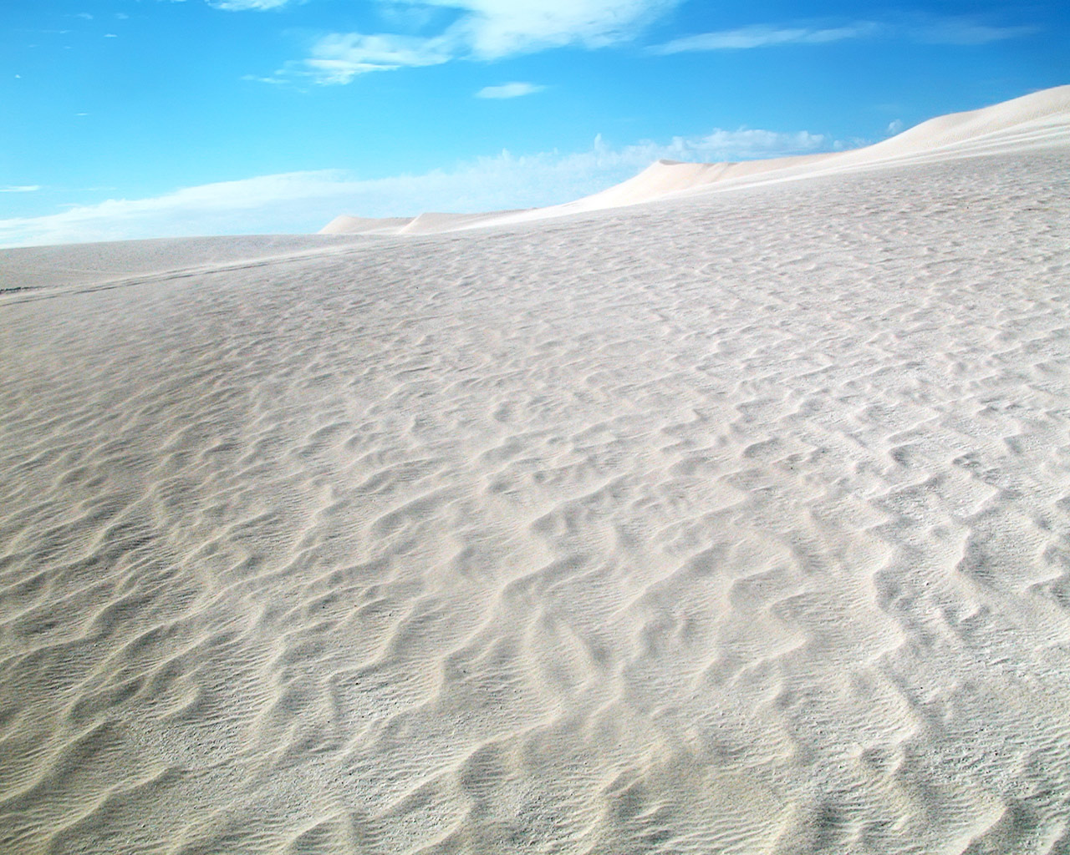
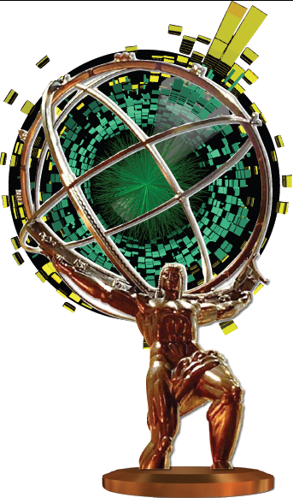

Measurements of charged particle spectra in √s_{NN}=2.76 Pb+Pb collisions with the ATLAS detector at the LHC
Alexander Milov
for ATLAS Collaboration

Slide 2
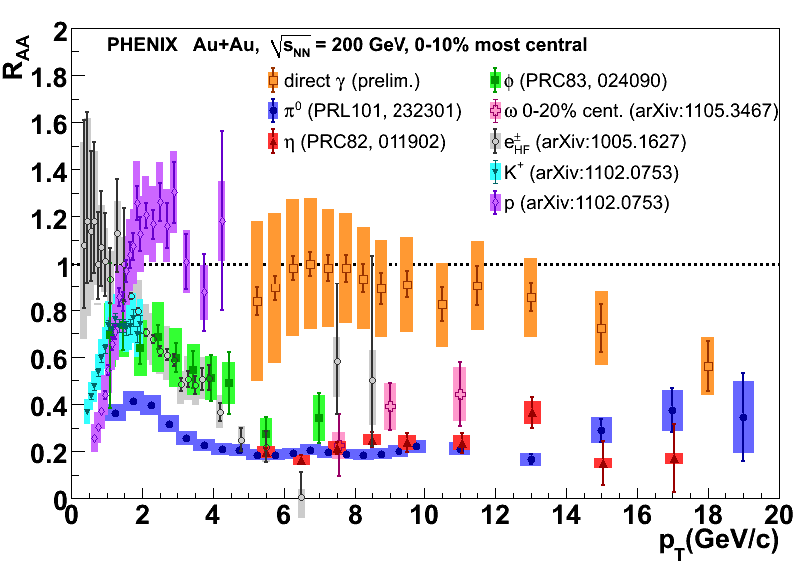
Spectra and R_{AA}
Measurement of unidentified particle spectra at high p_{T} in HI collisions is a way to understand the energy loss mechanism.
Large amount of experimental data exists on the suppression of high p_{T} particles in HI collisions at and below √s_{NN}=0.2TeV.
With the beginning of LHC operation the first data on the suppression become available at much higher initial energy.
Comparison between RHIC and LHC helps to answer the question how the QGP evolves between the two different energy regimes.

Slide 3
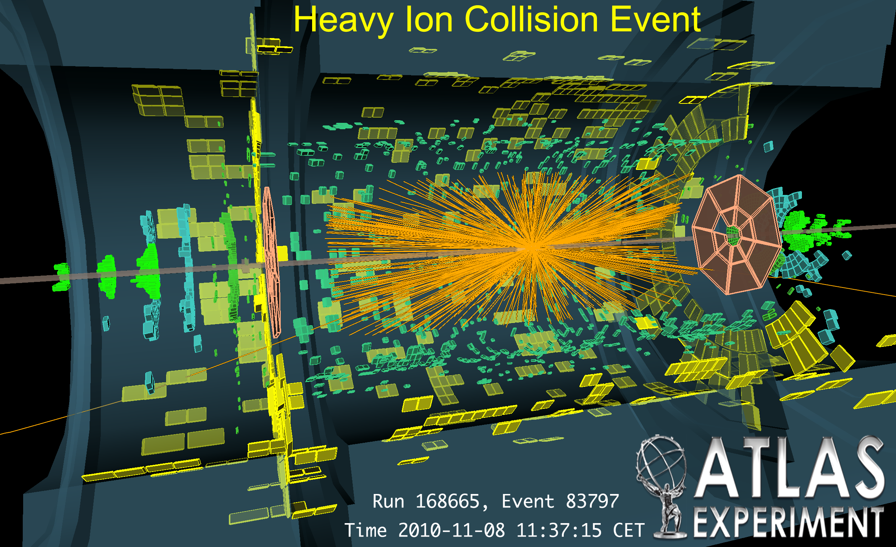
ATLAS performance in HI
Minimum Bias Trigger Scintillator
Zero Degree Calorimeter (140m from IP)
Forward Calorimeter
Inner Detector tracking system

Slide 4
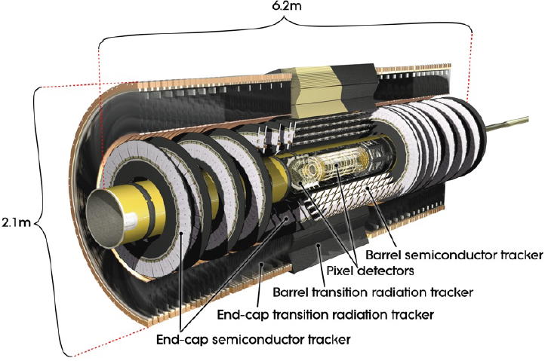
ATLAS Inner Detector tracker

Slide 5
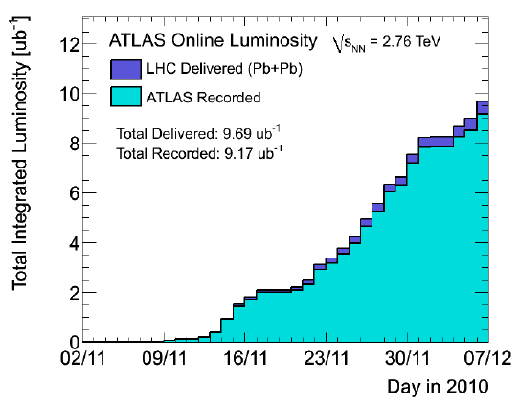
Event sample
This analysis uses 43.6M minimum biased events corresponding to integrated luminosity of 7 μb⁻¹.
Events were selected by:
Firing Minimum Bias Trigger Scintillators on both sides within Δt = 3ns
Producing a coincidence in Zero Degree Calorimeter
Reconstructed vertex within 150mm from ATLAS center

Slide 6
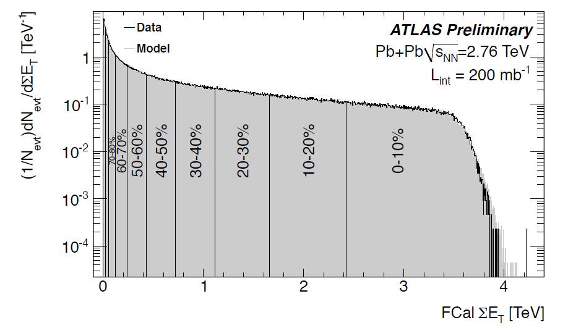
Centrality determination
ATLAS-HION-2011-05-001
Based on FCAL energy (3.2<|η|<4.9), Glauber model MC and p+p data @ √s=2.76 TeV. MB selection efficiency 100% ± 2% efficiency
FCAL response stability over entire run much better than 1% level.

Slide 7
Analysis
Tracking cuts.
Pixel detector:
At least 2 hits in 3 layers
The innermost layer hit, if such is expected
No missing hits in layers
SCT detector:
At least 7 hits in 9 layers
No missing hits in layers
Primary vertex pointing cuts:
within 3 standard deviations in transverse and
longitudinal directions
Systematic uncertainties (currently very conservative):
Main sources:
efficiency and feed-down at low p_{T} (~5%)
possible distortion of track p_{T} above 20 GeV
in the most central collisions (<30%).
uncertainty on N_{coll} for ratios.

Slide 8
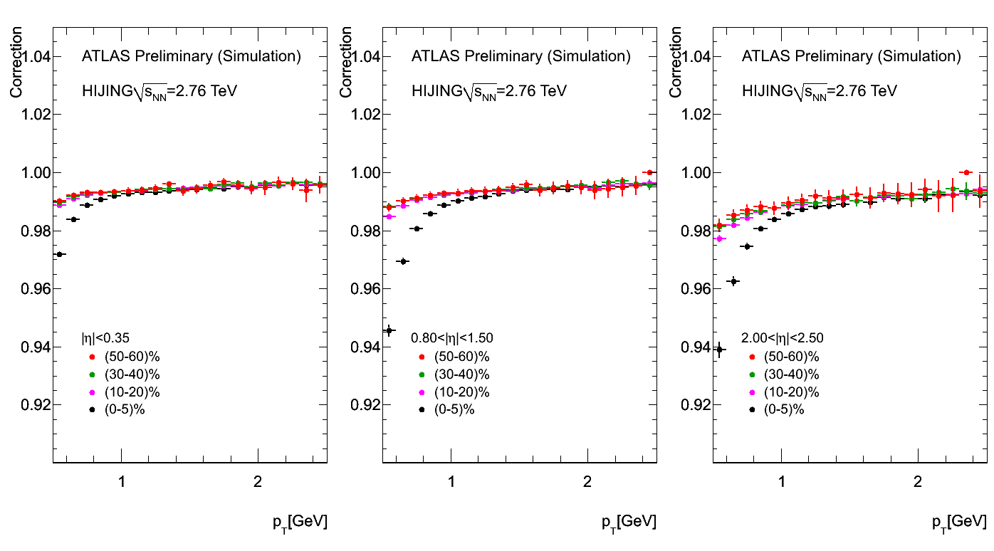
Correction for off vertex tracks
The raw spectra is corrected for the fake tracks and secondary particles at low p_{T}. Correction is based on the MC.

Slide 9
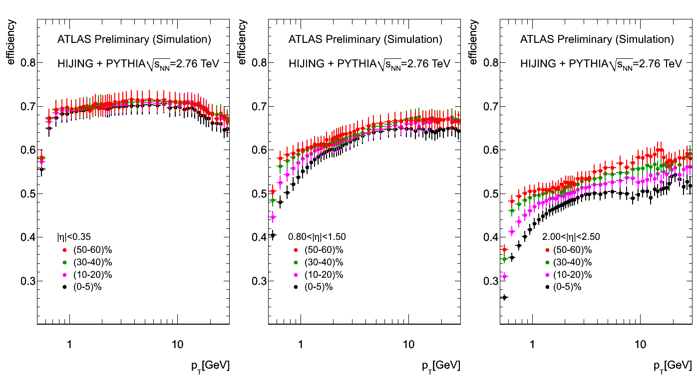
Efficiency Correction
Vertical bars show systematic uncertainty
Efficiency based on the PYTHIA events embedded in HIJING MC. Loss at higher η is due to very restrictive cuts used in the analysis

Slide 10
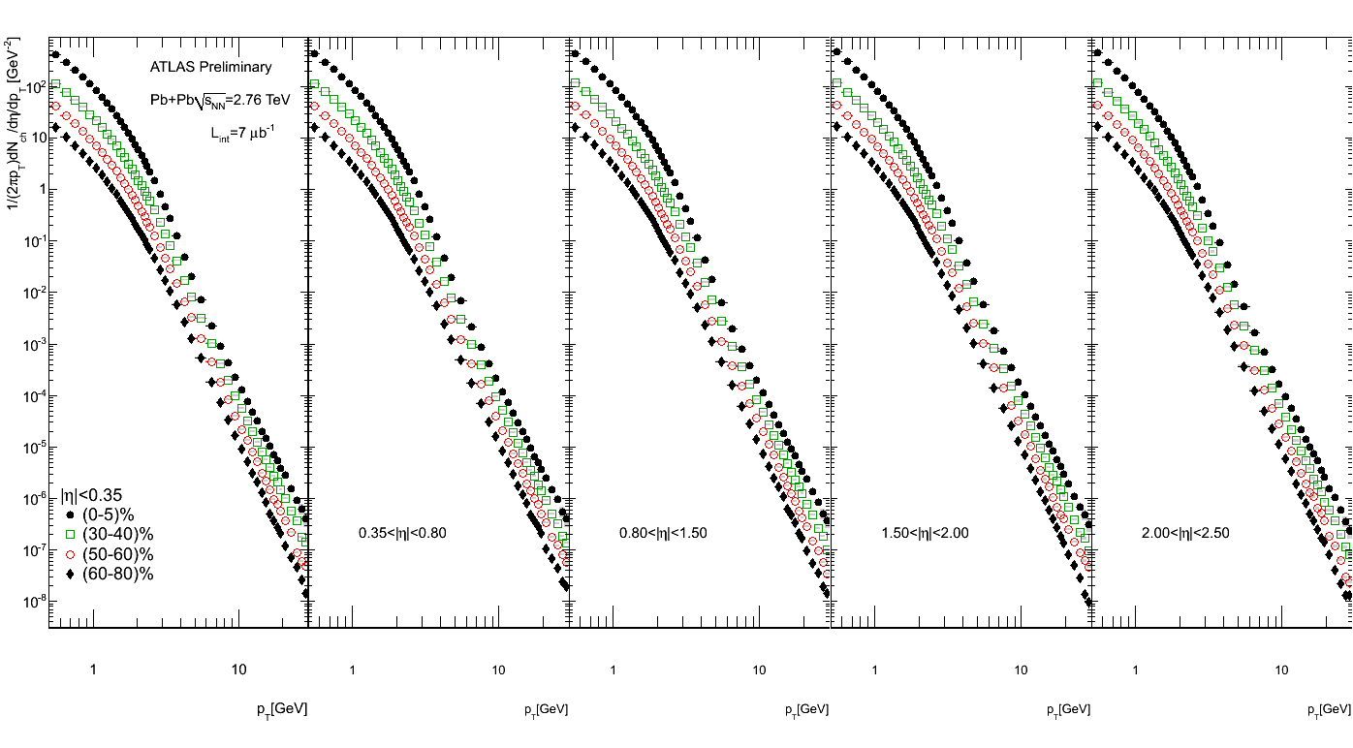
Spectra
Fully reconstructed invariant spectra for different centralities measured at different rapidities up to |η|<2.5. The spectra are shown up to 30 GeV

Slide 11
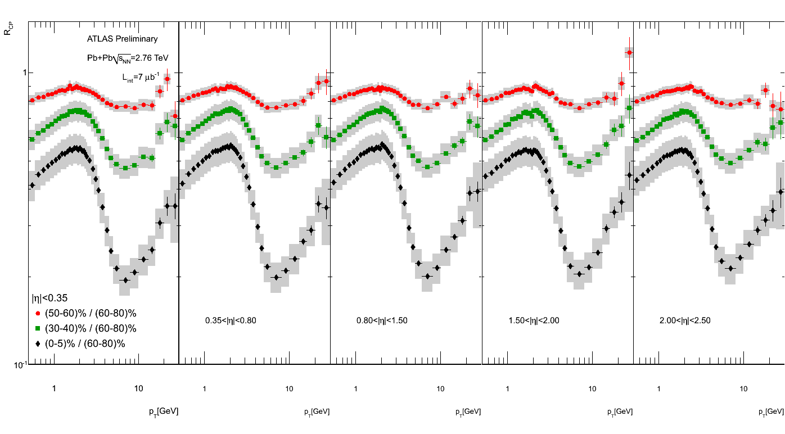
R_{CP}
Central-to-Peripheral Nuclear Modification Factor. For the main result ATLAS uses (60-80)% centrality bin as the denominator.

Slide 12
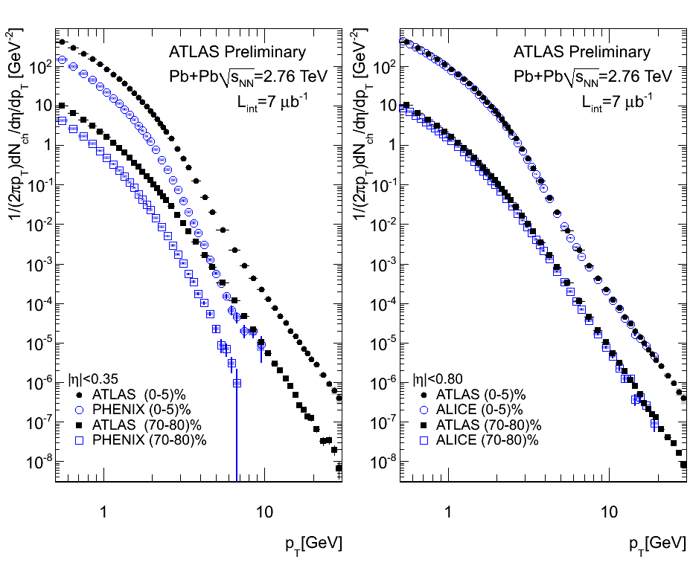
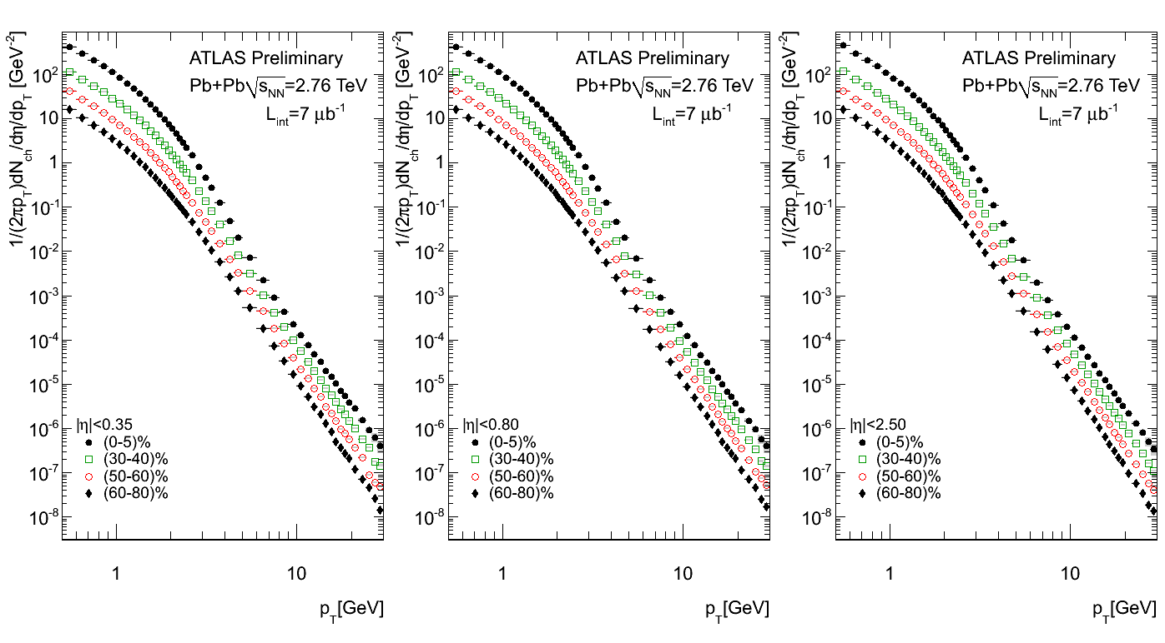
Spectra Comparison
PHENIX-like
rapidity
bin
ALICE-like
rapidity
bin
Full coverage
Significant increase in particle production compared to √s_{NN}=200GeV.
More prominent at high p_{T}.

Slide 13
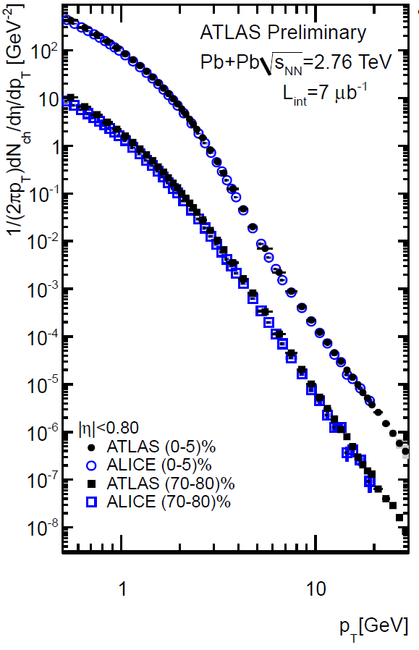
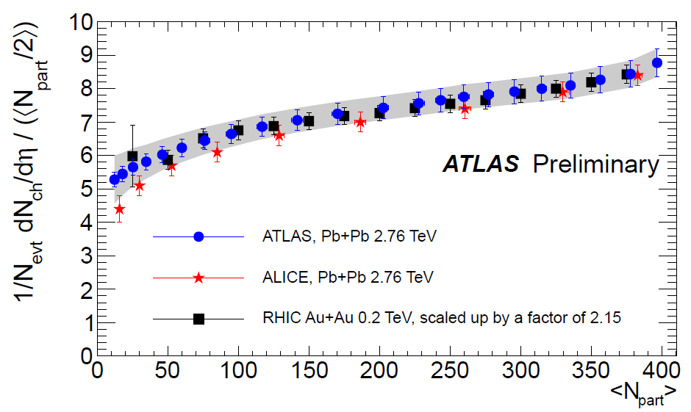
Spectra Comparison
Good agreement in central bin
Higher yield than ALICE in (70-80)%
PHENIX-like
rapidity
bin
ALICE-like
rapidity
bin
Full coverage
Similar effect is seen in the measurement of 2/N_{part} dN_{ch}/dη
[ATLAS-HION-2010-01-001]
This suggests that there is a difference in the centrality cuts between ATLAS and ALICE.
Significant increase in particle production compared to √s_{NN}=200GeV.
More prominent at high p_{T}.

Slide 14
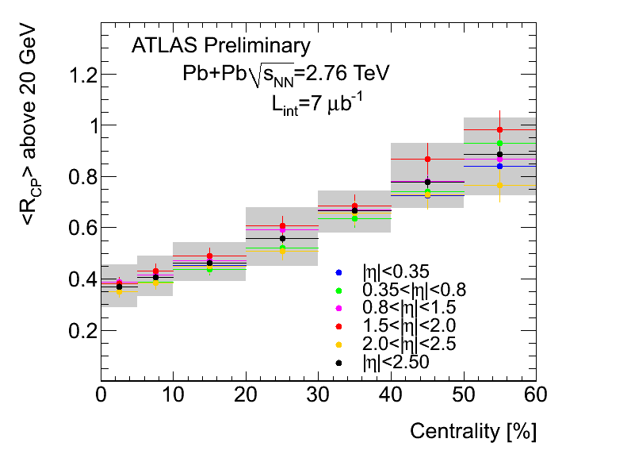
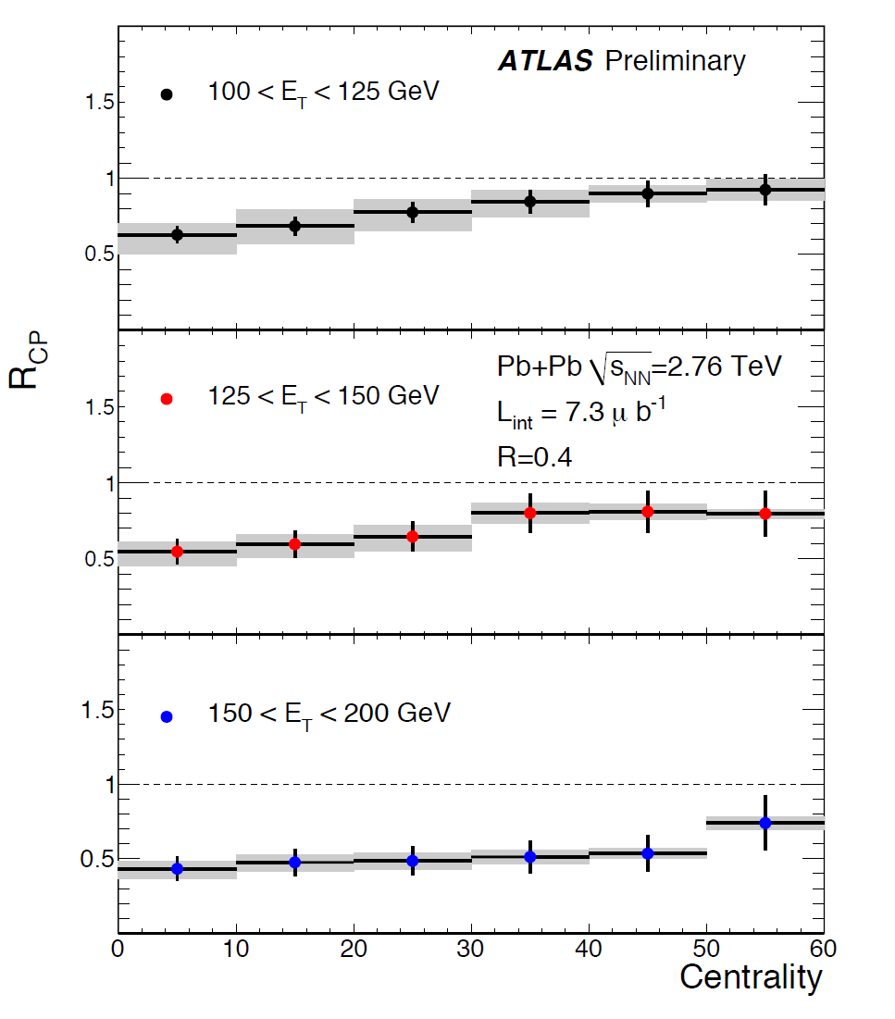
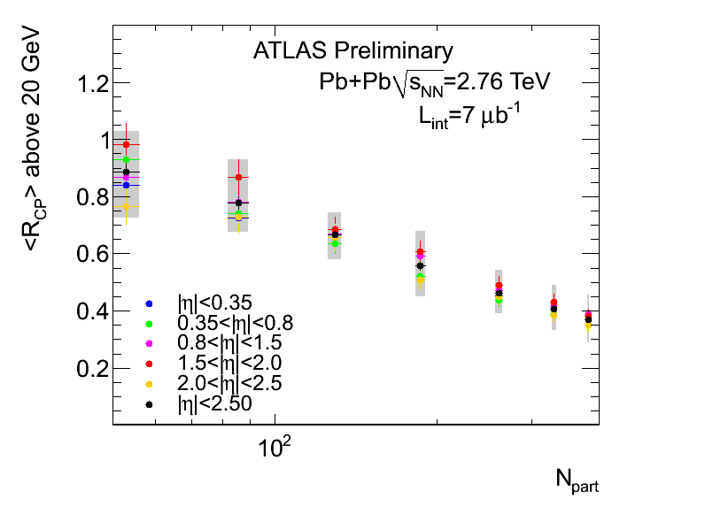
R_{CP} above 20 GeV
Centrality behavior of the charged particle R_{CP} resembles the suppression found in the measurement of fully reconstructed jets.
At the highest p_{T} currently analyzed, the R_{CP} remains below 0.4 for the most central collisions. We see no indication that the R_{CP} at high p_{T} would follow binary scaling.
“Measurements of Jets and Jets quenching…”
ATLAS Collaboration talk by A. Angerami 24/5

Slide 15
Summary
ATLAS measures charged particle spectra and R_{CP} in the rapidity range |η|<2.5.
All R_{CP} have minimum at around 7 GeV reaching 0.2 for the ratio of (0-5)% to (60-80)% centrality classes.
All R_{CP}s show steady rise with p_{T} above 10 GeV, and are still significantly suppressed at 30 GeV.
The spectra in (0-5)% centrality class agrees well with ALICE result, in (70-80)% class the shapes agree, with normalization consistent within stated centrality determination errors.

