Slide 1
Viscous Hydrodynamic Evolution with Non-Boost Invariant Flow for the Color Glass Condensate
AM and T. Hirano, arXiv:1102.5053 [nucl-th]
Akihiko Monnai
Department of Physics, The University of Tokyo
Collaborator: Tetsufumi Hirano
Quark Matter 2011
May 27th 2011, Annecy, France

Slide 2


Introduction
Quark-gluon plasma (QGP) at relativistic heavy ion collisions
Hadron phase
(crossover)
sQGP
QGP phase
(wQGP?)
RHIC experiments (2000-)
The QGP quantified as a nearly-perfect fluid
Viscosity is important for “improved” inputs (initial conditions, equation of state, etc.)
Consistent modeling is necessary to extract physical properties from experimental data
Introduction

Slide 3



Introduction
Modeling a high-energy heavy ion collision
ｔ
particles
t
Freezeout
Hadronic cascade
Hydro to particles
QGP phase
Hydrodynamic stage
hadronic phase
Pre-equilibrium
Initial condition
z
Color glass condensate
Color glass condensate (CGC)
Description of saturated gluons in the nuclei before a collision (τ < 0 fm/c)
Relativistic hydrodynamics
Description of collective motion of the QGP (τ ~ 1-10 fm/c)
First Results from LHC

Slide 4
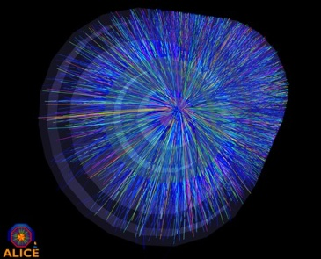
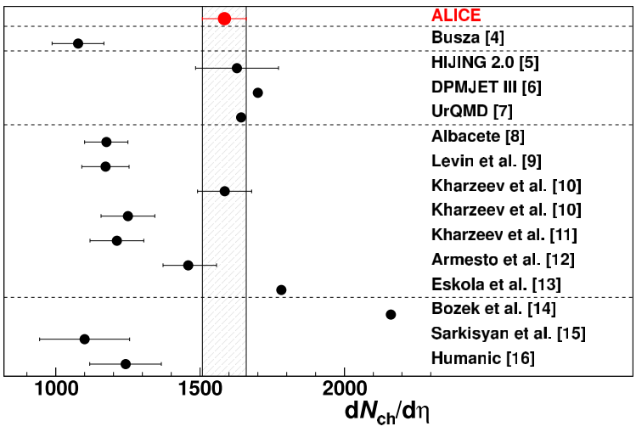

First Results from LHC
LHC experiments (2010-)
Mid-rapidity multiplicity
Heavy ion collisions of higher energies
Will the RHIC modeling of heavy ion collisions be working intact at LHC?
K. Aamodt et al. PRL105 252301
Pb+Pb, 2.76 TeV at η = 0
ALICE data (most central 0-5%)
CGC
CGC; fit to RHIC data
but no longer valid at LHC?
CGC in Heavy Ion Collisions

Slide 5
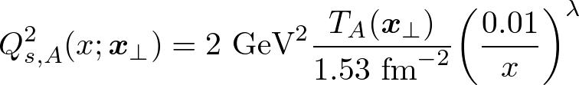
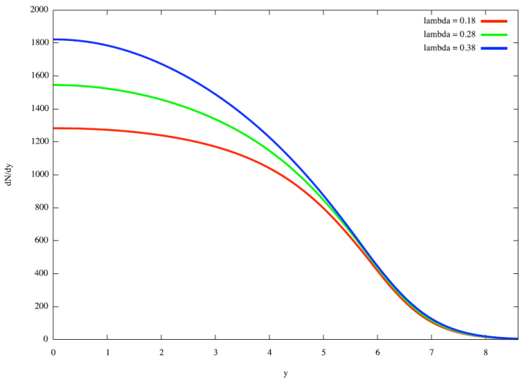
CGC in Heavy Ion Collisions
Saturation scale in MC-KLN model
CGC + Hydrodynamic Model
D. Kharzeev et al., NPA 730, 448
λ=0.38
λ=0.28
Fixed via direct comparison with data
λ=0.18
dN_{ch}/dη gets steeper with increasing λ;
RHIC data suggest λ~0.28
dN/dy
Initial condition
from the CGC
Initial condition
from the CGC
Hydrodynamic evolution
Observed particle distribution
Observed particle distribution
a missing piece!
We need to estimate hydrodynamic effects with
(i) non-boost invariant expansion
for the CGC
(ii) viscous corrections
Hydrodynamic Model

Slide 6
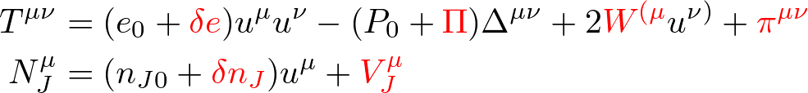



Hydrodynamic Model
Decomposition of the energy-momentum tensor by flow
Stability condition + frame fixing
where is the projection operator
2 equilibrium quantities
10 dissipative currents
Energy density:
Hydrostatic pressure:
Energy density deviation:
Bulk pressure:
Energy current:
Shear stress tensor:
related in equation of state
Thermodynamic stability demands
This leaves
and
Identify the flow as local energy flux
Hydrodynamic model

Slide 7



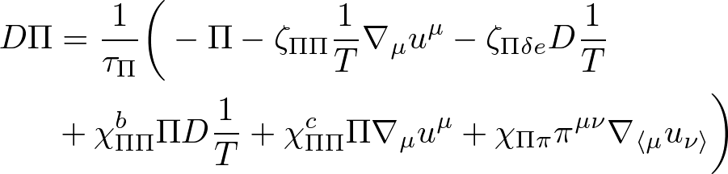
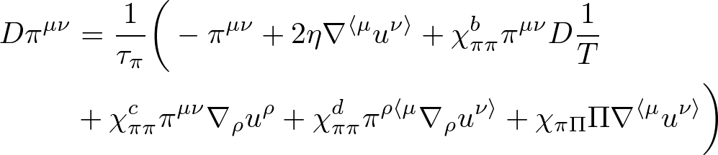
Hydrodynamic Model
Full 2nd order viscous hydrodynamic equations
+
Energy-momentum conservation
AM and T. Hirano, NPA 847, 283
EoM for bulk pressure
EoM for shear tensor
All the terms are kept
Solve in (1+1)-D relativistic coordinates (= no transverse flow)
with piecewise parabolic + iterative method
Note: (2+1)-D viscous hydro assumes boost-invariant flow
Model Input for Hydro

Slide 8
Model Input for Hydro
Equation of state and transport coefficients
Initial conditions
Equation of State: Lattice QCD
S. Borsanyi et al., JHEP 1011, 077
Shear viscosity: η = s/4π
P. Kovtun et al., PRL 94, 111601
A. Hosoya et al., AP 154, 229
Bulk viscosity: ζ_{eff} = (5/2)[(1/3) – c_{s}²]η
Relaxation times: Kinetic theory & η, ζ
AM and T. Hirano, NPA 847, 283
2nd order coefficients: Kinetic theory & η, ζ
Initial flow: Bjorken flow (i.e. flow rapidity Y_{f} = η_{s})
Energy distribution: MC-KLN type CGC model
H. J. Drescher and Y. Nara,
PRC 75, 034905; 76, 041903
Dissipative currents: δT^{μν} = 0
Initial time: τ = 1 fm/c
Results

Slide 9
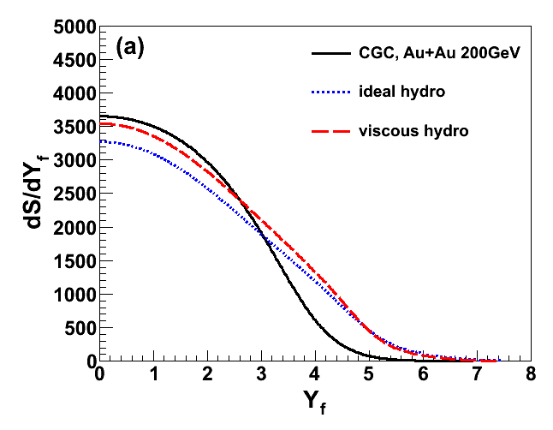
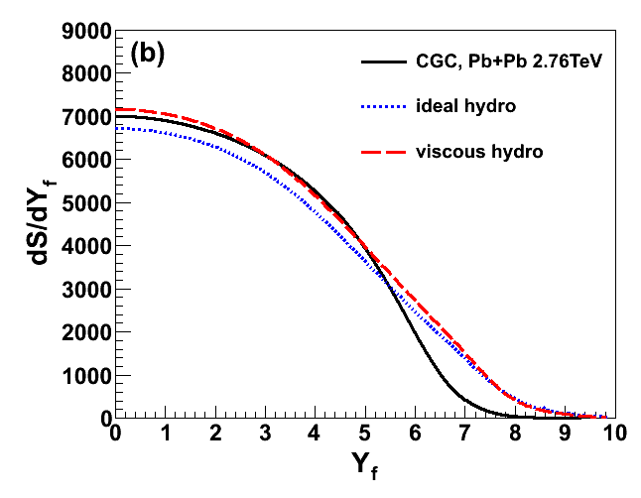
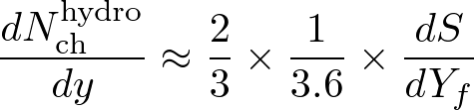
Results
CGC initial distributions + longitudinal viscous hydro
RHIC
LHC
Outward entropy flux
Flattening
Entropy production
Enhancement
If the true λ is larger at RHIC, it enhances dN/dy at LHC;
Hydro effect is a candidate for explaining the “gap” at LHC
Results

Slide 10

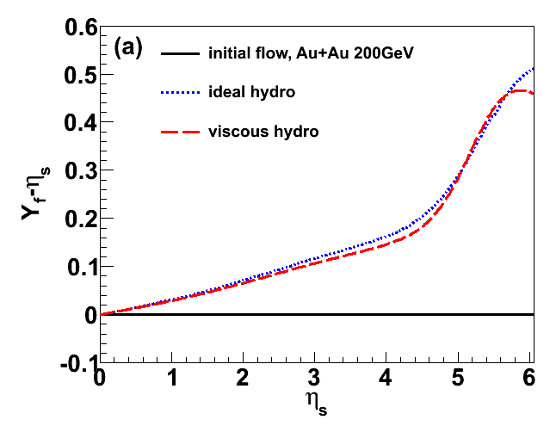
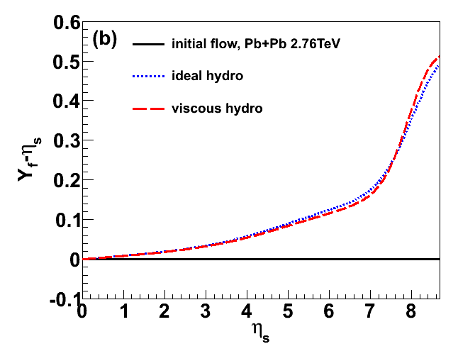
Results
Deviation from boost-invariant flow
Flow rapidity:
RHIC
LHC
τ = 30 fm/c
τ = 50 fm/c
The systems are far from boost invariant at RHIC and LHC
Ideal flow ≈ viscous flow due to competition between
deceleration by suppression of total pressure P₀ – Π + π at early stage and
acceleration by enhancement of hydrostatic pressure P₀ at late stage
Summary and Outlook

Slide 11
Summary and Outlook
We solved full 2nd order viscous hydro in (1+1)-dimensions for the “shattered” color glass condensate
Future prospect includes:
  Detailed analyses on parameter dependences, rcBK, etc…
  A (3+1)-dimensional viscous hydrodynamic model, etc…
Non-trivial deformation of CGC rapidity distribution due to
(i) outward entropy flux (non-boost invariant effect)
(ii) entropy production (viscous effect)
Viscous hydrodynamic effect may play an important role in understanding the seemingly large multiplicity at LHC
AM & T. Hirano, in preparation
The End

Slide 12
The End
Thank you for listening!
Website: http://tkynt2.phys.s.u-tokyo.ac.jp/~monnai/index.html
Appendices

Slide 13
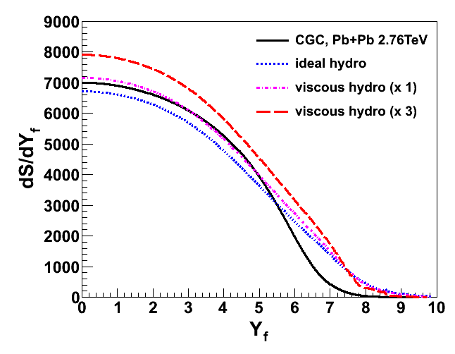
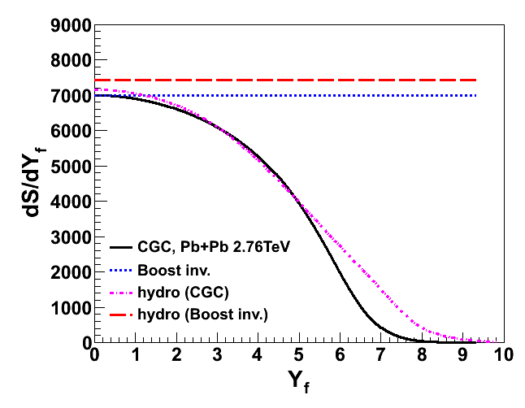
Results
Parameter dependences
Comparison to boost-invariant flow
(i) η/s = 0, ζ_{eff}/s = 0
(ii) η/s = 1/4π, ζ_{eff}/s = (5/2)[(1/3) – c_{s}²]/4π
(iii) η/s = 3/4π, ζ_{eff}/s = (15/2)[(1/3) – c_{s}²]/4π
Larger entropy production for more viscous systems
preliminary
Longitudinal viscous hydro expansion is essential
Appendices

Slide 14
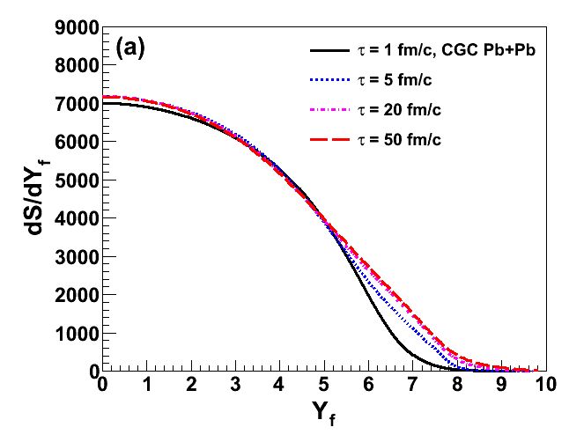
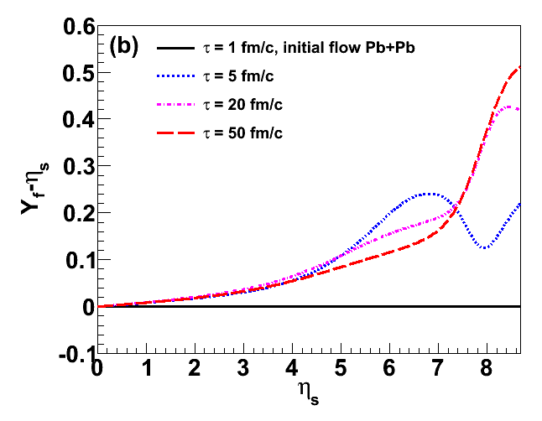
Results
Time evolution for LHC settings
Rapidity distribution: no sizable modification after 20 fm/c
It can be accidental; needs further investigation on parameter dependence
Flow rapidity: visible change even after 20 fm/c
Rise-and-dip at 5 fm/c is due to reduction in effective pressure P₀ – Π + π
Appendices

Slide 15


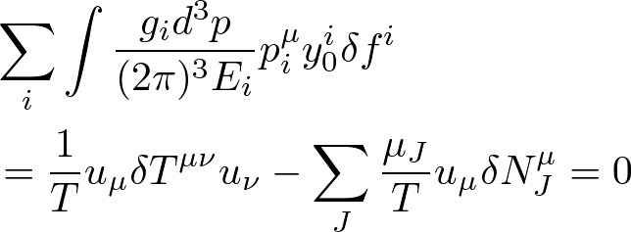


Thermodynamic Stability
Maximum entropy state condition
- Stability condition (1st order)
- Stability condition (2nd order)
automatically satisfied in kinetic theory
*Stability conditions are NOT the same as the law of increasing entropy
Appendices

Slide 16
Introduction
Properties of the QCD matter
Equation of state: relation among thermodynamic variables
  sensitive to degrees of freedom in the system
Transport coefficients: responses to thermodynamic forces
  sensitive to interaction in the system
Naïve interpretation of dissipative processes
Shear viscosity
= response to deformation
Bulk viscosity
= response to expansion
Energy dissipation
= response to
thermal gradient
Charge dissipation
= response to
chemical gradients
Appendices

Slide 17




Introduction
Geometrical setup of colliding nuclei
x
y
z
x
Longitudinal expansion
Transverse plane
Relativistic coordinates
Proper time:
Transverse mass:
Space-time rapidity:
Rapidity:
Centrality
Determined by groups (20-30%, etc.) of “events per number of participants”
Appendices

