Slide 1
Helsinki status of T2
K.Kurvinen on behalf of Helsinki TOTEM group
12.3.2008

Slide 2
HV divider board
A new board designed to improve power rating of resistors, to redesign some potential current leakage points and to enable cooling.
New features:
  components on the back side of the board to enable cooling
  All resistors surface mount components
  Power rating of the resistors 1 W
  Components will be assembled by company
Iterative electric field simulations done to find out the weak points of the design
  layout changed, order of serial resistors changed, filleting of sharp corners improved and openings added to the critical points
Cost > 2k€

Slide 3
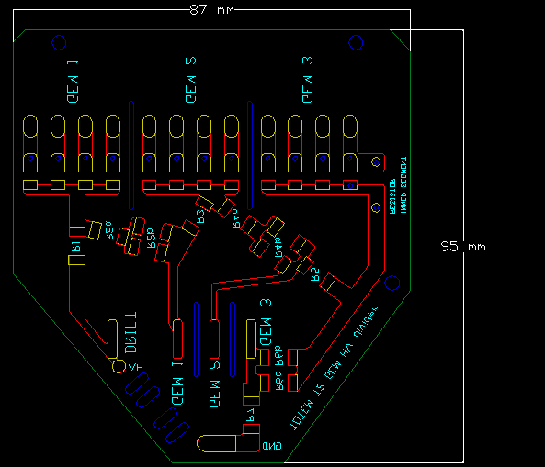
HV divider board
E-field simulations
Openings / holes
added

Slide 4
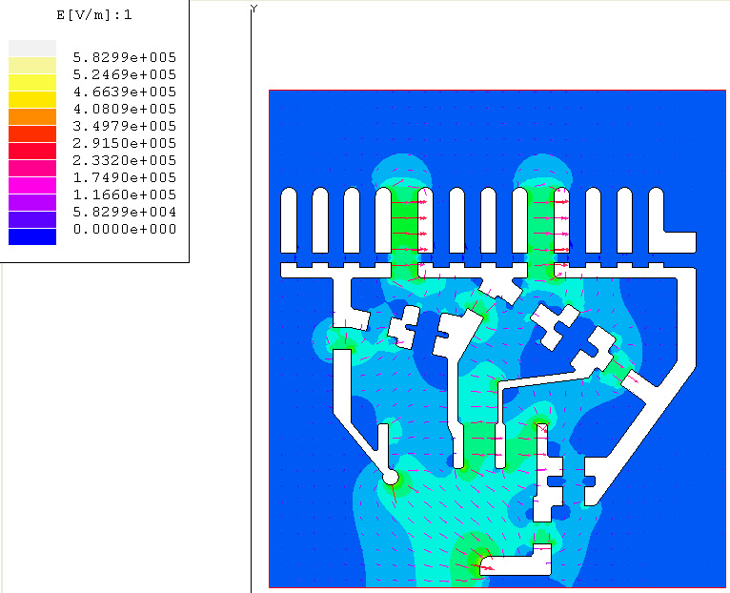
Static electric field simulation of HV divider board
High electric field !
Resistor network used in simulation
1M+0.55M+1M+0.525M+1M+0.455M+1M and
HV bias of 4.2 kV

Slide 5
EM shielding
Samples of PET+Al (50mm+9mm) foils received and sent to CERN for evaluation
Shaping of the foils by water cutting (cost 150€)

Slide 6
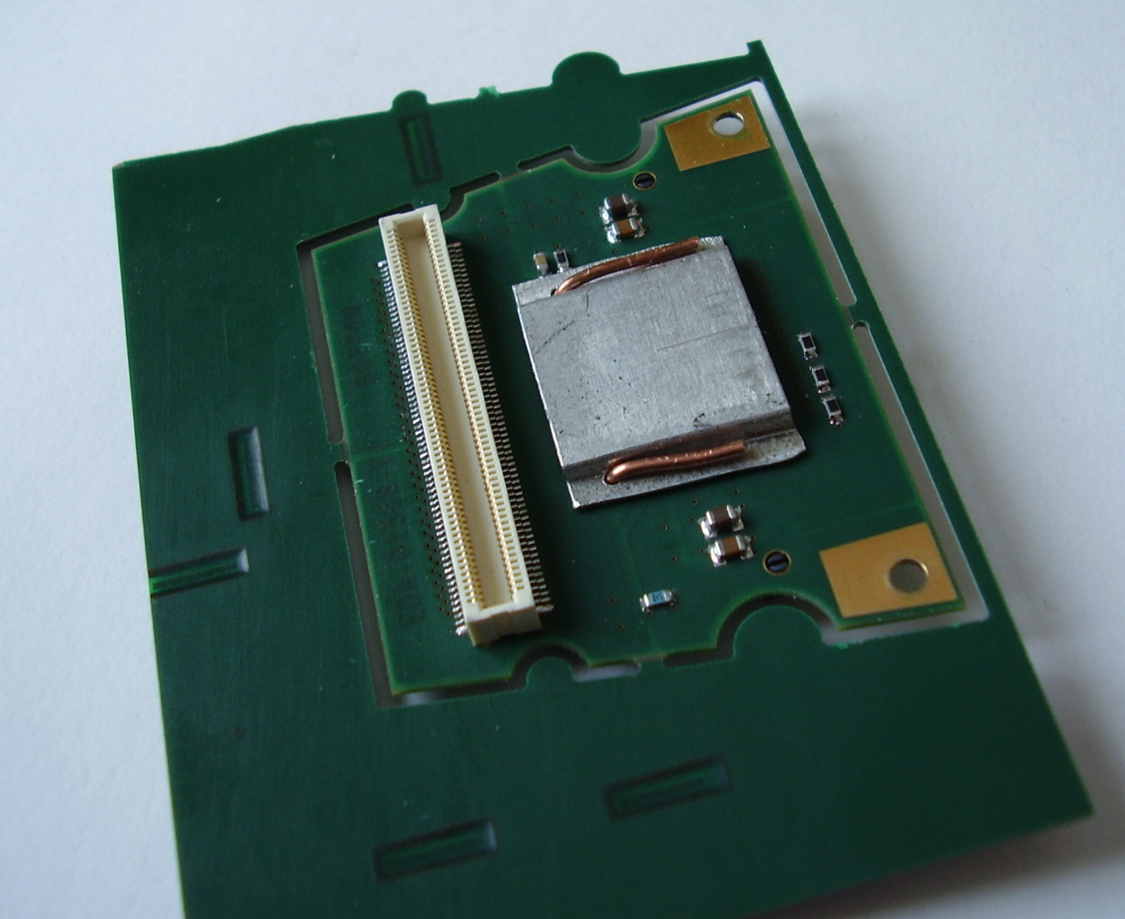
VFAT chip cover?
An alternative solution offered:
  0.5 mm Aluminium pressed in form
  Likely better thermal conduction
  Better emf-shielding expected (?)
  Less critical soldering
Cost:
  tool 750€
  0.55€/pc

